Slide 1

Final Exam Review
This web quiz may appear as two pages on tablets and laptops.
I recommend that you view it as one page by clicking on the open book icon at the bottom of the page.

Slide 2
Final Exam Review
THERE ARE SOME CHAPTERS THAT ARE MORE IMPORTANT THAN OTHERS
These are usually the chapters with the new models (i.e. graphs) and concepts. You can probably figure out yourself which chapters they are, but here is a list:
chapter 1: production possibilities graph
chapter 3: supply and demand graph
chapter 20: using the production possibilities graphs to determine comparative advantage
chapter 12: AD/AS graph
chapter 7: calculating GDP,
chapter 10 and 13: calculating and using the multipliers
chapters 14, 15, 16: showing how monetary policy works on the set of 3 graphs

Slide 3
Final Exam Review
See the FINAL EXAM REVIEW
link on Blackboard for a:
  Study Guide
  15 Minute YouTube review video

Slide 4
1. Which of the 5Es BEST explains high prices (eg. plywood) after a natural disaster?
Economic Growth
Productive Efficiency
Allocative Efficiency
Equity
Full employment

Slide 5
1. Which of the 5Es BEST explains high prices (eg. plywood) after a natural disaster?
Economic Growth
Productive Efficiency
Allocative Efficiency
Equity
Full employment

Slide 6
2. Which of the following will not produce an outward shift of the production possibilities curve?
an upgrading of the quality of a nation's human resources
the reduction of unemployment
an increase in the quantity of a society's labor force
the improvement of a society's technological knowledge

Slide 7
2. Which of the following will not produce an outward shift of the production possibilities curve?
an upgrading of the quality of a nation's human resources
the reduction of unemployment
an increase in the quantity of a society's labor force
the improvement of a society's technological knowledge

Slide 8
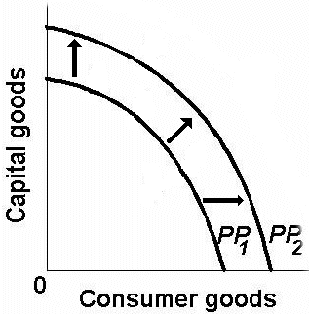
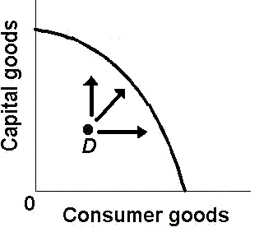
TWO TYPES OF ECONOMIC GROWTH
Achieving the Potential Increasing the Potential

Slide 9
3. Refer to the diagram. Other things equal, this economy will achieve the most rapid rate of growth if:
it chooses point A.
it chooses point B.
it chooses point C.
it chooses point D.

Slide 10
3. Refer to the diagram. Other things equal, this economy will achieve the most rapid rate of growth if:
it chooses point A.
it chooses point B.
it chooses point C.
it chooses point D.

Slide 11
4. The “invisible hand” promotes society’s interest because:
Individuals pursuing their self-interest will produce goods that people want
Individuals will produce goods for others out of concern for their fellow human beings
It makes sure that everybody wins from competition
Government regulation pushes businesses into producing the right mix of goods

Slide 12
4. The “invisible hand” promotes society’s interest because:
Individuals pursuing their self-interest will produce goods that people want
Individuals will produce goods for others out of concern for their fellow human beings
It makes sure that everybody wins from competition
Government regulation pushes businesses into producing the right mix of goods

Slide 13
5. The coordination problem in centrally planned economies refers to the idea that:
Planners had to direct required inputs to each enterprise
The price level and the level of employment are inversely related
The immediate effect of more investment was less consumption
exports had to equal imports for a central plan to work

Slide 14
5. The coordination problem in centrally planned economies refers to the idea that:
Planners had to direct required inputs to each enterprise
The price level and the level of employment are inversely related
The immediate effect of more investment was less consumption
exports had to equal imports for a central plan to work

Slide 15
6. Which of the following is a policy commonly associated with structural adjustment?
Trade restrictions
Import substitution
Price controls
Privatization
Nationalization

Slide 16
6. Which of the following is a policy commonly associated with structural adjustment?
Trade restrictions
Import substitution
Price controls
Privatization
Nationalization

Slide 17
Structural Adjustment Policies
Privatization
Promotion of Competition
Reduced Role of Government
Removing Price Controls
Freer Trade and Convertible Currency
Foreign Investment

Slide 18
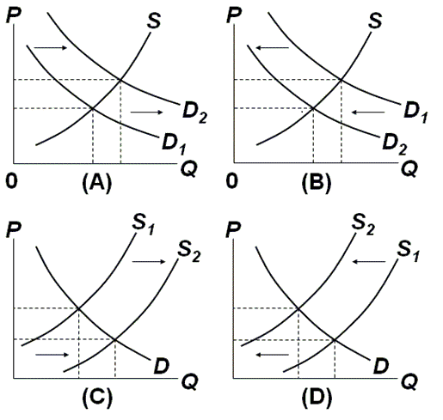
7. Which graph represents the effect of an increase in incomes on the market for secondhand clothing?
A
B
C
D

Slide 19
7. Which graph represents the effect of an increase in incomes on the market for secondhand clothing?
A
B
C
D

Slide 20
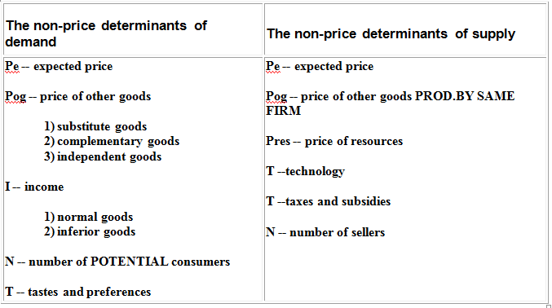

Slide 21
GRAPH IT!

Slide 22
8. What is the major source of Revenue for the Federal Government?
Income Tax
Sales and Excise Taxes
Payroll Taxes
Property Taxes
Corporate Income Tax
Licenses and fees

Slide 23
8. What is the major source of Revenue for the Federal Government?
Income Tax
Sales and Excise Taxes
Payroll Taxes
Property Taxes
Corporate Income Tax
Licenses and fees

Slide 24
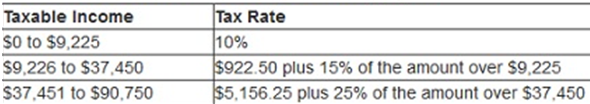
9. Use the tax table above. If income is $10,225 what is the average tax rate?
10 %
10.5 %
15 %
25 %

Slide 25
9. Use the tax table above. If income is $10,225 what is the average tax rate?
10 %
10.5 %
15 %
25 %

Slide 26
Average tax rate = taxes paid / income
Average tax rate = $1072.50 / $10,225.00
Average tax rate = 10.5%

Slide 27
10. International trade is economically beneficial primarily because it:
Allows everyone to have a job they like
Facilitates trade by bartering
Guarantees full employment
Permits more output from the same resources

Slide 28
10. International trade is economically beneficial primarily because it:
Allows everyone to have a job they like
Facilitates trade by bartering
Guarantees full employment
Permits more output from the same resources

Slide 29
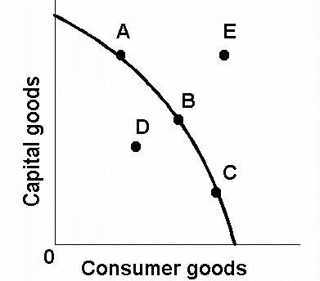
11. Use the PPC below. Which is possible only with trade?
A
B
C
D
E

Slide 30
11. Use the PPC below. Which is possible only with trade?
A
B
C
D
E

Slide 31
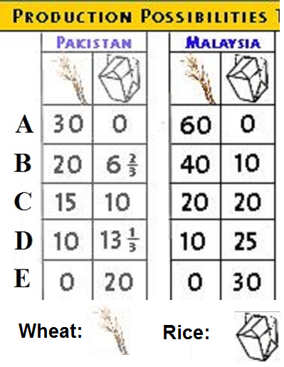
12. Assume before specialization, Pakistan is at “C” and Malaysia at “B”,
If they specialize 100%, then the gains will be:
45 wheat and 20 rice
20 rice
5 wheat
15 wheat

Slide 32
12. Assume before specialization, Pakistan is at “C” and Malaysia at “B”,
If they specialize 100%, then the gains will be:
45 wheat and 20 rice
20 rice
5 wheat
15 wheat

Slide 33
13. Consider the currency market for Japanese yens and U.S. dollars. An increase in the supply for Japanese yen results in:
An appreciation of the yen and a depreciation of the dollar
A depreciation of the yen and a depreciation of the dollar
An appreciation of the yen and an appreciation of the dollar
A depreciation of the yen and an appreciation of the dollar

Slide 34
13. Consider the currency market for Japanese yens and U.S. dollars. An increase in the supply for Japanese yen results in:
An appreciation of the yen and a depreciation of the dollar
A depreciation of the yen and a depreciation of the dollar
An appreciation of the yen and an appreciation of the dollar
A depreciation of the yen and an appreciation of the dollar

Slide 35
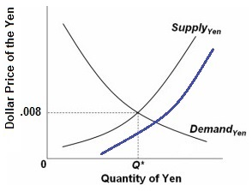
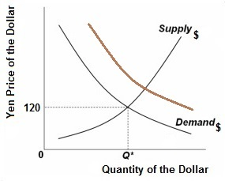
If interest rates in the US increase compared to those in Japan, then we would expect:

Slide 36
Determinants of Foreign Exchange
We demand a foreign currency to ( DYen):
  Buy foreign goods (Pe, Pog, I, Npot, T)
  Make financial investments in foreign country (high interest rate)
We supply our currency when we ( S$):
  Buy foreign goods (Pe, Pog, I, Npot, T)
  Make financial investments in foreign country (high interest rate)

Slide 37
Determinants of Foreign Exchange
They demand our currency to ( D$):
  Buy our goods (Pe, Pog, I, Npot, T)
  Make financial investments in our country
  (high interest rate)
They supply foreign currency when they ( Syen):
  Buy our goods (Pe, Pog, I, Npot, T)
  Make financial investments in our country
  (high interest rate)

Slide 38
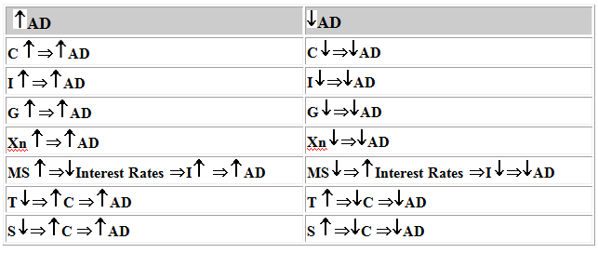
Determinants of AD

Slide 39
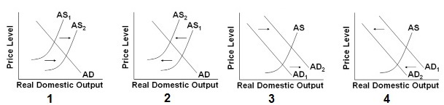
14. In 2007 home values began to decline significantly. Which graph above illustrates the effect on the economy?
1
2
3
4
What happens to
UE, IN, and EG?

Slide 40
14. In 2007 home values began to decline significantly. Which graph above illustrates the effect on the economy?
1
2
3
4
What happens to
UE, IN, and EG?

Slide 41
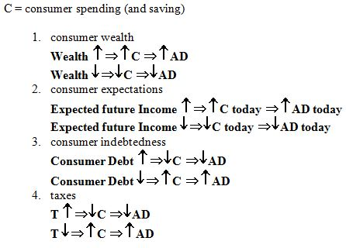

Slide 42
15. Which is an economic investment (I)?
A student buys stock in Apple computers
An investor buy a government bond
A carpenter buys a hammer
A professor buys new skis

Slide 43
15. Which is an economic investment (I)?
A student buys stock in Apple computers
An investor buy a government bond
A carpenter buys a hammer
A professor buys new skis

Slide 44
16. Assume business have increased excess capacity. Which graph above illustrates the effect on the economy?
1
2
3
4
What happens to
UE, IN, and EG?

Slide 45
16. Assume business have increased excess capacity. Which graph above illustrates the effect on the economy?
1
2
3
4
What happens to
UE, IN, and EG?

Slide 46
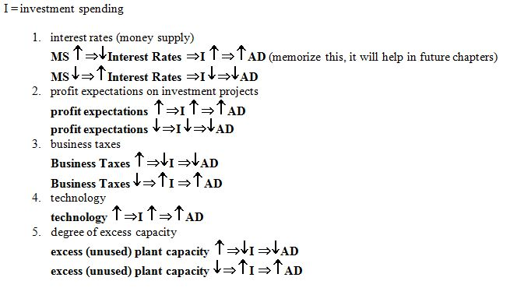

Slide 47
17. Assume the $ appreciates. Which graph above illustrates the effect on the economy?
1
2
3
4
What happens to
UE, IN, and EG?

Slide 48
17. Assume the $ appreciates. Which graph above illustrates the effect on the economy?
1
2
3
4
What happens to
UE, IN, and EG?

Slide 49
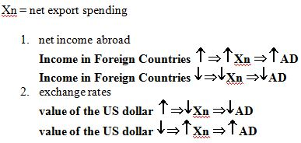

Slide 50
18. Which graph above illustrates the stagflation of the late 1970s and early 1980s?
1
2
3
4
What happens to
UE, IN, and EG?

Slide 51
18. Which graph above illustrates the stagflation of the late 1970s and early 1980s?
1
2
3
4
What happens to
UE, IN, and EG?

Slide 52
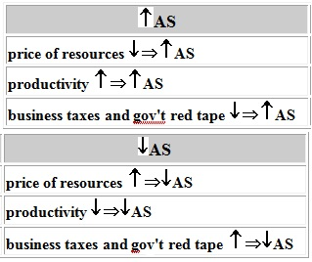
Determinants of AS

Slide 53
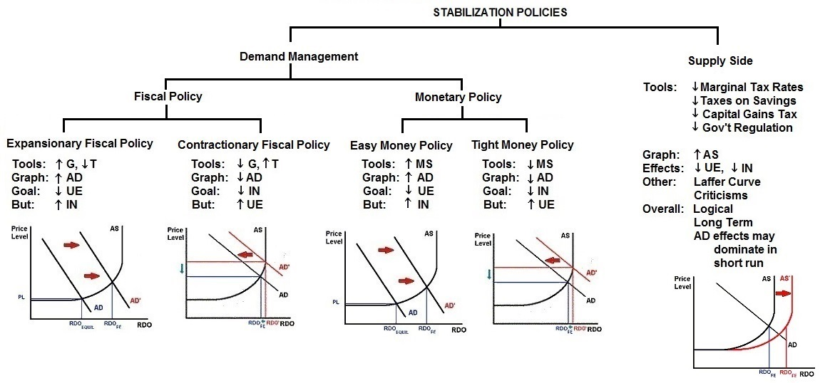
12c – Stabilization Policies (YP 33)

Slide 54
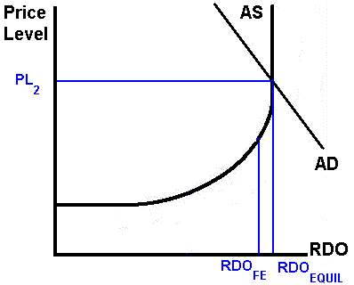
19. What would be the appropriate fiscal policy?
Increase Taxes
Decrease Gov’t
Spending
Decrease Taxes
Increase Money Supply
What happens to
UE, IN, and EG?

Slide 55
19. What would be the appropriate fiscal policy?
Increase Taxes
Decrease Gov’t
Spending
Decrease Taxes
Increase Money Supply
What happens to
UE, IN, and EG?

Slide 56
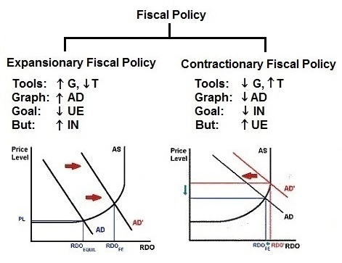

Slide 57
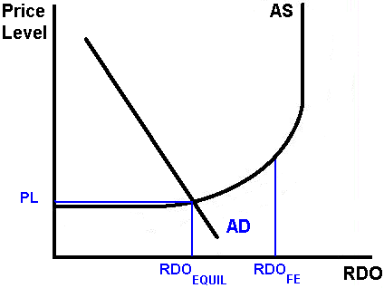
20. What would be the appropriate monetary policy?
Increase Taxes
Increase Gov’t
Spending
Decrease Money Supply
Increase Money Supply
What happens to
UE, IN, and EG?

Slide 58
20. What would be the appropriate monetary policy?
Increase Taxes
Increase Gov’t
Spending
Decrease Money Supply
Increase Money Supply
What happens to
UE, IN, and EG?

Slide 59
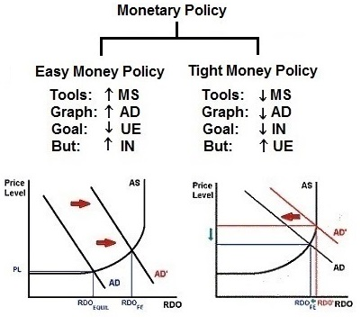

Slide 60
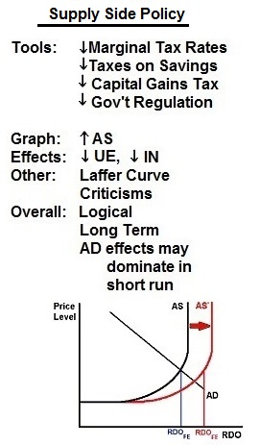

Slide 61
21. What most likely caused the Great Depression (1929-1939)?
Increase in AD
Decrease in AD
Increase in AS
Decrease in AS

Slide 62
21. What most likely caused the Great Depression (1929-1939)?
Increase in AD
Decrease in AD
Increase in AS
Decrease in AS

Slide 63
22. Chris lost his job as a ski lift operator when the ski season ended and is looking for a new job. Which type of UE is this?
Frictional
Structural
Cyclical
Chris is not included in the UE rate

Slide 64
22. Chris lost his job as a ski lift operator when the ski season ended and is looking for a new job. Which type of UE is this?
Frictional
Structural
Cyclical
Chris is not included in the UE rate

Slide 65
23. The “full employment (natural) rate of unemployment” is 4.5%, then:
Frictional UE is 4.5%
Structural UE is 4.5%
Cyclical UE is 4.5%
Frictional + Structural UE is 4.5%
Structural + Cyclical UE is 4.5%

Slide 66
23. The “full employment (natural) rate of unemployment” is 4.5%, then:
Frictional UE is 4.5%
Structural UE is 4.5%
Cyclical UE is 4.5%
Frictional + Structural UE is 4.5%
Structural + Cyclical UE is 4.5%

Slide 67
24. What was the inflation rate in 1974?
: CPI = 54
1974: CPI = 50
1973: CPI = 45
50 %
45 %
11 %
5 %
4 %

Slide 68
24. What was the inflation rate in 1974?
: CPI = 54
1974: CPI = 50
1973: CPI = 45
50 %
45 %
11 %
5 %
4 %

Slide 69
25. Which of the following causes GDP to OVERSTATE social welfare (standard of living)?
Non-market transactions
Pollution
Leisure
Underground economy
Improved product quality

Slide 70
25. Which of the following causes GDP to OVERSTATE social welfare (standard of living)?
Non-market transactions
Pollution
Leisure
Underground economy
Improved product quality

Slide 71
GDP AND SOCIAL WELFARE
a. non-market transactions are not included in GDP: GDP UNDERSTATES
b. leisure increases the standard of living but it isn't counted: GDP UNDERSTATES
c. improved product quality often isn't accounted for in GDP: GDP UNDERSTATES
d. GDP does not account for the composition of output: GDP OVERSTATES
e.GDP does not account for the distribution of output : GDP OVERSTATES
f. increases in GDP may harm the environment : GDP OVERSTATES
g. the underground economy produces goods and services but they are not included in GDP: GDP OVERSTATES
h. GDP does not account for a possible future decline in output due to resource depletion.
GDP OVERSTATES
i. Noneconomic Sources of Well-Being like courtesy, crime reduction, etc., are not covered in GDP.: GDP OVERSTATES
j. We must use per capita GDP to compare the living standards of different countries.

Slide 72
26. Expenditures approach: GDP = ?
C + G + T + Xn
C + MS + T + Xn
C + G + Ig + Xn
C + G + In + Xn

Slide 73
26. Expenditures approach: GDP = ?
C + G + T + Xn
C + MS + T + Xn
C + G + Ig + Xn
C + G + In + Xn

Slide 74
7a – Measuring GDP - Mac
Required Formulas:
GDP = C + Ig + G + Xn
NI = wages + rents + interest + corporate profits + proprietor's income
NDP = C + In + G + Xn = GDP - depreciation
NDP = GDP - depreciation
In = Ig - depreciation
Xn = X - M
real GDP = (nominal GDP / price index) x 100

Slide 75
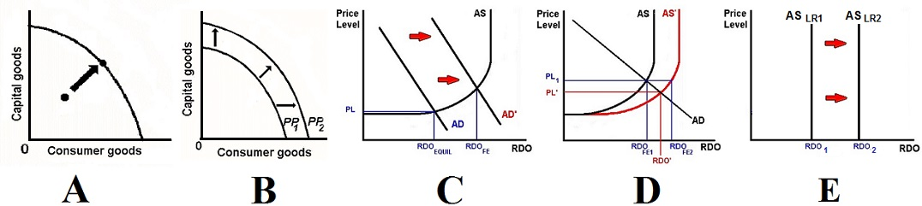
27. Which graphs above represents the type of economic growth that occurs if government spending increases?
A, C
A, B
C, D
B, D, E
A, B, D
Achieving the Potential OR Increasing the Potential?

Slide 76
27. Which graphs above represents the type of economic growth that occurs if government spending increases?
A, C
A, B
C, D
B, D, E
A, B, D
Achieving the Potential OR Increasing the Potential?

Slide 77
Two Types of Economic Growth
INCREASING THE POTENTIAL ACHIEVING THE POTENTIAL
5Es EG
More resources
Better resources
Better technology
Change in AS
Lower resource prices
Increase productivity
Less gov’t regulation and lower business taxes
Change in AD
C
I
G
XN
MS
T
S
Prod. Eff.
Don’t use more resources than necessary
Use resources where they are best suited
Use appropriate technology

Slide 78
28. If the economy is growing at an annual rate of 2% a year, about how many years will it take for GDP to double?
15
25
35
45

Slide 79
28. If the economy is growing at an annual rate of 2% a year, about how many years will it take for GDP to double?
15
25
35
45

Slide 80
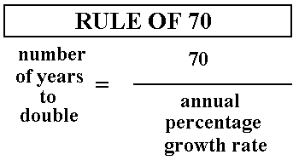
Years to double = 70/2 = 35 years

Slide 81
29. US government subsidies to American farmers are an obstacle to economic growth in the LDCs (DVCs) because the subsidies ______
increase the “brain Drain” from LDCs
increase population growth rates
decrease agricultural prices
decrease foreign aid and business investment

Slide 82
29. US government subsidies to American farmers are an obstacle to economic growth in the LDCs (DVCs) because the subsidies ______
increase the “brain Drain” from LDCs
increase population growth rates
decrease agricultural prices
decrease foreign aid and business investment

Slide 83
30. Why is a high population growth rate seen as an obstacle to economic growth in many LDCs (DVCs)?
It decreases growth in real output
It decreases growth in real output per capita
It increases the infant mortality rate
It increases consumption per capita

Slide 84
30. Why is a high population growth rate seen as an obstacle to economic growth in many LDCs (DVCs)?
It decreases growth in real output
It decreases growth in real output per capita
It increases the infant mortality rate
It increases consumption per capita

Slide 85
31. What happens to the gap between the per capita income of an LDC and an MDC if they both grow at 2% a year?
The gap gets smaller
The gap stays the same
The gap gets bigger
It depends on the level of income

Slide 86
31. What happens to the gap between the per capita income of an LDC and an MDC if they both grow at 2% a year?
The gap gets smaller
The gap stays the same
The gap gets bigger
It depends on the level of income

Slide 87
The absolute income gap between rich and poor nations has been widening.
For example,
  LDC: if per capita income is $400 a year in a DVC, a 2% growth rate means an $8 increase in income. (2% of $400 = $8)
  MDC: if per capita income is $20,000 per year in an IAC, the same 2% growth rate translates into a $400 increase in income.
  (2% of $20,000 = $400)

Slide 88
32. If I take $10 out of my wallet and put it into my savings account what happens to M1 and M2?
M1 decreases; M2 increases
M1 increases; M2 decreases
M1 stays the same; M2 increases
M1 decreases; M2 stays the same

Slide 89
32. If I take $10 out of my wallet and put it into my savings account what happens to M1 and M2?
M1 decreases; M2 increases
M1 increases; M2 decreases
M1 stays the same; M2 increases
M1 decreases; M2 stays the same

Slide 90
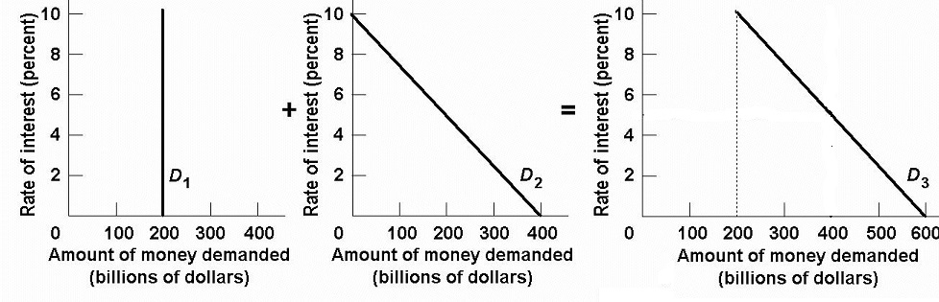
33. What is D1?
Transactions demand for money
Asset demand for money
Total demand for money

Slide 91
33. What is D1?
Transactions demand for money
Asset demand for money
Total demand for money

Slide 92
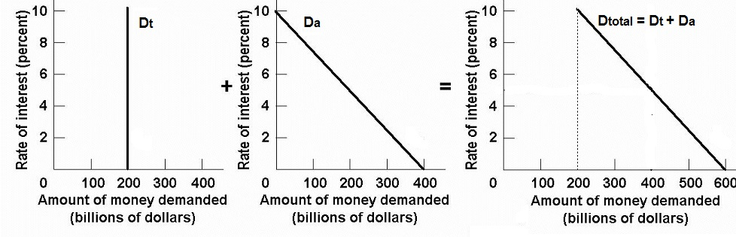
Money Demand
Transactions Demand + Asset Demand = Total Demand for Money

Slide 93
34. Assume the RR is 20% and a $10 bill in deposited in a checking account of Bank A.
How much does the money creation potential increase for Bank A and for the banking system?
Bank A’s $10; banking system’s $50
Bank A’s $8; banking system’s $40
Bank A’s $10; banking system’s $20
Bank A’s $8; banking system’s $20

Slide 94
34. Assume the RR is 20% and a $10 bill in deposited in a checking account of Bank A.
How much does the money creation potential increase for Bank A and for the banking system?
Bank A’s $10; banking system’s $50
Bank A’s $8; banking system’s $40
Bank A’s $10; banking system’s $20
Bank A’s $8; banking system’s $20

Slide 95
FORMULAS:
  Change in MS = ER x Money Multiplier
  ER = Total Reserves - Req. Res
  Money Multiplier = 1/RR
IF: RR is 20% and a $10 bill in deposited:
  Money Multiplier = 1/RR = 1/.20 = 5
  Req. Res = RR x Liabilities = .20 x $10 = $2
  ER = Total Reserves – Req. Res = $10 – $2 = $8
  Change in MS = ER x Money Multiplier
  Change in MS = $8 x 5 = $40.

Slide 96
35. RR= 20%. If this single bank made the largest loan it could safely make the MS will increase by how much?
Assets | Liabilities + Net Worth
Reserves $ 60,000 Loans 60,000 Securities 40,000 Property 240,000 | Checkable deposits $100,000 Stock shares 300,000
$10,000
$40,000
$100,000
$300,000

Slide 97
35. RR= 20%. If this single bank made the largest loan it could safely make the MS will increase by how much?
Assets | Liabilities + Net Worth
Reserves $ 60,000 Loans 60,000 Securities 40,000 Property 240,000 | Checkable deposits $100,000 Stock shares 300,000
$10,000
$40,000
$100,000
$300,000

Slide 98
36. RR= 20%. If this bank balance sheet was for the commercial banking system, rather than a single bank, the MS could increase by how much?
Assets | Liabilities + Net Worth
Reserves $ 60,000 Loans 60,000 Securities 40,000 Property 240,000 | Checkable deposits $100,000 Stock shares 300,000
$10,000
$40,000
$100,000
$200,000
$300,000

Slide 99
36. RR= 20%. If this bank balance sheet was for the commercial banking system, rather than a single bank, the MS could increase by how much?
Assets | Liabilities + Net Worth
Reserves $ 60,000 Loans 60,000 Securities 40,000 Property 240,000 | Checkable deposits $100,000 Stock shares 300,000
$10,000
$40,000
$100,000
$200,000
$300,000

Slide 100
37. Assume that the Fed buys a $1000 bond (security) from COMMERCIAL BANKS (RR = 20%), What is the max. possible increase in the MS?
$200
$1000
$4000
$5000
$10,000

Slide 101
37. Assume that the Fed buys a $1000 bond (security) from COMMERCIAL BANKS (RR = 20%), What is the max. possible increase in the MS?
$200
$1000
$4000
$5000
$10,000

Slide 102
38. See graph. What is the appropriate monetary policy?
sell sec, increase RR, decrease DR
sell sec, decrease RR, increase DR
buy sec, increase RR, increase DR
buy sec, decrease RR, decrease DR

Slide 103
38. See graph. What is the appropriate monetary policy?
sell sec, increase RR, decrease DR
sell sec, decrease RR, increase DR
buy sec, increase RR, increase DR
buy sec, decrease RR, decrease DR

Slide 104
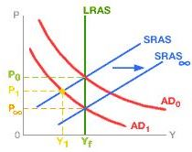
39. Which view of macroeconomic theory is shown in this graph?
Mainstream
Monetarist
New Keynesian
Supply-Side
MP: Does Economy Self-Correct?

Slide 105
39. Which view of macroeconomic theory is shown in this graph?
Mainstream
Monetarist
New Keynesian
Supply-Side
MP: Does Economy Self-Correct?

Slide 106
40. MV = PQ, What is PQ?
Real GDP
Nominal GDP
Price times Quantity
Money Supply
MP: Rules or Discretion?

Slide 107
40. MV = PQ, What is PQ?
Real GDP
Nominal GDP
Price times Quantity
Money Supply
MP: Rules or Discretion?

Slide 108
41. How do the Mainstream and Monetarist economists differ in the way they view the efficacy of MP in response to a change in AD?
Main: MP not too effective; use it
Monet: MP very effective; don’t use it
Main: MP not too effective; don’t use it
Monet: MP very effective; use it
Main: MP very effective; use it
Monet: MP not too effective; don’t use it
Main: MP very effective; don’t use it
Monet: MP not too effective; use it
MP: Rules or Discretion?

Slide 109
41. How do the Mainstream and Monetarist economists differ in the way they view the efficacy of MP in response to a change in AD?
Main: MP not too effective; use it
Monet: MP very effective; don’t use it
Main: MP not too effective; don’t use it
Monet: MP very effective; use it
Main: MP very effective; use it
Monet: MP not too effective; don’t use it
Main: MP very effective; don’t use it
Monet: MP not too effective; use it
MP: Rules or Discretion?

Slide 110
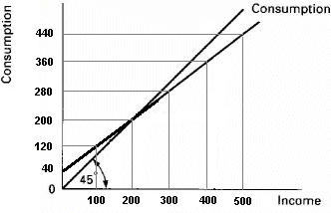
42. If G increase by $20, the AD will increase by ________?
$20
$40
$60
$80
$100

Slide 111
42. If G increase by $20, the AD will increase by ________?
$20
$40
$60
$80
$100

Slide 112
43. If Taxes decrease by $20, the AD will increase by ________?
$20
$40
$60
$80
$100

Slide 113
43. If Taxes decrease by $20, the AD will increase by ________?
$20
$40
$60
$80
$100

Slide 114
44. If G increases by $20 and Taxes increase by $20 then AD will increase by:
$20
$40
$60
$80

Slide 115
44. If G increases by $20 and Taxes increase by $20 then AD will increase by:
$20
$40
$60
$80

Slide 116
45. If Expansionary FP causes higher interest rates FP will be _______ effective because the multiplier will be ________.
just as; the same
more; larger
less; smaller
The Multiplier with Crowding Out

Slide 117
45. If Expansionary FP causes higher interest rates FP will be _______ effective because the multiplier will be ________.
just as; the same
more; larger
less; smaller
The Multiplier with Crowding Out

Slide 118
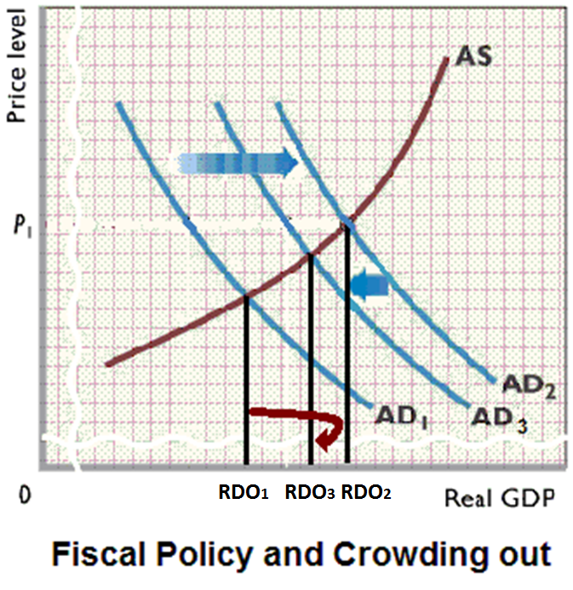

Slide 119
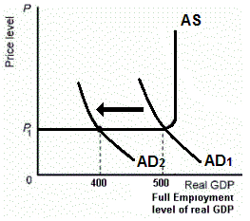
46. What if AD decreases and the government does nothing?
AD will decrease but then increase a little
Inflation goes up
Economic growth goes up
GDP will be $400
Built-in Stabilizers

Slide 120
46. What if AD decreases and the government does nothing?
AD will decrease but then increase a little
Inflation goes up
Economic growth goes up
GDP will be $400
Built-in Stabilizers

Slide 121
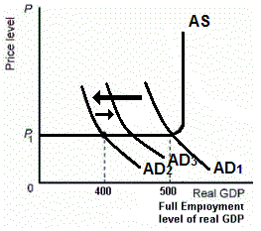
What if AD decreases from AD1 to AD2 and the government does NOTHING?
AD will increase from AD2 to AD3 because of built-in stabilizers.
Built-in Stabilizers

Slide 122
47. If the cyclically-adjusted budget shows a surplus of about $50 billion and the actual budget shows a deficit of about $150 billion, it can be concluded that there is:
Contractionary FP
Contractionary (tight) MP
Expansionary FP
Expansionary (easy) MP
We cannot be sure
Built-in Stabilizers

Slide 123
47. If the cyclically-adjusted budget shows a surplus of about $50 billion and the actual budget shows a deficit of about $150 billion, it can be concluded that there is:
Contractionary FP
Contractionary (tight) MP
Expansionary FP
Expansionary (easy) MP
We cannot be sure
Built-in Stabilizers

Slide 124
48. Expansionary FP can lead to budget deficits. How do budget deficits affect trade?
Budget deficits cause lower interest rates and the $ depreciates
Budget deficits cause lower interest rates and the $ appreciates
Budget deficits cause higher interest rates and the $ depreciates
Budget deficits cause higher interest rates and the $ appreciates
Government Budget Deficits and Trade

Slide 125
48. Expansionary FP can lead to budget deficits. How do budget deficits affect trade?
Budget deficits cause lower interest rates and the $ depreciates
Budget deficits cause lower interest rates and the $ appreciates
Budget deficits cause higher interest rates and the $ depreciates
Budget deficits cause higher interest rates and the $ appreciates
Government Budget Deficits and Trade

Slide 126
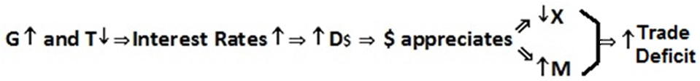
Vice President Walter Mondale in 1984 was running for president against President Ronald Reagan.
During a debate he was asked what he would do about the large trade deficit of the time.
His answer was that to reduce the trade deficit we need to reduce the budget deficit and he would raise taxes to do that.
Government Budget Deficits and Trade

Slide 127
49. Supply-side economists sometimes argue that if you cut taxes it could increase gov’t revenue. Which does NOT explain WHY?
Lower taxes encourage economic activity
An increase in AS enlarges the tax base
There is less tax avoidance and tax evasion
There is a decrease in gov’t spending
Supply-Side Multiplier

Slide 128
49. Supply-side economists sometimes argue that if you cut taxes it could increase gov’t revenue. Which does NOT explain WHY?
Lower taxes encourage economic activity
An increase in AS enlarges the tax base
There is less tax avoidance and tax evasion
There is a decrease in gov’t spending
Supply-Side Multiplier

Slide 129
