Slide 1
Exam 3 Review
This web quiz may appear as two pages on tablets and laptops.
I recommend that you view it as one page by clicking on the open book icon at the bottom of the page.

Slide 2
Unit 3 – Macroeconomic Policy
MONETARY POLICY
Chapter 14 - Money, Money Markets, the Fed
Chapter 15 - How Banks Create Money
Chapter 16 - Monetary Policy
FISCAL POLICY
Chapter 10 - The Spending Multiplier
Chapter 13 - Fiscal Policy

Slide 3
1. Which is NOT one of the functions of money?
A store of value
A unit of account
A legal tender
A medium of exchange

Slide 4
1. Which is NOT one of the functions of money?
A store of value
A unit of account
A legal tender
A medium of exchange

Slide 5
2. If I take a $10 bill out of my pocket and put in in my savings account, what happened to M1 and M2?
Both increase
M1 increases, M2 decreases
M1 decreases, M2 stays the same
Both decrease

Slide 6
2. If I take a $10 bill out of my pocket and put in in my savings account, what happened to M1 and M2?
Both increase
M1 increases, M2 decreases
M1 decreases, M2 stays the same
Both decrease

Slide 7
3. In the above series of graphs showing the MONEY MARKET, graph 2 is:
Asset demand for money
Transactions demand for money
Money supply
Total money demand

Slide 8
3. In the above series of graphs showing the MONEY MARKET, graph 2 is:
Asset demand for money
Transactions demand for money
Money supply
Total money demand

Slide 9
The Money Market

Slide 10
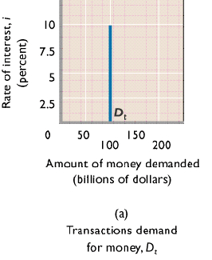
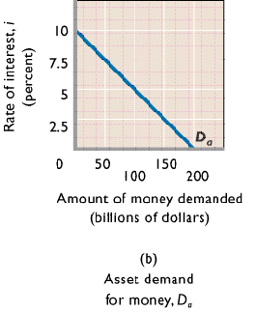
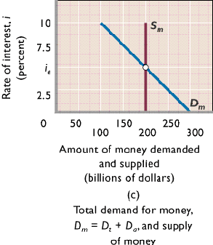
The Money Market

Slide 11
4. Which is NOT true about the Federal reserve banks?
They are “bankers’ banks”
They are “quasi public”
They are the country’s “central bank”
They are “thrift institutions”
They are the “government’s bank”

Slide 12
4. Which is NOT true about the Federal reserve banks?
They are “bankers’ banks”
They are “quasi public”
They are the country’s “central bank”
They are “thrift institutions”
They are the “government’s bank”

Slide 13
5. Goldsmiths created money when they:
Accepted deposits of gold for safe storage
Charged people who deposited their gold
Used deposited gold to produce products for sale to others
Issued paper receipts for the gold they held

Slide 14
5. Goldsmiths created money when they:
Accepted deposits of gold for safe storage
Charged people who deposited their gold
Used deposited gold to produce products for sale to others
Issued paper receipts for the gold they held

Slide 15
6. Which is NOT an ASSET for a commercial bank?
Net worth
Reserves
Loans
Securities
Property

Slide 16
6. Which is NOT an ASSET for a commercial bank?
Net worth
Reserves
Loans
Securities
Property

Slide 17
7. Banks use ER for all of the following EXCEPT
Making loans
Loaning to the Fed
Buying securities
Paying back depositors

Slide 18
7. Banks use ER for all of the following EXCEPT
Making loans
Loaning to the Fed
Buying securities
Paying back depositors

Slide 19
8. If the RR= 10%, then what are the ER?
Assets | Liabilities + Net Worth
Reserves $ 40,000 Loans 70,000 Securities 50,000 Property 400,000 | Checkable deposits $100,000 Stock shares 460,000
$10,000
$20,000
$30,000
$40,000
$50,000

Slide 20
8. If the RR= 10%, then what are the ER?
Assets | Liabilities + Net Worth
Reserves $ 40,000 Loans 70,000 Securities 50,000 Property 400,000 | Checkable deposits $100,000 Stock shares 460,000
$10,000
$20,000
$30,000
$40,000
$50,000

Slide 21
MONETARY POLICY FORMULAS
Change in Money Supply = ER x Money Multiplier
Total Reserves = Cash in bank + Deposits at Fed
Required Reserves = RR x Liabilities
Excess Reserves = Total Reserves - Required Reserves
Money Multiplier = 1 / RR

Slide 22
9. If the RR= 10%, then what is the largest loan that this bank could safely make?
Assets | Liabilities + Net Worth
Reserves $ 40,000 Loans 70,000 Securities 50,000 Property 400,000 | Checkable deposits $100,000 Stock shares 460,000
$10,000
$20,000
$30,000
$40,000
$50,000

Slide 23
9. If the RR= 10%, then what is the largest loan that this bank could safely make?
Assets | Liabilities + Net Worth
Reserves $ 40,000 Loans 70,000 Securities 50,000 Property 400,000 | Checkable deposits $100,000 Stock shares 460,000
$10,000
$20,000
$30,000
$40,000
$50,000

Slide 24
10. RR= 10%. If this bank made the largest loan it could safely make the MS will increase by how much?
Assets | Liabilities + Net Worth
Reserves $ 40,000 Loans 70,000 Securities 50,000 Property 400,000 | Demand deposits (DD) $100,000 Stock shares 460,000
$10,000
$30,000
$100,000
$300,000

Slide 25
10. RR= 10%. If this bank made the largest loan it could safely make the MS will increase by how much?
Assets | Liabilities + Net Worth
Reserves $ 40,000 Loans 70,000 Securities 50,000 Property 400,000 | Demand deposits (DD) $100,000 Stock shares 460,000
$10,000
$30,000
$100,000
$300,000

Slide 26
11. RR= 10%. If this bank balance sheet was for the commercial banking system, rather than a single bank, the MS could increase by how much?
Assets | Liabilities + Net Worth
Reserves $ 40,000 Loans 70,000 Securities 50,000 Property 400,000 | Demand deposits (DD) $100,000 Stock shares 460,000
$10,000
$30,000
$100,000
$300,000

Slide 27
11. RR= 10%. If this bank balance sheet was for the commercial banking system, rather than a single bank, the MS could increase by how much?
Assets | Liabilities + Net Worth
Reserves $ 40,000 Loans 70,000 Securities 50,000 Property 400,000 | Demand deposits (DD) $100,000 Stock shares 460,000
$10,000
$30,000
$100,000
$300,000

Slide 28
12. Raise RR to 20%. If this bank balance sheet was for the commercial banking system, the MS could increase by how much?
Assets | Liabilities + Net Worth
Reserves $ 40,000 Loans 70,000 Securities 50,000 Property 400,000 | Demand deposits (DD) $100,000 Stock shares 460,000
$10,000
$30,000
$100,000
$300,000

Slide 29
12. Raise RR to 20%. If this bank balance sheet was for the commercial banking system, the MS could increase by how much?
Assets | Liabilities + Net Worth
Reserves $ 40,000 Loans 70,000 Securities 50,000 Property 400,000 | Demand deposits (DD) $100,000 Stock shares 460,000
$10,000
$30,000
$100,000
$300,000

Slide 30
13. Which is correct when the Fed increases the MS? An increase in the MS CAUSES ________
I up CAUSES int. rates down CAUSES AD up
AD up CAUSES I up CAUSES int. rates down
AD down CAUSES int rates down CAUSES I up
Int rates down CAUSES I up CAUSES AD up

Slide 31
13. Which is correct when the Fed increases the MS? An increase in the MS CAUSES ________
I up CAUSES int. rates down CAUSES AD up
AD up CAUSES I up CAUSES int. rates down
AD down CAUSES int rates down CAUSES I up
Int rates down CAUSES I up CAUSES AD up

Slide 32
14. Assume the required reserve ratio is 25 percent. If the Federal Reserve buys $50 million in government securities directly from commercial bank, then the money supply will potentially:
Decrease $50 million
Increase $50 million
Decrease $200 million
Increase $200 million

Slide 33
14. Assume the required reserve ratio is 25 percent. If the Federal Reserve buys $50 million in government securities directly from commercial bank, then the money supply will potentially:
Decrease $50 million
Increase $50 million
Decrease $200 million
Increase $200 million

Slide 34
15. Assume the required reserve ratio is 25 percent. If the Federal Reserve buys $50 in government securities from the public, then the money supply will immediately increase by:
nothing, and potential increase in MS is $50
nothing, and potential increase in MS is $200
$50, and potential increase in MS is $50
$50, and potential increase in MS is $200

Slide 35
15. Assume the required reserve ratio is 25 percent. If the Federal Reserve buys $50 in government securities from the public, then the money supply will immediately increase by:
nothing, and potential increase in MS is $50
nothing, and potential increase in MS is $200
$50, and potential increase in MS is $50
$50, and potential increase in MS is $200

Slide 36
16. If you read in the news that the Fed will increase the Fed Funds Rate then you know they are using the _________.
DR tool to fight UE
OMO tool to fight IN
RR tool to fight UE
OMO tool to fight UE

Slide 37
16. If you read in the news that the Fed will increase the Fed Funds Rate then you know they are using the _________.
DR tool to fight UE
OMO tool to fight IN
RR tool to fight UE
OMO tool to fight UE

Slide 38
17. The tools of the Fed change the money supply by changing the ____ of banks.
Liabilities
Stock shares
Net worth
Excess reserves

Slide 39
17. The tools of the Fed change the money supply by changing the ____ of banks.
Liabilities
Stock shares
Net worth
Excess reserves

Slide 40
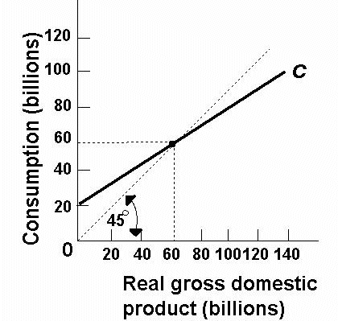
18. MPC = ?
1/4
1/3
1/2
2/3

Slide 41
18. MPC = ?
1/4
1/3
1/2
2/3

Slide 42
19. MPS = ?
1/4
1/3
1/2
2/3

Slide 43
19. MPS = ?
1/4
1/3
1/2
2/3

Slide 44
20. What is the simple multiplier?
1
2
3
4

Slide 45
20. What is the simple multiplier?
1
2
3
4

Slide 46
21. If G increases by $20 then AD will increase by ________.
$20
$40
$60
$80

Slide 47
21. If G increases by $20 then AD will increase by ________.
$20
$40
$60
$80

Slide 48
22. If Taxes decrease by $20 then AD will increase by:
$20
$40
$60
$80

Slide 49
22. If Taxes decrease by $20 then AD will increase by:
$20
$40
$60
$80

Slide 50
23. If G increases by $20 and Taxes increase by $20 then AD will increase by:
$20
$40
$60
$80

Slide 51
23. If G increases by $20 and Taxes increase by $20 then AD will increase by:
$20
$40
$60
$80

Slide 52
24. If G increases by $20 and as a result the price level increases, then real GDP will increase by ______.
< $60
$60
>$60
$80

Slide 53
24. If G increases by $20 and as a result the price level increases, then real GDP will increase by ______.
< $60
$60
>$60
$80

Slide 54
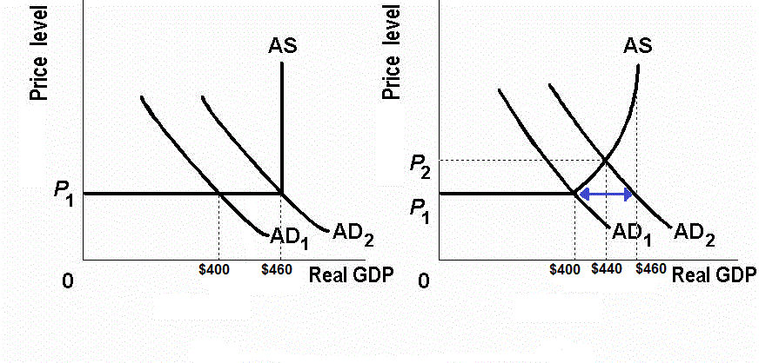
Increases in the price level reduces the size of the multiplier
MPS = 1/3
Increase G by $20

Slide 55
25. If MPC = 0.8 and the government increases spending by $50 million then GDP will increase by _______.
$50
$100
$200
$250

Slide 56
25. If MPC = 0.8 and the government increases spending by $50 million then GDP will increase by _______.
$50
$100
$200
$250

Slide 57
26. If MPC = 0.8 and the government increases taxes by $50 million then GDP will decrease by _______.
$50
$100
$200
$250

Slide 58
26. If MPC = 0.8 and the government increases taxes by $50 million then GDP will decrease by _______.
$50
$100
$200
$250

Slide 59
27. If MPC = 0.8 and the government increases spending by $50 million AND increases taxes by $50 million then GDP will decrease by _______.
$0
$50
$100
$200
$250

Slide 60
27. If MPC = 0.8 and the government increases spending by $50 million AND increases taxes by $50 million then GDP will decrease by _______.
$0
$50
$100
$200
$250

Slide 61
28. From the mainstream perspective, instability in the economy is due to:
Flexible prices, and shocks to either aggregate demand or aggregate supply
Inflexible prices, and shocks to either aggregate demand or aggregate supply
Flexible prices, and government policies and regulation
Inflexible prices, and government policies and regulation

Slide 62
28. From the mainstream perspective, instability in the economy is due to:
Flexible prices, and shocks to either aggregate demand or aggregate supply
Inflexible prices, and shocks to either aggregate demand or aggregate supply
Flexible prices, and government policies and regulation
Inflexible prices, and government policies and regulation

Slide 63
29. From the monetarist perspective, instability in the economy is due to:
Secular trends in the economy
The instability of velocity as a policy tool
Discretionary changes in monetary policy
The use of a monetary rule for monetary policy

Slide 64
29. From the monetarist perspective, instability in the economy is due to:
Secular trends in the economy
The instability of velocity as a policy tool
Discretionary changes in monetary policy
The use of a monetary rule for monetary policy

Slide 65
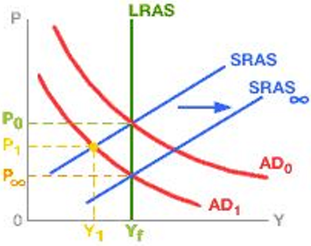
30. Which view of macroeconomic theory is shown in this graph?
Mainstream
Monetarist
New Keynesian
Supply-Side
MP: Does Economy Self-Correct?

Slide 66
30. Which view of macroeconomic theory is shown in this graph?
Mainstream
Monetarist
New Keynesian
Supply-Side
MP: Does Economy Self-Correct?

Slide 67
31. Expansionary FP can lead to budget deficits. How do budget deficits affect trade?
Budget deficits cause lower interest rates and the $ depreciates
Budget deficits cause lower interest rates and the $ appreciates
Budget deficits cause higher interest rates and the $ depreciates
Budget deficits cause higher interest rates and the $ appreciates
Government Budget Deficits and Trade

Slide 68
31. Expansionary FP can lead to budget deficits. How do budget deficits affect trade?
Budget deficits cause lower interest rates and the $ depreciates
Budget deficits cause lower interest rates and the $ appreciates
Budget deficits cause higher interest rates and the $ depreciates
Budget deficits cause higher interest rates and the $ appreciates
Government Budget Deficits and Trade

Slide 69
Government Budget Deficits and Trade

Slide 70
32. How do the Mainstream and Monetarist economists differ in the way they view the equation of exchange (MV=PQ)?
Main: V unstable; equation unimportant Monet: V stable; equation important
Main: V stable; equation unimportant Monet: V unstable; equation important
Main: V unstable; equation important Monet: V stable; equation unimportant
Main: V stable; equation unimportant Monet: V unstable; equation important
MP: Rules or Discretion?

Slide 71
32. How do the Mainstream and Monetarist economists differ in the way they view the equation of exchange (MV=PQ)?
Main: V unstable; equation unimportant Monet: V stable; equation important
Main: V stable; equation unimportant Monet: V unstable; equation important
Main: V unstable; equation important Monet: V stable; equation unimportant
Main: V stable; equation unimportant Monet: V unstable; equation important
MP: Rules or Discretion?

Slide 72
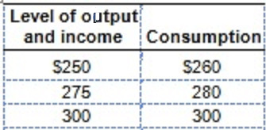
33. If a tax of $5 is added, what is the new C schedule? Current schedule: 260, 280, 300
255; 275; 295
256; 276; 296
260; 280; 300
266; 286; 306
The Lump-Sum Tax Multiplier

Slide 73
33. If a tax of $5 is added, what is the new C schedule? Current schedule: 260, 280, 300
255; 275; 295
256; 276; 296
260; 280; 300
266; 286; 306
The Lump-Sum Tax Multiplier

Slide 74
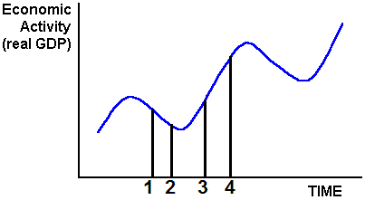
34. The time lag between time 2 and time 3 is the:
Operational lag
Administrative lag
Recognition lag
Time Lags

Slide 75
34. The time lag between time 2 and time 3 is the:
Operational lag
Administrative lag
Recognition lag
Time Lags

