Slide 1
MACRO: Unit 3 Review – Double Bb
To set channel:
Menu
Down arrow (Yes) to “Change Channel”
Enter
Type in channel number
Enter

Slide 2
Unit 3
MONETARY POLICY
Chapter 14 - Money, Money Markets, the Fed
Chapter 15 - How Banks Create Money
Chapter 16 - Monetary Policy
FISCAL POLICY
Chapter 10 - The Spending Multiplier
Chapter 13 - Fiscal Policy

Slide 3
Please Select a Team.
Team 1
Team 2
Team 3
Team 4
Team 5
Team 6
Team 7
Team 8
Team 9

Slide 4
1t. If the RR= 10%, then what are the ER? TEAM
Assets | Liabilities + Net Worth
Reserves $ 40,000 Loans 70,000 Securities 50,000 Property 400,000 | Checkable deposits $100,000 Stock shares 460,000
$10,000
$20,000
$30,000
$40,000
$50,000

Slide 5
1t. If the RR= 10%, then what are the ER? TEAM
Assets | Liabilities + Net Worth
Reserves $ 40,000 Loans 70,000 Securities 50,000 Property 400,000 | Checkable deposits $100,000 Stock shares 460,000
$10,000
$20,000
$30,000
$40,000
$50,000

Slide 6
MONETARY POLICY FORMULAS
Change in Money Supply = ER x Money Multiplier
Total Reserves = Cash in bank + Deposits at Fed
Required Reserves = RR x Liabilities
Excess Reserves = Total Reserves - Required Reserves
Money Multiplier = 1 / RR

Slide 7
1i. If the RR= 20%, then what are the ER? INDIVIDUAL
Assets | Liabilities + Net Worth
Reserves $ 60,000 Loans 60,000 Securities 40,000 Property 240,000 | Checkable deposits $100,000 Stock shares 300,000
$10,000
$20,000
$30,000
$40,000
$50,000

Slide 8
1i. If the RR= 20%, then what are the ER? INDIVIDUAL
Assets | Liabilities + Net Worth
Reserves $ 60,000 Loans 60,000 Securities 40,000 Property 240,000 | Checkable deposits $100,000 Stock shares 300,000
$10,000
$20,000
$30,000
$40,000
$50,000

Slide 9
2t. If the RR= 10%, then what is the largest loan that this bank could safely make? TEAM
Assets | Liabilities + Net Worth
Reserves $ 40,000 Loans 70,000 Securities 50,000 Property 400,000 | Checkable deposits $100,000 Stock shares 460,000
$10,000
$20,000
$30,000
$40,000
$50,000

Slide 10
2t. If the RR= 10%, then what is the largest loan that this bank could safely make? TEAM
Assets | Liabilities + Net Worth
Reserves $ 40,000 Loans 70,000 Securities 50,000 Property 400,000 | Checkable deposits $100,000 Stock shares 460,000
$10,000
$20,000
$30,000
$40,000
$50,000

Slide 11
2i. If the RR= 20%, then what is the largest loan that this bank could safely make? INDIVIDUAL
Assets | Liabilities + Net Worth
Reserves $ 60,000 Loans 60,000 Securities 40,000 Property 240,000 | Checkable deposits $100,000 Stock shares 300,000
$10,000
$20,000
$30,000
$40,000
$50,000

Slide 12
2i. If the RR= 20%, then what is the largest loan that this bank could safely make? INDIVIDUAL
Assets | Liabilities + Net Worth
Reserves $ 60,000 Loans 60,000 Securities 40,000 Property 240,000 | Checkable deposits $100,000 Stock shares 300,000
$10,000
$20,000
$30,000
$40,000
$50,000

Slide 13
3t. RR= 10%. If this bank made the largest loan it could safely make the MS will increase by how much?
Assets | Liabilities + Net Worth
Reserves $ 40,000 Loans 70,000 Securities 50,000 Property 400,000 | Demand deposits (DD) $100,000 Stock shares 460,000
$10,000
$30,000
$100,000
$300,000

Slide 14
3t. RR= 10%. If this bank made the largest loan it could safely make the MS will increase by how much?
Assets | Liabilities + Net Worth
Reserves $ 40,000 Loans 70,000 Securities 50,000 Property 400,000 | Demand deposits (DD) $100,000 Stock shares 460,000
$10,000
$30,000
$100,000
$300,000

Slide 15
3i. RR= 20%. If this bank made the largest loan it could safely make the MS will increase by how much?
Assets | Liabilities + Net Worth
Reserves $ 60,000 Loans 60,000 Securities 40,000 Property 240,000 | Checkable deposits $100,000 Stock shares 300,000
$10,000
$40,000
$100,000
$300,000

Slide 16
3i. RR= 20%. If this bank made the largest loan it could safely make the MS will increase by how much?
Assets | Liabilities + Net Worth
Reserves $ 60,000 Loans 60,000 Securities 40,000 Property 240,000 | Checkable deposits $100,000 Stock shares 300,000
$10,000
$40,000
$100,000
$300,000

Slide 17
4t. If the RR= 20% (instead of 10%), then what is the largest loan that this bank could safely make?
Assets | Liabilities + Net Worth
Reserves $ 40,000 Loans 70,000 Securities 50,000 Property 400,000 | Demand deposits (DD) $100,000 Stock shares 460,000
$10,000
$20,000
$30,000
$40,000
$50,000

Slide 18
4t. If the RR= 20% (instead of 10%), then what is the largest loan that this bank could safely make?
Assets | Liabilities + Net Worth
Reserves $ 40,000 Loans 70,000 Securities 50,000 Property 400,000 | Demand deposits (DD) $100,000 Stock shares 460,000
$10,000
$20,000
$30,000
$40,000
$50,000

Slide 19
4i. If the RR= 25% (instead of 20%), then what is the largest loan that this bank could safely make?
Assets | Liabilities + Net Worth
Reserves $ 60,000 Loans 60,000 Securities 40,000 Property 240,000 | Checkable deposits $100,000 Stock shares 300,000
$15,000
$25,000
$35,000
$45,000
$55,000

Slide 20
4i. If the RR= 25% (instead of 20%), then what is the largest loan that this bank could safely make?
Assets | Liabilities + Net Worth
Reserves $ 60,000 Loans 60,000 Securities 40,000 Property 240,000 | Checkable deposits $100,000 Stock shares 300,000
$15,000
$25,000
$35,000
$45,000
$55,000

Slide 21
5t. RR= 10%. If this bank balance sheet was for the commercial banking system, rather than a single bank, the MS could increase by how much?
Assets | Liabilities + Net Worth
Reserves $ 40,000 Loans 70,000 Securities 50,000 Property 400,000 | Demand deposits (DD) $100,000 Stock shares 460,000
$10,000
$30,000
$100,000
$200,000
$300,000

Slide 22
5t. RR= 10%. If this bank balance sheet was for the commercial banking system, rather than a single bank, the MS could increase by how much?
Assets | Liabilities + Net Worth
Reserves $ 40,000 Loans 70,000 Securities 50,000 Property 400,000 | Demand deposits (DD) $100,000 Stock shares 460,000
$10,000
$30,000
$100,000
$200,000
$300,000

Slide 23
5i. RR= 20%. If this bank balance sheet was for the commercial banking system, rather than a single bank, the MS could increase by how much?
Assets | Liabilities + Net Worth
Reserves $ 60,000 Loans 60,000 Securities 40,000 Property 240,000 | Checkable deposits $100,000 Stock shares 300,000
$10,000
$40,000
$100,000
$200,000
$300,000

Slide 24
5i. RR= 20%. If this bank balance sheet was for the commercial banking system, rather than a single bank, the MS could increase by how much?
Assets | Liabilities + Net Worth
Reserves $ 60,000 Loans 60,000 Securities 40,000 Property 240,000 | Checkable deposits $100,000 Stock shares 300,000
$10,000
$40,000
$100,000
$200,000
$300,000

Slide 25
6t. Raise RR from 10% to 20%. If this bank balance sheet was for the commercial banking system, the MS could increase by how much?
Assets | Liabilities + Net Worth
Reserves $ 40,000 Loans 70,000 Securities 50,000 Property 400,000 | Demand deposits (DD) $100,000 Stock shares 460,000
$10,000
$30,000
$100,000
$300,000

Slide 26
6t. Raise RR from 10% to 20%. If this bank balance sheet was for the commercial banking system, the MS could increase by how much?
Assets | Liabilities + Net Worth
Reserves $ 40,000 Loans 70,000 Securities 50,000 Property 400,000 | Demand deposits (DD) $100,000 Stock shares 460,000
$10,000
$30,000
$100,000
$300,000

Slide 27
6i. Raise RR from 20% to 25%. If this bank balance sheet was for the commercial banking system, the MS could increase by how much?
Assets | Liabilities + Net Worth
Reserves $ 60,000 Loans 60,000 Securities 40,000 Property 240,000 | Checkable deposits $100,000 Stock shares 300,000
$30,000
$100,000
$140,000
$300,000

Slide 28
6i. Raise RR from 20% to 25%. If this bank balance sheet was for the commercial banking system, the MS could increase by how much?
Assets | Liabilities + Net Worth
Reserves $ 60,000 Loans 60,000 Securities 40,000 Property 240,000 | Checkable deposits $100,000 Stock shares 300,000
$30,000
$100,000
$140,000
$300,000

Slide 29
7t. Assume the required reserve ratio is 25 percent. If the Federal Reserve buys $50 million in government securities directly from commercial banks (commercial banking system), then the money supply will potentially:
Decrease $50 million
Increase $50 million
Decrease $200 million
Increase $200 million

Slide 30
7t. Assume the required reserve ratio is 25 percent. If the Federal Reserve buys $50 million in government securities directly from commercial banks (commercial banking system), then the money supply will potentially:
Decrease $50 million
Increase $50 million
Decrease $200 million
Increase $200 million

Slide 31
7i. Assume the required reserve ratio is 10 percent. If the Federal Reserve buys $4 million in government securities directly from commercial banks (commercial banking system), then the money supply will potentially:
Decrease $4 million
Increase $4 million
Decrease $40 million
Increase $40 million

Slide 32
7i. Assume the required reserve ratio is 10 percent. If the Federal Reserve buys $4 million in government securities directly from commercial banks (commercial banking system), then the money supply will potentially:
Decrease $4 million
Increase $4 million
Decrease $40 million
Increase $40 million

Slide 33
8t. Assume the required reserve ratio is 25 percent. If the Federal Reserve buys $50 in government securities from the public, then the money supply will immediately increase by:
nothing, and potential increase in MS is $50
nothing, and potential increase in MS is $200
$50, and potential increase in MS is $50
$50, and potential increase in MS is $200

Slide 34
8t. Assume the required reserve ratio is 25 percent. If the Federal Reserve buys $50 in government securities from the public, then the money supply will immediately increase by:
nothing, and potential increase in MS is $50
nothing, and potential increase in MS is $200
$50, and potential increase in MS is $50
$50, and potential increase in MS is $200

Slide 35
8i. Assume the required reserve ratio is 10 percent. If the Federal Reserve buys $4 in government securities from the public, then the money supply will immediately increase by:
nothing, and potential increase in MS is $4
nothing, and potential increase in MS is $40
$4, and potential increase in MS is $4
$4, and potential increase in MS is $40

Slide 36
8i. Assume the required reserve ratio is 10 percent. If the Federal Reserve buys $4 in government securities from the public, then the money supply will immediately increase by:
nothing, and potential increase in MS is $4
nothing, and potential increase in MS is $40
$4, and potential increase in MS is $4
$4, and potential increase in MS is $40

Slide 37
9t. If you read in the news that the Fed will increase the Fed Funds Rate then you know they are using the _________.
DR tool to fight UE
OMO tool to fight IN
RR tool to fight UE
OMO tool to fight UE

Slide 38
9t. If you read in the news that the Fed will increase the Fed Funds Rate then you know they are using the _________.
DR tool to fight UE
OMO tool to fight IN
RR tool to fight UE
OMO tool to fight UE

Slide 39
10t. The tools of the Fed change the money supply by changing the ____ of banks.
Liabilities
Stock shares
Net worth
Excess reserves

Slide 40
10t. The tools of the Fed change the money supply by changing the ____ of banks.
Liabilities
Stock shares
Net worth
Excess reserves

Slide 41
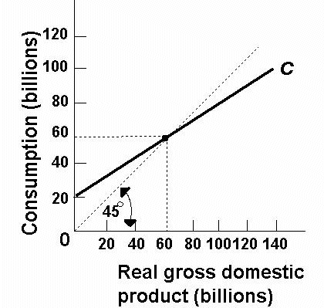
11t. MPC = ?
1/4
1/3
1/2
2/3

Slide 42
11t. MPC = ?
1/4
1/3
1/2
2/3

Slide 43
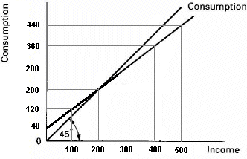
11i. MPC = ?
0.2
0.4
0.6
0.8

Slide 44
11i. MPC = ?
0.2
0.4
0.6
0.8

Slide 45
12t. MPS = ?
1/4
1/3
1/2
2/3

Slide 46
12t. MPS = ?
1/4
1/3
1/2
2/3

Slide 47
12i. MPS = ?
0.2
0.4
0.6
0.8

Slide 48
12i. MPS = ?
0.2
0.4
0.6
0.8

Slide 49
13t. What is the simple multiplier?
1
2
3
4
5

Slide 50
13t. What is the simple multiplier?
1
2
3
4
5

Slide 51
13i. What is the simple multiplier?
1
2
3
4
5

Slide 52
13i. What is the simple multiplier?
1
2
3
4
5

Slide 53
14t. If G increases by $20 then AD will increase by ________.
$20
$40
$60
$80
$100

Slide 54
14t. If G increases by $20 then AD will increase by ________.
$20
$40
$60
$80
$100

Slide 55
14i. If G increase by $20, the AD will increase by ________?
$20
$40
$60
$80
$100

Slide 56
14i. If G increase by $20, the AD will increase by ________?
$20
$40
$60
$80
$100

Slide 57
15t. If Taxes decrease by $20 then AD will increase by:
$20
$40
$60
$80

Slide 58
15t. If Taxes decrease by $20 then AD will increase by:
$20
$40
$60
$80

Slide 59
15i. If Taxes decrease by $20, the AD will increase by ________?
$20
$40
$60
$80
$100

Slide 60
15i. If Taxes decrease by $20, the AD will increase by ________?
$20
$40
$60
$80
$100

Slide 61
16t. If G increases by $20 and Taxes increase by $20 then AD will increase by:
$20
$40
$60
$80

Slide 62
16t. If G increases by $20 and Taxes increase by $20 then AD will increase by:
$20
$40
$60
$80

Slide 63
16i. If G increases by $20 and Taxes increase by $20 then AD will increase by:
$20
$40
$60
$80

Slide 64
16i. If G increases by $20 and Taxes increase by $20 then AD will increase by:
$20
$40
$60
$80

Slide 65
17t. If G increases by $20 and as a result the price level increases, then real GDP will increase by ______.
< $60
$60
>$60
$80

Slide 66
17t. If G increases by $20 and as a result the price level increases, then real GDP will increase by ______.
< $60
$60
>$60
$80

Slide 67
17i. If G increases by $20 and as a result the price level increases, then real GDP will increase by ______.
< $100
$100
>$100
$120

Slide 68
17i. If G increases by $20 and as a result the price level increases, then real GDP will increase by ______.
< $100
$100
>$100
$120

Slide 69
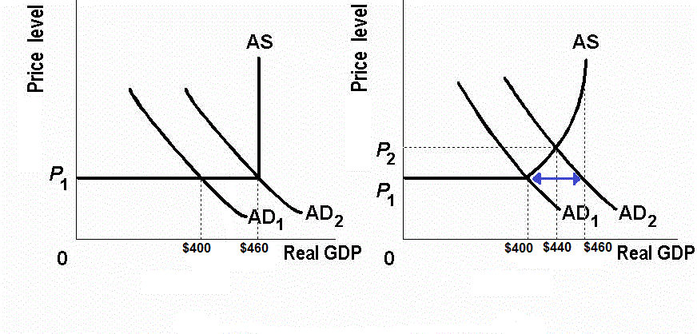
Increases in the price level reduces the size of the multiplier
if MPS = 1/3
Increase G by $20

Slide 70
18t. If MPC = 0.8 and the government increases spending by $50 million then GDP will increase by _______.
$50
$100
$200
$250

Slide 71
18t. If MPC = 0.8 and the government increases spending by $50 million then GDP will increase by _______.
$50
$100
$200
$250

Slide 72
18i. If MPC = 0.9 and the government increases spending by $50 million then GDP will increase by _______.
$50
$100
$200
$450
$500

Slide 73
18i. If MPC = 0.9 and the government increases spending by $50 million then GDP will increase by _______.
$50
$100
$200
$450
$500

Slide 74
19t. If MPC = 0.8 and the government increases taxes by $50 million then GDP will decrease by _______.
$50
$100
$200
$250

Slide 75
19t. If MPC = 0.8 and the government increases taxes by $50 million then GDP will decrease by _______.
$50
$100
$200
$250

Slide 76
19i. If MPC = 0.9 and the government increases taxes by $50 million then GDP will decrease by _______.
$50
$100
$200
$450
$500

Slide 77
19i. If MPC = 0.9 and the government increases taxes by $50 million then GDP will decrease by _______.
$50
$100
$200
$450
$500

Slide 78
20t. If MPC = 0.8 and the government increases spending by $50 million AND increases taxes by $50 million then GDP will decrease by _______.
$0
$50
$100
$200
$250

Slide 79
20t. If MPC = 0.8 and the government increases spending by $50 million AND increases taxes by $50 million then GDP will decrease by _______.
$0
$50
$100
$200
$250

Slide 80
20i. If MPC = 0.9 and the government increases spending by $50 million AND increases taxes by $50 million then GDP will decrease by _______.
$50
$100
$200
$450
$500

Slide 81
20i. If MPC = 0.9 and the government increases spending by $50 million AND increases taxes by $50 million then GDP will decrease by _______.
$50
$100
$200
$450
$500

Slide 82
Team Scores
26 | Team 6
23.33 | Team 1
23 | Team 4
23 | Team 8
22 | Team 5

