Slide 1
Exam 2 Review
This web quiz may appear as two pages on tablets and laptops.
I recommend that you view it as one page by clicking on the open book icon at the bottom of the page.

Slide 2
Unit 2
Ch. 12 – AS and AD
Ch. 8 – UE and IN
Ch. 7 GDP
Ch. 9 EG
Ch. 22W - LDCs

Slide 3
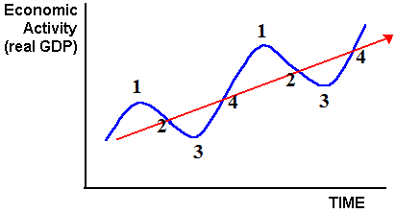
1. When would inflation be at its lowest on the business cycle below?
1
2
3
4

Slide 4
1. When would inflation be at its lowest on the business cycle below?
1
2
3
4

Slide 5
2. Which is NOT one of the reasons why the AD curve is downward sloping?
Price effect
Wealth effect
Interest rate effect
Foreign purchases effect

Slide 6
2. Which is NOT one of the reasons why the AD curve is downward sloping?
Price effect
Wealth effect
Interest rate effect
Foreign purchases effect

Slide 7
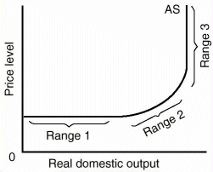
3. Range 1 is called the ______________
Monetary range
Keynesian range
Intermediate range
Classical range

Slide 8
3. Range 1 is called the ______________
Monetary range
Keynesian range
Intermediate range
Classical range

Slide 9
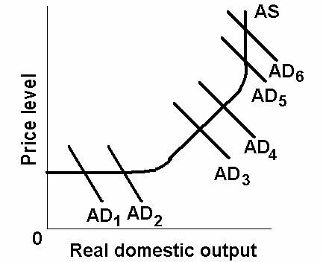
4. Which change in AD will cause the MOST inflation?
AD1 to AD2
AD3 to AD4
AD5 to AD6
None cause IN

Slide 10
4. Which change in AD will cause the MOST inflation?
AD1 to AD2
AD3 to AD4
AD5 to AD6
None cause IN

Slide 11
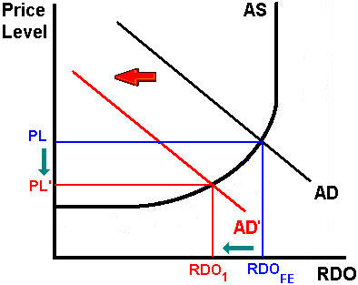
5. What happens to UE and IN?
UE up; IN up
UE up; IN down
UE down; IN down
UE down; IN up

Slide 12
5. What happens to UE and IN?
UE up; IN up
UE up; IN down
UE down; IN down
UE down; IN up

Slide 13
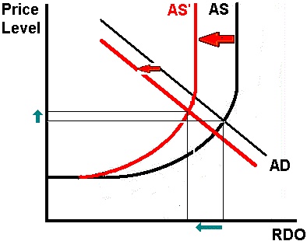
6. What happens to UE and IN?
UE up; IN up
UE up; IN down
UE down; IN down
UE down; IN up

Slide 14
6. What happens to UE and IN?
UE up; IN up
UE up; IN down
UE down; IN down
UE down; IN up

Slide 15
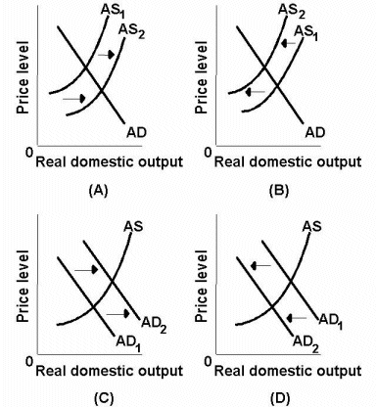

Slide 16
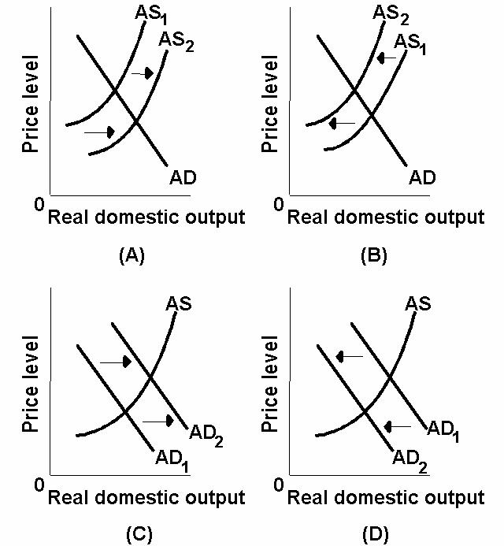
7. If taxes increase:
A
B
C
D

Slide 17
7. If taxes increase:
A
B
C
D

Slide 18
8. If Money Supply increases:
A
B
C
D

Slide 19
8. If Money Supply increases:
A
B
C
D

Slide 20
9. If the economies of Europe and Asia grow rapidly, what happens in the US?
A
B
C
D

Slide 21
9. If the economies of Europe and Asia grow rapidly, what happens in the US?
A
B
C
D

Slide 22
10. Which causes stagflation?
A
B
C
D

Slide 23
10. Which causes stagflation?
A
B
C
D

Slide 24
11. Which causes the ratchet effect?
A
B
C
D

Slide 25
11. Which causes the ratchet effect?
A
B
C
D

Slide 26
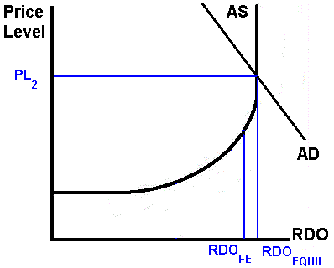
12. What should the government do?
Expans. FP
Contrac. FP
Easy MP
Contrac. Supply Side Policy

Slide 27
12. What should the government do?
Expans. FP
Contrac. FP
Easy MP
Expans. Supply Side Policy

Slide 28
13. Which is correct when the Fed increases the MS? An increase in the MS CAUSES ________
I up CAUSES int. rates down CAUSES AD up
AD up CAUSES I up CAUSES int. rates down
AD down CAUSES int rates down CAUSES I up
Int rates down CAUSES I up CAUSES AD up

Slide 29
13. Which is correct when the Fed increases the MS? An increase in the MS CAUSES ________
I up CAUSES int. rates down CAUSES AD up
AD up CAUSES I up CAUSES int. rates down
AD down CAUSES int rates down CAUSES I up
Int rates down CAUSES I up CAUSES AD up

Slide 30
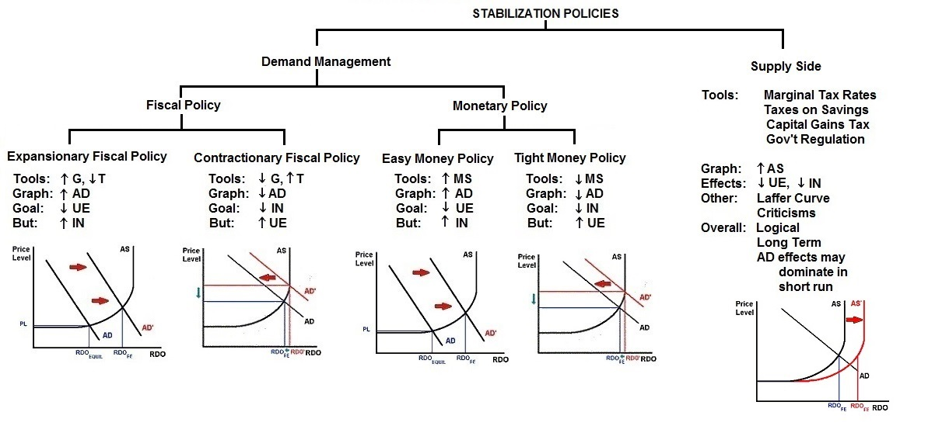
Macroeconomic Policies

Slide 31
14. Full employment is about ____ UE?
2 - 3%
4 - 5%
6 - 7%
8 - 9%

Slide 32
14. Full employment is about ____ UE?
2 - 3%
4 - 5%
6 - 7%
8 - 9%

Slide 33
15. When there is full employment there is still ________________ .
Frictional UE
Structural UE
Cyclical UE
Frictional and Structural UE

Slide 34
15. When there is full employment there is still ________________ .
Frictional UE
Structural UE
Cyclical UE
Frictional and Structural UE

Slide 35
16. Who IS included in the calculations when UE is measured ?
Discouraged workers
Part-time workers
Underground economy workers
Homemakers

Slide 36
16. Who IS included in the calculations when UE is measured ?
Discouraged workers
Part-time workers
Underground economy workers
Homemakers

Slide 37
17. Who LIKES unanticipated inflation?
People in debt
Lenders
Students
People on fixed pensions

Slide 38
17. Who LIKES unanticipated inflation?
People in debt
Lenders
Students
People on fixed pensions

Slide 39
18. If you get a 4% raise and there is 5% inflation then your real income _______
Is unchanged
Increases
Decreases

Slide 40
18. If you get a 4% raise and there is 5% inflation then your real income _______
Is unchanged
Increases
Decreases

Slide 41
19. If the inflation rate is 2%, prices will double in approximately how many years?
2
15
35
70

Slide 42
19. If the inflation rate is 2%, prices will double in approximately how many years?
2
15
35
70

Slide 43
20. Calculate GDP:
Consumption: $ 400
Govt purchases 128
Gross investment 88
Imports 3
Exports 10
Wages 369
Rents 12
Interest 15
Proprietor’s income 52
Corporate profits 82
Depreciation 23
530
600
623
769

Slide 44
20. Calculate GDP:
Consumption: $ 400
Govt purchases 128
Gross investment 88
Imports 3
Exports 10
Wages 369
Rents 12
Interest 15
Proprietor’s income 52
Corporate profits 82
Depreciation 23
530
600
623
769

Slide 45
21. Calculate NI:
Consumption: $ 400
Govt purchases 128
Gross investment 88
Imports 3
Exports 10
Wages 369
Rents 12
Interest 15
Proprietor’s income 52
Corporate profits 82
Depreciation 23
530
600
623
769

Slide 46
21. Calculate NI:
Consumption: $ 400
Govt purchases 128
Gross investment 88
Imports 3
Exports 10
Wages 369
Rents 12
Interest 15
Proprietor’s income 52
Corporate profits 82
Depreciation 23
530
600
623
769

Slide 47
22. Calculate NDP:
Consumption: $ 400
Govt purchases 128
Gross investment 88
Imports 3
Exports 10
Wages 369
Rents 12
Interest 15
Proprietor’s income 52
Corporate profits 82
Depreciation 23
530
600
623
769

Slide 48
22. Calculate NDP:
Consumption: $ 400
Govt purchases 128
Gross investment 88
Imports 3
Exports 10
Wages 369
Rents 12
Interest 15
Proprietor’s income 52
Corporate profits 82
Depreciation 23
530
600
623
769

Slide 49
23. Which is an intermediate good?
Textbook bought by a student
Skis bought by a snowboarder
Monthly rent paid by a family
Buns bought McDonald’s

Slide 50
23. Which is an intermediate good?
Textbook bought by a student
Skis bought by a snowboarder
Monthly rent paid by a family
Buns bought McDonald’s

Slide 51
24. Which is included in GDP?
Textbook bought by a student
Social security payments
The value of a used car
The price paid to buy stock in Amazon.com

Slide 52
24. Which is included in GDP?
Textbook bought by a student
Social security payments
The value of a used car
The price paid to buy stock in Amazon.com

Slide 53
25. Which of the following OVERSTATES GDP as a measure of social welfare?
Non-market transactions
More leisure time
The underground economy
Harmful effects of pollution

Slide 54
25. Which of the following OVERSTATES GDP as a measure of social welfare?
Non-market transactions
More leisure time
The underground economy
Harmful effects of pollution

Slide 55
26. In which years was there a recession?
1 and 2
1 and 3
2 and 3
2 and 4
YEAR | NOM GDP | PRICE INDEX
1 | 143 | 85
2 | 149 | 96
3 | 178 | 112
4 | 220 | 143

Slide 56
26. In which years was there a recession?
1 and 2
1 and 3
2 and 3
2 and 4
YEAR | NOM GDP | PRICE INDEX
1 | 143 | 85
2 | 149 | 96
3 | 178 | 112
4 | 220 | 143

Slide 57
ANSWER: You must calculate real GDP: 26. In which year was there a recession?
YEAR | NOM GDP | PRICE INDEX | REAL GDP
1 | 143 | 85 | 168
2 | 149 | 96 | 155
3 | 178 | 112 | 159
4 | 220 | 143 | 154
1 and 2
1 and 3
2 and 3
2 and 4

Slide 58
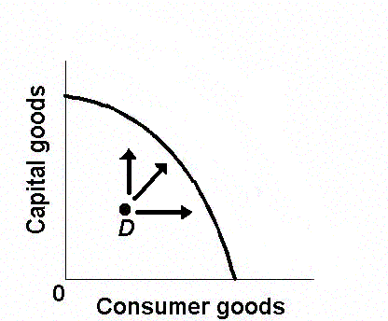
27. Which would cause the type of economic growth illustrated in this graph?
Improvements in technology
More capital goods
Increase in AD
More natural resources

Slide 59
27. Which would cause the type of economic growth illustrated in this graph?
Improvements in technology
More capital goods
Increase in AD
More natural resources

Slide 60
28. Which is “ACHIEVING OUR POTENTIAL” type of economic growth?
Supply factor
Demand factor
Efficiency factor
Demand and Efficiency factors

Slide 61
28. Which is “ACHIEVING OUR POTENTIAL” type of economic growth?
Supply factor
Demand factor
Efficiency factor
Demand and Efficiency factors

Slide 62
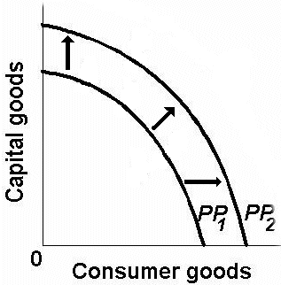
29. Which would cause the type of economic growth illustrated in this graph?
Supply factor
Demand factor
Efficiency factor
Demand and Efficiency factors

Slide 63
29. Which would cause the type of economic growth illustrated in this graph?
Supply factor
Demand factor
Efficiency factor
Demand and Efficiency factors

Slide 64
30. Which will NOT increase labor productivity?
More workers
More capital per worker
Improved technology
More education and training

Slide 65
30. Which will NOT increase labor productivity?
More workers
More capital per worker
Improved technology
More education and training

Slide 66
31. Which is NOT an indicator of a LDC (DVC)?:
Rapid population growth rate
Large % of population in agriculture
Low urbanization rate
Poor infrastructure
High GDP per capita

Slide 67
31. Which is NOT an indicator of a LDC (DVC)?:
Rapid population growth rate
Large % of population in agriculture
Low urbanization rate
Poor infrastructure
High GDP per capita

Slide 68
32. If a rich country and a poor country both have the same economic growth rate then the absolute income gap between the two countries will:
Not change
Increase
Decrease

Slide 69
32. If a rich country and a poor country both have the same economic growth rate then the absolute income gap between the two countries will:
Not change
Increase
Decrease

Slide 70
33. Which of the following is NOT and obstacle to growth for LDCs (DVCs)?
Uncertain ownership of resources
Rapid population growth
Lack of capital
Lack of workers

Slide 71
33. Which of the following is NOT and obstacle to growth for LDCs (DVCs)?
Uncertain ownership of resources
Rapid population growth
Lack of capital
Lack of workers

Slide 72
34. What fraction of the U. S. federal government's budget is spent on FOREIGN AID?
Less than 1%
5%
10%
15%
20%
25%

Slide 73
34. What fraction of the U. S. federal government's budget is spent on FOREIGN AID?
Less than 1%
5%
10%
15%
20%
25%

Slide 74
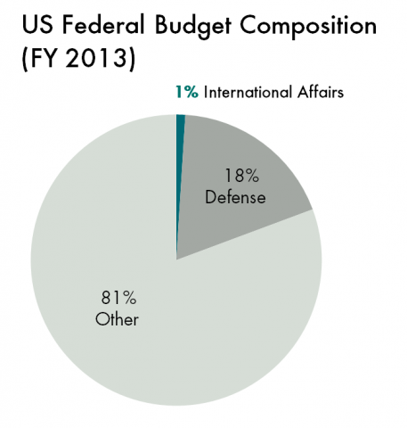

Slide 75
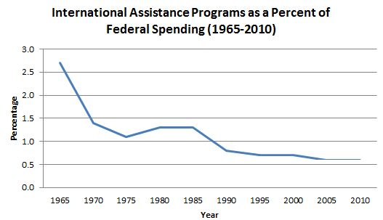
United States

Slide 76
35. What fraction of the U. S. income (NI) is spent on FOREIGN AID?
0.1% to 0.2%
0.5 to 0.7%
1% to 2%
4% to 5%
over 5%

Slide 77
35. What fraction of the U. S. income (NI) is spent on FOREIGN AID?
0.1% to 0.2%
0.5 to 0.7%
1% to 2%
4% to 5%
over 5%

Slide 78
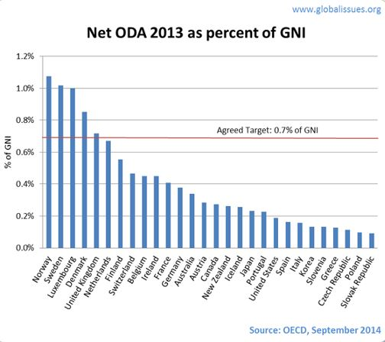

Slide 79
