Slide 1

Exam 1 Review
This web quiz may appear as two pages on tablets and laptops.
I recommend that you view it as one page by clicking on the open book icon at the bottom of the page.

Slide 2
Exam 1 Review
Exam 1 covers:
  5Es
  Chapter 1
  Chapter 2
  Chapter 3
  Chapter 20
Be sure to see the exact textbook pages listed on our “LESSONS” page.

Slide 3
Exam 1 Review
Major topics :
  5Es
  PPC
  Market and Command Economies
  Role of Government
  Government Finance
  Market Failures
  S, D, and efficiency
  Comparative Advantage and the Benefits of trade
  International Trade
  Exchange Rates
Be sure to see the “Must Know/Outcomes” listed on our LESSONS page.

Slide 4
Exam 1 Review
Study Ideas:
Learn the vocabulary – see the list of concepts at the end of each chapter
Define each graph – know what a point on the graph means (Define, Draw, Describe)
S and D determinants – know how they shift the curves
Comparative Advantage
International trade
Exchange Rates (know the determinants)

Slide 5
Exam 1 Review
Study Ideas – DO PROBLEMS:
Do the Yellow Page problems
Do the Required Activities
Do Study Guide problems
Do the Clicker Quizzes, Pre-quizzes, and Practice Exercises, (see Blackboard)
Be sure to see the “Must Know/Outcomes” listed on our LESSONS page.

Slide 6
Exam 1 Review
Study Ideas:
Do you understand
each of the
“Must Know/Outcomes” listed on our
LESSONS page?

Slide 7
1. Which of the following explains why it is good if the price of plywood increases after a hurricane?
Economic Growth
Allocative Efficiency
Productive Efficiency
Equity
Full employment

Slide 8
1. Which of the following explains why it is good if the price of plywood increases after a hurricane?
Economic Growth
Allocative Efficiency
Productive Efficiency
Equity
Full employment

Slide 9
2. Which of the following explains why it is good when Coke-Cola laid off 6000 employees but produced the same quantity?
Economic Growth
Allocative Efficiency
Productive Efficiency
Equity
Full employment

Slide 10
2. Which of the following explains why it is good when Coke-Cola laid off 6000 employees but produced the same quantity?
Economic Growth
Allocative Efficiency
Productive Efficiency
Equity
Full employment

Slide 11
3. You win a summer trip to Europe, all expenses paid, but you cannot afford to go, why?
You cannot afford to buy the airline ticket
You cannot afford the opportunity cost
You would rather go to South America
You would rather go in the winter when you can ski.

Slide 12
3. You win a summer trip to Europe, all expenses paid, but you cannot afford to go, why?
You cannot afford to buy the airline ticket
You cannot afford the opportunity cost
You would rather go to South America
You would rather go in the winter when you can ski.

Slide 13
4. Which of the following is NOT one of the assumptions behind the PPC?
Fixed resources
Fixed technology
Productive efficiency
Allocative efficiency
Full employment
Only two goods

Slide 14
4. Which of the following is NOT one of the assumptions behind the PPC?
Fixed resources
Fixed technology
Productive efficiency
Allocative efficiency
Full employment
Only two goods

Slide 15
5. Other things equal, this economy will achieve the most rapid rate of growth if:
it chooses point A.
it chooses point B.
it chooses point C.
it chooses point D.

Slide 16
5. Other things equal, this economy will achieve the most rapid rate of growth if:
it chooses point A.
it chooses point B.
it chooses point C.
it chooses point D.

Slide 17
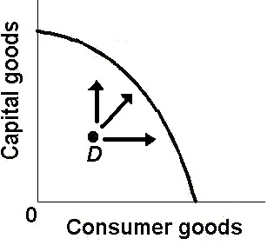
6. The arrows represent:
Achieving allocative efficiency.
Increasing economic growth.
Increasing our potential.
Achieving our potential.

Slide 18
6. The arrows represent:
Achieving allocative efficiency.
Increasing economic growth.
Increasing our potential.
Achieving our potential.

Slide 19
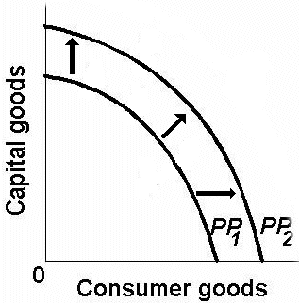

Two Types of “Economic Growth”
Increasing the Potential Achieving the Potential

Slide 20
Answer the next question on the basis of the following information for four highway programs of increasing scope. All figures are in millions of dollars.
7. Which alternative should the government build?
A.
B.
C.
D.

Slide 21
Answer the next question on the basis of the following information for four highway programs of increasing scope. All figures are in millions of dollars.
7. Which alternative should the government build?
A.
B.
C.
D.

Slide 22
8. If the MB < MC, then:
You should do more
You should do less
The result is optimal
The best choice was made

Slide 23
8. If the MB < MC, then:
You should do more
You should do less
The result is optimal
The best choice was made

Slide 24
9. Which of the following is NOT a policy of structural adjustment (globalization)?
Privatization
Promotion of Competition
Reduced Role of Government
Price Controls to help the poor
Freer Trade
Foreign Investment

Slide 25
9. Which of the following is NOT a policy of structural adjustment (globalization)?
Privatization
Promotion of Competition
Reduced Role of Government
Price Controls to help the poor
Freer Trade
Foreign Investment

Slide 26
10. Which of the following is a distinguishing feature of the command economic system?
Private ownership of capital
Central planning
Heavy reliance on markets
Widespread dispersion of economic power

Slide 27
10. Which of the following is a distinguishing feature of the command economic system?
Private ownership of capital
Central planning
Heavy reliance on markets
Widespread dispersion of economic power

Slide 28
11. Economic profits in an industry suggest the industry:
Can earn more profits by increasing the price
Should be larger to satisfy consumers
Has excess capacity
Is the correct size for consumers

Slide 29
11. Economic profits in an industry suggest the industry:
Can earn more profits by increasing the price
Should be larger to satisfy consumers
Has excess capacity
Is the correct size for consumers

Slide 30
12. The “invisible hand” promotes society’s interest because:
Individuals pursuing their self-interest will produce goods that people want
Individuals will produce goods for others out of concern for their fellow human beings
It makes sure that everybody wins from competition
Government regulation pushes businesses into producing the right mix of goods

Slide 31
12. The “invisible hand” promotes society’s interest because:
Individuals pursuing their self-interest will produce goods that people want
Individuals will produce goods for others out of concern for their fellow human beings
It makes sure that everybody wins from competition
Government regulation pushes businesses into producing the right mix of goods

Slide 32
13. Which is a correct policy for the stabilization function of government?
Increase taxes when there is unemployment
Increase taxes when there is inflation
Decrease spending when there is unemployment
Increase money supply when there is inflation

Slide 33
13. Which is a correct policy for the stabilization function of government?:
Increase taxes when there is unemployment
Increase taxes when there is inflation
Decrease spending when there is unemployment
Increase money supply when there is inflation

Slide 34
14. If the price in this market for wheat was $4:
The market would “clear”, Qd would equal Qs
Buyers would want to purchase more wheat than is currently being supplied
Farmers would not be able to sell all of their wheat
There would be a shortage of wheat

Slide 35
14. If the price in this market for wheat was $4:
The market would “clear”, Qd would equal Qs
Buyers would want to purchase more wheat than is currently being supplied
Farmers would not be able to sell all of their wheat
There would be a shortage of wheat

Slide 36
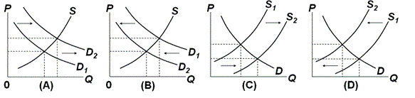
15 and 16

Slide 37
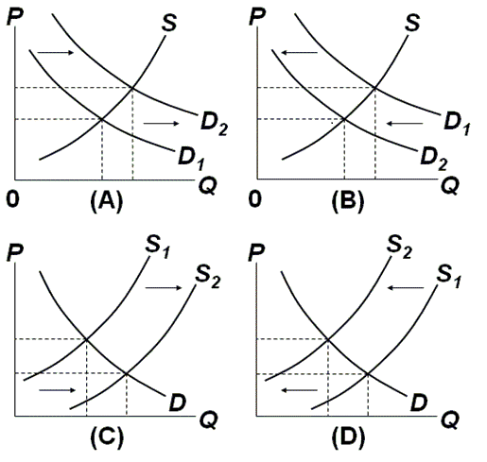
15. Which graph represents the effect of an increase in auto worker wages on the market for cars?
A
B
C
D

Slide 38
15. Which graph represents the effect of an increase in auto worker wages on the market for cars?
A
B
C
D

Slide 39
16. Which graph represents the effect of an increase in incomes on the market for secondhand clothing?
A
B
C
D

Slide 40
16. Which graph represents the effect of an increase in incomes on the market for secondhand clothing?
A
B
C
D

Slide 41
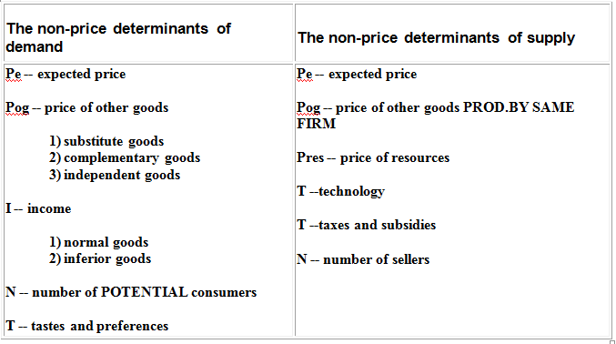

Slide 42
17. One can say for certainty that the equilibrium price will decline if:
S and D both increase
S increases and D decreases
S decreases and D increases
S and D both decrease

Slide 43
17. One can say for certainty that the equilibrium price will decline if:
S and D both increase
S increases and D decreases
S decreases and D increases
S and D both decrease

Slide 44
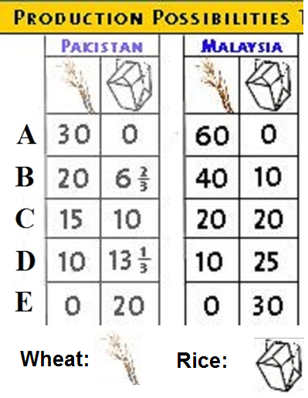
18. Assume before specialization, Pakistan is at “C” and Malaysia at “B”, If they specialize 100%, then the gains will be:
45 wheat and 20 rice
20 rice
5 wheat
15 wheat

Slide 45
18. Assume before specialization, Pakistan is at “C” and Malaysia at “B”, If they specialize 100%, then the gains will be:
45 wheat and 20 rice
20 rice
5 wheat
15 wheat

Slide 46
19. Which of the following would be a likely terms of trade?
1 rice = 1 wheat
1 rice = 1 and 1/3 wheat
1 rice = 1 and 2/3 wheat
1 rice = 2 and 1/3 wheat

Slide 47
19. Which of the following would be a likely terms of trade?
1 rice = 1 wheat
1 rice = 1 1/3 wheat
1 rice = 1 2/3 wheat
1 rice = 2 1/3 wheat

Slide 48
20. Which argument is this for restricting trade?
“Restrict trade to build up a new industry.
The restrictions are then later removed.“
Military Self-Sufficiency
Increase Domestic Employment
Infant Industry
Protection Against Dumping
Cheap Foreign Labor

Slide 49
20. Which argument for restricting trade?
“Restrict trade to build up a new industry.
The restrictions are then later removed.”
Military Self-Sufficiency
Increase Domestic Employment
Infant Industry
Protection Against Dumping
Cheap Foreign Labor

Slide 50
21. Which is a valid counter argument for the cheap foreign labor argument?
Imports may eliminate some jobs BUT they also create jobs.
Often once the protection is removed the industries fail
There are few documented cases of this.
If this were true then one country should never trade with another country that has lower wages.

Slide 51
21. Which is a valid counter argument for the cheap foreign labor argument?
Imports may eliminate some jobs BUT they also create jobs.
Often once the protection is removed the industries fail
There are few documented cases of this.
If this were true then one country should never trade with another country that has lower wages.

Slide 52
Trade Restrictions:
1. Arguments that make some sense, but often abused
a. Military Self-Sufficiency
b. Diversification
c. Infant Industry
d. Protection from Dumping
2. Arguments that do not make sense, but are very popular
a. increase domestic employment
b. cheap foreign labor

Slide 53
22. An effective Price Floor will:
Induce firms to leave the industry
Result in a product surplus
Result in a product shortage
Clear the market

Slide 54
22. An effective Price Floor will:
Induce firms to leave the industry
Result in a product surplus
Result in a product shortage
Clear the market

Slide 55
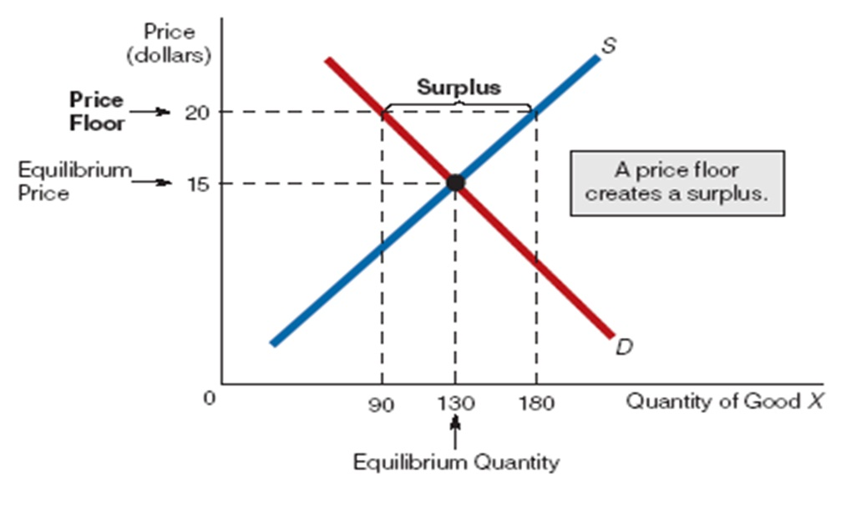
An Effective Price Floor

Slide 56
23. If a legal ceiling price is set above the equilibrium price:
A shortage of the product will occur
A surplus of the product will occur
A black market will evolve
Neither the price or quantity of the product will be affected

Slide 57
23. If a legal ceiling price is set above the equilibrium price:
A shortage of the product will occur
A surplus of the product will occur
A black market will evolve
Neither the price or quantity of the product will be affected

Slide 58
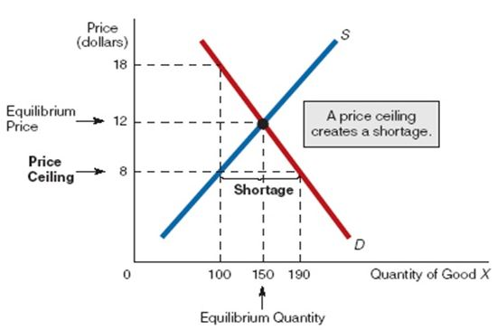
An Effective Price Ceiling

Slide 59
24. The allocative inefficiency of an effective price ceiling can be seen in the fact that:
MSB = MSC
MSB > MSC
MSB < MSC
There is no dead weight loss

Slide 60
24. The allocative inefficiency of an effective price ceiling can be seen in the fact that:
MSB = MSC
MSB > MSC
MSB < MSC
There is no dead weight loss

Slide 61
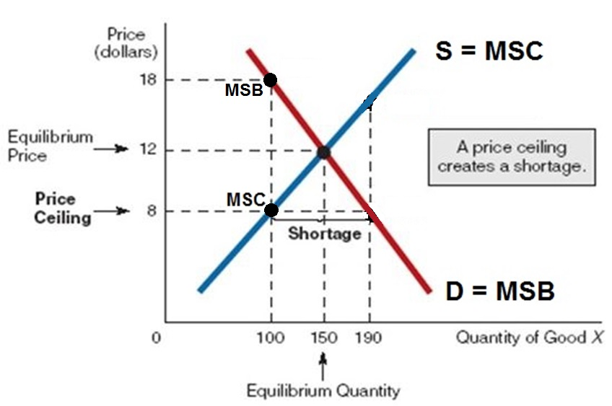
The allocative inefficiency of an effective price ceiling: MSB>MSC

Slide 62
25. If the production of a good results in negative externalities (external costs or spillover costs), then
The socially optimum (alloc. eff.) quantity will be produced
More than the alloc. eff. Q will be produced
Less than the alloc. eff. Q will be produced
There will be a shortage of the good

Slide 63
25. If the production of a good results in negative externalities (external costs or spillover costs), then
The socially optimum (alloc. eff.) quantity will be produced
More than the alloc. eff. Q will be produced
Less than the alloc. eff. Q will be produced
There will be a shortage of the good

Slide 64
26. When positive externalities are in a market for a good, the market
Succeeds, because it is producing the socially optimal (alloc. eff.) output
Fails, because it overproduces the good
Succeeds, because it overproduces the good
Fails, because it underproduces the good

Slide 65
26. When positive externalities are in a market for a good, the market
Succeeds, because it is producing the socially optimal (alloc. eff.) output
Fails, because it overproduces the good
Succeeds, because it overproduces the good
Fails, because it underproduces the good

Slide 66
27. Which of the following is correct about externalities? The government should ______________ .
Tax negative; subsidize positive
Tax positive; subsidize negative
Tax both
Subsidize both

Slide 67
27. Which of the following is correct about externalities? The government should ______________ .
Tax negative; subsidize positive
Tax positive; subsidize negative
Tax both
Subsidize both

Slide 68
28. Which of the following is the best example of a public good?
A hamburger
A music download
A public park
Light from a streetlight

Slide 69
28. Which of the following is the best example of a public good?
A hamburger
A music download
A public park
Light from a streetlight

Slide 70
29. A public good:
Is a rival, exclusive good
Is a non-rival, exclusive good
Is a non-rival, non-exclusive good
Does not have the free rider problem

Slide 71
29. A public good:
Is a rival, exclusive good
Is a non-rival, exclusive good
Is a non-rival, non-exclusive good
Does not have the free rider problem

Slide 72
30. The role of government concerning public goods is to:
Tax the product
Regulate the product
Produce the product
Apply the Coase theorem

Slide 73
30. The role of government concerning public goods is to:
Tax the product
Regulate the product
Produce the product
Apply the Coase theorem

Slide 74
31. Which of the following is NOT a major source of revenue for the federal government?
Income taxes
Payroll taxes
Corporate income taxes
Property Taxes

Slide 75
31. Which of the following is NOT a major source of revenue for the federal government?
Income taxes
Payroll taxes
Corporate income taxes
Property Taxes

Slide 76
32. Which of the following is NOT a major expenditure for the federal government?
Defense
Income security
Education
Healthcare

Slide 77
32. Which of the following is NOT a major expenditure for the federal government?
Defense
Income security
Education
Healthcare

Slide 78
33. If there is high unemployment, the appropriate government policy would be to:
Raise taxes and cut gov’t spending
Raise taxes and raise gov’t spending
Cut taxes and raise gov’t spending
Cut taxes and cut gov’t spending

Slide 79
33. If there is high unemployment, the appropriate government policy would be to:
Raise taxes and cut gov’t spending
Raise taxes and raise gov’t spending
Cut taxes and raise gov’t spending
Cut taxes and cut gov’t spending

Slide 80
34. Which of the following is a regressive tax?
Social security (payroll) tax
Sales tax
Property tax
All of the above

Slide 81
34. Which of the following is a regressive tax?
Social security (payroll) tax
Sales tax
Property tax
All of the above

Slide 82
35. If income is $15,000, what is the average tax rate?
5%
10%
13%
15%
20%
INCOME TAX PAID
5,000 250
10,000 1,000
15,000 2,000

Slide 83
35. If income is $15,000, what is the average tax rate?
5%
10%
13%
15%
20%
INCOME TAX PAID
5,000 250
10,000 1,000
15,000 2,000

Slide 84
36. On incomes over $10,000, what is the marginal tax rate?
5%
10%
13%
15%
20%
INCOME TAX PAID
5,000 250
10,000 1,000
15,000 2,000

Slide 85
36. On incomes over $10,000, what is the marginal tax rate?
5%
10%
13%
15%
20%
INCOME TAX PAID
5,000 250
10,000 1,000
15,000 2,000

Slide 86
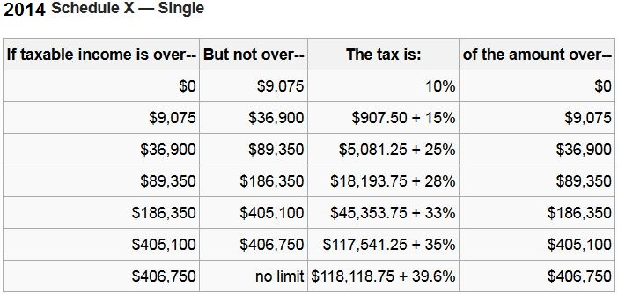
If your income is $10,075, what is your marginal tax
rate and how much do you owe in taxes?

Slide 87
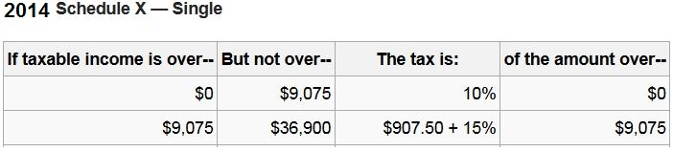
37. If your income is $10,075, what is your marginal tax rate and how much do you owe in taxes?
10% ; $907.50
15%; $907.50
10%; $1057.50
15%; $1057.50

Slide 88
37. If your income is $10,075, what is your marginal tax rate and how much do you owe in taxes?
10% ; $907.50
15%; $907.50
10%; $1057.50
15%; $1057.50

Slide 89
38. If your income is $10,075, what is your average tax rate?
10%
10.5%
15%
20%

Slide 90
38. If your income is $10,075, what is your average tax rate?
10%
10.5%
15%
20%

Slide 91
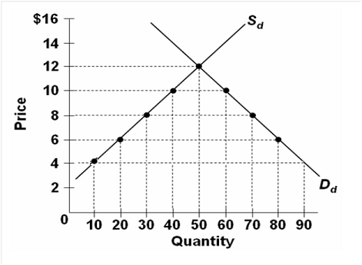
39. Graph: Domestic S & D.
-World Price: $4.00
-Tariff: $4.00
-How much imported?
10
20
30
40

Slide 92
39. Graph: Domestic S & D.
-World Price: $4.00
-Tariff: $4.00
-How much imported?
10
20
30
40

Slide 93
40. Consider the currency market for Japanese yens and U.S. dollars. An increase in the demand for Japanese yen results in:
An appreciation of the yen and a depreciation of the dollar
A depreciation of the yen and a depreciation of the dollar
An appreciation of the yen and an appreciation of the dollar
A depreciation of the yen and an appreciation of the dollar

Slide 94
40. Consider the currency market for Japanese yens and U.S. dollars. An increase in the demand for Japanese yen results in:
An appreciation of the yen and a depreciation of the dollar
A depreciation of the yen and a depreciation of the dollar
An appreciation of the yen and an appreciation of the dollar
A depreciation of the yen and an appreciation of the dollar

Slide 95
41. If the US has slow economic growth compared to Japan:
Yen appreciates; $ depreciates
Yen depreciates; $ appreciates
Yen appreciates; $ appreciates
Yen depreciates; $ depreciates

Slide 96
41. If the US has slow economic growth compared to Japan:
Yen appreciates; $ depreciates
Yen depreciates; $ appreciates
Yen appreciates; $ appreciates
Yen depreciates; $ depreciates

Slide 97
42. If a country has rapid economic growth then we would expect:
Fewer imports
larger trade deficit
Its currency to appreciate
Fixed exchange rates

Slide 98
42. If a country has rapid economic growth then we would expect:
Fewer imports
larger trade deficit
Its currency to appreciate
Fixed exchange rates

Slide 99
Study hard!

