Slide 1
9b – Inflation
This web quiz may appear as two pages on tablets and laptops.
I recommend that you view it as one page by clicking on the open book icon at the bottom of the page.

Slide 2
9b – Inflation
TOPICS
Definition of Inflation?
What is a Price Index?
Calculate the Inflation Rate using an Index
Causes and Effects of Inflation
Costs of Inflation

Slide 3
9b – Inflation
OUTCOMES
Define inflation, deflation, and disinflation
Calculate the inflation rate using price index data
What is a price index and how is the CPI measured?
Explain the two types of inflation (demand-pull; cost-push) using the AD/AS graph
What is the rule of 70 and apply it to the price level.
If the population of a country is 25 million and it is growing a rate of 4% a year, how many years will it take for the population to reach 50 million? 100 million? 200 million (assuming that the growth rate stays at 4%)?
Who is hurt by unanticipated inflation and who may benefit from unanticipated inflation. (redistributive effects of inflation).
What are the output and employment effects of demand-pull and cost-push inflation? (Who is hurt and who is helped?)
How does the inflation rate affect real income growth?
Recently a teachers' union argued that the standard of living of teachers working for the school district was falling. The negotiating team for the school board replied that this was not true because the teachers had received significant increases in nominal income through collective bargaining. Could the union statement be correct?
If inflation is going down then what is happening to the average level of prices in an economy. OR what is the difference between deflation and disinflation?

Slide 4
9b – Inflation
KEY TERMS:
inflation, inflation rate, deflation, disinflation, price index, CPI, purchasing power, rule of 70, cost-push inflation, demand-pull inflation, redistributive effects, output effects, hyperinflation, nominal income, real income, COLAs, menu costs,

Slide 5
1. The annual current rate of IN in the US is about _______.
0 %
1 %
3 %
5 %

Slide 6
1. The annual current rate of IN in the US is about _______.
0 %
1 %
3 %
5 %

Slide 7
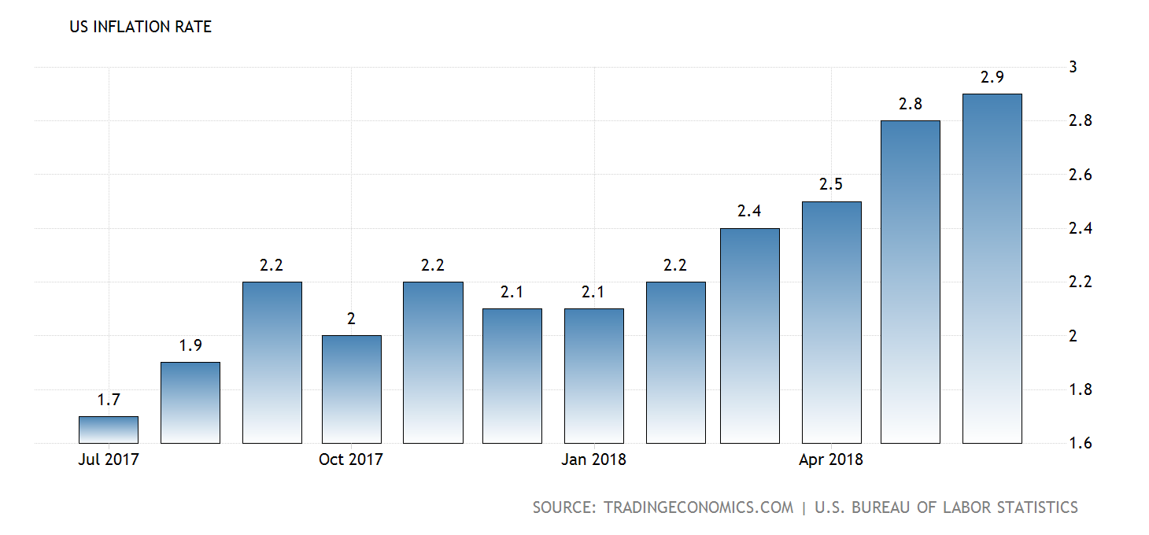
Inflation Rates - Current

Slide 8
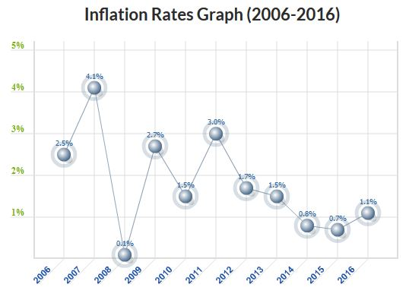

Slide 9
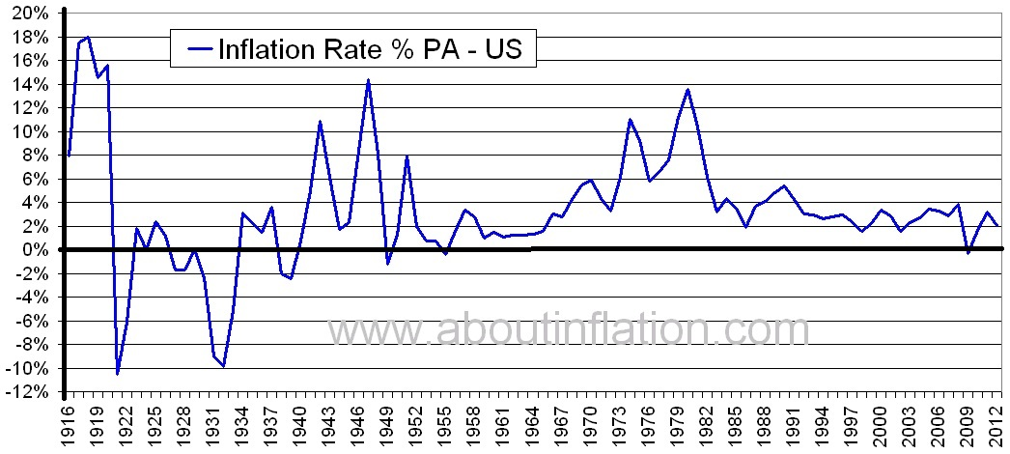
Inflation Rates 1916-2012

Slide 10
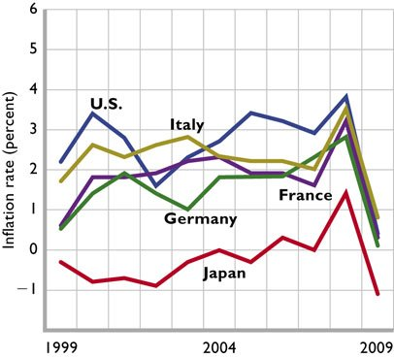
International Comparisons

Slide 11
2. Define inflation:
A high price level
A car costs more this year than last year
The rate of increase in the price level
Directly related to real GDP

Slide 12
2. Define inflation:
A high price level
A car costs more this year than last year
The rate of increase in the price level
Directly related to real GDP

Slide 13
3. If the inflation rate decreases from 3% to 2% then:
The price level goes down
The price level goes up

Slide 14
3. If the inflation rate decreases from 3% to 2% then:
The price level goes down
The price level goes up
If the inflation rate is 2% then the price level
is increasing at a rate of 2% per year.

Slide 15
4. Disinflation occurs when:
The price level goes up
The price level increases more slowly
Inflation rate decreases but is still positive
All of the above

Slide 16
4. Disinflation occurs when:
The price level goes up
The price level increases more slowly
Inflation rate decreases but is still positive
All of the above

Slide 17
Inflation Rates 1916-2012

Slide 18
5. Define deflation:
A low price level
A car costs less this year than last year
The rate of decrease in the price level
Inversely related to real GDP

Slide 19
5. Define deflation:
A low price level
A car costs less this year than last year
The rate of decrease in the price level
Inversely related to real GDP

Slide 20
Inflation Rates 1916-2012

Slide 21
6. What do economists use to measure the Price Level?
A price index
An inflation index
Real GDP
The rule of 70

Slide 22
6. What do economists use to measure the Price Level?
A price index
An inflation index
Real GDP
The rule of 70

Slide 23
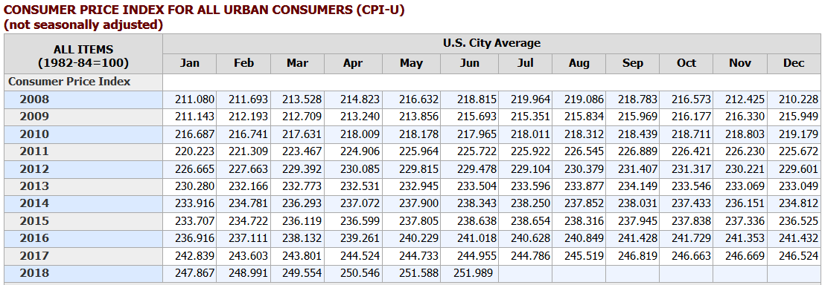
Consumer Price Index
https://www.bls.gov/
United States CPI 1913 - 2018

Slide 24
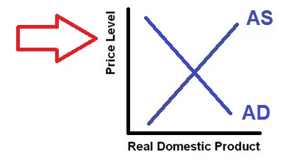
Consumer Price Index is a Measure of the Price Level

Slide 25
7. What was the inflation rate in 1974?
: CPI = 54
1974: CPI = 50
1973: CPI = 45
50 %
45 %
11 %
5 %
4 %

Slide 26
7. What was the inflation rate in 1974?
: CPI = 54
1974: CPI = 50
1973: CPI = 45
50 %
45 %
11 %
5 %
4 %

Slide 27
How to Calculate the IN Rate Using a Price Index (PI)
PI this year – PI last year _______________________________________________________________________________
PI last year
IN rate =
X 100

Slide 28
How to Calculate the IN Rate
To measure inflation, subtract last year's price index from this year's price index and divide by last year's index; then multiply by 100 to express as a percentage.
Inflation Rate = [ (Price Index this year - Price Index last year) / Price Index last year ] x 100
IN rate 1974 = [ (PL 1974 - PL 1973) / PL 1973 ] x 100
IN rate in 1974 = [(50-45) / 45] x 100 = 5/45 x 100 = 11 %
: CPI = 54
1974: CPI = 50
1973: CPI = 45

Slide 29
8. If the inflation rate is 7% , how many years will it take for prices to double?
1
3
7
10
14

Slide 30
8. If the inflation rate is 7% , how many years will it take for prices to double?
1
3
7
10
14

Slide 31
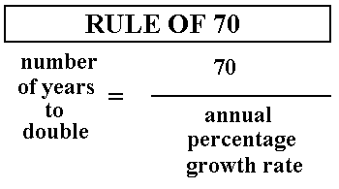
If the price level rises at 7 % a year:
Number of years to double = 70 / 7 = 10 years

Slide 32
9. Which of the following causes inflation?
Decrease in the money supply
Decrease in Aggregate Demand
Increase in Aggregate Demand
Increase in Aggregate Supply

Slide 33
9. Which of the following causes inflation?
Decrease in the money supply
Decrease in Aggregate Demand
Increase in Aggregate Demand
Increase in Aggregate Supply

Slide 34
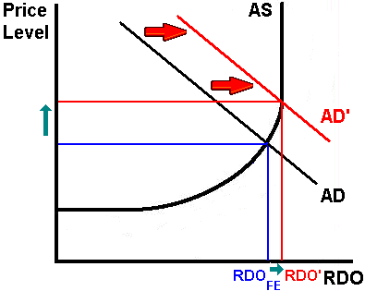
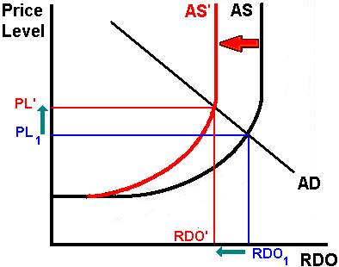
Causes of Inflation
Demand-Pull Inflation Cost-Push Inflation

Slide 35
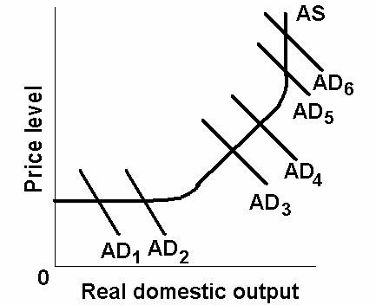
10. Inflation is most harmful if AD increases from:
AD1 to AD2
AD3 to AD4
AD5 to AD6

Slide 36
10. Inflation is most harmful if AD increases from:
AD1 to AD2
AD3 to AD4
AD5 to AD6

Slide 37
11. Who likes inflation?
People who are in debt
Savers
People on a fixed income without a COLA
Creditors who did not anticipated the inflation

Slide 38
11. Who likes inflation?
People who are in debt
Savers
People on a fixed income without a COLA
Creditors who did not anticipated the inflation

Slide 39
12. The redistributive effects of inflation do the greatest harm to:
People in debt
People on a fixed income with a COLA
People on a fixed income without a COLA
Creditors who anticipated the inflation

Slide 40
12. The redistributive effects of inflation do the greatest harm to:
People in debt
People on a fixed income with a COLA
People on a fixed income without a COLA
Creditors who anticipated the inflation

Slide 41
Effects of Inflation
redistributive effects – HURT or HELP?
a. Fixed nominal income receivers / HURT unless COLA
COLA - An automatic increase in the incomes (wages) of workers when inflation occurs; guaranteed by a collective bargaining contract between firms and workers.
b. Savers / HURT c. Debtors/HELPED
d. Creditors/HURT unless anticipated
anticipated and unanticipated inflation
anticipated: Increases in the price level (inflation) which occur at the expected rate.
unanticipated: Increases in the price level (inflation) at a rate greater than expected.

Slide 42
Effects of Inflation
2. output effects
a. Stimulus (Gain) of demand-pull inflation b. Loss with cost-push inflation and unemployment c. Loss with Hyperinflation and breakdown
A very rapid rise in the price level. results in LESS OUTPUT because:
people no longer will accept money
they will therefore either
barter, or
produce everything for themselves
there will therefore not be the gains in output caused by specialization and exchange (trade)

Slide 43
Output Effects of Inflation
Demand Pull Inflation Cost Push Inflation
Output increases Output Decreases
UE Decreases UE Increases

