Slide 1
9a – Unemployment
This web quiz may appear as two pages on tablets and laptops.
I recommend that you view it as one page by clicking on the open book icon at the bottom of the page.

Slide 2
9a – Unemployment
What is Unemployment?
Calculate the UE rate
Who is included and who is not?
The official Unemployment Rate and the "Real" Rate of Unemployment
What is Full Employment and the Types of UE?
The Natural (Full employment ) Rate of Unemployment
Changes in the Natural Rate of Unemployment
The Costs of Unemployment

Slide 3
9a – Unemployment – Outcomes (1)
What is unemployment?
Describe how unemployment is measured. How is the unemployment rate calculated? Who is included as employed, unemployed, and who is not in the labor force?
Why might UE increase as an economy is beginning to recover from a recession?
Define the "Real Rate of UE".

Slide 4
9a – Unemployment – Outcomes (2)
What is full employment? Identify the full employment, or natural rate, of unemployment and explain why 5% unemployment can be called full employment.
Define and give examples of frictional, cyclical, and structural unemployment.
How and why has the natural rate of unemployment changed over the past five or six decades?
Why might UE increase as an economy is beginning to recover?
Jan. 2015: US population 320,090,000; US labor force 157,180,000 Sept. 2015: US population 321,650,000; US labor force 156,715,000 How can the size of the labor force decline as the size of the population increases?
Identify the economic costs of unemployment and the groups that bear unusually heavy unemployment burdens.
What is a positive GDP gap and a negative GDP gap?

Slide 5
9a – Unemployment
KEY TERMS:
unemployment rate, unemployed, employed, labor force, underemployed, discouraged worker, "natural rate of UE" or "full employment rate of UE", "real rate of UE", frictional UE, structural UE, cyclical UE, potential output, GDP gap, labor force participation rate,

Slide 6
1. The current rate of UE in the US is about what?
3.0%
4.0%
5.0%
6.0%
7.0%

Slide 7
1. The current rate of UE in the US is about what?
3.0%
4.0%
5.0%
6.0%
7.0%

Slide 8
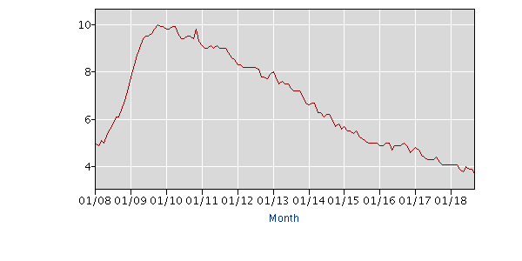
U.S Unemployment Rates
http://www.bls.gov/

Slide 9
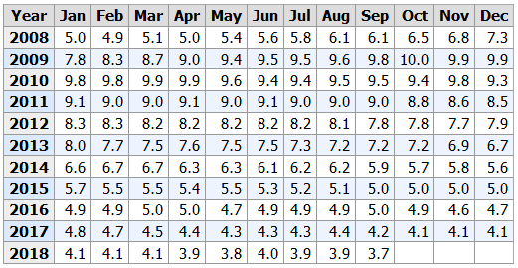
U.S Unemployment Rates
http://www.bls.gov/

Slide 10
2. 3.7 % OF WHAT are unemployed?
the population
adults
the labor force
people able to work

Slide 11
2. 3.7 % OF WHAT are unemployed?
the population
adults
the labor force
people able to work

Slide 12
3. Who IS included in the labor force?
Students
Discouraged workers
Retired
Homemakers
Underemployed

Slide 13
3. Who IS included in the labor force?
Students
Discouraged workers
Retired
Homemakers
Underemployed

Slide 14
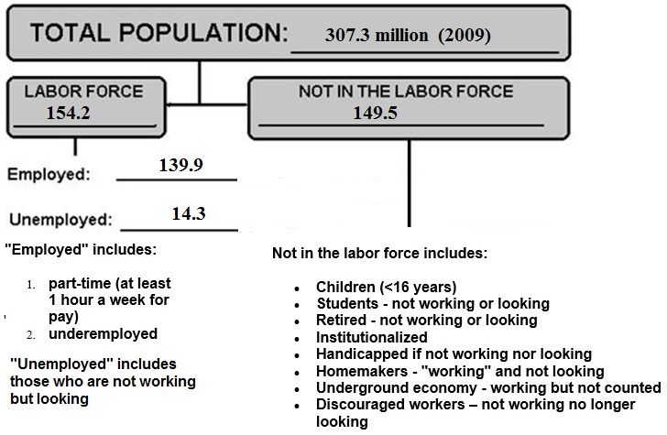

Slide 15
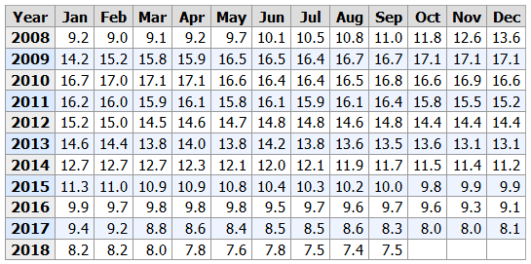
The “Real” Rate of UE (U6) includes: - the unemployed, - the underemployed - and the discouraged workers
U6 Unemployment Rate in the US

Slide 16
4. The UE rate often increases as an economy is beginning to recover from a recession because:
There are more discouraged workers
More people enter the labor force
Inflation begins to rise
Potential UE increases

Slide 17
4. The UE rate often increases as an economy is beginning to recover from a recession because:
There are more discouraged workers
More people enter the labor force
Inflation begins to rise
Potential UE increases

Slide 18
How can the size of the labor force decline as the size of the population increases?
Jan. 2015
Pop. 320,090,000
labor force 157,180,000
Sept. 2015
Pop. 321,650,000;
labor force 156,715,000

Slide 19
5. How can the size of the labor force decline as the size of the population increases?
More people retire
More immigrants
More people on welfare
Impossible!

Slide 20
5. How can the size of the labor force decline as the size of the population increases?
More people retire
More immigrants
More people on welfare
Impossible!

Slide 21
6. In the US, how much unemployment is there when we have full employment?
0% - 1%
2% - 3%
4% - 5%
6% - 7%

Slide 22
6. In the US, how much unemployment is there when we have full employment?
0% - 1%
2% - 3%
4% - 5%
6% - 7%

Slide 23
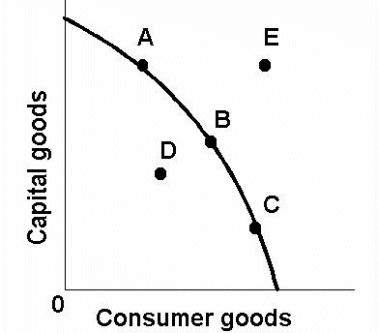
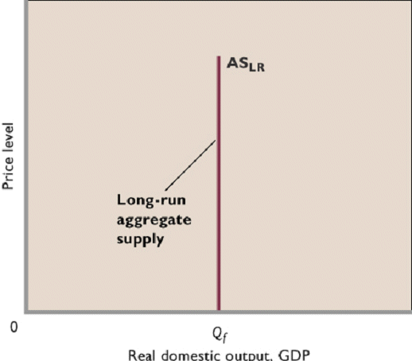
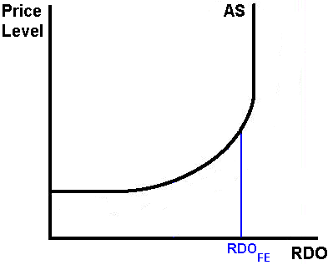
Where are we when UE is 4% to 5%?
- We are on the PPC
- We are at the full employment level of real GDP

Slide 24
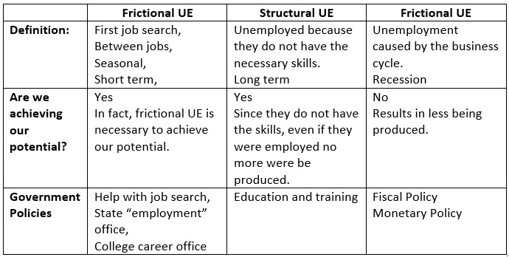
Types of Unemployment

Slide 25
7. Chris lost his job as a ski lift operator when the ski season ended. Which type of UE is this?
Frictional
Structural
Cyclical
Chris is not included in the UE rate

Slide 26
7. Chris lost his job as a ski lift operator when the ski season ended. Which type of UE is this?
Frictional
Structural
Cyclical
Chris is not included in the UE rate

Slide 27
8. Chris was a good auto mechanic, but he knows little about new car technology. What type of UE?
Frictional
Structural
Cyclical
Chris is not included in the UE rate

Slide 28
8. Chris was a good auto mechanic, but he knows little about new car technology. What type of UE?
Frictional
Structural
Cyclical
Chris is not included in the UE rate

Slide 29
9. Chris has looked for a job for the last 6 months but he has quit looking. He is now living with his mother? What type of UE?
Frictional
Structural
Cyclical
Chris is not included in the UE rate

Slide 30
9. Chris has looked for a job for the last 6 months but he has quit looking. He is now living with his mother? What type of UE?
Frictional
Structural
Cyclical
Chris is not included in the UE rate

Slide 31
10. Chris lost his job in the auto factory when car sales declined and UE rose. What type of UE?
Frictional
Structural
Cyclical
Chris is not included in the UE rate

Slide 32
10. Chris lost his job in the auto factory when car sales declined and UE rose. What type of UE?
Frictional
Structural
Cyclical
Chris is not included in the UE rate

Slide 33
11. The “full employment rate of unemployment includes _____________
Frictional UE only
Structural UE only
Cyclical UE only
Frictional + Structural UE
Structural + Cyclical UE

Slide 34
11. The “full employment rate of unemployment includes _____________
Frictional UE only
Structural UE only
Cyclical UE only
Frictional + Structural UE
Structural + Cyclical UE

Slide 35
12. Which of the following did NOT increase the natural rate of UE in the mid to late 20th century in the US?
More women entering the labor force
Large college graduation class sizes
Expanded UE insurance program
Rapidly changing technology
Improved job training programs

Slide 36
12. Which of the following did NOT increase the natural rate of UE in the mid to late 20th century in the US?
More women entering the labor force
Large college graduation class sizes
Expanded UE insurance program
Rapidly changing technology
Improved job training programs

Slide 37
13. The GDP gap = ________________
Actual GDP – Potential GDP
Actual GDP + Potential GDP
Potential GDP – Actual GDP
Potential GDP – Actual GDP

Slide 38
13. The GDP gap = ________________
Actual GDP – Potential GDP
Actual GDP + Potential GDP
Potential GDP – Actual GDP
Potential GDP – Actual GDP

Slide 39
14. Can the GDP gap be positive? (Can the actual GDP be more than the potential?) GDP gap = actual GDP - potential GDP
yes
no

Slide 40
14. Can the GDP gap be positive? (Can the actual GDP be more than the potential?) GDP gap = actual GDP - potential GDP
yes
no

Slide 41
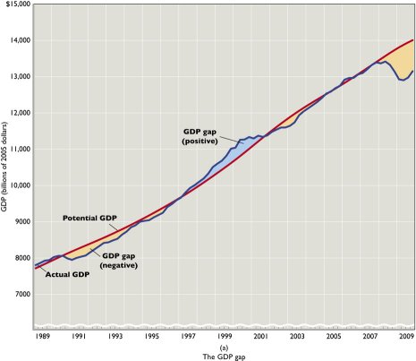

Slide 42
15. What is the most important COST of UE?
Unequal burdens
Lost output
The need for job training
Inefficiency

Slide 43
15. What is the most important COST of UE?
Unequal burdens
Lost output
The need for job training
Inefficiency

