Slide 1
8a – Economic Growth
This web quiz may appear as two pages on tablets and laptops.
I recommend that you view it as one page by clicking on the open book icon at the bottom of the page.

Slide 2
8a – Economic Growth (EG)
Definitions of EG
EG in the US
Modern EG
Determinants of EG
Causes of Productivity Growth

Slide 3
8a – Economic Growth
Outcomes / Must Know:
Give three definitions of economic growth and illustrate them on the 5Es, PPC, AS/AD, and LRAS models.
Use the 5Es, PPC, AS/AD, and LRAS models to differenciate between "achieving our potential" and "increasing our potential".
Explain why growth is a desirable goal.
Define “modern economic growth” , "great divergence", "leading country", and "follower country".
Identify two main sources of growth (more resources, more productivity) and apply them to the growth history of the United States.
Explain and apply the "rule of 70."
Identify and explain the supply factors (INCREASING the potential)
Identify and explain the demand, and efficiency factors (ACHIEVING the potential)
Differentiate between ACHIEVING the potential and INCREASING the potential using the PPC. AD/AD, and long-run AS models
According to the authors, why is the real GDP per capita of the United States in 2007 so much higher than that of other rich countries?
Differentiate between production, productive efficiency, and productivity
If the quantity of labor increases, what happens to productivity? ANSWER: Nothing. The quantity of labor will affect production, but the quality of labor affects productivity
What are the determinants of productivity growth?
Identify and explain the arguments for and against economic growth.

Slide 4
8a – Economic Growth
KEY TERMS:
economic growth, increasing the potential, achieving the potential, GDP per capita, rule of 70, productivity, production, productive efficiency, modern economic growth, the great divergence, leader countries, follower countries, property rights, patents and copyrights, simultaneous consumption, network effects, labor force participation, infrastructure, human capital, economies of scale,

Slide 5
3 Types of Economic Growth
INCREASING OUR POTENTIAL (an increase in the ability to produce)
ACHIEVING OUR POTENTIAL (an increase in real GDP)
Increase in real GDP PER CAPITA

Slide 6
1. What is the EG rate of the US?
1970 thru 1990’s: 3%; 2000’s to now: 2%
1970 thru 1990’s: 4%; 2000’s to now: 3%
1970 thru 1990’s: 8%; 2000’s to now: 6%
1970 thru 1990’s: 10%; 2000’s to now: 5%

Slide 7
1. What is the EG rate of the US?
1970 thru 1990’s: 3%; 2000’s to now: 2%
1970 thru 1990’s: 4%; 2000’s to now: 3%
1970 thru 1990’s: 8%; 2000’s to now: 6%
1970 thru 1990’s: 10%; 2000’s to now: 5%

Slide 8
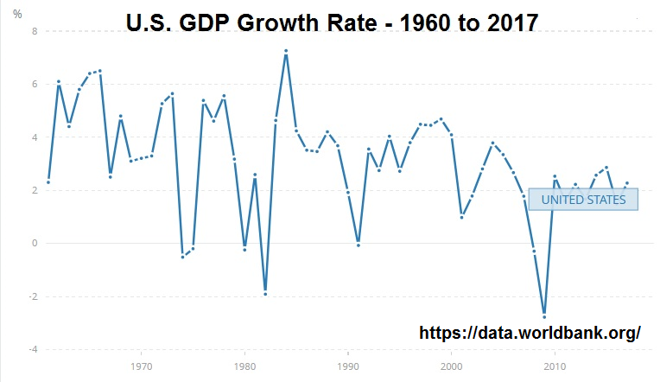

Slide 9
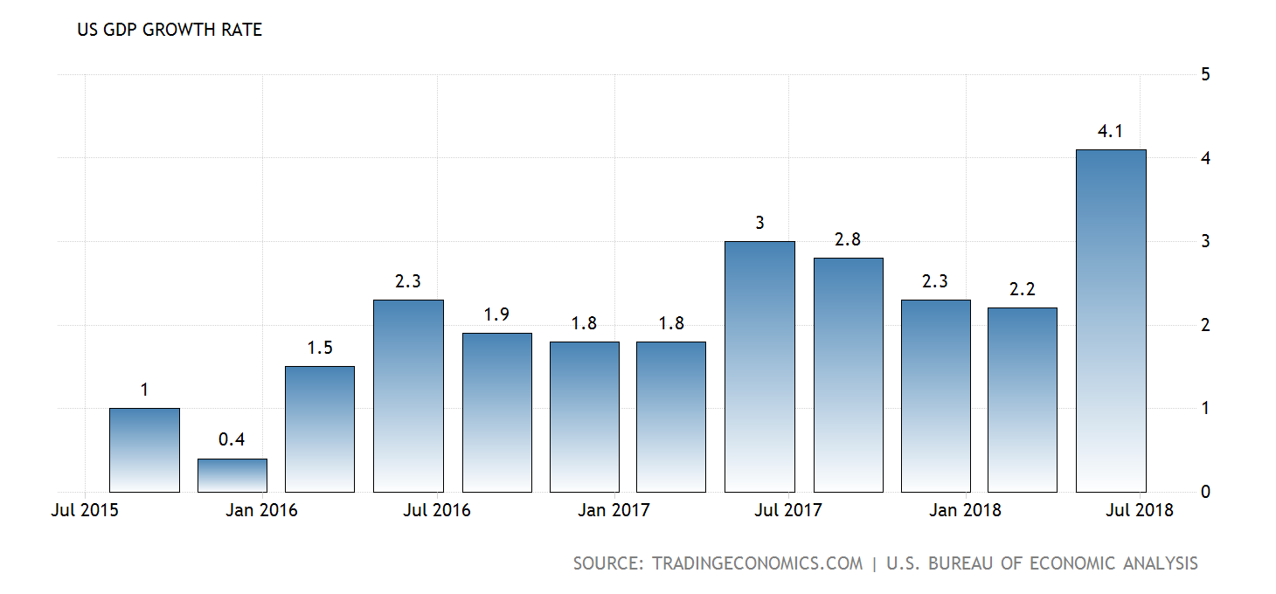

Slide 10
2. Which graph(s) represent(s) INCREASING THE POTENTIAL?
A
A, B
C, D
B, D, E
A, B, D

Slide 11
2. Which graph(s) represent(s) INCREASING THE POTENTIAL?
A
A, B
C, D
B, D, E
A, B, D

Slide 12
3. Which graphs above represents the type of economic growth that occurs if consumer spending increases?
A, C
A, B
C, D
B, D, E
A, B, D

Slide 13
3. Which graphs above represents the type of economic growth that occurs if consumer spending increases?
A, C
A, B
C, D
B, D, E
A, B, D

Slide 14
4. Which graph(s) represent(s) ACHIEVING THE POTENTIAL?
A
A, C
C, D
B, D, E
A, B, D

Slide 15
4. Which graph(s) represent(s) ACHIEVING THE POTENTIAL?
A
A, C
C, D
B, D, E
A, B, D

Slide 16
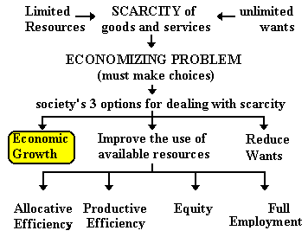
5. Which graphs above represents the 5Es type of EG?
A, C
A, B
C, D
B, D, E
A, B, D

Slide 17
5. Which graphs above represents the 5Es type of EG?
A, C
A, B
C, D
B, D, E
A, B, D

Slide 18
6. Which of these is INCREASING THE POTENTIAL?
Demand factors
Supply factors
Efficiency factors
Growth factors

Slide 19
6. Which of these is INCREASING THE POTENTIAL?
Demand factors
Supply factors
Efficiency factors
Growth factors

Slide 20
7. Which is ACHIEVING OUR POTENTIAL?
5Es economic growth
Supply factors
Efficiency factors
Growth factors

Slide 21
7. Which is ACHIEVING OUR POTENTIAL?
5Es economic growth
Supply factors
Efficiency factors
Growth factors

Slide 22
INCREASING OUR POTENTIAL
5Es: EG
Supply factor
Shift the PPC
Increase AS
Increase LRAS
ACHIEVING OUR POTENTIAL
5Es: Full Employ.
5Es: Prod. Eff.
Demand factor
Efficiency factor
Increase AD
Move from point inside of PPC to a point nearer to the curve

Slide 23
Determinants of Growth - SIX FACTORS from the textbook
Four SUPPLY FACTORS relate to the ability to produce = INCREASE THE POTENTIAL
The quantity and quality of natural resources,
The quantity and quality of human resources,
The supply or stock of capital goods, and
Technology.
More Resources, Better Resources, Better Technology
Two DEMAND and EFFICIENCY FACTORS are also related to growth = ACHIEVE THE POTENTIAL
Aggregate demand must increase for production to expand.
Full employment of resources and productive efficiency are necessary to get the maximum amount of production possible.

Slide 24
Determinants of Growth – From previous chapters
INCREASING THE POTENTIAL ACHIEVING THE POTENTIAL
5Es EG
More resources
Better resources
Better technology
Change in AS
Lower resource prices
Increase productivity
Less gov’t regulation and lower business taxes
Change in AD
C
I
G
XN
MS
T
S
Prod. Eff.
Don’t use more resources than necessary
Use resources where they are best suited
Use appropriate technology

Slide 25
8. If the economy is growing at an annual rate of 2% a year, about how many years will it take for GDP to double?
15
25
35
45

Slide 26
8. If the economy is growing at an annual rate of 2% a year, about how many years will it take for GDP to double?
15
25
35
45

Slide 27
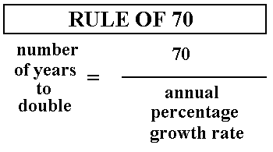
Years to double = 70/2 = 35 years

Slide 28
Modern Economic Growth
there was little to no growth in living standards from the beginning of time to about 200 years ago
during this period of little or no growth, all areas of the world had similar standards of living
therefore the type of economic growth that we see now is a recent phenomenon in the history of the world
also, the great differences in living standards is a recent phenomenon in the history of the world

Slide 29
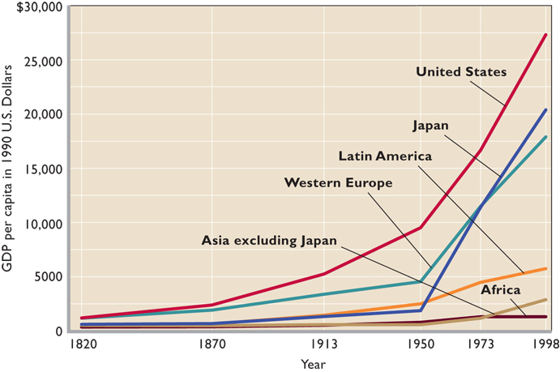
The Great Divergence

Slide 30
9. Why was there a “great divergence”? According to the textbook, what is the main cause for the "vast differences in per capita income levels seen today”?
Different education levels
Different amount of resources
Different time when they started modern growth
Different climate

Slide 31
9. Why was there a “great divergence”? According to the textbook, what is the main cause for the "vast differences in per capita income levels seen today”?
Different education levels
Different amount of resources
Different time when they started modern growth
Different climate

Slide 32
The Great Divergence

Slide 33
10. Is it possible for “follower countries” to catch up to the “leader countries”?
No, rapid population growth makes it unlikely
Yes, by increasing their population
Yes, by adopting technology developed in the rich countries
No, it is too late

Slide 34
10. Is it possible for “follower countries” to catch up to the “leader countries”?
No, rapid population growth makes it unlikely
Yes, by increasing their population
Yes, by adopting technology developed in the rich countries
No, it is too late

Slide 35
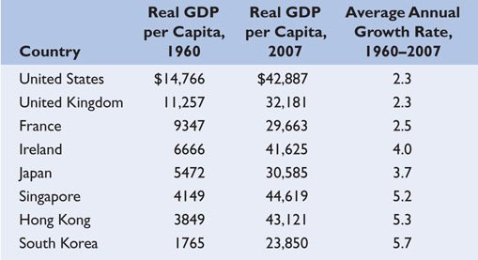
Catching Up Is Possible

Slide 36
Catching Up is Possible
The poorer 'follower countries' can grow much faster because they can simply adopt existing technologies from rich 'leader countries'.
Also, remember the “Rule of 70”

Slide 37
11. According to the authors, why is the real GDP per capita of the United States in 2007 so much higher than that of other rich countries?
We work more
We are more productive
We have more education
We take more vacations

Slide 38
11. According to the authors, why is the real GDP per capita of the United States in 2007 so much higher than that of other rich countries?
We work more
We are more productive
We have more education
We take more vacations

Slide 39
According to the authors, why is the real GDP per capita of the United States in 2007 so much higher than that of other rich countries?
larger fraction of population is working
longer work weeks

Slide 40
12. Which is NOT one of the institutional features that promotes modern economic growth?
Strong property rights
Efficient financial institutions
Education
Good central planning
Free trade
Competitive market system

Slide 41
12. Which is NOT one of the institutional features that promotes modern economic growth?
Strong property rights
Efficient financial institutions
Education
Good central planning
Free trade
Competitive market system

Slide 42
Institutional Features that Promote EG:
1. Strong Property Rights
2. Patents and copyrights
3. Efficient financial institutions
4. Literacy and widespread education
5. Free trade
6. A competitive market system

Slide 43
Note the role of Structural Adjustment that we studied in unit 1:
Chapter 8: Economic Growth
strong property rights = privatization
free trade
a competitive market system
Chapter 2: Structural Adjustment Policies
Privatization
Promotion of Competition
Reduced Role of Government
Removing Price Controls
Freer Trade and Convertible Currency
Foreign Investment

Slide 44
“Difficult-to-Measure" Factors that help EG:
stable political system
internal order (no wars)
strong sense of the right of property ownership
strong legal status accorded to businesses
strong laws to enforce contracts
"no social or moral taboos on production and material progress"
belief that wealth creation is a desirable goal
positive attitude toward work
I would add that the more equal status afforded to women in the leader countries has aided economic growth

Slide 45
13. Economic growth is caused by getting more resources and increasing productivity (better resources and technology). In the U.S. ABOUT what fraction comes from each?
1/4 more resources, 3/4 productivity
1/3 more resources, 2/3 productivity
1/2 more resources, 1/2 productivity
2/3 more resources, 1/3 productivity

Slide 46
13. Economic growth is caused by getting more resources and increasing productivity (better resources and technology). In the U.S. ABOUT what fraction comes from each?
1/4 more resources, 3/4 productivity
1/3 more resources, 2/3 productivity
1/2 more resources, 1/2 productivity
2/3 more resources, 1/3 productivity

Slide 47
Causes of Economic Growth in the United States

Slide 48
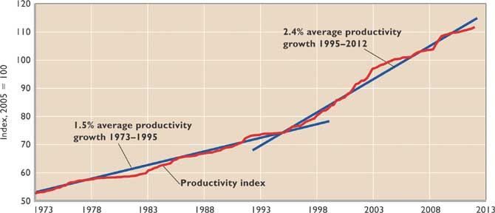
U.S. Average Productivity Growth:
1973-1995 1.5 %
1995-2010 2.6 %
2010-2015 0.4 %

Slide 49
14. Which is NOT one of the reasons for the Productivity Acceleration since the mid-1990s?
Tech. advance
More Capital
Education
More resources
Economies of scale

Slide 50
14. Which is NOT one of the reasons for the Productivity Acceleration since the mid-1990s?
Tech. advance
More Capital
Education
More resources
Economies of scale

Slide 51
15. If the quantity of labor increases, what happens to productivity?
It increases
It decreases
It stays the same
We don’t know

Slide 52
15. If the quantity of labor increases, what happens to productivity?
It increases
It decreases
It stays the same
We don’t know

Slide 53
The Quantity of Labor does NOT affect the Productivity of Labor
more workers would mean more production
but more workers does not necessarily mean more productivity (more BETTER workers would increase productivity)
Know the difference between:
production - the quantity that is produced (the production of cars increased last month)
productive efficiency - producing at the minimum cost (one of the 5Es)
productivity - how much is produced per unit of resources (output per worker per hour)
the quantity of labor affects economic growth and the productivity of labor affects economic growth, but just because we have more workers doesn't mean that we have better workers

Slide 54
Four Causes of an Increase in the Productivity of Labor
Technological advance, the most important factor in productivity growth, accounts for 40 % of productivity growth.
Increases in quantity of capital are estimated to explain about 30 % of productivity growth.
Education and training improve the quality of labor, and account for about 15 % of productivity growth
Improved resource allocation and economies of scale also contribute to growth and explain about 15% of total productivity growth (partially resulting from Freer Trade)

Slide 55
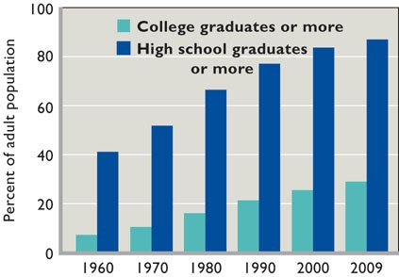
Four causes of an increase in the Productivity of labor: EDUCATION

Slide 56
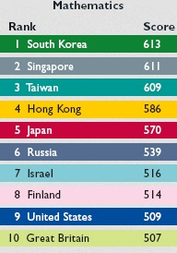
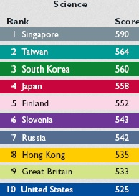
Performance of eighth graders in the Fifth International Math and Science Study (2011) Four causes of an increase in the Productivity of labor: EDUCATION

Slide 57
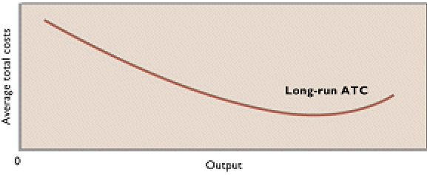
Four causes of an increase in the Productivity of labor: Economies of Scale/Increasing Returns and Trade
As business get larger their average costs of production (cost per unit produced) decreases. (The long run average total cost curve [from microeconomics] is downward sloping This means that they can produce each unit of output with fewer resources.)

Slide 58
Sources of increasing returns and economies of scale include:
More specialized inputs.
Ability to spread development costs over large output quantities since marginal costs are low.
Simultaneous consumption by many customers at the same time.
Network effects make widespread use of information goods more valuable as more use the products.
Learning increases with practice.
Freer trade and lower shipping costs
Four causes of an increase in the Productivity of labor: Economies of Scale/Increasing Returns and Trade

Slide 59
AGAIN: Four causes of an increase in the Productivity of labor
Technological advance, the most important factor in productivity growth, accounts for 40 % of productivity growth.
Increases in quantity of capital are estimated to explain about 30 % of productivity growth.
Education and training improve the quality of labor, and account for about 15 % of productivity growth
Improved resource allocation and economies of scale also contribute to growth and explain about 15% of total productivity growth (partially resulting from Freer Trade)

Slide 60
Reasons for the Productivity Acceleration
U.S. Average Productivity Growth:
1973-1995 1.5 %
1995-2010 2.6 %
2010-2015 0.4 %

Slide 61
Reasons for the Productivity Acceleration 1995-2010
Productivity Growth:
1973-1995 1.5 %
1995-2010 2.6 %
2010-2015 0.4 %
Microchips and information technology
New firms and increasing returns characterize the new economy.
Some of today's most successful firms didn't exist 25 years ago: Dell, Apple, Microsoft, Oracle, Cisco Systems, Google, Amazon, PayPal, eBay are just a few of many.
Economies of scale and increasing returns in new firms encourage rapid growth
Global competition encourages innovation and efficiency and economies of scale = Free Trade

Slide 62
The Recent Productivity Slowdown
May be transitory, not permanent
Maybe the rapid growth from 1995-2010 was a one-time thing caused by rapid changes in information technology
Some theories of the recent productivity slowdown:
High debt levels of consumers and businesses before the great recession
Entrepreneurs unable to obtain loans
Overcapacity – business expanded too much before the great recession therefore businesses are reluctant to replace capital with new more productive capital instead they use their older machines
Many recent products do not add much to GDP because there is no monetary payment (Facebook, YouTube, Instagram)
Technological progress has slowed

Slide 63
Is Growth Desirable and Sustainable?
ANTI-GROWTH:
1. Growth causes pollution, global warming, ozone depletion, and other problems.
2. "More" is not always better if it means dead-end jobs, burnout, and alienation from one's job.
3. High growth creates high stress.
PRO-GROWTH:
1. Growth leads to an improved standard of living.
2. Growth helps to reduce poverty in poor countries.
3. Growth has improved working conditions.
4. Growth allows more leisure and less alienation from work.
5. Environmental concerns are important, but growth actually has allowed more sensitivity to environmental concerns and the ability to deal with them.

