Slide 1
7a – Measuring GDP
This web quiz may appear as two pages on tablets and laptops.
I recommend that you view it as one page by clicking on the open book icon at the bottom of the page.

Slide 2
7a – Measuring GDP
Define GDP
Problems with using GDP as a Measure of Social Welfare (Standard of Living)
Define and Calculate:
GDP
National Income (NI)
NDP
net investment (In)
net exports (Xn)
Define Personal Income and Disposable Income
Nominal GDP and Real GDP (RDO)

Slide 3
7a – Measuring GDP
Outcomes / Must Know
Use a circular flow diagram to show the two ways of calculating GDP
Define and calculate GDP and NI when given national income data.
Define and give examples of final goods, intermediate goods, and double counting.
Differentiate between gross and net investment.
Define Investment and state what is included. Explain why changes in inventories are investments.
Calculate net investment and explain how it indicates a growing, static, or declining economy.
Explain why imports are subtracted to calculate GDP
List and explain the shortcomings of using GDP as a measure of social welfare.
India's GDP is much greater than is Switzerland's GDP yet Switzerland has a higher standard of living. Explain.
After a major natural disaster (flood, tornado, earthquake) GDP often increases. Is GDP in this case a good indicator of social welfare? Explain.
Find real GDP by adjusting nominal GDP with use of a price index (GDP price index, also called the GDP deflator) and be able to find the years of recessions given nominal GDP data.

Slide 4
7a – Measuring GDP
KEY TERMS: GDP, intermediate goods, final goods, double counting, non-market transactions, underground economy, GDP per capita, expenditures approach, income approach, national income (NI), proprietor's income, personal income (PI), disposable income (DI), nominal GDP, real GDP, gross private domestic investment, net private domestic investment, net domestic product (NDP), net exports

Slide 5
7a – Measuring GDP
Required Formulas:
GDP = C + Ig + G + Xn
NI = wages + rents + interest + corporate profits + proprietor's income
NDP = C + In + G + Xn = GDP - depreciation
NDP = GDP - depreciation
In = Ig - depreciation
Xn = X - M
real GDP = (nominal GDP / price index) x 100

Slide 6
1. What is the approximate GDP of the US (2017)?
$ 8.5 trillion
$ 11.5 trillion
$ 14.5 trillion
$ 19.4 trillion

Slide 7
1. What is the approximate GDP of the US (2017)?
$ 8.5 trillion
$ 11.5 trillion
$ 14.5 trillion
$ 19.4 trillion

Slide 8
What is Gross Domestic Product (GDP)?
GDP is the total market value of all final goods and services produced in the economy in one year
SUM P x Q of final goods and services produced

Slide 9
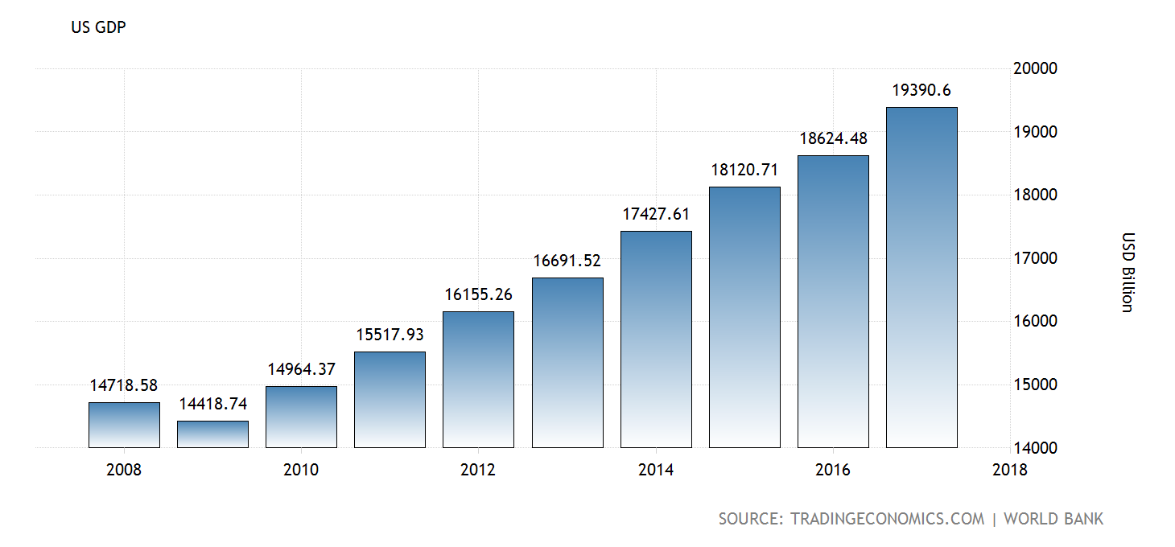
U.S. GDP

Slide 10
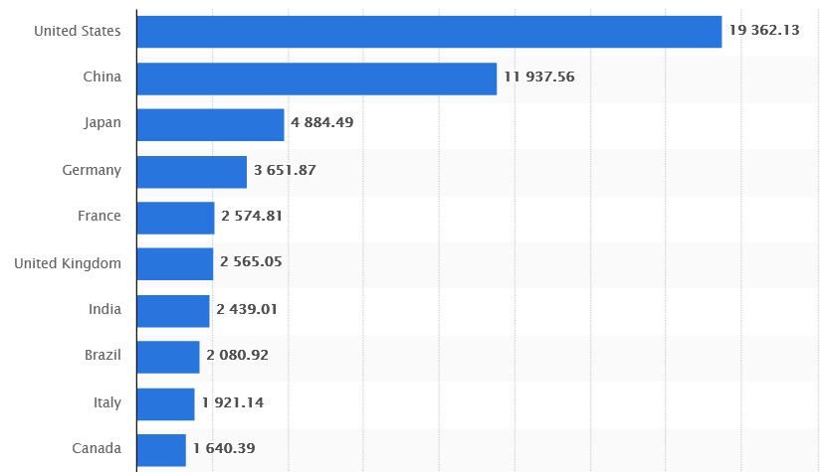
World’s 10 Largest Economies - 2017

Slide 11
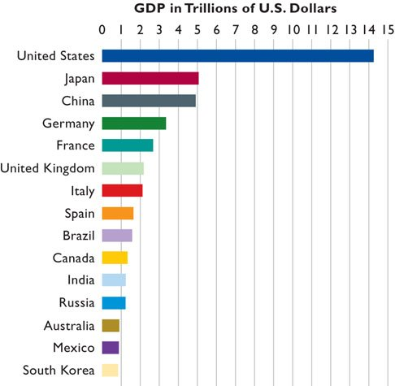
Populations:
US: 303 million
Japan: 128 million
Germany: 82 million
China: 1,324 million
UK: 60 million
France: 61 million
Italy: 59 million
Canada: 32 million
Brazil: 192 million
India: 1,158 million
S. Korea: 48 million
Mexico: 112 million
Australia: 20 million
2009

Slide 12
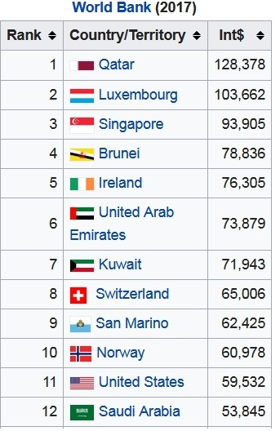
GDP Per Capita
($ 1000’s)

Slide 13
Nationmaster.com
http://www.nationmaster.com/country-info/stats/Economy/GDP
http://www.nationmaster.com/country-info/stats/Economy/GDP/Per-capita

Slide 14
GDP
YP 50 -- What is included in GDP?
YP 51 – GDP and Social Welfare

Slide 15
2. Which is a final good?
Bun bought by McDonalds
Computer bought by Harper
Meat bought by Jewel
Skis bought by me
GDP is the total market value of all final goods and services produced in the economy in one year

Slide 16
2. Which is a final good?
Bun bought by McDonalds
Computer bought by Harper
Meat bought by Jewel
Skis bought by me
GDP is the total market value of all final goods and services produced in the economy in one year

Slide 17
3. Which is NOT counted in GDP?
Bun bought by McDonalds
Meat bought by Jewel
Stock in Apple bought by you
Computer bought by Harper
GDP is the total market value of all final goods and services produced in the economy in one year

Slide 18
3. Which is NOT counted in GDP?
Bun bought by McDonalds
Meat bought by Jewel
Stock in Apple bought by you
Computer bought by Harper
GDP is the total market value of all final goods and services produced in the economy in one year

Slide 19
4. Which is counted in GDP for 2015?
Illegal drugs sold in 2015
Real Estate agent’s salary in 2015
2014 car sold in 2015
Time I spend mowing my lawn in 2015
GDP is the total market value of all final goods and services produced in the economy in one year

Slide 20
4. Which is counted in GDP for 2015?
Illegal drugs sold in 2015
Real Estate agent’s salary in 2015
2014 car sold in 2015
Time I spend mowing my lawn in 2015
GDP is the total market value of all final goods and services produced in the economy in one year

Slide 21
5. Which of the following causes GDP to OVERSTATE social welfare (standard of living)?
Non-market transactions
Pollution
Leisure
Underground economy
Improved product quality

Slide 22
5. Which of the following causes GDP to OVERSTATE social welfare (standard of living)?
Non-market transactions
Pollution
Leisure
Underground economy
Improved product quality

Slide 23
6. Which of the following causes GDP to UNDERSTATE social welfare (standard of living)?
Resource depletion
Pollution
Leisure
Large population

Slide 24
6. Which of the following causes GDP to UNDERSTATE social welfare (standard of living)?
Resource depletion
Pollution
Leisure
Large population

Slide 25
GDP AND SOCIAL WELFARE
a. non-market transactions are not included in GDP: GDP UNDERSTATES
b. leisure increases the standard of living but it isn't counted: GDP UNDERSTATES
c. improved product quality often isn't accounted for in GDP: GDP UNDERSTATES
d. GDP does not account for the composition of output: GDP OVERSTATES
e.GDP does not account for the distribution of output : GDP OVERSTATES
f. increases in GDP may harm the environment : GDP OVERSTATES
g. the underground economy produces goods and services but they are not included in GDP: GDP OVERSTATES
h. GDP does not account for a possible future decline in output due to resource depletion.
GDP OVERSTATES
i. Noneconomic Sources of Well-Being like courtesy, crime reduction, etc., are not covered in GDP.: GDP OVERSTATES
j. We must use per capita GDP to compare the living standards of different countries.

Slide 26
7. India's GDP is much greater than is Switzerland's GDP yet Switzerland has a higher standard of living. Why?
There are smaller mountains in Switzerland
There are fewer people in Switzerland
Switzerland is in Europe
India produces more crude oil

Slide 27
7. India's GDP is much greater than is Switzerland's GDP yet Switzerland has a higher standard of living. Why?
There are smaller mountains in Switzerland
There are fewer people in Switzerland
Switzerland is in Europe
India produces more crude oil

Slide 28
Switzerland:
GDP: $239.3 billion (2003)
Population: 7,450,867 (2003)
GDP per capita: $32,700 (2003)
India:
GDP: $3.033 trillion (2003)
Population: 1,065,070,607 ( 2003)
GDP per capita: $2,900 (2003)

Slide 29
8. What is the difference between GDP and GNP?
GDP is produced with a country
GDP is produced by citizens of a country
GDP does not include home production
GDP includes changes in inventories

Slide 30
8. What is the difference between GDP and GNP?
GDP is produced with a country
GDP is produced by citizens of a country
GDP does not include home production
GDP includes changes in inventories

Slide 31
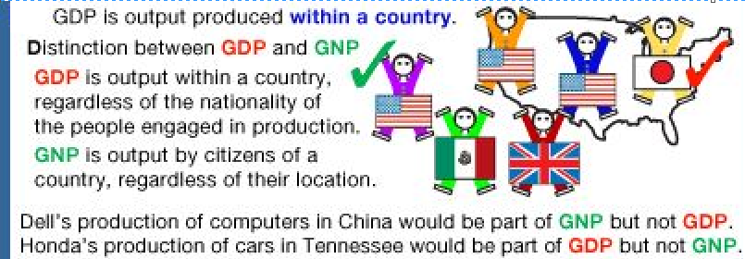
GDP vs. GNP
GDP is produced Domestically (within a country’s borders
GNP is produced by Nationals of a country wherever they live

Slide 32
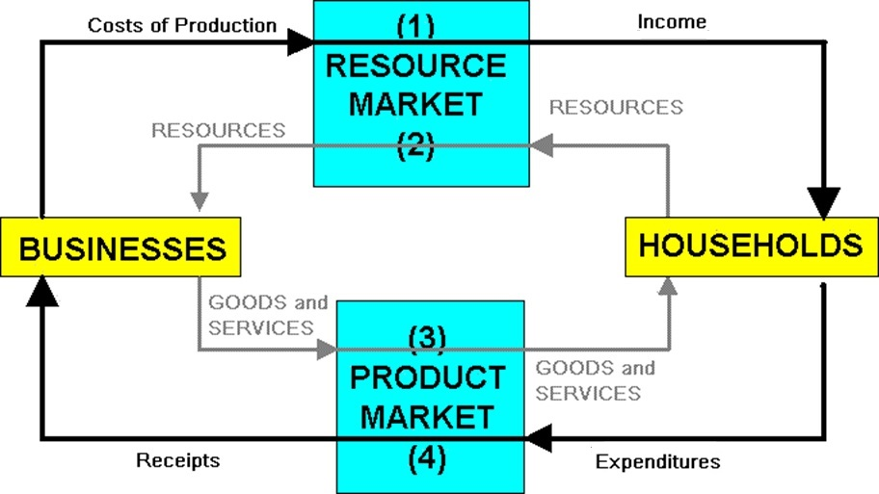
9. Which flow on the circular flow diagram best represents GDP?
1
2
3
4

Slide 33
9. Which flow on the circular flow diagram best represents GDP?
1
2
3
4

Slide 34
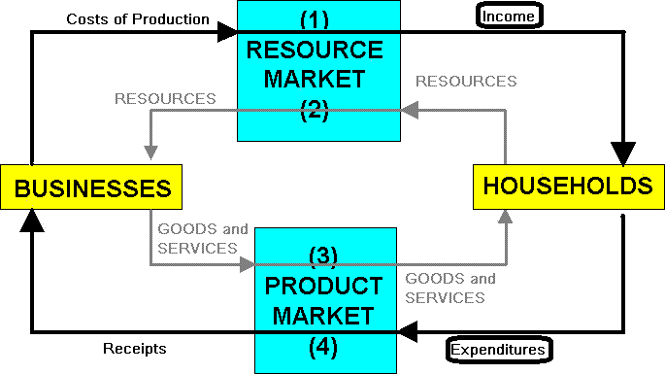
Two Approaches to Calculating GDP (Expenditures / Income)

Slide 35
10. Expenditures approach: GDP = ?
C + G + T + Xn
C + MS + T + Xn
C + G + Ig + Xn
C + G + In + Xn

Slide 36
10. Expenditures approach: GDP = ?
C + G + T + Xn
C + MS + T + Xn
C + G + Ig + Xn
C + G + In + Xn

Slide 37
11. Income approach: GDP almost = ?
Wages + Rents + Interest + Profits
Consumption + Rents + Interest + investment
Wages + Rents + Profits
Investment + Rents + Interest + Gov’t Spend.

Slide 38
11. Income approach: GDP almost = ?
Wages + Rents + Interest + Profits
Consumption + Rents + Interest + investment
Wages + Rents + Profits
Investment + Rents + Interest + Gov’t Spend.

Slide 39
Income Approach: National income (NI) =
Wages
+ Rents
+ Interest
+ Corporate profits
+ Proprietor’s income
= National Income (almost equals GDP)

Slide 40
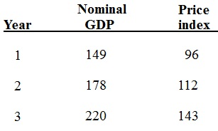
12. In which year was there a recession?
2
3
none

Slide 41
12. In which year was there a recession?
2
3
none

Slide 42
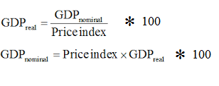

Slide 43
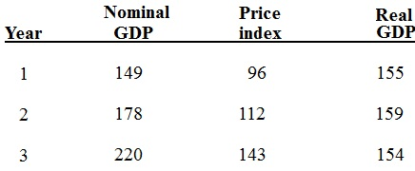
In which year was there a recession?
In which year did Real GDP decrease?

Slide 44
REQUIRED FORMULAS (YP 49)
GDP = C + Ig + G + Xn
NI = wages + rents + interest + corporate profits + proprietor's income
NDP = C + In + G + Xn = GDP - depreciation
NDP = GDP - depreciation
In = Ig - depreciation
Xn = X - M
real GDP = (nominal GDP / price index) x 100

