Slide 1

3b – Supply
This web quiz may appear as two pages on tablets and laptops.
I recommend that you view it as one page by clicking on the open book icon at the bottom of the page.

Slide 2
3b - Supply
Must Know / Outcomes:
define supply (note: it has a DIFFERENT DEFINITION in economics)
be able to correctly draw and label a supply graph
if the price of pizza goes up why does the supply not change?
why do economists employ the ceteris paribus assumption when creating a supply curve?
what is the law of supply?
why is the supply curve upward sloping (two explanations)
list the non-price determinants of supply (Pe, Pog, Pres, Tech, Taxes, Nprod) or (P,P,P,T,T,N) and understand how they affect the supply schedule and curve. This is VERY IMPORTANT. BE ABLE TO DO THIS! See the 3a/3b/3c yellow pages.
explain the difference between the a "change in the quantity supplied" and a "change in supply"
what is an increase in supply and a decrease in supply and show how they affect the supply schedule and the supply curve
what is "market supply"?

Slide 3
3b - Supply
KEY TERMS:
supply,
quantity supplied,
market supply,
horizontal summation,
law of supply,
change in supply,
change in quantity supplied,
increase in supply,
decrease in supply,
non-price determinants of supply

Slide 4
1. DEFINE -- Supply is:
A mathematical representation of the quantity of a good that a supplier will put on the market
A schedule showing the amount of a good that consumers are willing to buy at various prices
A schedule showing the amount of a good that producers are willing to sell at various prices
The amount of a good that is available for sale

Slide 5
1. DEFINE -- Supply is:
A mathematical representation of the quantity of a good that a supplier will put on the market
A schedule showing the amount of a good that consumers are willing to buy at various prices
A schedule showing the amount of a good that producers are willing to sell at various prices
The amount of a good that is available for sale

Slide 6
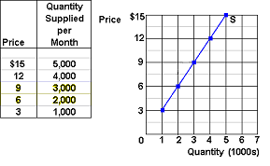
DRAW – Supply – YP 38

Slide 7
2. DESCRIBE -- The reason that producers supply more to a market only at higher prices is that as the price increases:
Producers’ costs of producing that good falls
Producers’ costs of producing that good increases
Consumers demand more so producers must raise the price
Consumers demand less so producers must raise the price

Slide 8
2. DESCRIBE -- The reason that producers supply more to a market only at higher prices is that as the price increases:
Producers’ costs of producing falls
Producers’ costs of producing increases
Consumers demand more so producers must raise the price
Consumers demand less so producers must raise the price

Slide 9
3. As the price of apples increases, apple growers will:
Decrease the supply of apples
Increase the supply of apples
Switch to less expensive methods of production
Increase the quantity of apples supplied

Slide 10
3. As the price of apples increases, apple growers will:
Decrease the supply of apples
Increase the supply of apples
Switch to less expensive methods of production
Increase the quantity of apples supplied

Slide 11
Change in Quantity Supplied

Slide 12
4. Which of the following will not shift the supply curve of product X?
A change in the price of resources used to produce X
A change in the price of other goods also produced by the makers of X
A change in the technology used to produce X
A change in the price of X

Slide 13
4. Which of the following will not shift the supply curve of product X?
A change in the price of resources used to produce X
A change in the price of other goods also produced by the makers of X
A change in the technology used to produce X
A change in the price of X

Slide 14
Change in Quantity Supplied

Slide 15
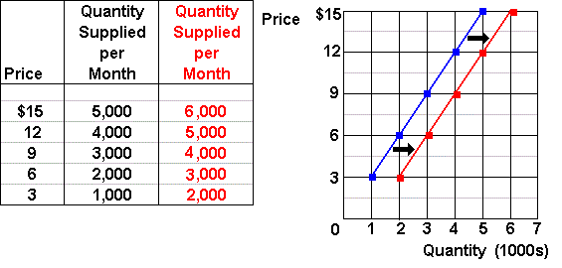
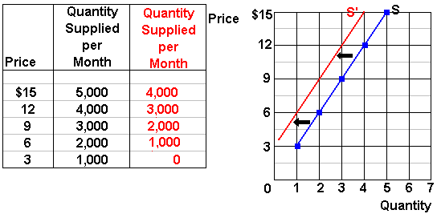
Change in Supply
Increase in Supply:
Decrease in supply:

Slide 16
Non-Price Determinants of Supply
Pe -- expected price
Pog -- price of other goods produced by the same firm
Pres -- price of resources
T – production technology
T --taxes and subsidies
N -- number of sellers
YP 35

Slide 17
5. The supply curve of apples will shift to the right if:
Very bad weather afflicts the apple-growing areas of the country
Apples are rumored to have been treated with cancer-causing insecticides
The government required that all employees in apple orchards are given more health benefits
Fruit growers see the price of pears decreasing permanently

Slide 18
5. The supply curve of apples will shift to the right if:
Very bad weather afflicts the apple-growing areas of the country
Apples are rumored to have been treated with cancer-causing insecticides
The government required that all employees in apple orchards are given more health benefits
Fruit growers see the price of pears decreasing permanently

Slide 19
6. If a pretzel maker hears rumors that pretzel prices will fall at the end of the month, the firm now:
Saves it supply for selling at a future date
Increases the supply
Decreases the supply
Waits to supply pretzels when the market is more stable

Slide 20
6. If a pretzel maker hears rumors that pretzel prices will fall at the end of the month, the firm now:
Saves it supply for selling at a future date
Increases the supply
Decreases the supply
Waits to supply pretzels when the market is more stable

Slide 21
7. Which of the following will cause a decrease in the market supply for ice cream?
An increase in the price of ice cream
A decrease in the price of ice cream
An increase in the price of milk used to make ice cream
An expectation that the price of ice cream will be lower in the future

Slide 22
7. Which of the following will cause a decrease in the market supply for ice cream?
An increase in the price of ice cream
A decrease in the price of ice cream
An increase in the price of milk used to make ice cream
An expectation that the price of ice cream will be lower in the future

Slide 23
8. An improvement in production technology will:
Shift the demand curve to the left
Shift the supply curve to the left
Shift the demand curve to the right
Shift the supply curve to the right

Slide 24
8. An improvement in production technology will:
Shift the demand curve to the left
Shift the supply curve to the left
Shift the demand curve to the right
Shift the supply curve to the right

Slide 25
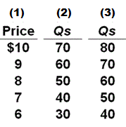
9. Refer to the table. In relation to column (1), a change from column (2) to column (3) would most likely be caused by:
Government reducing the tax on the good
Expectations of higher future prices
An increase in consumer incomes
An increase in input prices

Slide 26
9. Refer to the table. In relation to column (1), a change from column (2) to column (3) would most likely be caused by:
Government reducing the tax on the good
Expectations of higher future prices
An increase in consumer incomes
An increase in input prices

Slide 27
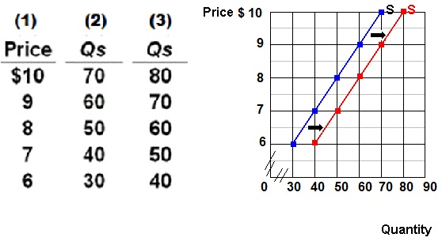

Slide 28
10. The market supply of a good or service:
Is the horizontal summation of the individual supply curves
Is the vertical summation of the individual supply curves
Is the inverse relationship between price and quantity supplied
All of the above

Slide 29
10. The market supply of a good or service:
Is the horizontal summation of the individual supply curves
Is the vertical summation of the individual supply curves
Is the inverse relationship between price and quantity supplied
All of the above

Slide 30
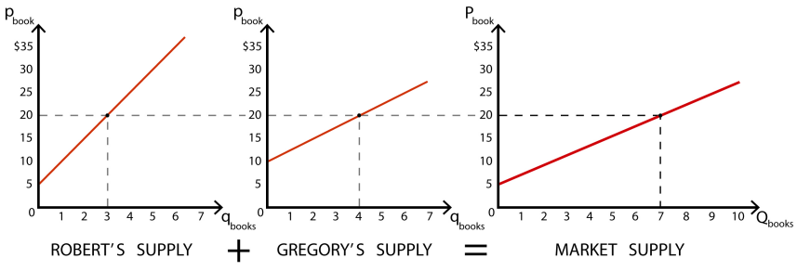
Market Supply

