Slide 1

3a – Demand
This web quiz may appear as two pages on tablets and laptops.
I recommend that you view it as one page by clicking on the open book icon at the bottom of the page.

Slide 2
3a - Demand
TOPICS
Definition of Demand
Changes in Demand vs. Changes in Quantity Demanded
Non-price determinants of demand and their effect on the demand curve

Slide 3
3a - Demand
Must Know / Outcomes:
define demand (note: it has a DIFFERENT DEFINITION in economics)
If the price of pizza goes up, why does the demand for pizza stay the same?
be able to correctly draw and label a demand graph
why do economists employ the ceteris paribus assumption when creating a demand curve?
what is the law of demand?
why is the demand curve downward sloping (three explanations)
list the non-price determinants of demand (Pe. Pog, I, Npot, T) or (P, P, I, N, T ) and understand how they affect the demand schedule and curve. This is VERY IMPORTANT. BE ABLE TO DO THIS! See the 3a/3b/3c yellow pages.
explain the difference between the a "change in the quantity demanded" and a "change in demand"
what is an "increase in demand" and a "decrease in demand" and show how they affect the demand schedule and the demand curve
what is "market demand"?
what is that Campbell's Pork and Beans can doing on the display for VanCamp's Pork and Beans (see picture at left)? Which non-price determinant of demand explains why that Campbell's soup can is there? Draw a supply and demand graph illustrating what happened in the market for Campbell's Pork and Beans when VanCamp's were put on sale.

Slide 4
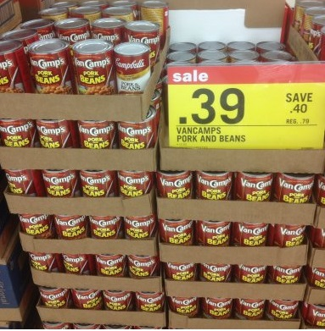
3a - Demand
Must Know / Outcomes:
What is that Campbell's Pork and Beans can doing on the display for VanCamp's Pork and Beans (see picture)? Which non-price determinant of demand explains why that Campbell's soup can is there? Draw a supply and demand graph illustrating what happened in the market for Campbell's Pork and Beans when VanCamp's were put on sale.

Slide 5
3a - Demand
KEY TERMS:
demand, quantity demanded, law of demand, market demand, horizontal summation, income effect, substitution effect,
diminishing marginal utility,
change in demand,
change in quantity demanded,
increase in demand, decrease in demand, non-price determinants of demand,
normal good, inferior good, substitute good, complementary good (complement), independent goods

Slide 6
1. If the price of pizza increases then the demand for pizza will ___________:
Increase
Decrease
Not change

Slide 7
1. If the price of pizza increases then the demand for pizza will ___________:
Increase
Decrease
Not change

Slide 8
2. If the price of pizza increases then the quantity demanded of pizza will ___________:
Increase
Decrease
Not change

Slide 9
2. If the price of pizza increases then the quantity demanded of pizza will ___________:
Increase
Decrease
Not change

Slide 10
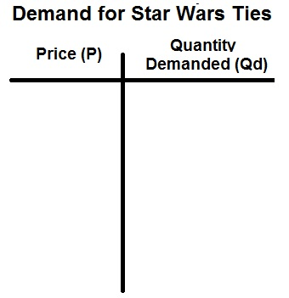
Demand
“Demand” is a SCHEDULE which shows the various quantities that a consumer is willing and able to buy at various prices in a given time period, ceteris paribus.

Slide 11
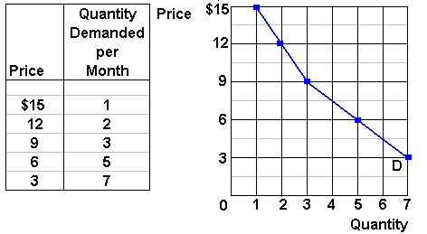
Demand
YP #31
“Demand” is a SCHEDULE which shows the various quantities that a consumer is willing and able to buy at various prices in a given time period, ceteris paribus.

Slide 12
For ALL Graphs:
Define
Draw
Describe
the Shape
Why is the demand curve downward sloping?
1. Law of Diminishing Marginal Utility
2. Income effect
3. Substitution Effect

Slide 13
3. The income and substitution effects explain:
the ceteris paribus assumption
The downward sloping demand curve
Movements along a given demand curve
Shifts in the demand curve

Slide 14
3. The income and substitution effects explain:
the ceteris paribus assumption
The downward sloping demand curve
Movements along a given demand curve
Shifts in the demand curve

Slide 15
4. Graphically, the market demand is:
Steeper than any individual demand curve that is part of it
Greater than the sum of the individual demand curves
The horizontal sum of individual demand curves
The vertical sum of individual demand curves

Slide 16
4. Graphically, the market demand is:
Steeper than any individual demand curve that is part of it
Greater than the sum of the individual demand curves
The horizontal sum of individual demand curves
The vertical sum of individual demand curves

Slide 17
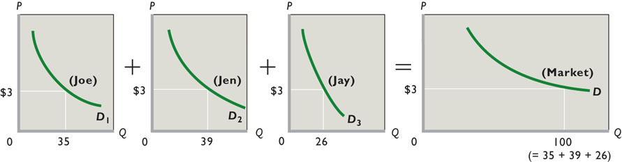
Market Demand: Horizontal Summation
Three individual Demand Curves Market Demand

Slide 18
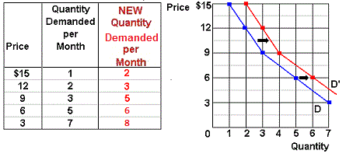
Increase in Demand

Slide 19
Decrease in Demand

Slide 20
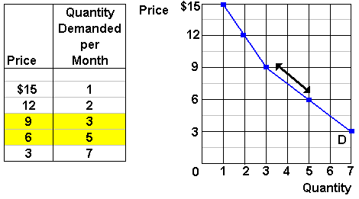
Change is Demand vs.
Change in Quantity Demanded
|
|
|
|
|
|
|
|
|
|
|
|
|
|
Change in Demand Change in Quantity Demanded
Caused by a change in the
non-price determinants
of demand
Caused by a change in the
price of the product
See Yellow Page 34

Slide 21
5. When an economist says that the demand for a product has increased, this means that:
Consumers are now willing to purchase more of this product at each possible price
The product has become particularly scarce for some reason
Product price has fallen and as a consequence consumers are buying a larger quantity of the product
The demand curve has shifted to the left

Slide 22
5. When an economist says that the demand for a product has increased, this means that:
Consumers are now willing to purchase more of this product at each possible price
The product has become particularly scarce for some reason
Product price has fallen and as a consequence consumers are buying a larger quantity of the product
The demand curve has shifted to the left

Slide 23
Increase in Demand

Slide 24
Decrease in Demand

Slide 25
Change in Quantity Demanded
CAUSED BY a change in the price

Slide 26
What Causes a Change in Quantity?
VODKA

Slide 27
Non-Price Determinants of Demand
Pe -- expected price
Pog -- price of other goods
  substitute goods
  complementary goods
  independent goods
I -- income
  normal goods
  inferior goods
N -- number of POTENTIAL consumers
T -- tastes and preferences
YP #35
Cause a CHANGE IN DEMAND – Shifting the curve

Slide 28
6. Which of the following will NOT cause the demand for product K to change?
A change in the price of a close substitute product J
An increase in incomes of buyers of product K
A change in the price of product K
A change in consumer tastes for K

Slide 29
6. Which of the following will NOT cause the demand for product K to change?
A change in the price of a close substitute product J
An increase in incomes of buyers of product K
A change in the price of product K
A change in consumer tastes for K

Slide 30
Change in Quantity Demanded
CAUSED BY a change in the price

Slide 31
7. Which of the following items go together?
A change in quantity demanded and a movement along the demand curve
A change in income and a movement along a demand curve
A change in price and a shift of the demand curve
A change in quantity demanded and a shift of the demand curve

Slide 32
7. Which of the following items go together?
A change in quantity demanded and a movement along the demand curve
A change in income and a movement along a demand curve
A change in price and a shift of the demand curve
A change in quantity demanded and a shift of the demand curve

Slide 33
Change in Quantity Demanded
CAUSED BY a change in the price

Slide 34
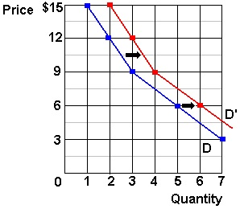
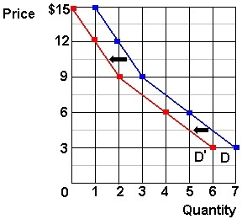
Change in Demand
NON-PRICE DETERMINANTS
_____OF DEMAND________
Increase in Demand
Pe -- expected price
Pog -- price of other goods
  substitute goods
  complementary goods
  independent goods
I -- income
  normal goods
  inferior goods
N -- number of POTENTIAL consumers
T -- tastes and preferences
Decrease in Demand
CAUSES a change in the price
(lesson 3c)

Slide 35
8. An economist for a bicycle company predicts that, other things equal, a rise in consumer incomes will increase the demand for bicycles. This prediction assumes that:
There are many substitutes for bicycles
There are many complements for bicycles
There are few substitutes for bicycles
Bicycles are normal goods

Slide 36
8. An economist for a bicycle company predicts that, other things equal, a rise in consumer incomes will increase the demand for bicycles. This prediction assumes that:
There are many substitutes for bicycles
There are many complements for bicycles
There are few substitutes for bicycles
Bicycles are normal goods

Slide 37
9. If the demand for product Y shifts to the right as the price of product X declines, then:
Both X and Y are inferior goods
X is a superior good and Y is an inferior good
X is and inferior good and Y is a superior good
X and Y are complementary goods

Slide 38
9. If the demand for product Y shifts to the right as the price of product X declines, then:
Both X and Y are inferior goods
X is a superior good and Y is an inferior good
X is and inferior good and Y is a superior good
X and Y are complementary goods

Slide 39
10. Which of the following will cause the demand for product X to shift to the left?
Population growth that causes an expansion in the number of persons consuming X
An increase in the money income if X is a normal good
A decrease in the price of complementary product Y
An increase in money income if X is an inferior good

Slide 40
10. Which of the following will cause the demand for product X to shift to the left?
Population growth that causes an expansion in the number of persons consuming X
An increase in the money income if X is a normal good
A decrease in the price of complementary product Y
An increase in money income if X is an inferior good

Slide 41
11. If you expect the price of ice cream to increase next week, your demand for ice cream today will:
Shift to the left
Shift to the right
Not shift at all
Become steeper

Slide 42
11. If you expect the price of ice cream to increase next week, your demand for ice cream today will:
Shift to the left
Shift to the right
Not shift at all
Become steeper

Slide 43
12. If a type of clothing suddenly becomes fashionable, there will be a/an:
Movement down this good’s demand curve
increase in the quantity demanded
Shift to the right of the good’s demand curve
Shift to the left of the good’s demand curve

Slide 44
12. If a type of clothing suddenly becomes fashionable, there will be a/an:
Movement down this good’s demand curve
increase in the quantity demanded
Shift to the right of the good’s demand curve
Shift to the left of the good’s demand curve

