Slide 1
2b – Functions of Government and Government Finance
This web quiz may appear as two pages on tablets and laptops.
I recommend that you view it as one page by clicking on the open book icon at the bottom of the page.

Slide 2
2b
Functions of Government
Government Finance

Slide 3
2b
Functions of Government
Providing the Legal Structure
Maintaining Competition
Redistributing Income
Reallocating Resources
Correct Externalities
Provide Public Goods
Promoting Stability

Slide 4
2b
Government Finance
Government Revenue and Expenditures
Federal
State
Local
Regressive, Proportional, and Progressive Taxes
Average Tax Rates
Marginal Tax Rates

Slide 5
1. What is the major expenditure category for the Federal Government?
National defense
Public Welfare (Income Security) including Pensions
Health Care
Transportation
Education
Housing

Slide 6
1. What is the major expenditure category for the Federal Government?
National defense
Public Welfare (Income Security) including Pensions
Health Care
Transportation
Education
Housing

Slide 7
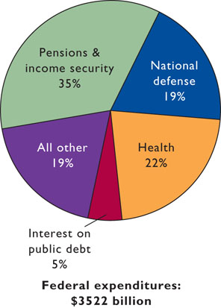
Federal
Spending
2009

Slide 8
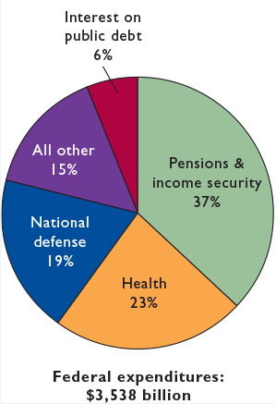
Federal
Spending
2011

Slide 9
2. What is the major source of Revenue for the Federal Government?
Income Tax
Sales and Excise Taxes
Payroll Taxes
Property Taxes
Corporate Income Tax
Licenses and fees

Slide 10
2. What is the major source of Revenue for the Federal Government?
Income Tax
Sales and Excise Taxes
Payroll Taxes
Property Taxes
Corporate Income Tax
Licenses and fees

Slide 11
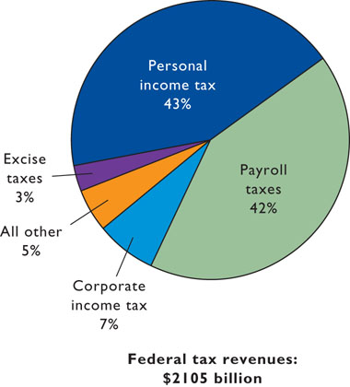
Federal
Revenues
2009

Slide 12
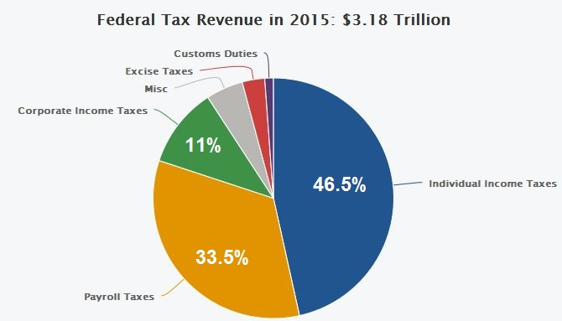

Slide 13
3. What is the major expenditure category for State Governments?
National defense
Public Welfare (Income Security) including Pensions
Health Care
Transportation
Education
Housing

Slide 14
3. What is the major expenditure category for State Governments?
National defense
Public Welfare (Income Security) including Pensions
Health Care
Transportation
Education
Housing

Slide 15
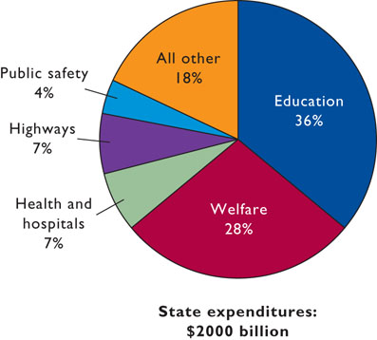
State
Spending
2007

Slide 16
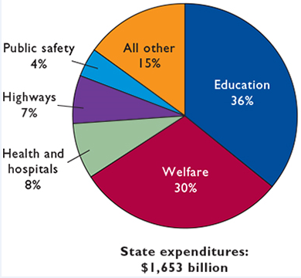
State
Spending
2011

Slide 17
4. What is the major source of Revenue for State Governments?
Income Tax
Sales and Excise Taxes
Payroll Taxes
Property Taxes
Corporate Income Tax
Licenses and fees

Slide 18
4. What is the major source of Revenue for State Governments?
Income Tax
Sales and Excise Taxes
Payroll Taxes
Property Taxes
Corporate Income Tax
Licenses and fees

Slide 19
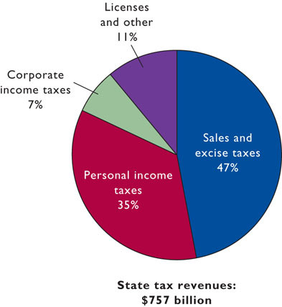
State
Revenues
2007

Slide 20
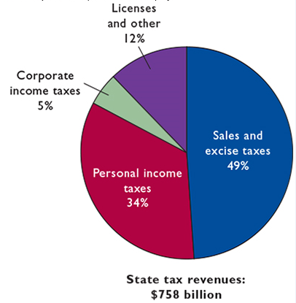
State
Revenues
2011

Slide 21
5. What is the major expenditure category for Local Governments?
National defense
Public Welfare (Income Security) including Pensions
Health Care
Transportation
Education
Housing

Slide 22
5. What is the major expenditure category for Local Governments?
National defense
Public Welfare (Income Security) including Pensions
Health Care
Transportation
Education
Housing

Slide 23
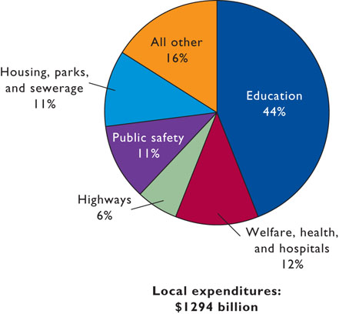
Local
Government Spending
2007

Slide 24
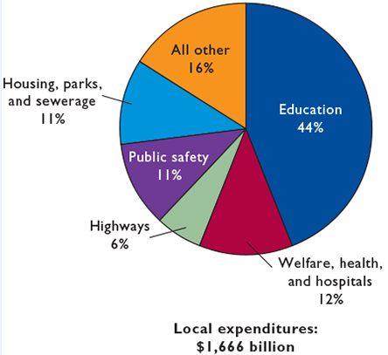
Local
Government Spending
2010

Slide 25
6. What is the major source of Revenue for Local Governments?
Income Tax
Sales and Excise Taxes
Payroll Taxes
Property Taxes
Corporate Income Tax
Licenses and fees

Slide 26
6. What is the major source of Revenue for Local Governments?
Income Tax
Sales and Excise Taxes
Payroll Taxes
Property Taxes
Corporate Income Tax
Licenses and fees

Slide 27
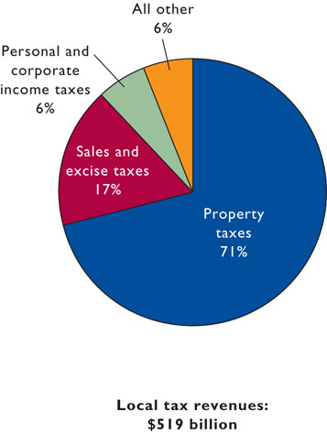
Local
Government
Revenues
2007

Slide 28
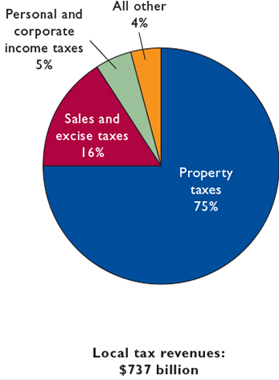
Local
Government
Revenues
2010

Slide 29
7. A Progressive Tax is one where those with higher incomes:
Pay more than those with lower incomes
Pay the same as everyone else
Pay a higher % of their income in taxes
Pay less than those with lower incomes

Slide 30
7. A Progressive Tax is one where those with higher incomes:
Pay more than those with lower incomes
Pay the same as everyone else
Pay a higher % of their income in taxes
Pay less than those with lower incomes

Slide 31
8. A Regressive Tax is one where those with higher incomes:
Pay less than those with lower incomes
Pay the same as everyone else
Pay a higher % of their income in taxes
Pay a lower % of their income in taxes

Slide 32
8. A Regressive Tax is one where those with higher incomes:
Pay less than those with lower incomes
Pay the same as everyone else
Pay a higher % of their income in taxes
Pay a lower % of their income in taxes

Slide 33
9. A Proportional Tax is one where those with higher incomes:
Pay less than those with lower incomes
Pay the same % of their income in taxes
Pay a higher % of their income in taxes
Pay a lower %e of their income in taxes

Slide 34
9. A Proportional Tax is one where those with higher incomes:
Pay less than those with lower incomes
Pay the same % of their income in taxes
Pay a higher % of their income in taxes
Pay a lower %e of their income in taxes

Slide 35
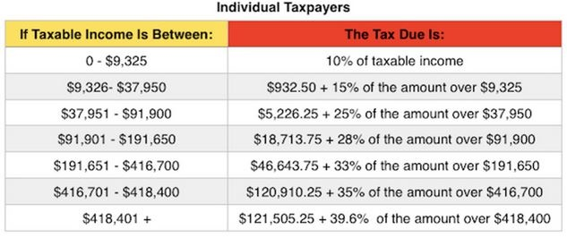
2017 Tax Rates – Single Taxpayer
YP # 29

Slide 36
10. Use the tax table above. If income is $10,325 what is the marginal tax rate?
10 %
15 %
25 %
28 %
33 %
35 %

Slide 37
10. Use the tax table above. If income is $10,325 what is the marginal tax rate?
10 %
15 %
25 %
28 %
33 %
35 %

Slide 38
11. Use the tax table above. If income is $10,325 what is the amount owed in taxes?
$ 0
$ 932.50
$1,082.50
$1,548.75

Slide 39
11. Use the tax table above. If income is $10,325 what is the amount owed in taxes?
$ 0
$ 932.50
$1,082.50
$1,548.75

Slide 40
12. Use the tax table above. If income is $10,325 what is the average tax rate?
10 %
10.5 %
15 %
25 %

Slide 41
12. Use the tax table above. If income is $10,325 what is the average tax rate?
10 %
10.5 %
15 %
25 %

Slide 42
Average tax rate = taxes paid / income
Average tax rate = $1077.50 / $10,275.00
Average tax rate = 10.5%

Slide 43
13. The federal income tax is ____________
Regressive
Proportional
Progressive

Slide 44
13. The federal income tax is ____________
Regressive
Proportional
Progressive

Slide 45
14. A sales tax is ____________
Regressive
Proportional
Progressive

Slide 46
14. A sales tax is ____________
Regressive
Proportional
Progressive

Slide 47
15. The payroll (Soc. Sec.) tax is ________
Regressive
Proportional
Progressive

Slide 48
15. The payroll (Soc. Sec.) tax is ________
Regressive
Proportional
Progressive

Slide 49
16. The property tax is ____________
Regressive
Proportional
Progressive

Slide 50
16. The property tax is ____________
Regressive
Proportional
Progressive

