Slide 1
2a – Economic Systems and Globalization
This web quiz may appear as two pages on tablets and laptops.
I recommend that you view it as one page by clicking on the open book icon at the bottom of the page.

Slide 2
2a – Economic Systems and Globalization
Economic Systems:
Market Economies
Command Economies
Mixed Economies
Globalization (Structural Adjustment)
Economic Systems and the 5Es
Circular Flow Model

Slide 3
1. Which of the following is a distinguishing feature of the command system?
Private ownership of capital
Central planning
Heavy reliance on markets
Widespread dispersion of economic power

Slide 4
1. Which of the following is a distinguishing feature of the command system?
Private ownership of capital
Central planning
Heavy reliance on markets
Widespread dispersion of economic power

Slide 5
2. The French term “laissez-faire” means:
“there is no free lunch”
“let it be”
“circular flow”
“public ownership”

Slide 6
2. The French term “laissez-faire” means:
“there is no free lunch”
“let it be”
“circular flow”
“public ownership”

Slide 7
3. Specialization in production is economically beneficial primarily because it:
Allows everyone to have a job they like
Facilitates trade by bartering
Guarantees full employment
Permits more output from the same resources

Slide 8
3. Specialization in production is economically beneficial primarily because it:
Allows everyone to have a job they like
Facilitates trade by bartering
Guarantees full employment
Permits more output from the same resources

Slide 9
4. Economic profits in an industry suggest the industry:
Can earn more profits by increasing the price
Should be larger to satisfy consumers
Has excess capacity
Is the correct size for consumers

Slide 10
4. Economic profits in an industry suggest the industry:
Can earn more profits by increasing the price
Should be larger to satisfy consumers
Has excess capacity
Is the correct size for consumers

Slide 11
5. The “invisible hand” promotes society’s interest because:
Individuals pursuing their self-interest will produce goods that people want
Individuals will produce goods for others out of concern for their fellow human beings
It makes sure that everybody wins from competition
Government regulation pushes businesses into producing the right mix of goods

Slide 12
5. The “invisible hand” promotes society’s interest because:
Individuals pursuing their self-interest will produce goods that people want
Individuals will produce goods for others out of concern for their fellow human beings
It makes sure that everybody wins from competition
Government regulation pushes businesses into producing the right mix of goods

Slide 13
6. The coordination problem in centrally planned economies refers to the idea that:
Planners had to direct required inputs to each enterprise
The price level and the level of employment are inversely related
The immediate effect of more investment was less consumption
exports had to equal imports for a central plan to work

Slide 14
6. The coordination problem in centrally planned economies refers to the idea that:
Planners had to direct required inputs to each enterprise
The price level and the level of employment are inversely related
The immediate effect of more investment was less consumption
exports had to equal imports for a central plan to work

Slide 15
7. Which of the following is a policy commonly associated with structural adjustment?
Trade restrictions
Import substitution
Price controls
Privatization
Nationalization

Slide 16
7. Which of the following is a policy commonly associated with structural adjustment?
Trade restrictions
Import substitution
Price controls
Privatization
Nationalization

Slide 17
Structural Adjustment Policies
Privatization
Promotion of Competition
Reduced Role of Government
Removing Price Controls
Freer Trade and Convertible Currency
Foreign Investment

Slide 18
8. Which of the following most likely will NOT occur as a result of structural adjustment?
More economic equality
More economic growth
More productive efficiency
More allocative efficiency

Slide 19
8. Which of the following most likely will NOT occur as a result of structural adjustment?
More economic equality
More economic growth
More productive efficiency
More allocative efficiency

Slide 20
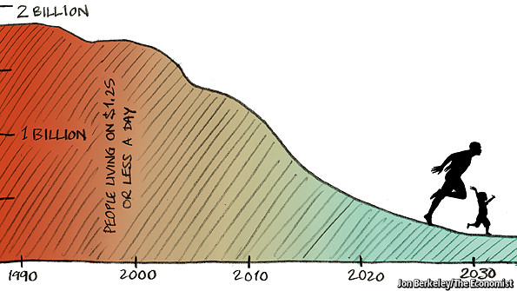
Reduction in World Poverty

Slide 21
9 In the soap factory discussed in the Poland Case Study video 350, workers were laid off "BUT PRODUCTION MORE THAN DOUBLED“. Which “E” is being achieved?
Economic Growth
Allocative Efficiency
Productive Efficiency
Full Employment
Equity

Slide 22
9 In the soap factory discussed in the Poland Case Study video 350, workers were laid off "BUT PRODUCTION MORE THAN DOUBLED“. Which “E” is being achieved?
Economic Growth
Allocative Efficiency
Productive Efficiency
Full Employment
Equity

Slide 23
10. A worker in the soap factory discussed in the Poland Case Study video said, “Our product is much better now. It is for the market.”. Which “E” is being achieved?
Economic Growth
Allocative Efficiency
Productive Efficiency
Full Employment
Equity

Slide 24
10. A worker in the soap factory discussed in the Poland Case Study video said, “Our product is much better now. It is for the market.”. Which “E” is being achieved?
Economic Growth
Allocative Efficiency
Productive Efficiency
Full Employment
Equity

Slide 25
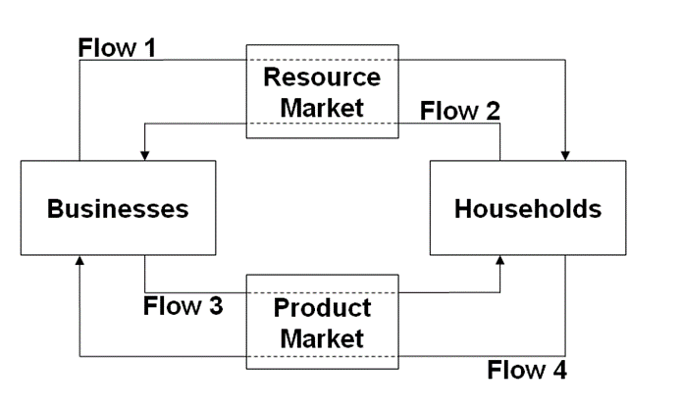
11. Flow 3 represents:
Wages, rents, interest, profits
Land, labor, capital, entrepreneurs
Goods and services
Consumer expenditures

Slide 26
11. Flow 3 represents:
Wages, rents, interest, profits
Land, labor, capital, entrepreneurs
Goods and services
Consumer expenditures

