Slide 1
22Wa – Economic Growth: The Less Developed Countries
This web quiz may appear as two pages on tablets and laptops.
I recommend that you view it as one page by clicking on the open book icon at the bottom of the page.

Slide 2
22wa -LDCs:
The International Distribution of Income
Characteristics of the LDCS (DVCs)
Obstacles to Development and the Role of Government

Slide 3
22wa -Things to know - 1:
Identify various terms that are used to name the rich and poor countries, including the "global south" and have a general understanding of where they are on a world map.
Where do most of the world's people live?
Describe the world distribution of wealth
What is the "vicious cycle" and how does population growth affect it?
How is the level of saving related to the level of investment and productivity in the cycle of poverty?
Identify the characteristics of DVCs.
How does population growth affect the growth in GDP per capita?
Define and give examples of the primary, secondary, and tertiary sectors of an economy

Slide 4
22wa -Things to know - 2:
List some of the obstacles to economic development.
Discuss the role of the DVC government in promoting economic development within their country
Describe how IACs can help low-income countries including the trade vs. aid debate
How can agricultural subsidies in the IACs (MDCs) negatively affect economic growth in the DVCs (LDCs)?
Describe the growth rates of IACs and DVCs and the growing absolute income gap between rich and poor countries.

Slide 5
22wa -Things to know - 3:
KEY TERMS: LDCs (DVCs), MDCs (IACs), primary activities, secondary activities, tertiary activities, vicious circle (cycle of poverty), brain drain, land reform, microfinance and Grameen Bank, World Bank, foreign direct investment, GDP per capita, capital flight, supply chain, Malthus, green revolution, financial intermediary

Slide 6
Identify various terms that are used to name the rich and poor countries
RICH COUNTRIES
POOR COUNTRIES

Slide 7
Identify various terms that are used to name the rich and poor countries
RICH COUNTRIES
MDCs
IACs
Global North
First World
Developed
Industrial
High Income
POOR COUNTRIES
LDCs
DVCs
Global South
Third World
Underdeveloped or Developing
Agricultural
Low Income

Slide 8
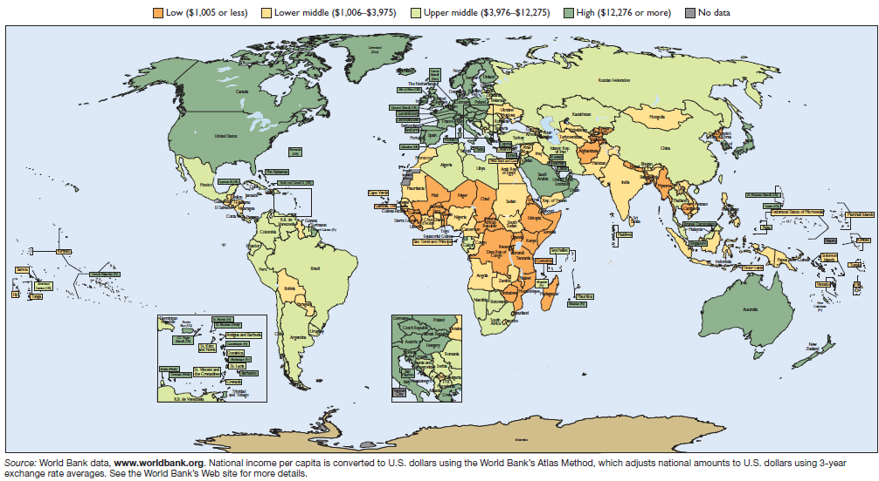
Where are the Less Developed Countries (LDCs or DVCs)?
MDCs (IACs) in dark green. LDCs (DVCs) in light green, yellow, and orange

Slide 9
1. The richest 20% of the world’s population receives what % of total world income?
20%
40%
60%
80%

Slide 10
1. The richest 20% of the world’s population receives what % of total world income?
20%
40%
60%
80%

Slide 11
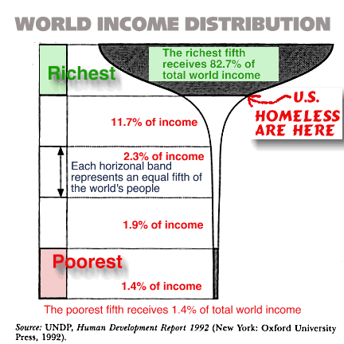

Slide 12
A Short Video Showing the Unequal Distribution of Income (Real GDP per capita)
The Basic Facts of Wealth – MRUniversity – 4:27
https://www.youtube.com/watch?v=PzAr_mL0Qd8
NOTE: Although the title says “The Basic Facts of Wealth” They really mean “The Basic Facts of Income”.
WEALTH is NOT the same as INCOME

Slide 13
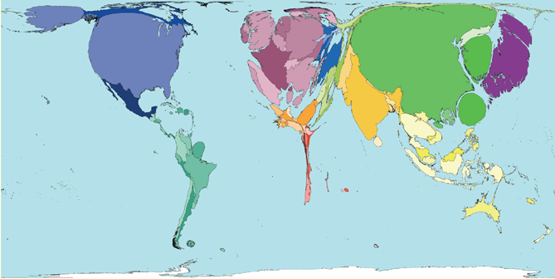
How the world would look if it were measured by its wealth. Country size = Country’s relative wealth
Where are the Less Developed Countries (LDCs or DVCs)?

Slide 14
2. Which measure of development is characteristically HIGH in LDCs (DVCs)?
Literacy rate
Urbanization rate
Population growth
Per capita consumption

Slide 15
2. Which measure of development is characteristically HIGH in LDCs (DVCs)?
Literacy rate
Urbanization rate
Population growth
Per capita consumption

Slide 16
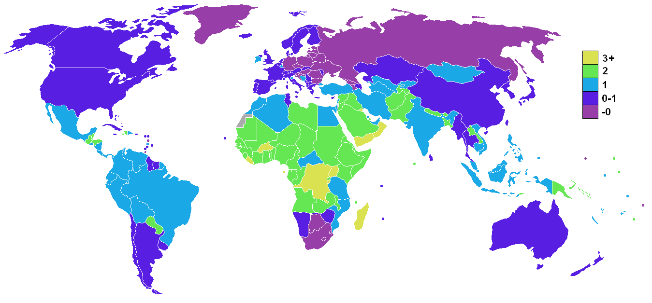
Population Growth Rates
Where are the Less Developed Countries (LDCs or DVCs)?

Slide 17
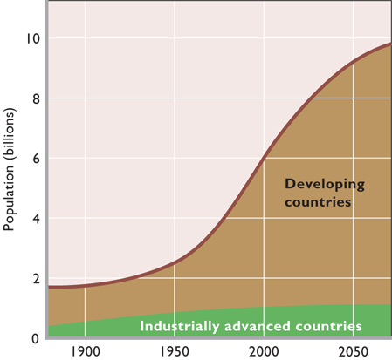

Slide 18
3. Which economic sector is characteristically LARGE in LDCs (DVCs)?
Primary (agriculture and mining)
Secondary (manufacturing)
Tertiary (service sector)

Slide 19
3. Which economic sector is characteristically LARGE in LDCs (DVCs)?
Primary (agriculture and mining)
Secondary (manufacturing)
Tertiary (service sector)

Slide 20
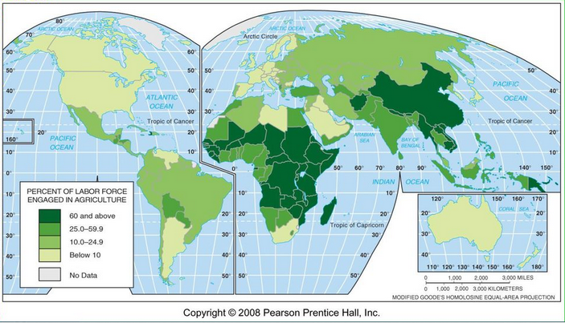
Where are the Less Developed Countries (LDCs or DVCs)?

Slide 21
Characteristics of LDC (DVCs)
1. GDP per capita: LOW
2. Population Growth rates: HIGH
3. Occupational Structure of the Labor Force: PRIMARY and more recently, SECONDARY
4. Urbanization: LOW
5. Consumption per capita: LOW
6. Infrastructure: POOR
7. Social Conditions
- literacy rates: LOW - infant mortality: HIGH
- life expectancy: LOW - caloric intake: LOW
- health care: POOR

Slide 22
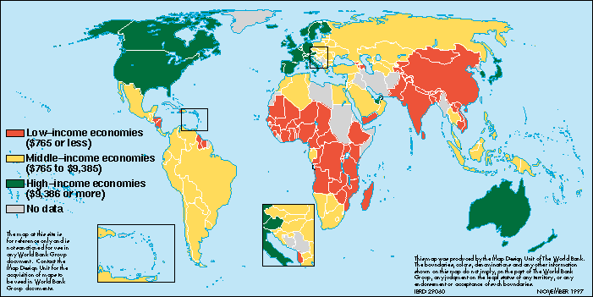
Where are the Less Developed Countries (LDCs or DVCs)?

Slide 23
Where are the Less Developed Countries (LDCs or DVCs)?
MDCs (IACs) in dark green. LDCs (DVCs) in light green, yellow, and orange

Slide 24
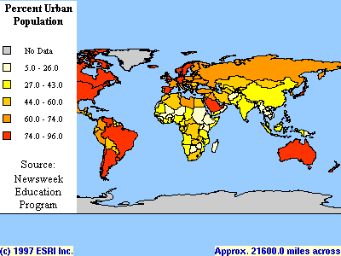
Where are the Less Developed Countries (LDCs or DVCs)?

Slide 25
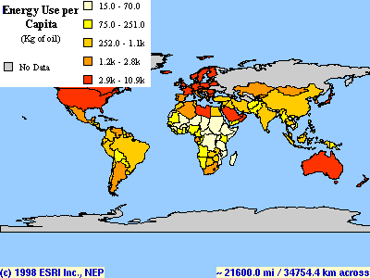
Where are the Less Developed Countries (LDCs or DVCs)?

Slide 26
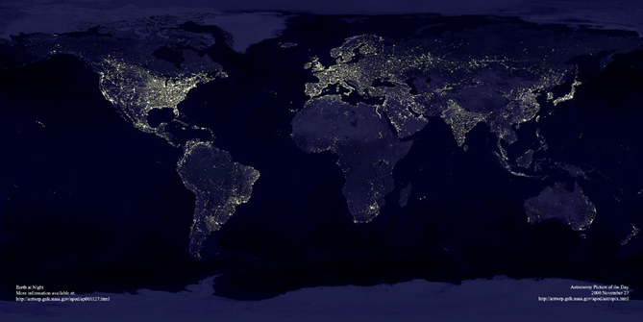
Where are the Less Developed Countries (LDCs or DVCs)?

Slide 27
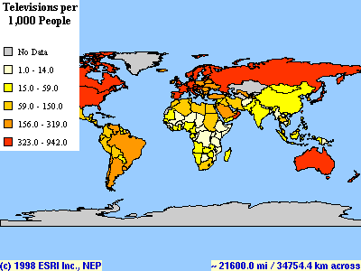
Where are the Less Developed Countries (LDCs or DVCs)?

Slide 28
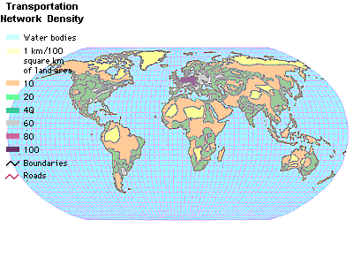
Where are the Less Developed Countries (LDCs or DVCs)?

Slide 29
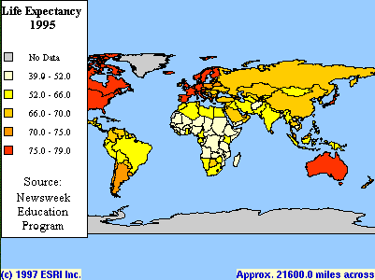
Where are the Less Developed Countries (LDCs or DVCs)?

Slide 30
Website with world data:
http://www.nationmaster.com/

Slide 31
NOTE: The term “characteristic” does not necessarily mean “causation”.
For example: rapid population growth may not CAUSE low levels of development, but rather low development may cause rapid population growth.
For example: high infant mortality does not CAUSE low levels of development, but rather low development may cause high infant mortality.

Slide 32
4. US government subsidies to American farmers are an obstacle to economic growth in the LDCs (DVCs) because the subsidies ______
increase the “brain Drain” from LDCs
increase population growth rates
decrease agricultural prices
decrease foreign aid and business investment

Slide 33
4. US government subsidies to American farmers are an obstacle to economic growth in the LDCs (DVCs) because the subsidies ______
increase the “brain Drain” from LDCs
increase population growth rates
decrease agricultural prices
decrease foreign aid and business investment

Slide 34
5. What happens to the gap between the per capita income of an LDC and an MDC if they both grow at 2% a year?
The gap gets smaller
The gap stays the same
The gap gets bigger
It depends on the level of income

Slide 35
5. What happens to the gap between the per capita income of an LDC and an MDC if they both grow at 2% a year?
The gap gets smaller
The gap stays the same
The gap gets bigger
It depends on the level of income

Slide 36
The absolute income gap between rich and poor nations has been widening.
For example,
LDC: if per capita income is $400 a year in a DVC, a 2% growth rate means an $8 increase in income. (2% of $400 = $8)
MDC: if per capita income is $20,000 per year in an IAC, the same 2% growth rate translates into a $400 increase in income. (2% of $20000 = $400)

Slide 37
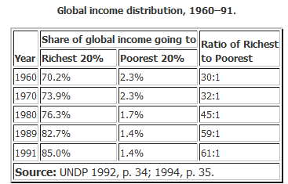

Slide 38
6. Why is a high population growth rate seen as an obstacle to economic growth in many LDCs (DVCs)?
It decreases growth in real output
It decreases growth in real output per capita
It increases the infant mortality rate
It increases consumption per capita

Slide 39
6. Why is a high population growth rate seen as an obstacle to economic growth in many LDCs (DVCs)?
It decreases growth in real output
It decreases growth in real output per capita
It increases the infant mortality rate
It increases consumption per capita

Slide 40
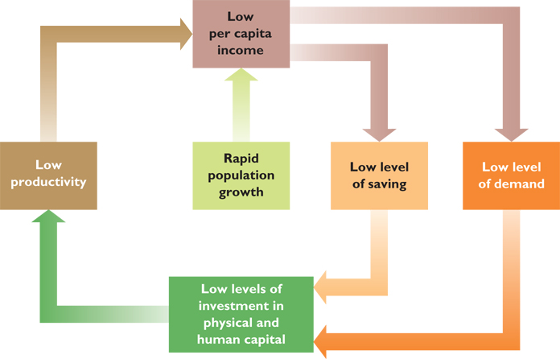
Development and Investment
The Vicious Circle: They are poor because they are poor

Slide 41
7. Which of the following is NOT a role of the LDC (DVC) government in promoting economic growth?
Establishing the rule of law
Building infrastructure
Building human capital
Restricting trade to promote companies

Slide 42
7. Which of the following is NOT a role of the LDC (DVC) government in promoting economic growth?
Establishing the rule of law
Building infrastructure
Building human capital
Restricting trade to promote companies

Slide 43
Role of LDC Government in Development
Establishing the rule of law
Building infrastructure
Embracing globalization
Building human capital
Promoting entrepreneurship
Developing credit systems
Controlling population growth
Making peace with neighbors
See Lesson 8a Economic Growth (next slides):
Institutional Factors that Promote Growth
Other Difficult to Measure Factors that Promote Growth

Slide 44
Lesson 8a - Institutional Features that Promote EG:
1. Strong Property Rights
2. Patents and copyrights
3. Efficient financial institutions
4. Literacy and widespread education
5. Free trade
6. A competitive market system

Slide 45
“Difficult-to-Measure" Factors that help EG:
stable political system
internal order (no civil wars)
strong sense of the right of property ownership
strong legal status accorded to businesses
strong laws to enforce contracts
"no social or moral taboos on production and material progress"
belief that wealth creation is a desirable goal
positive attitude toward work
I would add that the more equal status afforded to women in the leader countries has aided economic growth

Slide 46
Role of the Advanced Countries (IACs) in Helping the LDCs (DVCs)
Expanding trade
Admitting temporary workers
Discouraging arms sales
Foreign aid including debt forgiveness
Private business investment

Slide 47
Expanding Trade vs. Aid
1. Expanding trade may be the simplest way to help DVCs, and IACs can lower trade barriers against DVC products.
2. However, many countries also need basic foreign aid and private business investment

Slide 48
8. What fraction of the U. S. federal government's budget is spent on FOREIGN AID?
1%
5%
10%
15%
20%
25%

Slide 49
8. What fraction of the U. S. federal government's budget is spent on FOREIGN AID?
1%
5%
10%
15%
20%
25%

Slide 50
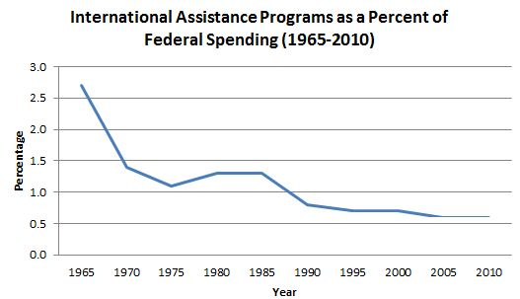

Slide 51
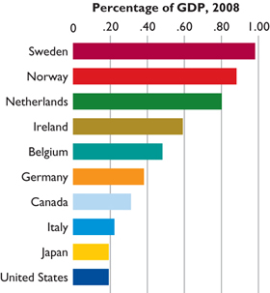
Foreign Aid as a % of GDP
The UN recommends
that rich countries
contribute at least 0.7%
of their GDPs to aid the
LDCs.
US: 0.19%

Slide 52
Largest Foreign Aid Donors 2013
United States – $31.55 billion
United Kingdom – $17.88 billion
Germany – $14.06 billion
Japan – $11.79 billion
France – $11.38 billion
Sweden – $5.83 billion
Norway – $5.58 billion
Netherlands – $5.44 billion
Canada – $4.91 billion
Australia – $4.85 billion
Italy – $3.25 billion
Switzerland – $3.20 billion
Denmark – $2.93 billion
Belgium – $2.28 billion
Spain – $2.20 billion
South Korea – $1.74 billion
Finland – $1.44 billion
Austria – $1.17 billion
Ireland – $0.82 billion
Portugal – $0.48 billion
Poland – $0.47 billion
New Zealand – $0.46 billion
Luxembourg – $0.43 billion
Greece – $0.31 billion
Czech Republic – $0.21 billion
Slovak Republic – $0.09 billion
Slovenia – $0.06 billion
Iceland – $0.04 billion

Slide 53
Foreign Aid as a % of National Income 2013
Norway – 1.07%
Sweden – 1.02%
Luxembourg – 1.00%
Denmark – 0.85%
United Kingdom – 0.72%
Netherlands – 0.67%
Finland – 0.55%
Switzerland – 0.47%
Belgium – 0.45%
Ireland – 0.45%
France- 0.41%
Germany – 0.38%
Australia – 0.34%
Austria – 0.28%
Canada – 0.27%
New Zealand – 0.26%
Iceland – 0.26%
Japan – 0.23%
Portugal – 0.23%
United States – 0.19%
Spain – 0.16%
Italy – 0.16%
South Korea – 0.13%
Slovenia - 0.13%
Greece – 0.13%
Czech Republic - 0.11%
Poland - 0.10%
Slovak Republic - 0.09%

Slide 54
9. An example of “infrastructure” is _________
Highways and bridges
Crude oil reserves
Skills of the labor force
Entrepreneurial ability

Slide 55
9. An example of “infrastructure” is _________
Highways and bridges
Crude oil reserves
Skills of the labor force
Entrepreneurial ability

Slide 56
Where are the Less Developed Countries (LDCs or DVCs)?

Slide 57
Infrastructure:
the basic equipment and structures (such as roads, bridges schools, power supply, ports, etc.) that are needed for a country, region, or organization to function properly

Slide 58
10. Where do most people in the world live?
LDCs (DVCs)
MDCs (IACs)
Africa
South America

Slide 59
10. Where do most people in the world live?
LDCs (DVCs)
MDCs (IACs)
Africa
South America

Slide 60
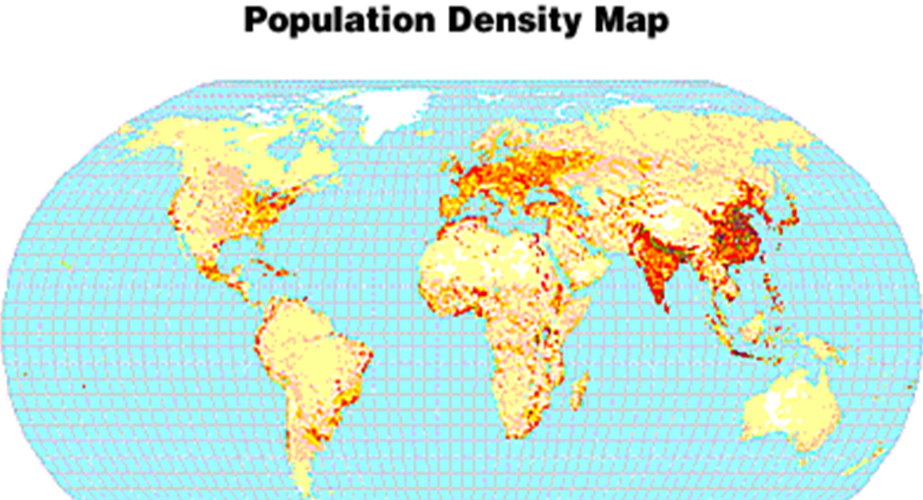
Where are the Less Developed Countries (LDCs or DVCs)?

Slide 61
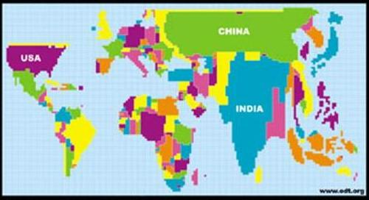
Population Cartogram – size of country based on the size of the country’s population

Slide 62
Tomlinson Video 16.2.3: Women’s Role in Rural Economic Development:
Video Notes:
http://www.harpercollege.edu/mhealy/eco212/macvideonotes.htm#1623

