Slide 1
20a – The Gains from Trade
This web quiz may appear as two pages on tablets and laptops.
I recommend that you view it as one page by clicking on the open book icon at the bottom of the page.

Slide 2
20a - Macro – Why We Trade: Comparative Advantage
The Economic Benefits of Trade
Absolute Advantage
Comparative Advantage
The Gains from Trade
The Terms of Trade

Slide 3
20a - Macro – Why We Trade: Comparative Advantage
Outcomes
why do the gains from trade appear to be hidden from many people?
what is the economic basis for specialization and exchange (trade)?
calculate the opportunity costs using straight line production possibilities
define and find absolute advantage and comparative advantage using straight line (constant costs) production possibilities
calculate how specialization and trade increases output using the production possibilities tables or graphs of two different countries (i.e. calculate the gains from trade)
compute the minimum and maximum terms of trade

Slide 4
20a - Macro – Why We Trade: Comparative Advantage
Key Terms
opportunity cost, constant costs, increasing costs, absolute advantage, comparative advantage, gains from trade, free trade, terms of trade, minimum and maximum terms of trade

Slide 5
1. Specialization in production is economically beneficial primarily because it:
Allows everyone to have a job they like
Facilitates trade by bartering
Guarantees full employment
Permits more output from the same resources

Slide 6
1. Specialization in production is economically beneficial primarily because it:
Allows everyone to have a job they like
Facilitates trade by bartering
Guarantees full employment
Permits more output from the same resources

Slide 7
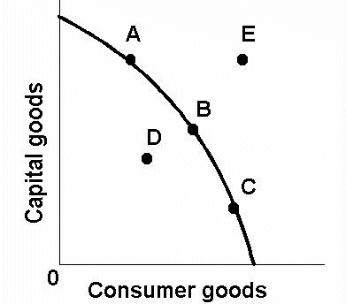
2. Use the PPC below. Which is possible only with trade?
A
B
C
D
E

Slide 8
2. Use the PPC below. Which is possible only with trade?
A
B
C
D
E

Slide 9
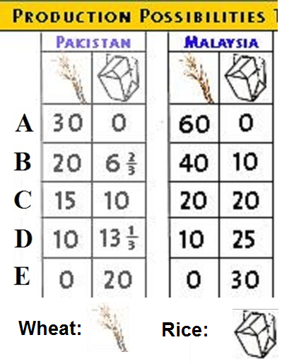
3. If we assume both Pakistan and Malaysia have the same amount of resources, who has an absolute advantage in producing rice?
Both countries
Neither country
Pakistan
Malaysia

Slide 10
3. If we assume both Pakistan and Malaysia have the same amount of resources, who has an absolute advantage in producing rice?
Both countries
Neither country
Pakistan
Malaysia

Slide 11
4. If Malaysia has an absolute advantage in production both wheat and rice why can Malaysia still benefit from trade with Pakistan?
Malaysia has constant costs
Malaysia has increasing costs
Each country has different opportunity costs
Pakistan is better at producing wheat

Slide 12
4. If Malaysia has an absolute advantage in production both wheat and rice why can Malaysia still benefit from trade with Pakistan?
Malaysia has constant costs
Malaysia has increasing costs
Each country has different opportunity costs
Pakistan is better at producing wheat

Slide 13
5. In Pakistan, the op. cost of 1 Wheat is:
0 Rice
½ rice
2/3 Rice
20 Rice3

Slide 14
5. In Pakistan, the op. cost of 1 Wheat is:
0 Rice
½ rice
2/3 Rice
20 Rice3

Slide 15
6. Who should export what?
Pakistan both wheat and rice
Pakistan wheat, Malaysia rice
Pakistan rice,
Malaysia wheat
Malaysia both wheat and rice

Slide 16
6. Who should export what?
Pakistan both wheat and rice
Pakistan wheat, Malaysia rice
Pakistan rice, Malaysia wheat
Malaysia both wheat and rice

Slide 17
7. Assume before specialization, Pakistan is at “C” and Malaysia at “B”, If they specialize 100%, then the gains will be:
45 wheat and 20 rice
20 rice
5 wheat
15 wheat

Slide 18
7. Assume before specialization, Pakistan is at “C” and Malaysia at “B”, If they specialize 100%, then the gains will be:
45 wheat and 20 rice
20 rice
5 wheat
15 wheat

Slide 19
8. Which of the following would be an acceptable terms of trade?
1 rice for ½ wheat
1 rice for 1 wheat
1 rice for 1 ¾ wheat
1 rice for 2 wheat

Slide 20
8. Which of the following would be an acceptable terms of trade?
1 rice for ½ wheat
1 rice for 1 wheat
1 rice for 1 ¾ wheat
1 rice for 2 wheat

Slide 21
Pakistan: Malaysia:
1W = 2/3 R 1W=1/2R
1 R = 1 ½ W 1R=2W
So Pakistan sells rice
Min. they’ll accept= 1 ½ W
Malaysia buys rice:
Max they’ll pay = 2W
So the terms of trade must be
between: 1R for 1 ½ W and 1R for 2W.
1R for 1 ¾ W is possible

Slide 22
9. Which of the following would be an acceptable terms of trade?
1 W for 1/2 R
1 W for 3/5 R
1 W for 1 R
1 W for 2 R

Slide 23
9. Which of the following would be an acceptable terms of trade?
1 W for 1/2 R
1 W for 3/5 R
1 W for 1 R
1 W for 2 R

Slide 24
10. Why do the benefits of free trade appear to be hidden?
Politicians don’t want to tell us
Unions oppose free trade
The benefits of trade are spread among many, the costs fall on a few
The benefits are less than the costs

Slide 25
10. Why do the benefits of free trade appear to be hidden?
Politicians don’t want to tell us
Unions oppose free trade
The benefits of trade are spread among many, the costs fall on a few
The benefits are less than the costs

