Slide 1

1c – Production Possibilities
This web quiz may appear as two pages on tablets and laptops.
I recommend that you view it as one page by clicking on the open book icon at the bottom of the page.

Slide 2
1c – PPC -
PPC: define, assumptions, graph
The PPC can be use to illustrate:
  we must make choices
  choices have opportunity costs
  the law of increasing costs
  the effect of unemployment
  the effect of productive inefficiency
  the effect of economic growth
  how present choices affect future possibilities
  the gains from trade
  it does NOT show the optimum product mix (allocative efficiency)
  The PPC does NOT show the optimum product mix (allocative efficiency)

Slide 3
1c – PPC – Macro – Outcomes (1)
Construct a production possibilities curve (PPC) when given appropriate data; what is the production possibilities curve (PPC) or production possibilities frontier (PPF)?; what does it show?
What are the assumptions behind the PPC
Illustrate the following using the production possibilities curve:
  we must make choices
  choices have opportunity costs
  the law of increasing costs
  the effect of unemployment
  the effect of productive inefficiency
  how present choices affect future possibilities
  the effect of international trade
  two types of "economic growth"
  it does NOT show the optimum product mix (allocative efficiency)

Slide 4
1c – PPC – Macro – Outcomes (2)
Explain WHY the PPC has the shape that it does -- concave to the origin. What is the law of increasing cost?
Why are there increasing costs? Why is the PPC concave to the origin? (Draw, Define. Describe all graphs)
What would the PPC look like if there were constant costs?
What does a point outside the PPC represent?
What two things (2 Es) would a point inside the PPC indicate?
Give some real-world applications of the production possibilities concept.
Summarize the general relationship between investment and economic growth.
What is the difference between "achieving the potential" and "increasing the potential"? Show the difference on a PPC. What are the two types of "economic growth" and how are they shown on a PPC?
What would cause a PPC to shift inward?
Use a PPC to illustrate the effect of international trade
Be able to draw and explain the Circular Flow Model

Slide 5
1c – PPC – Macro – Key Terms
production possibilities, necessity of choice, law of increasing costs, concave to the origin, opportunity cost, constant cost, benefit cost analysis (marginal analysis), economic growth, consumer goods, capital goods, shrinking PPC, nonproportional growth

Slide 6
1. A production possibilities curve illustrates:
the necessity of making choices.
market prices.
consumer preferences.
the distribution of income.

Slide 7
1. A production possibilities curve illustrates:
the necessity of making choices.
market prices.
consumer preferences.
the distribution of income.

Slide 8
2. Refer to the production possibilities curve. At the onset of the Second World War the United States had large amounts of idle human and property resources. Its economic adjustment from peacetime to wartime can best be described by the movement from point:
c to point b.
b to point c.
a to point b.
c to point d.

Slide 9
2. Refer to the production possibilities curve. At the onset of the Second World War the United States had large amounts of idle human and property resources. Its economic adjustment from peacetime to wartime can best be described by the movement from point:
c to point b.
b to point c.
a to point b.
c to point d.

Slide 10
3. Refer to the production possibilities curve. At the onset of the Second World War the Soviet Union was already at full employment. Its economic adjustment from peacetime to wartime can best be described by the movement from point:
c to point b.
b to point c.
a to point b.
c to point d.

Slide 11
3. Refer to the production possibilities curve. At the onset of the Second World War the Soviet Union was already at full employment. Its economic adjustment from peacetime to wartime can best be described by the movement from point:
c to point b.
b to point c.
a to point b.
c to point d.

Slide 12
4. Refer to the diagram. If society is currently producing the combination of bicycles and computers shown by point D, the production of 2 more units of bicycles: YP 15 #13
cannot be achieved because resources are fully employed.
will cost 1 unit of computers.
will cost 2 units of computers.
will cause some resources to become unemployed.

Slide 13
4. Refer to the diagram. If society is currently producing the combination of bicycles and computers shown by point D, the production of 2 more units of bicycles: YP 15 #13
cannot be achieved because resources are fully employed.
will cost 1 unit of computers.
will cost 2 units of computers.
will cause some resources to become unemployed.

Slide 14
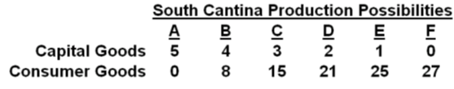
5. Refer to the table. If South Cantina is producing at production alternative D, the opportunity cost of the third unit of capital goods will be:
3 units of consumer goods.
4 units of consumer goods.
5 units of consumer goods.
6 units of consumer goods.

Slide 15
5. Refer to the table. If South Cantina is producing at production alternative D, the opportunity cost of the third unit of capital goods will be:
3 units of consumer goods.
4 units of consumer goods.
5 units of consumer goods.
6 units of consumer goods.

Slide 16
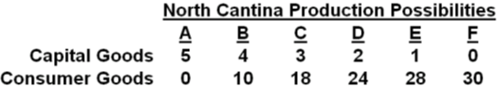
6. Refer to the table. If North Cantina is producing at production alternative B, the opportunity cost of the eleventh unit of consumer goods will be:
10 units of capital goods.
¹/₄ of a unit of capital goods.
8 units of capital goods.
¹/₈ of a unit of capital goods.

Slide 17
6. Refer to the table. If North Cantina is producing at production alternative B, the opportunity cost of the eleventh unit of consumer goods will be:
10 units of capital goods.
¹/₄ of a unit of capital goods.
8 units of capital goods.
¹/₈ of a unit of capital goods.

Slide 18
7. The production possibilities curve is:
1. convex to the origin because opportunity costs are constant.
2. linear because opportunity costs are constant.
3. concave to the origin because of increasing opportunity costs.
4. convex to the origin because of increasing opportunity costs.

Slide 19
7. The production possibilities curve is:
1. convex to the origin because opportunity costs are constant.
2. linear because opportunity costs are constant.
3. concave to the origin because of increasing opportunity costs.
4. convex to the origin because of increasing opportunity costs.

Slide 20
8. If the production possibilities curve is a straight line:
1. the two products will sell at the same market prices.
2. economic resources are perfectly substitutable between the production of the two products.
3. the two products are equally important to consumers.
4. equal quantities of the two products will be produced at each possible point on the curve.

Slide 21
8. If the production possibilities curve is a straight line:
1. the two products will sell at the same market prices.
2. economic resources are perfectly substitutable between the production of the two products.
3. the two products are equally important to consumers.
4. equal quantities of the two products will be produced at each possible point on the curve.

Slide 22
9. The combination of computers and bicycles shown by point F:
YP 15 #14
is unattainable, given currently available resources and technology.
is attainable, but implies productive inefficiency
is attainable, but implies allocative inefficiency
is attainable, but implies full employment

Slide 23
9. The combination of computers and bicycles shown by point F:
YP 15 #14
is unattainable, given currently available resources and technology.
is attainable, but implies productive inefficiency
is attainable, but implies allocative inefficiency
is attainable, but implies full employment

Slide 24
10. Refer to the diagram. This economy will experience unemployment if it produces at
A.
B.
C.
D.

Slide 25
10. Refer to the diagram. This economy will experience unemployment if it produces at
A.
B.
C.
D.

Slide 26
11. If all discrimination in the United States were eliminated, the economy would:
have a less concave production possibilities curve.
produce at some point closer to its production possibilities curve.
be able to produce at some point outside of its production possibilities curve.
shift the production possibilities curve outward.

Slide 27
11. If all discrimination in the United States were eliminated, the economy would:
have a less concave production possibilities curve.
produce at some point closer to its production possibilities curve.
be able to produce at some point outside of its production possibilities curve.
shift the production possibilities curve outward.

Slide 28
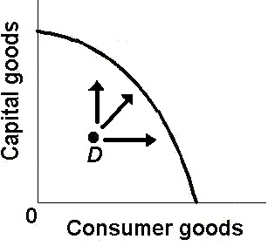

Slide 29
12. Which of the following will not produce an outward shift of the production possibilities curve?
an upgrading of the quality of a nation's human resources
the reduction of unemployment
an increase in the quantity of a society's labor force
the improvement of a society's technological knowledge

Slide 30
12. Which of the following will not produce an outward shift of the production possibilities curve?
an upgrading of the quality of a nation's human resources
the reduction of unemployment
an increase in the quantity of a society's labor force
the improvement of a society's technological knowledge

Slide 31
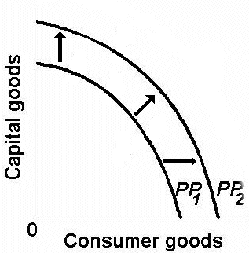
TWO TYPES OF ECONOMIC GROWTH
Achieving the Potential Increasing the Potential

Slide 32
13. Refer to the diagram. Other things equal, this economy will achieve the most rapid rate of growth if:
it chooses point A.
it chooses point B.
it chooses point C.
it chooses point D.

Slide 33
13. Refer to the diagram. Other things equal, this economy will achieve the most rapid rate of growth if:
it chooses point A.
it chooses point B.
it chooses point C.
it chooses point D.

Slide 34
14. Which point on this graph shows the “GAINS FROM TRADE”:
A.
B.
C.
D.
E.

Slide 35
14. Which point on this graph shows the “GAINS FROM TRADE”:
A.
B.
C.
D.
E.

Slide 36
1c – PPC
PPC: define, assumptions, graph
The PPC can be use to illustrate:
  we must make choices
  choices have opportunity costs
  the law of increasing costs
  the effect of unemployment
  the effect of productive inefficiency
  the effect of economic growth
  how present choices affect future possibilities
  the gains from trade
  it does NOT show the optimum product mix (allocative efficiency)
  The PPC does NOT show the optimum product mix (allocative efficiency)

