Slide 1
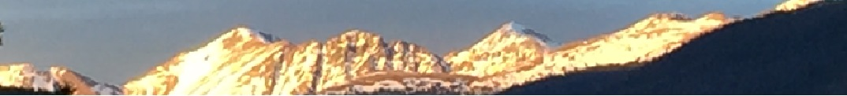
1a – The Class and the Math
This web quiz may appear as two pages on tablets and laptops.
I recommend that you view it as one page by clicking on the open book icon at the bottom of the page.

Slide 2
Lesson 1a – The Class and the Math
TOPICS
  Basic math skills
  How to find class information
  What is economics?

Slide 3
Lesson 1a – The Class and the Math
CLASS INFORMATION
  Syllabus
  Blackboard
  Yellow Pages
  SCHEDULE
  LESSONS webpage
  MICWEBAPP
  Key term Flashcards
  WebQuizzes
BASIC MATH SKILLS
  Calculate marginal
  Calculate average
  Arithmetic of fractions
  and decimals
  Find area of a rectangle
  Find area of a triangle
  Basic algebra
  Calculate and use
  percentages
  Graph a line on a Cartesian
  coordinate system
  Marginal is the slope
  of the total

Slide 4
ECO 212
1a - Welcome to Macroeconomics
Name Tents (both sides / meet)
Yellow Pages
MacWebApp (put on phone)
Syllabus

Slide 5
1a - ECO 212 - SYLLABUS
Basic Info. / Course Description
Macroeconomics in the Global Economy
Mathematics Skills (Blackboard Quiz)
Course Structure
Course Materials (Textbook / Videos)
Blackboard
E-mail
Grading
DAILY SCHEDULE
Other

Slide 6
1. Students are required to take an online Pre-Quiz almost EVERYDAY BEFORE CLASS (by 12:00 noon).
True or False?
True
False

Slide 7
1. Students are required to take an online Pre-Quiz almost EVERYDAY BEFORE CLASS (by 12:00 noon).
True or False?
True
False

Slide 8
2. Where do you find the DATES for the Pre-Quizzes and Reading/Video Assignments?
YELLOW PAGES
LESSONS
SCHEDULE
VIDEO NOTES

Slide 9
2. Where do you find the DATES for the Pre-Quizzes and Reading/Video Assignments?
YELLOW PAGES
LESSONS
SCHEDULE
VIDEO NOTES

Slide 10
3. Where do you find the correct daily reading assignments and the assigned video lectures?
SYLLABUS
YELLOW PAGES
STUDY GUIDE
LESSONS or MACWEBAPP

Slide 11
3. Where do you find the correct daily reading assignments and the assigned video lectures?
SYLLABUS
YELLOW PAGES
STUDY GUIDE
LESSONS or MACWEBAPP

Slide 12
1a – LESSONS / MACWEBAPP
Introduction
Something Interesting
Assignments – Reading / Video
Outcomes – What you should learn
Key Term Flashcards
Key Formulas
Key Graphs
Review Videos (YouTube)

Slide 13
ECO 212 – Course Structure
BEFORE CLASS:
  Read Lesson Introduction / Something Interesting
  Read Textbook
  Watch Video Lectures
  Key Term Flashcards
  Take Pre-Quiz by noon (12:00)
DURING CLASS:
  Clicker Quizzes
  Yellow Pages
  Lecture
AFTER CLASS:
  Required Activities
  Yellow Pages
  Review quizzes / Practice Exercises

Slide 14
ECO 212 – Next Class – Lesson 1b
  For Monday, Jan 22 = Lesson 1b
  See Schedule
  Read Lesson Introduction / Something Interesting
  Read Textbook and online reading
  Watch Assigned Video Lectures
  Key Term Flashcards
  Take Pre-Quiz for lesson 1b on Blackboard before 12:00 noon
  Get Ahead !

Slide 15
4. Should the United States have free trade with Mexico, China, Canada, etc?
(What would most economists say?)
Yes
No
Macroeconomics in a Global Economy

Slide 16
4. Should the United States have free trade with Mexico, China, Canada, etc?
(What would most economists say?)
Yes
No
Macroeconomics in a Global Economy

Slide 17
Macroeconomics in a Global Economy
Almost every day we hear news reports of economic problems and successes from around the world.
All over the world, countries are undertaking economic reforms (often called GLOBALIZATION or STRUCTURAL ADJUSTMENT POLICIES) that their leaders believe will provide their citizens with lower unemployment and higher living standards.
We will review basic microeconomic concepts and learn new macroeconomic concepts in an international context.

Slide 18
5. Assume that a hurricane has struck the coast of Florida causing massive destruction. As a result, the prices of many products like hotel rooms, water, plywood, etc. increase significantly. For example, let's say the price of plywood increases from a price of $10 a sheet before the hurricane to $30 a sheet after the hurricane.
To help the people of Florida, should the Florida government pass a law keeping the price of these products (like plywood) to their levels before the hurricane struck?
(What would most economists say?)
Yes. Pass law keeping prices low (at their pre-hurricane level)
No. Let prices increase
(do nothing about prices)
https://mises.org/library/price-gouging-saves-lives-hurricane

Slide 19
5. Assume that a hurricane has struck the coast of Florida causing massive destruction. As a result, the prices of many products like hotel rooms, water, plywood, etc. increase significantly. For example, let's say the price of plywood increases from a price of $10 a sheet before the hurricane to $30 a sheet after the hurricane.
To help the people of Florida, should the Florida government pass a law keeping the price of these products (like plywood) to their levels before the hurricane struck?
(What would most economists say?)
Yes. Pass law keeping prices low (at their pre-hurricane level)
No. Let prices increase
(do nothing about prices)
https://mises.org/library/price-gouging-saves-lives-hurricane

Slide 20
6. Jan. 26, 2000, Coca-Cola announced plans to cut 6,000 jobs, about a fifth of its workforce.
Assuming that they will produce the same amount of Coke, are these job cuts good for society?
(What would most economists say?)
Yes
No
Coke Cutting 21% of Jobs

Slide 21
6. Jan. 26, 2000, Coca-Cola announced plans to cut 6,000 jobs, about a fifth of its workforce.
Assuming that they will produce the same amount of Coke, are these job cuts good for society?
(What would most economists say?)
Yes
No
Coke Cutting 21% of Jobs

Slide 22
7. Are gasoline prices too low?
(What would many economists say?)
Yes
No
http://www.globalpetrolprices.com/gasoline_prices/

Slide 23
7. Are gasoline prices too low?
(What would many economists say?)
Yes
No
http://www.globalpetrolprices.com/gasoline_prices/

Slide 24
ECO 212 – Next Class – Lesson 1b
This course will cover the area of economics commonly defined as macroeconomics. The main goal of macroeconomics is to gain a better understanding of the causes of:
  UNEMPLOYMENT
  INFLATION,
  ECONOMIC GROWTH
We will study these macroeconomic issues in an international context to try to understand the economic reforms many countries are undertaking.

Slide 25
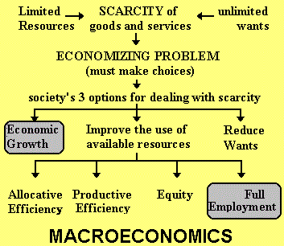
The 5Es of Economics – Lesson 1b

Slide 26
ECO 212 – Next Class – Lesson 1b
  For Monday, Jan 22 = Lesson 1b
  See Schedule
  Read Lesson Introduction / Something Interesting
  Read Textbook and online reading
  Watch Assigned Video Lectures
  Key Term Flashcards
  Take Pre-Quiz for lesson 1b on Blackboard before 12:00 noon
  Get Ahead !

