Slide 1
16b – Other Monetary Policy Issues
This web quiz may appear as two pages on tablets and laptops.
I recommend that you view it as one page by clicking on the open book icon at the bottom of the page.

Slide 2
16b – Other Monetary Policy Issues
Strengths and Shortcomings of Monetary Policy.
Compare Mainstream and Monetarist views:
Causes of Macroeconomic instability
Does the economy self-correct?
Rules or Discretion? (Should the Fed do anything?)
NOTE: We will keep things simple:
Mainstream = New Keynesian
Monetarist = New Classical

Slide 3
Monetary Policy (MP)
Mainstream Economists (Keynesians) believe:
MP is NOT effective, but it should be used
Monetarist Economists (Classical) believe:
MP is VERY effective and therefore it should NOT be used

Slide 4
16b – Other Monetary Policy Issues
Must Know / Outcomes:
Know the strengths and shortcomings of monetary policy.
Describe two alternative perspectives on the causes of macroeconomic instability: those held by mainstream (Keynesian) economists and the monetarists (Classical)
Explain what the equation of exchange is and how it relates to "monetarism."
Discuss why new classical economists (monetarists) believe the economy will "self-correct" from aggregate demand and aggregate supply shocks. Explain the view of self-correction held by mainstream economists.
List three reasons why a higher wage could result in greater efficiency.
Identify and describe the variations on the debate over "rules" versus "discretion" in conducting stabilization policy.
Mainstream (New Keynesian) economists believe monetary policy is not very effective but it should be used to accommodate fiscal policy. Monetarists (New Classical) economists believe monetary policy is very effective but should not be used with discretion. EXPLAIN.

Slide 5
16b – Other Monetary Policy Issues
KEY TERMS: recognition lag, administrative lag, operational lag, cyclical asymetry, liquidity trap, equation of exchange, velocity of money, new classical economists (monetarists), mainstream economists (Keynesian), efficiency wage, monetary rule, inflation targeting,

Slide 6
16b – Other Monetary Policy Issues
Strengths and Shortcomings of monetary policy.
Compare Mainstream and Monetarist views:
Causes of Macroeconomic instability
Does the economy self-correct?
Rules or Discretion? (Should the Feddo anything?)

Slide 7
1. What are the tools of Monetary Policy (MP) and the tools of Fiscal Policy (FP)?
MP: G, T, MS; FP: DR, RR
MP: C, I, Xn; FP: G, OMO
MP: OMO, DR, RR; FP: G, T
MP: C, I, G, Xn FP: S, T, In
MP: Strengths and Shortcomings

Slide 8
1. What are the tools of Monetary Policy (MP) and the tools of Fiscal Policy (FP)?
MP: G, T, MS; FP: DR, RR
MP: C, I, Xn; FP: G, OMO
MP: OMO, DR, RR; FP: G, T
MP: C, I, G, Xn FP: S, T, In
MP: Strengths and Shortcomings

Slide 9
2. What are the two advantages of Monetary Policy (MP) over Fiscal Policy (FP)?
Speed/flexibility and free from political pressure
More democratic and less corruption
Can reduce IN without UE and shorter recognition lag
Supply side effects and no ratchet effect
MP: Strengths and Shortcomings

Slide 10
2. What are the two advantages of Monetary Policy (MP) over Fiscal Policy (FP)?
Speed/flexibility and free from political pressure
More democratic and less corruption
Can reduce IN without UE and shorter recognition lag
Supply side effects and no ratchet effect
MP: Strengths and Shortcomings

Slide 11
3. Compared to FP, MP has a SHORTER:
Recognition Lag
Administrative Lag
Operational Lag
Structural Lag
MP: Strengths and Shortcomings

Slide 12
3. Compared to FP, MP has a SHORTER:
Recognition Lag
Administrative Lag
Operational Lag
Structural Lag
MP: Strengths and Shortcomings

Slide 13
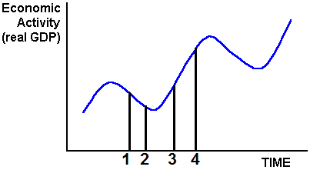
MP: Strengths and Shortcomings
Time 1 to 2:
Recognition Lag
Time 2 to 3:
Administrative Lag
Time 3 to 4:
Operational Lag
Time 1: Economy enters a recession
Time 2: Recession is recognized
Time 3: Gov’t enacts policy
Time 4: Policy takes effect

Slide 14
Time Lags and Macroeconomic Policy
Recognition Lag: Same for FP and MP
Administrative Lag: Shorter for MP
Operational Lag: Same for FP and MP
MP: Strengths and Shortcomings

Slide 15
MP: Strengths and Shortcomings
Monetary policy is relatively speedy and flexible relative to fiscal policy because the decision-making body is smaller and the decisions to change monetary policy can be implemented immediately.
A second strength is that monetary policy is largely removed from political pressure since the members of the Board of Governors are appointed to 14-year terms. Unpopular, but necessary, changes can thus be made which might not be possible with fiscal policy where the decision makers are elected officials who may be reluctant to make unpopular decisions

Slide 16
4. What is the textbook discussing when it says expansionary MP like “pushing on a string”?
Recognition Lag
Cyclical Asymmetry
Monetary Rule
Velocity
MP: Strengths and Shortcomings

Slide 17
4. What is the textbook discussing when it says expansionary MP like “pushing on a string”?
Recognition Lag
Cyclical Asymmetry
Monetary Rule
Velocity
MP: Strengths and Shortcomings

Slide 18
Cyclical Asymmetry
Monetary policy works better at fighting inflation, like “pulling on a string” to decrease AD and bring prices down.
Monetary policy does not work as well to fight unemployment. It is like “pushing on a string” to increase AD. If businesses have a lot of excess capacity and see that consumers are not buying much they may not increase investment even if interest rates are low.
MP: Strengths and Shortcomings

Slide 19
Liquidity Trap / Cyclical Asymetry
The Fed cannot be certain of achieving its goal when it adds reserves to the banking system because of the so-called liquidity trap
A situation in a severe recession in which the Fed's injection of additional reserves into the banking system has little or no additional positive impact on lending, borrowing, investment, or aggregate demand.,
MP: Strengths and Shortcomings

Slide 20
MP: Strengths and Shortcomings
Strengths
Speed and flexibility
Isolation from political pressure
Shortcomings
Lags
Cyclical Asymmetry and the Liquidity Trap

Slide 21
16b – Other Monetary Policy Issues
Strengths and Shortcomings of monetary policy.
Compare Mainstream and Monetarist views:
Causes of Macroeconomic instability
Does the economy self-correct?
Rules or Discretion? (Should the Fed do anything?)

Slide 22
5. According to the Mainstream and Monetarist economists why is there economic instability?
Main: Flexible prices Monet: Inflexible prices
Main: Stable velocity Monet: Unstable Velocity
Main: AD and AS shocks Monet: Inappropriate MP
Main: Government policies Monet: Changes in Investment
MP: Causes of Instability

Slide 23
5. According to the Mainstream and Monetarist economists why is there economic instability?
Main: Flexible prices Monet: Inflexible prices
Main: Stable velocity Monet: Unstable Velocity
Main: AD and AS shocks Monet: Inappropriate MP
Main: Government policies Monet: Changes in Investment
MP: Causes of Instability

Slide 24
16b – Other Monetary Policy Issues
Strengths and Shortcomings of monetary policy.
Compare Mainstream and Monetarist views:
Causes of Macroeconomic instability
Does the economy self-correct?
Rules or Discretion? (Should the Fed do anything?)

Slide 25
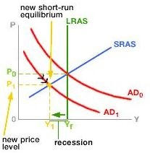
6. Which view of macroeconomic theory is shown in this graph?
Mainstream
Monetarist
Supply-Side
Rational Expectations
MP: Does Economy Self-Correct?

Slide 26
6. Which view of macroeconomic theory is shown in this graph?
Mainstream
Monetarist
Supply-Side
Rational Expectations
MP: Does Economy Self-Correct?

Slide 27
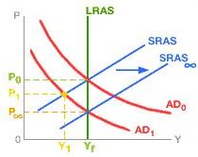
7. Which view of macroeconomic theory is shown in this graph?
Mainstream
Monetarist
New Keynesian
Supply-Side
MP: Does Economy Self-Correct?

Slide 28
7. Which view of macroeconomic theory is shown in this graph?
Mainstream
Monetarist
New Keynesian
Supply-Side
MP: Does Economy Self-Correct?

Slide 29
8. Which of the following is NOT one of the reasons that Mainstream economists believe wages are inflexible downwards?
Wage contracts
Minimum wage laws
Wage stabilization policies
Efficiency wage
MP: Does Economy Self-Correct?

Slide 30
8. Which of the following is NOT one of the reasons that Mainstream economists believe wages are inflexible downwards?
Wage contracts
Minimum wage laws
Wage stabilization policies
Efficiency wage
MP: Does Economy Self-Correct?

Slide 31
9. Which of the following is NOT a reason why an Efficiency Wage that is HIGHER than the market wage may LOWER a firm’s labor costs?
Rational expectations
Greater work effort
Lower supervision costs
Reduced job turnover
MP: Does Economy Self-Correct?

Slide 32
9. Which of the following is NOT a reason why an Efficiency Wage that is HIGHER than the market wage may LOWER a firm’s labor costs?
Rational expectations
Greater work effort
Lower supervision costs
Reduced job turnover
MP: Does Economy Self-Correct?

Slide 33
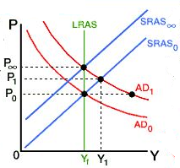
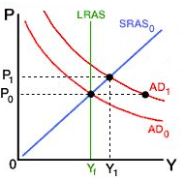
Mainstream View Monetarist View
MP: Does Economy Self-Correct?
If AD Increases:
NO YES

Slide 34
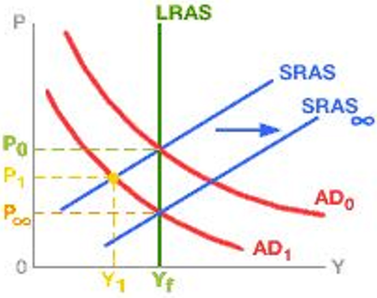
Mainstream View Monetarist View
MP: Does Economy Self-Correct?
If AD Decreases:
NO YES

Slide 35
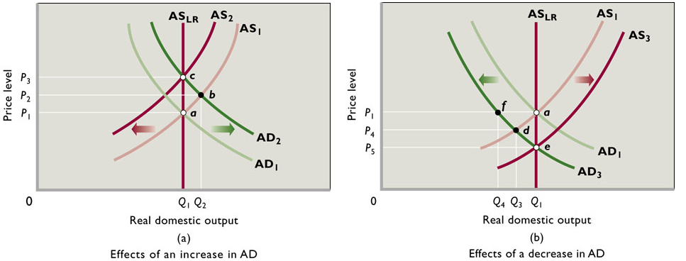
Monetarist View of Self Correction

Slide 36
16b – Other Monetary Policy Issues
Strengths and Shortcomings of monetary policy.
Compare Mainstream and Monetarist views:
Causes of Macroeconomic instability
Does the economy self-correct?
Rules or Discretion? (Should the Fed do anything?)

Slide 37
10. Which is correct about Mainstream (New Keynesian) economic theory?
Prices flexible down, gov’t should intervene
Prices flexible down, gov’t should not intervene
Prices inflexible down, gov’t should not intervene
Prices inflexible down, gov’t should intervene
MP: Rules or Discretion?

Slide 38
10. Which is correct about Mainstream (New Keynesian) economic theory?
Prices flexible down, gov’t should intervene
Prices flexible down, gov’t should not intervene
Prices inflexible down, gov’t should not intervene
Prices inflexible down, gov’t should intervene
MP: Rules or Discretion?

Slide 39
11. Which is correct about Monetarist (New Classical) economic theory?
Prices flexible, gov’t should intervene
Prices flexible, gov’t should not intervene
Prices inflexible, gov’t should not intervene
Prices inflexible, gov’t should intervene
MP: Rules or Discretion?

Slide 40
11. Which is correct about Monetarist (New Classical) economic theory?
Prices flexible, gov’t should intervene
Prices flexible, gov’t should not intervene
Prices inflexible, gov’t should not intervene
Prices inflexible, gov’t should intervene
MP: Rules or Discretion?

Slide 41
12. MV = PQ, What is PQ?
Real GDP
Nominal GDP
Price times Quantity
Money Supply
MP: Rules or Discretion?

Slide 42
12. MV = PQ, What is PQ?
Real GDP
Nominal GDP
Price times Quantity
Money Supply
MP: Rules or Discretion?

Slide 43
13. How do the Mainstream and Monetarist economists differ in the way they view the equation of exchange (MV=PQ)?
Mainstream: V unstable; equation unimportant Monetarism: V stable; equation important
Mainstream: V stable; equation unimportant Monetarism: V unstable; equation important
Mainstream: V unstable; equation important Monetarism: V stable; equation unimportant
Mainstream: V stable; equation unimportant Monetarism: V unstable; equation important
MP: Rules or Discretion?

Slide 44
13. How do the Mainstream and Monetarist economists differ in the way they view the equation of exchange (MV=PQ)?
Mainstream: V unstable; equation unimportant Monetarism: V stable; equation important
Mainstream: V stable; equation unimportant Monetarism: V unstable; equation important
Mainstream: V unstable; equation important Monetarism: V stable; equation unimportant
Mainstream: V stable; equation unimportant Monetarism: V unstable; equation important
MP: Rules or Discretion?

Slide 45
14. How do the Mainstream and Monetarist economists differ in the way they view the efficacy of MP in response to a change in AD?
Mainstream: MP not too effective; use it Monetarism: MP very effective; don’t use it
Mainstream: MP not too effective; don’t use it Monetarism: MP very effective; use it
Mainstream: MP very effective; use it Monetarism: MP not too effective; don’t use it
Mainstream: MP very effective; don’t use it Monetarism: MP not too effective; use it
MP: Rules or Discretion?

Slide 46
14. How do the Mainstream and Monetarist economists differ in the way they view the efficacy of MP in response to a change in AD?
Mainstream: MP not too effective; use it Monetarism: MP very effective; don’t use it
Mainstream: MP not too effective; don’t use it Monetarism: MP very effective; use it
Mainstream: MP very effective; use it Monetarism: MP not too effective; don’t use it
Mainstream: MP very effective; don’t use it Monetarism: MP not too effective; use it
MP: Rules or Discretion?

Slide 47
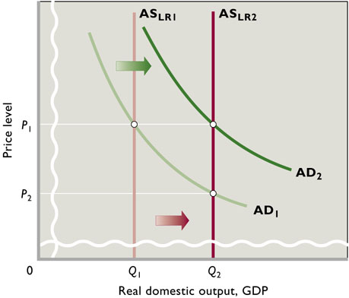
How the Monetary Rule Maintains Stable Prices
An increase in the long run AS would cause real GDP to increase. The Monetarists believe the Fed should then increase the MS to match the increase in GDP. This will increase AD and keep prices stable.
MP: Rules or Discretion?

Slide 48
15. When John Maynard Keynes said “in the long run we are all dead”, to what was he referring?
Cyclical Asymmetry
Prices are “sticky” downwards.
Equation of Exchange
Money Supply
MP: Rules or Discretion?

Slide 49
15. When John Maynard Keynes said “in the long run we are all dead”, to what was he referring?
Cyclical Asymmetry
Prices are “sticky” downwards.
Equation of Exchange
Money Supply
MP: Rules or Discretion?

Slide 50
Mainstream View Monetarist View
If AD Decreases:

Slide 51
Mainstream
Prices inflexible down
Favor gov’t policy
MP helps FP
Velocity unstable
Instability caused by shocks
Level of output depends on spending
GDP=C+Ig+G+Xn
Also called New Keynesian
Monetarist
Prices flexible down
No gov’t policy
Monetary Rule
Velocity stable
Instability caused by MP
Level of output depends on MS
MV = PQ
Also called New Classical, RET

Slide 52
MV = PQ
Mainstream
Since V is unstable MP is NOT effective, but it should be used.
Economy self corrects slowly
A discretionary easy MP can accommodate expansionary FP by reducing crowding out
Monetarist
Since V is stable MP is VERY effective and therefore it should NOT be used.
Economy self corrects quickly
The Fed should follow a monetary rule. No discretionary policy

