Slide 1
16a – Monetary Policy
This web quiz may appear as two pages on tablets and laptops.
I recommend that you view it as one page by clicking on the open book icon at the bottom of the page.

Slide 2
16a – Monetary Policy
Tools of the Fed
OMO (Open Market Operations)
DR (Discount Rate)
RR (Required Reserve Ration)
The Monetary Policy Cause Effect Chain

Slide 3
16a – Monetary Policy
Must Know / Outcomes:
List the principal assets and liabilities of the Federal Reserve Banks.
Explain how each of the three tools of monetary policy may be used by the Fed to expand and to contract the money supply.
Explain the relative importance of the monetary policy tools. (OMO most important)
Describe expansionary and contractionary monetary policies, and explain when, why, and how they are used.
Describe the relationship between the interest rate, expected rate of return, and investment and construct an investment demand curve.
Identify the factors (determinants) that may cause a shift in the investment-demand curve.
Explain the cause-effect chain between monetary policy and changes in equilibrium GDP.
Demonstrate graphically the money market and how a change in the money supply will affect the interest rate.
Show the effects of interest rate changes on investment spending.
Describe the impact of changes in investment on aggregate demand, equilibrium GDP, and UE, IN, and EG.
Describe how the Fed targets the Federal Funds Rate (Fed Funds) as part of its OMO monetary policy actions.
Listen to the first minute and ten seconds of the podcast below. Can you GRAPH what is happening in China? (The first two minutes are NOT about basketball in Cuba.) http://www.marketplace.org/topics/economy/podcast-basketball-heads-cuba

Slide 4
16a – Monetary Policy
KEY TERMS:
expected rate of return, investment demand, assets of the Federal Reserve banks, liabilities of the Federal Reserve banks, Federal Reserve notes, Open Market Operations (OMO), Discount Rate (DR), Required Reserve Ratio (RR), Federal funds rate (Fed funds)

Slide 5
The MP Cause Effect Chain: Easy MP

Slide 6
The MP Cause Effect Chain: Tight MP

Slide 7
Tools of the Fed
OMO (Open Market Operations)
DR (Discount Rate)
RR (Required Reserve Ratio)

Slide 8
1. Assume the RR is 20% and a $10 bill in deposited in a checking account of Bank A. How much does the money creation potential increase for Bank A and for the banking system?
Bank A’s $10; banking system’s $50
Bank A’s $8; banking system’s $40
Bank A’s $10; banking system’s $20
Bank A’s $8; banking system’s $20

Slide 9
1. Assume the RR is 20% and a $10 bill in deposited in a checking account of Bank A. How much does the money creation potential increase for Bank A and for the banking system?
Bank A’s $10; banking system’s $50
Bank A’s $8; banking system’s $40
Bank A’s $10; banking system’s $20
Bank A’s $8; banking system’s $20

Slide 10
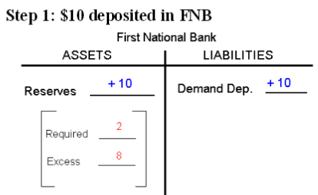
FORMULAS:
ER = Total Reserves - Req. Res (Bank A can increase MS by ER)
Change in MS = ER x Multiplier (Use for the “banking system”)
Money Multiplier = 1/RR

Slide 11
FORMULAS:
ER = Total Reserves - Req. Res
Change in MS = ER x Money Multiplier
Money Multiplier = 1/RR
IF: RR is 20% and a $10 bill in deposited:
Money Multiplier = 1/RR = 1/.20 = 5
Req. Res = RR x Liabilities = .20 x $10 = $2
ER = Total Reserves – Req. Res = $10 – $2 = $8
Change in MS = ER x Money Multiplier
Change in MS = $8 x 5 = $40.

Slide 12
2. Assume the RR is reduced to 10% and a $10 bill in deposited in a checking account of Bank A. How much does the money creation potential increase for Bank A and for the banking system?
Bank A’s $8; banking system’s $40
Bank A’s $8; banking system’s $80
Bank A’s $9; banking system’s $45
Bank A’s $9; banking system’s $90
Tools of the Fed: RR

Slide 13
2. Assume the RR is reduced to 10% and a $10 bill in deposited in a checking account of Bank A. How much does the money creation potential increase for Bank A and for the banking system?
Bank A’s $8; banking system’s $40
Bank A’s $8; banking system’s $80
Bank A’s $9; banking system’s $45
Bank A’s $9; banking system’s $90
Tools of the Fed: RR

Slide 14
FORMULAS:
Change in MS = ER x Money Multiplier
ER = Total Reserves - Req. Res
Money Multiplier = 1/RR
RR is reduced to 10% and a $10 bill in deposited
Money Multiplier = 1/RR = 1/.10 = 10
Req. Res = RR x Liabilities = .10 x $10 = $1
ER = Total Reserves – Req. Res = $10 – $1 = $9
Change in MS = ER x Money Multiplier
Change in MS = $9 x 10 = $90.
Tools of the Fed: RR

Slide 15
Tools of the Fed: RR
Changing the reserve ratio (RR) has two effects:
a. It affects the size of excess reserves.
RR 20% and $10 deposited: ER = 8
RR 10% and $10 deposited: ER = 9
b. It also changes the size of the monetary multiplier.
RR 20%: multiplier = 5
RR 10%: multiplier = 10
ER x money multiplier = Change in MS
8 x 5 = 50
9 x 10 = 90
Therefore it is very disruptive and is seldom used.

Slide 16
Tools of the Fed
OMO
DR
RR
Decrease in the RR increases ER and therefore increase the MS
Increase in the RR decreases ER and therefore decrease the MS

Slide 17
3. What are OMO?
The rate the Fed pays banks for their reserves
Overnight loans made by banks to other banks
The Fed buys or sells securities to change the MS
The fraction of liabilities that banks must keep
Tools of the Fed: OMO

Slide 18
3. What are OMO?
The rate the Fed pays banks for their reserves
Overnight loans made by banks to other banks
The Fed buys or sells securities to change the MS
The fraction of liabilities that banks must keep
Tools of the Fed: OMO

Slide 19
4. Which of the following is correct about the balance sheet of the Fed?
Securities are a liability
Reserves of banks are a liability
US treasury deposits are an asset
Loans to banks are a liability
Federal reserve notes are an asset
Tools of the Fed: OMO

Slide 20
4. Which of the following is correct about the balance sheet of the Fed?
Securities are a liability
Reserves of banks are a liability
US treasury deposits are an asset
Loans to banks are a liability
Federal reserve notes are an asset
Tools of the Fed: OMO

Slide 21
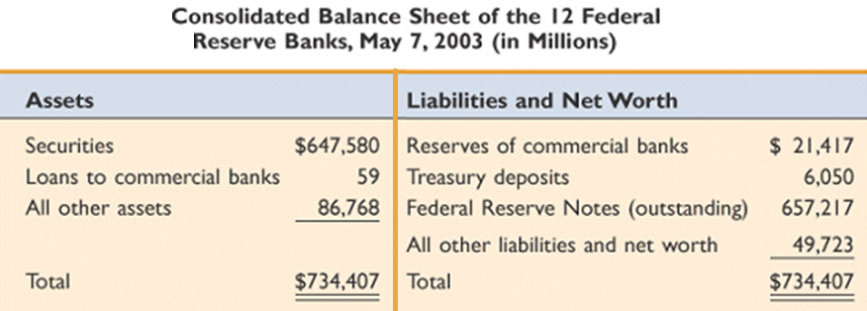

Slide 22
5. Assume that the Fed buys a $1000 bond (security) from COMMERCIAL BANKS (RR = 20%), What is the max. possible increase in the MS?
$200
$1000
$4000
$5000
$10,000
Tools of the Fed: OMO

Slide 23
5. Assume that the Fed buys a $1000 bond (security) from a COMMERCIAL BANKS (RR = 20%), What is the max. possible increase in the MS?
$200
$1000
$4000
$5000
$10,000
Tools of the Fed: OMO

Slide 24
FORMULAS:
Change in MS = ER x Money Multiplier
ER = Total Reserves - Req. Res
Money Multiplier = 1/RR
Fed buys a $1000 bond from a BANK (RR = 20%),
Money Multiplier = 1/RR = 1/.20 = 5
Req. Res = RR x Liabilities = .20 x $0 = $0
ER = Total Reserves – Req. Res = $1000 – $0 = $1000
Change in MS = ER x Money Multiplier
Change in MS = $1000 x 5 = $5000.
Tools of the Fed: OMO

Slide 25
6. Assume that the Fed buys a $1000 bond (security) from THE PUBLIC (RR = 20%), What is the max possible increase in the MS?
$200
$1000
$4000
$5000
$10,000
Tools of the Fed: OMO

Slide 26
6. Assume that the Fed buys a $1000 bond (security) from THE PUBLIC (RR = 20%), What is the max possible increase in the MS?
$200
$1000
$4000
$5000
$10,000
Tools of the Fed: OMO

Slide 27
FORMULAS:
Change in MS = ER x Money Multiplier
ER = Total Reserves - Req. Res
Money Multiplier = 1/RR
Fed buys a $1000 bond from PUBLIC (RR = 20%),
Money Multiplier = 1/RR = 1/.20 = 5
Req. Res = RR x Liabilities = .20 x $1000 = $200
ER = Total Reserves – Req. Res = $1000 – $200 = $800
Change in MS = ER x Money Multiplier
Change in MS = $800 x 5 = $4000.
PLUS the original $1000 deposited in bank by PUBLIC
Change in MS = $4000 + $1000 = $5000
Tools of the Fed: OMO

Slide 28
Tools of the Fed
OMO
BUY securities increases ER and therefore increase the MS
SELL securities decreases ER and therefore decrease the MS
DR
RR
Decrease in the RR increases ER and therefore increase the MS
Increase in the RR decreases ER and therefore decrease the MS

Slide 29
7. The Discount rate (DR) is charged by _______ to ________ for _________ .
The Fed / banks / loans
Banks / the Fed / reserves
Fed; banks; reserves
Banks / other banks / overnight loans
Tools of the Fed: DR

Slide 30
7. The Discount rate (DR) is charged by _______ to ________ for _________ .
The Fed / banks / loans
Banks / the Fed / reserves
Fed; banks; reserves
Banks / other banks / overnight loans
Tools of the Fed: DR

Slide 31
8. Assume the RR is 20% and the Fed lowers the DR which results in banks borrowing $10 billion. How much does this change the money creation potential for the banking system?
$10
$40
$50
$200
Tools of the Fed: DR

Slide 32
8. Assume the RR is 20% and the Fed lowers the DR which results in banks borrowing $10 billion. How much does this change the money creation potential for the banking system?
$10
$40
$50
$200
Tools of the Fed: DR

Slide 33
FORMULAS:
Change in MS = ER x Money Multiplier
ER = Total Reserves - Req. Res
Money Multiplier = 1/RR
RR is 20%, Fed lowers the DR, banks borrow $10
Money Multiplier = 1/RR = 1/.20 = 5
Req. Res = RR x Liabilities = .20 x $0 = $0
ER = Total Reserves – Req. Res =$10 – $0 = $10
Change in MS = ER x Money Multiplier
Change in MS = $10 x 5 = $50.
Tools of the Fed: DR

Slide 34
Tools of the Fed: DR
DISCOUNT RATE
Definition: the interest rate that the Fed charges to
commercial banks that borrow from the Fed.
An increase in the discount rate signals that borrowing
reserves is more difficult and will tend to shrink excess
reserves.
A decrease in the discount rate signals that borrowing reserves
will be easier and will tend to expand excess reserves.

Slide 35
Tools of the Fed
OMO
BUY securities increases ER and therefore increase the MS
SELL securities decreases ER and therefore decrease the MS
DR
Increase the DR decreases ER and therefore decrease the MS
Decrease the DR increases ER and therefore increase the MS
RR
Decrease in the RR increases ER and therefore increase the MS
Increase in the RR decreases ER and therefore decrease the MS

Slide 36
9. Which tool does the Fed use most often?
OMO
RR
DR
Tools of the Fed

Slide 37
9. Which tool does the Fed use most often?
OMO
RR
DR
Tools of the Fed

Slide 38
For several reasons, Fed uses open-market operations most often:
1. Open-market operations are most important. This decision is flexible because securities can be bought or sold quickly and in great quantities. Reserves change quickly in response.
2. The reserve ratio is rarely changed since this could destabilize bank’s lending and profit positions.
3. Changing the discount rate has little direct effect, since only 2-3 percent of bank reserves are borrowed from Fed. At best it has an "announcement effect" that signals direction of monetary policy.
Tools of the Fed

Slide 39
10. The Federal Funds interest rate (Fed. Funds) is charged by _______ to ________ for _________ .
The Fed / banks /overnight loans
Banks / the Fed / reserves
Fed / banks / reserves
Banks / other banks / overnight loans

Slide 40
10. The Federal Funds interest rate (Fed. Funds) is charged by _______ to ________ for _________ .
The Fed / banks /overnight loans
Banks / the Fed / reserves
Fed / banks / reserves
Banks / other banks / overnight loans

Slide 41
11. If you read that the Fed is raising the Fed funds rate then which tool are they using?
OMO
DR
RR

Slide 42
11. If you read that the Fed is raising the Fed funds rate then which tool are they using?
OMO
DR
RR

Slide 43
12. What is the CORRECT order?
Fed tool => ER => Interest Rate => MS => I=> AD
Fed tool => Interest Rate => ER => MS => I=> AD
Fed tool => ER => MS => Interest Rate => I=> AD
Fed tool => Interest Rate => MS => ER => I=> AD

Slide 44
12. What is the CORRECT order?
Fed tool => ER => Interest Rate => MS => I=> AD
Fed tool => Interest Rate => ER => MS => I=> AD
Fed tool => ER => MS => Interest Rate => I=> AD
Fed tool => Interest Rate => MS => ER => I=> AD

Slide 47
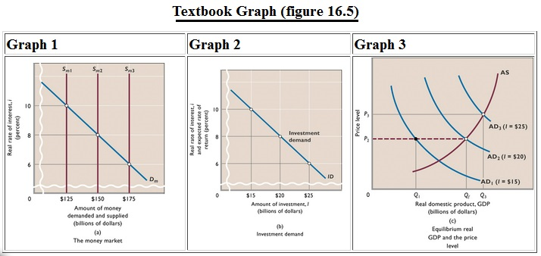

Slide 48
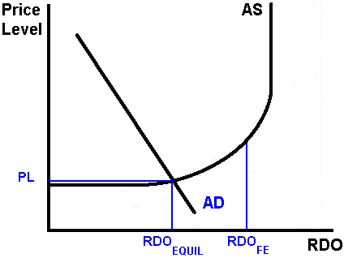
13. If the graph at the right represents the current economy, what should the Fed do?
Decrease the MS
Increase the DR
Increase the RR
Buy Securities

Slide 49
13. If the graph at the right represents the current economy, what should the Fed do?
Decrease the MS
Increase the DR
Increase the RR
Buy Securities

Slide 51
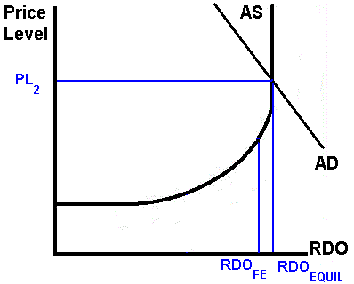
14. If the graph at the right represents the current economy, what should the Fed do?
Increase the MS
Decrease the DR
Increase the RR
Buy Securities

Slide 52
14. If the graph at the right represents the current economy, what should the Fed do?
Increase the MS
Decrease the DR
Increase the RR
Buy Securities

