Slide 1
MONETARY POLICY 14a – What is Money?
This web quiz may appear as two pages on tablets and laptops.
I recommend that you view it as one page by clicking on the open book icon at the bottom of the page.

Slide 2
MONETARY POLICY 14a – What is Money?
What is Money?
The Money Market Model: MD and MS
The Structure and Functions of the Federal Reserve and Banking Systems

Slide 3
MONETARY POLICY 14a – What is Money?
OUTCOMES
Why is money important? Why do we use money? Why do we care about money? What is wrong with barter?
What is money? How can cigarettes or beer be money?
List and explain the three functions of money.
Define the money supply M1, and near monies M2.
Identify two types of demand for money and the main determinant of each.
The money market graph: explain what is meant by equilibrium in the money market and the equilibrium rate of interest; what happens when there is a change in the money supply?
What causes interest rates to change?
Describe the structure of the U.S. banking system.
Explain why Federal Reserve Banks are central banks, quasi public banks, and bankers' banks.
Describe the functions of the Federal Reserve System and point out which role is the most important.

Slide 4
MONETARY POLICY 14a – What is Money?
KEY TERMS:
barter, coincidence of wants, money, medium of exchange, unit of account, store of value, commodity money, near demand, transactions demand, assemoney, liquidity, M1, M2, money supply, Federal Reserve notes, checkable deposits, money t demand, Federal Reserve System, Board of Governors, FOMC,

Slide 5
1. Why is money important?
Because gold is scarce
To assist a barter economy
It facilitates trade and promotes specialization
To avoid token money

Slide 6
1. Why is money important?
Because gold is scarce
To assist a barter economy
It facilitates trade and promotes specialization
To avoid token money

Slide 7
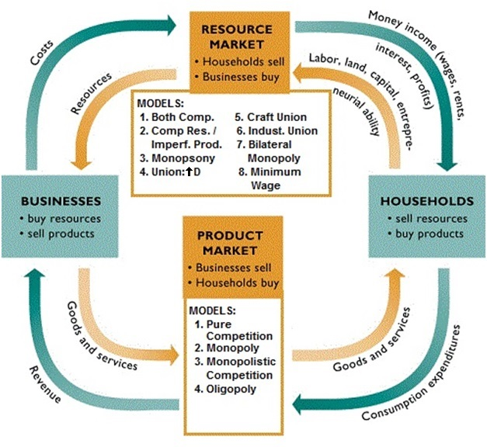

Slide 8
2. Which of the following has NOT been used as “money”?
Dollar bills
Checking account balances
Cigarettes
Gold
Credit Cards

Slide 9
2. Which of the following has NOT been used as “money”?
Dollar bills
Checking account balances
Cigarettes
Gold
Credit Cards

Slide 10
3. Which is NOT one of the functions of money?
Federal reserve note
Medium of exchange
Unit of account
Store of value

Slide 11
3. Which is NOT one of the functions of money?
Federal reserve note
Medium of exchange
Unit of account
Store of value

Slide 12
4. If I take $10 from my wallet and put it into my checking account, what happens to M1?
Increases
Decreases
Does not change

Slide 13
4. If I take $10 from my wallet and put it into my checking account, what happens to M1?
Increases
Decreases
Does not change

Slide 14
5. If I take $10 out of my wallet and put it into my savings account what happens to M1 and M2?
M1 decreases; M2 increases
M1 increases; M2 decreases
M1 stays the same; M2 increases
M1 decreases; M2 stays the same

Slide 15
5. If I take $10 out of my wallet and put it into my savings account what happens to M1 and M2?
M1 decreases; M2 increases
M1 increases; M2 decreases
M1 stays the same; M2 increases
M1 decreases; M2 stays the same

Slide 16
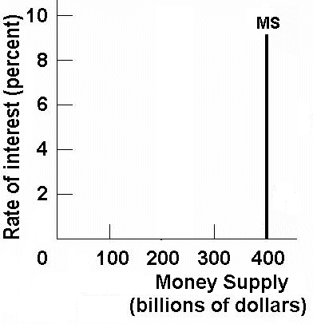
Money Supply Graph
The Money Supply (MS) is set by the
Federal Open Market Committee (FOMC)

Slide 17
6. What is money demand?
The demand for a higher wage
The demand for liquidity
The demand for gold
The demand for physical assets

Slide 18
6. What is money demand?
The demand for a higher wage
The demand for liquidity
The demand for gold
The demand for physical assets

Slide 19
7. What is D1?
Transactions demand for money
Asset demand for money
Total demand for money
Money supply

Slide 20
7. What is D1?
Transactions demand for money
Asset demand for money
Total demand for money
Money supply

Slide 21
Money Demand
Transactions Demand + Asset Demand = Total Demand for Money

Slide 22
8. If MD increases what will happen to interest rates?
Decrease
Increase
Stay the same

Slide 23
8. If MD increases what will happen to interest rates?
Decrease
Increase
Stay the same

Slide 24
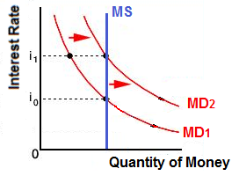
The Money Market

Slide 25
What would
cause an
increase in
money
demand?
ANSWER:
An increase in nominal GDP:
PL
rGDP

Slide 26
9. If MS increases what happens to interest rates?
Decrease
Increase
Stay the same

Slide 27
9. If MS increases what happens to interest rates?
Decrease
Increase
Stay the same

Slide 28
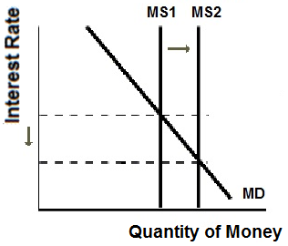
The Money Market

Slide 30
10. What is the FOMC?
Federal Operations Management Corporation
Federal Open Market Committee
Federal Operations Management Corporation
Federal Optimal Money Compliance
Federal Output Money Council

Slide 31
10. What is the FOMC?
Federal Operations Management Corporation
Federal Open Market Committee
Federal Operations Management Corporation
Federal Optimal Money Compliance
Federal Output Money Council

Slide 32
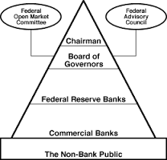
The Federal Reserve System

Slide 33
11. Which is NOT a function of the Fed?
Issuing currency
Making loans to banks
Being the government’s bank
Clearing checks for businesses
Collecting taxes
Controlling the money supply

Slide 34
11. Which is NOT a function of the Fed?
Issuing currency
Making loans to banks
Being the government’s bank
Clearing checks for businesses
Collecting taxes
Controlling the money supply

Slide 35
Functions of the Fed
issue currency = Federal Reserve Notes
setting reserve requirements or reserve ratios (RR see chapter 16)
3. lending money to banks and thrifts (the discount rate [DR] is the interest rate banks are charged for borrowing from the Fed)
4. providing for check collection
5. acting as fiscal agent for the US government
6. supervising banks
7. controlling the money supply

Slide 36
12. Who owns the Fed?
The Federal Government
Donald Trump
U.S. Banks
Citibank
US Treasury

Slide 37
12. Who owns the Fed?
The Federal Government
Donald Trump
U.S. Banks
Citibank
US Treasury

Slide 38
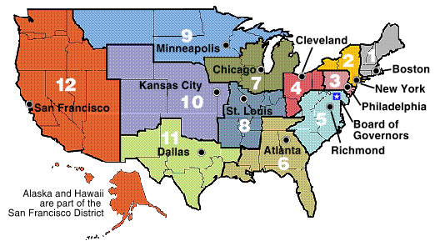
The 12 Federal Reserve Banks

Slide 39
The 12 Federal Reserve Banks
U. S. Central Bank
Quasi-Public Banks
Banker’s Banks (a bank for banks)

