Slide 1
13b – Other Fiscal Policy Issues and the Government Debt
This web quiz may appear as two pages on tablets and laptops.
I recommend that you view it as one page by clicking on the open book icon at the bottom of the page.

Slide 2
13b – Other Fiscal Policy Issues and the Debt
Other FP Issues
Policy in the Great Depression
New Keynesian and New Classical FP
Government Budget Deficits and Trade
The Federal Deficits and Debt
Facts
False Concerns
Substantive Issues

Slide 3
13b – Other Fiscal Policy Issues and the Debt
Outcomes / Must Know - 1:
- Discuss the causes of, and the government reaction to, the Great Depression.
- Explain the differences between the New Keynesian view of fiscal policy and the New Classical view

Slide 4
13b – The Debt
Outcomes / Must Know - 2:
Discuss the causes and government reaction to the Great Depression.
Explain the differences between the New Keynesian view of fiscal policy and the New Classical view
How does a budget deficit affect the trade deficit?
Vice President Walter Mondale in 1984 was running for president against President Ronald Reagan. During a debate he was asked what he would do about the large trade deficit of the time. His answer was that to reduce the trade deficit we need to reduce the budget deficit and he would raise taxes to do that. He was not elected president, but explain his argument.
Differentiate between the deficit and the debt.
State the relative size of the debt as a percentage of GDP and describe how that has changed in recent years.
Describe the annual interest charges on the debt, who holds the debt, and the impact of inflation on the debt.
Explain why the debt can also be considered public credit.
Identify and discuss two widely held "False Concerns" about the public debt.
Explain the "Substantive Issues" of the public debt including: income distribution, economic incentives, the foreign owned debt, crowding out, and public investments.
What effects might the Social Security and Medicare programs have on the public debt?
The Glass-Steagall Act has been repealed, income inequality is increasing, and the stock market is near an all-time high. Are we in danger of another great depression?
Will the public debt bankrupt the United States' government?
What effect would a constitutional amendment requiring the federal government balance its budget have on the effectiveness of fiscal policy? Hint: procyclical

Slide 5
13b – Other Fiscal Policy Issues and the Debt
KEY TERMS: New Keynesian, New Classical, Glass-Steagall, Smoot-Hawley Tariff Act, U.S. Securities, public deficits, public debt, public debt held by the public, intragovernmental debt, external public debt, crowding out, public investments, public-private complementarity, efficiency wage

Slide 6
1. According to the video which of the following was NOT a cause of the Great Depression (1929-1933)?
Unequal distribution of wealth
People borrowed money to buy stocks
A decrease in government spending
The stock market crash of 1929
NOTE: there is not complete agreement among
economists on what caused the Great Depression
Policy in the Great Depression

Slide 7
1. According to the video which of the following was NOT a cause of the Great Depression (1929-1933)?
Unequal distribution of wealth
People borrowed money to buy stocks
A decrease in government spending
The stock market crash of 1929
NOTE: there is not complete agreement among
economists on what caused the Great Depression
Policy in the Great Depression

Slide 9
2. During the early part of the Great Depression UE increased. What did the government do?
Cut taxes
Raised taxes
Restricted trade
Decreased the MS
2, 3, and 4 above
Policy in the Great Depression

Slide 10
2. During the early part of the Great Depression UE increased. What did the government do?
Cut taxes
Raised taxes
Restricted trade
Decreased the MS
2, 3, and 4 above
Policy in the Great Depression

Slide 11
Policy
in the
Great
Depression

Slide 12
3. Which of these did NOT contribute to ending the Great Depression?
FDR’s New Deal spending programs
WWII
Raising taxes to pay for WWII
Unemployment insurance
NOTE: there is not complete agreement among
economists on what ended the Great Depression
Policy in the Great Depression

Slide 13
3. Which of these did NOT contribute to ending the Great Depression?
FDR’s New Deal spending programs
WWII
Raising taxes to pay for WWII
Unemployment insurance
NOTE: there is not complete agreement among
economists on what ended the Great Depression
Policy in the Great Depression

Slide 14
In 1932, Franklin D. Roosevelt was elected President based on his promises to create Federal Government programs to end the Great Depression.
Within 100 days the New Deal was signed into law. This created 42 new agencies designed to create jobs, allow unionization, and provide unemployment insurance.
Many of these programs, such as Social Security, the SEC (Securities and Exchange Commission), and FDIC (Federal Deposit Insurance Corporation) are still here today, helping to safeguard the economy.

Slide 15
The Glass-Steagall Act - 1
Passed in 1933 as the Banking Act, prohibited commercial banks from participating in the investment banking business.
The Act was passed as an emergency measure to counter the failure of almost 5,000 banks during the Great Depression. The Glass-Steagall lost its potency in subsequent decades and was finally repealed in 1999.

Slide 16
The Glass-Steagall Act - 2
Many commentators have stated that the repeal of the Glass–Steagall Act was an important cause of the late-2000s financial crisis.
Some critics of that repeal argue it permitted Wall Street investment banking firms to gamble with their depositors' money that was held in affiliated commercial banks.

Slide 17
The Glass-Steagall Act - 3
Others have argued that the activities linked to the financial crisis were not prohibited (or, in most cases, even regulated) by the Glass–Steagall Act.
Commentators, including former President Clinton in 2008 and the American Bankers Association in January 2010, have also argued that the ability of commercial banking firms to acquire securities firms (and of securities firms to convert into bank holding companies) helped mitigate the financial crisis.

Slide 18
4. What is the likely effect of an increase in government spending if prices and wages are very flexible?
Both output and prices will rise.
Output will rise, and prices will remain unchanged
Both output and prices will fall.
Prices will rise, and output will remain unchanged.
New Keynesian and New Classical FP

Slide 19
4. What is the likely effect of an increase in government spending if prices and wages are very flexible?
Both output and prices will rise.
Output will rise, and prices will remain unchanged
Both output and prices will fall.
Prices will rise, and output will remain unchanged.
New Keynesian and New Classical FP

Slide 20
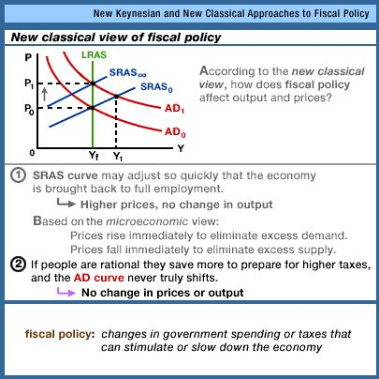
New
Keynesian
and New
Classical FP

Slide 21
5. According to New Keynesians, fiscal policy can have an effect on output because of which of the following factors?
Wages are sticky.
Prices adjust instantly.
Producers cut back production when faced with rising prices
People save more when government spending increases.
New Keynesian and New Classical FP

Slide 22
5. According to New Keynesians, fiscal policy can have an effect on output because of which of the following factors?
Wages are sticky.
Prices adjust instantly.
Producers cut back production when faced with rising prices
People save more when government spending increases.
New Keynesian and New Classical FP

Slide 23
New
Keynesian
and New
Classical FP

Slide 24
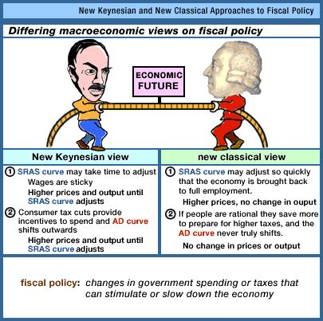
New
Keynesian
and New
Classical FP

Slide 25
6. Which is NOT one of the reason, believed by the Mainstream economists, why wages are “sticky downwards”?
Wage Contracts
Minimum Wage
Efficiency Wage
Wages Limits
Why might wages be “sticky downwards”? New Keynesian View

Slide 26
6. Which is NOT one of the reason, believed by the Mainstream economists, why wages are “sticky downwards”?
Wage Contracts
Minimum Wage
Efficiency Wage
Wages Limits
Why might wages be “sticky downwards”? New Keynesian View

Slide 27
Efficiency Wages: How can a higher wage result in greater efficiency?
Greater work effort The above-market wage, in effect, raises the cost to workers of losing their jobs as a result of poor performance. Because workers have a strong incentive to retain their relatively high-paying jobs, they are more likely to provide greater work effort. Looked at differently, workers are more reluctant to shirk (neglect or avoid work) because the higher wage makes job loss more costly to them. Consequently, the above-market wage can be the efficient wage; it can enhance worker productivity so much that the higher wage more than pays for itself.
Lower supervision costs With less incentive among workers to shirk, the firm needs fewer supervisory personnel to monitor work performance. This, too, can lower the firm's overall wage cost per unit of output.
Reduced job turnover The above-market pay discourages workers from voluntarily leaving their jobs. The lower turnover rate reduces the firm's cost of hiring and training workers. It also gives the firm a more experienced, more productive workforce.
Why might wages be “sticky downwards”? New Keynesian View

Slide 28
How can a higher wage result in greater efficiency?
The key implication for macroeconomic instability is that efficiency wages add to the downward inflexibility of wages. Firms that pay efficiency wages will be reluctant to cut wages when aggregate demand declines, since such cuts may encourage shirking, require more supervisory personnel, and increase turnover. In other words, wage cuts that reduce productivity and raise per-unit labor costs are self-defeating.
Why might wages be “sticky downwards”? New Keynesian View

Slide 29
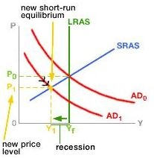
If wages are inflexible downwards:
A decrease in AD
will not cause lower
wages and therefore
will not cause a
quick increase in AS
And will not return the economy to
full employment.
Why might wages be “sticky downwards”? New Keynesian View

Slide 30
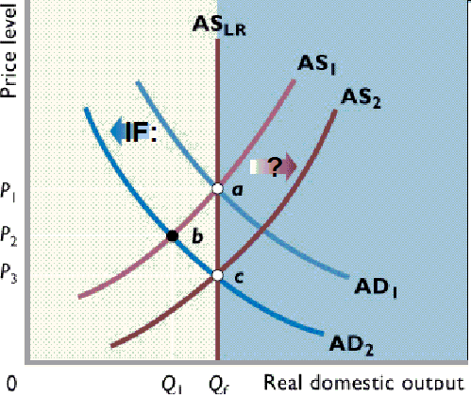
If wages are inflexible downwards:
A decrease in AD
will not cause lower
wages and therefore
will not cause a
quick increase in AS
And will not return the economy to
full employment.
Why might wages be “sticky downwards”? New Keynesian View

Slide 31
7. Expansionary FP can lead to budget deficits. How do budget deficits affect trade?
Budget deficits cause lower interest rates and the $ depreciates
Budget deficits cause lower interest rates and the $ appreciates
Budget deficits cause higher interest rates and the $ depreciates
Budget deficits cause higher interest rates and the $ appreciates
Government Budget Deficits and Trade

Slide 32
7. Expansionary FP can lead to budget deficits. How do budget deficits affect trade?
Budget deficits cause lower interest rates and the $ depreciates
Budget deficits cause lower interest rates and the $ appreciates
Budget deficits cause higher interest rates and the $ depreciates
Budget deficits cause higher interest rates and the $ appreciates
Government Budget Deficits and Trade

Slide 33
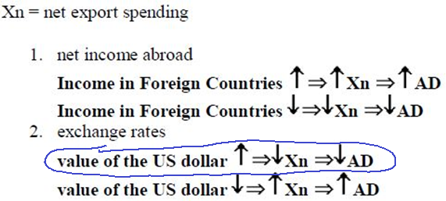
Government Budget Deficits and Trade

Slide 34
Vice President Walter Mondale in 1984 was running for president against President Ronald Reagan. During a debate he was asked what he would do about the large trade deficit of the time. His answer was that to reduce the trade deficit we need to reduce the budget deficit and he would raise taxes to do that.
Government Budget Deficits and Trade

Slide 35
8. What is the approximate size of the U.S government debt (public debt)?
$ 5 trillion
$ 8 trillion
$ 15 trillion
$ 21 trillion
$ 25 trillion
http://www.usdebtclock.org/
Federal Deficits and Debt: Facts

Slide 36
8. What is the approximate size of the U.S government debt (public debt)?
$ 5 trillion
$ 8 trillion
$ 15 trillion
$ 21 trillion
$ 25 trillion
http://www.usdebtclock.org/
Federal Deficits and Debt: Facts

Slide 37
2012: Total debt held outside the federal gov’t= 60%
33% foreign owned (China owns about a quarter, Japan a fifth)
10% owned by banks, etc.
6% owned by US individuals
11% Other including state and local gov/t
2012: Debt held within the federal gov’t* = 40%
29% US government agencies
11% Federal Reserve
*government securities held by government trust funds, such as the Social Security trust fund and the Medicare trust fund, and the Federal Reserve
Federal Deficits and Debt: Facts

Slide 38
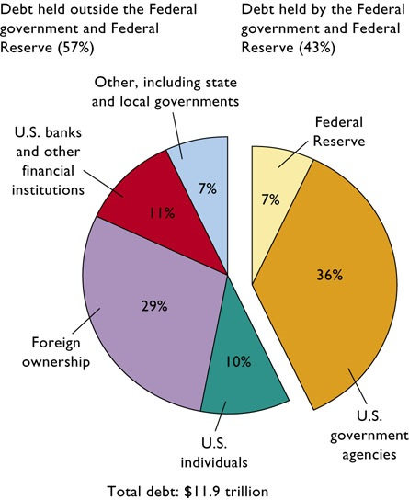
2009
Federal Deficits
and Debt:
Facts

Slide 39
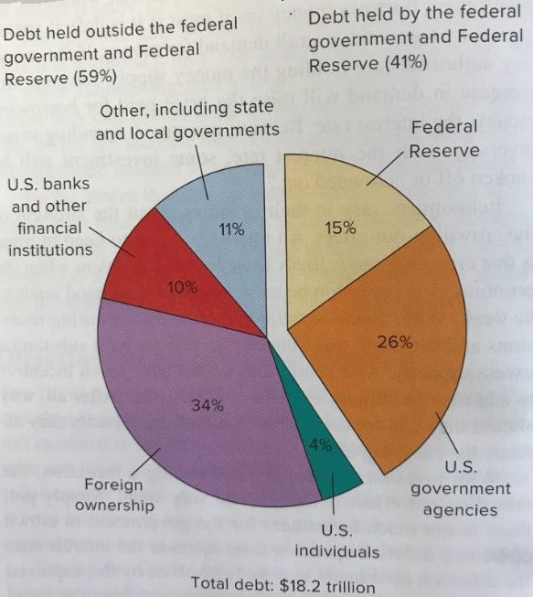
2015
Federal Deficits
and Debt:
Facts

Slide 40
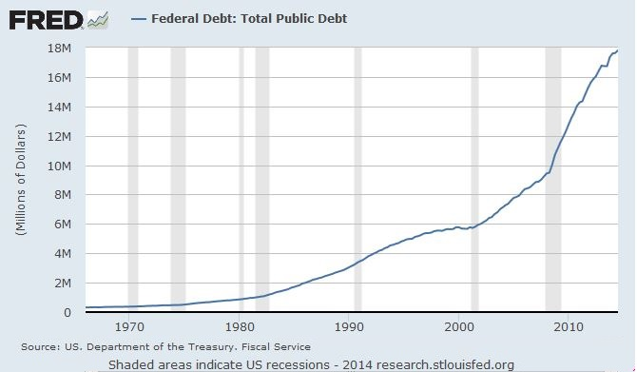
Federal Deficits and Debt: Facts

Slide 41
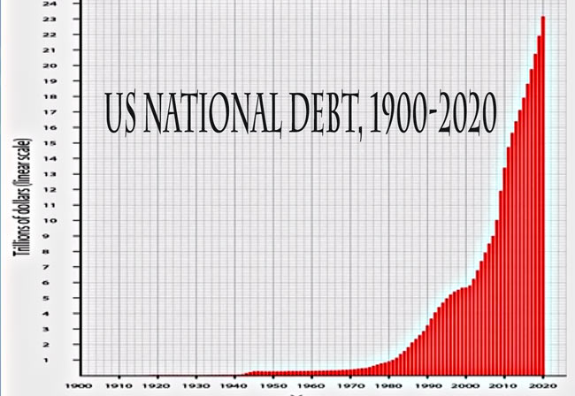
Federal Deficits and Debt: Facts

Slide 42
9. Who is more in debt, a person with what income and what debt?
Income = $1,000,000; debt = $500,000
Income = $100,000; debt = $50,000
Income = $10,000; debt = $5,000
Income = $10,000; debt = $8,000
Federal Deficits and Debt: Facts

Slide 43
9. Who is more in debt, a person with what income and what debt?
Income = $1,000,000; debt = $500,000
Income = $100,000; debt = $50,000
Income = $10,000; debt = $5,000
Income = $10,000; debt = $8,000
Federal Deficits and Debt: Facts

Slide 44
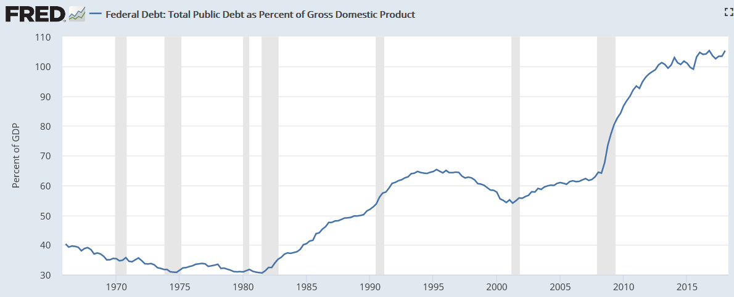
U.S. Total Debt as a Percent of GDP
Federal Deficits and Debt: Facts

Slide 45
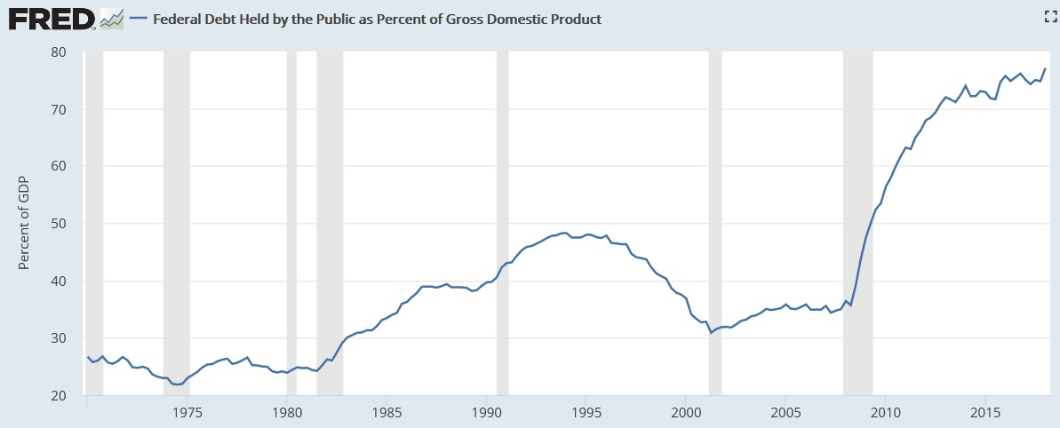
U.S. Debt Held by Public as a Percent of GDP
Federal Deficits and Debt: Facts

Slide 46
Government Debt as a % of GDP
United States http://visual.ly/united-states-debt-percentage-gdp-1940-2012
Other Countries
http://www.nationmaster.com/country-info/stats/Economy/Debt/Government-debt/Gross-government-debt-as-%25-of-GDP
Federal Deficits and Debt: Facts

Slide 47
10. Which of the following are “False concerns” regarding the public debt?
Income distribution and crowding-out
Gov’t bankruptcy and burden on future generations
Distortion of incentives and debt owned to foreigners
Public investment and public-private complementarities
Federal Deficits and Debt: False Concerns

Slide 48
10. Which of the following are “False concerns” regarding the public debt?
Income distribution and crowding-out
Gov’t bankruptcy and burden on future generations
Distortion of incentives and debt owned to foreigners
Public investment and public-private complementarities
Federal Deficits and Debt: False Concerns

Slide 49
11. Which is NOT a substantive issue concerning the large federal government debt?
The debt held by U.S. citizens
Income distribution
incentives
Foreign-owned public debt
Crowding out effect
Federal Deficits and Debt: Substantive Issues

Slide 50
11. Which is NOT a substantive issue concerning the large federal government debt?
The debt held by the U.S. citizens
Income distribution
incentives
Foreign-owned public debt
Crowding out effect
Federal Deficits and Debt: Substantive Issues

Slide 51
Federal Deficits and Debt: Substantive Issues
Income Distribution: payment of interest on the
publically held public debt transfers income from the tax payers to the bond holders
Incentives: higher taxes to pay interest on the debt may reduce incentives to work, innovate, and invest
Foreign-Owned Public Debt: payment of interest on the 33% of the debt owned by foreigners is not “paying ourselves”.
Crowding Out: caused by higher interest rates may reduce private investment

Slide 52
BUT, there are some positive aspects of government borrowing even with crowding out.
If borrowing is for public investment that causes the economy to grow more in the future, the burden on future generations will be less than if the government had not borrowed for this purpose.
Public investment makes private investment more attractive. For example, new federal buildings generate private business; good highways help private shipping, etc. Called “public-private complementarity”
Federal Deficits and Debt: Substantive Issues

Slide 53
The Future
The Budget and Economic Outlook: 2018 to 2028
If current laws governing taxes and spending generally remained unchanged, the federal budget deficit would grow substantially over the next few years, CBO projects, with accumulating deficits driving debt held by the public to nearly 100 percent of GDP by 2028. That amount would be far greater than the debt in any year since just after World War II. The debt is now about 77 percent of GDP.
Federal Deficits and Debt: Substantive Issues

