Slide 1

13a – Fiscal Policy
This web quiz may appear as two pages on tablets and laptops.
I recommend that you view it as one page by clicking on the open book icon at the bottom of the page.

Slide 2
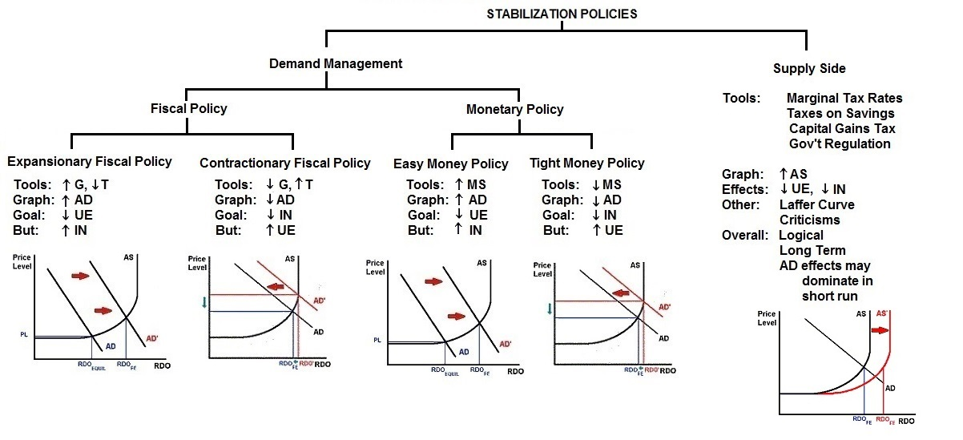
13a – Government Economic Policies

Slide 3
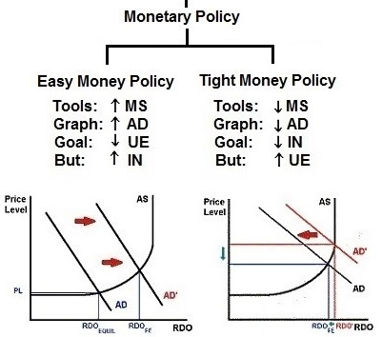
Monetary Policy

Slide 4
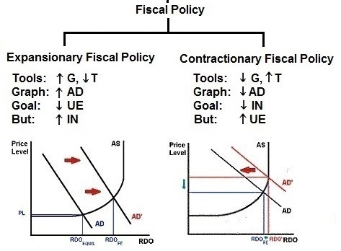
13a – Fiscal Policy – Lesson 12c

Slide 5
HOW MUCH?
13a – Fiscal Policy – Chapter 13

Slide 6
13a – Fiscal Policy
Review Simple Multiplier
Review Complex (actual) multiplier
Review multiplier with inflation
Government Spending Multiplier
Lump-Sum Tax Multiplier
Balanced Budget Multiplier
Multiplier with Crowding Out
Built-In Stability (Automatic Stabilizers) and the Cyclically Adjusted Budget
Fiscal Policy: Problems, Criticisms, and Complication
Supply-Side Fiscal Policy

Slide 7
13a – Fiscal Policy - 1
Outcomes / What you should learn:
  We know that GDP = C + Ig + G + Xn.
  If at full employment GDP would equal $500 billion, but it is currently at $400 billion, then what increase in government purchases (G) are needed to achieve full employment? MPC=0.8
  Explain expansionary and contractionary fiscal policy and its effects on the economy and Federal budget.
  Compare and explain the difference between the government spending multiplier and the lump-sum tax multiplier
  What is the balanced budget multiplier and why is it equal to one?
  If we increase government spending by $500 million AND raise taxes by $500 million to pay for the additional spending. What will happen to real GDP?
  Explain how the multiplier effect is weakened when there is demand-pull inflation.
  Explain how crowding out affects the multiplier.

Slide 8
13a – Fiscal Policy -2
Outcomes / What you should learn:
  Describe supply-side fiscal policy and its affect on the multiplier
  Some politicians say that if you CUT tax rates then the government will collect MORE in tax revenue. Explain.
  Explain how built in stabilizers help eliminate recession or inflation.
  Explain the differential impacts of progressive, proportional, and regressive taxes on the built in stabilzers.
  Explain the significance of the "cyclically-adjusted budget" concept.
  Describe recent U.S. fiscal policy actions and the motivation behind them.
  List and define three timing problems encountered with fiscal policy
  State political problems that limit effective fiscal policy and explain the "political business cycle".
  Identify actions by state and local governments that can offset fiscal policy.

Slide 9
13a – Fiscal Policy
KEY TERMS:
fiscal policy (FP), discretionary fiscal policy, expansionary FP, contractionary FP,
lump-sum tax multiplier,
"balanced budget" multiplier,
built-in stabilizers, tax progressivity,
cyclically-adjusted (full employment or standardized) budget, cyclical deficit, crowding-out effect,
monetary policy accommodation,
supply-side FP, recognition lag,
administrative lag, operational lag,
political business cycle, pro-cyclical policy, counter-cyclical policy, Laffer curve

Slide 10
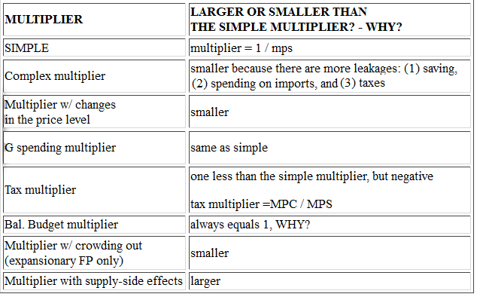
MULTIPLIERS (Lesson 10a)

Slide 11
10a Review. Assume no government and no foreign sector.
If MPC is 0.6 and investment spending increases by $100 billion, what happens to GDP?
GDP increases by $100 billion
GDP decreases by $100 billion
GDP increases by $250 billion
GDP increases by $600 billion
The Simple Multiplier

Slide 12
10a Review. Assume no government and no foreign sector.
If MPC is 0.6 and investment spending increases by $100 billion, what happens to GDP?
GDP increases by $100 billion
GDP decreases by $100 billion
GDP increases by $250 billion
GDP increases by $600 billion
g
GDP = I x multiplier
Multiplier = 1/MPS = 1/.4
GDP = 100 x 2.5
The Simple Multiplier

Slide 13
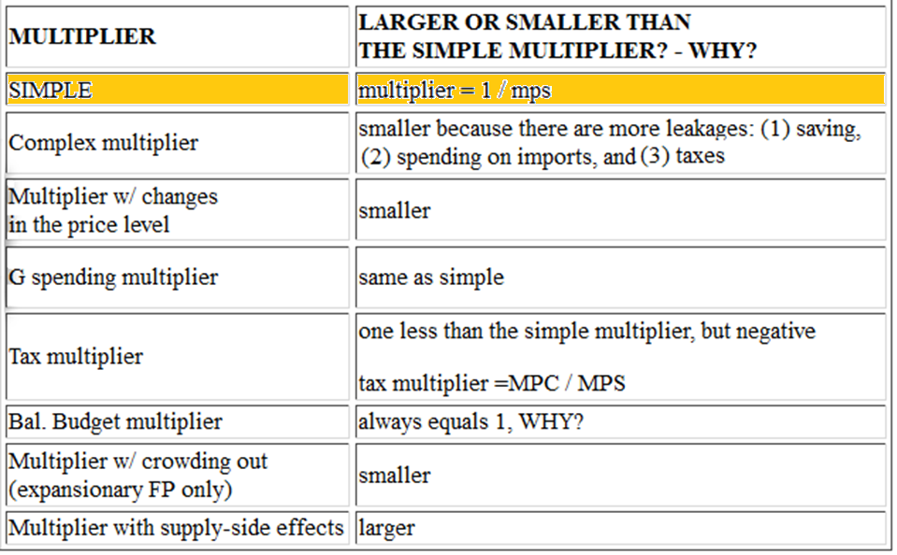
SIMPLE MULTIPLIER (Lesson 10a)

Slide 14
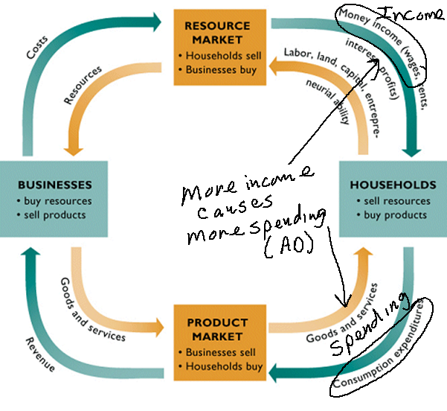
10a The Complex Multiplier
Adding Government and the Foreign Sector
The Income-Expenditure stream:
Income becomes consumption expenditures (which is AD), but . . . . .

Slide 15
10a - 14. We have been ignoring leakages from the Income = Expenditure stream. Leakages will reduce consumption expenditures.
(What else can we do with our income besides spend it?)
Which of the following is NOT a Leakage?
Savings (S)
Investment (I)
Taxes (T)
Imports (M)
The Complex Multiplier

Slide 16
10a - 14. We have been ignoring leakages from the Income = Expenditure stream. Leakages will reduce consumption expenditures.
(What else can we do with our income besides spend it?)
Which of the following is NOT a Leakage?
Savings (S)
Investment (I)
Taxes (T)
Imports (M)
The Complex Multiplier

Slide 17
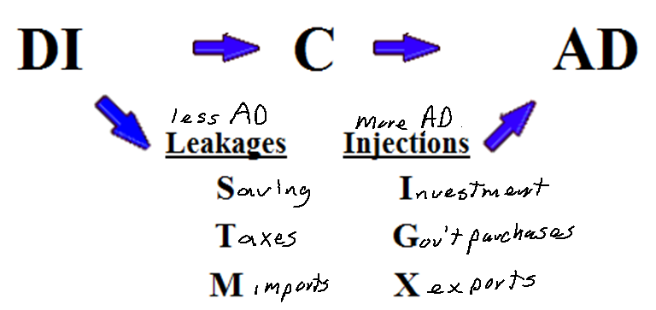
Disposable Income Becomes Spending (AD), but . . .
There are leakages AND additional spending
The Complex Multiplier

Slide 18
15. If we add taxes and imports to our model then what happens to the size of the multiplier?
It increases
It decreases
It doesn’t change
The Complex Multiplier

Slide 19
15. If we add taxes and imports to our model then what happens to the size of the multiplier?
It increases
It decreases
It doesn’t change
The Complex Multiplier

Slide 20
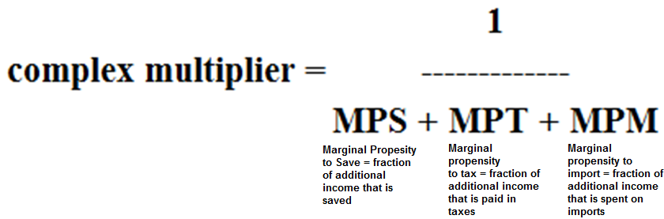
In the real world, with these additional leakages, the size of the multiplier is smaller than the simple multiplier.
The Complex Multiplier

Slide 21
Assume there IS government and there IS a foreign sector.
If MPC is 0.6 and investment spending increases by $100 billion, what happens to GDP?
GDP increases by $250 billion
GDP in creases by more than $250 billion
GDP increases by less than $250 billion
The Complex Multiplier

Slide 22
Assume there IS government and there IS a foreign sector.
If MPC is 0.6 and investment spending increases by $100 billion, what happens to GDP?
GDP increases by $250 billion
GDP in creases by more than $250 billion
GDP increases by less than $250 billion
The Complex Multiplier

Slide 23
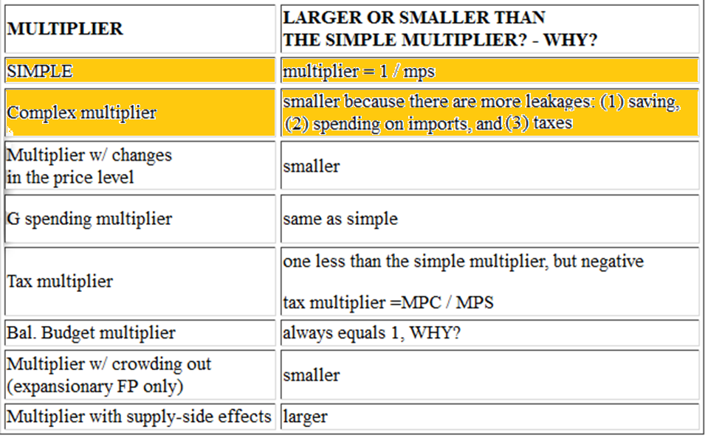
COMPLEX MULTIPLIER (Lesson 10a)

Slide 24
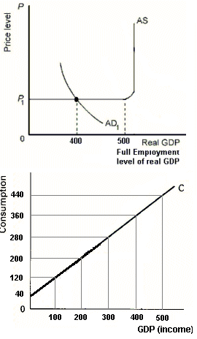
16. What change in G needed to achieve FE? (We will use the simple multiplier for government spending unless told otherwise)
$ 100
$ 80
$ 40
$ 20
The Government Spending Multiplier

Slide 25
16. What change in G needed to achieve FE? (We will use the simple multiplier for government spending unless told otherwise)
$ 100
$ 80
$ 40
$ 20
The Government Spending Multiplier

Slide 26
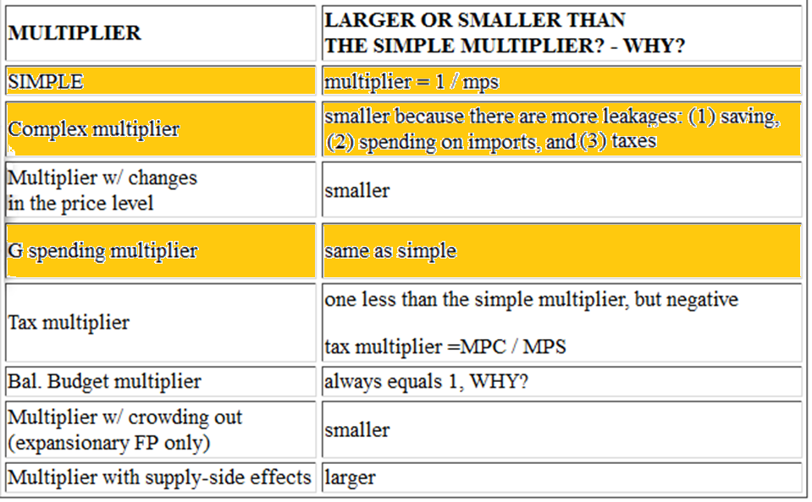
GOV’T SPENDING MULTIPLIER

Slide 27
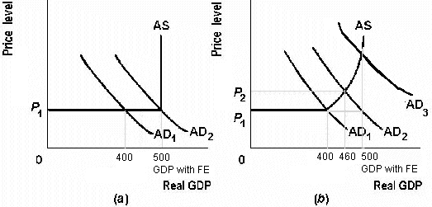
But what is the multiplier if there is inflation?
NO INFLATION INFLATION OCCURS
The Multiplier with Changes in the Price Level

Slide 28
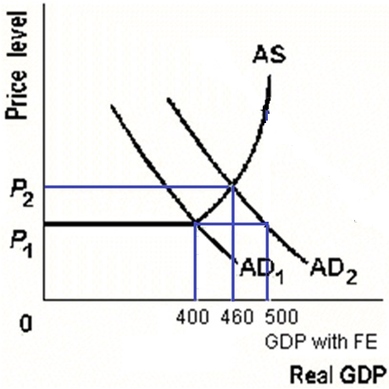
17. So, if MPC =.8, and G increases by $20, AND THERE IS INFLATION, what is the multiplier in the graph at right?
1
2
3
4
5
The Multiplier with Changes in the Price Level

Slide 29
17. So, if MPC =.8, and G increases by $20, AND THERE IS INFLATION, what is the multiplier in the graph at right?
1
2
3
4
5
X GDP = X G x multiplier
60 = 20 x multiplier
60 = 20 x 3
The Multiplier with Changes in the Price Level

Slide 30
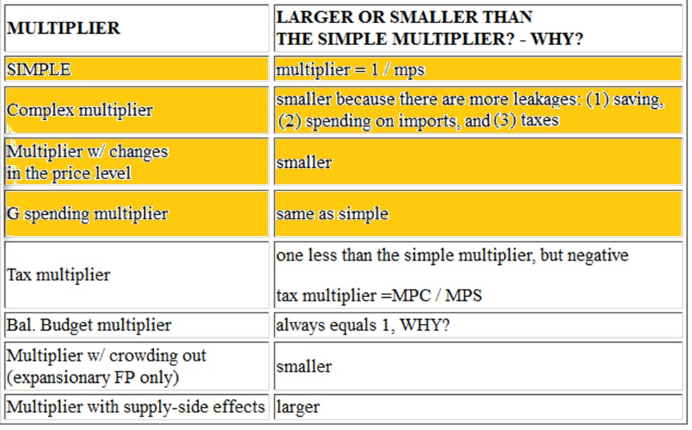
MULTIPLIERS (Lesson 10a)

Slide 31
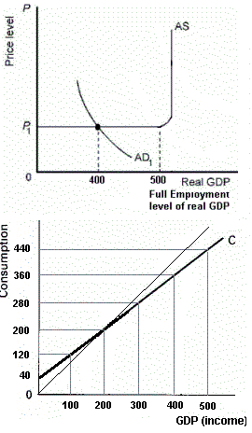
1. What increase in G is needed to achieve full employment?
$ 100
$ 50
$ 25
$ 20
The Government
Spending Multiplier

Slide 32
1. What increase in G is needed to achieve full employment?
$ 100
$ 50
$ 25
$ 20
X GDP = X G x multiplier
100 = X G x 5
100 = 20 x 5
Multiplier = 1/MPS
MPC = X C / X Y
MPC = 80 / 100 = .8
MPC + MPS = 1
.8 + MPS = 1
.8 + .2 = 1
The Government
Spending Multiplier

Slide 33
2. What decrease in taxes is needed to achieve full employment?
$ 100
$ 50
$ 25
$ 20
The Lump-Sum
Tax Multiplier

Slide 34
2. What decrease in taxes is needed to achieve full employment?
X GDP = X T x tax multiplier
100 = X T x -4
100 = -25 x -4
Tax mult = - MPC / MPS
Tax mult. = -.8 / .2 = -4
OR
Tax mult. = one less than
the simple multiplier
but negative
$ 100
$ 50
$ 25
$ 20
The Lump-Sum
Tax Multiplier

Slide 35
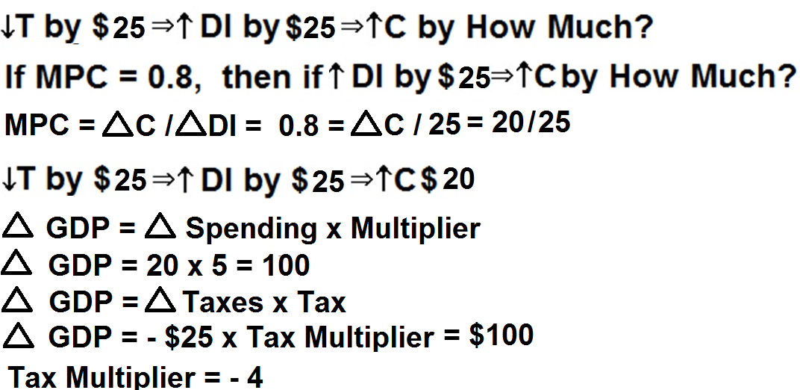
The Lump-Sum Tax Multiplier
The Lump-Sum Tax Multiplier

Slide 36
Tax Multiplier = - MPC / MPS
or
Tax Multiplier is always one
less than the simple multiplier
but negative
The Lump-Sum Tax Multiplier

Slide 37
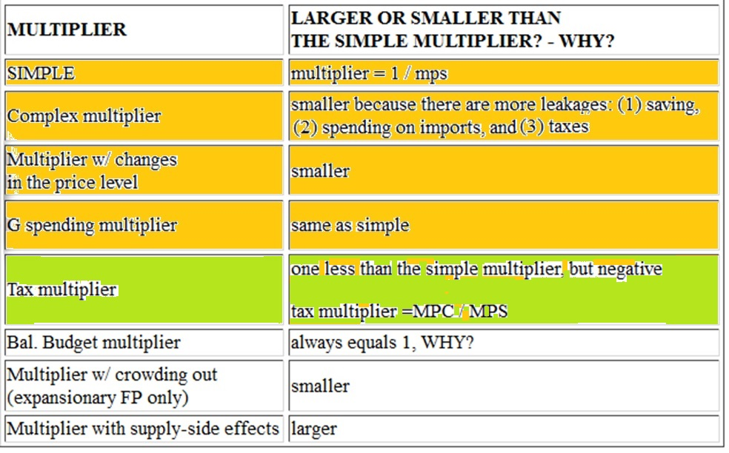
The Lump-Sum Tax Multiplier

Slide 38
3. If MPC = 2/3 and taxes decrease by $10, how much will the AD curve to the right?
$ 10
$ 20
$ 25
$ 30
The Lump-SumTax Multiplier

Slide 39
3. If MPC = 2/3 and taxes decrease by $10, how much will the AD curve to the right?
$ 10
$ 20
$ 25
$ 30
X GDP = X T x tax mult.
X GDP = -10 x -2
20 = -10 x -2
Simple mult = 1 / MPS) = 1/ (1-MPC)
Simple mult = 1 / (1/3) = 3
Tax mult = one less than the simple
multiplier but negative
Tax mult = -2
The Lump-SumTax Multiplier

Slide 40
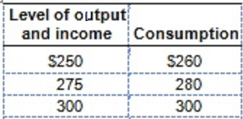
4. If a tax of $5 is added, what is the new C schedule?
Current schedule:
260, 280, 300
255; 275; 295
256; 276; 296
260; 280; 300
266; 286; 306
The Lump-Sum Tax Multiplier

Slide 41
4. If a tax of $5 is added, what is the new C schedule?
Current schedule:
260, 280, 300
See next slide for how to get the answer
See Yellow Pages for another problem
255; 275; 295
256; 276; 296
260; 280; 300
266; 286; 306
The Lump-Sum Tax Multiplier

Slide 42
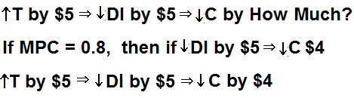
How taxes affect Consumption, or
Why taxes have a smaller multiplier
MPC = change in C/change in Y = 0.8 = ?/ 5 = 4/5
See Yellow Pages for an additional example
The Lump-Sum Tax Multiplier

Slide 43
5. MPC is 0.75, GDP is $200, full employment GDP is $320. What change in G is needed to achieve full employment? What change in T?
Increase G=$120; Decrease T=$120
Increase G=$120; Decrease T=$140
Increase G=$25; Decrease T=$30
Increase G=$30; Decrease T=$40
The G Multiplier and the Lump-Sum Tax Multiplier

Slide 44
5. MPC is 0.75, GDP is $200, full employment GDP is $320. What change in G is needed to achieve full employment? What change in T?
Increase G=$120; Decrease T=$120
Increase G=$120; Decrease T=$140
Increase G=$25; Decrease T=$30
Increase G=$30; Decrease T=$40
The G Multiplier and the Lump-Sum Tax Multiplier

Slide 45
Expansionary FP tends to cause budget deficits
(G up, T down).
What if politicians don’t want to increase the budget deficit?
What if they increased G and T by the SAME AMOUNT so that the budget deficit does not grow?
Will this change AD and GDP?
The Balanced Budget Multiplier

Slide 46
6. What equal change in G and T would achieve FE? Increase BOTH by _____?
$ 20
$ 25
$ 50
$100
The Balanced
Budget Multiplier

Slide 47
6. What equal change in G and T would achieve FE? Increase BOTH by _____?
$ 20
$ 25
$ 50
$100
The Balanced
Budget Multiplier

Slide 48
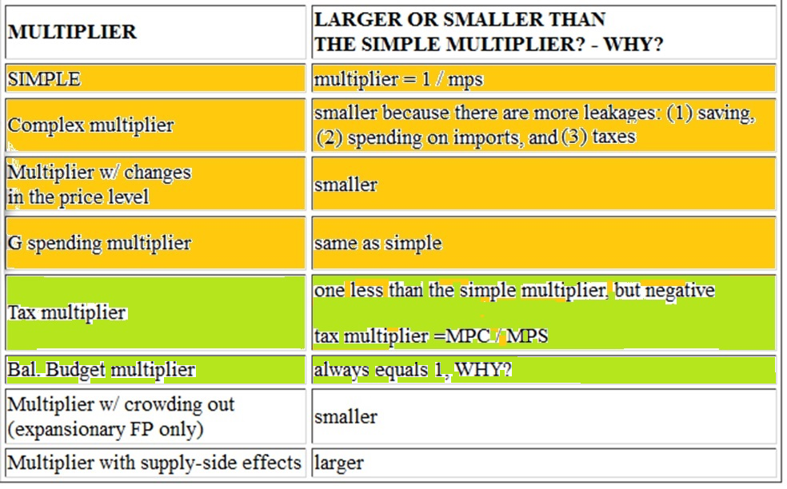
MULTIPLIERS

Slide 49
7. If MPC equals 0.9 and both G and T decrease by $50, How would AD shift?
Left by $50
Right by $50
Left by $500
Right by $500
The Balanced Budget Multiplier

Slide 50
7. If MPC equals 0.9 and both G and T decrease by $50, How would AD shift?
Left by $50
Right by $50
Left by $500
Right by $500
The Balanced Budget Multiplier

Slide 51
Expansionary FP increases AD.
But, it also causes budget deficits, therefore the government must borrow.
This borrowing increases the demand for loanable funds and will therefore will raise interest rates.
An increase in interest rates will decrease Investment (I).
A decrease in I will decrease AD.
So . . . . ?
The Multiplier with Crowding Out

Slide 52
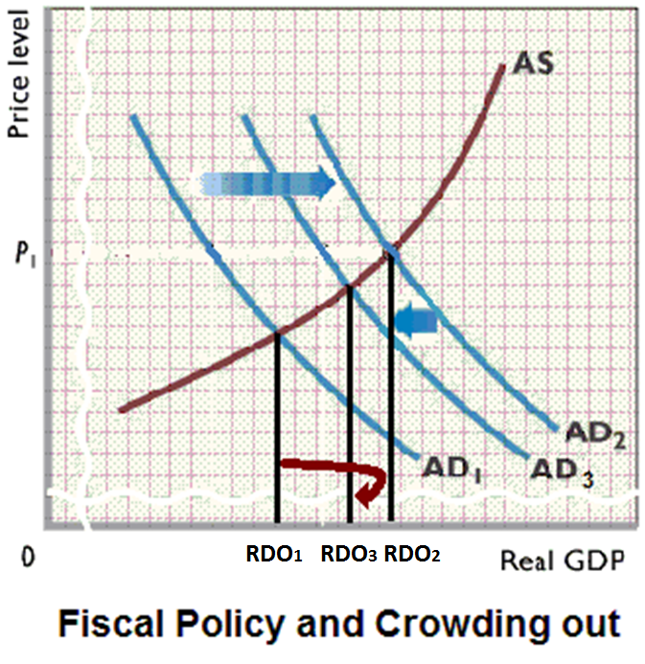

Slide 53
8. If Expansionary FP causes higher interest rates FP will be _______ effective because the multiplier will be ________.
just as; the same
more; larger
less; smaller
The Multiplier with Crowding Out

Slide 54
8. If Expansionary FP causes higher interest rates FP will be _______ effective because the multiplier will be ________.
just as; the same
more; larger
less; smaller
The Multiplier with Crowding Out

Slide 56
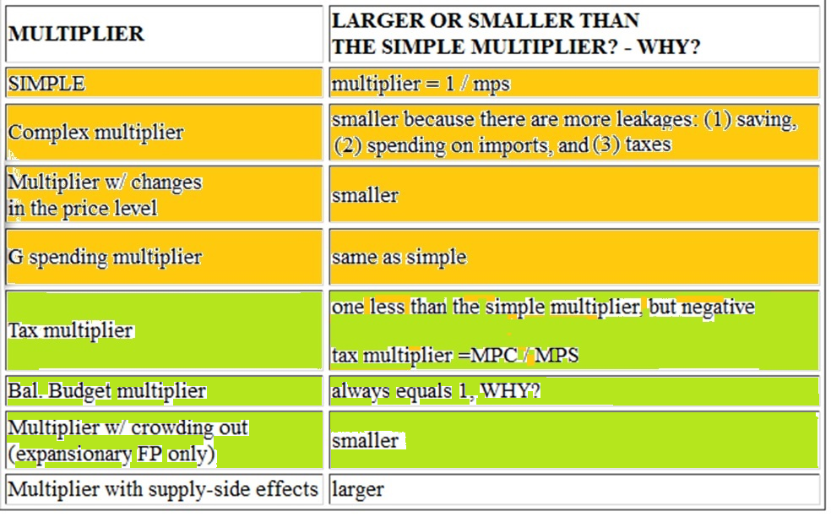
MULTIPLIERS

Slide 57
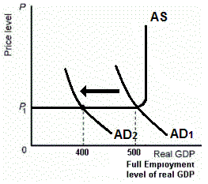
What if AD decreases and the government does NOTHING?
Built-in Stabilizers

Slide 58
9. What if AD decreases and the government does nothing?
AD will decrease but then increase a little
Inflation goes up
Economic growth goes up
GDP will be $400
Built-in Stabilizers

Slide 59
9. What if AD decreases and the government does nothing?
AD will decrease but then increase a little
Inflation goes up
Economic growth goes up
GDP will be $400
Built-in Stabilizers

Slide 60
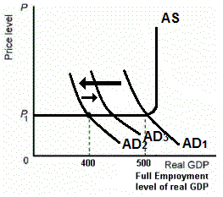
What if AD decreases from AD1 to AD2 and the government does NOTHING?
AD will increase from AD2 to AD3 because of built-in stabilizers.
Total change in AD: AD1 to AD3
Built-in Stabilizers

Slide 61
10. If the government’s budget deficit increases, this indicates what type of policy?
Expansionary FP
Contractionary FP
Easy MP
We cannot be sure
Built-in Stabilizers

Slide 62
10. If the government’s budget deficit increases, this indicates what type of policy?
Expansionary FP
Contractionary FP
Easy MP
We cannot be sure
Built-in Stabilizers

Slide 63
11. The cyclically-adjusted budget measures the Federal budget deficit or surplus if:
The rate of inflation was zero
The economy was at full employment
The MPC was zero
The government had a balanced budget
The cyclically adjusted budget is also called
the full employment budget and the
standardized budget
Built-in Stabilizers

Slide 64
11. The cyclically-adjusted budget measures the Federal budget deficit or surplus if:
The rate of inflation was zero
The economy was at full employment
The MPC was zero
The government had a balanced budget
The cyclically adjusted budget is also called
the full employment budget and the
standardized budget
Built-in Stabilizers

Slide 65
12. If the cyclically-adjusted budget shows a surplus of about $50 billion and the actual budget shows a deficit of about $150 billion, it can be concluded that there is:
Contractionary FP
Contractionary (tight) MP
Expansionary FP
Expansionary (easy) MP
We cannot be sure
Built-in Stabilizers

Slide 66
12. If the cyclically-adjusted budget shows a surplus of about $50 billion and the actual budget shows a deficit of about $150 billion, it can be concluded that there is:
Contractionary FP
Contractionary (tight) MP
Expansionary FP
Expansionary (easy) MP
We cannot be sure
Built-in Stabilizers

Slide 67
13. Which of these is NOT a problem or criticism of FP?
Timing problems
Political considerations
Future policy reversals
Accommodating MP
State and local policy may offset FP
Crowding out
Fiscal Policy: Problems, Criticisms, and Complications

Slide 68
13. Which of these is NOT a problem or criticism of FP?
Timing problems
Political considerations
Future policy reversals
Accommodating MP
State and local policy may offset FP
Crowding out
Fiscal Policy: Problems, Criticisms, and Complications

Slide 69
Fiscal Policy:
Problems, Criticisms, and Complications
Problems of Timing
Political Considerations
Future Policy Reversals
State and Local Policy may offset FP
Crowding-Out Effect
Fiscal Policy: Problems, Criticisms, and Complications

Slide 70
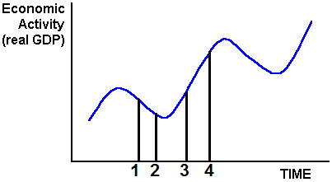
Time 1-2:
Recognition Lag
Time 2-3:
Administrative Lag
Time 3-4:
Operational Lag
TIMING PROBLEM:
  Time 1: Economy enters a recession
  Time 2: Recession is recognized
  Time 3: Gov’t enacts policy (increase G, cut T)
  Time 4: Policy takes effect BUT at the wrong time
Policy may become PRO-CYCLICAL making cycle worse
Fiscal Policy: Problems, Criticisms, and Complications

Slide 71
Time Lags and Macroeconomic Policy
Recognition Lag: Same for FP and MP
Administrative Lag: Short for MP, long for FP
Operational Lag: Same for FP and MP
Fiscal Policy: Problems, Criticisms, and Complications

Slide 72
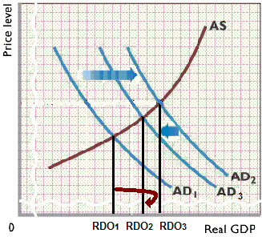
14. What does this graph illustrate?
Supply side FP
Crowding out
Timing problem
Bal. budget mult.
Fiscal Policy: Problems, Criticisms, and Complications

Slide 73
14. What does this graph illustrate?
Supply side FP
Crowding out
Timing problem
Bal. budget mult.
Fiscal Policy: Problems, Criticisms, and Complications

Slide 74
15. Supply-side economists sometimes argue that if you cut taxes it will increase Aggregate SUPPLY. HOW? Which does NOT explain WHY?
Increased incentive to work
Increased incentive to save and invest
Increased productivity
Increase in the Laffer curve
Supply-Side Multiplier

Slide 75
15. Supply-side economists sometimes argue that if you cut taxes it will increase Aggregate SUPPLY. HOW? Which does NOT explain WHY?
Increased incentive to work
Increased incentive to save and invest
Increased productivity
Increase in the Laffer curve
Supply-Side Multiplier

Slide 76
16. How would these supply-side effects affect the fiscal policy multiplier?
Increase it
Decrease it
Leave it unchanged
Supply-Side Multiplier

Slide 77
16. How would these supply-side effects affect the fiscal policy multiplier?
Increase it
Decrease it
Leave it unchanged
Supply-Side Multiplier

Slide 78
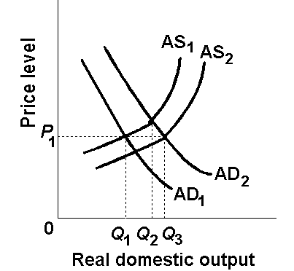
Without supply-side
effects expansionary FP would increase RDO from Q1 to Q2.
With supply-side effects, expansionary FP would increase RDO from Q1 to Q3
Supply-Side Multiplier

Slide 79
17. Supply-side economists sometimes argue that if you cut taxes it could increase gov’t revenue. Which does NOT explain WHY?
Lower taxes encourage economic activity
An increase in AS enlarges the tax base
There is less tax avoidance and tax evasion
There is a decrease in gov’t spending
Supply-Side Multiplier

Slide 80
17. Supply-side economists sometimes argue that if you cut taxes it could increase gov’t revenue. Which does NOT explain WHY?
Lower taxes encourage economic activity
An increase in AS enlarges the tax base
There is less tax avoidance and tax evasion
There is a decrease in gov’t spending
Supply-Side Multiplier

Slide 81
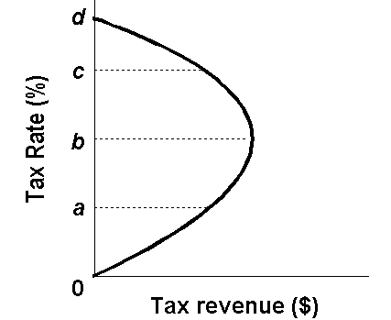
Laffer Curve

Slide 82
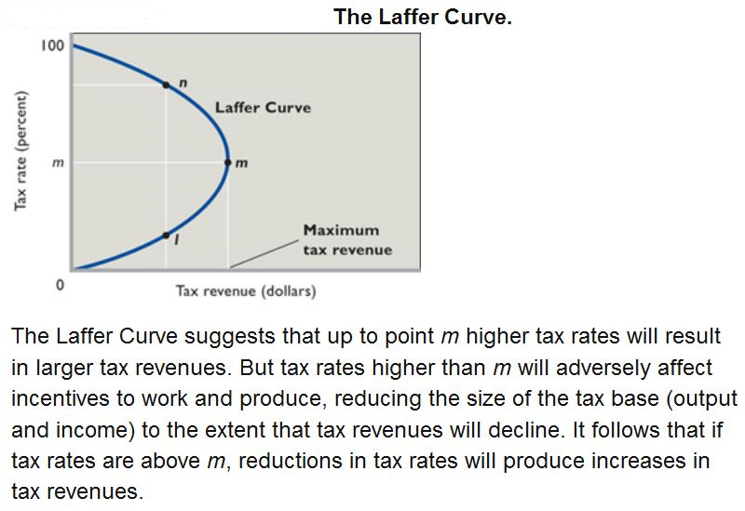

Slide 83
Multiplier and FP Effectiveness
The textbook does not discuss the SIZE
of the multiplier as much as we do. The
textbook instead discusses how effective FP is.
They mean the same thing.
A large multiplier is a more effective FP
A small multiplier is a less effective FP

Slide 84
MULTIPLIERS

