Slide 1
13a – Fiscal Policy
This web quiz may appear as two pages on tablets and laptops.
I recommend that you view it as one page by clicking on the open book icon at the bottom of the page.

Slide 2
13a – Fiscal Policy
TOPICS:
Review Simple Multiplier
Review Complex (actual) multiplier
Review multiplier with inflation
Government Spending Multiplier
Lump-Sum Tax Multiplier
Balanced Budget Multiplier
Multiplier with Crowding Out
Built-In Stability (Automatic Stabilizers) and the Cyclically Adjusted Budget
Fiscal Policy: Problems, Criticisms, and Complication
Supply-Side Fiscal Policy

Slide 3
13a – Fiscal Policy - 1
Outcomes / What you should learn:
We know that GDP = C + Ig + G + Xn. If at full employment GDP would equal $500 billion, but it is currently at $400 billion, then what increase in government purchases (G) are needed to achieve full employment? MPC=0.8
Explain expansionary and contractionary fiscal policy and its effects on the economy and Federal budget.
Compare and explain the difference between the government spending multiplier and the lump-sum tax multiplier
What is the balanced budget multiplier and why is it equal to one?
If we increase government spending by $500 million AND raise taxes by $500 million to pay for the additional spending. What will happen to real GDP?
Explain how the multiplier effect is weakened when there is demand-pull inflation.
Explain how crowding out affects the multiplier.

Slide 4
13a – Fiscal Policy - 2
Outcomes / What you should learn:
Describe supply-side fiscal policy and its affect on the multiplier
Some politicians say that if you CUT tax rates then the government will collect MORE in tax revenue. Explain.
Explain how built in stabilizers help eliminate recession or inflation.
Explain the differential impacts of progressive, proportional, and regressive taxes on the built in stabilzers.
Explain the significance of the "cyclically-adjusted budget" concept.
Describe recent U.S. fiscal policy actions and the motivation behind them.
List and define three timing problems encountered with fiscal policy
State political problems that limit effective fiscal policy and explain the "political business cycle".
Identify actions by state and local governments that can offset fiscal policy.

Slide 5
13a – Fiscal Policy
KEY TERMS:
fiscal policy (FP), discretionary fiscal policy, expansionary FP, contractionary FP, lump-sum tax multiplier, "balanced budget" multiplier, built-in stabilizers, tax progressivity, cyclically-adjusted (full employment or standardized) budget, cyclical deficit, crowding-out effect, monetary policy accommodation, supply-side FP, recognition lag, administrative lag, operational lag, political business cycle, pro-cyclical policy, counter-cyclical policy, Laffer curve

Slide 6
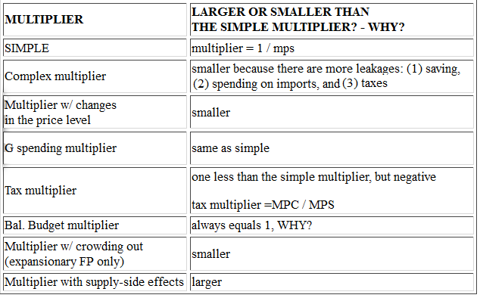
MULTIPLIERS

Slide 7
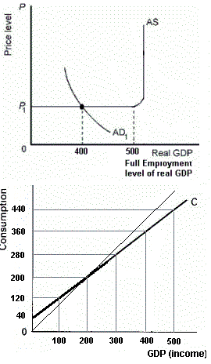
1. What increase in G is needed to achieve full employment?
$ 100
$ 50
$ 25
$ 20
The Government Spending Multiplier

Slide 8
1. What increase in G is needed to achieve full employment?
$ 100
$ 50
$ 25
$ 20
The Government Spending Multiplier

Slide 9
2. What decrease in taxes is needed to achieve full employment?
$ 100
$ 50
$ 25
$ 20
The Lump-SumTax Multiplier

Slide 10
2. What decrease in taxes is needed to achieve full employment?
$ 100
$ 50
$ 25
$ 20
The Lump-SumTax Multiplier

Slide 11
3. If MPC = 2/3 and taxes decrease by $10, how much will the AD curve shift to the right?
$ 10
$ 20
$ 25
$ 30
The Lump-SumTax Multiplier

Slide 12
3. If MPC = 2/3 and taxes decrease by $10, how much will the AD curve shift to the right?
$ 10
$ 20
$ 25
$ 30
The Lump-SumTax Multiplier

Slide 13
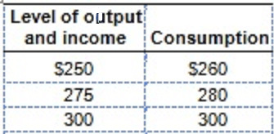
4. If a tax of $5 is added, what is the new C schedule? Current schedule: 260, 280, 300
255; 275; 295
256; 276; 296
260; 280; 300
266; 266; 306
The Lump-Sum Tax Multiplier

Slide 14
4. If a tax of $5 is added, what is the new C schedule? Current schedule: 260, 280, 300
255; 275; 295
256; 276; 296
260; 280; 300
266; 286; 306
The Lump-Sum Tax Multiplier

Slide 15
How taxes affect Consumption, or Why taxes have a smaller multiplier
MPC = change in C/change in Y = 0.8 = ?/ 5 = 4/5
See Yellow Pages for an additional example
The Lump-Sum Tax Multiplier

Slide 16
5. MPC is 0.75, GDP is $200, full employment GDP is $320. What change in G is needed to achieve full employment? What change in T?
Increase G=$120; Decrease T=$120
Increase G=$120; Decrease T=$140
Increase G=$25; Decrease T=$30
Increase G=$30; Decrease T=$40
The Lump-Sum Tax Multiplier

Slide 17
5. MPC is 0.75, GDP is $200, full employment GDP is $320. What change in G is needed to achieve full employment? What change in T?
Increase G=$120; Decrease T=$120
Increase G=$120; Decrease T=$140
Increase G=$25; Decrease T=$30
Increase G=$30; Decrease T=$40
The Lump-Sum Tax Multiplier

Slide 18
Expansionary FP tends to cause budget deficits (G up, T down). What if politicians don’t want to increase the budget deficit? What if they increased G and T by the SAME AMOUNT so that the budget deficit does not grow?
The Balanced Budget Multiplier

Slide 19
6. What equal change in G and T would achieve FE? Increase BOTH by _____?
$ 20
$ 25
$ 50
$100
The Balanced Budget Multiplier

Slide 20
6. What equal change in G and T would achieve FE? Increase BOTH by _____?
$ 20
$ 25
$ 50
$100
The Balanced Budget Multiplier

Slide 21
MULTIPLIERS

Slide 22
7. If MPC equals 0.9 and both G and T decrease by $50, How would AD shift?
Left by $50
Right by $50
Left by $500
Right by $500
The Balanced Budget Multiplier

Slide 23
7. If MPC equals 0.9 and both G and T decrease by $50, How would AD shift?
Left by $50
Right by $50
Left by $500
Right by $500
The Balanced Budget Multiplier

Slide 24
Expansionary FP increases AD. But, it also causes budget deficits, therefore the government must borrow. This borrowing increases the demand for loanable funds and will therefore will raise interest rates. An increase in interest rates will decrease Investment (I). A decrease in I will decrease AD. So . . . . ?
The Multiplier with Crowding Out

Slide 25
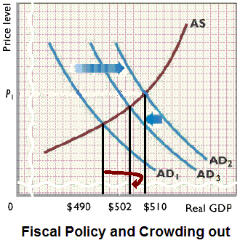

Slide 26
8. If Expansionary FP causes higher interest rates FP will be _______ effective because the multiplier will be ________.
just as; the same
more; larger
less; smaller
The Multiplier with Crowding Out

Slide 27
8. If Expansionary FP causes higher interest rates FP will be _______ effective because the multiplier will be ________.
just as; the same
more; larger
less; smaller
The Multiplier with Crowding Out

Slide 29
MULTIPLIERS

Slide 30
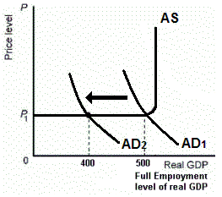
What if AD decreases and the government does NOTHING?
Built-in Stabilizers

Slide 31
9. What if AD decreases and the government does nothing?
AD will decrease but then increase a little
Inflation goes up
Economic growth goes up
GDP will be $400
Built-in Stabilizers

Slide 32
9. What if AD decreases and the government does nothing?
AD will decrease but then increase a little
Inflation goes up
Economic growth goes up
GDP will be $400
Built-in Stabilizers

Slide 33
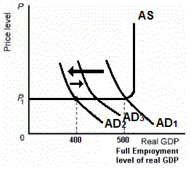
What if AD decreases from AD1 to AD2 and the government does NOTHING? AD will increase from AD2 to AD3 because of built-in stabilizers.
Built-in Stabilizers

Slide 34
10. If the government’s budget deficit increases, this indicates what type of policy?
Expansionary FP
Contractionary FP
Easy MP
We cannot be sure
Built-in Stabilizers

Slide 35
10. If the government’s budget deficit increases, this indicates what type of policy?
Expansionary FP
Contractionary FP
Easy MP
We cannot be sure
Built-in Stabilizers

Slide 36
11. The cyclically-adjusted budget measures the Federal budget deficit or surplus if:
The rate of inflation was zero
The economy was at full employment
The MPC was zero
The government had a balanced budget
The cyclically adjusted budget is also called
the full employment budget and the
standardized budget
Built-in Stabilizers

Slide 37
11. The cyclically-adjusted budget measures the Federal budget deficit or surplus if:
The rate of inflation was zero
The economy was at full employment
The MPC was zero
The government had a balanced budget
The cyclically adjusted budget is also called
the full employment budget and the
standardized budget
Built-in Stabilizers

Slide 38
12. If the cyclically-adjusted budget shows a surplus of about $50 billion and the actual budget shows a deficit of about $150 billion, it can be concluded that there is:
Contractionary FP
Contractionary (tight) MP
Expansionary FP
Expansionary (easy) MP
We cannot be sure
Built-in Stabilizers

Slide 39
12. If the cyclically-adjusted budget shows a surplus of about $50 billion and the actual budget shows a deficit of about $150 billion, it can be concluded that there is:
Contractionary FP
Contractionary (tight) MP
Expansionary FP
Expansionary (easy) MP
We cannot be sure
Built-in Stabilizers

Slide 40
13. Which of these is NOT a problem or criticism of FP?
Timing problems
Political considerations
Future policy reversals
Accommodating MP
State and local policy may offset FP
Crowding out
Fiscal Policy: Problems, Criticisms, and Complications

Slide 41
13. Which of these is NOT a problem or criticism of FP?
Timing problems
Political considerations
Future policy reversals
Accommodating MP
State and local policy may offset FP
Crowding out
Fiscal Policy: Problems, Criticisms, and Complications

Slide 42
Fiscal Policy: Problems, Criticisms, and Complications
Problems of Timing
Political Considerations
Future Policy Reversals
State and Local Policy may offset FP
Crowding-Out Effect
Fiscal Policy: Problems, Criticisms, and Complications

Slide 43
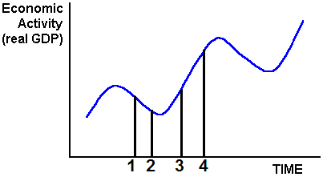
Time 1 to 2:
Recognition Lag
Time 2 to 3:
Administrative Lag
Time 3 to 4:
Operational Lag
TIMING PROBLEM:
Time 1: Economy enters a recession
Time 2: Recession is recognized
Time 3: Gov’t enacts policy (increase G, cut T)
Time 4: Policy takes effect BUT at the wrong time
Policy becomes PRO-CYCLICAL making cycle worse
Fiscal Policy: Problems, Criticisms, and Complications

Slide 44
Time Lags and Macroeconomic Policy
Recognition Lag: Same for FP and MP
Administrative Lag: Short for MP, long for FP
Operational Lag: Same for FP and MP
Fiscal Policy: Problems, Criticisms, and Complications

Slide 45
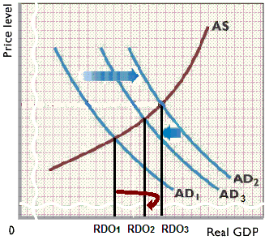
14. What does this graph illustrate?
Supply side FP
Crowding out
Timing problem
Simple multiplier
Fiscal Policy: Problems, Criticisms, and Complications

Slide 46
14. What does this graph illustrate?
Supply side FP
Crowding out
Timing problem
Simple multiplier
Fiscal Policy: Problems, Criticisms, and Complications

Slide 47
15. Supply-side economists sometimes argue that if you cut taxes it will increase Aggregate SUPPLY. HOW? Which does NOT explain WHY?
Increased incentive to work
Increased incentive to save and invest
Increased productivity
Increase in the Laffer curve
Supply-Side Multiplier

Slide 48
15. Supply-side economists sometimes argue that if you cut taxes it will increase Aggregate SUPPLY. HOW? Which does NOT explain WHY?
Increased incentive to work
Increased incentive to save and invest
Increased productivity
Increase in the Laffer curve
Supply-Side Multiplier

Slide 49
16. How would these supply-side effects affect the fiscal policy multiplier?
Increase it
Decrease it
Leave it unchanged
Supply-Side Multiplier

Slide 50
16. How would these supply-side effects affect the fiscal policy multiplier?
Increase it
Decrease it
Leave it unchanged
Supply-Side Multiplier

Slide 51
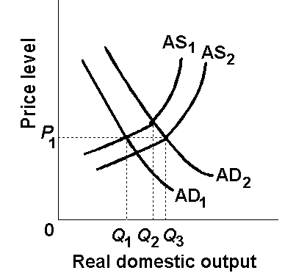
Without supply-side
effects expansionary FP would increase RDO from Q1 to Q2.
With supply-side effects, expansionary FP would increase RDO from Q1 to Q3
Supply-Side Multiplier

Slide 52
Multiplier and FP Effectiveness
The textbook does not discuss the SIZE
of the multiplier as much as we do. The
textbook instead discusses how effective FP is.
They mean the same thing.
A large multiplier is a more effective FP
A small multiplier is a less effective FP

Slide 53
17. Supply-side economists sometimes argue that if you cut taxes it could increase gov’t revenue. Which does NOT explain WHY?
Lower taxes encourage economic activity
An increase in AS enlarges the tax base
There is less tax avoidance and tax evasion
There is a decrease in gov’t spending
Supply-Side Multiplier

Slide 54
17. Supply-side economists sometimes argue that if you cut taxes it could increase gov’t revenue. Which does NOT explain WHY?
Lower taxes encourage economic activity
An increase in AS enlarges the tax base
There is less tax avoidance and tax evasion
There is a decrease in gov’t spending
Supply-Side Multiplier

Slide 55
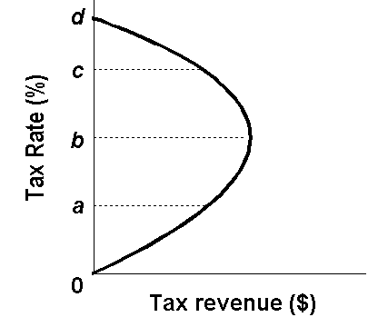
Laffer Curve

Slide 57
Multiplier and FP Effectiveness
The textbook does not discuss the SIZE
of the multiplier as much as we do. The
textbook instead discusses how effective FP is.
They mean the same thing.
A large multiplier is a more effective FP
A small multiplier is a less effective FP

Slide 58
MULTIPLIERS

