Slide 1
12c – The AD /AS Model: Stabilization Policies
This web quiz may appear as two pages on tablets and laptops.
I recommend that you view it as one page by clicking on the open book icon at the bottom of the page.

Slide 2
12c - Stabilization Policies and AS/AD in the Long Run
Stabilization Policies
Fiscal Policy (FP)
Monetary Policy (MP)
Supply-Side Policy
AS/AD in the Long Run
AS/AD and the Economic History of the U.S.
The Phillips Curve

Slide 3
12c - Stabilization Policies and AS/AD in the Long Run
Key Terms:
stabilization policies
demand management
fiscal policy (FP)
expansionary FP
contractionary FP,
monetary policy (MP)
easy (expansionary) MP,
tight (contractionary) MP
supply-side policy
Laffer curve,
stagflation,
aggregate supply shocks,
short run,
long run,
long-run AS,
Phillips curve,
long-run Phillips Curve,
the Great Depression,
disinflation

Slide 4
12c
Outcomes / Must Know:
Differentiate between expansionary and contractionary fiscal policy and recognize the conditions on an AD/AS graph for recommending an expansionary or contractionary policy.
Differentiate between easy (expansionary) and tight (contractionary) monetary policy and recognize the conditions on an AD/AS graph for recommending an expansionary or contractionary policy.
Know how a change in the money supply is transmitted to a change in AD [MS interest rates I AD]
Supply-side policies and equilibrium output
Explain long run adjustments to changes in AD and why the long-run aggregate supply curve is a vertical line (LRAS).
The first paragraph of chapter 18 says:
"During the early years of the Great Depression, many economists suggested that the economy would correct itself in the long run without government intervention. To this line of thinking, economist John Maynard Keynes remarked, “In the long run we are all dead!” Using the AS/AD model explain and show how an economy will "correct itself" if it has high unemployment.
Using the AS/AD model explain and show how an economy will "correct itself" if it has high inflation.
Use the AD/AS model (graph) to explain the economic history of the United States in the past hundred years including the "Great Depression" of 1929-1939 and the "Great Recession" of 2008-2009.
The Phillips Curve

Slide 5
Stabilization Policies
Demand Management Policies
Fiscal Policy (FP)
Expansionary FP
Contractionary FP
Monetary Policy (MP)
Easy Money (Expansionary MP)
Tight Money (Contractionary MP)
Supply Side Policies

Slide 6
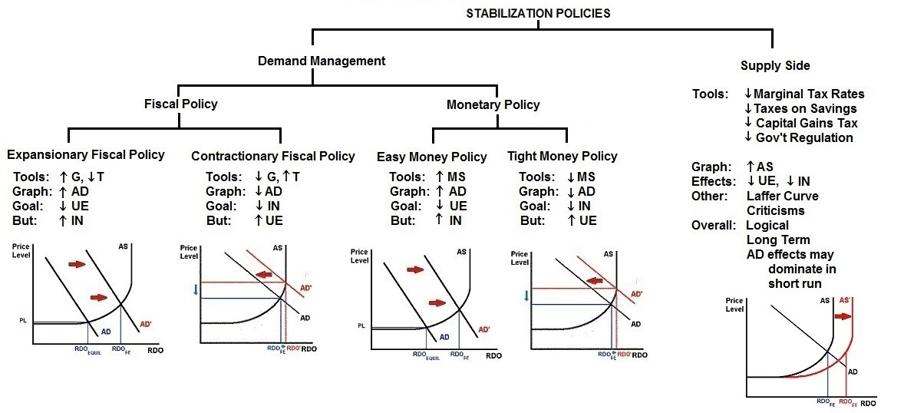
12c – Stabilization Policies (YP 33)

Slide 7
1. What would be the appropriate fiscal policy to combat high inflation?
Increase Government Spending
Increase Money Supply
Increase Taxes
Increase AD

Slide 8
1. What would be the appropriate fiscal policy to combat high inflation?
Increase Government Spending
Increase Money Supply
Increase Taxes
Increase AD
What happens to
UE, IN, and EG?

Slide 9
2. What would be the appropriate fiscal policy to combat high unemployment?
Increase Money Supply
Decrease Gov’t Spending
Decrease Taxes
Decrease AS

Slide 10
2. What would be the appropriate fiscal policy to combat high unemployment?
Increase Money Supply
Decrease Gov’t Spending
Decrease Taxes
Decrease AS
What happens to
UE, IN, and EG?

Slide 11
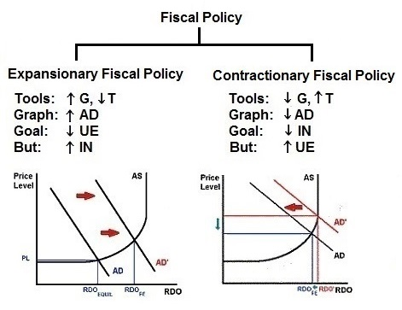

Slide 12
3. Which is correct?
Increasing the MS increases interest rates
Increasing interest rates increases the MS
Decreasing the MS increases interest rates
Decreasing interest rates increases the MS

Slide 13
3. Which is correct?
Increasing the MS increases interest rates
Increasing interest rates increases the MS
Decreasing the MS increases interest rates
Decreasing interest rates increases the MS

Slide 14
MONETARY POLICY
Easy Money Policy:
Tight Money Policy:
MEMORIZE THIS !!

Slide 15
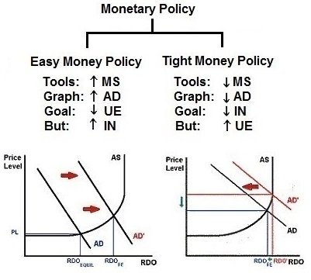

Slide 16
4. When using FP and MP to reduce unemployment, inflation may result. When using FP and MP to reduce inflation, unemployment may result. What policy might decrease BOTH unemployment AND inflation?
Demand management policy
Consumption Policy
Contractionary Policy
Supply-side Policy

Slide 17
4. When using FP and MP to reduce unemployment, inflation may result. When using FP and MP to reduce inflation, unemployment may result. What policy might decrease BOTH unemployment AND inflation?
Demand management policy
Consumption Policy
Contractionary Policy
Supply-side Policy

Slide 18
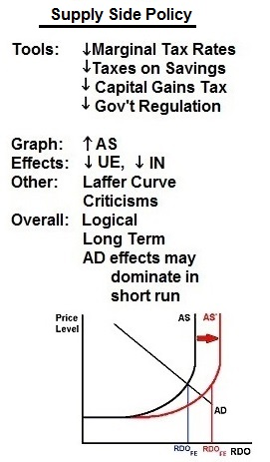

Slide 19
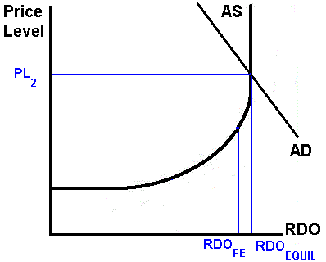
5. What would be the appropriate fiscal policy?
Increase Taxes
Decrease Gov’t Spending
Decrease Taxes
Increase Money Supply

Slide 20
5. What would be the appropriate fiscal policy?
Increase Taxes
Decrease Gov’t Spending
Decrease Taxes
Increase Money Supply
What happens to
UE, IN, and EG?

Slide 21
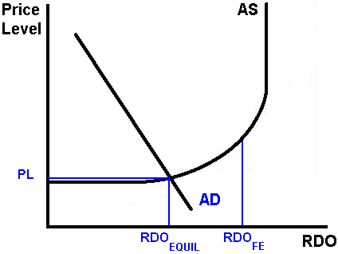
6. What would be the appropriate monetary policy?
Increase Taxes
Increase Gov’t Spending
Decrease Money Supply
Increase Money Supply

Slide 22
6. What would be the appropriate monetary policy?
Increase Taxes
Increase Gov’t Spending
Decrease Money Supply
Increase Money Supply
What happens to
UE, IN, and EG?

Slide 23
7. President Reagan argued that a tax cut will increase government revenues. Which economic concept illustrates this?
Phillips Curve
Laffer Curve
AD Curve
AS Curve
Long-run AS Curve

Slide 24
7. President Reagan argued that a tax cut will increase government revenues. Which economic concept illustrates this?
Phillips Curve
Laffer Curve
AD Curve
AS Curve
Long-run AS Curve

Slide 25
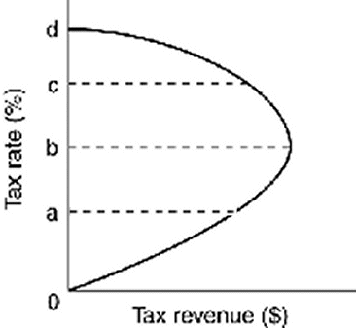
The Laffer Curve

Slide 26
8. In the long run:
All prices are fixed
Resource prices are fixed but product prices are variable
Product prices are fixed but resource prices are variable
All prices are variable

Slide 27
8. In the long run:
All prices are fixed
Resource prices are fixed but product prices are variable
Product prices are fixed but resource prices are variable
All prices are variable

Slide 28
9. In the long run:
The economy achieves full employment
There is high unemployment
The government should use fiscal policy
The government should use monetary policy

Slide 29
9. In the long run:
The economy achieves full employment
There is high unemployment
The government should use fiscal policy
The government should use monetary policy

Slide 30
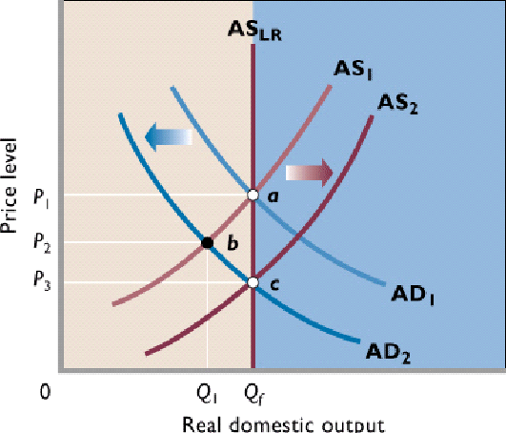
In the SR: If AD decreases
from AD1 to AD2 the result is UE
In the LR:
If AD decreases
from AD1 to AD2 prices and wages
will fall and AS will increase.
The result is full employment in the LR

Slide 31
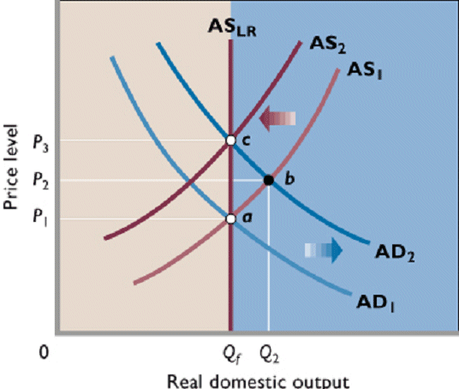
In the SR: If AD increases
from AD1 to AD2 the result is IN
In the LR:
If AD increases
from AD1 to AD2 prices and wages
will rise and AS will decrease.
The result is full employment in the LR

Slide 32
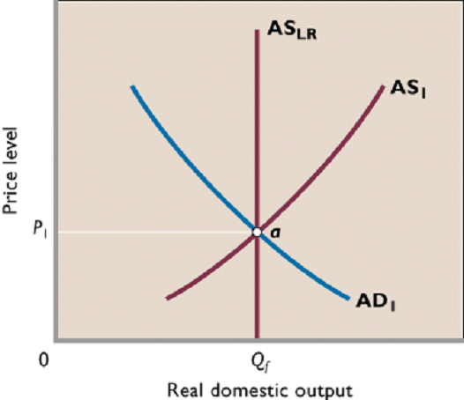
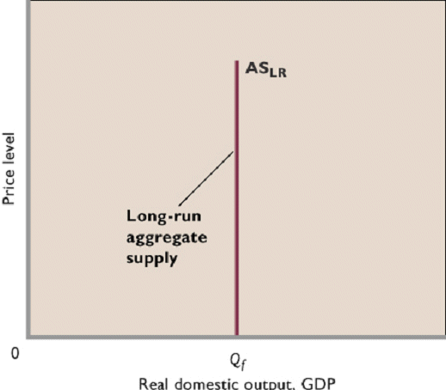
The Long-Run AS Curve

Slide 33
Historical Review of the U.S. Economy
- Great Depression (1929-1939) - W.W.II Boom (1940-1945) - Vietnam War Inflation (1962 – mid 1070s) - Monetary Restraint: 1979-1982 - Aggregate Supply Shocks in the late 1970s & Early 1980s: Stagflation
- Great Recession of 2008-2009

Slide 34
10. Which occurred during the Great Depression (1929-1939)?
Low UE and low IN
High UE and high IN
Low UE and high IN
High UE and low IN

Slide 35
10. Which occurred during the Great Depression (1929-1939)?
Low UE and low IN
High UE and high IN
Low UE and high IN
High UE and low IN

Slide 36
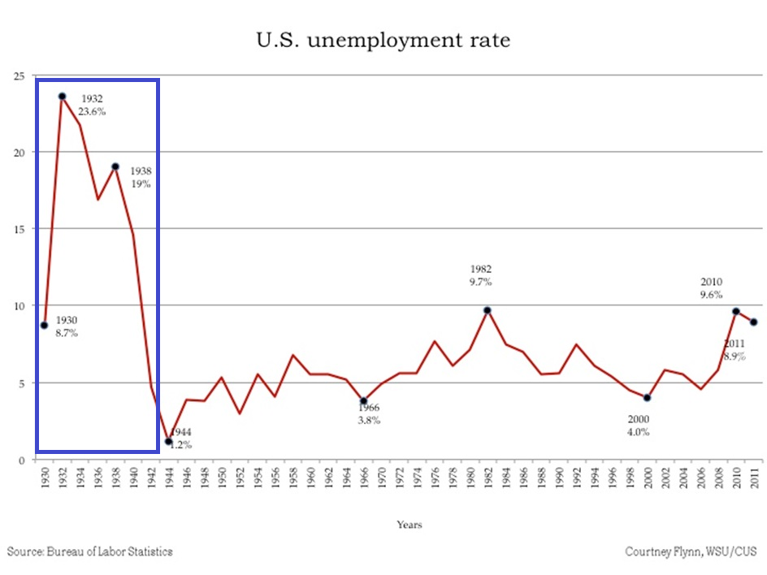
Great Depression (1929-1939)

Slide 37
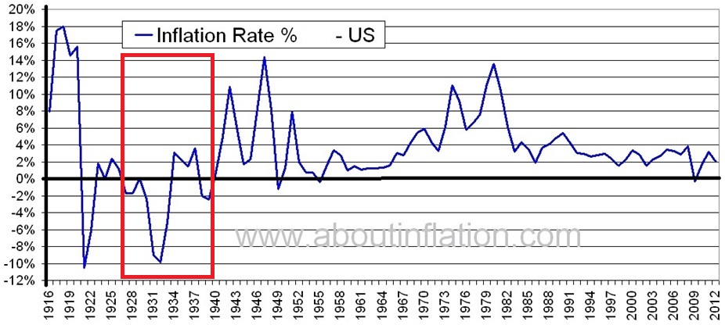
Great Depression (1929-1939)

Slide 38
11. What most likely caused the Great Depression (1929-1939)?
Increase in AD
Decrease in AD
Increase in AS
Decrease in AS

Slide 39
11. What most likely caused the Great Depression (1929-1939)?
Increase in AD
Decrease in AD
Increase in AS
Decrease in AS

Slide 40
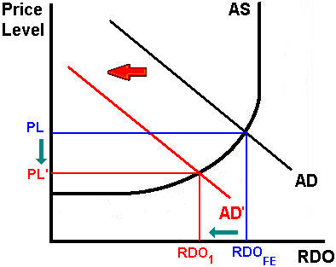
A decrease in AD will cause high UE and low IN.

Slide 41
Causes of the Great Depression
- Stock Market Crash of 1929: Decrease in wealth
- Bank Failures: Fewer loans decreases investment
- Reduction in Spending:
consumer and business expectations decreased
- American Trade Policy with Europe Higher tariffs to “protect” US jobs causes trading partners to retaliate and exports decreased
- Drought Conditions: farm spending decreased

Slide 42
12. The Phillips Curve shows the relationship between:
EG and UE
EG and IN
UE and IN

Slide 43
12. The Phillips Curve shows the relationship between:
EG and UE
EG and IN
UE and IN

Slide 44
The Phillips Curve
Both low inflation and low unemployment are major goals. But are they compatible?
The Phillips Curve is named after A.W. Phillips, who developed his theory in
Great Britain by observing the British relationship between unemployment and wage inflation.

Slide 45
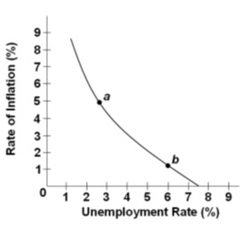
The Phillips Curve - Definition
- graph showing the trade- off between unemployment and inflation
- a curve showing the relationship between the unemployment rate (on the horizontal axis) and the annual rate of increase in the price level - inflation (on the vertical axis)

Slide 46
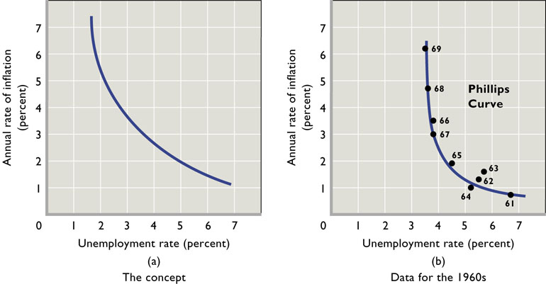
The Phillips Curve – U.S. in the 1960s

Slide 47
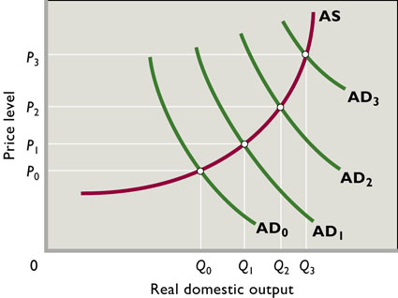
The Phillips Curve
The basic idea is that given the short run aggregate supply curve, an increase in aggregate demand will cause the price level to increase and real output to expand, and the reverse for a decrease in AD.

Slide 48
The Phillips Curve – Does it Exist?
This trade-off between output and inflation does not occur over long time periods.
Empirical work in the 1960s verified the inverse relationship between the unemployment rate and the rate of inflation in the United States for 1961-1969.
The stable Phillips Curve of the 1960s gave way to great instability of the curve in the 1970s and 1980s. The obvious inverse relationship of 1961-1969 had become obscure and highly questionable. (See Figure next slide)
In the 1970s the economy experienced increasing inflation and rising unemployment: STAGFLATION.
At best, the data may suggest a less generally higher unemployment and inflation. At worse, the data imply no predictable trade off between unemployment and inflation.

Slide 49
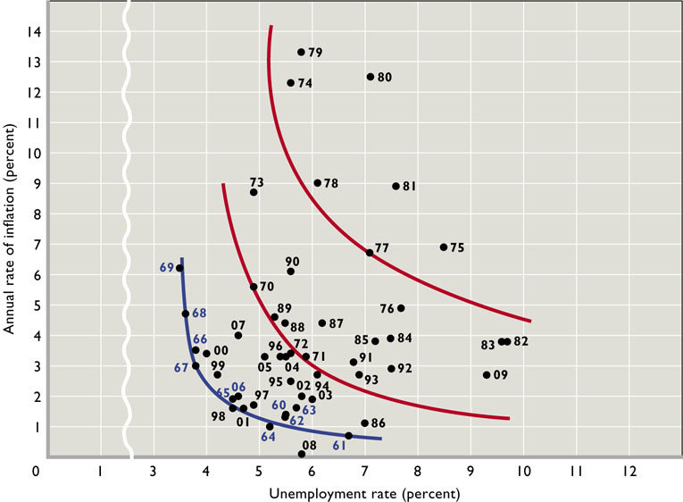

Slide 50
Historical Review of the U.S. Economy
- Great Depression (1929-1939) - W.W.II Boom (1940-1945) - Vietnam War Inflation (1962 – mid 1070s) - Monetary Restraint: 1979-1982 - Aggregate Supply Shocks in the late 1970s & Early 1980s: Stagflation
- Great Recession of 2008-2009

Slide 51
13. What most likely caused the stagflation of the late 1970s and early 1980s?
Increase in AD
Decrease in AD
Increase in AS
Decrease in AS

Slide 52
13. What most likely caused the stagflation of the late 1970s and early 1980s?
Increase in AD
Decrease in AD
Increase in AS
Decrease in AS
What happens to
UE, IN, and EG?

Slide 53
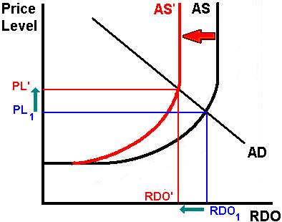
A decrease in AS will cause high UE and high IN.

Slide 54
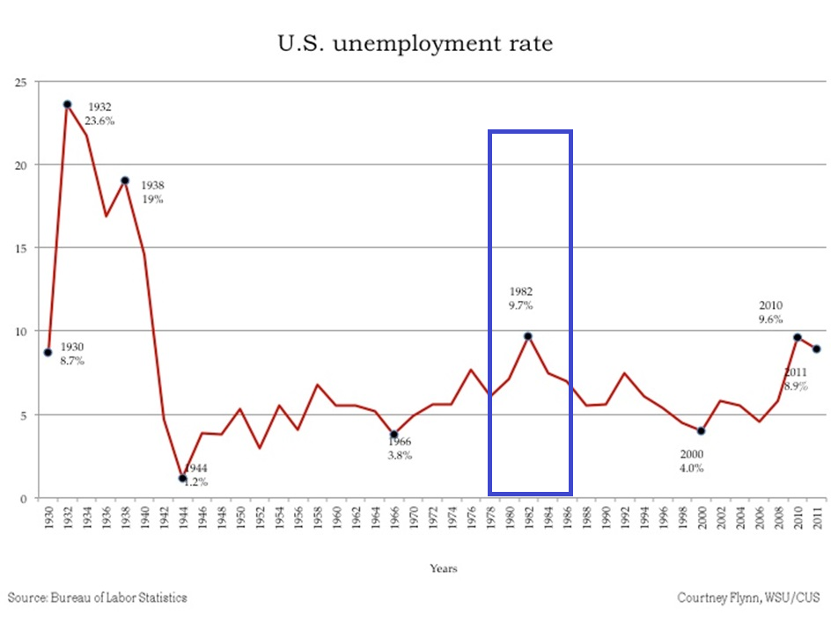
Aggregate Supply Shocks in the late 1970s & Early 1980s: Stagflation

Slide 55
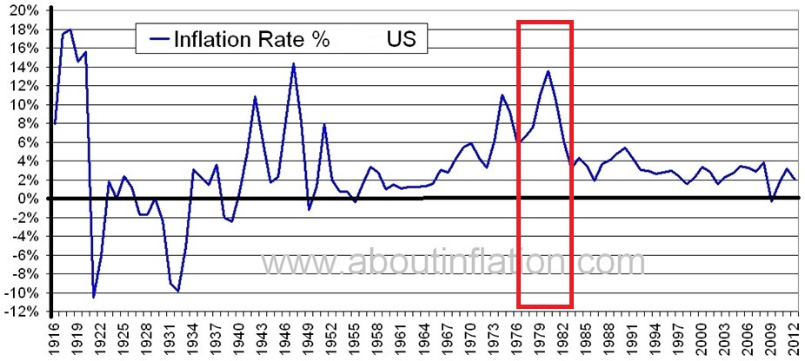
Aggregate Supply Shocks in the late 1970s & Early 1980s: Stagflation

Slide 56
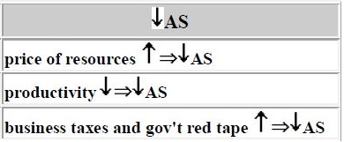
Causes of the Aggregate Supply Shocks in the 1970s & Early 1980s:
1. OPEC and energy
prices 2. agricultural shortfalls 3. depreciated dollar 4. demise of wage-price
controls 5. productivity decline 6. inflationary
expectations and
higher wages

Slide 57
Historical Review of the U.S. Economy
- Great Depression (1929-1939) - W.W.II Boom (1940-1945) - Vietnam War Inflation (1962 – mid 1070s) - Monetary Restraint: 1979-1982 - Aggregate Supply Shocks in the late 1970s & Early 1980s: Stagflation
- Great Recession of 2008-2009

Slide 58
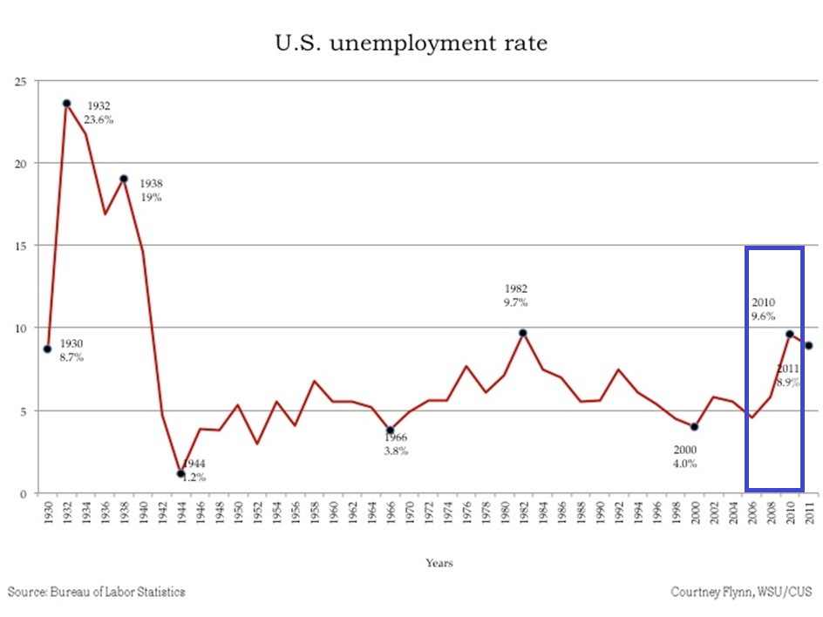
Great Recession of 2008-2009

Slide 59
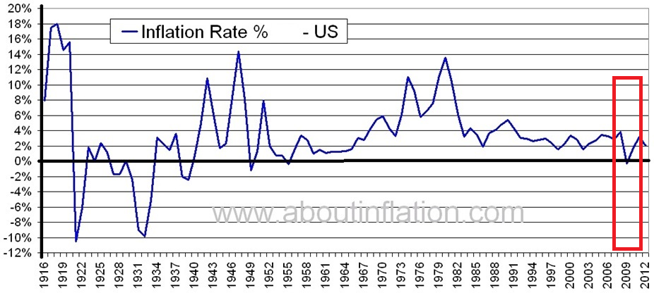
Great Recession of 2008-2009

Slide 60
Great Recession of 2008-2009 in the U.S.
Officially lasted from Dec. 2007 to June 2009
began with the bursting of an 8 trillion dollar
housing bubble.
The resulting loss of wealth led to sharp cutbacks
in consumer spending. This loss of consumption,
combined with the financial market chaos
triggered by the bursting of the bubble, also
led to a collapse in business investment.
As consumer spending and business investment
dried up, massive job loss followed.

Slide 61
Great Recession of 2008-2009 in the U.S.
- 8 million jobs were lost.
- UE rose from 4.6 % to 10.1%
- EG slowed to just 0.4% in 2008 and to a negative 2.4 % in 2009

Slide 62
Historical Review of the U.S. Economy
- Great Depression (1929-1939) - W.W.II Boom (1940-1945) - Vietnam War Inflation (1962 – mid 1070s) - Monetary Restraint: 1979-1982 - Aggregate Supply Shocks in the late 1970s & Early 1980s: Stagflation
- Great Recession of 2008-2009

