Slide 1
12b – The AD /AS Model: AS Graph and Equilibrium
This web quiz may appear as two pages on tablets and laptops.
I recommend that you view it as one page by clicking on the open book icon at the bottom of the page.

Slide 2
12b – AS and Equilibrium
Aggregate Supply (AS)
Define
Draw
Describe
Determinants
Macroeconomic Equilibrium
UE
IN
EG

Slide 3
12b – AS and Equilibrium
OUTCOMES
Define, draw, and describe the shape of the immediate short-run, short-run, and long-run AS curves, and understand the determinants of the short-run AS curve [Define, Draw, Describe, Determinants]
Find an economy's equilibrium price level and real domestic output using AD/AS graph
Explain using an AD/AS graph what happens to RDO, the price level, UE, IN, and EG when there is a change in AD and/or AS.
Explain the ratchet effect and demand pull inflation
Explain cost-push inflation and stagflation
Two (or three) definitions of economic growth
IN THE NEWS - Use the AS/AD model to explain what might happen to UE, IN, and EG following these events in the news:
2003: "the recently-signed tax-cut plan, which will give rebate checks to families with children in late summer, right in time for back-to-school spending"
2003: "improving consumer confidence -- critical, since consumer spending makes up more than two-thirds of the economy"
2003: "The Commerce Department's report last week of a surprising August improvement in the international trade balance "
2009: "Personal spending jumped 1.3% last month, the government said."
2011: "With energy prices already well on the rise before the latest crisis hit the Middle East and North Africa, is the global economy headed for another tumble?"
How can an economy go beyond the full employment level of output?

Slide 4
12b – AS and Equilibrium
Key Terms
AS, immediate-short-run AS, short-run AS, long-run AS, Keynesian range, Intermediate range, Classical range, equilibrium price level, equilibrium real output (RDO), demand-pull inflation, cost-push inflation, efficiency wages, ratchet effect, stagflation, OPEC

Slide 5
1. DEFINE: Aggregate Supply is a schedule or curve showing the relationship between a nation’s:
aggregate demand and the price level
price level and the amount of output that would be demanded
the amount of output produced and the aggregate demand
price level and the amount of output produced

Slide 6
1. DEFINE: Aggregate Supply is a schedule or curve showing the relationship between a nation’s:
aggregate demand and the price level
price level and the amount of output that would be demanded
the amount of output produced and the aggregate demand
price level and the amount of output produced

Slide 7
2. Draw: Which graph below correctly shows the aggregate supply curve (short run):
A
B
C
D

Slide 8
2. Draw: Which graph below correctly shows the aggregate supply curve (short run):
A
B
C
D

Slide 9
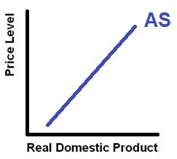
Aggregate Supply

Slide 10
3. DESCRIBE: At very low levels of output, the short-run aggregate supply curve is relatively:
Flat, , because increasing output will cause small increases in per-unit production costs
flat, because firms are reluctant to give their workers raises when output is so low
steep, because firms are reluctant to give their workers raises when output is so low
steep, because increasing output will cause aggregate demand to increase

Slide 11
3. DESCRIBE: At very low levels of output, the short-run aggregate supply curve is relatively:
Flat, , because increasing output will cause small increases in per-unit production costs
flat, because firms are reluctant to give their workers raises when output is so low
steep, because firms are reluctant to give their workers raises when output is so low
steep, because increasing output will cause aggregate demand to increase

Slide 12
4. DETERMINANTS: Higher prices of imported resources will:
move the economy downward and to the right along the aggregate demand curve
make the aggregate demand curve steeper
shift the aggregate demand curve to the left
shift the aggregate supply curve to the left

Slide 13
4. DETERMINANTS: Higher prices of imported resources will:
move the economy downward and to the right along the aggregate demand curve
make the aggregate demand curve steeper
shift the aggregate demand curve to the left
shift the aggregate supply curve to the left

Slide 14
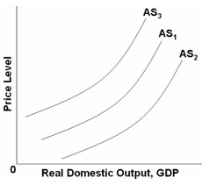
5. DETERMINANTS: Which of the following factors will shift AS₁ to AS₃?
increase in productivity
decrease in business taxes
decrease in household indebtedness
increase in input prices

Slide 15
5. DETERMINANTS: Which of the following factors will shift AS₁ to AS₃?
increase in productivity
decrease in business taxes
decrease in household indebtedness
increase in input prices

Slide 16
6. DETERMINANTS: Which of the following factors will shift AS₁ to AS₂?
increase in gov’t spending
decrease in business taxes
increase in net exports
increase in productivity

Slide 17
6. DETERMINANTS: Which of the following factors will shift AS₁ to AS₂?
increase in gov’t spending
decrease in business taxes
increase in net exports
increase in productivity

Slide 18
7. DETERMINANTS: Which of the following factors will shift AS₁ to AS₃?
increase in gov’t regulations
decrease in business taxes
decrease in resource peices
increase in productivity

Slide 19
7. DETERMINANTS: Which of the following factors will shift AS₁ to AS₃?
increase in gov’t regulations
decrease in business taxes
decrease in resource peices
increase in productivity

Slide 20
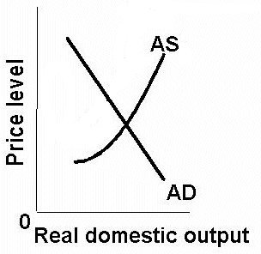
OUR GOAL:
To see what happens to:
UE
IN
EG
To do this we will need
both AD and AS then
find the macroeconomic EQUILIBRIUM.
Then when the DETERMINANTS change we will get a change in UE, IN, and EG.

Slide 21
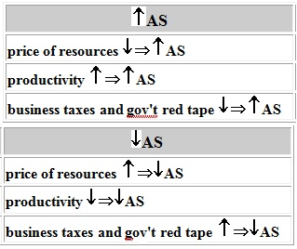
Determinants of AS

Slide 22
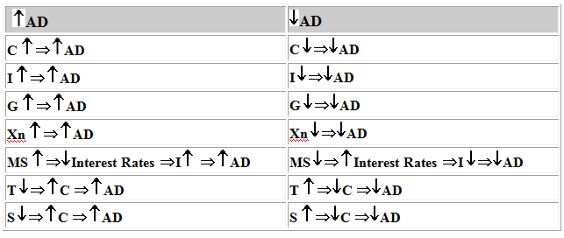
Determinants of AD

Slide 23
8. In 2007 home values began to decline significantly. Which graph above illustrates the effect on the economy?
1
2
3
4
What happens to
UE, IN, and EG?

Slide 24
8. In 2007 home values began to decline significantly. Which graph above illustrates the effect on the economy?
1
2
3
4
What happens to
UE, IN, and EG?

Slide 25
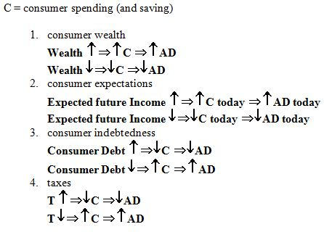

Slide 26
9. Which is an economic investment (I)?
A student buys stock in Apple computers
An investor buy a government bond
A carpenter buys a hammer
A professor buys new skis

Slide 27
9. Which is an economic investment (I)?
A student buys stock in Apple computers
An investor buy a government bond
A carpenter buys a hammer
A professor buys new skis

Slide 28
10. Assume business have increased excess capacity. Which graph above illustrates the effect on the economy?
1
2
3
4
What happens to
UE, IN, and EG?

Slide 29
10. Assume business have increased excess capacity. Which graph above illustrates the effect on the economy?
1
2
3
4
What happens to
UE, IN, and EG?

Slide 30
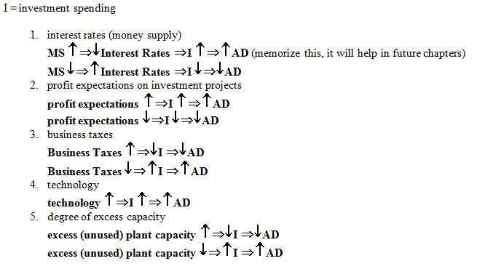

Slide 31
11. Assume the $ appreciates. Which graph above illustrates the effect on the economy?
1
2
3
4
What happens to
UE, IN, and EG?

Slide 32
11. Assume the $ appreciates. Which graph above illustrates the effect on the economy?
1
2
3
4
What happens to
UE, IN, and EG?

Slide 33
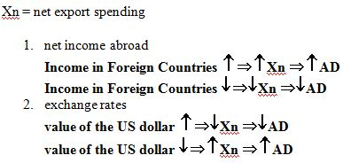

Slide 34
12. Which graph above illustrates the stagflation of the late 1970s and early 1980s??
1
2
3
4
What happens to
UE, IN, and EG?

Slide 35
12. Which graph above illustrates the stagflation of the late 1970s and early 1980s??
1
2
3
4
What happens to
UE, IN, and EG?

Slide 36
Determinants of AS

Slide 37
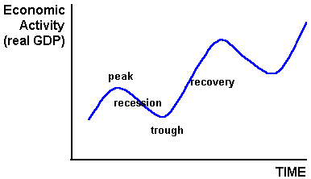
The Business Cycle

