Slide 1
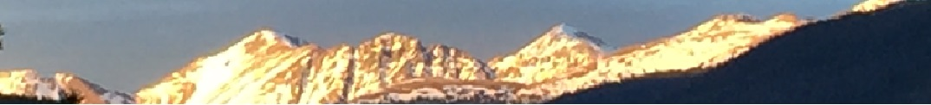
12a – The AD /AS Model:
AD Graph and its Determinants
This web quiz may appear as two pages on tablets and laptops.
I recommend that you view it as one page by clicking on the open book icon at the bottom of the page.

Slide 2
12a – The AD/AS Model:
AD Graph and its Determinants
UE, IN, and EG (Ch 6)
The Business Cycle (Ch. 9)
The AD (Ch. 12)
  Define
  Draw
  Describe
  Determinants

Slide 3
12a – The AD/AS Model:
AD Graph and its Determinants
OUTCOMES
What is the "miracle of modern economic growth"?
Economic growth, the choice between present and future consumption, and the role of saving and investment.
Unemployment, inflation and the business cycle: peak, recession, trough, and expansion (recovery); long run growth trend
Causes of the business cycle: demand shocks and price stickiness
Define, draw, and describe the shape, and understand the determinants of the AD curve
[Define, Draw, Describe, Determinants]

Slide 4
12a – The AD /AS Model:
AD Graph and its Determinants
KEY TERMS:
real GDP,
unemployment,
inflation,
modern economic growth,
saving,
economic investment,
financial investment,
business cycle,
peak,
recession,
trough,
expansion (recovery),
growth trend (secular trend), aggregate demand (AD),
real-balances effect,
interest-rate effect,
foreign-purchases effect,
determinants of aggregate demand,
wealth vs. income,
investment

Slide 5
12b – AS/AD Equilibrium
Why the Great Malaise of the World Economy Continues in 2016
  For the United States, 2015 was supposed to be the year that finally closed the book on the Great Recession that began back in 2008; instead, the U.S. recovery has been middling. . . . In early 2010, I warned in my book "Freefall," which describes the events leading up to the Great Recession, that without the appropriate responses, the world risked sliding into what I called a "Great Malaise." Unfortunately, I was right: We didn't do what was needed, and we have ended up precisely where I feared we would.
Why the Great Malaise of the World Economy Continues in 2016 by Joseph Stiglitz, The World Post
01/04/2016 01:20 pm ET | Updated Jan 04, 2016
http://www.huffingtonpost.com/joseph-e-stiglitz/world-economy-2016_b_8908560.html

Slide 6
12a – AD
Why the Great Malaise of the World Economy Continues in 2016
  The only cure for the world's malaise is an increase in aggregate demand. Far-reaching redistribution of income would help, as would deep reform of our financial system -- not just to prevent it from imposing harm on the rest of us, but also to get banks and other financial institutions to do what they are supposed to do: match long-term savings to long-term investment needs.
Why the Great Malaise of the World Economy Continues in 2016 by Joseph Stiglitz, The World Post
01/04/2016 01:20 pm ET | Updated Jan 04, 2016
http://www.huffingtonpost.com/joseph-e-stiglitz/world-economy-2016_b_8908560.html

Slide 7
1. Which is an economic investment (I)?
A student buys stock in Apple computers
An investor buy a government bond
A carpenter buys a hammer
A professor buys new skis

Slide 8
1. Which is an economic investment (I)?
A student buys stock in Apple computers
An investor buy a government bond
A carpenter buys a hammer
A professor buys new skis
Investment (economic investment):
spending on the production and accumulation of newly created capital goods such as machinery, tools, factories, and warehouses
- example: a carpenter buying a hammer

Slide 9
2. Before the late 1700's, living standards in the richest part of the world compared to the poorest parts were ?
About five times higher
At most only two to three times higher
About 50 times higher
About the same

Slide 10
2. Before the late 1700's, living standards in the richest part of the world compared to the poorest parts were ?
About five times higher
At most only two to three times higher
About 50 times higher
About the same

Slide 11
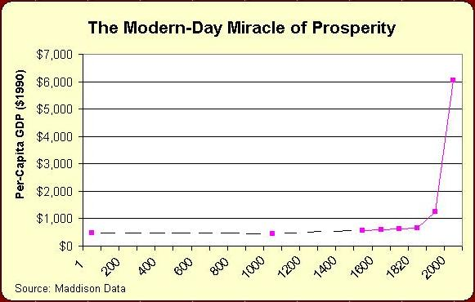

Slide 12
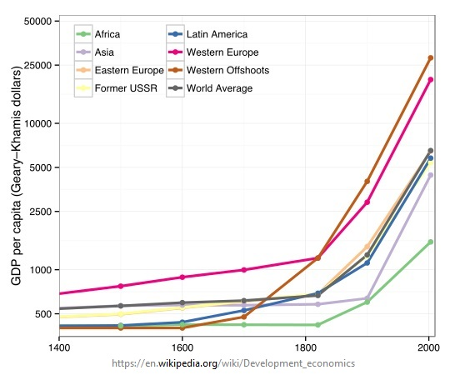

Slide 13
3. During a recession:
UE is high and IN is high
UE is low and IN is low
UE is high and IN is low
UE is low and IN is high

Slide 14
3. During a recession:
UE is high and IN is high
UE is low and IN is low
UE is high and IN is low
UE is low and IN is high

Slide 15
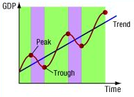
4. This graph is:
S and D
Business Cycle
AD and AD
PPC

Slide 16
4. This graph is:
S and D
Business Cycle
AD and AD
PPC

Slide 17
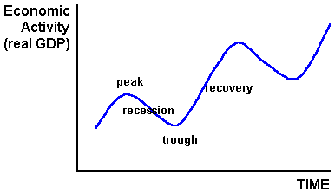
The Business Cycle
Peak: UE low; IN high Recession: UE increase; IN decrease
Trough: UE high; IN low Recovery: UE decrease; IN increase
CAUSES: changes in AD

Slide 18
5. DEFINE: The aggregate demand curve shows the:
inverse relationship between the price level and the quantity of real GDP purchased
Direct relationship between the price level and the quantity of real GDP produced
Inverse relationship between interest rates and the quantity of real GDP produced
Direct relationship between real-balances and the quantity of real GDP purchased

Slide 19
5. DEFINE: The aggregate demand curve shows the:
inverse relationship between the price level and the quantity of real GDP purchased
Direct relationship between the price level and the quantity of real GDP
Inverse relationship between interest rates and the quantity of real GDP produced
Direct relationship between real-balances and the quantity of real GDP purchased

Slide 20
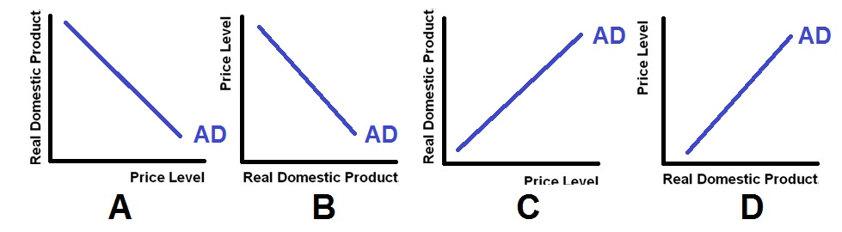
6. DRAW: Which graph below correctly shows the aggregate demand (AD) curve?
A
B
C
D

Slide 21
6. DRAW: Which graph below correctly shows the aggregate demand (AD) curve?
A
B
C
D

Slide 22
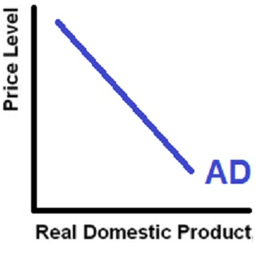
DEFINE / DRAW:
The AD Curve:
a schedule or curve that shows the total quantity of goods and services demanded (purchased) at different price levels
the inverse relationship between the price level and the amount of real GDP demanded

Slide 23
7. DESCRIBE: Which is NOT one of the reasons why the AD curve is downward sloping?
Price effect
Real-Balances (Wealth) effect
Interest rate effect
Foreign purchases effect

Slide 24
7. DESCRIBE: Which is NOT one of the reasons why the AD curve is downward sloping?
Price effect
Real-Balances (Wealth) effect
Interest rate effect
Foreign purchases effect
2. PL up causes decrease value of financial assets causes RDO
demanded down
3. PL up causes increase in interest rates causes RDO demanded down
4. PL in US up causes more imports from lower priced foreign products causes RDO demanded down

Slide 25
For ALL Graphs:
Define – what does the graph represent
Draw – be able to draw and label
Describe the Shape – why does the graph have the shape that it does?
Sometimes: Determinants shift the graph
It would be a good idea to prepare 3 x 5 cards that Define, Draw, and Describe, all graphs.

Slide 26
8. Which of the following factors will shift AD₁ to AD₃?
increase in savings
decrease in taxes
decrease in household indebtedness
increase in investment

Slide 27
8. Which of the following factors will shift AD₁ to AD₃?
increase in savings
decrease in taxes
decrease in household indebtedness
increase in investment

Slide 28
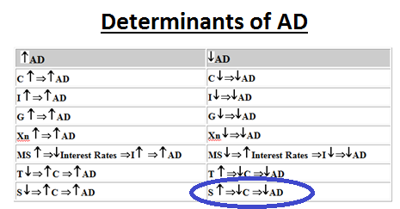

Slide 29
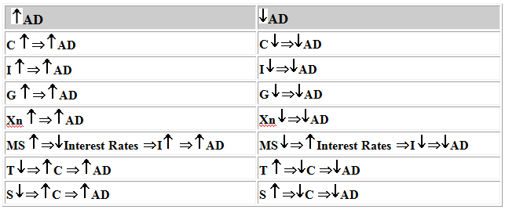
Determinants of AD
If these change then AD shifts either left (increase) or right (decrease)

Slide 30
9. Which of the following factors will shift AD₁ to AD₃?
increase in gov’t spending
decrease in taxes
decrease in net exports
increase in money supply

Slide 31
9. Which of the following factors will shift AD₁ to AD₃?
increase in gov’t spending
decrease in taxes
decrease in net exports
increase in money supply

Slide 32
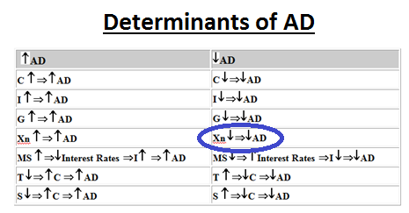

Slide 33
10. Which is correct when the MS increases?
A decrease in the interest rate CAUSES a decrease in Investment which CAUSES a decrease in AD
A decrease in the interest rate CAUSES an increase in Investment which CAUSES an increase in AD
An increase in the interest rate CAUSES a decrease in Investment which CAUSES a decrease in AD
An increase in the interest rate CAUSES an increase in Investment which CAUSES an increase in AD

Slide 34
10. Which is correct when the MS increases?
A decrease in the interest rate CAUSES a decrease in Investment which CAUSES a decrease in AD
A decrease in the interest rate CAUSES an increase in Investment which CAUSES an increase in AD
An increase in the interest rate CAUSES a decrease in Investment which CAUSES a decrease in AD
An increase in the interest rate CAUSES an increase in Investment which CAUSES an increase in AD

Slide 35
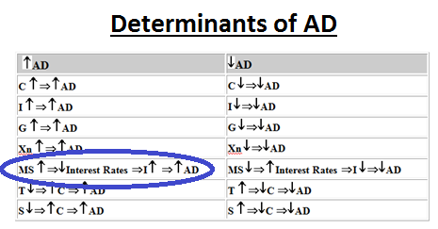
Memorize this!

Slide 36
11. In 2007 home values began to decline significantly. Which is correct as a result?
Investment increased causing AD to go up
Taxes increased causing AD to go down
Wealth decreased causing AD to go down
Value of the $ increased causing AD to go down

Slide 37
11. In 2007 home values began to decline significantly. Which is correct as a result?
Investment increased causing AD to go up
Taxes increased causing AD to go down
Wealth decreased causing AD to go down
Value of the $ increased causing AD to go down

Slide 38
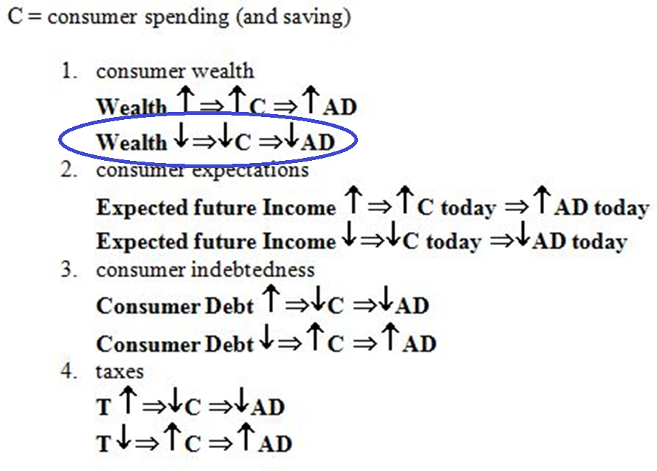

Slide 39
12. Assume business have increased excess capacity. Which is correct as a result?
Investment decreased causing AD to go down
Consumption decreased causing AD to go down
Wealth decreased causing AD to go down
Cons. Debt increased causing AD to go down

Slide 40
12. Assume business have increased excess capacity. Which is correct as a result?
Investment decreased causing AD to go down
Consumption decreased causing AD to go down
Wealth decreased causing AD to go down
Cons. Debt increased causing AD to go down

Slide 41
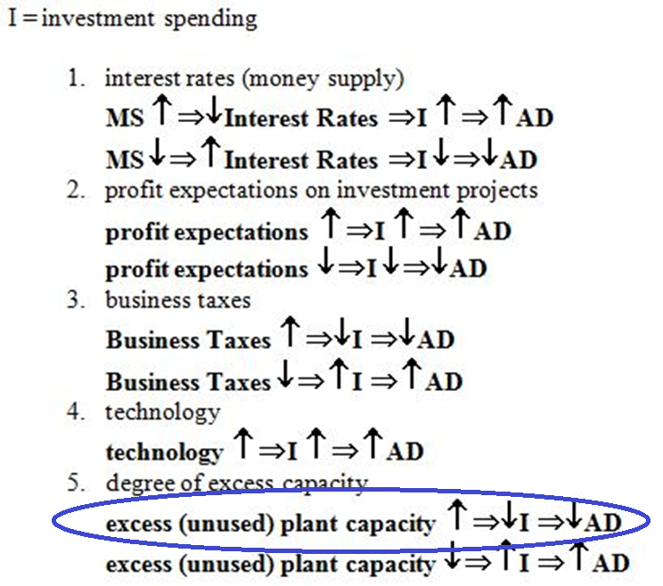

Slide 42
13. Assume the $ appreciates.
Which is correct as a result?
Exports decrease causing AD to go down
Consumer Debt increases causing AD to go down
Wealth increases causing AD to go up
Net Exports decrease causing AD to go down

Slide 43
13. Assume the $ appreciates.
Which is correct as a result?
Exports decrease causing AD to go down
Consumer Debt increases causing AD to go down
Wealth increases causing AD to go up
Net Exports decrease causing AD to go down

Slide 44
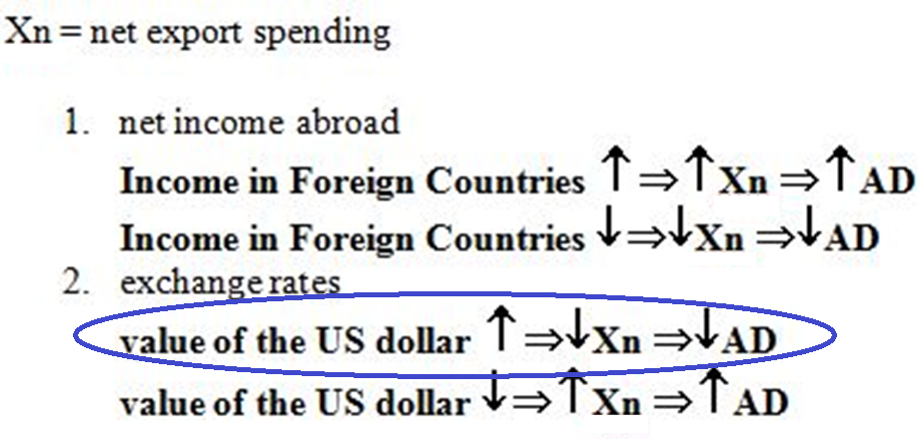

Slide 45
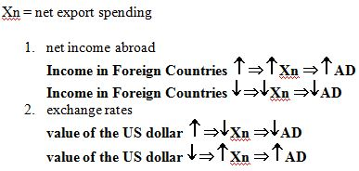

Slide 46
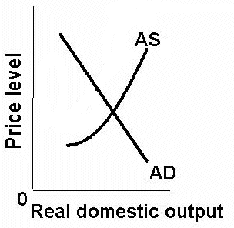
OUR GOAL:
To see what happens to:
  Unemployment (UE)
  Inflation (IN)
  Economic Growth (EG)
To do this we will need
both AD and AS and then
find the macroeconomic
equilibrium

