Slide 1
FISCAL POLICY 10a – The Spending Multiplier
This web quiz may appear as two pages on tablets and laptops.
I recommend that you view it as one page by clicking on the open book icon at the bottom of the page.

Slide 2
FISCAL POLICY 10a – The Spending Multiplier
TOPICS:
Consumption and Saving Schedules
APC, APS, MPC, MPS
The Multiplier Effect
The Multiplier with Inflation
The Complex Multiplier

Slide 3
10a – The Spending Multiplier
Outcomes / Must Know:
Recognize, construct, and explain the consumption and saving schedules.
Calculate and differentiate between the average and marginal propensities to consume (and save).
Provide an intuitive explanation of the multiplier effect.
We know that GDP = C + Ig + G + Xn.
If at full employment GDP equals $500 billion, but it is currently at $400 billion, then what increase in investment (I) is needed to achieve full employment? MPC = 0.8
Calculate the multiplier and changes in real GDP given information about changes in spending and the marginal propensities.
Discuss why the actual multiplier may differ from the theoretical examples (complex multiplier).
Why might a payroll tax cut have a bigger impact on GDP than a cut in income tax rates? Is MPC the same at all income levels? OR If you cut taxes on lower income people and raise the same amount of taxes from higher income people, what effect, if any, will it have on aggregate demand?
How does the spending multiplier work in "reverse"?
Describe the reasons for the instability in investment spending

Slide 4
10a – The Spending Multiplier
KEY TERMS: multiplier effect, consumption schedule, saving schedule, APC, APS, MPC, MPS, leakages and injections, income=expenditures stream, simple multiplier, complex (actual) multiplier, multiplier w/ changes in the price level (IN),

Slide 5
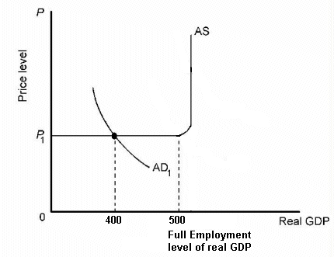
1. We know: GDP = C + Ig + G + Xn If full employment GDP = $500 billion and the equilibrium GDP = $400 billion, what change in I is needed to achieve full employment?
$100 billion
$200 billion
$300 billion
Less than $100 billion

Slide 6
1. We know: GDP = C + Ig + G + Xn If full employment GDP = $500 billion and the equilibrium GDP = $400 billion, what change in I is needed to achieve full employment?
$100 billion
$200 billion
$300 billion
Less than $100 billion

Slide 7
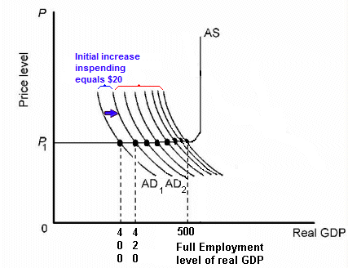
The Multiplier Effect
An initial change in spending (like Investment) causes a larger change in GDP.

Slide 8
2. MPC = ?
Level of output and income | Consumption | Saving
$100 | $120 | −$20
130 | 140 | −10
160 | 160 | 0
190 | 180 | 10
220 | 200 | 20
250 | 220 | 30
1/4
1/3
2/3
3/4

Slide 9
2. MPC = ?
Level of output and income | Consumption | Saving
$100 | $120 | −$20
130 | 140 | −10
160 | 160 | 0
190 | 180 | 10
220 | 200 | 20
250 | 220 | 30
1/4
1/3
2/3
3/4

Slide 10
3. MPS = ?
Level of output and income | Consumption | Saving
$100 | $120 | −$20
130 | 140 | −10
160 | 160 | 0
190 | 180 | 10
220 | 200 | 20
250 | 220 | 30
1/4
1/3
2/3
3/4

Slide 11
3. MPS = ?
Level of output and income | Consumption | Saving
$100 | $120 | −$20
130 | 140 | −10
160 | 160 | 0
190 | 180 | 10
220 | 200 | 20
250 | 220 | 30
1/4
1/3
2/3
3/4

Slide 12
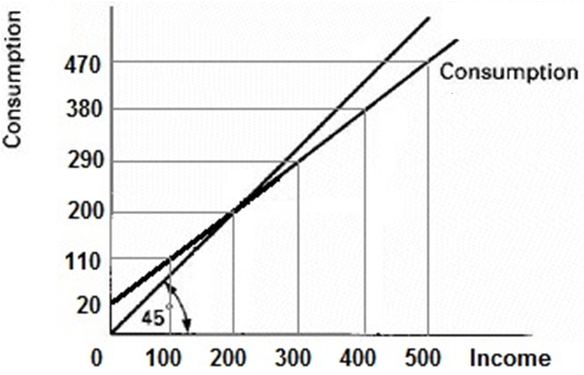
4. MPC = ?
0.1
0.5
0.8
0.9

Slide 13
4. MPC = ?
0.1
0.5
0.8
0.9

Slide 14
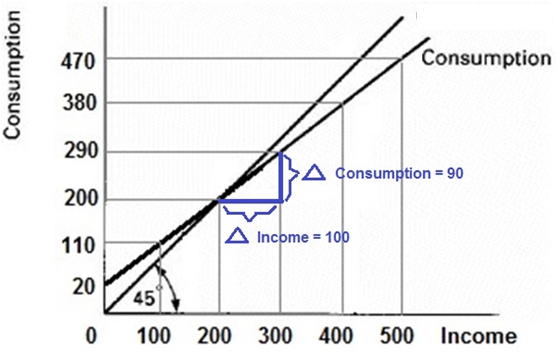
MPC = 0.9 = Slope of C = rise/run

Slide 15
5. MPS = ?
0.1
0.5
0.8
0.9

Slide 16
5. MPS = ?
0.1
0.5
0.8
0.9

Slide 17
6. Assume MPC = 0.8. We know: GDP = C + Ig + G + Xn If full employment GDP = $500 billion and the equilibrium GDP = $400 billion, what change in I is needed to achieve full employment?
$100 billion
$200 billion
$300 billion
$20 billion

Slide 18
6. Assume MPC = 0.8. We know: GDP = C + Ig + G + Xn If full employment GDP = $500 billion and the equilibrium GDP = $400 billion, what change in I is needed to achieve full employment?
$100 billion
$200 billion
$300 billion
$20 billion

Slide 19
The Multiplier Effect
An initial change in spending (like Investment) causes a larger change in GDP.

Slide 20
7. If Investment increases by $5, GDP will increase by how much?
Level of output and income | Consumption | Saving
$100 | $120 | −$20
130 | 140 | −10
160 | 160 | 0
190 | 180 | 10
220 | 200 | 20
250 | 220 | 30
$ 5
$10
$15
$30

Slide 21
7. If Investment increases by $5, GDP will increase by how much?
Level of output and income | Consumption | Saving
$100 | $120 | −$20
130 | 140 | −10
160 | 160 | 0
190 | 180 | 10
220 | 200 | 20
250 | 220 | 30
$ 5
$10
$15
$30

Slide 22
8. If Investment increases by $5, GDP will increase by how much?
$ 5
$ 15
$ 25
$ 50
$ 100

Slide 23
8. If Investment increases by $5, GDP will increase by how much?
$ 5
$ 15
$ 25
$ 50
$ 100

Slide 24
9. MPC = 0.6 If Investment increases by $100, and there is no inflation, what happens to GDP?
Stays the same
Increases by $ 60
Increases by $ 100
Increases by $ 200
Increases by $ 250

Slide 25
9. MPC = 0.6 If Investment increases by $100, and there is no inflation, what happens to GDP?
Stays the same
Increases by $ 60
Increases by $ 100
Increases by $ 200
Increases by $ 250

Slide 26
10. What happens to the size of the multiplier if the MPC increases (MPS decreases)?
It increases
It decreases
It doesn’t change

Slide 27
10. What happens to the size of the multiplier if the MPC increases (MPS decreases)?
It increases
It decreases
It doesn’t change

Slide 28
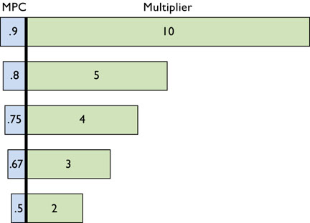

Slide 29
11. We have been assuming that MPC is constant over all income levels. Which is true “in the real world”?
MPC is constant
MPC is higher for the rich
MPC is higher for the poor.

Slide 30
11. We have been assuming that MPC is constant over all income levels. Which is true “in the real world”?
MPC is constant
MPC is higher for the rich
MPC is higher for the poor.

Slide 31
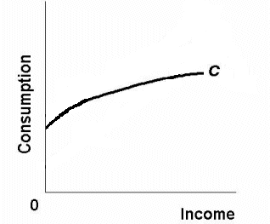
We have been assuming that MPC is constant over all income levels. But, in reality MPC is lower, and MPS is higher, for those with higher incomes.

Slide 32
12. Which would be a more effective expansionary FP?
Cutting taxes on the poor
Cutting taxes on the rich

Slide 33
12. Which would be a more effective expansionary FP?
Cutting taxes on the poor
Cutting taxes on the rich

Slide 34
13. If you cut taxes on lower income people and raise the same amount of taxes from higher income people, what effect, if any, will it have on aggregate demand?
No effect
AD will increase (and UE decrease)
AD will decrease (and UE increase)

Slide 35
13. If you cut taxes on lower income people and raise the same amount of taxes from higher income people, what effect, if any, will it have on aggregate demand?
No effect
AD will increase (and UE decrease)
AD will decrease (and UE increase)

Slide 36
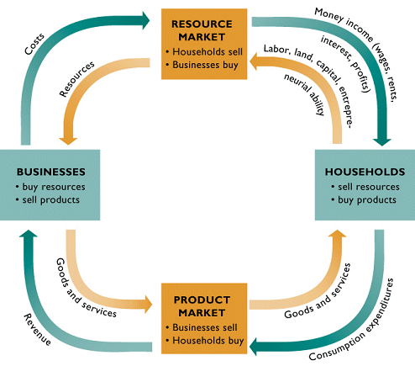
The Complex Multiplier
The Income-Expenditure stream:
Leakages and Injections

Slide 37
14. We have been ignoring leakages from the Income = Expenditure stream. Leakages will reduce spending \ Which of the following is NOT a Leakage?
Savings (S)
Investment (I)
Taxes (T)
Imports (M)
The Complex Multiplier

Slide 38
14. We have been ignoring leakages from the Income = Expenditure stream. Leakages will reduce spending \ Which of the following is NOT a Leakage?
Savings (S)
Investment (I)
Taxes (T)
Imports (M)
The Complex Multiplier

Slide 39
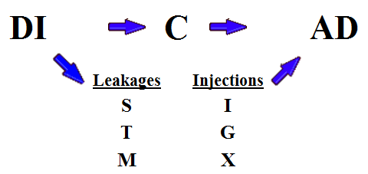
Disposable Income Becomes Spending (AD), but . . .
The Complex Multiplier

Slide 40
15. If we add taxes and imports to our model then what happens to the size of the multiplier?
It increases
It decreases
It doesn’t change
The Complex Multiplier

Slide 41
15. If we add taxes and imports to our model then what happens to the size of the multiplier?
It increases
It decreases
It doesn’t change
The Complex Multiplier

Slide 42
In the real world, with these additional leakages, the size of the multiplier is smaller than the simple multiplier. MPS = fraction of add’l income spent MPT = fraction of add’l income paid in taxes MPM = fraction of add’l income spent on imports
The Complex Multiplier

Slide 43
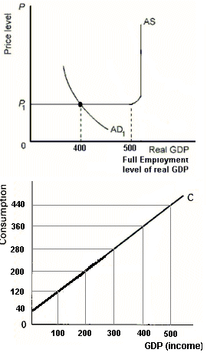
16. Change in G needed to achieve FE? (We will use the simple multiplier for government spending unless told otherwise)
$ 100
$ 80
$ 40
$ 20
The Government
Spending Multiplier

Slide 44
16. Change in G needed to achieve FE? (We will use the simple multiplier for government spending unless told otherwise)
$ 100
$ 80
$ 40
$ 20
The Government
Spending Multiplier

Slide 45
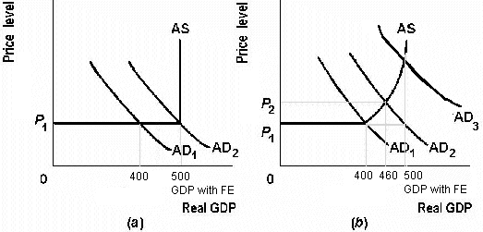
But what if there is inflation?
(a) No Inflation (b) Inflation
The Multiplier with Changes in the Price Level

Slide 46
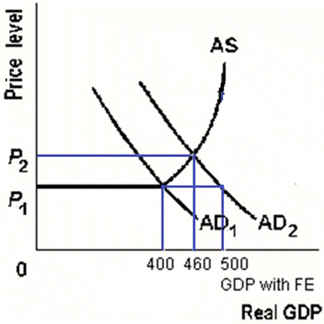
17. So, if MPC =.8, and G increases by $20, AND THERE IS INFLATION, what is the multiplier in the graph at right?
1
2
3
4
5
The Multiplier with Changes in the Price Level

Slide 47
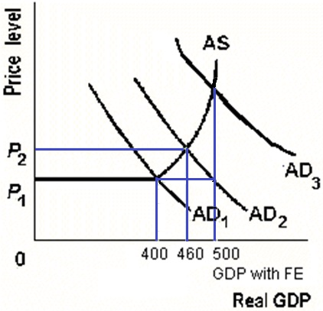
17. So, if MPC =.8, and G increases by $20, AND THERE IS INFLATION, what is the multiplier in the graph at right?
1
2
3
4
5
The Multiplier with Changes in the Price Level

Slide 48
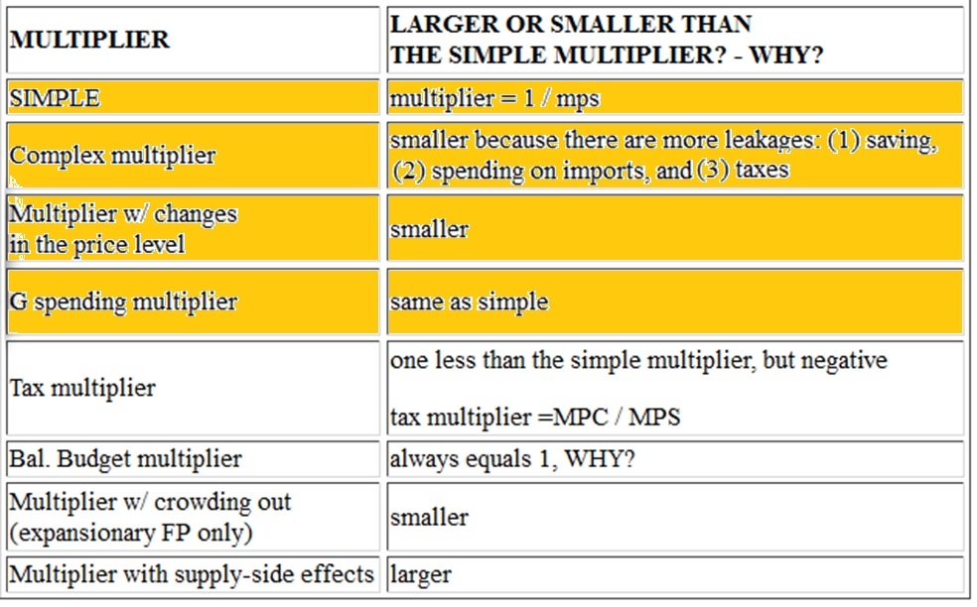
MULTIPLIERS (Lesson 10a)

