Slide 1
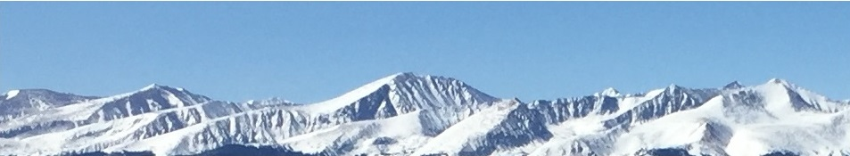
Final Exam Review – Short
(36 Questions)
This web quiz may appear as two pages on tablets and laptops.
I recommend that you view it as one page by clicking on the open book icon at the bottom of the page.

Slide 2
4. Other things equal, this economy will achieve the most rapid rate of growth if:
it chooses point A.
it chooses point B.
it chooses point C.
it chooses point D.

Slide 3
4. Other things equal, this economy will achieve the most rapid rate of growth if:
it chooses point A.
it chooses point B.
it chooses point C.
it chooses point D.

Slide 4
Answer the next question on the basis of the above information for four highway programs of increasing scope. All figures are in millions of dollars.
5. Which alternative should the government build?
A
B
C
D

Slide 5
Answer the next question on the basis of the above information for four highway programs of increasing scope. All figures are in millions of dollars.
5. Which alternative should the government build?
A
B
C
D

Slide 6
8. The “invisible hand” promotes society’s interest because:
Individuals pursuing their self-interest will produce goods that people want
Individuals will produce goods for others out of concern for their fellow human beings
It makes sure that everybody wins from competition
Government regulation pushes businesses into producing the right mix of goods

Slide 7
8. The “invisible hand” promotes society’s interest because:
Individuals pursuing their self-interest will produce goods that people want
Individuals will produce goods for others out of concern for their fellow human beings
It makes sure that everybody wins from competition
Government regulation pushes businesses into producing the right mix of goods

Slide 8

9. Assume before specialization both countries were producing at “B”, If they specialize 100% according to their comparative advantage, then the gains will be:
30 wheat
15 steel
60 steel and 60 wheat
60 steel and 20 wheat
YP 36

Slide 9
9. Assume before specialization both countries were producing at “B”, If they specialize 100% according to their comparative advantage, then the gains will be:
30 wheat
15 steel
60 steel and 60 wheat
60 steel and 20 wheat
YP 36

Slide 10
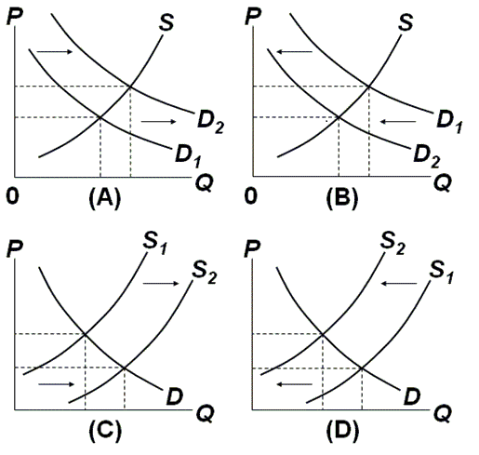
11 and 12

Slide 11
11. Which graph represents the effect of an increase in the price of oil on the market for gasoline?
A
B
C
D
Which Determinant?
Demand or Supply?
Increase or Decrease?
Graph it!

Slide 12
11. Which graph represents the effect of an increase in the price of oil on the market for gasoline?
A
B
C
D
Which Determinant?
Demand or Supply?
Increase or Decrease?
Graph it!

Slide 13
12. Which graph represents the effect of an increase in the smoking age on the market for cigarettes?
A
B
C
D
Which Determinant?
Demand or Supply?
Increase or Decrease?
Graph it!

Slide 14
12. Which graph represents the effect of an increase in the smoking age on the market for cigarettes?
A
B
C
D
Which Determinant?
Demand or Supply?
Increase or Decrease?
Graph it!

Slide 15
13. One can say for certainty that the equilibrium price will increase if:
S and D both increase
S increases and D decreases
S decreases and D increases
S and D both decrease

Slide 16
13. One can say for certainty that the equilibrium price will increase if:
S and D both increase
S increases and D decreases
S decreases and D increases
S and D both decrease

Slide 17
14. If a legal ceiling price is set above the equilibrium price:
A shortage of the product will occur
A surplus of the product will occur
A black market will evolve
Neither the price or quantity of the product will be affected

Slide 18
14. If a legal ceiling price is set above the equilibrium price:
A shortage of the product will occur
A surplus of the product will occur
A black market will evolve
Neither the price or quantity of the product will be affected

Slide 19
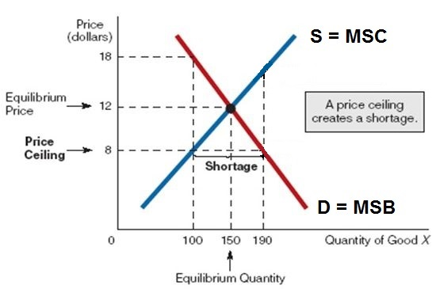
A price ceiling set below the equilibrium price will cause a shortage,
but a price ceiling set above the equilibrium price will have no effect.
Price ceilings are legally imposed maximum prices. They are used to decrease prices. Businesses can charge less than the price ceiling , but not more. Where is the profit maximizing price and quantity? ($12 and 150)

Slide 20
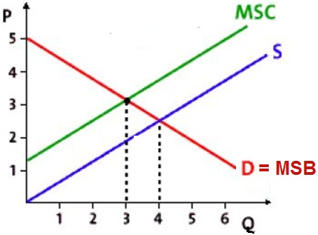
16. “S” is the supply with the negative externalities, How much will be produced?
Less than 3
3
4
More than 4
What is the allocatively efficient quantity?
WHAT WE WANT

Slide 21
16. “S” is the supply with the negative externalities, How much will be produced?
Less than 3
3
4
More than 4
What is the allocatively efficient quantity?
WHAT WE WANT

Slide 22
25. Which of the following is NOT a way to solve the efficiency problem of a positive externality?
Tax the product
Government produces the product itself
Increase demand for the product
Subsidize the product

Slide 23
25. Which of the following is NOT a way to solve the efficiency problem of a positive externality?
Tax the product
Government produces the product itself
Increase demand for the product
Subsidize the product

Slide 24
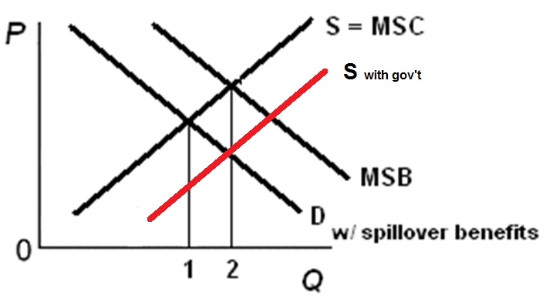
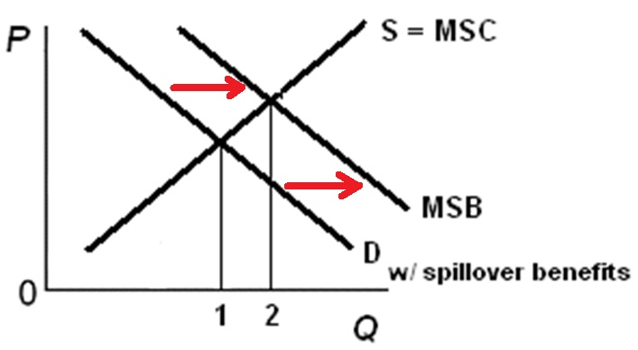
How to Correct for Positive Externalities
Increase Supply: Increase Demand:
Increase Supply: Increase Demand:
- subsidize producers - subsidize consumers
- example: solar panels - example: financial aid
- gov’t produces
- example: public schools, parks

Slide 25
26. A public good:
Is a rival, exclusive good
Is a non-rival, exclusive good
Is a non-rival, non-exclusive good
Does not have the free rider problem

Slide 26
26. A public good:
Is a rival, exclusive good
Is a non-rival, exclusive good
Is a non-rival, non-exclusive good
Does not have the free rider problem

Slide 27
28. Compared to the price elasticity of demand for gasoline, the elasticity of demand for Mobil gasoline is:
more inelastic
unit elastic
the same
more elastic

Slide 28
28. Compared to the price elasticity of demand for gasoline, the elasticity of demand for Mobil gasoline is:
more inelastic
unit elastic
the same
more elastic

Slide 29
29. What is the coefficient of price elasticity of supply between prices $2 and $10 (midpoints formula)?
5
2.5
1
0.25

Slide 30
29. What is the coefficient of price elasticity of supply between prices $2 and $10 (midpoints formula)?
5
2.5
1
0.25

Slide 31

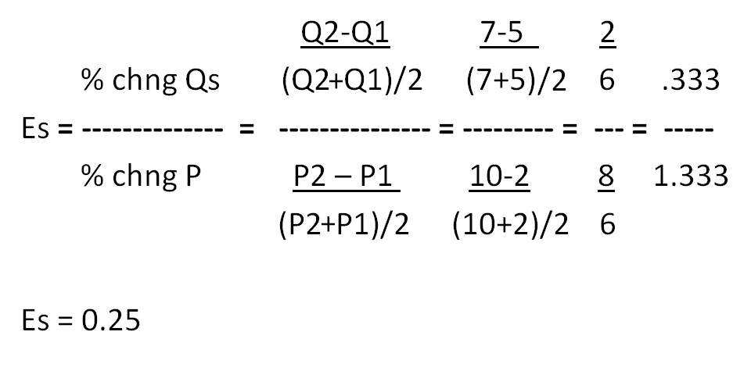
Price Elasticity of Supply – Midpoint Formula

Slide 32
30. If Es = 0.25, then a 10% increase in price will:
Increase quantity supplied by 2.5%
Decrease quantity supplied by 2.5%
Increase the quantity supplied by 25%
Not change the quantity supplied

Slide 33
30. If Es = 0.25, then a 10% increase in price will:
Increase quantity supplied by 2.5%
Decrease quantity supplied by 2.5%
Increase the quantity supplied by 25%
Not change the quantity supplied

Slide 34
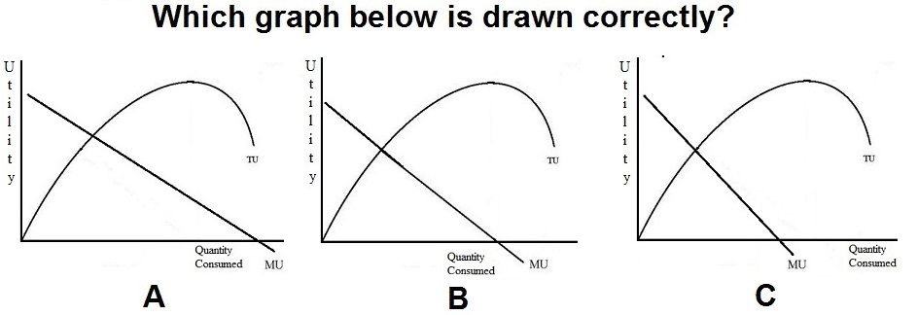
37.
A
B
C

Slide 35
37.
A
B
C

Slide 36
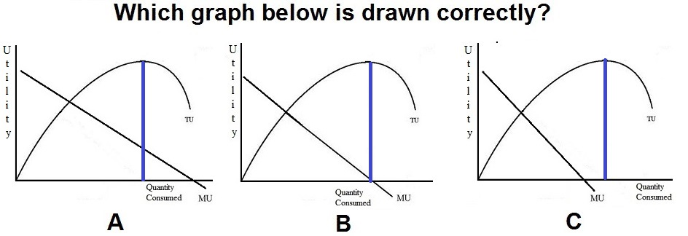
B is drawn correctly. MU is the slope of TU.
Initially the slope of TU is positive, but declining. So, MU
is positive and declining.
Then, at its peak the slope of TU is zero. And MU is zero
at that quantity
After that the slope is negative. So, MU is negative

Slide 37
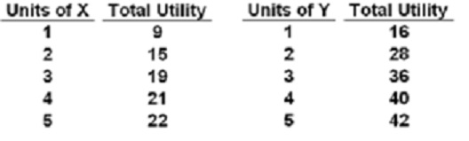
40. If:
PX=$2,
PY=$4, income=$18
How many of each will a rational consumer buy?
YP 26, #4
1X and 4Y
3X and 3Y
5X and 2Y
7X and 1Y

Slide 38
40. If:
PX=$2,
PY=$4, income=$18
How many of each will a rational consumer buy?
YP 26, #4
1X and 4Y
3X and 3Y
5X and 2Y
7X and 1Y

Slide 39
42. Pam runs her own plumbing business. Last year she earned $100 in total revenue and paid $65 to her suppliers and employees. Last year she was offered $40 to work for another plumber. What is Pam’s accounting profit?
$ 0
$ 35
-$ 5
$ 40

Slide 40
42. Pam runs her own plumbing business. Last year she earned $100 in total revenue and paid $65 to her suppliers and employees. Last year she was offered $40 to work for another plumber. What is Pam’s accounting profit?
$ 0
$ 35
-$ 5
$ 40

Slide 41
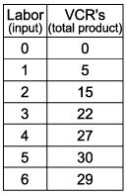
47. Diminishing marginal returns begin with the _____ worker.
1st
2nd
3rd
4th
5th
6th

Slide 42
47. Diminishing marginal returns begin with the _____ worker.
1st
2nd
3rd
4th
5th
6th

Slide 43
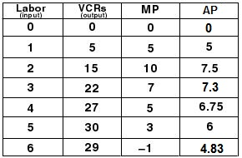
7a – Economic Profit and the Production Function

Slide 44
48. When the TP curve is increasing at a decreasing rate, then MP is:
Increasing and positive
Increasing and negative
Decreasing and positive
Decreasing and negative

Slide 45
48. When the TP curve is increasing at a decreasing rate, then MP is:
Increasing and positive
Increasing and negative
Decreasing and positive
Decreasing and negative

Slide 46
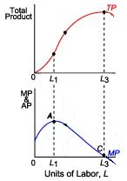

Slide 47
54. Which is NOT a characteristic of pure competition?
Very many firms
Price takers (no control over price)
Standardized product
High Herfindahl index
No barriers to entry
No non-price competition

Slide 48
54. Which is NOT a characteristic of pure competition?
Very many firms
Price takers (no control over price)
Standardized product
High Herfindahl index
No barriers to entry
No non-price competition

Slide 49
55. Which is NOT a characteristic of monopolies?
Single firm
A lot of control over price
Mutual interdependence
Unique product
Blocked entry
Public relations non-price competition

Slide 50
55. Which is NOT a characteristic of monopolies?
Single firm
A lot of control over price
Mutual interdependence
Unique product
Blocked entry
Public relations non-price competition

Slide 51
56. Which is not a characteristic of monopolistic competition?
Many firms
Standardized product
Some control over price (market power)
Low barriers to entry
A lot of non-price competition

Slide 52
56. Which is not a characteristic of monopolistic competition?
Many firms
Standardized product
Some control over price (market power)
Low barriers to entry
A lot of non-price competition

Slide 53
57. Which is not a characteristic of oligopolies?
Few firms
Standardized or differentiated products
Blocked entry
Mutual interdependence
Collusion possible

Slide 54
57. Which is not a characteristic of oligopolies?
Few firms
Standardized or differentiated products
Blocked entry
Mutual interdependence
Collusion possible

Slide 55
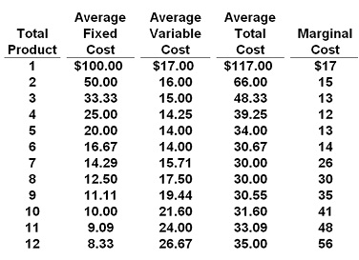
58. If P = $32, this competitive firm will produce:
6
7
8
9

Slide 56
58. If P = $32, this competitive firm will produce:
6
7
8
9

Slide 57
59. If the market price for the firm's product is $13, the competitive firm will produce:
5, loss = $105
5, profit = $105
8, loss = $136
zero, loss = $100

Slide 58
59. If the market price for the firm's product is $13, the competitive firm will produce:
5, loss = $105
5, profit = $105
8, loss = $136
zero, loss = $100

Slide 59
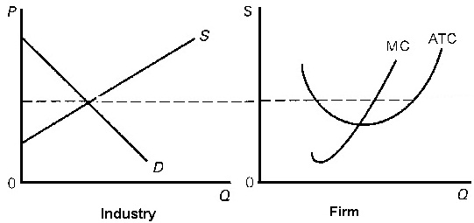
62. Assume pure competition.
What will happen in the long run?
Demand will increase
Demand will decrease
Supply will increase
Supply will decrease

Slide 60
62. Assume pure competition.
What will happen in the long run?
Demand will increase
Demand will decrease
Supply will increase
Supply will decrease

Slide 61
64. Productive efficiency:
MR = MC
MC = ATC
P = MC
MSB = MSC

Slide 62
64. Productive efficiency:
MR = MC
MC = ATC
P = MC
MSB = MSC

Slide 63
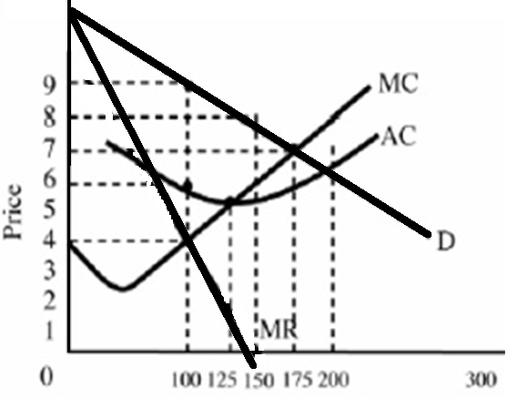
67. What would the profits be?
$1200
$900
$600
$400
$300

Slide 64
67. What would the profits be?
$1200
$900
$600
$400
$300

Slide 65
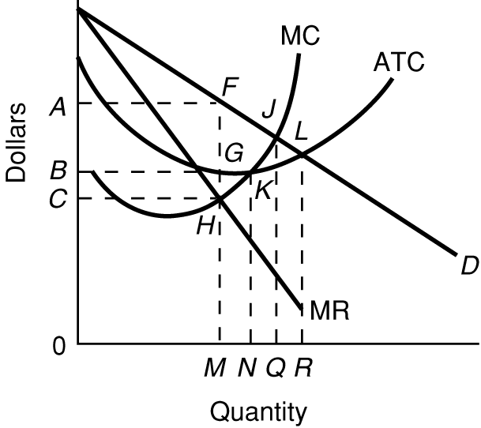
69. If this firm were a perfectly price discriminating monopolist, what quantity would be produced?
N
M
Q
R

Slide 66
69. If this firm were a perfectly price discriminating monopolist, what quantity would be produced?
N
M
Q
R

Slide 67
70. If the government uses AC pricing (fair return pricing) they would put a price ceiling at:
P1
P2
P3
P4

Slide 68
70. If the government uses AC pricing (fair return pricing) they would put a price ceiling at:
P1
P2
P3
P4

Slide 69
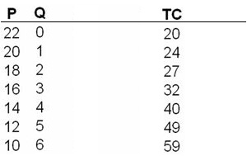
71. What is the profit-maximizing output and price for this monopolistically competitive firm?
P = 12; Q = 5
P = 14; Q = 4
P = 16; Q = 3
P = 18; Q = 2

Slide 70
71. What is the profit-maximizing output and price for this monopolistically competitive firm?
P = 12; Q = 5
P = 14; Q = 4
P = 16; Q = 3
P = 18; Q = 2

Slide 71
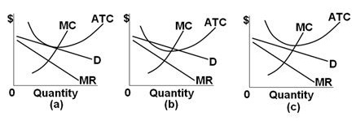
72. If the SR is (b), then in the LR for Monop. Comp. firms:
Entry is blocked so there will be no change
Firms will enter and demand will decrease
Firms will leave and supply will decrease
Firms will enter and demand will increase

Slide 72
72. If the SR is (b), then in the LR for Monop. Comp. firms:
Entry is blocked so there will be no change
Firms will enter and demand will decrease
Firms will leave and supply will decrease
Firms will enter and demand will increase

Slide 73
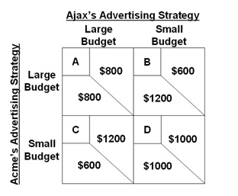
For the following questions refer to this game theory matrix where the numerical data show the profits resulting from alternative combinations of advertising strategies for Ajax and Acme.

Slide 74
77. The Nash equilibrium will be cell:
A
B
C
D

Slide 75
77. The Nash equilibrium will be cell:
A
B
C
D

Slide 76
78. How many workers will the firm hire if the wage rate is $8 per day? YP 23
3
4
5
6

Slide 77
78. How many workers will the firm hire if the wage rate is $8 per day? YP 23
3
4
5
6

Slide 78
Simple
Immigration
Model
YP 81 #5
Alphania's domestic labor force is F and that of Betania is g.
82. As a result of migration:
World output will increase by mljh minus MLJH
Betania’s output will increase, Alphania’s decrease, but world output will stay the same
World output will increase by gjhf minus GJHF
World output will decrease by gjhf minus GJHF

Slide 79
Simple
Immigration
Model
YP 81 #5
Alphania's domestic labor force is F and that of Betania is g.
82. As a result of migration:
World output will increase by mljh minus MLJH
Betania’s output will increase, Alphania’s decrease, but world output will stay the same
World output will increase by gjhf minus GJHF
World output will decrease by gjhf minus GJHF

Slide 80
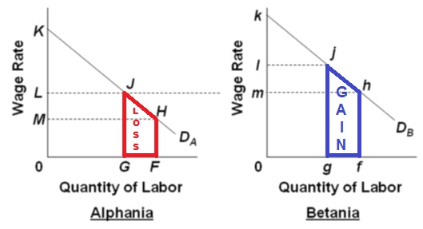
22a - Immigration

Slide 81
83. If initially the gov’t cannot stop illegal immigration, but then finds a way to block it, then ____ domestic workers gain jobs and ____ immigrants lose jobs. (YP 84 #5)
100,000 gain jobs, 200,000 lose
200,000 gain jobs, 200,000 lose
100,000 gain jobs, 250,000 lose
100,000 gain jobs, 150,000 lose

Slide 82
83. If initially the gov’t cannot stop illegal immigration, but then finds a way to block it, then ____ domestic workers gain jobs and ____ immigrants lose jobs. (YP 84 #5)
100,000 gain jobs, 200,000 lose
200,000 gain jobs, 200,000 lose
100,000 gain jobs, 250,000 lose
100,000 gain jobs, 150,000 lose

Slide 83
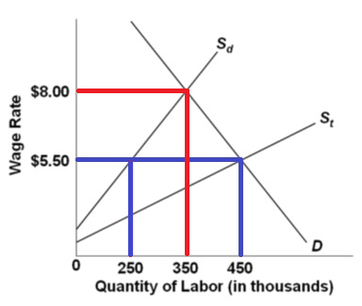
Total employment now = 350, so:
100 domestic workers gained jobs (350 – 250)
200 illegal workers lost jobs (450 – 250)

Slide 84
Study hard!

