Slide 1
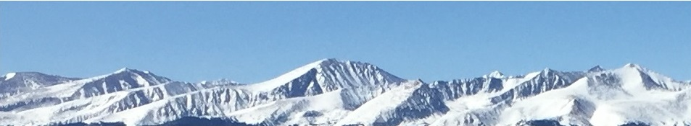
Final Exam Review – Long
(83 Questions)
This web quiz may appear as two pages on tablets and laptops.
I recommend that you view it as one page by clicking on the open book icon at the bottom of the page.

Slide 2
1. Suppose you have a money income of $10, all of which you spend on Coke and popcorn. The price of Coke is:
$.10
$.20
$.50
$1.00

Slide 3
1. Suppose you have a money income of $10, all of which you spend on Coke and popcorn. The price of Coke is:
$.10
$.20
$.50
$1.00

Slide 4
2. Which of the following is NOT one of the assumptions behind the PPC?
Fixed resources
Fixed technology
Productive efficiency
Allocative efficiency
Full employment
Only two goods

Slide 5
2. Which of the following is NOT one of the assumptions behind the PPC?
Fixed resources
Fixed technology
Productive efficiency
Allocative efficiency
Full employment
Only two goods

Slide 6
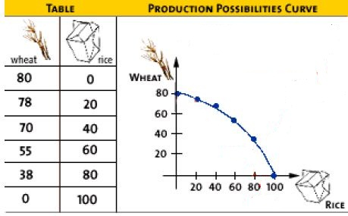
3. What is the opportunity cost of the first 20 rice?
80 wheat
78 wheat
70 wheat
2 wheat

Slide 7
3. What is the opportunity cost of the first 20 rice?
80 wheat
78 wheat
70 wheat
2 wheat

Slide 8
4. Other things equal, this economy will achieve the most rapid rate of growth if:
it chooses point A.
it chooses point B.
it chooses point C.
it chooses point D.

Slide 9
4. Other things equal, this economy will achieve the most rapid rate of growth if:
it chooses point A.
it chooses point B.
it chooses point C.
it chooses point D.

Slide 10
Answer the next question on the basis of the above information for four highway programs of increasing scope. All figures are in millions of dollars.
5. Which alternative should the government build?
A
B
C
D

Slide 11
Answer the next question on the basis of the above information for four highway programs of increasing scope. All figures are in millions of dollars.
5. Which alternative should the government build?
A
B
C
D

Slide 12
6. If the MB < MC, then:
You should do more
You should do less
The result is optimal
The best choice was made

Slide 13
6. If the MB < MC, then:
You should do more
You should do less
The result is optimal
The best choice was made

Slide 14
7. Economic profits in an industry suggest the industry (Lesson 2a):
Can earn more profits by increasing the price
Should be larger to satisfy consumers
Has excess capacity
Is the correct size for consumers

Slide 15
7. Economic profits in an industry suggest the industry (Lesson 2a):
Can earn more profits by increasing the price
Should be larger to satisfy consumers
Has excess capacity
Is the correct size for consumers

Slide 16
8. The “invisible hand” promotes society’s interest because:
Individuals pursuing their self-interest will produce goods that people want
Individuals will produce goods for others out of concern for their fellow human beings
It makes sure that everybody wins from competition
Government regulation pushes businesses into producing the right mix of goods

Slide 17
8. The “invisible hand” promotes society’s interest because:
Individuals pursuing their self-interest will produce goods that people want
Individuals will produce goods for others out of concern for their fellow human beings
It makes sure that everybody wins from competition
Government regulation pushes businesses into producing the right mix of goods

Slide 18

9. Assume before specialization both countries were producing at “B”, If they specialize 100% according to their comparative advantage, then the gains will be:
30 wheat
15 steel
60 steel and 60 wheat
60 steel and 20 wheat
YP 36

Slide 19
9. Assume before specialization both countries were producing at “B”, If they specialize 100% according to their comparative advantage, then the gains will be:
30 wheat
15 steel
60 steel and 60 wheat
60 steel and 20 wheat
YP 36

Slide 20
10. If the price in this market for wheat was $4:
The market would “clear”, Qd would equal Qs
Buyers would want to purchase more wheat than is currently being supplied
Farmers would not be able to sell all of their wheat
There would be a shortage of wheat

Slide 21
10. If the price in this market for wheat was $4:
The market would “clear”, Qd would equal Qs
Buyers would want to purchase more wheat than is currently being supplied
Farmers would not be able to sell all of their wheat
There would be a shortage of wheat

Slide 22
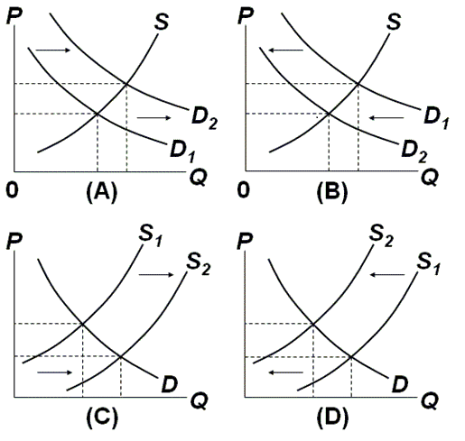
11 and 12

Slide 23
11. Which graph represents the effect of an increase in the price of oil on the market for gasoline?
A
B
C
D
Which Determinant?
Demand or Supply?
Increase or Decrease?
Graph it!

Slide 24
11. Which graph represents the effect of an increase in the price of oil on the market for gasoline?
A
B
C
D
Which Determinant?
Demand or Supply?
Increase or Decrease?
Graph it!

Slide 25
12. Which graph represents the effect of an increase in the smoking age on the market for cigarettes?
A
B
C
D
Which Determinant?
Demand or Supply?
Increase or Decrease?
Graph it!

Slide 26
12. Which graph represents the effect of an increase in the smoking age on the market for cigarettes?
A
B
C
D
Which Determinant?
Demand or Supply?
Increase or Decrease?
Graph it!

Slide 27
13. One can say for certainty that the equilibrium price will increase if:
S and D both increase
S increases and D decreases
S decreases and D increases
S and D both decrease

Slide 28
13. One can say for certainty that the equilibrium price will increase if:
S and D both increase
S increases and D decreases
S decreases and D increases
S and D both decrease

Slide 29
14. If a legal ceiling price is set above the equilibrium price:
A shortage of the product will occur
A surplus of the product will occur
A black market will evolve
Neither the price or quantity of the product will be affected

Slide 30
14. If a legal ceiling price is set above the equilibrium price:
A shortage of the product will occur
A surplus of the product will occur
A black market will evolve
Neither the price or quantity of the product will be affected

Slide 31
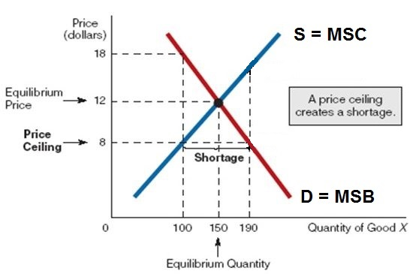
A price ceiling set below the equilibrium price will cause a shortage,
but a price ceiling set above the equilibrium price will have no effect.
Price ceilings are legally imposed maximum prices. They are used to decrease prices. Businesses can charge less than the price ceiling , but not more. Where is the profit maximizing price and quantity? ($12 and 150)

Slide 32
15. The allocative inefficiency of an effective price ceiling can be seen in the fact that:
MSB = MSC
MSB > MSC
MSB < MSC
There is no dead weight loss

Slide 33
15. The allocative inefficiency of an effective price ceiling can be seen in the fact that:
MSB = MSC
MSB > MSC
MSB < MSC
There is no dead weight loss

Slide 34
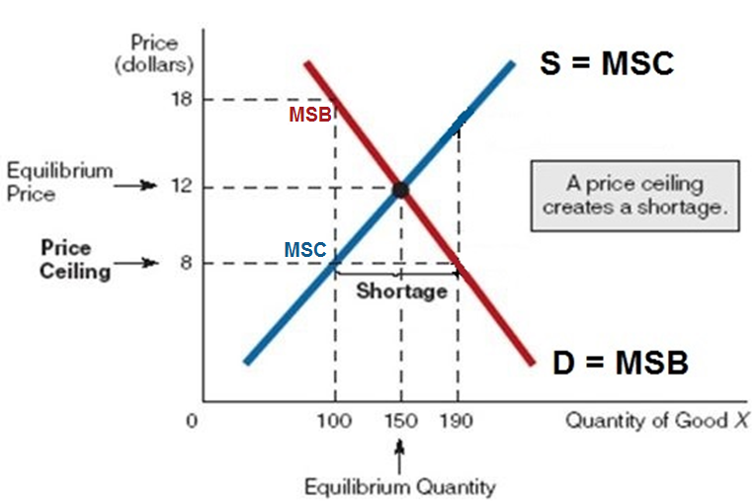
If there is an effective price ceiling set at $8, then businesses will produce 100. When quantity is 100 the MSB (red line) are greater then the MSC (blue line).
At Q = 100: MSB>MSC (MSB = 18, MSC = 8) We want more.

Slide 35
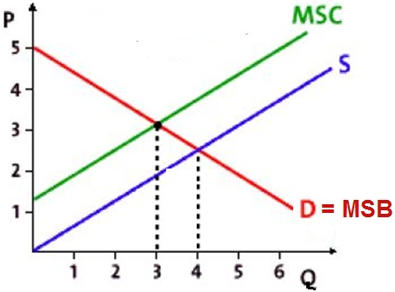
16. “S” is the supply with the negative externalities, How much will be produced?
Less than 3
3
4
More than 4
What is the allocatively efficient quantity?
WHAT WE WANT

Slide 36
16. “S” is the supply with the negative externalities, How much will be produced?
Less than 3
3
4
More than 4
What is the allocatively efficient quantity?
WHAT WE WANT

Slide 37
17. What is the Alloc. Eff. Q?
Less than 3
3
4
More than 4

Slide 38
17. What is the Alloc. Eff. Q?
Less than 3
3
4
More than 4

Slide 39
18. Why is the S curve to the right of the MSC curve?
Firm’s costs are
higher because
of neg. ext.
Firm’s costs are lower because of neg. ext.
Firm’s costs are higher because of pos. ext.
Firm’s costs are lower because of pos. ext.

Slide 40
18. Why is the S curve to the right of the MSC curve?
Firm’s costs are
higher because
of neg. ext.
Firm’s costs are lower because of neg. ext.
Firm’s costs are higher because of pos. ext.
Firm’s costs are lower because of pos. ext.

Slide 41
19. The allocative inefficiency caused by a negative externality can be seen in the fact that:
MSB = MSC
MSB > MSC
MSB < MSC
There is no dead weight loss

Slide 42
19. The allocative inefficiency caused by a negative externality can be seen in the fact that:
MSB = MSC
MSB > MSC
MSB < MSC
There is no dead weight loss

Slide 43
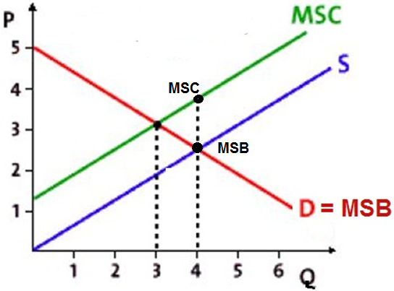
If there are neg. externalities then 4 will be produced
(where Qs=Qd, the profit max. Q, WHAT WE GET).
At a quantity of 4: MSB < MSC
indicating that too much is being produced.

Slide 44
20. Which of the following is NOT a way to solve the efficiency problem of a negative externality?
Tax the product
Government regulations
Coase theorem
Subsidize the product

Slide 45
20. Which of the following is NOT a way to solve the efficiency problem of a negative externality?
Tax the product
Government regulations
Coase theorem
Subsidize the product

Slide 46
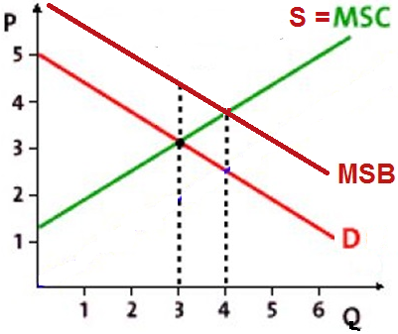
21. This graph shows the effect of a:
Price ceiling
Price floor
Positive externality
Negative externality

Slide 47
21. This graph shows the effect of a:
Price ceiling
Price floor
Positive externality
Negative externality

Slide 48
22. When positive externalities are in a market for a good, the market
Succeeds, because it is producing the socially optimal (alloc. eff.) output
Fails, because it overproduces the good
Succeeds, because it overproduces the good
Fails, because it underproduces the good

Slide 49
22. When positive externalities are in a market for a good, the market
Succeeds, because it is producing the socially optimal (alloc. eff.) output
Fails, because it overproduces the good
Succeeds, because it overproduces the good
Fails, because it underproduces the good

Slide 50
23. “D” is the demand when there are positive externalities.
How much will be produced?
Less than 3
3
4
More than 4

Slide 51
23. “D” is the demand when there are positive externalities.
How much will be produced?
Less than 3
3
4
More than 4

Slide 52
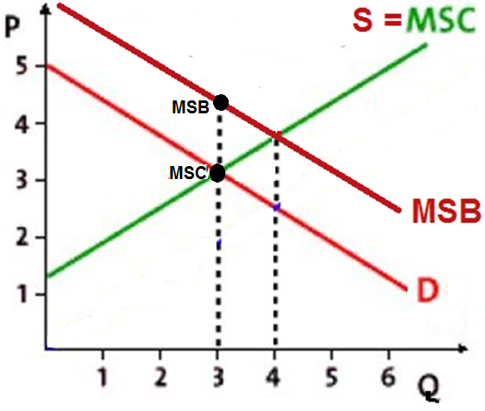
If there are pos. externalities then 3 will be produced
(where Qs=Qd, the profit max. Q, WHAT WE GET).
At a quantity of 3: MSB > MSC
indicating that too little is being produced.

Slide 53
24. What is the Alloc. Eff. Q?
Less than 3
3
4
More than 4

Slide 54
24. What is the Alloc. Eff. Q?
Less than 3
3
4
More than 4

Slide 55
25. Which of the following is NOT a way to solve the efficiency problem of a positive externality?
Tax the product
Government produces the product itself
Increase demand for the product
Subsidize the product

Slide 56
25. Which of the following is NOT a way to solve the efficiency problem of a positive externality?
Tax the product
Government produces the product itself
Increase demand for the product
Subsidize the product

Slide 57
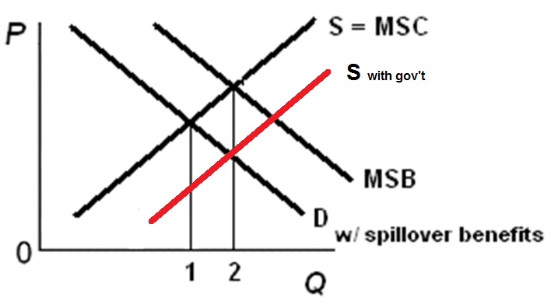
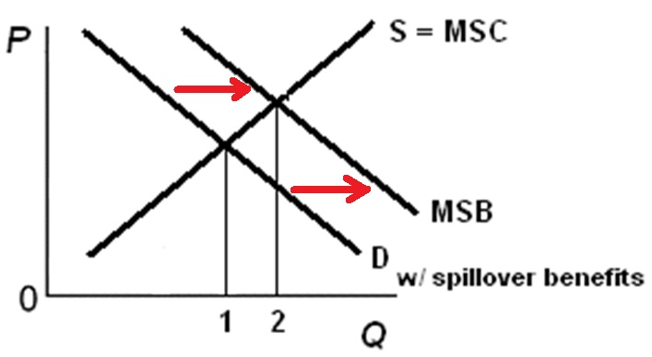
How to Correct for Positive Externalities
Increase Supply: Increase Demand:
Increase Supply: Increase Demand:
- subsidize producers - subsidize consumers
- example: solar panels - example: financial aid
- gov’t produces
- example: public schools, parks

Slide 58
26. A public good:
Is a rival, exclusive good
Is a non-rival, exclusive good
Is a non-rival, non-exclusive good
Does not have the free rider problem

Slide 59
26. A public good:
Is a rival, exclusive good
Is a non-rival, exclusive good
Is a non-rival, non-exclusive good
Does not have the free rider problem

Slide 60
27. The role of government concerning public goods is to:
Tax the product
Regulate the product
Produce the product
Apply the Coase theorem

Slide 61
27. The role of government concerning public goods is to:
Tax the product
Regulate the product
Produce the product
Apply the Coase theorem

Slide 62
28. Compared to the price elasticity of demand for gasoline, the elasticity of demand for Mobil gasoline is:
more inelastic
unit elastic
the same
more elastic

Slide 63
28. Compared to the price elasticity of demand for gasoline, the elasticity of demand for Mobil gasoline is:
more inelastic
unit elastic
the same
more elastic

Slide 64
29. What is the coefficient of price elasticity of supply between prices $2 and $10 (midpoints formula)?
5
2.5
1
0.25

Slide 65
29. What is the coefficient of price elasticity of supply between prices $2 and $10 (midpoints formula)?
5
2.5
1
0.25

Slide 66

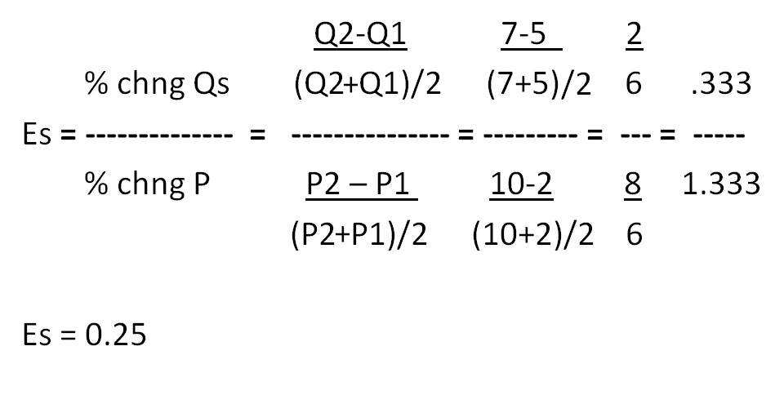
Price Elasticity of Supply – Midpoint Formula

Slide 67
30. If Es = 0.25, then a 10% increase in price will:
Increase quantity supplied by 2.5%
Decrease quantity supplied by 2.5%
Increase the quantity supplied by 25%
Not change the quantity supplied

Slide 68
30. If Es = 0.25, then a 10% increase in price will:
Increase quantity supplied by 2.5%
Decrease quantity supplied by 2.5%
Increase the quantity supplied by 25%
Not change the quantity supplied

Slide 69
31. If Es = 2.5, then a 10% increase in price will:
Increase quantity supplied by 2.5%
Decrease quantity supplied by 2.5%
Increase the quantity supplied by 25%
Not change the quantity supplied

Slide 70
31. If Es = 2.5, then a 10% increase in price will:
Increase quantity supplied by 2.5%
Decrease quantity supplied by 2.5%
Increase the quantity supplied by 25%
Not change the quantity supplied

Slide 71
32. If the price of almonds increases 10% causing the quantity of walnuts sold to increase 5%, then Eab= ?
(What is the cross elasticity of demand?)
- 0.1
+ 0.1
- 0.5
+ 0.5
- 5.0
+ 5.0

Slide 72
32. If the price of almonds increases 10% causing the quantity of walnuts sold to increase 5%, then Eab= ?
(What is the cross elasticity of demand?)
- 0.1
+ 0.1
- 0.5
+ 0.5
- 5.0
+ 5.0

Slide 73

Cross Elasticity of Demand
% chng Qa +5
Es = -------------- = --------- = + 0.5
% chng Pb +10

Slide 74
33. If the cross elasticity of demand is - 2, this means a 10% increase in the price of product A will:
decrease the quantity of product B sold by 2%
increase the quantity of product B sold by 2%
decrease the quantity of product B sold by 20%
increase the quantity of product B sold by 20%
Substitutes or Complements?
Cross Elastic or Cross Inelastic?

Slide 75
33. If the cross elasticity of demand is - 2, this means a 10% increase in the price of product A will:
decrease the quantity of product B sold by 2%
increase the quantity of product B sold by 2%
decrease the quantity of product B sold by 20%
increase the quantity of product B sold by 20%
Substitutes or Complements?
Cross Elastic or Cross Inelastic?

Slide 76
34. If the cross elasticity of demand is + 0.5, this means:
The demand is cross elastic
The demand is cross inelastic
The demand for toys is income elastic
The demand for toys is income inelastic
Substitutes or Complements?

Slide 77
34. If the cross elasticity of demand is + 0.5, this means:
The demand is cross elastic
The demand is cross inelastic
The demand for toys is income elastic
The demand for toys is income inelastic
Substitutes or Complements?

Slide 78
Cross Elasticity of Demand
See Lesson 4b Key Problems for more Cross Elasticity problems.

Slide 79
35. If the incomes increases 10% causing the quantity of ramen noodles sold to decrease 5%, then Edy = ?
(What is the income elasticity of demand?)
- 0.1
+ 0.1
- 0.5
+ 0.5
- 5.0
+ 5.0

Slide 80
35. If the incomes increases 10% causing the quantity of ramen noodles sold to decrease 5%, then Edy = ?
(What is the income elasticity of demand?)
- 0.1
+ 0.1
- 0.5
+ 0.5
- 5.0
+ 5.0

Slide 81

Income Elasticity of Demand
% chang Q -5
Edy = -------------------- = --------- = - 0.5
% chang Income +10

Slide 82
36. If the income elasticity of demand for toys is + 1.5, this means:
Toys and candy are substitutes
Toys are normal goods
Toys are inferior goods
Toys are necessities
Income Elastic or Income Inelastic?

Slide 83
36. If the income elasticity of demand for toys is + 1.5, this means:
Toys and candy are substitutes
Toys are normal goods
Toys are inferior goods
Toys are necessities
Income Elastic or Income Inelastic?

Slide 84

4 Types of Elasticity

Slide 85
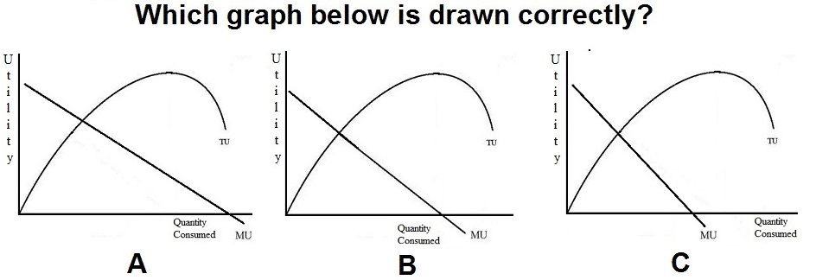
37.
A
B
C

Slide 86
37.
A
B
C

Slide 87
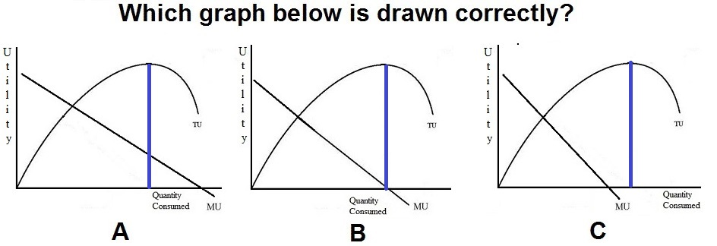
B is drawn correctly. MU is the slope of TU.
Initially the slope of TU is positive, but declining. So, MU
is positive and declining.
Then, at its peak the slope of TU is zero. And MU is zero
at that quantity
After that the slope is negative. So, MU is negative

Slide 88
38. To maximize utility a consumer should spend their money so that the:
Elasticity of demand on all products is the same
MU obtained from the last dollar spent on each product is the same
TU derived from each product consumed is the same
MU of the last unit of each product consumed is the same

Slide 89
38. To maximize utility a consumer should spend their money so that the:
Elasticity of demand on all products is the same
MU obtained from the last dollar spent on each product is the same
TU derived from each product consumed is the same
MU of the last unit of each product consumed is the same

Slide 90
39. Suppose that the MUx/Px > MUy/Py, to maximize utility the consumer should buy:
Less of X only if its price rises
More of Y only if its price rises
More Y and less X
More X and less Y

Slide 91
39. Suppose that the MUx/Px > MUy/Py, to maximize utility the consumer should buy:
Less of X only if its price rises
More of Y only if its price rises
More Y and less X
More X and less Y

Slide 92
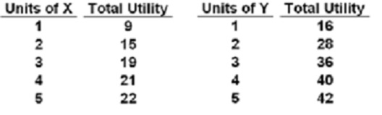
40. If:
PX=$2,
PY=$4, income=$18
How many of each will a rational consumer buy?
YP 26, #4
1X and 4Y
3X and 3Y
5X and 2Y
7X and 1Y

Slide 93
40. If:
PX=$2,
PY=$4, income=$18
How many of each will a rational consumer buy?
YP 26, #4
1X and 4Y
3X and 3Y
5X and 2Y
7X and 1Y

Slide 94
41. If:
PX=$2, PY=$4, income=$18 what is the maximum utility possible?
YP 26, #5
49 utils
50 utils
52 utils
55 utils

Slide 95
41. If:
PX=$2, PY=$4, income=$18 what is the maximum utility possible?
YP 26, #5
49 utils
50 utils
52 utils
55 utils

Slide 96
42. Pam runs her own plumbing business. Last year she earned $100 in total revenue and paid $65 to her suppliers and employees. Last year she was offered $40 to work for another plumber. What is Pam’s accounting profit?
$ 0
$ 35
-$ 5
$ 40

Slide 97
42. Pam runs her own plumbing business. Last year she earned $100 in total revenue and paid $65 to her suppliers and employees. Last year she was offered $40 to work for another plumber. What is Pam’s accounting profit?
$ 0
$ 35
-$ 5
$ 40

Slide 98
43. Pam runs her own plumbing business. Last year she earned $100 in total revenue and paid $65 to her suppliers and employees. Last year she was offered $40 to work for another plumber. What is Pam’s economic profit?
$ 0
$ 35
- $ 5
$ 40

Slide 99
43. Pam runs her own plumbing business. Last year she earned $100 in total revenue and paid $65 to her suppliers and employees. Last year she was offered $40 to work for another plumber. What is Pam’s economic profit?
$ 0
$ 35
- $ 5
$ 40

Slide 100
Pam runs her own plumbing business. Last year she earned $100 in total revenue and paid $65 to her suppliers and employees. Last year she was offered $40 to work for another plumber.
Accounting profit = $35
Economic profit = - $ 5
What should Pam do, stay in business or work for the other plumber?
7a – Economic Profit and the Production Function

Slide 101
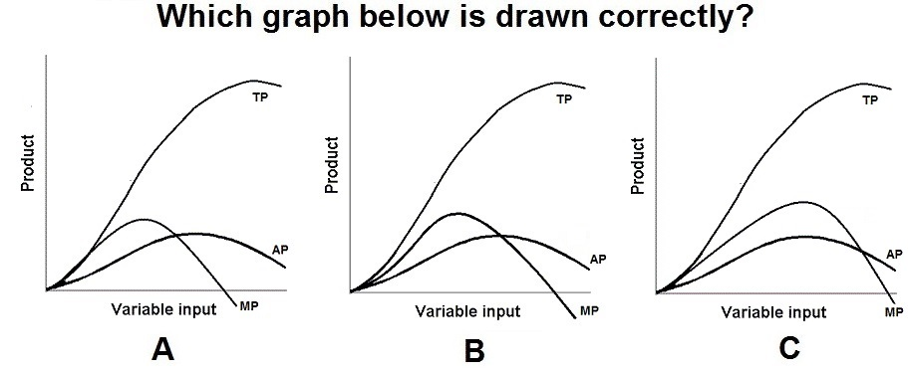
44.
A
B
C

Slide 102
44.
A
B
C

Slide 103
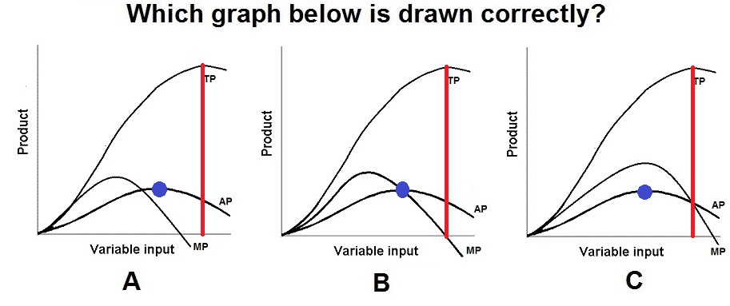
7a – Economic Profit and the Production Function

Slide 104
45. The production function (TP curve) shows how:
costs change with output
costs change with the number of inputs
output changes with the number of inputs
profits change with output

Slide 105
45. The production function (TP curve) shows how:
costs change with output
costs change with the number of inputs
output changes with the number of inputs
profits change with output

Slide 106
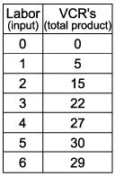
46. The slope of the TP curve equals zero with the _____ worker.
1st
2nd
3rd
4th
5th
6th

Slide 107
46. The slope of the TP curve equals zero with the _____ worker.
1st
2nd
3rd
4th
5th
6th

Slide 108
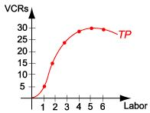
7a – Economic Profit and the Production Function

Slide 109
47. Diminishing marginal returns begin with the _____ worker.
1st
2nd
3rd
4th
5th
6th

Slide 110
47. Diminishing marginal returns begin with the _____ worker.
1st
2nd
3rd
4th
5th
6th

Slide 111
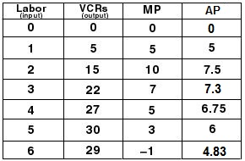
7a – Economic Profit and the Production Function

Slide 112
48. When the TP curve is increasing at a decreasing rate, then MP is:
Increasing and positive
Increasing and negative
Decreasing and positive
Decreasing and negative

Slide 113
48. When the TP curve is increasing at a decreasing rate, then MP is:
Increasing and positive
Increasing and negative
Decreasing and positive
Decreasing and negative

Slide 114
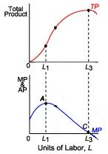

Slide 115
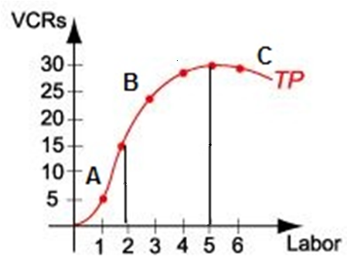
49. Section A of the TP curve is explained by:
Teamwork and specialization
Problem of
congestion
Overcrowded
Diminishing
marginal returns

Slide 116
49. Section A of the TP curve is explained by:
Teamwork and specialization
Problem of
congestion
Overcrowded
Diminishing
marginal returns

Slide 117
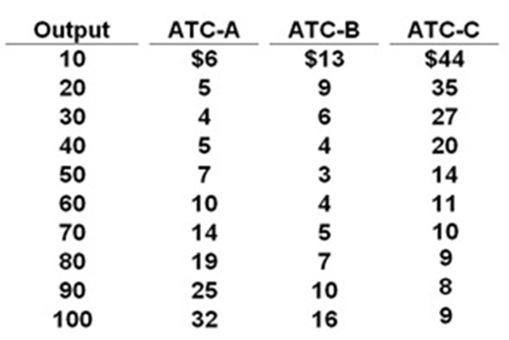
50. To produce an output of 30 in the long run, what size factory should be used?
YP #50
A
B
C
Can’t tell

Slide 118
50. To produce an output of 30 in the long run, what size factory should be used?
YP #50
A
B
C
Can’t tell

Slide 119
51. Economies of scale occur between ______; Diseconomies of scale occur between _____.
YP #50
10-30; 30-100
10-40; 40-100
10-50; 50-100
10-70; 70-100

Slide 120
51. Economies of scale occur between ______; Diseconomies of scale occur between _____.
YP #50
10-30; 30-100
10-40; 40-100
10-50; 50-100
10-70; 70-100

Slide 121
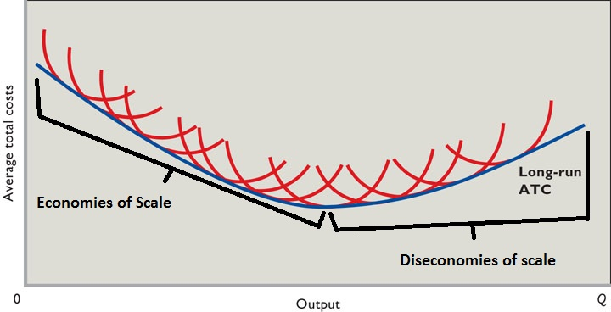
NOTE - in the video lectures:
  Economies of scale = increasing returns to scale
  Diseconomies of scale = decreasing returns to scale

Slide 122
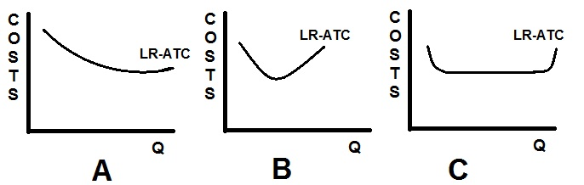
52. Which represents an industry with small and large firms?
A
B
C

Slide 123
52. Which represents an industry with small and large firms?
A
B
C

Slide 124
53. Which represents the car industry?
A
B
C

Slide 125
53. Which represents the car industry?
A
B
C

Slide 126
54. Which is NOT a characteristic of pure competition?
Very many firms
Price takers (no control over price)
Standardized product
High Herfindahl index
No barriers to entry
No non-price competition

Slide 127
54. Which is NOT a characteristic of pure competition?
Very many firms
Price takers (no control over price)
Standardized product
High Herfindahl index
No barriers to entry
No non-price competition

Slide 128
55. Which is NOT a characteristic of monopolies?
Single firm
A lot of control over price
Mutual interdependence
Unique product
Blocked entry
Public relations non-price competition

Slide 129
55. Which is NOT a characteristic of monopolies?
Single firm
A lot of control over price
Mutual interdependence
Unique product
Blocked entry
Public relations non-price competition

Slide 130
56. Which is not a characteristic of monopolistic competition?
Many firms
Standardized product
Some control over price (market power)
Low barriers to entry
A lot of non-price competition

Slide 131
56. Which is not a characteristic of monopolistic competition?
Many firms
Standardized product
Some control over price (market power)
Low barriers to entry
A lot of non-price competition

Slide 132
57. Which is not a characteristic of oligopolies?
Few firms
Standardized or differentiated products
Blocked entry
Mutual interdependence
Collusion possible

Slide 133
57. Which is not a characteristic of oligopolies?
Few firms
Standardized or differentiated products
Blocked entry
Mutual interdependence
Collusion possible

Slide 134
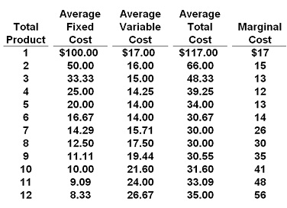
58. If P = $32, this competitive firm will produce:
6
7
8
9

Slide 135
58. If P = $32, this competitive firm will produce:
6
7
8
9

Slide 136
59. If the market price for the firm's product is $13, the competitive firm will produce:
5, loss = $105
5, profit = $105
8, loss = $136
zero, loss = $100

Slide 137
59. If the market price for the firm's product is $13, the competitive firm will produce:
5, loss = $105
5, profit = $105
8, loss = $136
zero, loss = $100

Slide 138
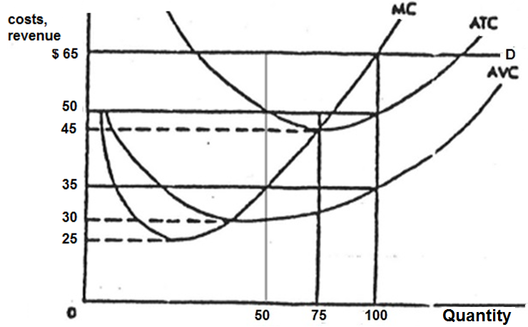
60. What are this firm’s economic profits?
$65
$1500
$5000
$6500

Slide 139
60. What are this firm’s economic profits?
$65
$1500
$5000
$6500

Slide 140
61. For a perfectly competitive FIRM, why is the demand curve perfectly elastic?
The firms must lower its price in order to sell more
When a firm lowers its price it must lower it on ALL that it sells
Because entry is blocked
The firm only sells a small fraction of the total sales in the industry

Slide 141
61. For a perfectly competitive FIRM, why is the demand curve perfectly elastic?
The firms must lower its price in order to sell more
When a firm lowers its price it must lower it on ALL that it sells
Because entry is blocked
The firm only sells a small fraction of the total sales in the industry

Slide 142
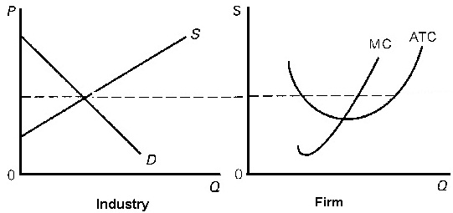
62. Assume pure competition.
What will happen in the long run?
Demand will increase
Demand will decrease
Supply will increase
Supply will decrease

Slide 143
62. Assume pure competition.
What will happen in the long run?
Demand will increase
Demand will decrease
Supply will increase
Supply will decrease

Slide 144
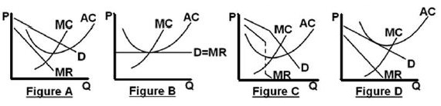
63. Which graph shows a perfectly competitive firm in long run equilibrium?
A
B
C
D

Slide 145
63. Which graph shows a perfectly competitive firm in long run equilibrium?
A
B
C
D

Slide 146
64. Productive efficiency:
MR = MC
MC = ATC
P = MC
MSB = MSC

Slide 147
64. Productive efficiency:
MR = MC
MC = ATC
P = MC
MSB = MSC

Slide 148
65. Which is NOT allocative efficiency?
Maximum consumer plus producer surplus
P = MC
MSB = MSC
Minimum ATC

Slide 149
65. Which is NOT allocative efficiency?
Maximum consumer plus producer surplus
P = MC
MSB = MSC
Minimum ATC

Slide 150
66. For a monopoly, why is the marginal revenue (MR) less than the price?
MR only includes the EXTRA revenue
When a firm lowers its price it must lower it on ALL that it sells
Because there are few barriers to entry
A monopoly only sells a small fraction of the total sales in the industry

Slide 151
66. For a monopoly, why is the marginal revenue (MR) less than the price?
MR only includes the EXTRA revenue
When a firm lowers its price it must lower it on ALL that it sells
Because there are few barriers to entry
A monopoly only sells a small fraction of the total sales in the industry

Slide 152
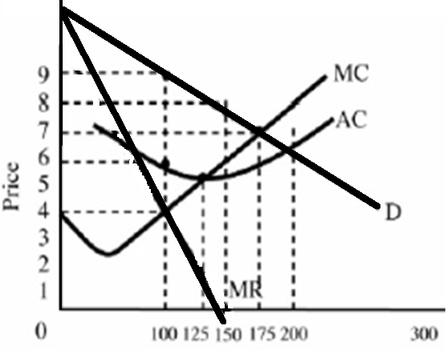
67. What would the profits be?
$1200
$900
$600
$400
$300

Slide 153
67. What would the profits be?
$1200
$900
$600
$400
$300

Slide 154
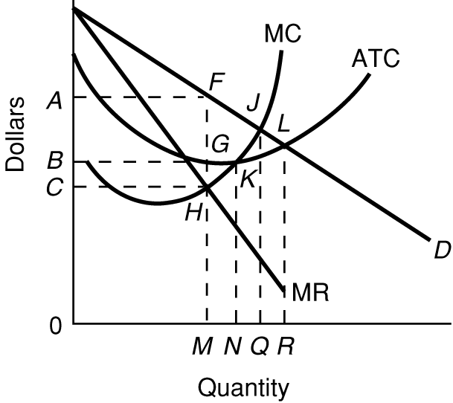
68. In the LR what is the:
- Profit Max Q ?
- Prod Eff Q ?
- Alloc. Eff. Q ?
M, N, R
N, Q, R
Q, M, N
M, N, Q

Slide 155
68. In the LR what is the:
- Profit Max Q ?
- Prod Eff Q ?
- Alloc. Eff. Q ?
M, N, R
N, Q, R
Q, M, N
M, N, Q

Slide 156
69. If this firm were a perfectly price discriminating monopolist, what quantity would be produced?
N
M
Q
R

Slide 157
69. If this firm were a perfectly price discriminating monopolist, what quantity would be produced?
N
M
Q
R

Slide 158
70. If the government uses AC pricing (fair return pricing) they would put a price ceiling at:
P1
P2
P3
P4

Slide 159
70. If the government uses AC pricing (fair return pricing) they would put a price ceiling at:
P1
P2
P3
P4

Slide 160
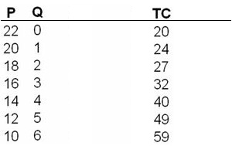
71. What is the profit-maximizing output and price for this monopolistically competitive firm?
P = 12; Q = 5
P = 14; Q = 4
P = 16; Q = 3
P = 18; Q = 2

Slide 161
71. What is the profit-maximizing output and price for this monopolistically competitive firm?
P = 12; Q = 5
P = 14; Q = 4
P = 16; Q = 3
P = 18; Q = 2

Slide 162
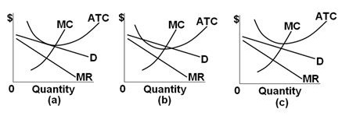
72. If the SR is (b), then in the LR for Monop. Comp. firms:
Entry is blocked so there will be no change
Firms will enter and demand will decrease
Firms will leave and supply will decrease
Firms will enter and demand will increase

Slide 163
72. If the SR is (b), then in the LR for Monop. Comp. firms:
Entry is blocked so there will be no change
Firms will enter and demand will decrease
Firms will leave and supply will decrease
Firms will enter and demand will increase

Slide 164
73. Which graph shows a monopolistically competitive firm in long run equilibrium?
A
B
C
D

Slide 165
73. Which graph shows a monopolistically competitive firm in long run equilibrium?
A
B
C
D

Slide 166
74. In the kinked demand model:
Demand is more price elastic above the kink
Firms collude to restrict output and raise the price
Firms ignore price decreases of competitors
Marginal revenue is always positive

Slide 167
74. In the kinked demand model:
Demand is more price elastic above the kink
Firms collude to restrict output and raise the price
Firms ignore price decreases of competitors
Marginal revenue is always positive

Slide 168
75. Which graphs best represent oligopolies in long run equilibrium?
A only
C and D
C only
D only
A and C

Slide 169
75. Which graphs best represent oligopolies in long run equilibrium?
A only
C and D
C only
D only
A and C

Slide 170
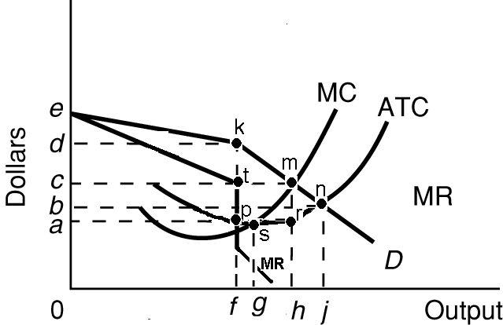
76. What is:
- prof max Q
- prod eff Q
- alloc eff Q?
f, g, j
g, h, f
h, f, j
f, h, g
f, g, h

Slide 171
76. What is:
- prof max Q
- prod eff Q
- alloc eff Q?
f, g, j
g, h, f
h, f, j
f, h, g
f, g, h

Slide 172
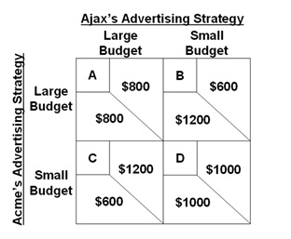
For the following questions refer to this game theory matrix where the numerical data show the profits resulting from alternative combinations of advertising strategies for Ajax and Acme.

Slide 173
77. The Nash equilibrium will be cell:
A
B
C
D

Slide 174
77. The Nash equilibrium will be cell:
A
B
C
D

Slide 175
78. How many workers will the firm hire if the wage rate is $8 per day? YP 23
3
4
5
6

Slide 176
78. How many workers will the firm hire if the wage rate is $8 per day? YP 23
3
4
5
6

Slide 177
79. Monopsony: what Q would be hired at what wage?
Q₁ and W₁
Q₂ and W₂
Q₁ and W₂
Q₁ and W₃

Slide 178
79. Monopsony: what Q would be hired at what wage?
Q₁ and W₁
Q₂ and W₂
Q₁ and W₂
Q₁ and W₃

Slide 179
80. If this was pure competition in the labor market, what Q would be hired at what W?
W₁ and Q₁
W₂ and Q₂
W₂ and Q₁
W₃ and Q₁

Slide 180
80. If this was pure competition in the labor market, what Q would be hired at what W?
W₁ and Q₁
W₂ and Q₂
W₂ and Q₁
W₃ and Q₁

Slide 181
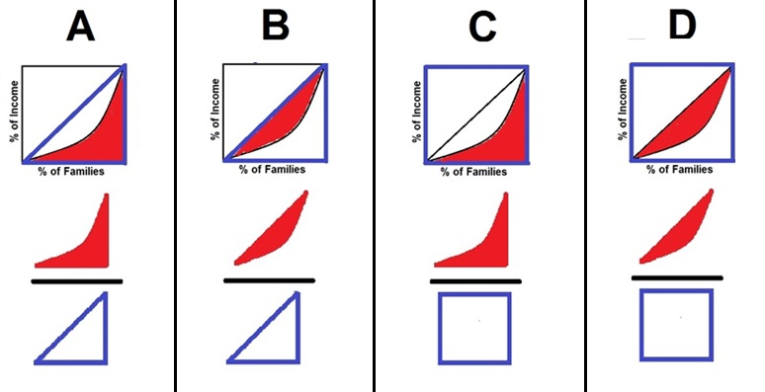
81. Which diagram below best explains how the Gini ratio is calculated? YP 61 #5
A
B
C
D

Slide 182
81. Which diagram below best explains how the Gini ratio is calculated? YP 61 #5
A
B
C
D

Slide 183
Simple
Immigration
Model
YP 81 #5
Alphania's domestic labor force is F and that of Betania is g.
82. As a result of migration:
World output will increase by mljh minus MLJH
Betania’s output will increase, Alphania’s decrease, but world output will stay the same
World output will increase by gjhf minus GJHF
World output will decrease by gjhf minus GJHF

Slide 184
Simple
Immigration
Model
YP 81 #5
Alphania's domestic labor force is F and that of Betania is g.
82. As a result of migration:
World output will increase by mljh minus MLJH
Betania’s output will increase, Alphania’s decrease, but world output will stay the same
World output will increase by gjhf minus GJHF
World output will decrease by gjhf minus GJHF

Slide 185
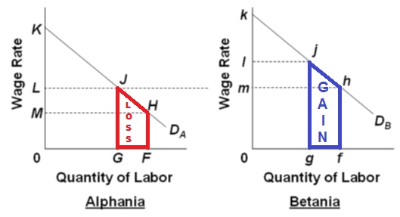
22a - Immigration

Slide 186
83. If initially the gov’t cannot stop illegal immigration, but then finds a way to block it, then ____ domestic workers gain jobs and ____ immigrants lose jobs. (YP 84 #5)
100,000 gain jobs, 200,000 lose
200,000 gain jobs, 200,000 lose
100,000 gain jobs, 250,000 lose
100,000 gain jobs, 150,000 lose

Slide 187
83. If initially the gov’t cannot stop illegal immigration, but then finds a way to block it, then ____ domestic workers gain jobs and ____ immigrants lose jobs. (YP 84 #5)
100,000 gain jobs, 200,000 lose
200,000 gain jobs, 200,000 lose
100,000 gain jobs, 250,000 lose
100,000 gain jobs, 150,000 lose

Slide 188
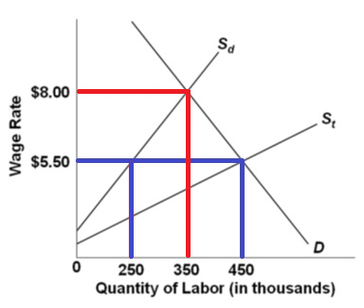
Total employment now = 350, so:
100 domestic workers gained jobs (350 – 250)
200 illegal workers lost jobs (450 – 250)

Slide 189
Study hard!

