Slide 1
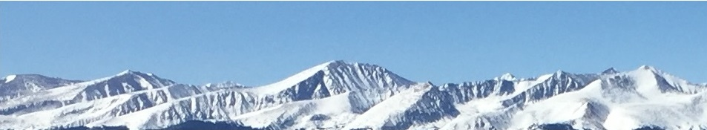
Exam 3 Review
This web quiz may appear as two pages on tablets and laptops.
I recommend that you view it as one page by clicking on the open book icon at the bottom of the page.

Slide 2
Exam 3 Covers:
The Four Product Market Models:
  Pure Competition - Chapters 8 and 9
  Monopoly - Chapter 10
  Monopolistic Competition - Chapter 11
  Oligopoly - Chapter 11
  Be sure to see the exact textbook pages listed on our “LESSONS” page.
PLUS:
  5 questions from unit 1
  5 questions from unit 2

Slide 3
Exam 3 Covers:
Plus:
  5 questions from unit 1
    Probable topics: 5Es, Benefit Cost Analysis, PPC, gains from trade, determinants of demand and supply, negative or positive externalities, public goods
  5 questions from unit 2
    Probable topics: price elasticity of demand, price elasticity of supply, determinants of price elasticity of demand, price elasticity and total revenue, graph TU and MU, utility maximizing rule, graph TP, MP, and AP, long-run ATC
For ALL graphs: Define, Draw, Describe Shape

Slide 4
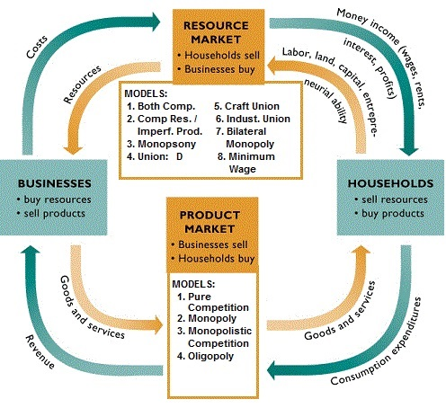
Exam 3 Covers: Product Markets

Slide 5
Exam 3 Review
For Each Market Model Know:
Characteristics and Examples
Nature of the Demand Curve
Short Run Equilibrium (3 graphs and 3 ways)
[Don’t forget the TR and TC graphs]
Long Run Equilibrium and Efficiency
  Find profit max Q
  Find alloc. Eff. Q
  Find prod. Eff. Q
Other Issues
.

Slide 6
Exam 3 Review
Study Ideas:
Learn the vocabulary – see the Quizlet Flashcards
For each graph (each line on a graph):
  Define
  Draw
  Describe the shape
Draw graphs – don’t just look at them
Know well the “Three Rules and Four Models” handout
Don’t just memorize; try to understand examples

Slide 7
Exam 3 Review
Study Ideas – DO PROBLEMS/ See Bb:
Yellow Pages (answers on Bb)
Required Activities (always click “submit”)
Pre-Quizzes (again, via gradebook)
Clicker Quizzes (again)
Other Review (online quizzes)
Practice Exercises

Slide 8
Exam 3 Review
Study Ideas:
Do you understand
each of the
Outcomes listed on our
LESSONS page?

Slide 9
REVIEW: BCA
Benefit Cost Analysis (MB = MC)
To make the best decision:
  Select all possible alternatives where the marginal benefits are greater than the marginal costs.
  select ALL possible options up to where MB = MC
  this implies ignoring sunk (fixed) costs
select all where: MB > MC
up to where: MB = MC
but never where: MB < MC

Slide 10
REVIEW: BCA
Benefit Cost Analysis (MB = MC)
Always ask: What are the extra benefits and what are the extra costs?
If the extra benefits (MB) are greater than the extra costs (MC) then you will gain by doing it.
Keep doing it as long as MB > MC
up to where MB = MC
ignore fixed or sunk costs (ignore costs that do not change as a result of the decision)

Slide 11
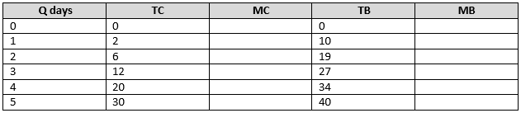
1. How many days to ski (using BCA):
1
2
3
4
5

Slide 12
1. How many days to ski (using BCA):
1
2
3
4
5

Slide 13
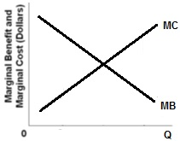
REVIEW: BCA
Benefit Cost Analysis (MB = MC)

Slide 14
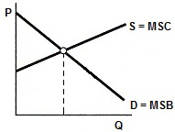
REVIEW: BCA
Allocative Efficiency Using BCA
To find the best quantity for society:
MSB = MSC

Slide 15
REVIEW: BCA
Three ways to find the Allocatively Efficiency Quantity:
(Three ways to find the best quantity for society)
P = MC
MSB = MSC
Maximum producer plus consumer surplus

Slide 16
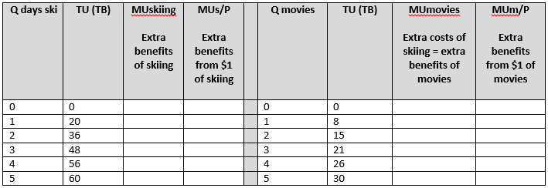
2. How many to buy (using BCA):
2 skiing and 6 movies
3 skiing and 4 movies
4 skiing and 2 movies
5 skiing and 0 movies
Price of skiing = $2
Price of movies = $1
Income = $10

Slide 17
2. How many to buy (using BCA):
2 skiing and 6 movies
3 skiing and 4 movies
4 skiing and 2 movies
5 skiing and 0 movies
Price of skiing = $2
Price of movies = $1
Income = $10

Slide 18
REVIEW: BCA
How many to buy?
MB = MC
MUa/Pa = MUb/Pb = MUc/Pc = . . .
MB skiing = MC skiing
MB skiing is the MU skiing
MC skiing is the MU missed from not going to movies
BUT: Price skiing = $2 and Price movies = $1
We can’t compare a $2 skiing with a $1 movie

Slide 19
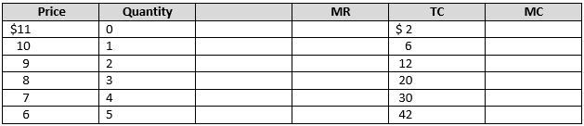
3. How many to produce (using BCA):
1
2
3
4
5

Slide 20
3. How many to produce (using BCA):
1
2
3
4
5

Slide 21
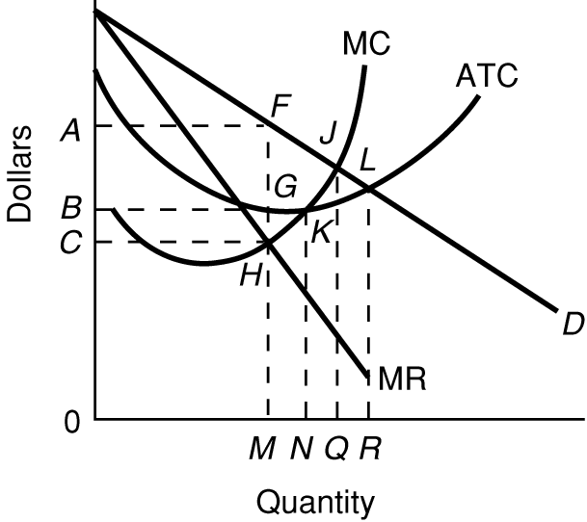
REVIEW: BCA
How many to produce? (MR = MC)

Slide 22
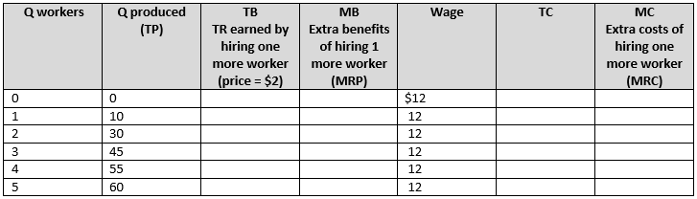
4. How many to hire (using BCA):
1
2
3
4
5
wage = $12
price of product = $2

Slide 23
4. How many to hire (using BCA):
1
2
3
4
5
wage = $12
price of product = $2

Slide 24
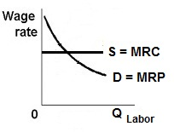
REVIEW: BCA
PREVIEW: How many to hire? (MRP = MRC)
(MB = MC)

Slide 25
5. Which is NOT a characteristic of pure competition?
Very many firms
Price takers (no control over price)
Standardized product
High Herfindahl index
No barriers to entry
No non-price competition

Slide 26
5. Which is NOT a characteristic of pure competition?
Very many firms
Price takers (no control over price)
Standardized product
High Herfindahl index
No barriers to entry
No non-price competition

Slide 27
6. Which is NOT a characteristic of monopolies?
Single firm
A lot of control over price
Mutual interdependence
Unique product
Blocked entry
Public relations non-price competition

Slide 28
6. Which is NOT a characteristic of monopolies?
Single firm
A lot of control over price
Mutual interdependence
Unique product
Blocked entry
Public relations non-price competition

Slide 29
7. Which is not a characteristic of monopolistic competition?
Many firms
Standardized product
Some control over price (market power)
Low barriers to entry
A lot of non-price competition

Slide 30
7. Which is not a characteristic of monopolistic competition?
Many firms
Standardized product
Some control over price (market power)
Low barriers to entry
A lot of non-price competition

Slide 31
8. Which is not a characteristic of oligopolies?
Few firms
Standardized or differentiated products
Blocked entry
Mutual interdependence
Collusion possible

Slide 32
8. Which is not a characteristic of oligopolies?
Few firms
Standardized or differentiated products
Blocked entry
Mutual interdependence
Collusion possible

Slide 33
9. Which of the following is a good example of a purely competitive industry?
A fast-food restaurant
A soft drink company
A local electric company
A construction firm
Agriculture

Slide 34
9. Which of the following is a good example of a purely competitive industry?
A fast-food restaurant
A soft drink company
A local electric company
A construction firm
Agriculture

Slide 35
10. Which of the following is a good example of a monopoly?
A fast-food restaurant
A soft drink company
A local electric company
A construction firm

Slide 36
10. Which of the following is a good example of a monopoly?
A fast-food restaurant
A soft drink company
A local electric company
A construction firm

Slide 37
11. Which of the following is an example of a monopolistically competitive industry?
Wheat farming
Cable TV
Automobiles
Restaurants

Slide 38
11. Which of the following is an example of a monopolistically competitive industry?
Wheat farming
Cable TV
Automobiles
Restaurants

Slide 39
12. Which of the following is an example of an oligopolistic industry?
Wheat farming
Electric utility
Automobiles
Restaurants

Slide 40
12. Which of the following is an example of an oligopolistic industry?
Wheat farming
Electric utility
Automobiles
Restaurants

Slide 41
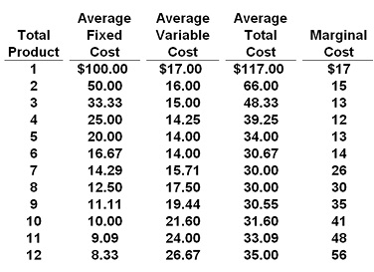
13. If P = $32, this competitive firm will produce:
6
7
8
9

Slide 42
13. If P = $32, this competitive firm will produce:
6
7
8
9

Slide 43
14. If the market price for the firm's product is $13, the competitive firm will produce:
5, loss = $105
5, profit = $105
8, loss = $136
zero, loss = $100

Slide 44
14. If the market price for the firm's product is $13, the competitive firm will produce:
5, loss = $105
5, profit = $105
8, loss = $136
zero, loss = $100

Slide 45
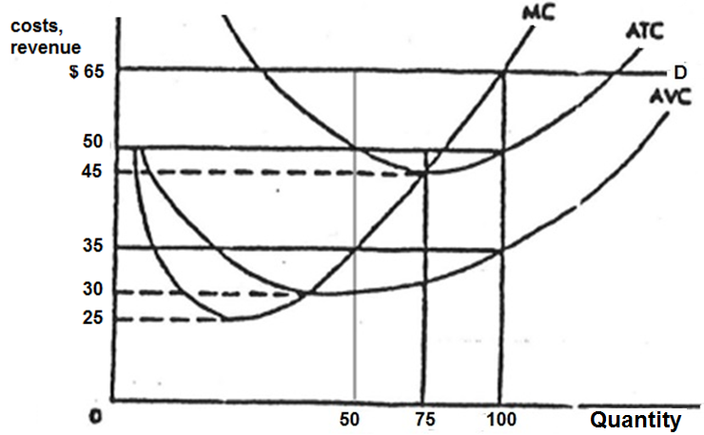
15. What are this firm’s economic profits?
$65
$1500
$5000
$6500

Slide 46
15. What are this firm’s economic profits?
$65
$1500
$5000
$6500

Slide 47
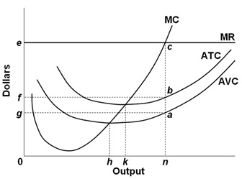
16. What are the max. profits possible?
fecb
fbag
0ecn
0fbn

Slide 48
16. What are the max. profits possible?
fecb
fbag
0ecn
0fbn

Slide 49
17. For a perfectly competitive FIRM, why is the demand curve perfectly elastic?
The firms must lower its price in order to sell more
When a firm lowers its price it must lower it on ALL that it sells
Because entry is blocked
The firm only sells a small fraction of the total sales in the industry

Slide 50
17. For a perfectly competitive FIRM, why is the demand curve perfectly elastic?
The firms must lower its price in order to sell more
When a firm lowers its price it must lower it on ALL that it sells
Because entry is blocked
The firm only sells a small fraction of the total sales in the industry

Slide 51
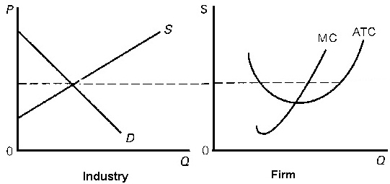
18. Assume pure competition.
What will happen in the long run?
Demand will increase
Demand will decrease
Supply will increase
Supply will decrease

Slide 52
18. Assume pure competition.
What will happen in the long run?
Demand will increase
Demand will decrease
Supply will increase
Supply will decrease

Slide 53
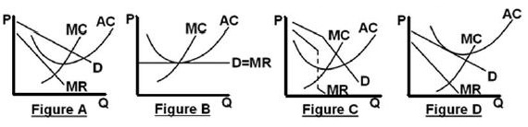
19 .Which graph shows a perfectly competitive firm in long run equilibrium?
A
B
C
D

Slide 54
19 .Which graph shows a perfectly competitive firm in long run equilibrium?
A
B
C
D

Slide 55
20. Productive efficiency:
MR = MC
MC = ATC
P = MC
MSB = MSC

Slide 56
20. Productive efficiency:
MR = MC
MC = ATC
P = MC
MSB = MSC

Slide 57
21. Which is NOT allocative efficiency?
Maximum consumer plus producer surplus
P = MC
MSB = MSC
Minimum ATC

Slide 58
21. Which is NOT allocative efficiency?
Maximum consumer plus producer surplus
P = MC
MSB = MSC
Minimum ATC

Slide 59
22. A monopolist can sell 1 widget for $5. In order to sell 2 widgets, the firm must lower the price to $4. What is the MR of the second widget?
MR = $1
MR = $2
MR = $3
MR = $4
MR = $5

Slide 60
22. A monopolist can sell 1 widget for $5. In order to sell 2 widgets, the firm must lower the price to $4. What is the MR of the second widget?
MR = $1
MR = $2
MR = $3
MR = $4
MR = $5

Slide 61
23. For a monopoly, why is the marginal revenue (MR) less than the price?
MR only includes the EXTRA revenue
When a firm lowers its price it must lower it on ALL that it sells
Because there are few barriers to entry
A monopoly only sells a small fraction of the total sales in the industry

Slide 62
23. For a monopoly, why is the marginal revenue (MR) less than the price?
MR only includes the EXTRA revenue
When a firm lowers its price it must lower it on ALL that it sells
Because there are few barriers to entry
A monopoly only sells a small fraction of the total sales in the industry

Slide 63
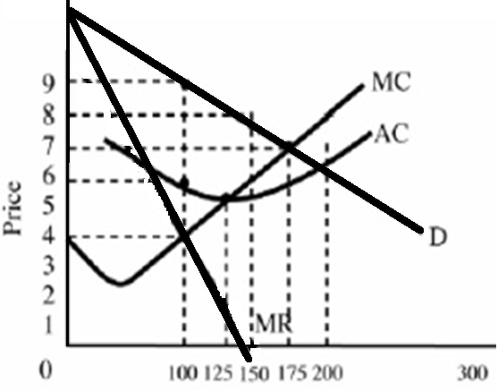
24. What would the profits be?
$1200
$900
$600
$400
$300

Slide 64
24. What would the profits be?
$1200
$900
$600
$400
$300

Slide 65
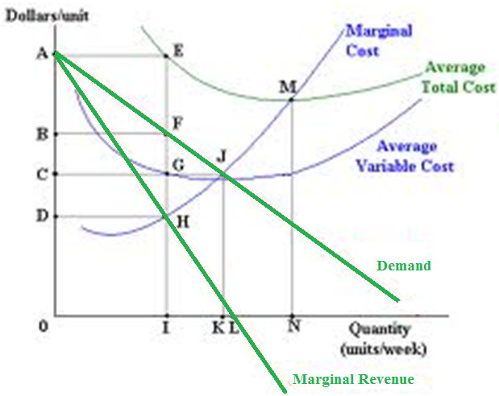
25. What are the profits or losses?
0AEI
0BFI
BAEF
CBFG

Slide 66
25. What are the profits or losses?
0AEI
0BFI
BAEF
CBFG

Slide 67
26. Monopolies can earn long run profits because:
They produce a unique product
They face a downward sloping demand
They are price makers (have market power)
Barriers to entry

Slide 68
26. Monopolies can earn long run profits because:
They produce a unique product
They face a downward sloping demand
They are price makers (have market power)
Barriers to entry

Slide 69
27. In the LR what is the:
- Profit Max Q ?
- Prod Eff Q ?
- Alloc. Eff. Q ?
M, N, R
N, Q, R
Q, M, N
M, N, Q

Slide 70
27. In the LR what is the:
- Profit Max Q ?
- Prod Eff Q ?
- Alloc. Eff. Q ?
M, N, R
N, Q, R
Q, M, N
M, N, Q

Slide 71
28. If this firm were a perfectly price discriminating monopolist, what quantity would be produced?
N
M
Q
R

Slide 72
28. If this firm were a perfectly price discriminating monopolist, what quantity would be produced?
N
M
Q
R

Slide 73
29. If the government uses AC pricing (fair return pricing) they would put a price ceiling at:
P1
P2
P3
P4

Slide 74
29. If the government uses AC pricing (fair return pricing) they would put a price ceiling at:
P1
P2
P3
P4

Slide 75
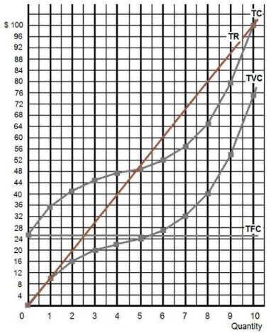
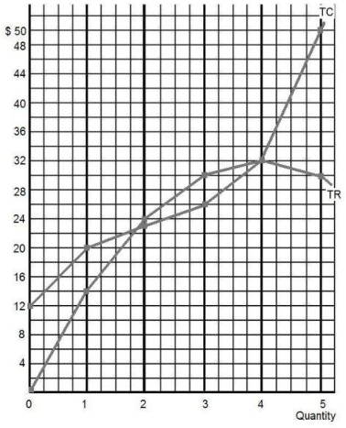
A B
See next question

Slide 76
30. Which of the following is correct?
A B
A = monopoly; B = pure competition
Both A and B are pure competition
Both A and B are monopolies
A = pure comp; B = Monopoly

Slide 77
30. Which of the following is correct?
A B
A = monopoly; B = pure competition
Both A and B are pure competition
Both A and B are monopolies
A=pure comp; B = Monopoly

Slide 78
31. Which of the following is probably not a method of product differentiation?
Product packaging
Large number of sellers
Brand name loyalty
Advertising

Slide 79
31. Which of the following is probably not a method of product differentiation?
Product packaging
Large number of sellers
Brand name loyalty
Advertising

Slide 80
32. Product differentiation matters for monopolistically competitive firms because :
It makes their demand downward sloping
Makes their demand perfectly elastic
It forces them to accept the market price for their product
It makes the demand for their products more elastic

Slide 81
32. Product differentiation matters for monopolistically competitive firms because :
It makes their demand downward sloping
Makes their demand perfectly elastic
It forces them to accept the market price for their product
It makes the demand for their products more elastic

Slide 82
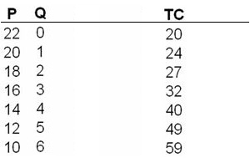
33. What is the profit-maximizing output and price for this monopolistically competitive firm?
P = 12; Q = 5
P = 14; Q = 4
P = 16; Q = 3
P = 18; Q = 2

Slide 83
33. What is the profit-maximizing output and price for this monopolistically competitive firm?
P = 12; Q = 5
P = 14; Q = 4
P = 16; Q = 3
P = 18; Q = 2

Slide 84
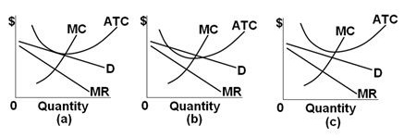
34. If the SR is (b), then in the LR for Monop. Comp. firms:
Entry is blocked so there will be no change
Firms will enter and demand will decrease
Firms will leave and supply will decrease
Firms will enter and demand will increase

Slide 85
34. If the SR is (b), then in the LR for Monop. Comp. firms:
Entry is blocked so there will be no change
Firms will enter and demand will decrease
Firms will leave and supply will decrease
Firms will enter and demand will increase

Slide 86
35. Which graph shows a monopolistically competitive firm in long run equilibrium?
A
B
C
D

Slide 87
35. Which graph shows a monopolistically competitive firm in long run equilibrium?
A
B
C
D

Slide 88
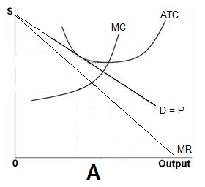
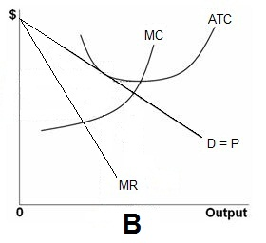
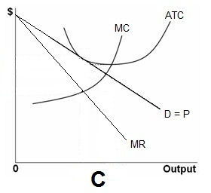
36. Which graph is drawn is correctly?
A
B
C

Slide 89
36. Which graph is drawn is correctly?
A
B
C

Slide 90
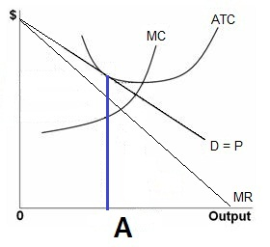
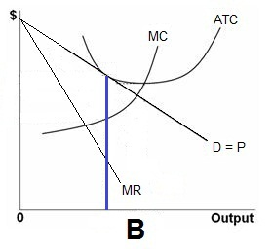
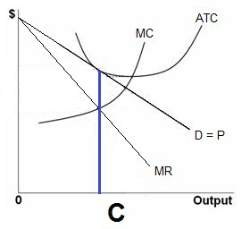

Slide 91
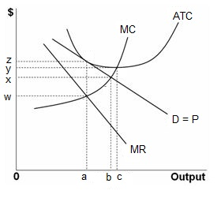
37. What is the:
- profit max Q?
- prod. Eff. Q?
- alloc. Eff. Q?
a, b, c,
a, c, b
b, a, c
b, c, a

Slide 92
37. What is the:
- profit max Q?
- prod. Eff. Q?
- alloc. Eff. Q?
a, b, c,
a, c, b
b, a, c
b, c, a

Slide 93
38. We know that monopolistically competitive firms are allocatively inefficient, but why isn’t that so bad?
They earn long run profits
They donate to charities
There is no mutual interdependence
There is product differentiation

Slide 94
38. We know that monopolistically competitive firms are allocatively inefficient, but why isn’t that so bad?
They earn long run profits
They donate to charities
There is no mutual interdependence
There is product differentiation

Slide 95
39. Which of the following is not one of the three oligopoly pricing models?
Collusive pricing
Price leadership
Differentiated oligopoly
Kinked demand

Slide 96
39. Which of the following is not one of the three oligopoly pricing models?
Collusive pricing
Price leadership
Differentiated oligopoly
Kinked demand

Slide 97
40. In the kinked demand model:
Demand is more price elastic above the kink
Firms collude to restrict output and raise the price
Firms ignore price decreases of competitors
Marginal revenue is always positive

Slide 98
40. In the kinked demand model:
Demand is more price elastic above the kink
Firms collude to restrict output and raise the price
Firms ignore price decreases of competitors
Marginal revenue is always positive

Slide 99
41. Which graph best shows a collusive oligopoly in long run equil.?
A
B
C
D

Slide 100
41. Which graph best shows a collusive oligopoly in long run equil.?
A
B
C
D

Slide 101
42. Which graphs best represent oligopolies in long run equilibrium?
A only
C and D
C only
D only
A and C

Slide 102
42. Which graphs best represent oligopolies in long run equilibrium?
A only
C and D
C only
D only
A and C

Slide 103
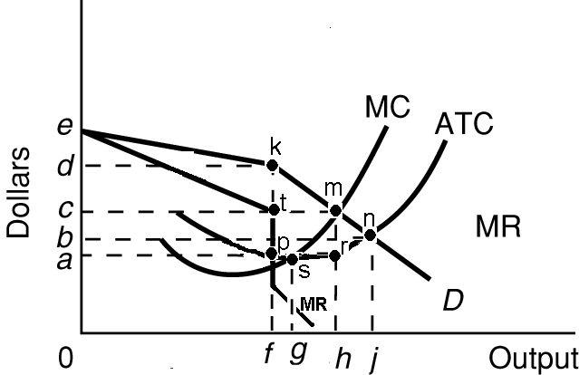
43 What is:
- prof max Q
- prod eff Q
- alloc eff Q?
f, g, j
g, h, f
h, f, j
f, h, g
f, g, h

Slide 104
43 What is:
- prof max Q
- prod eff Q
- alloc eff Q?
f, g, j
g, h, f
h, f, j
f, h, g
f, g, h

Slide 105
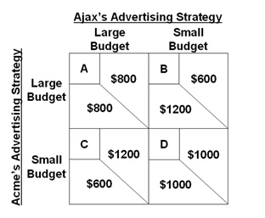
For the following questions refer to this game theory matrix where the numerical data show the profits resulting from alternative combinations of advertising strategies for Ajax and Acme.

Slide 106
44. The dominant strategy will be:
Large for Ajax; small for Acme
Small for Ajax; large for Acme
Large budget for both
Small budget for both

Slide 107
44. The dominant strategy will be:
Large for Ajax; small for Acme
Small for Ajax; large for Acme
Large budget for both
Small budget for both

Slide 108
45. The Nash equilibrium will be cell:
A
B
C
D

Slide 109
45. The Nash equilibrium will be cell:
A
B
C
D

Slide 110
46. With collusion and no cheating, the outcome of the game is cell:
A
B
C
D

Slide 111
46. With collusion and no cheating, the outcome of the game is cell:
A
B
C
D

Slide 112
Exam 3 Review: Game Theory
Dominant Strategy: a choice for a player that maximizes her satisfaction no matter what her rivals are doing
Nash Equilibrium: the outcome when each player is doing the best they can given what all other players are doing; No one can gain by changing strategies if nobody else does.

Slide 113
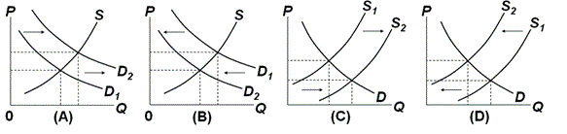
47. Which graph shows the changes for cars if improved technology lowers the costs of production?
A.
B
C
D

Slide 114
47. Which graph shows the changes for cars if improved technology lowers the costs of production?
A.
B
C
D

Slide 115
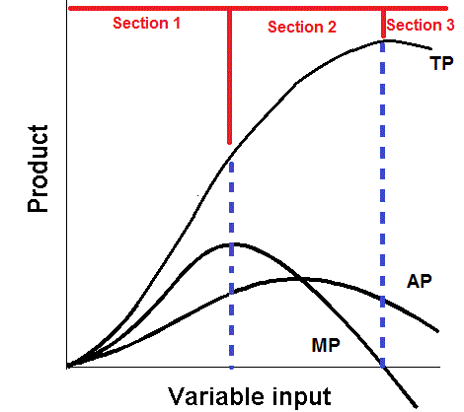
48. What explains the shape of the graphs in Section 2?
Specialization and teamwork
Getting crowded
Overcrowded

Slide 116
48. What explains the shape of the graphs in Section 2?
Specialization and teamwork
Getting crowded
Overcrowded

Slide 117

49. Refer to the above data. If Alpha and Omega each were producing at alternatives B before trade, the gain from specialization and trade would be:
30 tons of wheat.
15 tons of steel.
30 tons of steel and 30 tons of wheat.
60 tons of wheat and 60 tons of steel.

Slide 118
49. Refer to the above data. If Alpha and Omega each were producing at alternatives B before trade, the gain from specialization and trade would be:
30 tons of wheat.
15 tons of steel.
30 tons of steel and 30 tons of wheat.
60 tons of wheat and 60 tons of steel.

Slide 119
Study hard!

