Slide 1

Exam 1 Review
This web quiz may appear as two pages on tablets and laptops.
I recommend that you view it as one page by clicking on the open book icon at the bottom of the page.

Slide 2
Exam 1 Review
Exam 1 covers:
  5Es
  Lessons 1a, 1b, 1c, 1d
  Lesson 2a
  Lessons 3a, 3b, 3c
  Lessons 5a, 5b
Be sure to see the exact textbook pages listed on our “LESSONS” page or MICWEBAPP.

Slide 3
Exam 1 Review
Major topics :
  5Es
  PPC
  Market and Command Economies
  Gains from trade
  S, D, and Efficiency
  BCA
  Consumer and producer surplus
  Negative Externalities
  Positive Externalities
  Public goods
Be sure to see the “Must Know/Outcomes” listed on our LESSONS page or MICWEBAPP.

Slide 4
Exam 1 Review
Study Ideas:
Learn the vocabulary – see “Key Terms”
Graphs:
(budget line, PPC, D, S, Neg. Ext., Pos. Ext
  Define – know what a point on the graph means
  Draw – be able to correctly draw and label all of the graphs we have studied
  Describe shapes of graphs
S and D determinants – know how they shift the
curves
Be sure to see the “Must Know/Outcomes” listed on our LESSONS page.

Slide 5
Exam 1 Review
Study Ideas – DO PROBLEMS:
Yellow Page problems – check answers
Required Activities
Watch the Key Problem videos
Web Quizzes
Clicker Quizzes
Pre-Quizzes (click on score in gradebook)
Review Quizzes
IF YOU GET A QUESTION WRONG GO BACK AND STUDY MORE.

Slide 6
Exam 1 Review
Study Ideas – DO MORE PROBLEMS:
Yellow Page problems – check answers
Required Activities
Watch the Key Problem videos
Web Quizzes
Clicker Quizzes
Pre-Quizzes (click on score in gradebook)
Review Quizzes
IF YOU GET A QUESTION WRONG GO BACK AND STUDY MORE.

Slide 7
Exam 1 Review
Study Ideas:
Do you understand
each of the
“Must Know/Outcomes” listed on our
LESSONS page / MicWebApp?

Slide 8
1. Which of the following is NOT one of the three options that society has for dealing with scarcity?
Use existing resources wisely
Allocative Efficiency
Reduce wants or expectations
Economic growth

Slide 9
1. Which of the following is NOT one of the three options that society has for dealing with scarcity?
Use existing resources wisely
Allocative Efficiency
Reduce wants or expectations
Economic growth

Slide 10
2. Which of the 5Es BEST explains why the price of gasoline may be too low?
Economic Growth
Productive Efficiency
Allocative Efficiency
Equity
Full employment

Slide 11
2. Which of the 5Es BEST explains why the price of gasoline may be too low?
Economic Growth
Productive Efficiency
Allocative Efficiency
Equity
Full employment

Slide 12
3. Suppose you have a money income of $10, all of which you spend on Coke and popcorn. The price of Coke is:
$.10
$.20
$.50
$1.00

Slide 13
3. Suppose you have a money income of $10, all of which you spend on Coke and popcorn. The price of Coke is:
$.10
$.20
$.50
$1.00

Slide 14
4. Which of the following is NOT one of the assumptions behind the PPC?
Fixed resources
Fixed technology
Productive efficiency
Allocative efficiency
Full employment
Only two goods

Slide 15
4. Which of the following is NOT one of the assumptions behind the PPC?
Fixed resources
Fixed technology
Productive efficiency
Allocative efficiency
Full employment
Only two goods

Slide 16
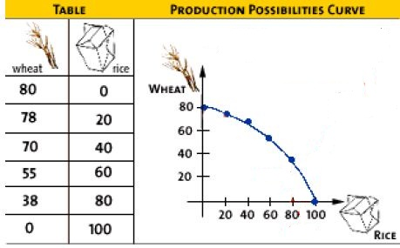
5. What is the opportunity cost of the first 20 rice?
80 wheat
78 wheat
70 wheat
2 wheat

Slide 17
5. What is the opportunity cost of the first 20 rice?
80 wheat
78 wheat
70 wheat
2 wheat

Slide 18
6. Other things equal, this economy will achieve the most rapid rate of growth if:
it chooses point A.
it chooses point B.
it chooses point C.
it chooses point D.

Slide 19
6. Other things equal, this economy will achieve the most rapid rate of growth if:
it chooses point A.
it chooses point B.
it chooses point C.
it chooses point D.

Slide 20
Answer the next question on the basis of the above information for four highway programs of increasing scope. All figures are in millions of dollars.
7. Which alternative should the government build?
A
B
C
D

Slide 21
Answer the next question on the basis of the above information for four highway programs of increasing scope. All figures are in millions of dollars.
7. Which alternative should the government build?
A
B
C
D

Slide 22
8. If the MB < MC, then:
You should do more
You should do less
The result is optimal
The best choice was made

Slide 23
8. If the MB < MC, then:
You should do more
You should do less
The result is optimal
The best choice was made

Slide 24
9. Which of the following is a distinguishing feature of the command system?
Private ownership of capital
Central planning
Heavy reliance on markets
Widespread dispersion of economic power

Slide 25
9. Which of the following is a distinguishing feature of the command system?
Private ownership of capital
Central planning
Heavy reliance on markets
Widespread dispersion of economic power

Slide 26
10. Economic profits in an industry suggest the industry (Lesson 2a):
Can earn more profits by increasing the price
Should be larger to satisfy consumers
Has excess capacity
Is the correct size for consumers

Slide 27
10. Economic profits in an industry suggest the industry:
Can earn more profits by increasing the price
Should be larger to satisfy consumers
Has excess capacity
Is the correct size for consumers

Slide 28
11. The “invisible hand” promotes society’s interest because:
Individuals pursuing their self-interest will produce goods that people want
Individuals will produce goods for others out of concern for their fellow human beings
It makes sure that everybody wins from competition
Government regulation pushes businesses into producing the right mix of goods

Slide 29
11. The “invisible hand” promotes society’s interest because:
Individuals pursuing their self-interest will produce goods that people want
Individuals will produce goods for others out of concern for their fellow human beings
It makes sure that everybody wins from competition
Government regulation pushes businesses into producing the right mix of goods

Slide 30

12. Assume before specialization both countries were producing at “B”, If they specialize 100% according to their comparative advantage, then the gains will be:
30 wheat
15 steel
60 steel and 60 wheat
60 steel and 20 wheat
YP 36

Slide 31
12. Assume before specialization both countries were producing at “B”, If they specialize 100% according to their comparative advantage, then the gains will be:
30 wheat
15 steel
60 steel and 60 wheat
60 steel and 20 wheat
YP 36

Slide 32
13. If the price in this market for wheat was $4:
The market would “clear”, Qd would equal Qs
Buyers would want to purchase more wheat than is currently being supplied
Farmers would not be able to sell all of their wheat
There would be a shortage of wheat

Slide 33
13. If the price in this market for wheat was $4:
The market would “clear”, Qd would equal Qs
Buyers would want to purchase more wheat than is currently being supplied
Farmers would not be able to sell all of their wheat
There would be a shortage of wheat

Slide 34
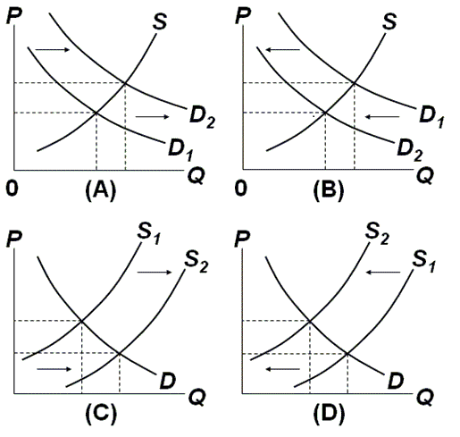
14 and 15

Slide 35
14 and 15
Non-Price Determinants of Demand (PPINT)
Pe -- expected price
Pog -- price of other goods
1) substitute goods
2) complementary goods
3) independent goods
I -- income
1) normal goods
2) inferior goods
N -- number of POTENTIAL consumers
T -- tastes and preferences

Slide 36
14 and 15
Non-Price Determinants of Supply (PPPTTN)
Pe -- expected price
Pog -- price of other goods produced by same firm
Pres -- price of resources
T -- technology
T --taxes and subsidies
N -- number of producers/sellers

Slide 37
14. Which graph represents the effect of an increase in the price of oil on the market for gasoline?
A
B
C
D
Which DETERMINANT has changed?

Slide 38
14. Which graph represents the effect of an increase in the price of oil on the market for gasoline?
A
B
C
D
Which DETERMINANT has changed?

Slide 39
15. Which graph represents the effect of an increase in the smoking age on the market for cigarettes?
A
B
C
D
Which DETERMINANT has changed?

Slide 40
15. Which graph represents the effect of an increase in the smoking age on the market for cigarettes?
A
B
C
D
Which DETERMINANT has changed?

Slide 41
16. One can say for certainty that the equilibrium price will increase if:
S and D both increase
S increases and D decreases
S decreases and D increases
S and D both decrease

Slide 42
16. One can say for certainty that the equilibrium price will increase if:
S and D both increase
S increases and D decreases
S decreases and D increases
S and D both decrease

Slide 43
16. One can say for certainty that the equilibrium price will decline if:
S and D both increase
S increases and D decreases
S decreases and D increases
S and D both decrease

Slide 44
17. An effective Price Floor will:
Induce firms to leave the industry
Result in a product surplus
Result in a product shortage
Clear the market

Slide 45
17. An effective Price Floor will:
Induce firms to leave the industry
Result in a product surplus
Result in a product shortage
Clear the market

Slide 46
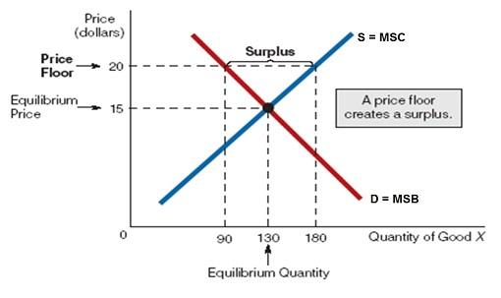

Slide 47
18. If a legal ceiling price is set above the equilibrium price:
A shortage of the product will occur
A surplus of the product will occur
A black market will evolve
Neither the price or quantity of the product will be affected

Slide 48
18. If a legal ceiling price is set above the equilibrium price:
A shortage of the product will occur
A surplus of the product will occur
A black market will evolve
Neither the price or quantity of the product will be affected

Slide 49
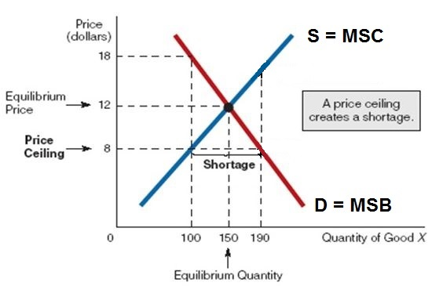
A price ceiling set below the equilibrium price will cause a shortage,
but a price ceiling set above the equilibrium price will have no effect.
Price ceilings are legally imposed maximum prices. They are used to decrease prices. Businesses can charge less than the price ceiling , but not more. Where is the profit maximizing price and quantity? ($12 and 150)

Slide 50
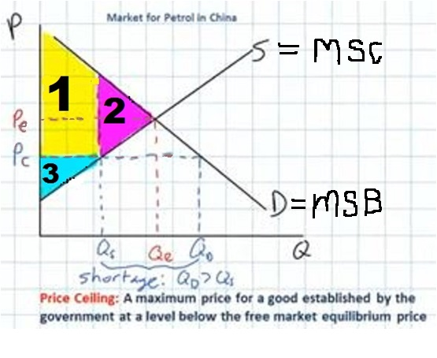
19. Which area represents the consumer surplus when there is price ceiling at Pc ?
1
2
3
1 plus 3

Slide 51
19. Which area represents the consumer surplus when there is price ceiling at Pc ?
1
2
3
1 plus 3

Slide 52
20. The allocative inefficiency of an effective price ceiling can be seen in the fact that:
MSB = MSC
MSB > MSC
MSB < MSC
There is no dead weight loss

Slide 53
20. The allocative inefficiency of an effective price ceiling can be seen in the fact that:
MSB = MSC
MSB > MSC
MSB < MSC
There is no dead weight loss

Slide 54
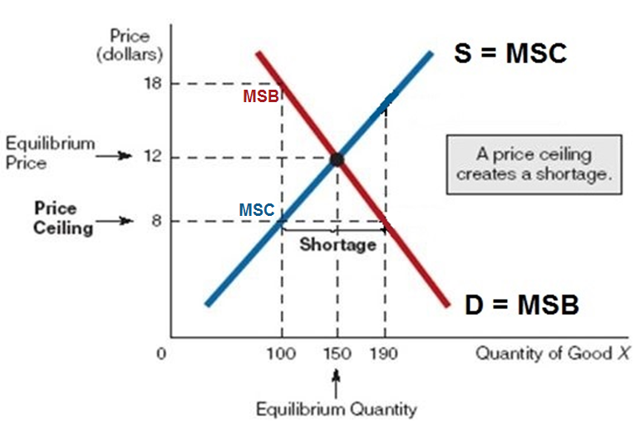
If there is an effective price ceiling set at $8, then businesses will produce 100. When quantity is 100 the MSB (red line) are greater then the MSC (blue line).
At Q = 100: MSB>MSC (MSB = 18, MSC = 8) We want more.

Slide 56
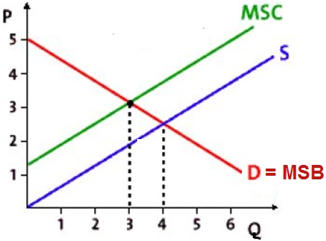
21. This graph shows the effect of a:
Price ceiling
Price floor
Positive externality
Negative externality

Slide 57
21. This graph shows the effect of a:
Price ceiling
Price floor
Positive externality
Negative externality

Slide 58
22. If the production of a good results in negative externalities (external costs or spillover costs), then
The socially optimum (alloc. eff.) quantity will be produced
More than the alloc. eff. Q will be produced
Less than the alloc. eff. Q will be produced
There will be a shortage of the good

Slide 59
22. If the production of a good results in negative externalities (external costs or spillover costs), then
The socially optimum (alloc. eff.) quantity will be produced
More than the alloc. eff. Q will be produced
Less than the alloc. eff. Q will be produced
There will be a shortage of the good

Slide 60
23. “S” is the supply with the negative externalities, How much will be produced?
Less than 3
3
4
More than 4

Slide 61
23. “S” is the supply with the negative externalities, How much will be produced?
Less than 3
3
4
More than 4
What is the allocatively efficient quantity?
WHAT WE WANT

Slide 62
24. What is the Alloc. Eff. Q?
Less than 3
3
4
More than 4

Slide 63
24. What is the Alloc. Eff. Q?
Less than 3
3
4
More than 4

Slide 64
25. Why is the S curve to the right of the MSC curve?
Firm’s costs are
higher because
of neg. ext.
Firm’s costs are lower because of neg. ext.
Firm’s costs are higher because of pos. ext.
Firm’s costs are lower because of pos. ext.

Slide 65
25. Why is the S curve to the right of the MSC curve?
Firm’s costs are
higher because
of neg. ext.
Firm’s costs are lower because of neg. ext.
Firm’s costs are higher because of pos. ext.
Firm’s costs are lower because of pos. ext.

Slide 66
26. The allocative inefficiency caused by a negative externality can be seen in the fact that:
MSB = MSC
MSB > MSC
MSB < MSC
There is no dead weight loss

Slide 67
26. The allocative inefficiency caused by a negative externality can be seen in the fact that:
MSB = MSC
MSB > MSC
MSB < MSC
There is no dead weight loss

Slide 68
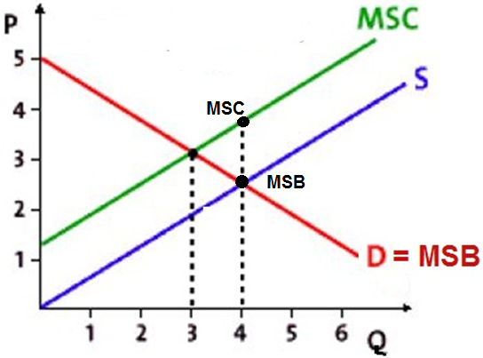
If there are neg. externalities then 4 will be produced
(where Qs=Qd, the profit max. Q, WHAT WE GET).
At a quantity of 4: MSB < MSC
indicating that too much is being produced.

Slide 69
27. Which of the following is NOT a way to solve the efficiency problem of a negative externality?
Tax the product
Government regulations
Coase theorem
Subsidize the product

Slide 70
27. Which of the following is NOT a way to solve the efficiency problem of a negative externality?
Tax the product
Government regulations
Coase theorem
Subsidize the product

Slide 71
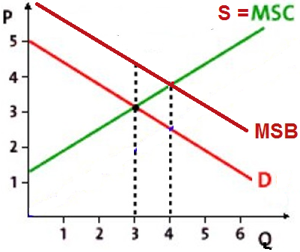
28. This graph shows the effect of a:
Price ceiling
Price floor
Positive externality
Negative externality

Slide 72
28. This graph shows the effect of a:
Price ceiling
Price floor
Positive externality
Negative externality

Slide 73
29. When positive externalities are in a market for a good, the market
Succeeds, because it is producing the socially optimal (alloc. eff.) output
Fails, because it overproduces the good
Succeeds, because it overproduces the good
Fails, because it underproduces the good

Slide 74
29. When positive externalities are in a market for a good, the market
Succeeds, because it is producing the socially optimal (alloc. eff.) output
Fails, because it overproduces the good
Succeeds, because it overproduces the good
Fails, because it underproduces the good

Slide 75
22. “D” is the demand when there are positive externalities.
How much will be produced?
Less than 3
3
4
More than 4

Slide 76
22. “D” is the demand when there are positive externalities.
How much will be produced?
Less than 3
3
4
More than 4

Slide 77
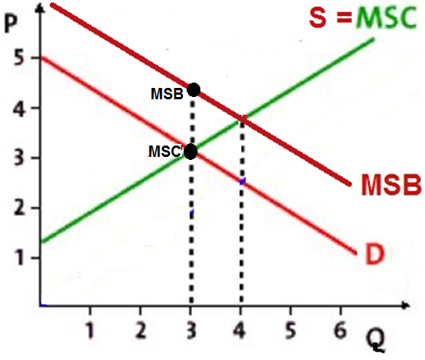
If there are pos. externalities then 3 will be produced
(where Qs=Qd, the profit max. Q, WHAT WE GET).
At a quantity of 3: MSB > MSC
indicating that too little is being produced.

Slide 78
31. What is the Alloc. Eff. Q?
Less than 3
3
4
More than 4

Slide 79
31. What is the Alloc. Eff. Q?
Less than 3
3
4
More than 4

Slide 80
32. Which of the following would be done to correct for (internalize) a positive externality?
Government regulations on production
Excise tax
Privatization
Subsidy

Slide 81
32. Which of the following would be done to correct for (internalize) a positive externality?
Government regulations on production
Excise tax
Privatization
Subsidy

Slide 82
33. Which of the following is NOT a way to solve the efficiency problem of a positive externality?
Tax the product
Government produces the product itself
Increase demand for the product
Subsidize the product

Slide 83
33. Which of the following is NOT a way to solve the efficiency problem of a positive externality?
Tax the product
Government produces the product itself
Increase demand for the product
Subsidize the product

Slide 84
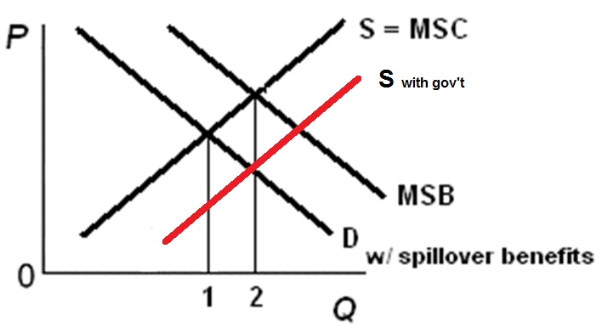
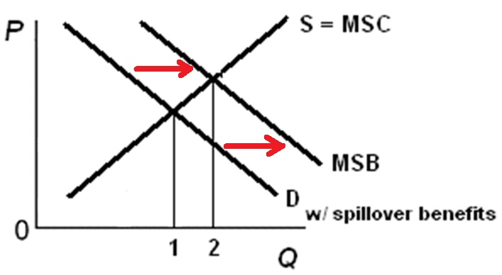
How to Correct for Positive Externalities
Increase Supply: Increase Demand:
Increase Supply: Increase Demand:
- subsidize producers - subsidize consumers
- example: solar panels - example: financial aid
- gov’t produces
- example: public schools, parks

Slide 85
34. Which of the following is the best example of a public good?
A hamburger
A music download
A public park
Light from a streetlight

Slide 86
34. Which of the following is the best example of a public good?
A hamburger
A music download
A public park
Light from a streetlight

Slide 87
35. A public good:
Is a rival, exclusive good
Is a non-rival, exclusive good
Is a non-rival, non-exclusive good
Does not have the free rider problem

Slide 88
35. A public good:
Is a rival, exclusive good
Is a non-rival, exclusive good
Is a non-rival, non-exclusive good
Does not have the free rider problem

Slide 89
36. The role of government concerning public goods is to:
Tax the product
Regulate the product
Produce the product
Apply the Coase theorem

Slide 90
36. The role of government concerning public goods is to:
Tax the product
Regulate the product
Produce the product
Apply the Coase theorem

Slide 91
Study hard!

