Slide 1
8/9b - ARE BUSINESSES EFFICIENT? Pure Competition in the Long Run
This web quiz may appear as two pages on tablets and laptops.
I recommend that you view it as one page by clicking on the open book icon at the bottom of the page.

Slide 2
8/9b Pure Competition in the Long Run
ARE BUSINESSES EFFICIENT?
Long Run Equilibrium
Pure Competition and Efficiency
Marginal Cost Pricing

Slide 3
Must Know / Outcomes:
Explain the difference between the short run and the long run..
Explain the shape of long run industry supply curves in constant cost and increasing cost industries.
Differentiate between productive and allocative efficiency.
Explain why allocative efficiency and productive efficiency are achieved where P = minimum ATC = MC.
Understand the adjustment process from the short run to the long run caused by the entry and exit of firms. Explain the role of barriers to entry and profits.
Why do competitive firms earn zero economic profits in the long run?
Draw the long run equilibrium graph for a purely competitive firm and indicate the profit maximizing quantity, the allocatively efficient quantity, and the productively efficient quantity.
How do you find the profit maximizing quantity?
How do you find the allocatively efficient quantity?
How do you find the productively efficient quantity?
Explain why allocative efficiency occurs where MSB=MSC and when consumer plus producer surplus is maximized
What is creative destruction?
8/9b Pure Competition in the Long Run

Slide 4
KEY TERMS: long-run equilibrium, long-run supply curve, constant-cost industry, increasing-cost industry, decreasing-cost industry, productive efficiency, allocative efficiency, consumer surplus, producer surplus, invisible hand of capitalism, creative destruction, marginal cost pricing, dynamic efficiency, X-efficiency, normal profit
8/9b Pure Competition in the Long Run

Slide 5
Review of Lesson 8/9a
Pure Competition in the Short Run
YP 11 - Draw the 3 graphs from Memory
YP 12 – 13 Short Run Equilibrium – Table of data
YP 13 #20 – MC above AVC = Short Run Supply
8/9b Pure Competition in the Long Run

Slide 6
8/9b Pure Competition in the Long Run
WHAT IS THE “LONG RUN”?

Slide 7
LESSON 8/9b INTRODUCTION 1 -- ARE BUSINESSES EFFICIENT?
Again, we return to the central issue of economics: reducing scarcity (the 5Es).
In lessons 8/9, 10, and 11 we will see if industries are: allocatively efficient, and (2) productively efficient, in the long run.
Here, we will learn that since there are no barriers to entry in the long run the competitive markets will produce the allocatively efficient quantity that people want at the lowest possible cost (productive efficiency; where MC = ATC).
Be sure to see the last 13 pages of the Unit 3 Yellow Pages ("3 Rules and 4 Models").
What do we already know?
This would be a good time to review the 5Es online reading from lesson 1b and reacquaint yourself with the definitions and examples of allocative and productive efficiency.
Allocative efficiency means producing the mix of goods and services that maximize society's satisfaction
Productive efficiency means producing at a minimum cost.

Slide 8
LESSON 8/9b INTRODUCTION 2 -- ARE BUSINESSES EFFICIENT?
What do we already know (continued)?
In lesson 1d we learned about benefit-cost analysis (marginal analysis). From lessons 3 and 5 we know that we find the allocatively efficient quantity where MSB = MSC and where consumer plus producer surplus are maximized. In lesson 4b we learned the definitions of short run and long run.
In lesson 2a we learned that competitive markets are efficient.
In lessons 5a and 5b we learned that sometimes markets fail to achieve efficiency. One of the market failures occurs when the markets are not competitive. We will explore imperfectly competitive markets in lessons 10a, 10b, 11a, and 11b.
In lesson 8/9a we learned the characteristics of competitive markets and how competitive businesses find the profit maximizing quantity to produce (where MR=MC or WHAT WE GET).
In lessons 8/9, 10, and 11 we will put all of this together to see if businesses are efficient. Of course we do not have time to study every individual business or industry, so we will examine the efficiency of four groups of industries or the four product market models.
In this lesson (8/9b) we again learn that competitive markets achieve allocative and productive efficiency. Finally in this lesson, once we learn that the allocatively efficient quantity occurs where P = MC, we will look at ways this might be used to improve the allocation of resources and reduce scarcity. (MC Pricing).

Slide 9
LESSON 8/9b INTRODUCTION 3 -- ARE BUSINESSES EFFICIENT?
What do we already know (continued)?
To maximize profits, businesses will produce the quantity where:
MR = MC
Never forget this.

Slide 10
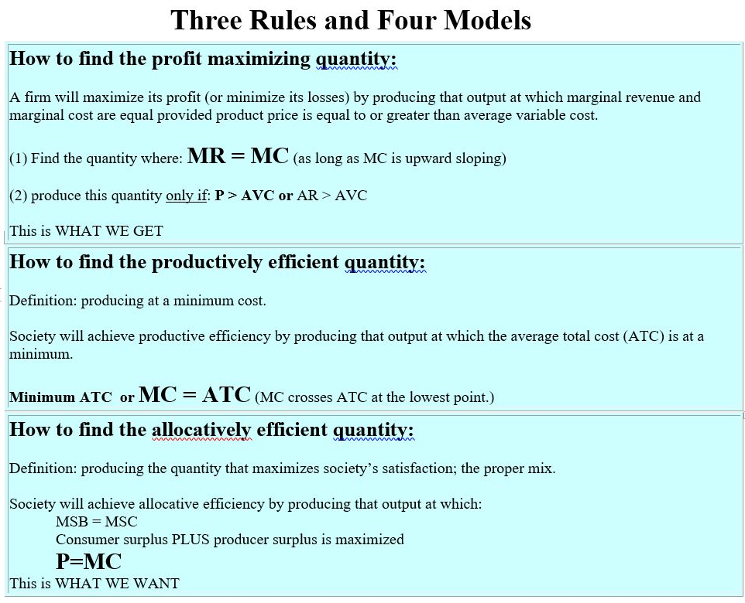
YP
16

Slide 11
Pure
Competition
Short Run
Earning
Profits
Pure
Competition
Short Run
Earning
Losses
Pure
Competition
Short Run
Shut Down
Losses = TFC
8/9b Pure Competition in the Long Run

Slide 12
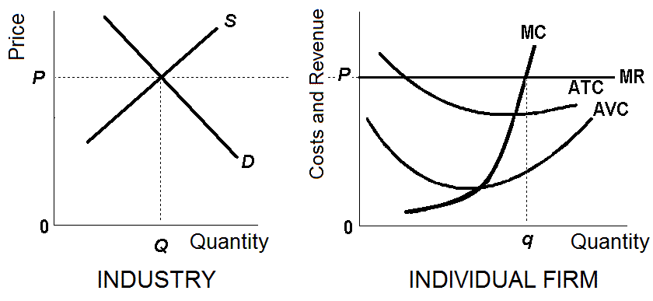
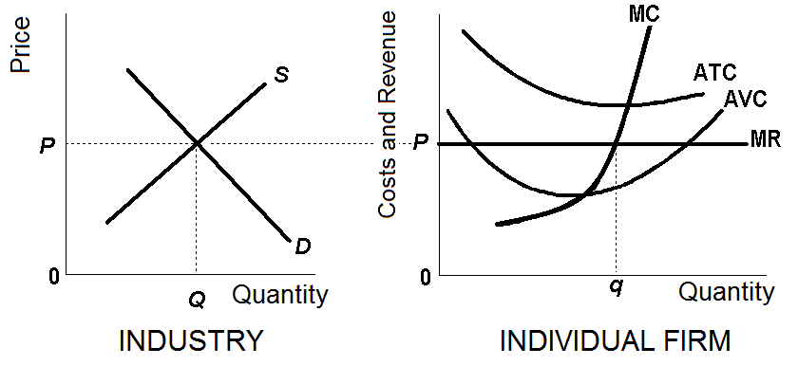
So what would happen in the long Run if:
Firms are earning short run profits:
Firms are learning short run losses:
YP 17: The Long Run Adjustment Process – Pure Comp.

Slide 13
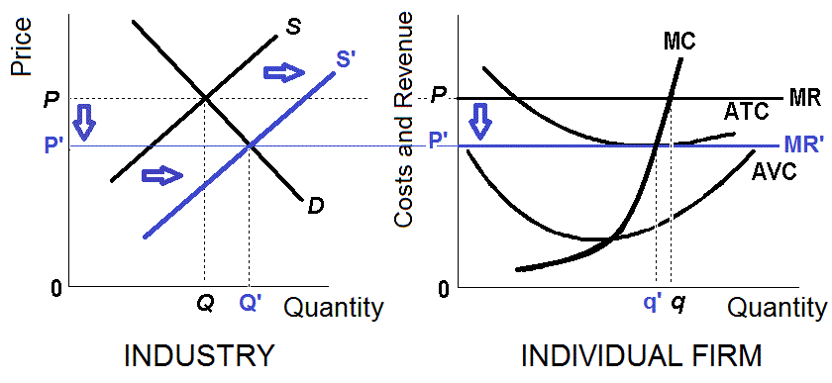
YP 17: The Long Run Adjustment Process – SR Profits
If firms are earning short run profits then new firms will enter the industry (remember there are no barriers to entry). New firms would cause the supply to increase (number of producers goes up) and cause the price to go down eliminating the profits

Slide 14
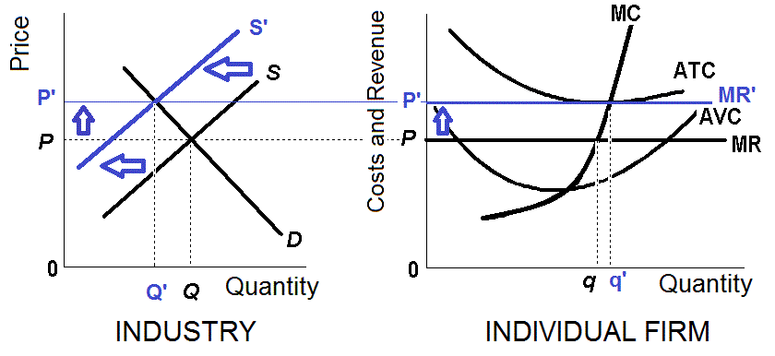
YP 17: The Long Run Adjustment Process – SR Losses
If firms are earning short run losses then firms will leave the industry The decrease in the number of producers would cause the supply to and cause the price to go up eliminating the lossess

Slide 15
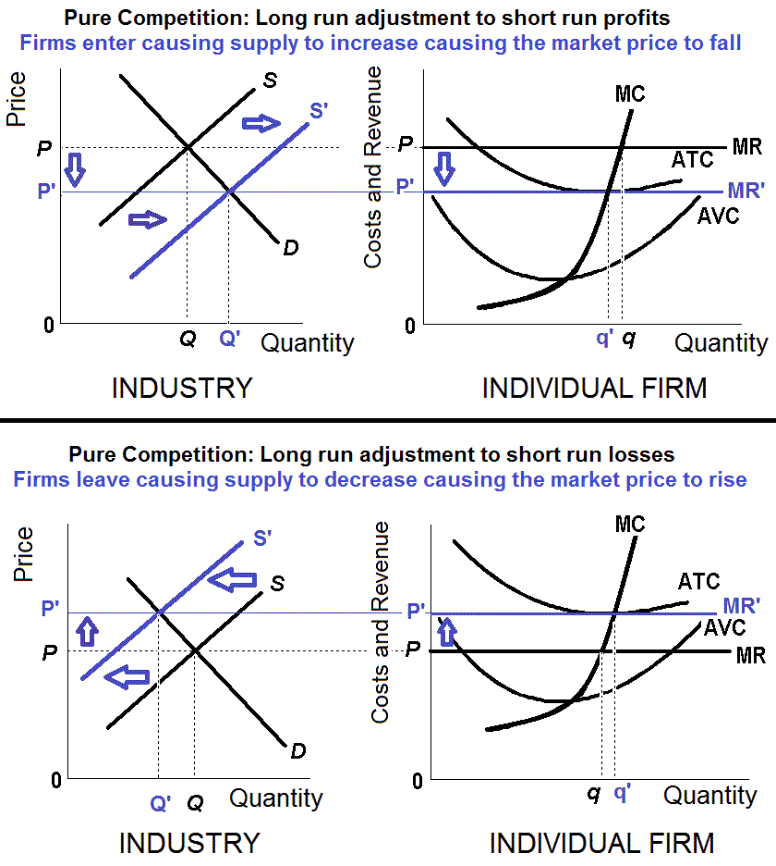
The Long run Adjustment Process:
Pure
Competition

Slide 16
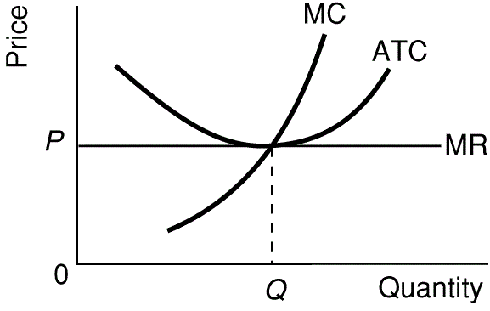
This long run adjustment process will stop when there are no profits or no losses.
YP 18 # 5 or YP 70
8/9b Pure Competition in the Long Run

Slide 17
Pure Competition and Efficiency
Alloc. Efficiency – YES – see next slide
Prod Efficiency – YES – see next slide
X-Efficiency – YES
Dynamic Efficiency - NO
8/9b Pure Competition in the Long Run

Slide 18
The Long Run Equilibrium – Pure Comp.
YP 18 # 5 or YP 70
Find on the graph:
profit maximizing quantity,
allocatively efficient quantity, and the
productively efficient quantity
Write the rules (formulas) that you used to find each (YP 16 – next slide)
8/9b Pure Competition in the Long Run

Slide 19
YP
16

Slide 20
The Long Run Adjustment Process – Pure Comp.
MicWebApp 8/9b - SOMETHING INTERESTING
Why will purely competitive firms always earn zero economic profits (called normal profits) in the long run?
ANSWER: because there are no barriers to entry
Why are zero economic profits good (or at least OK)?
- ANSWER: because economists include implicit costs when they calculate total costs (i.e. you pay yourself as much as you could have made in your next best opportunity).
8/9b Pure Competition in the Long Run

Slide 21
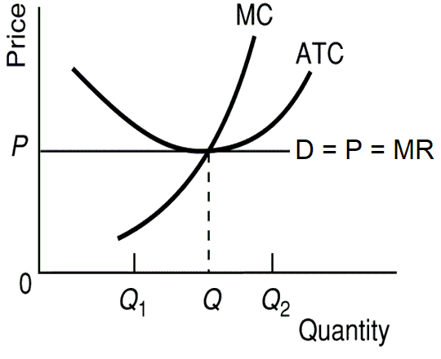
INefficiency occurs at:
Q1 P > MC
MSB > MSC
underallocation of resources
too little is being produced
we would get more utility from more of this product than we would from our next best alternative
Q2
P < MC
MSB < MSC
overallocation of resources
too much is being produced
we would get less utility from more of this product than we would from our next best alternative
8/9b Pure Competition in the Long Run

Slide 22
Pure Competition and Efficiency
Alloc. Efficiency - YES
Prod Efficiency - YES
X-Efficiency – YES
Dynamic Efficiency - NO
8/9b Pure Competition in the Long Run

Slide 23
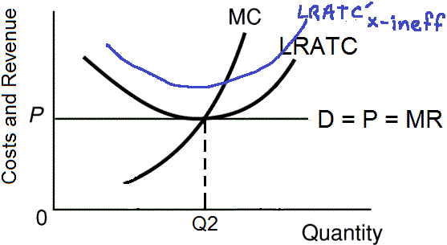
Pure Competition and Efficiency
X-Efficiency – YES
X-inefficiency occurs
when the ATC curve
is higher than it
could be.
If a competitive firm in long run equilibrium is X-inefficient, it would earn losses (P < ATC), and it would go out of business. They must be X-efficient to make at least a normal profit.
8/9b Pure Competition in the Long Run

Slide 24
Pure Competition and Efficiency
Alloc. Efficiency - YES
Prod Efficiency - YES
X-Efficiency – YES
Dynamic Efficiency - NO
Dynamic Efficiency is concerned with:
- Investing in research and development to invent new and better products.
- Also, investing in the development of new production technology to lower ATC.
8/9b Pure Competition in the Long Run

Slide 25
Pure Competition is NOT Dynamically Efficient
In the long run competitive firms earn only a normal profit.
But firms want a higher than normal profits - they want an economic profit.
Firms can earn higher than normal profits by inventing new production technologies to lower costs.
BUT competitive firms will NOT do this because they
LACK INCENTIVES: No matter how the firm manages to increase his profits, usually these are temporary profits, because new firms can enter and copy what they are doing.
LACK MEANS: Also, with only normal profits, they will not have the funds to conduct the necessary research
8/9b Pure Competition in the Long Run

Slide 26
Pure Competition and Efficiency
Competitive Markets Used as Standard of Efficiency
"The invisible hand" (introduced in Lesson 2a) works in a competitive market system.
Businesses are just trying to maximize their profits
but the result is:
1. Pure competition achieves Allocative Efficiency 2. Pure competition achieves Productive Efficiency 3. Purely competitive firms will be X-efficient 4. But purely competitive firms are not Dynamically Efficient
8/9b Pure Competition in the Long Run

Slide 27
Creative Destruction
Creative destruction occurs when the creation of new goods and production techniques destroys market shares of firms committed to old goods and old business methods.
Even the mere threat of new goods and technologies can cause existing firms to abandon their old ways.
There are many examples of creative destruction in transportation, entertainment, music, postal service, and retail industries.
in the 1800s railroads put horse drawn wagons out of business, later trucks took business from the trains
movies challenged live theater, television challenged movie theaters, the internet is challenging television
cassettes challenged records, CDs challenged cassettes, music downloads challenged CDs
As creative destruction evolves an industry, individuals will likely become unemployed (at least temporarily) so there are costs even though the benefits are greater.
8/9b Pure Competition in the Long Run

Slide 28
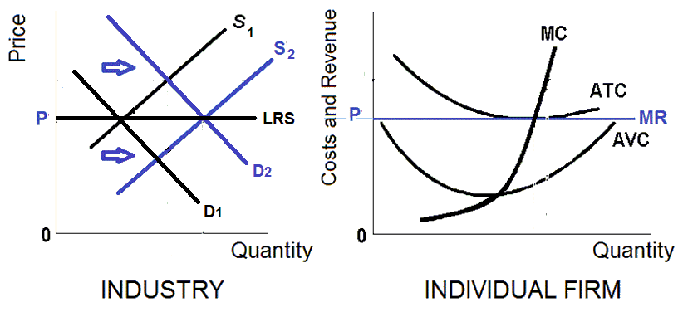
Long Run Supply: Constant Cost Industry
In constant cost industries, if demand goes up and creates profits, then new industries will enter increasing supply, but ATC do not change.
An industry in which expansion or contraction will not affect resource prices and therefore production costs. Graphically, it means the entry or exit of firms does not shift the ATC curves of individual firms
Occurs when the industry's demand for resources is small in relation to the total demand for those resource

Slide 29
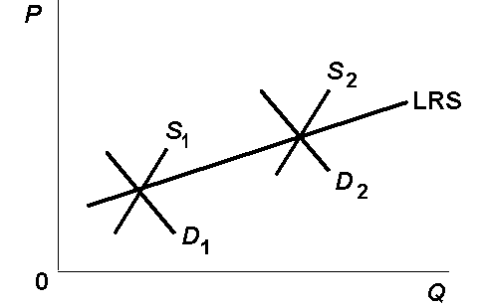
Long Run Supply: Increasing Cost Industry
In increasing cost industries, if demand goes up and creates profits, then new industries will enter increasing supply, and ATC will increase.
An industry in which expansion through the entry of new firms, because of an increase in demand, increases the prices firms in the industry must pay for resources and therefore increases their production costs (ATC rise).
Occurs when the industry's demand for resources is large in relation to the total demand for those
8/9b Pure Competition in the Long Run

Slide 30
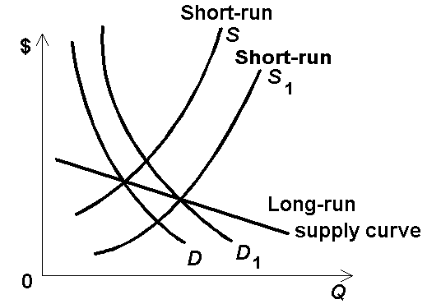
Long Run Supply: Decreasing Cost Industry
In decreasing cost industries, if demand goes up and creates profits, then new industries will enter increasing supply, and ATC will decrease.
An industry in which expansion through the entry of firms, because of an increase in demand, decreases the prices firms in the industry must pay for resources and therefore decreases their production costs.
Occurs when the industry's demand for resources allows its resource providers to take advantage of economies of scale
8/9b Pure Competition in the Long Run

Slide 31
Pure Competition – Advantages and Disadvantages
ADVANTAGES
Allocatively Efficient. This is because P = MC
Productively Efficient. This is because firms produce at the lowest point on the AC
X - Efficient. Competition between firms will keep their ATC as low as possible.
Resources will not be wasted through advertising because products are homogenous
Normal profit means consumers are getting the lowest price. This also leads to greater equality (or equity) in society.
8/9b Pure Competition in the Long Run

Slide 32
Pure Competition – Advantages and Disadvantages
DISADVANTAGES
No scope for economies of scale, this is because there are many small firms producing relatively small amounts. Industries with high fixed costs would be particularly unsuitable to perfect competition (like natural monopolies). This is one reason why pure competition is unlikely in the real world
Undifferentiated products are boring, giving little choice to consumers = narrow range of Consumer Choice..
Dynamically INefficient:
LACK MEANS: Lack of supernormal profit may make investment in R&D unlikely this would be important in an industry such as pharmaceuticals which require significant investment.
. LACK INCENTIVE: With perfect knowledge there is no incentive to develop new technology because it would be shared with other companies
With public goods, or if there are externalities in production or consumption, there is likely to be market failure without government intervention and allocative inefficiency will result
8/9b Pure Competition in the Long Run

Slide 33
MC Pricing
To achieve allocative efficiency: MSB should equal MSC.
If P measures MSB (no pos. ext.) and MC measure MSC (no neg. ext.) then to achieve allocative efficiency: P should equal MC.
Allocative INefficiency occurs when price does NOT equal MC.
If P>MC then we want more – too little is being produced or consumed (underallocation of resources).
If P < MC then too much is being produced and consumed (overallocation of resources).
8/9b Pure Competition in the Long Run

Slide 34
MC Pricing
EXAMPLE of Inefficiency - When P does not equal MC
All you can eat / free refills
what are the MSC to society (MC to the firm) of having one more?
what is the price (P) to the consumer of having one more?
does P=MC (or MSB=MSC) ?
if not, is P>MC (too little) or is P< MC (too much) ?
is allocative efficiency achieved? - or is there an OVER- or UNDER-allocation of resources?
8/9b Pure Competition in the Long Run

Slide 35
MC Pricing
EXAMPLES of Inefficiency - When P does not equal MC
rent with utilities included
what are the MSC to society (MC to the firm) of turning the heat up in the winter?
what is the price (P) to the consumer of turning the heat up in the winter?
does P=MC (or MSB=MSC) ?
if not, is P>MC or is P< MC ?
is allocative efficiency achieved or is there an OVER- or UNDER-allocation of resources?
8/9b Pure Competition in the Long Run

Slide 36
MC Pricing
EXAMPLES of Inefficiency - When P does not equal MC
electricity rates: summer vs. winter
in Illinois the price of electricity is the same in summer and winter
when is the MC higher?
therefore, to achieve allocative efficiency, when should the price be higher?
if the price is not higher what might happen?
8/9b Pure Competition in the Long Run

Slide 37
MC Pricing
EXAMPLES of Inefficiency - When P does not equal MC
bus fares – rush hour vs. noon hour/midnight
when is the cost (MC) to the bus company, or the cost to society (MSC), greater?
at rush hour ?
or at noon hour ?
when should the price be higher to achieve allocative efficiency?
8/9b Pure Competition in the Long Run

Slide 38
MC Pricing
EXAMPLES of Inefficiency - When P does not equal MC
tollway fares
when is the cost to society (MSC) of allowing one more car on the tollway greater?
rush hour when there is a lot of traffic?
noon hour when there is very little traffic?
when should the price be higher to achieve allocative efficiency?
how does this save resources?
8/9b Pure Competition in the Long Run

Slide 39
MC Pricing
EXAMPLES of Efficiency - When P does equal MC
electricity rates: days vs. evening
Some ski areas only make snow at night because they can buy electricity for less – Why?
when is the MC lower?
therefore, to achieve allocative efficiency, when should the price be lower?
8/9b Pure Competition in the Long Run

Slide 40
MC Pricing
EXAMPLES of Efficiency - When P does equal MC
plane fares
what is the MC of adding one more traveler to a plane that is half full?
what is the MC of adding one more traveler to a plane is is full?
Why do they charge less for "standby"?
Is this efficient?
8/9b Pure Competition in the Long Run

Slide 41
MC Pricing
EXAMPLE of Efficiency - When P does equal MC
congestion tolls for London and New York
when is the cost to society (MSC) of allowing one more person into London?
During the day when many are there?
At night when few are there?
when should the price be higher to achieve allocative efficiency?
what should the price be on weekends to be allocatively efficient assuming that there are very many empty parking spaces available?
8/9b Pure Competition in the Long Run

Slide 42
MC Pricing
Other Examples
Negative and Positive Externalities
Peak Pricing: Instructor’s childhood home – fuel oil heat AND electric heat
ComEd program to turn off air conditioning when power loads are high
8/9b Pure Competition in the Long Run

Slide 43
1.Which graph shows a perfectly competitive firm in long run equilibrium?
A
B
C
D

Slide 44
1.Which graph shows a perfectly competitive firm in long run equilibrium?
A
B
C
D

Slide 45
2. Which characteristic of perfectly competitive firms best explains why they earn normal profits in the long run?
Very many firms
Produce standardized product
No non-price competition
No barriers to entry

Slide 46
2. Which characteristic of perfectly competitive firms best explains why they earn normal profits in the long run?
Very many firms
Produce standardized product
No non-price competition
No barriers to entry

Slide 47
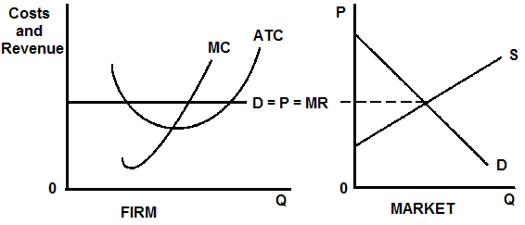
3. What will happen in the long run?
Demand will increase
Demand will decrease
Supply will increase
Supply will decrease

Slide 48
3. What will happen in the long run?
Demand will increase
Demand will decrease
Supply will increase
Supply will decrease

Slide 49
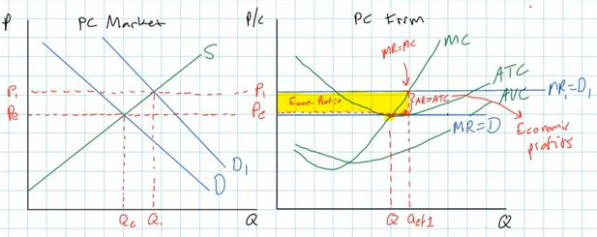
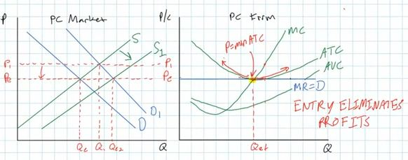
Entry
Eliminates
Profits
What happen if firms initially are in long run equilibrium and then demand increases?
D increases which raises the price creating profits
2. Profits attract new producers which will increase supply and decrease the price and back to zero profits
Remember: there are no barriers to entry and exit

Slide 50
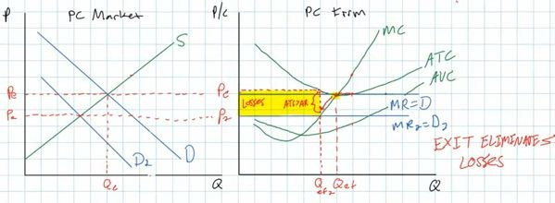
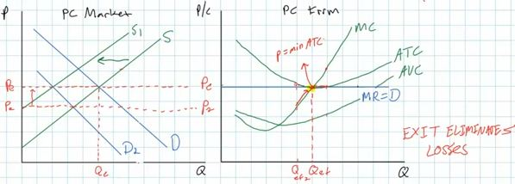
Exit
Eliminates
Losses
What happen if firms initially are in long run equilibrium and then demand decreases?
D decreases which lowers the price creating losses
2. Losses cause producers to leave which will decrease supply and increase the price and back to zero profits
Remember: there are no barriers to entry and exit

Slide 51
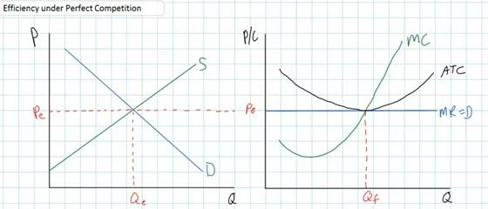
In the long
run in a
perfectly
competitive
market
we will
always get
ZERO (normal) profits
Remember: there are no barriers to entry and exit

Slide 52
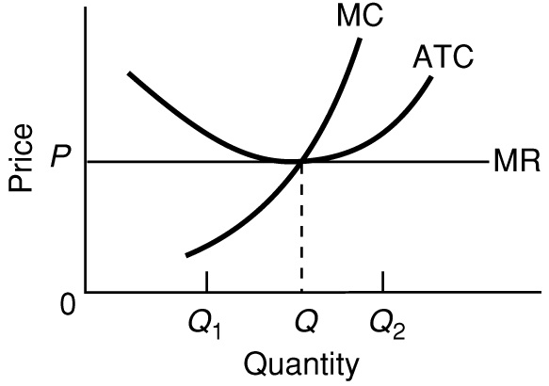

Slide 53
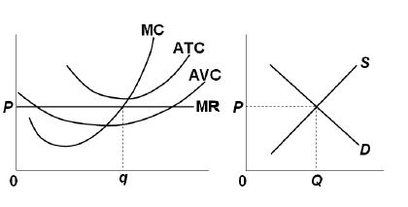
4. This graph shows:
Short run equilibrium
Long run equilibrium
Both LR and SR equil.
Neither LR or SR equil.

Slide 54
4. This graph shows:
Short run equilibrium
Long run equilibrium
Both LR and SR equil.
Neither LR or SR equil.

Slide 55
What is:
Productive efficiency?
Allocative efficiency?

Slide 56
5. Productive efficiency:
MR = MC
MC = ATC
P = MC
MSB = MSC

Slide 57
5. Productive efficiency:
MR = MC
MC = ATC
P = MC
MSB = MSC

Slide 58
At the equilibrium (profit maximizing) quantity
purely competitive firms achieve productive efficiency:
They produce the quantity where ATC is at a mimimum
They produce the quantity where MC = ATC

Slide 59
6. Which is NOT allocative efficiency?
Maximum consumer plus producer surplus
P = MC
MSB = MSC
Minimum ATC

Slide 60
6. Which is NOT allocative efficiency?
Maximum consumer plus producer surplus
P = MC
MSB = MSC
Minimum ATC

Slide 61
7. Perfectly competitive firms are most concerned with achieving:
Allocative efficiency (P = MC)
Productive efficiency (MC = ATC)
Maximum profit (MR = MC)
Maximum Consumer surplus

Slide 62
7. Perfectly competitive firms are most concerned with achieving:
Allocative efficiency (P = MC)
Productive efficiency (MC = ATC)
Maximum profit (MR = MC)
Maximum Consumer surplus

Slide 63
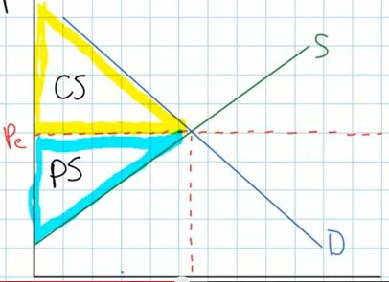
8. “PS” stands for:
Product Supplied
Producer Surplus
Productive Surplus
Perfect Short run

Slide 64
8. “PS” stands for:
Product Supplied
Producer Surplus
Productive Surplus
Perfect Short run

Slide 65
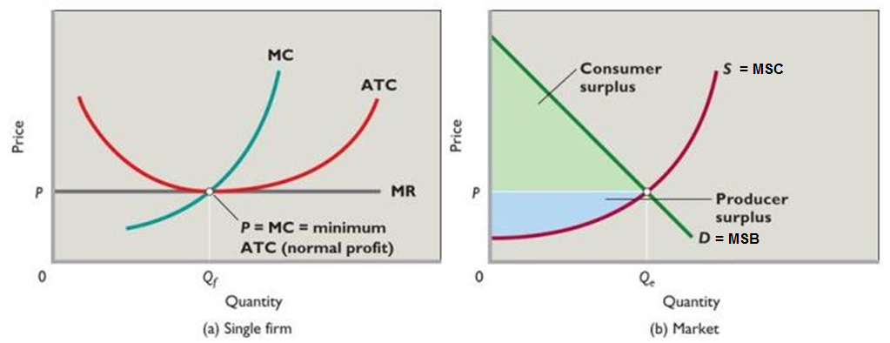
At the equilibrium (profit maximizing) quantity
purely competitive firms achieve allocative efficiency:
They produce the quantity where P = MC (MSB = MSC)
They maximize consumer plus producer surplus
They produce the quantity where MSB = MSC

Slide 66
9. “Socially optimal quantity” means:
Allocative efficiency
Productive efficiency
Profit maximizing
Consumer surplus

Slide 67
9. “Socially optimal quantity” means:
Allocative efficiency
Productive efficiency
Profit maximizing
Consumer surplus

Slide 68
10. If Py = $25 and the MCy = $18:
Y is being produced with the fewest resources possible
Society will gain if less of y is produced
Resources are being underallocated to Y
Too much Y is being produced

Slide 69
10. If Py = $25 and the MCy = $18:
Y is being produced with the fewest resources possible
Society will gain if less of y is produced
Resources are being underallocated to Y
Too much Y is being produced

Slide 70
Pure Comp. – Long Run Equilibrium
At the profit maximizing level of output of Q (MR = MC):
Allocative efficiency is achieved: P = MC
Productive efficiency is achieved: minimum ATC (MC=ATC)

