Slide 1
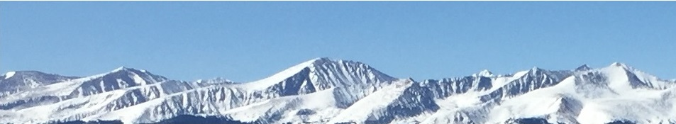
8/9a - ARE BUSINESSES EFFICIENT?
Pure Competition in the Short Run
This web quiz may appear as two pages on tablets and laptops.
I recommend that you view it as one page by clicking on the open book icon at the bottom of the page.

Slide 2
ARE BUSINESSES EFFICIENT?
8/9a – Pure Competition in the Short-Run
  Four Product Market Models
  Pure Competition
    Characteristics and Examples
    Short Run Equilibrium
      Profit maximizing case
      Loss minimizing case
      Shut down case

Slide 3
Goal for the rest of the Semester:
ARE BUSINESSES EFFICIENT?
Lessons 1-3 we said YES, competitive markets are efficient
Lesson 5 we discussed exceptions (Failures):
  Markets fail to Achieve Alloc. Eff. when:
    There are price ceilings and price floors
    Negative Externalities exist (5a)
    Positive Externalities exist (5b)
    There are Public Goods (5b)
    There is a Tragedy of the Commons (5b)
    They Lack Competition (10b, 11a, 11b )

Slide 4
Lessons 7-11: ARE BUSINESSES EFFICIENT?
DO BUSINESSES PRODUCE THE ALLOC. EFF. Q?
Does WHAT WE GET = WHAT WE WANT?
What we get: Profit Maximizing Q
Where Qs = Qd
Q where MR=MC
What we want: Allocatively Efficient Q
Q where MSB = MSC
Q where P = MC
8/9a – Pure Competition in the Short-Run

Slide 5
Lessons 12-13 (Unit 4): ARE BUSINESSES EFFICIENT?
DO BUSINESSES HIRE THE EFFICIENT Q OF WORKERS?
Does WHAT WE GET = WHAT WE WANT?
What we get: Profit Maximizing Q of workers
Where Qs = Qd
Q where MRP=MRC
What we want: Alloc. Efficient Q of workers
Q where MSB = MSC
Q where VMP = W
8/9a – Pure Competition in the Short-Run

Slide 6
Lessons 7-11: What quantity to produce?
Goal of Businesses: Maximize profits
MR=MC
Goal of Society: Allocative Efficiency
P=MC
Lessons 12a and 13a: What quantity to hire?
Goal of Businesses: maximize profits
MRP = MRC
Goal of Society: Allocative Efficiency
VMP = W
7a – Economic Profit and the Production Function

Slide 7
PRODUCT MARKETS
WHAT WE GET (lesson 8/9a):
Benefit-Cost Analysis and Producer Decisions
  - Decision: How Many to Produce:
  - Goal: Maximize Profits
  - Benefit Cost Analysis:
    Produce all where: MB > MC
    up to where: MB=MC
    but never where: MB<MC
To maximize profits a business will produce the quantity where:
MR = MC
[WHAT WE GET]
8/9a – Pure Competition in the Short-Run

Slide 8
PRODUCT MARKETS
WHAT WE WANT (Lesson 8/9b):
Benefit-Cost Analysis and Allocative Efficiency
  - What does society’s want?
  - Goal: Maximize Satisfaction (Allocative Efficiency)
  - Benefit Cost Analysis:
    all where: MB > MC
    up to where: MB=MC
    but never where: MB<MC
To maximize satisfaction society wants the quantity where: MSB = MSC
OR
Maximum Consumer Plus Producer Surplus
OR
P = MC
[WHAT WE WANT]
8/9a – Pure Competition in the Short-Run

Slide 9
ARE BUSINESSES EFFICIENT?
If:
WHAT WE GET: Q where MR = MC
Equals:
WHAT WE WANT: Q where P=MC
Then:
Businesses are Producing the Allocatively Efficient Quantity
8/9a – Pure Competition in the Short-Run

Slide 10

A Continuum of Product Markets
We can not study all businesses,
so we will study four categories of businesses:
  Pure Competition
  Monopoly
  Monopolistic Competition
  Oligopoly
These are the 4 Product Market Models
ARE BUSINESSES EFFICIENT?

Slide 11
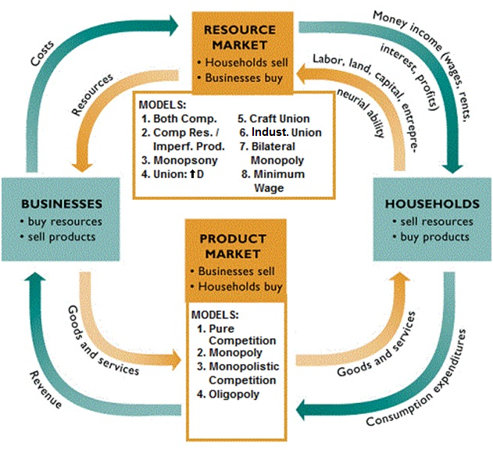

Slide 12
ARE BUSINESSES EFFICIENT? - 4 Product Market Models
General Outline for Each Model:
1. Characteristics and Examples
2. Nature of the Demand Curve
3. Short Run Equilibrium (Profit Max.)
4. Long Run Equilibrium and Efficiency
5. Other Issues
Characteristics and Examples:
  See YP 2
  See Practice Quiz on Blackboard
  See Table in Textbook
8/9a – Pure Competition in the Short-Run

Slide 13
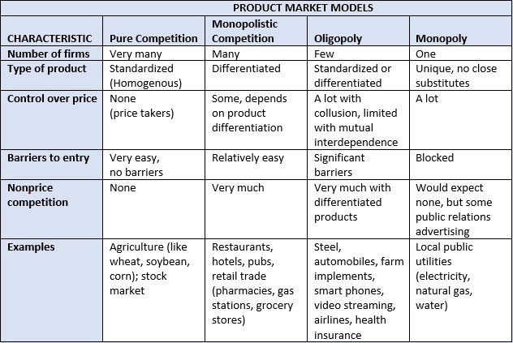
8a – Four Market Models

Slide 14
4 Product Market Models – ARE BUSINESSES EFFICIENT?
General Outline for Each Model:
Know the model's characteristics and examples
(8/9a Practice Quiz on Blackboard; YP 2)
Be able to explain the shape of the demand curve
Find short run equilibrium quantity (3 ways: table, graph, graph with letters) and draw graphs for:
(a) profit maximizing firms,
(b) loss minimizing firms, and
(c) firms that will shut down
Draw the long run equilibrium graph and find the profit maximizing quantity (WHAT WE GET), allocatively efficient quantity (WHAT WE WANT), and the productively efficient quantity. (See the last 13 pages of the Yellow Pages)
Understand any other issues associated with the model

Slide 15
Lesson 8/9a Outcomes /Must Know:
List the four basic market models and know characteristics and examples of each. (YP 2)
Describe characteristics and examples of a purely competitive firms and industries.
Explain how a purely competitive firm views demand for its product and marginal revenue from each additional unit sold.
Compute and graph price (also called demand or average revenue), total revenue, and marginal revenue when given a demand schedule for a purely competitive firm.
Use both the total revenue minus total cost approach and the marginal revenue = marginal cost approach to determine the short run price and output that maximizes profits (or minimizes losses) for a competitive firm.
  with a table of data
  on a graph with numbers
  on a graph using geometry (graph with letters)
Draw the short run equilibrium graphs for a purely competitive firm that
  maximizes profit,
  minimizes loss, and
  shuts down
Find the short run supply curve when given short run cost schedules for a competitive firm.
8/9a – Pure Competition in the Short-Run

Slide 16
KEY TERMS:
pure competition, pure monopoly,
monopolistic competition, oligopoly,
imperfect competition,
standardized (homogenous) product,
perfectly elastic demand, market power,
price taker, average revenue (usually price), marginal revenue, total revenue,
MR=MC rule (profit maximization rule),
short-run equilibrium, short-run supply curve
8/9a – Pure Competition in the Short-Run

Slide 17
ARE BUSINESSES EFFICIENT? - 4 Product Market Models
General Outline for Each Model:
1. Characteristics and Examples
2. Nature of the Demand Curve
3. Short Run Equilibrium (Profit Max.)
4. Long Run Equilibrium and Efficiency
(lesson 8/9b)
5. Other Issues
8/9a – Pure Competition in the Short-Run

Slide 18
1. Pure Competition is an industry structure in which:
All firms sell an identical (standardized) product
Each firm reacts to what the others do (mutual interdependence)
Each firm tries to gain market power by product differentiation
The market has significant barriers to entry

Slide 19
1. Pure Competition is an industry structure in which:
All firms sell an identical (standardized) product
Each firm reacts to what the others do (mutual interdependence)
Each firm tries to gain market power by product differentiation
The market has significant barriers to entry

Slide 20
2. Which of the following is not an assumption (characteristic) of perfectly competitive markets?
Barriers to entry
Standardized (homogeneous) products
Many firms
Firms face a horizontal demand (perfectly elastic)

Slide 21
2. Which of the following is not an assumption (characteristic) of perfectly competitive markets?
Barriers to entry
Standardized (homogeneous) products
Many firms
Firms face a horizontal demand (perfectly elastic)

Slide 22
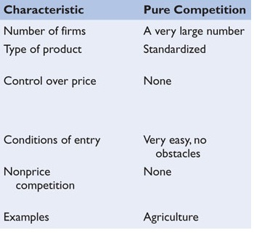

Slide 23
ARE BUSINESSES EFFICIENT? - 4 Product Market Models
General Outline for Each Model:
1. Characteristics and Examples
2. Nature of the Demand Curve
3. Short Run Equilibrium (Profit Max.)
4. Long Run Equilibrium and Efficiency
(lesson 8/9b)
5. Other Issues
8/9a – Pure Competition in the Short-Run

Slide 24
3. For purely competitive firms, Demand is:
Downward sloping and elastic
Downward sloping and inelastic
Horizontal and perfectly price elastic
Upward sloping and perfectly price elastic

Slide 25
3. For purely competitive firms, Demand is:
Downward sloping and elastic
Downward sloping and inelastic
Horizontal and perfectly price elastic
Upward sloping and perfectly price elastic

Slide 26
4. For purely competitive firms:
AR = ATC
P = MR (D = MR)
MC = ATC
AVC = AFC

Slide 27
4. For purely competitive firms:
AR = ATC
P = MR (D = MR)
MC = ATC
AVC = AFC

Slide 28
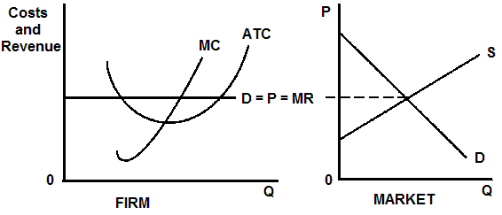
Pure Competition
Price is determined by the market
Demand is perfectly elastic for the individual firm – WHY?

Slide 29
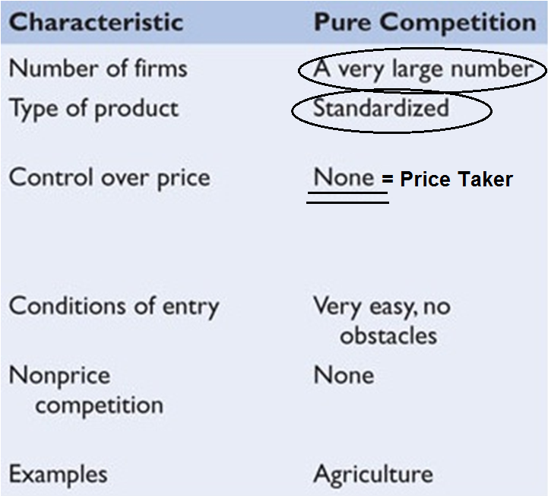
Why is the demand perfectly price elastic?
OR, why are purely competitive firms price takers?

Slide 30
ARE BUSINESSES EFFICIENT? - 4 Product Market Models
General Outline for Each Model:
1. Characteristics and Examples
2. Nature of the Demand Curve
3. Short Run Equilibrium (Profit Max.)
4. Long Run Equilibrium and Efficiency (lesson 8/9b)
5. Other Issues
8/9a – Pure Competition in the Short-Run

Slide 31
5. A firm in a competitive industry will try to produce the output level for which:
TR is at a maximum
ATC is at a minimum
TC = TR
MC = MR

Slide 32
5. A firm in a competitive industry will try to produce the output level for which:
TR is at a maximum
ATC is at a minimum
TC = TR
MC = MR

Slide 33
To maximize profits all firms will produce the quantity where:
MR = MC
as long as MC is increasing
and price is greater than AVC.

Slide 34
How to find the profit maximizing quantity:
A firm will maximize its profit (or minimize its losses) by producing that output at which marginal revenue and marginal cost are equal provided product price is equal to or greater than average variable cost.
(1) Find the quantity where: MR = MC
(as long as MC is upward sloping)
(2) produce this quantity only if: P > AVC
or AR > AVC
This is WHAT WE GET

Slide 35
ARE BUSINESSES EFFICIENT? - 4 Product Market Models
General Outline for Each Model:
1. Characteristics and Examples
2. Nature of the Demand Curve
3. Short Run Equilibrium YP 6-10
- earning a profit
- earning a loss but continues to produce
- shut down case (losses = TFC)
4. Long Run Equilibrium and Efficiency (lesson 8/9b)
5. Other Issues
8/9a – Pure Competition in the Short-Run

Slide 36
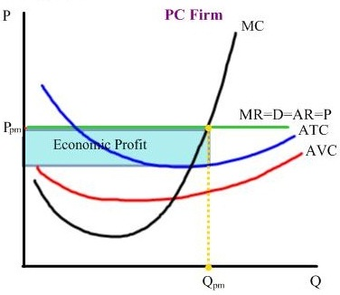
8/9a – Pure Competition in the Short-Run

Slide 37
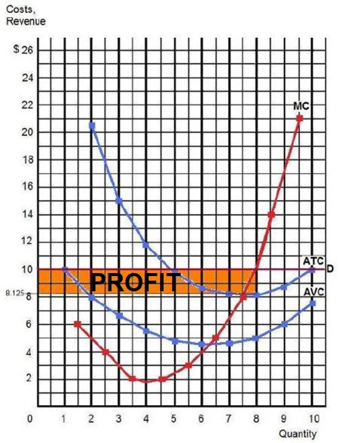
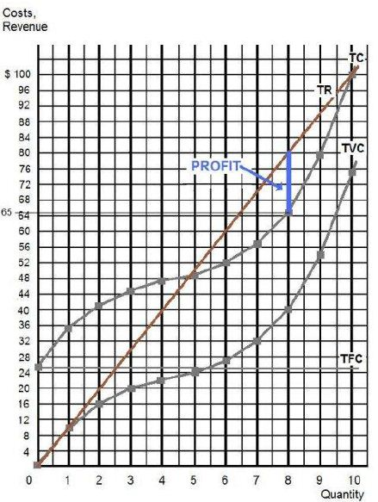
8/9a – Pure Competition earning PROFITS

Slide 38
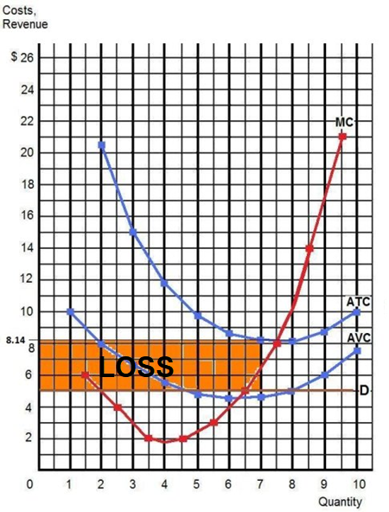
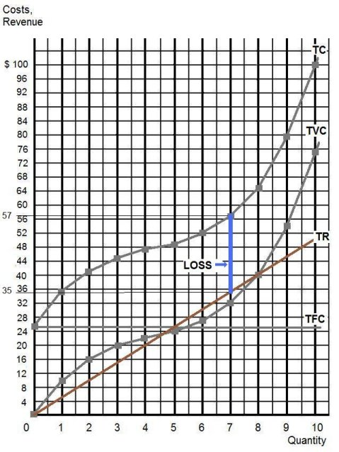
8/9a – Pure Competition earning LOSSES

Slide 39
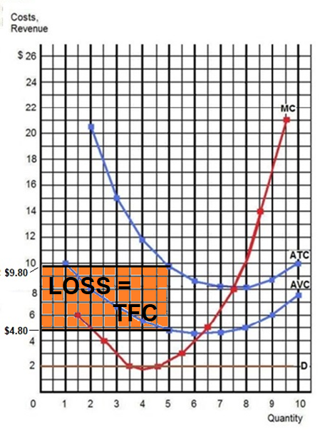
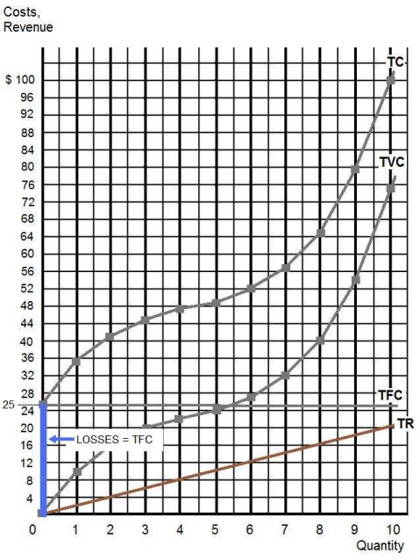
8/9a – Pure Competition SHUTTING DOWN

Slide 40
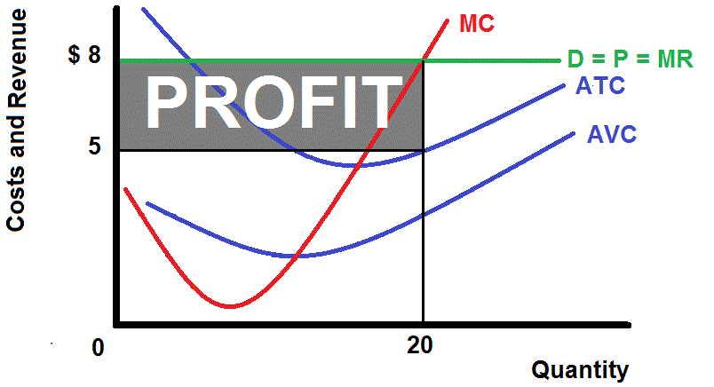
8/9a – Pure Competition earning PROFITS

Slide 41
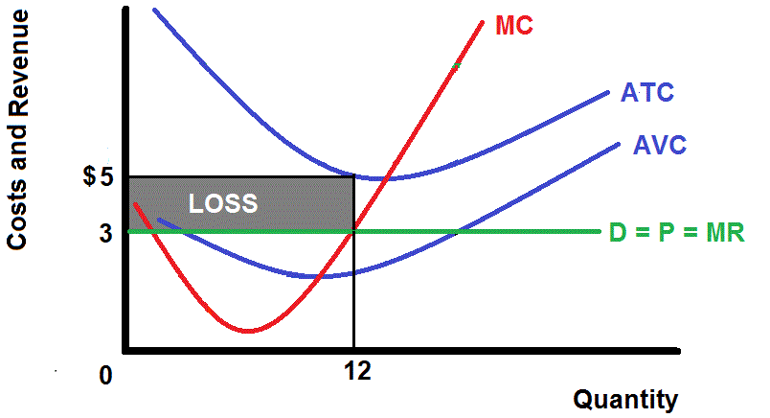
8/9a – Pure Competition earning LOSSES

Slide 42
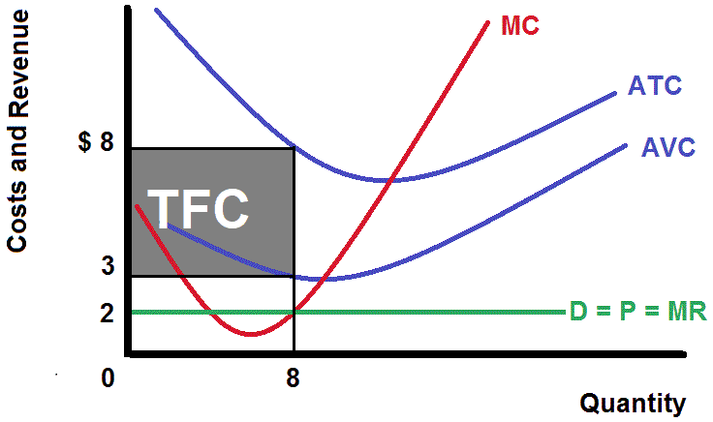
8/9a – Pure Competition SHUTTING DOWN

Slide 43
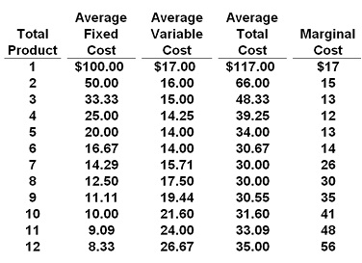
6. If P = $32, this competitive firm will produce: YP 14
8 at a profit of $16
6 at a profit of $12.50
10 at a profit of $4
7 at a profit of $41.50

Slide 44
6. If P = $32, this competitive firm will produce: YP14
8 at a profit of $16
6 at a profit of $12.50
10 at a profit of $4
7 at a profit of $41.50

Slide 45
7. If the market price for the firm's product is $13, the competitive firm will produce:
5, loss = $105
5, profit = $105
8, loss = $136
zero, loss = $100
YP #14

Slide 46
7. If the market price for the firm's product is $13, the competitive firm will produce:
5, loss = $105
5, profit = $105
8, loss = $136
zero, loss = $100
YP #14

Slide 47
How to find the profit maximizing quantity:
A firm will maximize its profit (or minimize its losses) by producing that output at which marginal revenue and marginal cost are equal provided product price is equal to or greater than average variable cost.
(1) Find the quantity where: MR = MC
(as long as MC is upward sloping)
(2) produce this quantity only if: P > AVC
or AR > AVC
This is WHAT WE GET

Slide 48
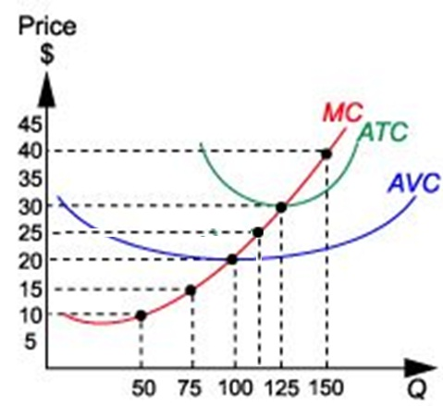
8. If P=$40, this profit max. competitive firm’s TR will equal:
$3,750
$2,000
$6,000
$10,000

Slide 49
8. If P=$40, this profit max. competitive firm’s TR will equal:
$3,750
$2,000
$6,000
$10,000

Slide 50
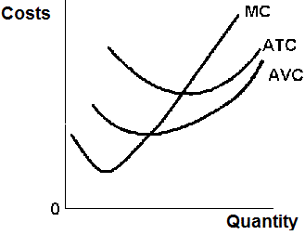
What is the error on the graph?
WRONG CORRECT

Slide 51
9. What are the max. profits?
(YP 15)
0AHE
0BGE
BAHG
CBGF

Slide 52
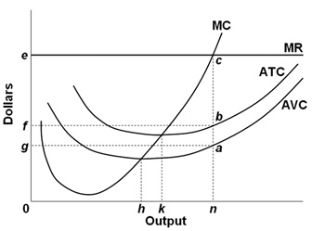
9. What are the max. profits?
(YP 15)
0AHE
0BGE
BAHG
CBGF

Slide 53
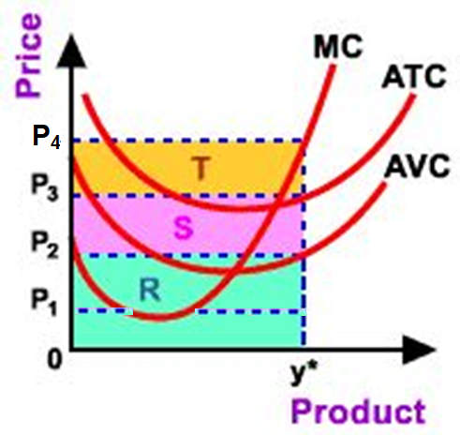
10. If Price is P1, then what area represents profits?
R
S
T
R + S

Slide 54
10. If Price is P1, then what area represents profits?
R
S
T
R + S

Slide 55
If the price is below the AVC curve then the firm will shut down
Q = 0
Losses will be equal to TFC

Slide 56
How to find the profit maximizing quantity:
A firm will maximize its profit (or minimize its losses) by producing that output at which marginal revenue and marginal cost are equal provided product price is equal to or greater than average variable cost.
(1) Find the quantity where: MR = MC
(as long as MC is upward sloping)
(2) produce this quantity only if: P > AVC
or AR > AVC
This is WHAT WE GET

Slide 57
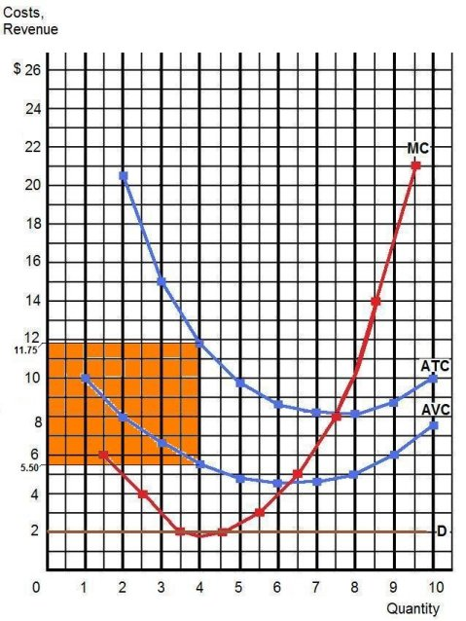
If the price is below the AVC curve then the firm will shut down
Q = 0
Losses will be equal to TFC

Slide 58
11. Many recreation parks shut down in the off-season because in the off-season:
Prices are below the average total costs
costs increase dramatically
revenue cannot cover variable costs
revenue cannot cover total costs

Slide 59
11. Many recreation parks shut down in the off-season because in the off-season:
Prices are below the average total costs
costs increase dramatically
revenue cannot cover variable costs
revenue cannot cover total costs

Slide 60
BE ABLE TO:
Find Short Run Price, Quantity, and Profits/Losses Three ways:
  Table of data (YP 7)
  Graph with numbers (YP 12-13)
  Graph with letters (YP 15)
Draw the Graph showing Short Run Price, Quantity, and Profits/Losses for firms earning:
  profits, (YP 8)
  losses, (YP 9)
  and shutting down (YP 10)
DO THE YELLOW PAGES AND ASK QUESTIONS!

