Slide 1
7c – Long Run Cost Curves
This web quiz may appear as two pages on tablets and laptops.
I recommend that you view it as one page by clicking on the open book icon at the bottom of the page.

Slide 2
7b Review – Short Run Costs
Lesson 7a – The Production Function
How output changes as we add more resources (workers)
Lesson 7b – Short Run Costs
How costs change as we produce more output in the same factory
Lesson 7c – Long Run Costs
How costs change in the long run as we produce more output in larger factories

Slide 3
7b Review - Short Run Cost Curves
Short Run Cost Curves
TC
TVC
TFC
ATC
AVC
AFC
and MC
Be able to:
Calculate
Define
Draw
Describe graph shapes
Give Examples

Slide 4
Be able to find:
TC
TVC
TFC
ATC
AVC
AFC
MC
On a:
Table of data (YP 35, 45)
Graph with numbers (YP 38-39)
Graph with letters using geometry (YP 44)
Do:
7b Yellow Pages
7b Web Quiz
7b Clicker quiz
7b Review - Short Run Cost Curves

Slide 5
Total Cost Curves Average Cost Curves
and MC
7b Review - Short Run Cost Curves

Slide 6
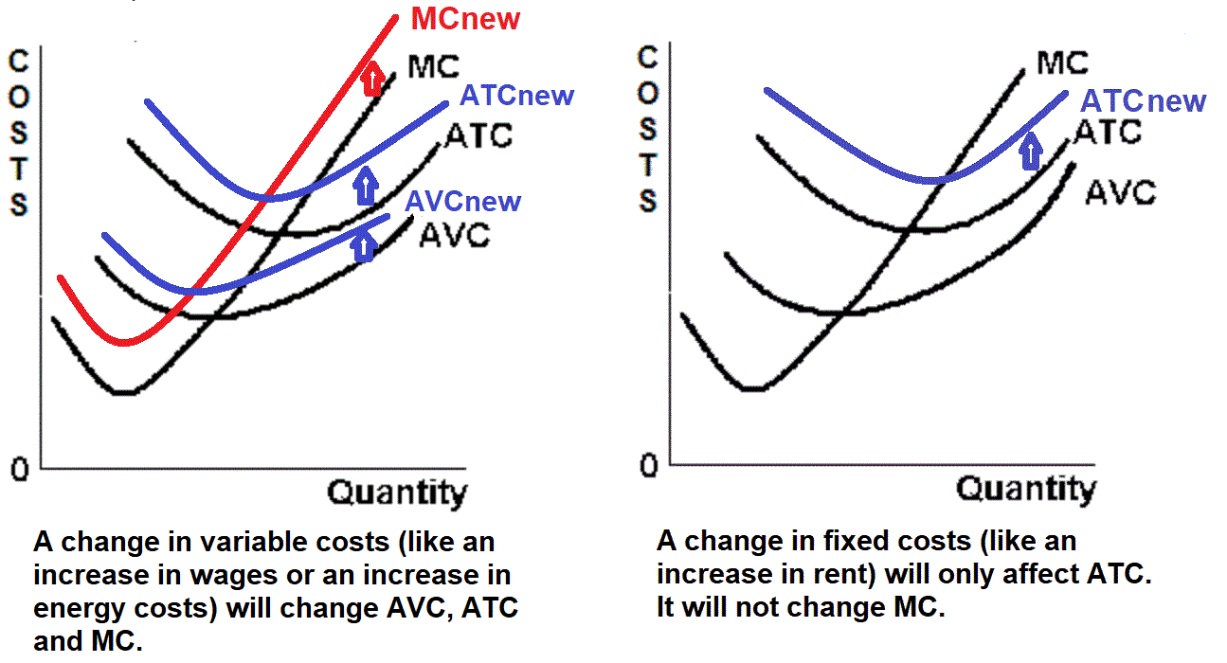
The profit max. Q is where MR = MC, therefore the rent paid is irrelevant to the question "should we produce more?“. Higher rent does not change the MC. “Ignore fixed costs”.
7b Review - Short Run Cost Curves

Slide 7
7c – Long Run Costs
Outcomes / What you should know:
Explain the difference between short run and long run costs
State why the long run average cost is expected to be U shaped
List and explain the causes of economies and diseconomies of scale
Indicate the relationship between economies of scale and number of firms in an industry and their sizes
Why are there many hardware stores in Illinois but only two automobile production plants?

Slide 8
Key Terms
short run, long run, economies of scale, diseconomies of scale, constant returns to scale, minimum efficient scale, natural monopoly
7c – Long Run Costs

Slide 9
Introduction
In lesson 7b we calculated and graphed SHORT RUN costs when the size of the factory was fixed (did not change). Here we will learn how costs change in the LONG RUN. In the long run we can change the size of the factory. Only in the long run can new firms enter an industry and only in the long run can firms leave the industry (go out of business). Be sure that you can define "short run" and "long run".
As always, be sure you know why the long run ATC curve has the shape it does; For all graphs: DEFINE, DRAW, DESCRIBE the shape.
Note that in the next unit (unit 3) we will use long run graphs to find the allocatively efficient quantity and the productively efficient quantity.
7c – Long Run Costs

Slide 10
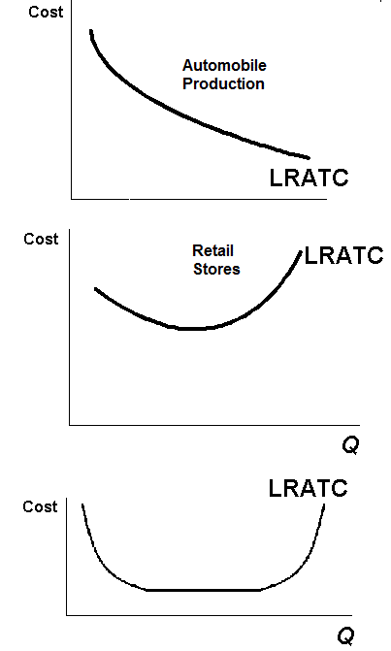
Something Interesting – Why are we studying this?
Why are there many hardware stores in Illinois but only two automobile production plants?
ANSWER: The answer has to do with the different shapes of the long run ATC curve for retail stores and for automobile production.
7c – Long Run Costs

Slide 11
1. In the long run, which is NOT true?
All inputs are variable
There are no fixed costs
The firm can change the size of its factory
The only fixed costs are from long term leases

Slide 12
1. In the long run, which is NOT true?
All inputs are variable
There are no fixed costs
The firm can change the size of its factory
The only fixed costs are from long term leases

Slide 13
2. Which is a long run change?
Hiring more workers
Shutting down for three weeks
Going out of business
Increasing advertising

Slide 14
2. Which is a long run change?
Hiring more workers
Shutting down for three weeks
Going out of business
Increasing advertising

Slide 15
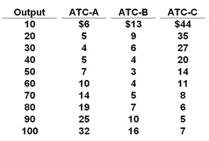
3. To produce an output of 30 in the long run, what size factory should be used? YP 50
A
B
C
Can’t tell

Slide 16
3. To produce an output of 30 in the long run, what size factory should be used? YP 50
A
B
C
Can’t tell

Slide 17
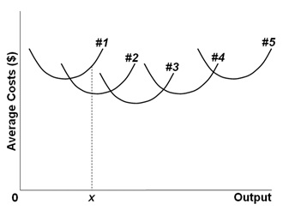
7c – Long Run Costs

Slide 18
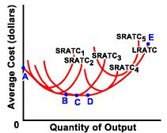

Slide 19
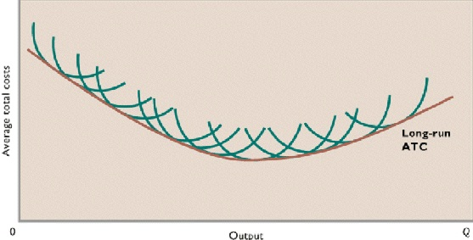
7c – Long Run Costs

Slide 20
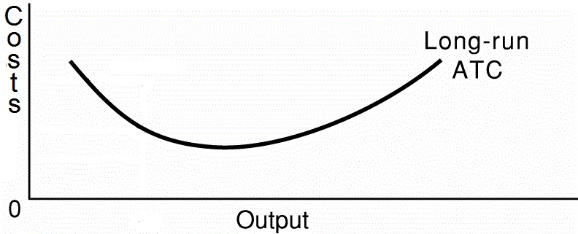
For ALL graphs:
Define
Draw
Describe the shape
7c – Long Run Costs

Slide 21
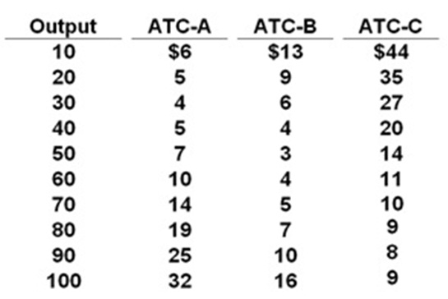
4. Economies of scale occur between ______; Disecon. Of scale occur between _____. YP 50
10-30; 30-100
10-40; 40-100
10-50; 50-100
10-70; 70-100

Slide 22
4. Economies of scale occur between ______; Disecon. Of scale occur between _____. YP 50
10-30; 30-100
10-40; 40-100
10-50; 50-100
10-70; 70-100

Slide 23
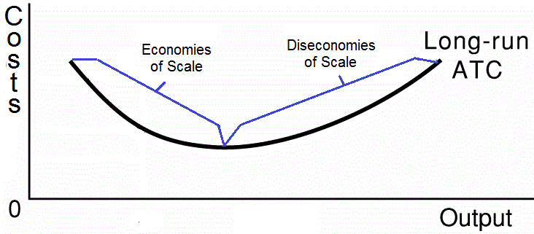
NOTE - in the video lectures:
Economies of scale = increasing returns to scale
Diseconomies of scale = decreasing returns to scale

Slide 24
7c – Long Run Costs
ECONOMIES OF SCALE
Explanation: Reductions in the average total cost of producing a product as the firm expands the size of plant (its output) in the long run; the economies of mass production.
Rationale:
(1) labor specialization (2) managerial specialization (3) productively efficient use of capital (4) other factors: such as design, development, or other "start up" costs such as advertising and "learning by doing."

Slide 25
7c – Long Run Costs
DISECONOMIES OF SCALE
Explanation: Increase in the average total cost of producing a product as the firm expands the size of its plant (its output) in the long run.
Rationale: some reasons include distant management, worker alienation, and problems with communication and coordination.

Slide 26
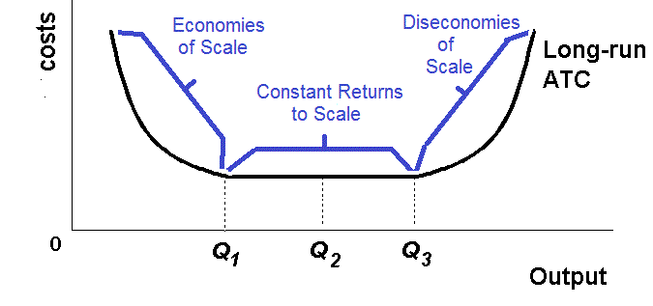
7c – Long Run Costs
CONSTANT RETURNS TO SCALE
Explanation: A situation wherein long-run average cost does not change. A given percentage increase in all outputs will cause a proportionate percentage increase in output.
In this range, ATC remains constant. (Between Q1 and Q3 below)

Slide 27
5. What causes diseconomies of scale?
Specialization of labor
Teamwork
Management problems
More efficient use of capital

Slide 28
5. What causes diseconomies of scale?
Specialization of labor
Teamwork
Management problems
More efficient use of capital

Slide 29
6. If output increases from 10 to 15 when a firm doubles all of its inputs then this firm has:
Economies of (increasing returns to) scale
Diseconomies of (decreasing returns to) scale
Constant returns to scale
A downward sloping long run ATC curve

Slide 30
6. If output increases from 10 to 15 when a firm doubles all of its inputs then this firm has:
Economies of (increasing returns to) scale
Diseconomies of (decreasing returns to) scale
Constant returns to scale
A downward sloping long run ATC curve

Slide 31
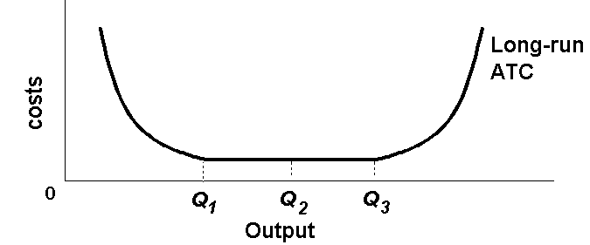
7. Minimum efficient scale occurs at:
Q1
Q2
Q3
Can’t tell

Slide 32
7. Minimum efficient scale occurs at:
Q1
Q2
Q3
Can’t tell

Slide 33
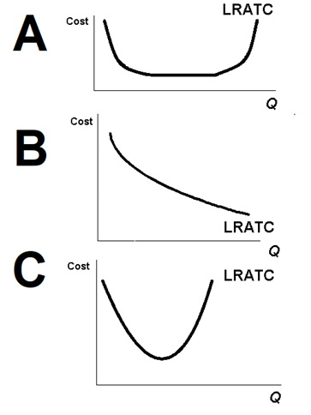
7c – Long Run Costs
Do YP 48

Slide 34
8. Which represents an industry with small and large firms?
A
B
C

Slide 35
8. Which represents an industry with small and large firms?
A
B
C

Slide 36
9. Which represents the car industry?
A
B
C

Slide 37
9. Which represents the car industry?
A
B
C

Slide 38
10. To maximize profits, firms will produce the quantity where:
MSB=MSC
LR-ATC is at a minimum
TR is at a maximum
MR = MC

Slide 39
10. To maximize profits, firms will produce the quantity where:
MSB=MSC
LR-ATC is at a minimum
TR is at a maximum
MR = MC

Slide 40
To maximize profits businesses will produce the quantity where:
MR = MC
This means they will produce:
All where MR > MC
Up to where MR = MC

