Slide 1

7b – Short Run Cost Curves
PRACTICE
This web quiz may appear as two pages on tablets and laptops.
I recommend that you view it as one page by clicking on the open book icon at the bottom of the page.

Slide 2
7b
Short Run Cost Curves
  TC
  TVC
  TFC
  ATC
  AVC
  AFC
  and MC
Be able to:
  Calculate
  Define
  Draw
  Describe graph shapes
  Give Examples

Slide 3
7b
Short Run Cost Curves
  TC
  TVC
  TFC
  ATC
  AVC
  AFC
  and MC
Be able to find on a:
  Table
  Graph with numbers
  Graph with letters using geometry

Slide 4
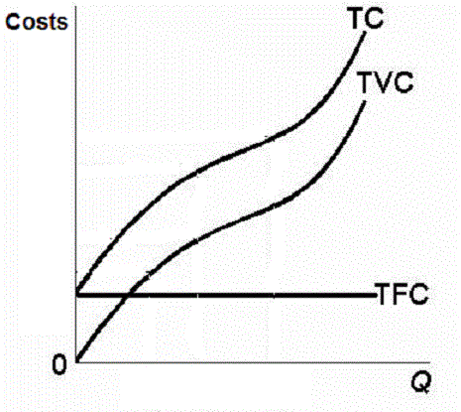
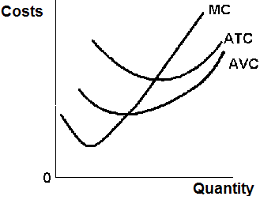
7b
Total Cost Curves Average Cost Curves
and MC

Slide 5
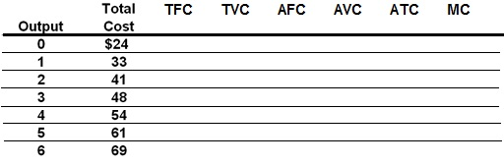
1. If quantity = 3, what is TC?
$ 24
$ 48
$ 72
$ 144
Cannot be found

Slide 6
1. If quantity = 3, what is TC?
$ 24
$ 48
$ 72
$ 144
Cannot be found

Slide 7
2. If quantity = 3, what is TFC?
$ 24
$ 48
$ 72
$ 144
Cannot be found

Slide 8
2. If quantity = 3, what is TFC?
$ 24
$ 48
$ 72
$ 144
Cannot be found

Slide 9
3. If quantity = 3, what is TVC?
$ 24
$ 48
$ 72
$ 144
Cannot be found

Slide 10
3. If quantity = 3, what is TVC?
$ 24
$ 48
$ 72
$ 144
Cannot be found

Slide 11
4. If quantity = 3, what is ATC?
$ 0
$ 12
$ 16
$ 48
Cannot be found

Slide 12
4. If quantity = 3, what is ATC?
$ 0
$ 12
$ 16
$ 48
Cannot be found

Slide 13
5. If quantity = 3, what is AFC?
$ 0
$ 6
$ 8
$ 12

Slide 14
5. If quantity = 3, what is AFC?
$ 0
$ 6
$ 8
$ 12

Slide 15
6. If quantity = 3, what is AVC?
$ 0
$ 6
$ 8
$ 12

Slide 16
6. If quantity = 3, what is AVC?
$ 0
$ 6
$ 8
$ 12

Slide 17
7. If quantity = 3, what is MC?
$ 0
$ 7
$ 48
$ 144

Slide 18
7. If quantity = 3, what is MC?
$ 0
$ 7
$ 48
$ 144

Slide 19
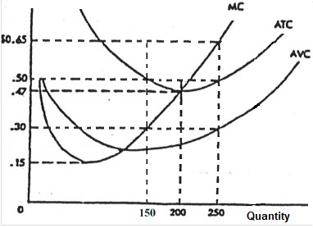
8. Q = 250, what is ATC?
$0.15
$0.30
$0.47
$0.50
$0.65

Slide 20
8. Q = 250, what is ATC?
$0.15
$0.30
$0.47
$0.50
$0.65

Slide 21
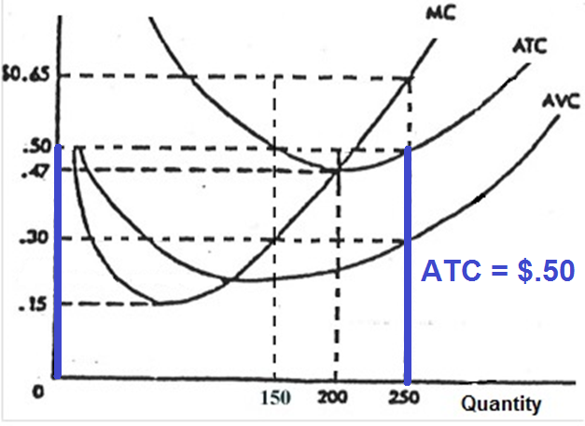
Q = 250, what is ATC?
$0.15
$0.30
$0.47
$0.50
$0.65

Slide 22
9. Q = 250, what is AVC?
$0.15
$0.30
$0.47
$0.50
$0.65

Slide 23
9. Q = 250, what is AVC?
$0.15
$0.30
$0.47
$0.50
$0.65

Slide 24
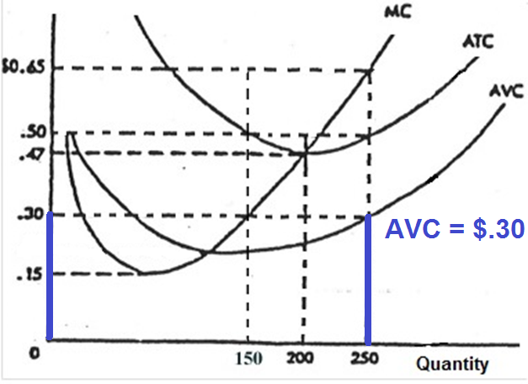
Q = 250, what is AVC?
$0.15
$0.30
$0.47
$0.50
$0.65

Slide 25
10. Q= 250, what is AFC?
$ 0.60
$ 0.50
$ 0.30
$ 0.20

Slide 26
10. Q= 250, what is AFC?
$ 0.60
$ 0.50
$ 0.30
$ 0.20

Slide 27
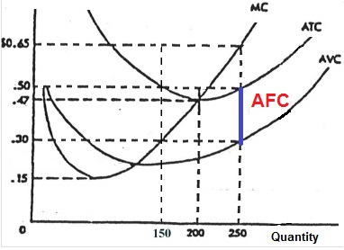
At Q = 250:
ATC - AVC = AFC
.50 - .30 = .20

Slide 28
11. Q = 250, what is TC?
$ 125
$ 150
$ 200
$ 250

Slide 29
11. Q = 250, what is TC?
$ 125
$ 150
$ 200
$ 250

Slide 30
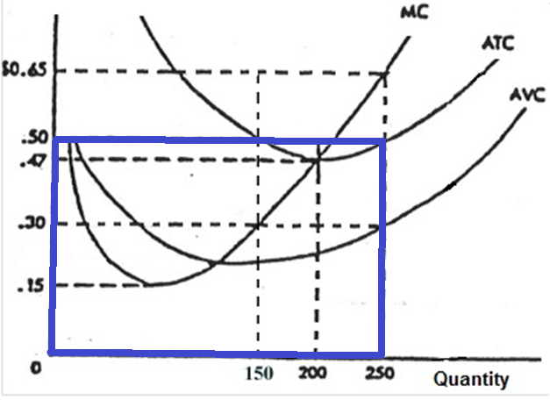
At Q = 250:
ATC x Q = TC
$ 0.50 x 250 = $ 125

Slide 31
12. Q = 250, what is TVC?
$30
$ 75
$ 150
$ 250

Slide 32
12. Q = 250, what is TVC?
$30
$ 75
$ 150
$ 250

Slide 33
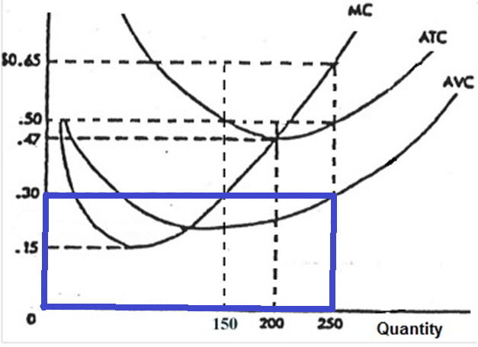
At Q = 250:
AVC x Q = TVC
$ 0.30 x 250 = $ 75

Slide 34
13. Q =250, what is TFC?
$ 30
$ 50
$ 75
$ 150
$ 250

Slide 35
13. Q =250, what is TFC?
$ 30
$ 50
$ 75
$ 150
$ 250

Slide 36
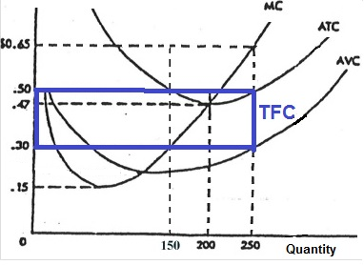
At Q = 250:
AFC x Q = TFC
.20 x 250 = $ 50

Slide 37
14. Q=250, what is MC?
$ 0.30
$ 0.50
$ 0.65
$ 162.50
$ 250

Slide 38
14. Q=250, what is MC?
$ 0.30
$ 0.50
$ 0.65
$ 162.50
$ 250

Slide 39
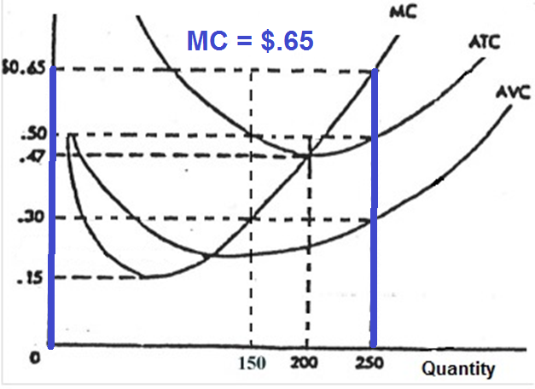
14. Q=250, what is MC?
$ 0.30
$ 0.50
$ 0.65
$ 162.50
$ 250

Slide 40
15. If quantity = Q, what is ATC?
0A
0B
0C
BC

Slide 41
15. If quantity = Q, what is ATC?
0A
0B
0C
BC

Slide 42
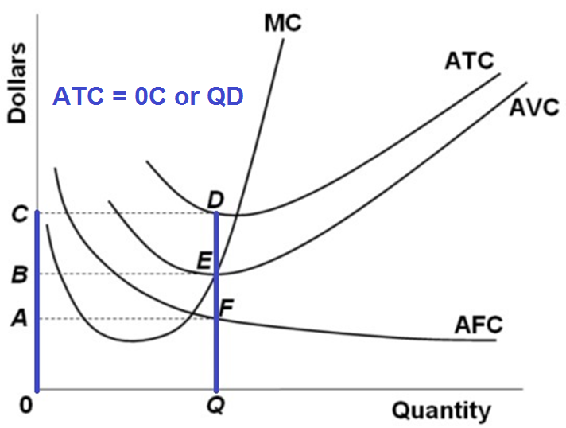
At quantity = Q:

Slide 43
16. If quantity = Q, what is AVC?
0A
0B
0C
BC

Slide 44
16. If quantity = Q, what is AVC?
0A
0B
0C
BC

Slide 45
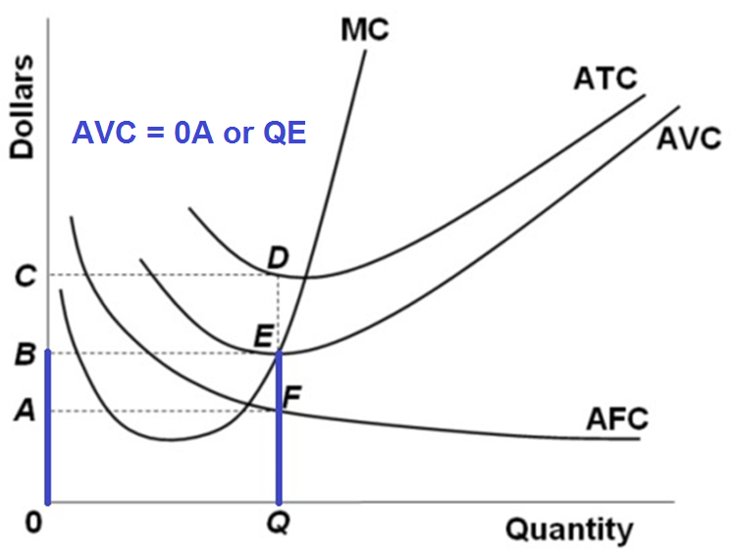
At quantity = Q:

Slide 46
17. If quantity = Q, what is AFC?
AB
OB
OC
BC

Slide 47
17. If quantity = Q, what is AFC?
AB
OB
OC
BC

Slide 48
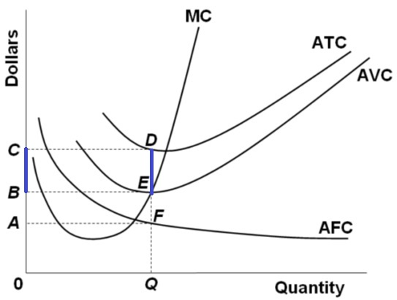
At quantity = Q:
ATC – AVC = AFC
0C – 0B = BC

Slide 49
18. If quantity = Q, what is TFC?
0CDQ
0BEQ
BCDE
0A

Slide 50
18. If quantity = Q, what is TFC?
0CDQ
0BEQ
BCDE
0A

Slide 51
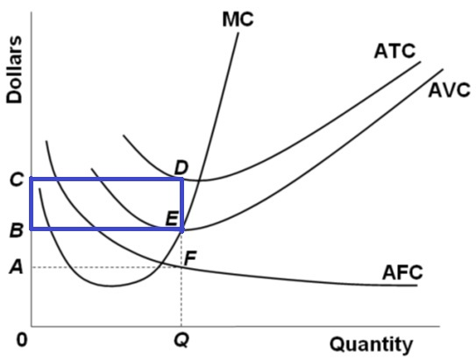
At quantity = Q:
TFC = AFC x Q
TFC = BCDE

Slide 52
19. If quantity = Q, what is TVC?
0CDQ
0BEQ
0AFQ
BCDE

Slide 53
19. If quantity = Q, what is TVC?
0CDQ
0BEQ
0AFQ
BCDE

Slide 54
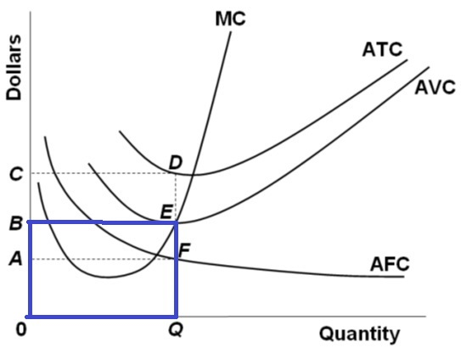
At quantity = Q:
TVC = AVC x Q
TVC = 0BEQ

Slide 55
20. If quantity = Q, what is TC?
0CDQ
OBEQ
BCDE
0AFQ

Slide 56
20. If quantity = Q, what is TC?
0CDQ
OBEQ
BCDE
0AFQ

Slide 57
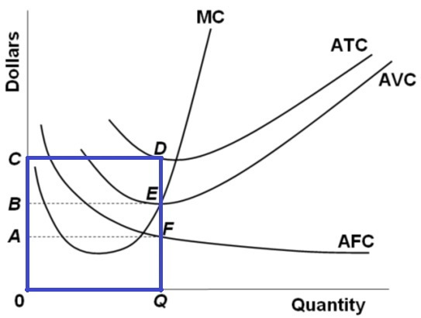
At quantity = Q:
TC = ATC x Q
TC = 0CDQ

Slide 58
21. If quantity = Q, what is MC?
0CDQ
0BEQ
BCDE
0B

Slide 59
21. If quantity = Q, what is MC?
0CDQ
0BEQ
BCDE
0B

Slide 60
