Slide 1
6a – Consumer Decisions
This web quiz may appear as two pages on tablets and laptops.
I recommend that you view it as one page by clicking on the open book icon at the bottom of the page.

Slide 2
6a – Consumer Decisions
Law of Diminishing Marginal Utility (the graphs)
Theory of Consumer Behavior (the utility maximizing rule)

Slide 3
6a – Consumer Decisions: Introduction
Yellow Page 17
REVIEW: Benefit-Cost Analysis
Definition: The selection of all possible alternatives where the marginal benefits are greater than the marginal costs.
select all where: MB > MC
up to where: MB = MC
but never where: MB < MC
Purpose: to make the best decision possible

Slide 4
6a – Consumer Decisions: Introduction
Making Decisions
Lessons/MicWebApp: “Introduction”: Why do we buy what we buy?
When I go into the grocery store why do I buy 12 cans of pop, 3 frozen pizzas, and 1 pound of hamburger? Why don't I buy 12 pounds of hamburger and 1 can of pop?
In this lesson we will use benefit-cost analysis to understand why we buy what we do. We will calculate the marginal benefits (MB) of consuming something and the marginal costs (MC) of consuming something. (Remember: all costs in economics are opportunity costs.)
If our goal is to maximize our satisfaction we will consume the quantity of goods and services where MB = MC.

Slide 5
6a – Consumer Decisions: Introduction
Making Decisions Using Benefit Cost Analysis MB = MC
6a – Consumer Decisions: What quantity to buy? Goal: Maximize utility (satisfaction)
MUa/Pa = MUb/Pb = MUc/Pc . . . .
Lessons 7-11 – Producer Decisions: What quantity to produce? Goal: Maximize profits MR=MC

Slide 6
6a – Consumer Decisions: Introduction
SOMETHING NEW: Spring Skiing (YP 17)
Lessons/MicWebApp: “Something Interesting”:
In October and November ski resorts in the west begin to open with just a few runs open and large crowds of skiers and snowboarders. In late April most western ski areas have a lot of snow and are mostly 100% open but few skiers and snowboarders come. Why?
Why are there so many customers when the snow is bad in the fall and so few when the snow is good in the spring?

Slide 7
Must Know / Outcomes
Define, Draw, and Describe the total utility and marginal utility graphs
Understand the relationship between the total utility and marginal utility graphs
Understand the law of diminishing marginal utility.
Describe how rational consumers maximize utility by using benefit-cost-analysis. (Utility maximizing rule; MUx/Px = MUy/Py = MUz/Pz )
Explain how a demand curve can be derived by observing the outcomes of price changes in the utility-maximization model
If lobster was free and if lobster was your favorite food, would you eat lobster for every meal everyday? Why or why not?
Why do pop vending machines allow you to only get one can at a time while newspaper vending machines allow you to take as many as you want when you only pay for one?
Why do we have to divide by price in the utility maximizing rule?
Benefit Cost Analysis: MB = MC
Utility Maximizing Rule: MUa/Pa = MUb/Pb
6a – Consumer Decisions

Slide 8
Key Terms
utility,
total utility (TU)
marginal utility (MU)
law of diminishing marginal utility
rational behavior
benefit-cost analysis
budget constraint
utility-maximizing rule
marginal utility per dollar (MU/P)
"util“
income effect
substitution effect
diamond-water paradox
6a – Consumer Decisions

Slide 9
1. The utility of a good or service:
is synonymous with usefulness
is the satisfaction one gets from consuming it
is easy to measure
rarely varies from person to person

Slide 10
1. The utility of a good or service:
is synonymous with usefulness
is the satisfaction one gets from consuming it
is easy to measure
rarely varies from person to person

Slide 11
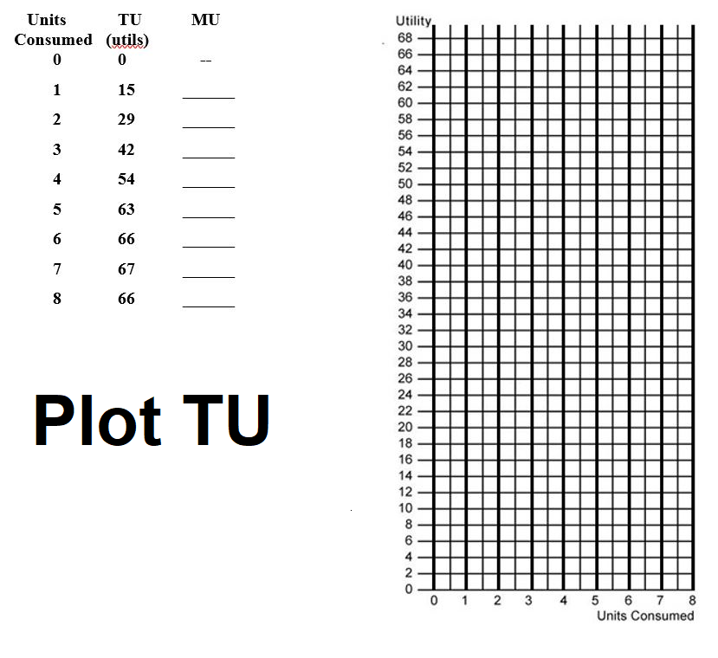
YP 18
6a – Consumer Decisions

Slide 12
2. Marginal Utility (MU) is the:
Sensitivity of consumer purchases of a good to changes in the price
Change in TU divided by the price
TU divided by the quantity consumed
Change in TU obtained from consuming one more unit

Slide 13
2. Marginal Utility (MU) is the:
Sensitivity of consumer purchases of a good to changes in the price
Change in TU divided by the price
TU divided by the quantity consumed
Change in TU obtained from consuming one more unit

Slide 14
6a – Consumer Decisions
Whenever we calculate a “marginal” it is always:
Change in Total / Change in Q
MB =Change in TB / Change in Q
MC = Change in TC / Change in Q
MU = Change in TU / Change in Q

Slide 15
6a – Consumer Decisions
Marginal = Change in Total / Change in Q
MU = Change in TU / Change in Q consumed (6a)
MP = Change in TP / Change in Q of resources (7a)
MC = Change in TC / Change in Q produced (7b)
MR = Change in TR / Change in Q sold (lessons 8-11)
MRP = Change in TR / Change in Q of resources (12-13)
MRC = Change in TC / Change in Q of resources (12-13)

Slide 16
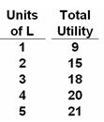
3. What is the MU of the fourth unit of product L?
20
18
4
2

Slide 17
3. What is the MU of the fourth unit of product L?
20
18
4
2

Slide 18
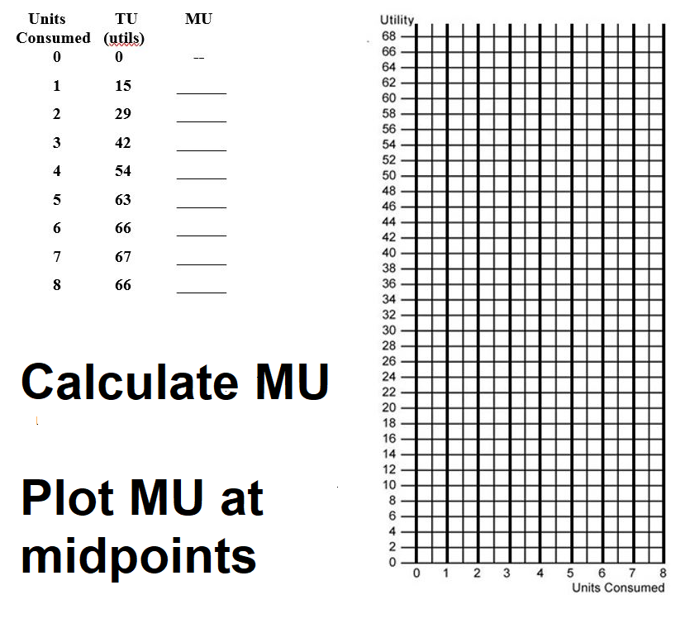
YP 18
6a – Consumer Decisions

Slide 19
4. The law of diminishing MU states that:
TU is max’ed when consumers obtain the same amount of utility per unit for each unit consumed
Beyond some point additional units of a product will yield less and less extra satisfaction
Prices must be decreased to induce firms to supply more of a product
When TU is at its max then MU is also at its max

Slide 20
4. The law of diminishing MU states that:
TU is max’ed when consumers obtain the same amount of utility per unit for each unit consumed
Beyond some point additional units of a product will yield less and less extra satisfaction
Prices must be decreased to induce firms to supply more of a product
When TU is at its max then MU is also at its max

Slide 21
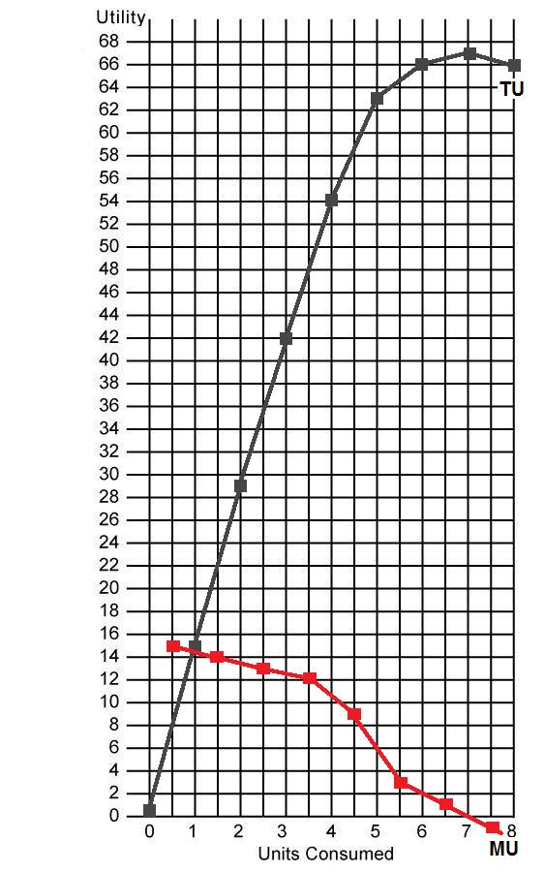
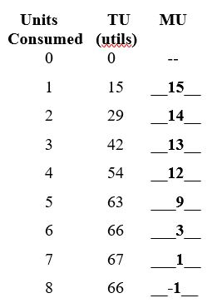
Yellow Page 18 – DESCRIBE SHAPE
#4 and 5
6a – Consumer Decisions

Slide 22
6a – Consumer Decisions: Introduction
MARGINALS – Review a few concepts
Marginal = change in total / change in quantity
Marginal = slope of total
Total = sum of the marginals
Total = area under the marginal graph

Slide 23
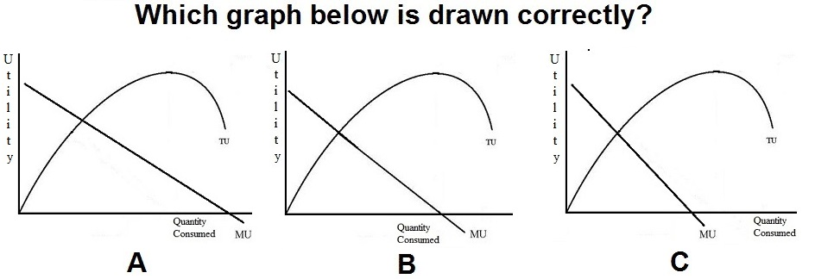
5.
A
B
C

Slide 24
5.
A
B
C

Slide 25
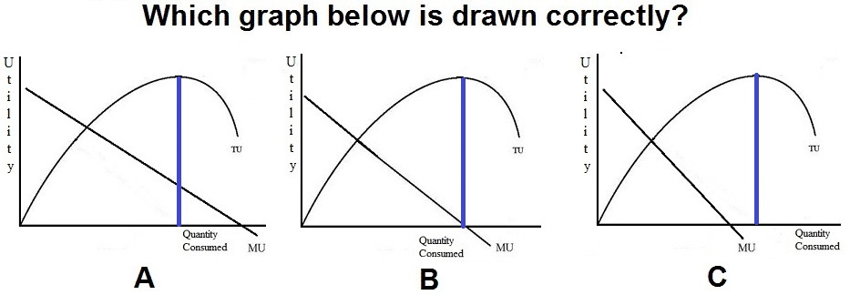
B is drawn correctly. MU is the slope of TU.
Initially the slope of TU is positive, but declining. So, MU
is positive and declining.
Then, at its peak the slope of TU is zero. And MU is zero
at that quantity
After that the slope is negative. So, MU is negative

Slide 26
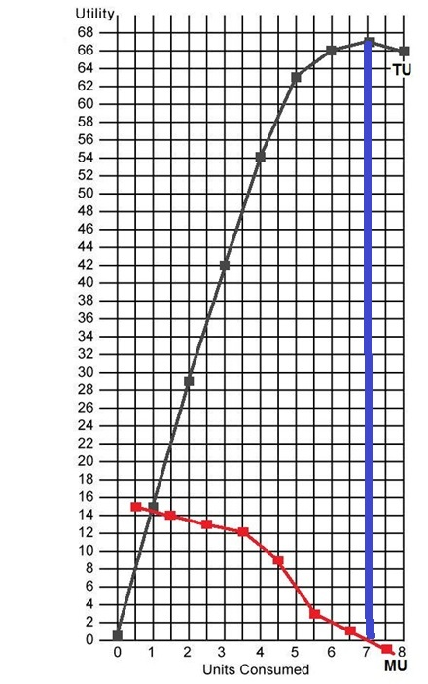
6a – Consumer Decisions
Yellow Page 18 – DESCRIBE SHAPE
#4 and 5

Slide 27
6a – Consumer Decisions:
Making Decisions Using Benefit Cost Analysis MB = MC
6a – Consumer Decisions: What quantity to buy? Goal: Maximize utility (satisfaction)
MUa/Pa = MUb/Pb = MUc/Pc . . . .

Slide 28
6a – Consumer Decisions:
Making Decisions Using Benefit Cost Analysis
Should I go skiing today?
MBskiing = MCskiing
MBskiing = MUskiing
MC skiing = MU movie (Opportunity Cost)
MBskiing = MCskiing
MUskiing = MUmovie. But they have different prices.
MUskiing/Pskiing = MUmovie/Pmovie

Slide 29
6a – Consumer Decisions:
Making Decisions Using Benefit Cost Analysis
Should I go skiing today?
MBskiing = MCskiing
MUskiing/Pskiing = MUmovie/Pmovie
MUa/Pa = MUb/Pb
Utility Maximizing Rule:
MUa/Pa = MUb/Pb = MUc/Pc . . . .

Slide 30
6. To maximize utility a consumer should spend their money so that the:
Elasticity of demand on all products is the same
MU obtained from the last dollar spent on each product is the same
TU derived from each product consumed is the same
MU of the last unit of each product consumed is the same

Slide 31
6. To maximize utility a consumer should spend their money so that the:
Elasticity of demand on all products is the same
MU obtained from the last dollar spent on each product is the same
TU derived from each product consumed is the same
MU of the last unit of each product consumed is the same

Slide 32
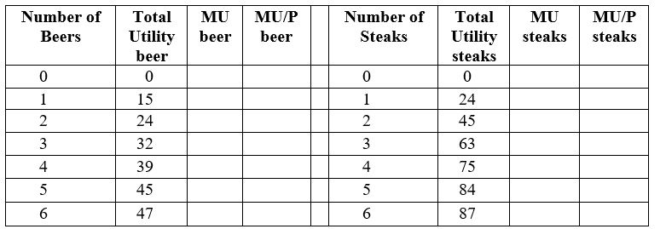
6a – Consumer Decisions
Yellow Page 23
You have $10
The price of beer is $1 per bottle
The price of a steak sandwich is $3
The utility received from consuming beer and steak is given above.
PROBLEM: How many beers and steak sandwiches should be bought to maximize utility?

Slide 33
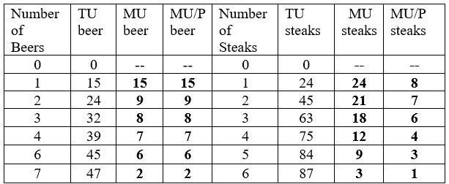
6a – Consumer Decisions
Yellow Page 23
You have $10
The price of beer is $1 per bottle
The price of a steak sandwich is $3
The utility received from consuming beer and steak is given above.
PROBLEM: How many beers and steak sandwiches should be bought to maximize utility?

Slide 34
7. Suppose that the MUx/Px > MUy/Py, to maximize utility the consumer should buy:
Less of X only if its price rises
More of Y only if its price rises
More Y and less X
More X and less Y

Slide 35
7. Suppose that the MUx/Px > MUy/Py, to maximize utility the consumer should buy:
Less of X only if its price rises
More of Y only if its price rises
More Y and less X
More X and less Y

Slide 36
8. If PX=$2, PY=$4, income = $18, how many of each will a rational consumer buy? YP 25, #3
1X and 4Y
3X and 3Y
5X and 2Y
7X and 1Y

Slide 37
8. If PX=$2, PY=$4, income = $18, how many of each will a rational consumer buy? YP 25, #4
1X and 4Y
3X and 3Y
5X and 2Y
7X and 1Y

Slide 38
9. If PX=$2, PY=$4, income = $18, what is the maximum utility possible? YP 25, #5
49 utils
50 utils
52 utils
55 utils

Slide 39
9. If PX=$2, PY=$4, income = $18, what is the maximum utility possible? YP 25, #5
49 utils
50 utils
52 utils
55 utils

Slide 40
10. TU can be determined by:
Change in TU / change in Q
Summing the MU of each unit consumed
Multiplying the MU of the last unit consumed by its price
Dividing the MU of the last unit consumed by its price

Slide 41
10. TU can be determined by:
Change in TU / change in Q
Summing the MU of each unit consumed
Multiplying the MU of the last unit consumed by its price
Dividing the MU of the last unit consumed by its price

Slide 42
11. When TU is at its maximum, MU is:
zero
negative
positive and increasing
positive but decreasing

Slide 43
11. When TU is at its maximum, MU is:
zero
negative
positive and increasing
positive but decreasing

Slide 44
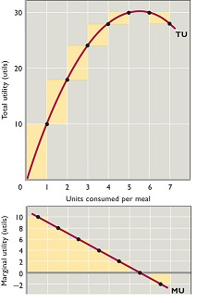
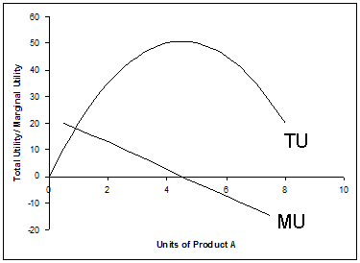

Slide 45
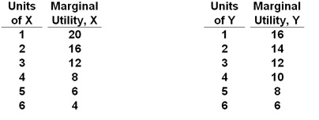
6a – Consumer Decisions
Yellow Page 26 - Compare # 2 and # 4
#2
#4

Slide 46
6a – Consumer Decisions: Introduction
MARGINALS – Review a few concepts
Marginal = change in total / change in quantity
Marginal = slope of total
Total = sum of the marginals
Total = area under the marginal graph

