Slide 1
5b – Positive Externalities, Public Goods, and Tragedy of the Commons
This web quiz may appear as two pages on tablets and laptops.
I recommend that you view it as one page by clicking on the open book icon at the bottom of the page.

Slide 2
5b – Market Failures - continued Positive Externalities, Public Goods, and Tragedy of the Commons
Market Failures (continued)
Positive Externalities
Public Goods
Tragedy of the Commons

Slide 3
5b – Market Failures - continued Positive Externalities, Public Goods, and Tragedy of the Commons
Markets fail to Achieve Alloc. Efficiency when:
They lack competition (lessons 10b, 11a, 11b)
There are effective price ceilings and price floors
Negative Externalities exist (5a)
Positive Externalities exist (5b)
There are Public Goods (5b)
There is a Tragedy of the Commons (5b)

Slide 4
5b – Market Failures - continued Positive Externalities, Public Goods, and Tragedy of the Commons
Markets fail to achieve alloc. efficiency when:
They lack competition (10b, 11a, 11b )
There are effective price ceilings and price floors (5a)
Negative Externalities exist (5a)
Positive Externalities exist (5b)
There are Public Goods (5b)
There is a Tragedy of the Commons (5b)

Slide 5
5b – Market Failures - continued Positive Externalities, Public Goods, and Tragedy of the Commons
For each Market Failure:
Define
Give examples
How they affect Allocative Efficiency - too much produced? (MSB<MSC) - too little produced? (MSB>MSC)
What can the government do?

Slide 6
5b – Outcomes / Must Know (1)
Market Failure: Positive Externalities
define positive externalities (external benefits or spillover benefits)
give examples of positive externalities
use the MSB=MSC model to show the effects on allocative efficiency of positive externalities
what can the government do to correct the market failure caused by positive externalities and show the effects of these policies on the MSB=MSC model
Demand is usually equal to MSB, but when there are positive externalities the demand curve is to the left of the MSB curve. Why?
Are positive externalities (spillover benefits) good or bad for society? Why or why not?
Comment on: EconMovies 7: Anchorman (Efficiency and Market Failures) (5:21) [ http://www.youtube.com/watch?v=FBjFDtH-iZM ]

Slide 7
5b Outcomes / Must Know (2)
Market Failure: Public Goods
define "public goods (public goods are non-exclusive and non-rival)"
give examples of public goods and explain why they are public goods
define private (exclusive) goods" and give examples
define "rival goods" and give examples
what is the "free rider problem"?
explain how to derive the demand curve for public goods
what effect do public goods have on allocative efficiency?
what can the government do to correct for the market failure of public goods?
Why are public schools, public parks, and public libraries NOT "public goods"? If they are not public goods then why does the government produce them?

Slide 8
5b Outcomes / Must Know (3)
Market Failure: Tragedy of the Commons
what is the Tragedy of the Commons (common access resources are non-exclusive, but rival)
how does the tragedy of the commons affect allocative efficiency?
what can be done to better achieve allocative efficiency when there is a tragedy of the commons?
5b – Market Failures - continued Positive Externalities, Public Goods, and Tragedy of the Commons

Slide 9
KEY TERMS:
positive externalities (external benefits /spillover benefits),
private goods, public goods,
rivalry (rival goods, nonrival goods)
excludability (exclusion principle, nonexcludability, exclusive goods, nonexclusive goods),
free-rider problem,
marginal-cost-marginal-benefit rule (MB=MC),
tragedy of the commons,
common access resources
5b – Market Failures - continued Positive Externalities, Public Goods, and Tragedy of the Commons

Slide 10
1. A positive externality (external benefit or spillover benefit) occurs when: (YP 80)
Product differentiation increases the variety of products available
The benefits associated with a product exceed those that the buyers receive
A firm does not pay all of the costs of producing a good
Firms earn positive economic profits

Slide 11
1. A positive externality (external benefit or spillover benefit) occurs when: (YP 80)
Product differentiation increases the variety of products available
The benefits associated with a product exceed those that the buyers receive
A firm does not pay all of the costs of producing a good
Firms earn positive economic profits

Slide 12
2. Which is the BEST example of an activity with a positive externality? YP 80
Smoking in a restaurant
Eating a hamburger
Planting a flower garden along a street
Selling a candy bar

Slide 13
2. Which is the BEST example of an activity with a positive externality? YP 80
Smoking in a restaurant
Eating a hamburger
Planting a flower garden along a street
Selling a candy bar

Slide 14
Examples of Products with Positive Externalities
Education
Vaccinations
Parks
Libraries
Ski Areas

Slide 15
3. When positive externalities are in a market for a good, the market: (YP 80)
Succeeds, because it is producing the socially optimal (alloc. eff.) output
Fails, because it overproduces the good
Succeeds, because it overproduces the good
Fails, because it underproduces the good

Slide 16
3. When positive externalities are in a market for a good, the market: (YP 80)
Succeeds, because it is producing the socially optimal (alloc. eff.) output
Fails, because it overproduces the good
Succeeds, because it overproduces the good
Fails, because it underproduces the good

Slide 17
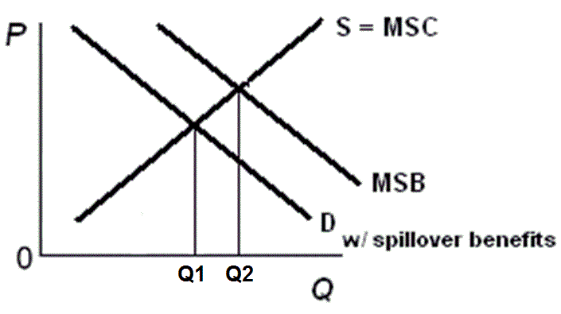
Effects of a Positive Externality YP 80
Q1 is what we get (without gov’t),
Q2 is what we want (MSB=MSC)
At Q1, MSB > MSC; too little is produced, underalloc. of resources
Goal of Gov’t: To increase the quantity produced

Slide 18
4. Which of the following would be done to correct for (internalize) a positive externality? YP 80
Government regulations on production
Excise tax
Privatization
Subsidy

Slide 19
4. Which of the following would be done to correct for (internalize) a positive externality? YP 80
Government regulations on production
Excise tax
Privatization
Subsidy

Slide 20
How to Correct a Positive Externality: YP 80
Subsidize producers (increase supply)
Subsidize consumers (increase demand)
Government produces the product (increase supply)
5b – Market Failures - continued Positive Externalities, Public Goods, and Tragedy of the Commons

Slide 21
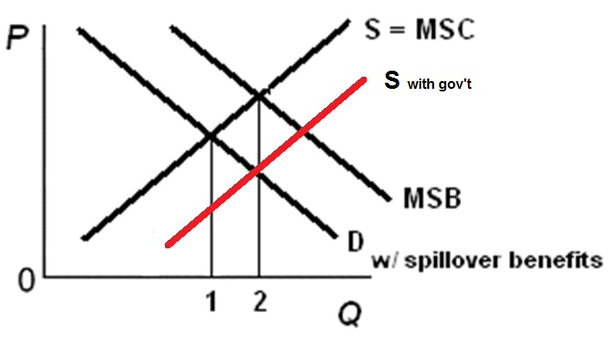
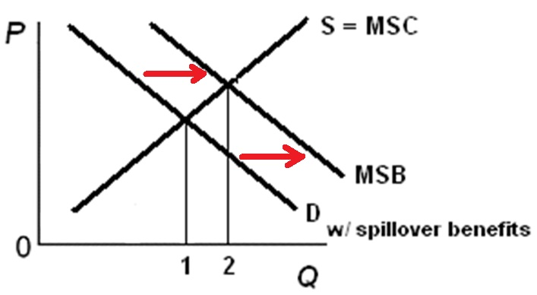
How to Correct for Positive Externalities
Increase Supply: Increase Demand:
Increase Supply: Increase Demand:
- subsidize producers - subsidize consumers
- example: solar panels - example: financial aid
- gov’t produces
- example: public schools, parks

Slide 22
5. Government subsidies of day care can be explained by government’s attempt to internalize a ______ associated with ________.
Cost, crime
Benefit, crime
Cost, education
Benefit, education

Slide 23
5. Government subsidies of day care can be explained by government’s attempt to internalize a ______ associated with ________.
Cost, crime
Benefit, crime
Cost, education
Benefit, education

Slide 24
6. A public good: YP 81
Is a rival, exclusive good
Is a non-rival, exclusive good
Is a non-rival, non-exclusive good
Does not have the free rider problem

Slide 25
6. A public good: YP 81
Is a rival, exclusive good
Is a non-rival, exclusive good
Is a non-rival, non-exclusive good
Does not have the free rider problem

Slide 26
7. Which of the following is the best example of a public good? YP 81
A hamburger
A music download
A public park
Light from a streetlight

Slide 27
7. Which of the following is the best example of a public good? YP 81
A hamburger
A music download
A public park
Light from a streetlight

Slide 28
Examples of Public Goods YP 81
streetlights
national defense
lighthouse
fireworks
flood control
5b – Market Failures - continued Positive Externalities, Public Goods, and Tragedy of the Commons

Slide 29
8. If the consumption of a good by one person reduces the amount of the good that can be consumed by others, the good is:
Exclusive
Non-exclusive
Rival
Non-rival

Slide 30
8. If the consumption of a good by one person reduces the amount of the good that can be consumed by others, the good is:
Exclusive
Non-exclusive
Rival
Non-rival

Slide 31
9. The market failure associated with public goods is that: YP 81
Too many will be produced without the government
None will be produced without the government
The government cannot produce them
Private businesses make very high profits producing them

Slide 32
9. The market failure associated with public goods is that: YP 81
Too many will be produced without the government
None will be produced without the government
The government cannot produce them
Private businesses make very high profits producing them

Slide 33
10. The role of government concerning public goods is to: YP 81
Tax the product
Regulate the product
Produce the product
Apply the Coase theorem

Slide 34
10. The role of government concerning public goods is to: YP 81
Tax the product
Regulate the product
Produce the product
Apply the Coase theorem

Slide 35
11. Are the following Public Goods? - public parks - public schools - public libraries
yes
no

Slide 36
11. Are the following Public Goods? - public parks - public schools - public libraries
yes
no

Slide 37
Public parks, public libraries, and public schools are NOT non-rival, and they are NOT non-exclusive, so they are NOT public goods. Why does the gov’t have them?
5b – Market Failures - continued Positive Externalities, Public Goods, and Tragedy of the Commons

Slide 38
5b – Market Failures - continued Positive Externalities, Public Goods, and Tragedy of the Commons
Markets fail to Achieve Alloc. Efficiency when:
They lack competition (lessons 10b, 11a, 11b)
There are effective price ceilings and price floors
Negative Externalities exist (5a)
Positive Externalities exist (5b)
There are Public Goods (5b)
There is a Tragedy of the Commons (5b)

Slide 39
12. Which of the following is associated with the Tragedy of the commons? YP 82
Nonrival
Spillover Benefits
Common Access Resources
Private goods

Slide 40
12. Which of the following is associated with the Tragedy of the commons? YP 82
Nonrival
Spillover Benefits
Common Access Resources
Private goods

Slide 41
Tragedy of the Commons - YP 82
Common Access Resources
natural resources over which there is no private ownership established and no system for managing the allocation of these resources
Tragedy of the Commons
individuals will have an incentive to consume as many common access resources as possible so that the competition does not use them first
private individuals will exploit common access resources unsustainably out of self-interest, ultimately leading to the depletion of the resource

Slide 42
13. Which of the following is NOT an example of the Tragedy of the Commons? YP 82
Fishing the oceans
Common pastures
Atmosphere
Forests
Public Schools

Slide 43
13. Which of the following is NOT an example of the Tragedy of the Commons? YP 82
Fishing the oceans
Common pastures
Atmosphere
Forests
Public Schools

Slide 44
14. Which of the following is NOT a role for government concerning the Tragedy of the Commons? YP 82
Assign property rights
Produce the product itself
Manage the property

Slide 45
14. Which of the following is NOT a role for government concerning the Tragedy of the Commons? YP 82
Assign property rights
Produce the product itself
Manage the property

