Slide 1
5a – Price Controls and Negative Externalities
This web quiz may appear as two pages on tablets and laptops.
I recommend that you view it as one page by clicking on the open book icon at the bottom of the page.

Slide 2
REVIEW - Lesson 3c Allocative Efficiency is achieved when:
MSB = MSC
Consumer + Producer Surplus is max’ed
P = MC (lesson 8/9b)

Slide 3
5a
Markets fail to Achieve Alloc. Efficiency when:
They lack competition (lessons 10b, 11a, 11b )
There are price ceilings and price floors
Negative Externalities exist (5a)
Positive Externalities exist (5b)
There are Public Goods (5b)
There is a Tragedy of the Commons (5b)

Slide 4
5b
For each Market Failure:
Define
Give examples
How they affect Allocative Efficiency (too much or too little produced?)
What can the government do?

Slide 5
Benefits and Problems of Market Economies (Lesson 2a)
BENEFITS:
The move toward capitalism has resulted in high rates of ECONOMIC GROWTH in many countries. Profits, private property, and freedom of enterprise and choice promote growth.
The price mechanism (supply and demand) and the role of self interest provides for an ALLOCATIVELY EFFICIENT use of resources.
Capitalism provides the incentives (profit) for a PRODUCTIVELY EFFICIENT use of resources.
PROBLEMS:
Capitalism does NOT have a mechanism to assure EQUITY. This may be a role of government.
Economists disagree over whether capitalism will guarantee FULL EMPLOYMENT.
Some say yes, and if there is unemployment it is usually caused by government interference
Some say no, and at times government involvement is needed to move the economy towards full employment

Slide 6
Role of Gov’t in a Market Economy
|
|
|
|
|
|
|
|
|
|
|
|
|
Characteristics of Market Economies: (Lesson 2a)
1. private property 2. freedom of enterprise and choice 3. role of self interest 4. competition 5. markets and prices 6. limited role for government
Role of Gov’t in Market Economies:
(Lesson 5a)
1. Provide legal and social framework
2. Maintain competition
3. Redistribution of Income
4. Correct for Market failures
5. Stabilize unemployment and inflation

Slide 7
Lesson 5a
Government CAUSES Inefficiency: Price Ceilings and Price Floors
Market Fails and Gov’t can fix it: Negative Externalities

Slide 8
Lesson 5a – Price Ceilings and Floors
Price ceilings and floors
define "price control" or "price ceiling"
give examples of price controls / price ceilings
how price controls/price ceilings affect allocative efficiency and explain using the MSB=MSC model and the consumer and producer surplus (dead weight loss) model
what other effects price controls/ceilings have
what happens if a price ceiling is set above the equilibrium? if a price floor is set below the equilibrium?
define price floor and give examples
what happens if the government sets a minimum wage rate that is higher then the equilibrium?
the efficiency effects of a price floor using the MSB=MSC model and show on a graph
what happens if a price floor is set below the equilibrium?

Slide 9
Lesson 5a – Negative Externalities
Market Failure: negative externalities (also called external costs or spillover costs)
what is a market failure?
what is an externality?
define negative externalities (external costs or spillover costs)
give examples of negative externalities
use the MSB=MSC model to show the effects (overallocation) on allocative efficiency of negative externalities
what can the government do to correct the market failure caused by negative externalities and show the effects of these policies on the MSB=MSC model
Supply is usually equal to MSC, but when there are negative externalities the supply curve is to the right of the MSC curve. Why?
what is an excise tax?
Why gasoline prices might be too low: http://www.npr.org/templates/story/story.php?storyId=4858826
Soda Is About To Get Pricier For Another 5 Million Americans http://www.huffingtonpost.com/entry/cook-county-soda-tax_us_58250427e4b0c4b63b0c0fe4
Why Mexico taxes junk food and soda: http://www.politico.com/story/2014/01/mexico-soda-tax-101645
what is the Coase theorem?
explain how according to the Coase Theorem that under certain circumstances bargaining can solve the problems created by negative externalities without the government using an example
what are the necessary condition needed for the Coase Theorem to work?
what is the tragedy of the commons?
how does the tragedy of the commons affect allocative efficiency?
what can be done to better achieve allocative efficiency when there is a tragedy of the commons?

Slide 10
1. An effective Price Floor will:
Induce firms to leave the industry
Result in a product surplus
Result in a product shortage
Clear the market

Slide 11
1. An effective Price Floor will:
Induce firms to leave the industry
Result in a product surplus
Result in a product shortage
Clear the market

Slide 12
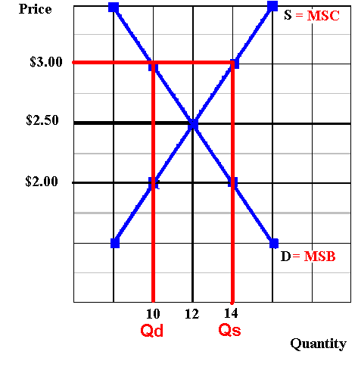
Effective Price Floor: $3.00

Slide 13
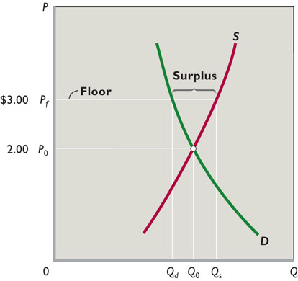
Price Floor

Slide 14
2. If a legal ceiling price is set above the equilibrium price:
A shortage of the product will occur
A surplus of the product will occur
A black market will evolve
Neither the price or quantity of the product will be affected

Slide 15
2. If a legal ceiling price is set above the equilibrium price:
A shortage of the product will occur
A surplus of the product will occur
A black market will evolve
Neither the price or quantity of the product will be affected

Slide 16
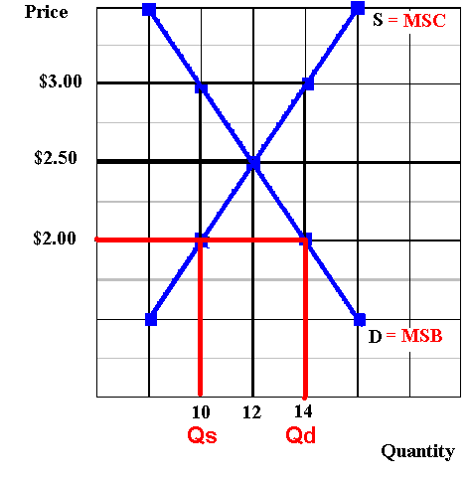
Effective Price Ceiling: $2.00

Slide 17
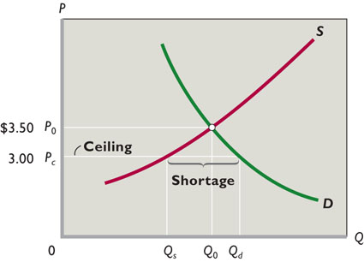
Price Ceiling

Slide 18
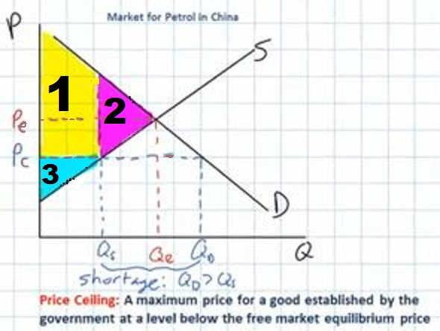
3. Which area represents the consumer surplus when there is price ceiling at Pc ?
1
2
3
none

Slide 19
3. Which area represents the consumer surplus when there is price ceiling at Pc ?
1
2
3
none

Slide 20
4. The allocative inefficiency of an effective price floor can be seen in the fact that:
MSB = MSC
MSB > MSC
MSB < MSC
There is no dead weight loss

Slide 21
4. The allocative inefficiency of an effective price floor can be seen in the fact that:
MSB = MSC
MSB > MSC
MSB < MSC
There is no dead weight loss

Slide 22
Effective Price Floor: $3.00

Slide 23
5. Which of the following is an example of a price floor?
Anti price gouging laws
Price controls on concert tickets
Rent controls
Minimum wage

Slide 24
5. Which of the following is an example of a price floor?
Anti price gouging laws
Price controls on concert tickets
Rent controls
Minimum wage

Slide 25
Lesson 5a Negative Externalities
The market FAILS to achieve allocative efficiency.
The government may CORRECT the market failure.
See Yellow Page 79.

Slide 26
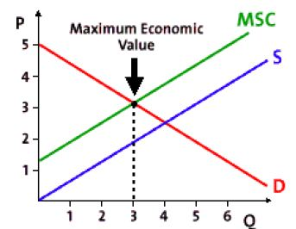
6. This graph shows the effect of a:
Price ceiling
Price floor
MSC
Negative externality

Slide 27
6. This graph shows the effect of a:
Price ceiling
Price floor
MSC
Negative externality

Slide 28
7. If the production of a good results in negative externalities (external costs or spillover costs), then:
The socially optimum (alloc. eff.) quantity will be produced
More than the alloc. eff. Q will be produced
Less than the alloc. eff. Q will be produced
There will be a shortage of the good

Slide 29
7. If the production of a good results in negative externalities (external costs or spillover costs), then:
The socially optimum (alloc. eff.) quantity will be produced
More than the alloc. eff. Q will be produced
Less than the alloc. eff. Q will be produced
There will be a shortage of the good

Slide 30
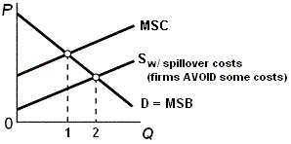
Effects of a Negative Externality

Slide 31
8. The main problem about negative externalities is that:
They overstate the cost of production
They maximize the costs of production
They understate the costs of production
They minimize the cost of production

Slide 32
8. The main problem about negative externalities is that:
They overstate the cost of production
They maximize the costs of production
They understate the costs of production
They minimize the cost of production

Slide 33
Effects of a Negative Externality

Slide 34
9. Which of the following is NOT a way to solve the efficiency problem of a negative externality?
Tax the product
Government regulations
Coase theorem
Subsidize the product

Slide 35
9. Which of the following is NOT a way to solve the efficiency problem of a negative externality?
Tax the product
Government regulations
Coase theorem
Subsidize the product

Slide 36
10. The Coase theorem suggests that:
People want to cooperate
People working in their own best interest can privately solve an externality
People will not respond to incentives
Government intervention is necessary to deal with externalities

Slide 37
10. The Coase theorem suggests that:
People want to cooperate
People working in their own best interest can privately solve an externality
People will not respond to incentives
Government intervention is necessary to deal with externalities

