Slide 1

4b – Other Types of Elasticity
This web quiz may appear as two pages on tablets and laptops.
I recommend that you view it as one page by clicking on the open book icon at the bottom of the page.

Slide 2
4b – Other Types of Elasticity
Four Types of Elasticity (HOW MUCH?)
Price Elasticity of Demand (4a)
Price Elasticity of Supply (4b)
Cross Elasticity of Demand (4b)
Income Elasticity of Demand (4b)

Slide 3
4 Types of Elasticity (HOW MUCH)?
  Price Elasticity of Demand (Ed)
  HOW MUCH does the quantity demanded change when the price changes
  Price Elasticity of Supply (Es)
  HOW MUCH does the quantity supplied change when the price changes
  Cross Elasticity of Demand (Eab)
  HOW MUCH does the quantity of one product change when the price of another product changes
  Income Elasticity of Demand (Edy)
  HOW MUCH does the quantity of one product change when incomes change
4b – Other Types of Elasticity

Slide 4




4 Types of Elasticity (HOW MUCH)?
Price Elasticity
of Demand
Price Elasticity
of Supply
Cross Elasticity
of Demand
Income Elasticity
of Demand

Slide 5
Must Know / Outcomes:
  Price Elasticity of Supply
  define price elasticity of supply
  calculate and interpret the coefficient of price elasticity of supply using the midpoint formula
  determinants of price elasticity of supply
  price elasticity of supply and the market period, the short run, and the long run
  Cross Elasticity of Demand
  define cross elasticity of demand
  interpret the coefficient of cross elasticity of demand including both its value and the sign (substitutes, complements, and unrelated goods)
  Income Elasticity of Demand
  define income elasticity of demand
  interpret the coefficient of income elasticity of demand including both its value and the sign (inferior goods, normal goods, luxury goods)
4b – Other Types of Elasticity

Slide 6
KEY TERMS:
price elasticity of supply,
coefficient of price elasticity of supply, midpoints formula,
market period,
short run,
long run,
cross elasticity of demand,
substitute good,
complement good,
income elasticity of demand,
normal good,
inferior good
4b – Other Types of Elasticity

Slide 7
1. The price elasticity of supply measures how:
Easily labor and capital can be substituted for one another in production
Responsive the quantity supplied of X is to changes in the price of X
Responsive the quantity supplied of Y is to changes in the price of X
Responsive the quantity supplied to changes in income

Slide 8
1. The price elasticity of supply measures how:
Easily labor and capital can be substituted for one another in production
Responsive the quantity supplied of X is to changes in the price of X
Responsive the quantity supplied of Y is to changes in the price of X
Responsive the quantity supplied to changes in income

Slide 9
Price Elasticity of Supply
4b – Other Types of Elasticity
Price Elasticity of Supply

Slide 10
2. What is the coefficient of price elasticity of supply between prices $2 and $10 (midpoints formula)?
5
2.5
1
0.25

Slide 11
2. What is the coefficient of price elasticity of supply between prices $2 and $10 (midpoints formula)?
5
2.5
1
0.25

Slide 12
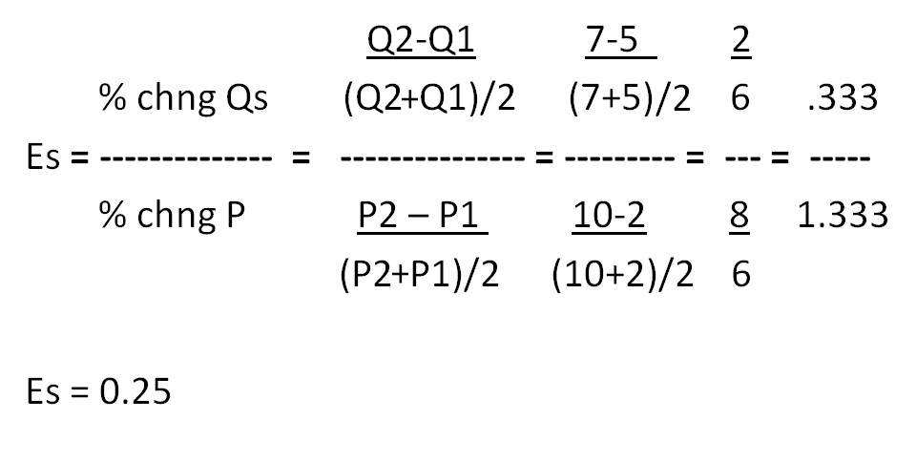
Price Elasticity of Supply – Midpoint Formula

Slide 13
3. If Es = 0.25 then:
Supply is price elastic
Supply is price inelastic
Supply is unit elastic
Supply in cross inelastic

Slide 14
3. If Es = 0.25 then:
Supply is price elastic
Supply is price inelastic
Supply is unit elastic
Supply in cross inelastic

Slide 15
4. If Es = 0.25, then a 10% increase in price will:
Increase quantity supplied by 2.5%
Decrease quantity supplied by 2.5%
Increase the quantity supplied by 25%
Not change the quantity supplied

Slide 16
4. If Es = 0.25, then a 10% increase in price will:
Increase quantity supplied by 2.5%
Decrease quantity supplied by 2.5%
Increase the quantity supplied by 25%
Not change the quantity supplied

Slide 17
If Es = 0.25, then a 10% increase in price will do what to the quantity supplied?
Es = 0.25 = % change Qs / % change P = ?/10 = 2.5/10 = 0.25
4b – Other Types of Elasticity
Price Elasticity of Supply

Slide 18
5. If Es = 2.5 then:
Supply is price elastic
Supply is price inelastic
Supply is unit elastic
Supply in cross inelastic

Slide 19
5. If Es = 2.5 then:
Supply is price elastic
Supply is price inelastic
Supply is unit elastic
Supply in cross inelastic

Slide 20
6. If Es = 2.5, then a 10% increase in price will:
Increase quantity supplied by 2.5%
Decrease quantity supplied by 2.5%
Increase the quantity supplied by 25%
Not change the quantity supplied

Slide 21
6. If Es = 2.5, then a 10% increase in price will:
Increase quantity supplied by 2.5%
Decrease quantity supplied by 2.5%
Increase the quantity supplied by 25%
Not change the quantity supplied

Slide 22
If Es = 2.5, then a 10% increase in price will do what to the quantity supplied?
Es = 2.5 = % change Qs / % change P = ?/10 = 25/10 = 2.5
4b – Other Types of Elasticity
Price Elasticity of Supply

Slide 23
If Es = 2.5, then a 10% increase in price will do what to the quantity supplied?
Es = 2.5 = % change Qs / % change P = ?/10 = 25/10 = 2.5
4b – Other Types of Elasticity
Price Elasticity of Supply

Slide 24
7. The main determinant of the price elasticity of supply is the:
Number of close substitutes
Whether the product is a luxury or a necessity
Number of uses of the product
Amount of time producers have to adjust to a price change

Slide 25
7. The main determinant of the price elasticity of supply is the:
Number of close substitutes
Whether the product is a luxury or a necessity
Number of uses of the product
Amount of time producers have to adjust to a price change

Slide 26
Determinants of Price Elasticity of Supply
YP 12 # 3
ease of storage (market period)
available excess capacity (short run)
characteristics of the production process (long run)
time
  market period
  short run
  long run
4b – Other Types of Elasticity - Price Elasticity of Supply

Slide 27
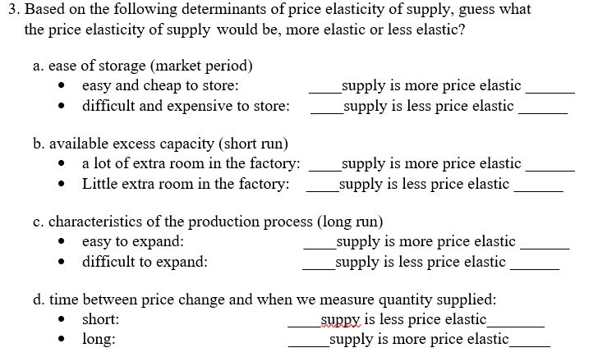
Determinants of Price Elasticity of Supply -- YP 12 # 3
4b – Other Types of Elasticity - Price Elasticity of Supply

Slide 28
8. The supply of product X is perfectly price inelastic if the price of X rises by:
5% and the Qs rises by 7%
8% and the Qs rises by 8%
10% and the Qs stays the same
7% and the Qs rises by 5%

Slide 29
8. The supply of product X is perfectly price inelastic if the price of X rises by:
5% and the Qs rises by 7%
8% and the Qs rises by 8%
10% and the Qs stays the same
7% and the Qs rises by 5%

Slide 30
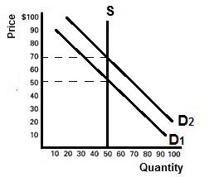
Perfectly Price Inelastic Supply
4b – Other Types of Elasticity - Price Elasticity of Supply

Slide 31
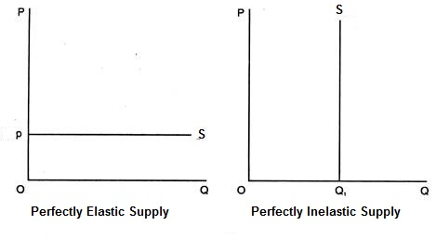
4b – Other Types of Elasticity
Price Elasticity of Supply

Slide 32
9. Cross elasticity of demand measures how sensitive purchases of a specific product are to changes in:
The price of some other product
The price of the same product
Income
Supply of the same product

Slide 33
9. Cross elasticity of demand measures how sensitive purchases of a specific product are to changes in:
The price of some other product
The price of the same product
Income
Supply of the same product

Slide 34
Cross Elasticity of Demand
4b – Other Types of Elasticity
Cross Elasticity of Demand

Slide 35
10. The formula for the cross elasticity of demand is:
% P of A / % P of B
% P of A / % Q of B
% Q of A / % P of B
% Q of A / % Q of B

Slide 36
10. The formula for the cross elasticity of demand is:
% P of A / % P of B
% P of A / % Q of B
% Q of A / % P of B
% Q of A / % Q of B

Slide 37
Cross Elasticity of Demand
4b – Other Types of Elasticity
Cross Elasticity of Demand

Slide 38
11. If the price of almonds increases 10% causing the quantity of walnuts sold to increase 5%, then Eab= ?
(What is the cross elasticity of demand?)
- 0.1
+ 0.1
- 0.5
+ 0.5
- 5.0
+ 5.0

Slide 39
11. If the price of almonds increases 10% causing the quantity of walnuts sold to increase 5%, then Eab= ?
(What is the cross elasticity of demand?)
- 0.1
+ 0.1
- 0.5
+ 0.5
- 5.0
+ 5.0

Slide 40
Cross Elasticity of Demand
% chng Qa +5
Es = -------------- = --------- = + 0.5
% chng Pb +10

Slide 41
12. If the cross elasticity of demand is - 2, this means a 10% increase in the price of product A will:
decrease the quantity of product B sold by 2%
increase the quantity of product B sold by 2%
decrease the quantity of product B sold by 20%
increase the quantity of product B sold by 20%
Substitutes or Complements?
Cross Elastic or Cross Inelastic?

Slide 42
12. If the cross elasticity of demand is - 2, this means a 10% increase in the price of product A will:
decrease the quantity of product B sold by 2%
increase the quantity of product B sold by 2%
decrease the quantity of product B sold by 20%
increase the quantity of product B sold by 20%
Substitutes or Complements?
Cross Elastic or Cross Inelastic?

Slide 43
Eab = - 2, this means a 10% increase in the price of product B will do what to quantity of A ?
% change Qa ? -20
Es = ----------------- = -------- = ------- = -2
% change Pb +10 +10
Substitutes or Complements?
Cross Elastic or Cross Inelastic?
4b – Other Types of Elasticity
Cross Elasticity of Demand

Slide 44
13. If the cross elasticity of demand is + 0.5, this means:
The products are substitutes
The products are complements
The products normal goods
The products inferior goods
Cross Elastic or Cross Inelastic?

Slide 45
13. If the cross elasticity of demand is + 0.5, this means:
The products are substitutes
The products are complements
The products normal goods
The products inferior goods
Cross Elastic or Cross Inelastic?

Slide 46
14. If the cross elasticity of demand is + 0.5, this means:
The demand is cross elastic
The demand is cross inelastic
The demand for toys is income elastic
The demand for toys is income inelastic
Substitutes or Complements?

Slide 47
14. If the cross elasticity of demand is + 0.5, this means:
The demand is cross elastic
The demand is cross inelastic
The demand for toys is income elastic
The demand for toys is income inelastic
Substitutes or Complements?

Slide 48
Cross Elasticity of Demand
See Lesson 4b Key Problems for more Cross Elasticity problems.

Slide 49
15. Income elasticity of demand measures how sensitive purchases of a specific product are to changes in:
The price of some other product
The price of the same product
Income
Supply of the same product

Slide 50
15. Income elasticity of demand measures how sensitive purchases of a specific product are to changes in:
The price of some other product
The price of the same product
Income
Supply of the same product

Slide 51
Income Elasticity of Demand
4b – Other Types of Elasticity
Income Elasticity of Demand

Slide 52
16. If the incomes increases 10% causing the quantity of ramen noodles sold to decrease 5%, then Edy = ?
(What is the income elasticity of demand?)
- 0.1
+ 0.1
- 0.5
+ 0.5
- 5.0
+ 5.0

Slide 53
16. If the incomes increases 10% causing the quantity of ramen noodles sold to decrease 5%, then Edy = ?
(What is the income elasticity of demand?)
- 0.1
+ 0.1
- 0.5
+ 0.5
- 5.0
+ 5.0

Slide 54
Income Elasticity of Demand
% change Q -5
Edy = -------------------- = --------- = - 0.5
% change Income +10
Income Elastic or Income Inelastic?
Normal Good or Inferior Good?

Slide 55
17. If the income elasticity of demand for toys is + 1.5, this means:
Toys and candy are substitutes
Toys are normal goods
Toys are inferior goods
Toys are necessities
Income Elastic or Income Inelastic?

Slide 56
17. If the income elasticity of demand for toys is + 1.5, this means:
Toys and candy are substitutes
Toys are normal goods
Toys are inferior goods
Toys are necessities
Income Elastic or Income Inelastic?

Slide 57
18. If the income elasticity of demand for fresh fruit is + 0.5, this means:
The demand for fresh fruit is price elastic
The demand for fresh fruit is price inelastic
The demand for fresh fruit is income elastic
The demand for fresh fruit is income inelastic
Normal Good or Inferior Good?

Slide 58
18. If the income elasticity of demand for fresh fruit is + 0.5, this means:
The demand for fresh fruit is price elastic
The demand for fresh fruit is price inelastic
The demand for fresh fruit is income elastic
The demand for fresh fruit is income inelastic
Normal Good or Inferior Good?

Slide 59
19. If the income elasticity of demand for toys is +1.5, this means:
A 10% increase in income will decrease the quantity of toys sold by 15%
A 10% increase in income will decrease the quantity of toys sold by 1.5%
A 10% increase in income will increase the quantity of toys sold by 15%
A 10% increase in income will increase the quantity of toys sold by 1.5%
Income Elastic or Income Inelastic?
Normal Good or Inferior Good?

Slide 60
19. If the income elasticity of demand for toys is +1.5, this means:
A 10% increase in income will decrease the quantity of toys sold by 15%
A 10% increase in income will decrease the quantity of toys sold by 1.5%
A 10% increase in income will increase the quantity of toys sold by 15%
A 10% increase in income will increase the quantity of toys sold by 1.5%
Income Elastic or Income Inelastic?
Normal Good or Inferior Good?

Slide 61
Edy = +1.5 means:
% change Q + 15
Edy = -------------------- = --------- = +1.5
% change Income +10
Income Elastic or Income Inelastic?
Normal Good or Inferior Good?

Slide 62
20. If the income elasticity of demand for margarine is - 0.2, this means:
A 10% increase in income will decrease the quantity of margarine sold by 2%
A 10% increase in income will decrease the quantity of margarine sold by 20%
A 10% increase in income will increase the quantity of margarine sold by 2%
A 10% increase in income will increase the quantity of margarine sold by 20%
Income Elastic or Income Inelastic?
Normal Good or Inferior Good?

Slide 63
20. If the income elasticity of demand for margarine is - 0.2, this means:
A 10% increase in income will decrease the quantity of margarine sold by 2%
A 10% increase in income will decrease the quantity of margarine sold by 20%
A 10% increase in income will increase the quantity of margarine sold by 2%
A 10% increase in income will increase the quantity of margarine sold by 20%
Income Elastic or Income Inelastic?
Normal Good or Inferior Good?

Slide 64
Edy = -0.2 means:
% change Q - 2
Edy = -------------------- = --------- = -0.2
% change Income +10
Income Elastic or Income Inelastic?
Normal Good or Inferior Good?

Slide 65
Income Elasticity of Demand
Automobiles 2.98
Books 1.44
Restaurant meals 1.40
Tobacco 0.42
Margarine −0.20
Public transportation −0.36
Luxuries: income elastic
Necessities: income inelastic
Wikipedia: “income elasticity”

Slide 66
Income Elasticity of Demand
See Lesson 4b Key Problems for more Income Elasticity problems.

Slide 67
4 Types of Elasticity (HOW MUCH)?
Price Elasticity
of Demand
Price Elasticity
of Supply
Cross Elasticity
of Demand
Income Elasticity
of Demand

