Slide 1
4a – Price Elasticity of Demand
This web quiz may appear as two pages on tablets and laptops.
I recommend that you view it as one page by clicking on the open book icon at the bottom of the page.

Slide 2
4a – Price Elasticity of Demand
Price Elasticity of Demand
Tax Incidence and Efficiency Loss

Slide 3
Must Know / Outcomes (1):
define price elasticity of demand
compare "the law of demand" with "price elasticity of demand"
calculate the coefficient of price elasticity of demand using the midpoint formula
explain why the midpoint formula is used
know how to interpret the coefficient (what does the number mean?)
price elastic demand
price inelastic demand
unit elastic demand
how does the price elasticity of demand change along a single demand curve?
4a – Price Elasticity of Demand

Slide 4
Must Know / Outcomes: (2)
perfectly price elastic demand (graph)
perfectly price inelastic demand (graph)
total revenue test (how do price changes affect total revenue with different elasticities (show graphically)
P x Q = TR
explain how the shape of the total revenue graph is explained by the price elasticity of demand
determinants of price elasticity of demand
Why might farm incomes fall if crops are good (bumper crops)?
how does the price elasticity of demand explain the rise in street crime after a major drug bust?
how does price elasticity of demand help[ explain how the minimum wage affects unemployment?
define price discrimination and explain the role of the price elasticity of demand
4a – Price Elasticity of Demand

Slide 5
Must Know / Outcomes (3):
define "excise tax" and give examples
understand the connection between price elasticity of demand and the effect of excise taxes on (1) tax incidence (burden), (2) tax revenue, and (3) allocative efficiency (social welfare)
explain the efficiency loss of excise taxes using the (1) MSB = MSC model and (2) the consumer and producer surplus model (dead weight loss)
the role of excise taxes in income redistribution and reducing negative externalities
4a – Price Elasticity of Demand

Slide 6
KEY TERMS:
elasticity, price elasticity of demand, midpoint formula, coefficient of price elasticity of demand, price elastic demand, price inelastic demand, unit elastic demand, perfectly elastic demand perfectly inelastic demand, total revenue, price discrimination, excise tax, tax incidence (tax burden), efficiency loss of a tax, payroll tax,
4a – Price Elasticity of Demand

Slide 7
ELASTICITY:
HOW MUCH does one variable change in response to a change in another variable.
Elasticity = HOW MUCH
4a – Price Elasticity of Demand

Slide 8
4 Types of Elasticity (HOW MUCH)?
Price Elasticity of Demand:
HOW MUCH does the Qd changes when the price changes?
Price Elasticity of Supply:
How much does the Qs change when the price changes?
Cross Elasticity of Demand:
How much does the Q of one product change when the P of another product changes?
Income Elasticity of Demand:
How much does the Q change when the price changes?

Slide 9
4 Types of Elasticity (HOW MUCH)?
Price Elasticity
of Demand
Price Elasticity
of Supply
Cross Elasticity
of Demand
Income Elasticity
of Demand

Slide 10
1. Another term for “elasticity” might be:
effectiveness
shortage
surplus
responsiveness

Slide 11
1. Another term for “elasticity” might be:
effectiveness
shortage
surplus
responsiveness

Slide 12
4a – Price Elasticity of Demand
Definition of Price Elasticity of Demand
A measure of the responsiveness of buyers to a change in the price of a product or resource.
The ratio of the percentage change in quantity demanded of a product or resource to the percentage change in its price.
HOW MUCH does quantity demanded change when the price changes

Slide 13
4a – Price Elasticity of Demand
Why Study this?
In 2012 there was a severe drought in the US corn growing region.
In 2014 the weather was great and the corn crop was at a record high.
In which year did farmers make the most money?
They made more in 2012 when the weather was bad !!!
After studying this lesson you should understand why good farming weather results in low farm incomes and bad farming weather results in high farm incomes. Really!
Sept. 2012: Despite Record Drought, Farmers Expect Banner Year
Sept. 2014: Corn, soybean crop expected to hit record high -- Great season could mean bad prices for farmers

Slide 14
2. Firm’s use the price elasticity of demand to determine how a change in price will affect:
prices of other goods
revenues
supply
demand

Slide 15
2. Firm’s use the price elasticity of demand to determine how a change in price will affect:
prices of other goods
revenues
supply
demand

Slide 16
4a – Price Elasticity of Demand
Ways to Assess the Price Elasticity of Demand:
Guess
gasoline?
Big Mac?
salt?
new car?
2. Calculate the Coefficient 3. Total Revenue Test 4. Make an informed guess: use the Determinants

Slide 17
4a – Price Elasticity of Demand
Ways to Assess the Price Elasticity of Demand:
Guess
2. Calculate the Coefficient
Midpoint formula YP 2
Elastic, inelastic, unit elastic
Interpret the coefficient YP 5 #3
Perfectly elastic, perfectly inelastic
3. Total Revenue Test 4. Make an informed guess: use the Determinants

Slide 18
4a – Price Elasticity of Demand
Another Definition of Price Elasticity of Demand
The ratio of the percentage change in quantity demanded of a product or resource to the percentage change in its price.
HOW MUCH does quantity demanded change when the price changes?
Elasticity = HOW MUCH?

Slide 19
3. The price elasticity of demand is calculated by
(% Qs) x (% P)
(% Qd) / (% P)
(% P) x (% Qs)
(% P) / (% Qd)

Slide 20
3. The price elasticity of demand is calculated by
(% Qs) x (% P)
(% Qd) / (% P)
(% P) x (% Qs)
(% P) / (% Qd)

Slide 21
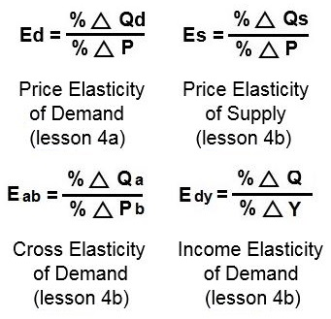
4a -Price Elasticity of Demand

Slide 22
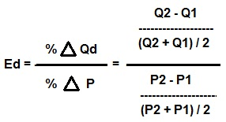
4a - Price Elasticity of Demand - Midpoints Formula
How to calculate % change: We will use the MIDPOINT FORMULA.
YP 2

Slide 23
4a - Price Elasticity of Demand - Midpoints Formula
Why use the midpoint?
Why not use the original P and Q?
Ppizza = $15; Qd = 1 Ppizza = $12; Q = 2
If we divide by the original price and the P increases from $12 to $15:
P2 – P1 / P1 = 3/12 = .25
If we divide by the original price and the P decreases from $15 to $12:
P2 – P1 / P1 = 3/15 = .20
If we use the original P and Q, then for the same change in price we get a different coefficient of elasticity depending on whether the price increases or decreases, BUT THE CONSUMER RESPONSE IS THE SAME.
So, we will estimate the consumer response with the midpoint formula.

Slide 24
4. The midpoint formula for calculating price elasticity of demand uses ______ in the denominator?

Slide 25
4. The midpoint formula for calculating price elasticity of demand uses ______ in the denominator?

Slide 26
5. A baker sells 30 bagels for $2 each and 50 bagels for $1 each. What is the price elasticity of demand?
1.32
0.5
0.75
0.66

Slide 27
5. A baker sells 30 bagels for $2 each and 50 bagels for $1 each. What is the price elasticity of demand?
1.32
0.5
0.75
0.66

Slide 28
4a -Price Elasticity of Demand Calculating Ed
A baker sells 30 bagels for $2 each and 50 bagels for $1 each. What is the price elasticity of demand?

Slide 29
6. An excellent harvest of oranges has caused the price to fall by 10%. Consumers respond by buying 5% more. The demand for oranges:
is price elastic
is price inelastic
is unit elastic
has increased

Slide 30
6. An excellent harvest of oranges has caused the price to fall by 10%. Consumers respond by buying 5% more. The demand for oranges:
is price elastic
is price inelastic
is unit elastic
has increased

Slide 31
4a - Price Elasticity of Demand
An excellent harvest of oranges has caused the price to fall by 10%. Consumers respond by buying 5% more. The demand for oranges:
Ed = % change Qd / % change P = +5/-10 = -0.5
Ed = 0.5 Since 0.5 < 1 the demand is price inelastic

Slide 32
7. If the price elasticity of demand for a good is 1.5, a 10% increase in price would result in a:
1.5% decrease in Qd
1.5% increase in Qd
15% decrease in Qd
10% decrease in Qd

Slide 33
7. If the price elasticity of demand for a good is 1.5, a 10% increase in price would result in a:
1.5% decrease in Qd
1.5% increase in Qd
15% decrease in Qd
10% decrease in Qd

Slide 34
4a - Price Elasticity of Demand
If the price elasticity of demand for a good is 1.5, a 10% increase in price would result in a:
Ed = % change Qd / % change P = 1.5 = ?/10
Ed = 1.5 = 15/10
So the Qd will decrease by 15%

Slide 35
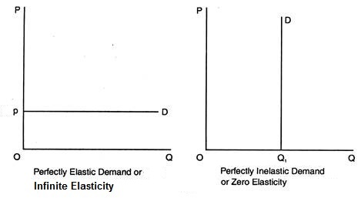
4a - Price Elasticity of Demand – PERFECTLY Elastic and Inelastic

Slide 36
4a – Price Elasticity of Demand
Ways to Assess the Price Elasticity of Demand:
Guess
2. Calculate the Coefficient 3. Total Revenue Test
YP 2
YP 5 #4 and #5
YP 6 #11
4. Make an informed guess: use the Determinants

Slide 37
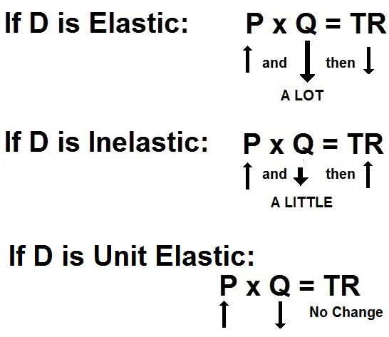
4a - Price Elasticity of Demand Total Revenue Test

Slide 38
8. The price of milk increases causing the quantity sold to decrease. If the total revenue received from the sale of milk increases, then the price elasticity of demand for milk is:
perfectly inelastic
perfectly elastic
inelastic
elastic

Slide 39
8. The price of milk increases causing the quantity sold to decrease. If the total revenue received from the sale of milk increases, then the price elasticity of demand for milk is:
perfectly inelastic
perfectly elastic
inelastic
elastic

Slide 40
4a – Price Elasticity of Demand
Ways to Assess the Price Elasticity of Demand:
Guess
2. Calculate the Coefficient 3. Total Revenue Test
Make an informed guess: use the Determinants (Paper #4)
YP 4
Number of substitutes
Luxury or necessity?
Price as a % of consumer income
Time between the price change and when we measure quantity demanded
YP 6 # 7

Slide 41
9. Which of the following is NOT a determinant of the price elasticity of demand?
The quantity produced
The amount of time available to adjust to a price change
The availability of close substitutes
The percentage of one’s budget spent on the product
Luxury or Necessity

Slide 42
9. Which of the following is NOT a determinant of the price elasticity of demand?
The quantity produced
The amount of time available to adjust to a price change
The availability of close substitutes
The percentage of one’s budget spent on the product
Luxury or Necessity

Slide 43
10. Compared to the price elasticity of demand for gasoline, the elasticity of demand for Mobil gasoline is:
more inelastic
unit elastic
the same
more elastic

Slide 44
10. Compared to the price elasticity of demand for gasoline, the elasticity of demand for Mobil gasoline is:
more inelastic
unit elastic
the same
more elastic

Slide 45
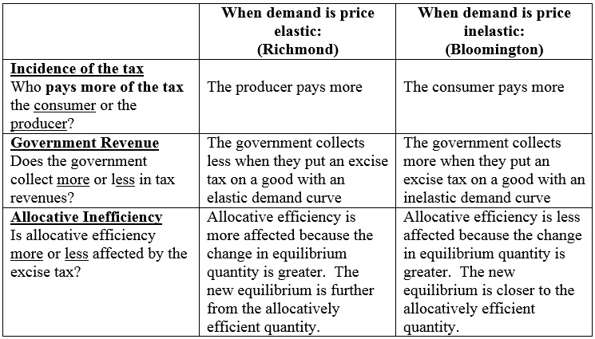
4a - Price Elasticity of Demand Incidence of a Tax
YP 7 and 8

