Slide 1
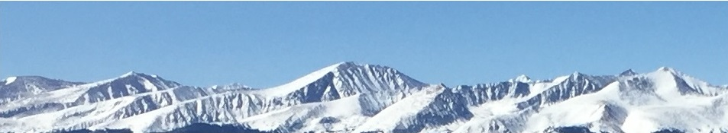
3c – Market Equilibrium
This web quiz may appear as two pages on tablets and laptops.
I recommend that you view it as one page by clicking on the open book icon at the bottom of the page.

Slide 2
3c – Market Equilibrium
Market Equilibrium
Equilibrium and Efficiency
  MSB = MSC
  Consumer and Producer Surplus

Slide 3
3c – Market Equilibrium
Must Know / Outcomes (1):
What are the two assumptions of a competitive equilibrium?
Define equilibrium
How to find the equilibrium price and quantity on a supply and demand schedule and graph
What happens if the price is below the equilibrium price? If it is above it?
Define "shortage" and "surplus" and explain using a supply and demand graph
What is the "bidding mechanism"?
The three (or four) steps to finding a new equilibrium when a non-price determinant changes and how to use them
What happens to the equilibrium price and quantity if (1) demand increases, (2) demand decreases, (3) supply increases, and (4) supply decreases?
What happens if both supply and demand changes

Slide 4
3c - Markets and Efficiency
Must Know / Outcomes (2):
be able to use two models to show why competitive market economies achieve allocative efficiency
  MSB=MSC
  maximum consumer plus producer surplus
define marginal social benefit and explain why it is often measured by the demand curve
define marginal social cost and explain why it is often measured by the supply curve
explain why allocative inefficiency occurs where MSB > MSC causing an underallocation of resources (too little produced); show on graph using the MSB=MSC model
explain why allocative inefficiency occurs where MSB < MSC causing an overallocation of resources (too much produced); show on graph using the MSB=MSC model
be able to find WHAT WE GET and WHAT WE WANT on the MSB=MSC model graph
define consumer surplus and producer surplus and shade them in on a supply and demand graph
define deadweight loss and be able to locate it on a supply and demand graph if too much or too little is produced

Slide 5
3c – Key Terms
Market Equilibrium
equilibrium, market equilibrium, bidding mechanism, surplus, shortage, scalping
Efficiency
productive efficiency, allocative efficiency, marginal social benefits, marginal social costs, "what we get", "what we want", profit maximizing quantity, underallocation of resources, overallocation of resources, consumer surplus, producer surplus, deadweight loss

Slide 6
1. Equilibrium price for wheat will be:
YP 67 #13
$4
$3
$2
$1

Slide 7
1. Equilibrium price for wheat will be:
YP 67 # 13
$4
$3
$2
$1

Slide 8
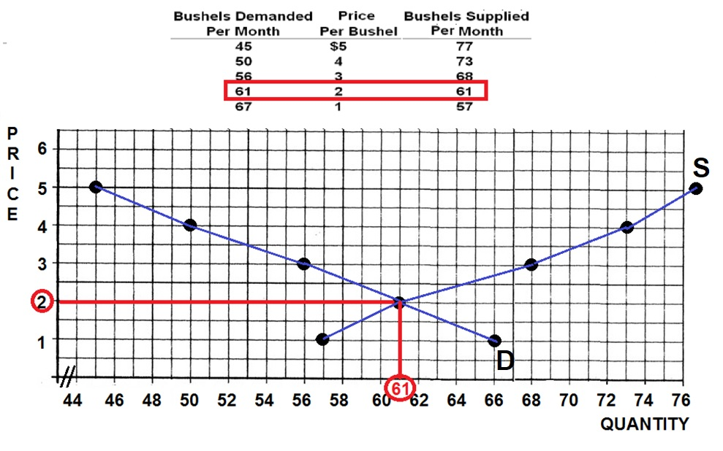

Slide 9
2. If the price in this market for wheat was $4:
YP 67 #14
The market would clear, Qd would equal Qs
Buyers would want to purchase more wheat than is currently being supplied
Farmers would not be able to sell all of their wheat
There would be a shortage of wheat

Slide 10
2. If the price in this market for wheat was $4:
YP 67 #14
The market would clear, Qd would equal Qs
Buyers would want to purchase more wheat than is currently being supplied
Farmers would not be able to sell all of their wheat
There would be a shortage of wheat

Slide 11
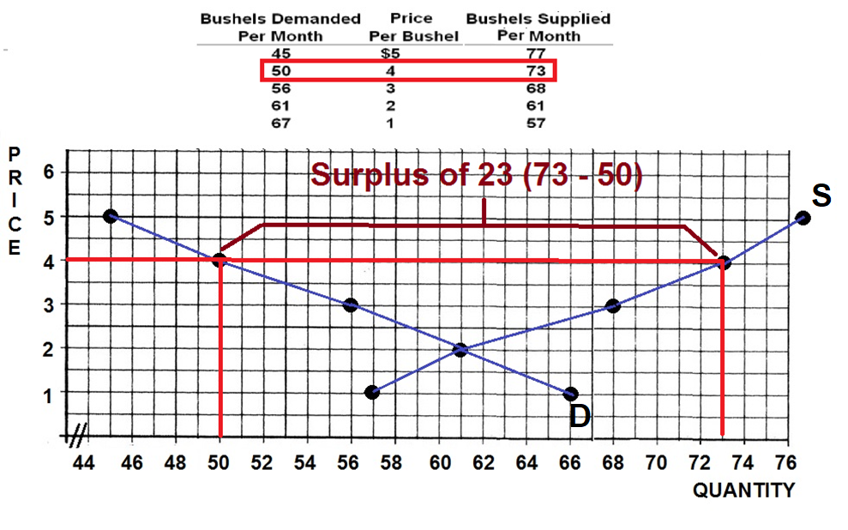

Slide 12
3. If the market for bread is experiencing a surplus, then you would expect:
P will increase, Qd will fall and Qs will rise
P will increase, Qd will rise and Qs will fall
P will decrease, Qd will rise and Qs will fall
P will decrease, Qd will fall and Qs will rise

Slide 13
3. If the market for bread is experiencing a surplus, then you would expect:
P will increase, Qd will fall and Qs will rise
P will increase, Qd will rise and Qs will fall
P will decrease, Qd will rise and Qs will fall
P will decrease, Qd will fall and Qs will rise

Slide 15
4. An increase in the supply of chocolate bars results in:
P increases and Q decreases
P decreases and Q increases
P increases and Q increases
P decreases and Q decreases

Slide 16
4. An increase in the supply of chocolate bars results in:
P increases and Q decreases
P decreases and Q increases
P increases and Q increases
P decreases and Q decreases

Slide 18
5. Which of the following will cause a decrease in supply?
Improved technology
Higher labor costs
Decrease in the price of substitutes
Decreased demand

Slide 19
5. Which of the following will cause a decrease in supply?
Improved technology
Higher labor costs
Decrease in the price of substitutes
Decreased demand

Slide 20
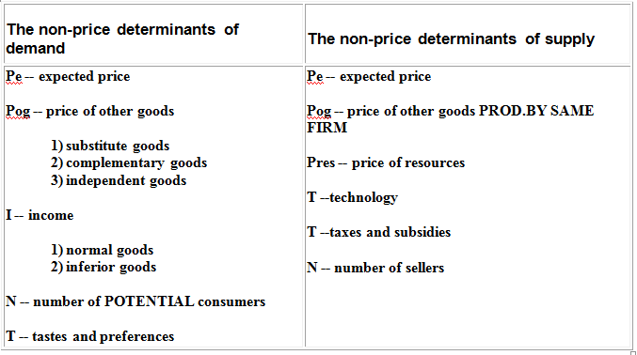

Slide 21
6. If the equilibrium P and Q both rise, the cause is:
An increase in D and a decrease in S
An increase in D without a change in S
A decrease in both D and S
A decrease in D and an increase in S

Slide 22
6. If the equilibrium P and Q both rise, the cause is:
An increase in D and a decrease in S
An increase in D without a change in S
A decrease in both D and S
A decrease in D and an increase in S

Slide 23
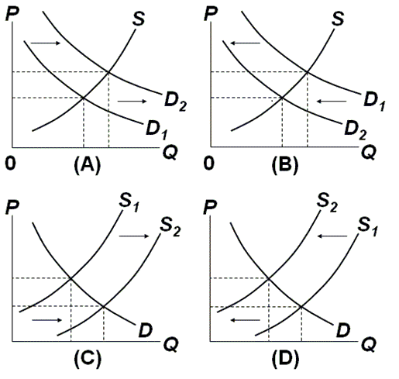
7, 8, 9

Slide 24
7. Which graph represents the effect of an increase in auto worker wages on the market for cars?
A
B
C
D

Slide 25
7. Which graph represents the effect of an increase in auto worker wages on the market for cars?
A
B
C
D

Slide 26
8. Which graph represents the effect of an increase in incomes on the market for secondhand clothing?
A
B
C
D

Slide 27
8. Which graph represents the effect of an increase in incomes on the market for secondhand clothing?
A
B
C
D

Slide 28
9. Which graph represents the effect of an increase in excise taxes on the market for cigarettes?
A
B
C
D

Slide 29
9. Which graph represents the effect of an increase in excise taxes on the market for cigarettes?
A
B
C
D

Slide 30
10. One can say for certainty that the equilibrium price will decline if:
S and D both increase
S increases and D decreases
S decreases and D increases
S and D both decrease

Slide 31
10. One can say for certainty that the equilibrium price will decline if:
S and D both increase
S increases and D decreases
S decreases and D increases
S and D both decrease

Slide 32
GRAPH IT!

