Slide 1
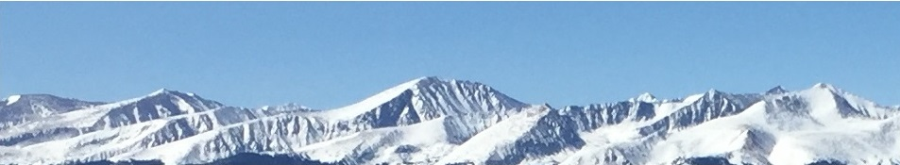
3b - Supply
This web quiz may appear as two pages on tablets and laptops.
I recommend that you view it as one page by clicking on the open book icon at the bottom of the page.

Slide 2
3b – Supply
TOPICS
  Definition of supply
  Changes in Supply vs. Changes in Quantity Supplied
  Non-price determinants of supply and how they affect the supply curve
The Supply Curve:
Define, Draw, Describe, Determinants

Slide 3
3b - Supply
Must Know / Outcomes (1):
define supply (note: it has a DIFFERENT DEFINITION in economics)
be able to correctly draw and label a supply graph
if the price of pizza goes up why does the supply not change?
why do economists employ the ceteris paribus assumption when creating a supply curve?
what is the law of supply?
why is the supply curve upward sloping (two explanations)
list the non-price determinants of supply (Pe, Pog, Pres, Tech, Taxes, Nprod) or (P,P,P,T,T,N) and understand how they affect the supply schedule and curve. This is VERY IMPORTANT. BE ABLE TO DO THIS! See the 3a/3b/3c yellow pages.
explain the difference between the a "change in the quantity supplied" and a "change in supply"
what is an increase in supply and a decrease in supply and show how they affect the supply schedule and the supply curve
what is "market supply"?

Slide 4
3b - Supply
Must Know / Outcomes (2):
Read the following and answer these questions:
  Which determinant has changed?
  Will it affect S or D of gasoline?
  Will the S or D of gasoline increase or decrease? Shift to the right or to the left? "According to the Lundberg Survey, the average price for regular gasoline dropped 3.99 cents over the three weeks up to July 11 to $3.6699 per gallon. . . . Lundberg explained that the average gasoline price continues to decrease because refiners, enjoying the lower crude oil prices in the market, are passing down the savings to the consumers. "
  From: http://www.techtimes.com/articles/10378/20140714/average-price-of-gasoline-in-u-s-drops-four-cents-now-at-3-67-a-gallon.htm

Slide 5
3b - Supply
KEY TERMS:
supply,
quantity supplied,
market supply,
law of supply,
change in supply,
change in quantity supplied,
increase in supply,
decrease in supply,
non-price determinants of supply

Slide 6
1. DEFINE -- Supply is:
A mathematical representation of the quantity of a good that a supplier will put on the market
A schedule showing the amount of a good that consumers are willing to buy at various prices
A schedule showing the amount of a good that producers are willing to sell at various prices
The amount of a good that is available for sale
For all graphs:
  Define
  Draw
  Describe

Slide 7
1. DEFINE -- Supply is:
A mathematical representation of the quantity of a good that a supplier will put on the market
A schedule showing the amount of a good that consumers are willing to buy at various prices
A schedule showing the amount of a good that producers are willing to sell at various prices
The amount of a good that is available for sale
For all graphs:
  Define
  Draw
  Describe

Slide 8
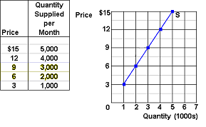
DRAW – Supply – YP 37
For all graphs:
  Define
  Draw
  Describe
Law of Supply:
the direct relationship between
price and quantity supplied

Slide 9
2. DESCRIBE -- Why will businesses produce more ONLY if the price increases:
Producers’ costs of producing that good falls
Producers’ costs of producing that good increases
Consumers demand more so producers must raise the price
Consumers demand less so producers must raise the price
Law of Supply:
There is a direct relationship between price and quantity supplied.
For all graphs:
  Define
  Draw
  Describe

Slide 10
2. DESCRIBE -- Why will businesses produce more ONLY if the price increases:
Producers’ costs of producing that good falls
Producers’ costs of producing that good increases
Consumers demand more so producers must raise the price
Consumers demand less so producers must raise the price
Law of Supply:
There is a direct relationship between price and quantity supplied.
For all graphs:
  Define
  Draw
  Describe

Slide 11
3. As the price of apples increases, apple growers will:
Decrease the supply of apples
Increase the supply of apples
Switch to less expensive methods of production
Increase the quantity of apples supplied

Slide 12
3. As the price of apples increases, apple growers will:
Decrease the supply of apples
Increase the supply of apples
Switch to less expensive methods of production
Increase the quantity of apples supplied

Slide 13
Change in Quantity Supplied
A change is quantity supplied is caused by a change in the price of the product.

Slide 14
Change in Quantity Supplied vs. Change in Supply
A CHANGE IN QUANTITY SUPPLIED is caused by a change in the price of the product. (Px)
A CHANGE IN SUPPLY is caused by a change in the non-price determinants of supply. (PPPTTN)
  Pe -- expected price
  Pog -- price of other goods produced by the same firm
  Pres -- price of resources
  T -- technology
  T -- taxes and subsidies
  N -- number of sellers

Slide 15
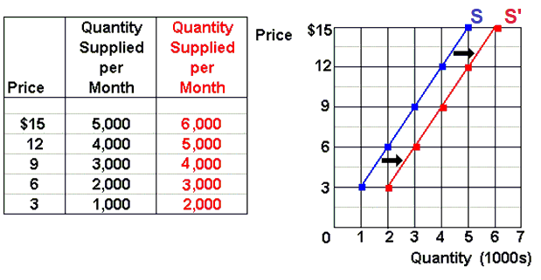
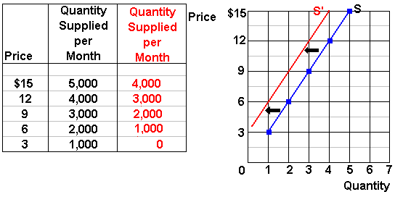
Change in Supply – YP 41
Increase in Supply:
Decrease in supply:

Slide 16
Change in Quantity Supplied vs. Change in Supply
Change in Quantity Supplied:
Change in Supply:
Do YP 39

Slide 17
4. Which of the following will not shift the supply curve of product X?
A change in the price of resources used to produce X
A change in the price of other goods also produced by the makers of X
A change in the technology used to produce X
A change in the price of X

Slide 18
4. Which of the following will not shift the supply curve of product X?
A change in the price of resources used to produce X
A change in the price of other goods also produced by the makers of X
A change in the technology used to produce X
A change in the price of X

Slide 19
Non-Price Determinants of Supply
( P, P, P, T, T, N )
Pe -- expected price
Pog -- price of other goods produced by the same firm
Pres -- price of resources
T -- technology
T -- taxes and subsidies
N -- number of sellers
Cause the Supply Curve to Shift = A Change in Supply
YP 40, 42

Slide 20
5. The supply curve of apples will shift to the right if:
Very bad weather afflicts the apple-growing areas of the country
Apples are rumored to have been treated with cancer-causing insecticides
The government required that all employees in apple orchards are given more health benefits
Fruit growers see the price of pears decreasing permanently

Slide 21
5. The supply curve of apples will shift to the right if:
Very bad weather afflicts the apple-growing areas of the country
Apples are rumored to have been treated with cancer-causing insecticides
The government required that all employees in apple orchards are given more health benefits
Fruit growers see the price of pears decreasing permanently

Slide 22
6. If a pretzel maker hears rumors that pretzel prices will fall at the end of the month, the firm now:
Saves it supply for selling at a future date
Increases the supply
Decreases the supply
Waits to supply pretzels when the market is more stable

Slide 23
6. If a pretzel maker hears rumors that pretzel prices will fall at the end of the month, the firm now:
Saves it supply for selling at a future date
Increases the supply
Decreases the supply
Waits to supply pretzels when the market is more stable

Slide 24
7. Which of the following will cause a decrease in the market supply for ice cream?
An increase in the price of ice cream
A decrease in the price of ice cream
An increase in the price of milk used to make ice cream
An expectation that the price of ice cream will be lower in the future

Slide 25
7. Which of the following will cause a decrease in the market supply for ice cream?
An increase in the price of ice cream
A decrease in the price of ice cream
An increase in the price of milk used to make ice cream
An expectation that the price of ice cream will be lower in the future

Slide 26
8. An improvement in production technology will:
Shift the demand curve to the left
Shift the supply curve to the left
Shift the demand curve to the right
Shift the supply curve to the right

Slide 27
8. An improvement in production technology will:
Shift the demand curve to the left
Shift the supply curve to the left
Shift the demand curve to the right
Shift the supply curve to the right

Slide 28
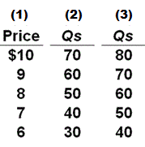
9. Refer to the table. In relation to column (1), a change from column (2) to column (3) would most likely be caused by:
Government reducing the tax on the good
Expectations of higher future prices
An increase in consumer incomes
An increase in input prices

Slide 29
9. Refer to the table. In relation to column (1), a change from column (2) to column (3) would most likely be caused by:
Government reducing the tax on the good
Expectations of higher future prices
An increase in consumer incomes
An increase in input prices

Slide 30
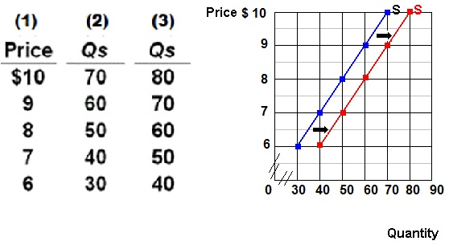

Slide 31
10. The market supply of a good or service:
Is the sum of the individual supply curves
Is determined by all the determinants of individual supply and by the number of producers
Reflects a direct relationship between price and quantity supplied
All of the above

Slide 32
10. The market supply of a good or service:
Is the sum of the individual supply curves
Is determined by all the determinants of individual supply and by the number of producers
Reflects a direct relationship between price and quantity supplied
All of the above

Slide 33
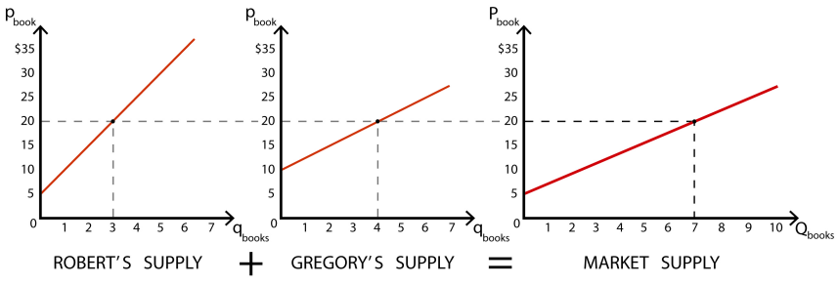
Market Supply

