Slide 1

22a – Immigration
This web quiz may appear as two pages on tablets and laptops.
I recommend that you view it as one page by clicking on the open book icon at the bottom of the page.

Slide 2
22a - Immigration
U.S. Immigration – The Numbers
Economic Effects of Immigration (Model)
The Illegal Immigration Debate (Model)

Slide 3
22a - Immigration
Review: Lesson 20a – Income Inequality
YP 67 #9 - The Case for Equality Model of Income Distribution: The President Trump Example
YP 71 # 13 - The Occupational Segregation Model of Discrimination
YP 72-73 - “As Our Jobs Are Automated, Some Say We'll Need A Guaranteed Basic Income”

Slide 4
22a - Immigration
U.S. Immigration – The Numbers
Economic Effects of Immigration (Model)
The Illegal Immigration Debate (Model)

Slide 5
22a - Immigration
Three Short Videos
Costs, Benefits and How Best to Respond - Professor Richard D Wolff. begin at 3:35
CNN Report on the economics of immigration (2:24)
"Three Ways To Totally Transform U.S. Immigration Policy" NPR, Planet Money, Feb. 21, 2013 – Audio only
  1. The Best And The Brightest
  2. The Highest Bidder
  3. Let 'Em In

Slide 6
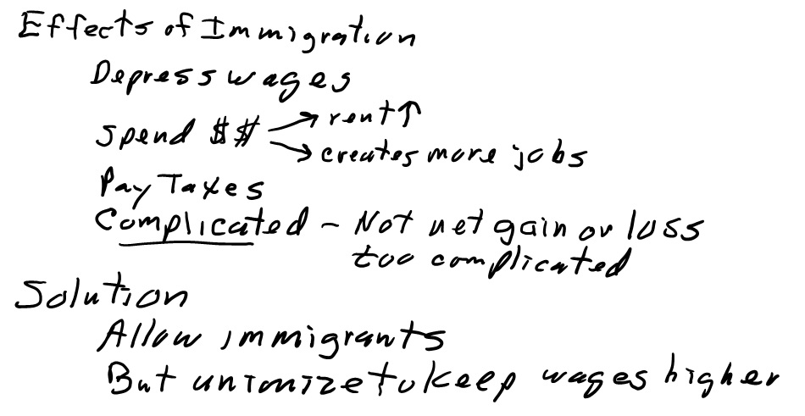
22a - Immigration
Three Short Videos (1)
Costs, Benefits and How Best to Respond - Professor Richard D Wolff. begin at 3:35

Slide 7
22a - Immigration
Three Short Videos (2)
CNN Report on the economics of immigration (2:24)

Slide 8
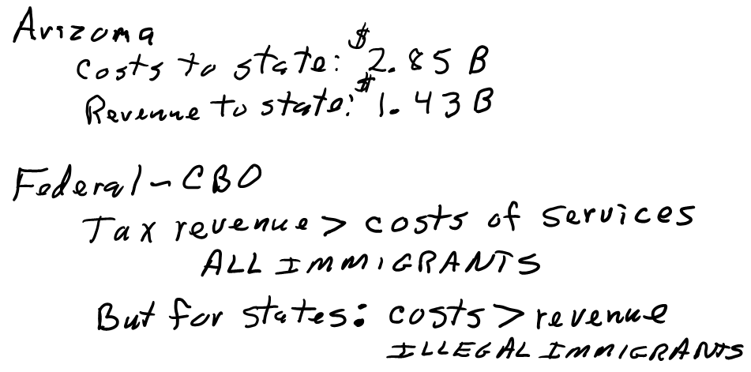
22a - Immigration
Three Short Videos (2)
CNN Report on the economics of immigration (2:24)

Slide 9
22a - Immigration
Three Short Videos (3)
"Three Ways To Totally Transform U.S. Immigration Policy" NPR, Planet Money, Feb. 21, 2013 – Audio only
  1. The Best And The Brightest
  2. The Highest Bidder
  3. Let 'Em In

Slide 10
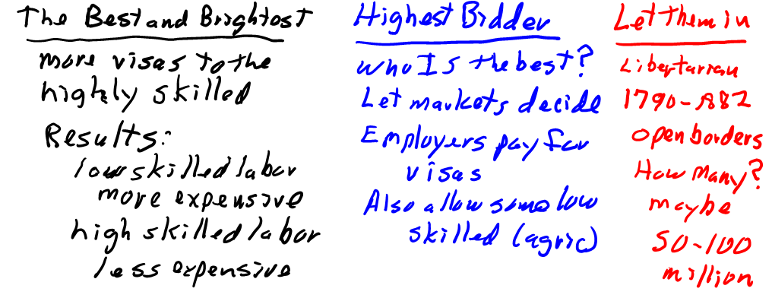
22a - Immigration
Three Short Videos (3)
"Three Ways To Totally Transform U.S. Immigration Policy" NPR, Planet Money, Feb. 21, 2013 – Audio only
  1. The Best And The Brightest
  2. The Highest Bidder
  3. Let 'Em In

Slide 11
22a - Immigration
Introduction
Immigration is another labor issue that has become an important political topic. We will first study some historical data on U.S. immigration, then we will look at two immigration models:
  a simple immigration model showing the "Impact on Wage Rates, Efficiency, and Output", and
  a model showing the impact of illegal workers in a low wage labor market
The YELLOW PAGES, the LESSONS webpage, and the MICWEBAPP have one page summaries of each of these models. You should find them and study them.

Slide 12
22a - Immigration
Something Interesting – Why Study This?
Read this short news article from 2013:
http://www.nytimes.com/2013/02/17/magazine/do-illegal-immigrants-actually-hurt-the-us-economy.html
From the eighth paragraph of the above website:
  Nearly all economists, of all political persuasions, agree that immigrants — those here legally or not — benefit the overall economy. “That is not controversial,” Heidi Shierholz, an economist at the Economic Policy Institute, told me. Shierholz also said that “there is a consensus that, on average, the incomes of families in this country are increased by a small, but clearly positive amount, because of immigration."

Slide 13
22a - Immigration
Must Know / Outcomes:
Understand the historical pattern of legal and illegal immigration the United States.
Understand what motivates an individual to migrate.
List the factors influencing the decision to migrate.
Understand the potential impact immigration can have on wage rates, efficiency, and output. “MODEL: Impact on Wage Rates, Efficiency, and Output" YP 102
Identify potential complications with the traditional model of immigration: Remittances, Backflows, Full-Employment or Unemployment, and Complements and Substitutes.
Understand the effect immigration to the United States has on Federal, State, and Local governments' fiscal position.
Understand the illegal immigration debate in the context of job "crowding-out. “MODEL: Impact of Illegal Workers in a Low Wage Labor Market“ YP 103
Explain the potential price effects that illegal immigration can have on an economy.
Understand the concept of 'optimal' immigration.

Slide 14
22a - Immigration
KEY TERMS:
economic immigrants, legal immigrants,
illegal immigrants, human capital, beaten paths, backflows, efficiency gains from migration,
brain drain, remittances,
complementary resource, substitute resource, fiscal impacts

Slide 15
22a - Immigration
U.S. Immigration – The Numbers
Economic Effects of Immigration (Model)
The Illegal Immigration Debate (Model)

Slide 16
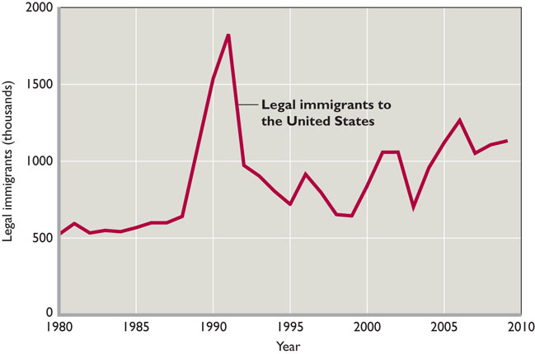
U.S Legal Immigration: About 1 million each year 2010-2016

Slide 17
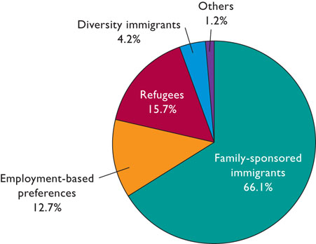
U.S. Legal Immigrants – Which programs? - 2009
22a - Immigration

Slide 18
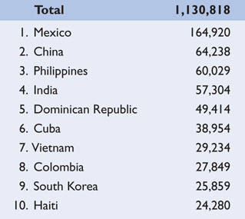
# Legal Immigrants into the United States
TOP 10 COUNTRIES
2009
22a - Immigration

Slide 19
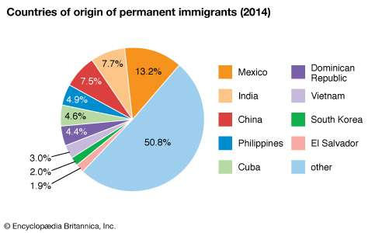
Legal Immigrants into the United States - 2014

Slide 20
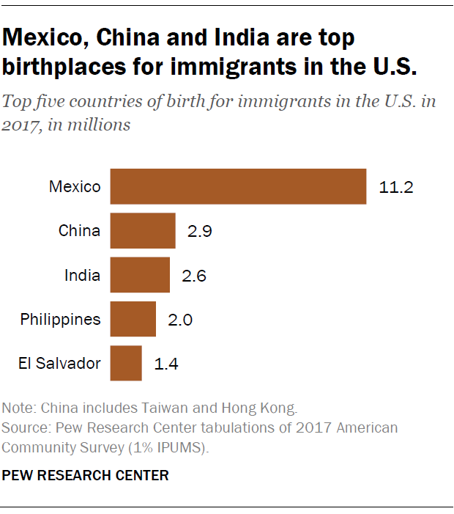
Legal Immigrants in the United States - 2017
(% total)
22a - Immigration

Slide 21
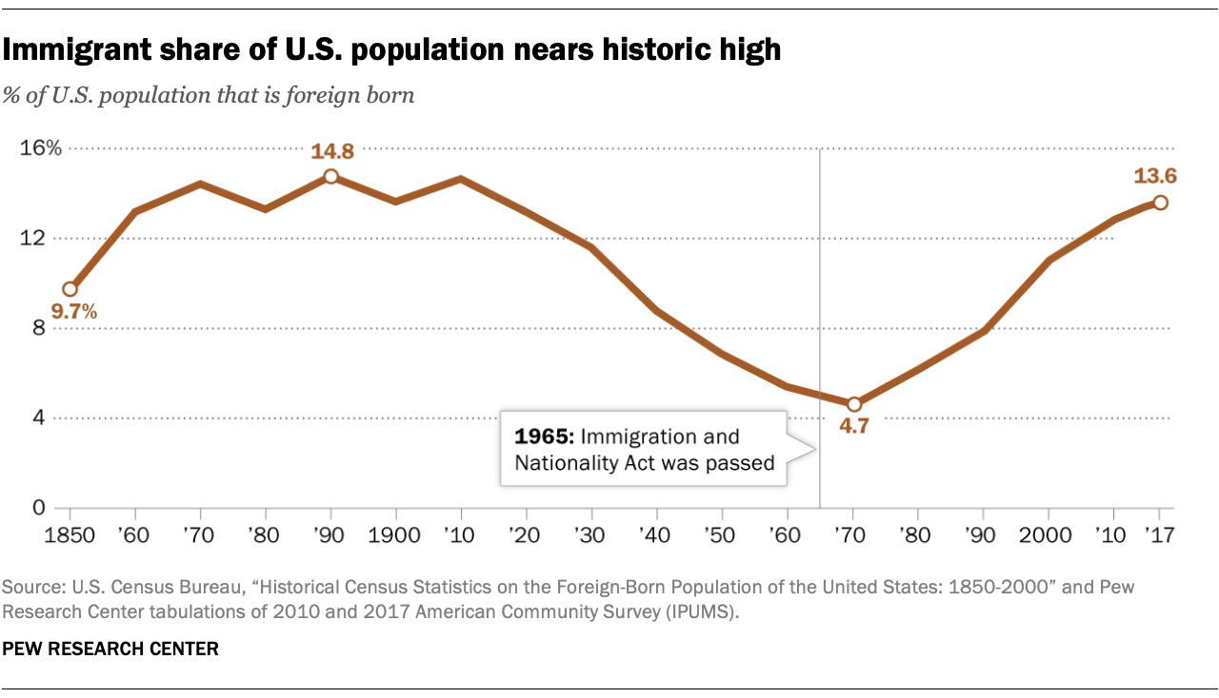
22a - Immigration

Slide 22
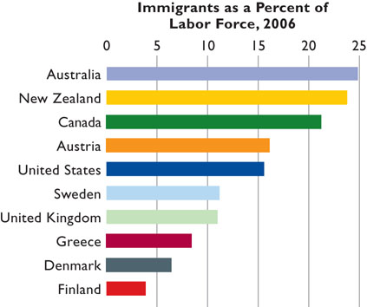
Foreign-born workers represented 16.1 percent of the U.S. labor force in 2012.

Slide 23
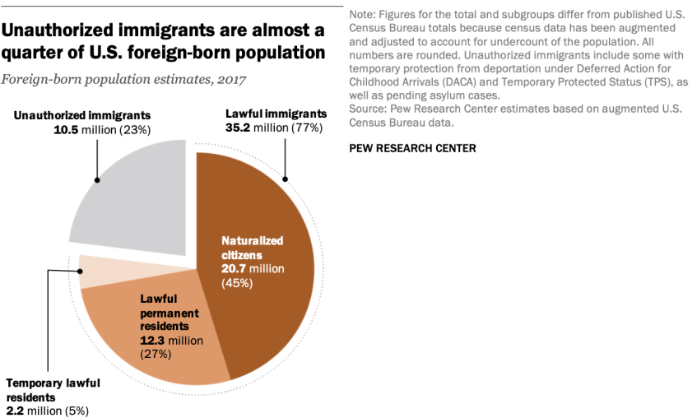
22a - Immigration

Slide 24
U.S. Immigration Numbers – SUMMARY
About 1 million additional legal immigrants per year
Over half come as family reunification immigrants
Top source countries: Mexico, China, India, Philippines (about 20% of total)
About 13% of U.S. population (near historic high)
About 35 million legal and 10 million unauthorized
About 16% of U.S. Labor Force
22a - Immigration

Slide 25
22a - Immigration
U.S. Immigration – The Numbers
Economic Effects of Immigration (Model)
The Illegal Immigration Debate (Model)

Slide 26
Simple Immigration
Model
YP 81-82
Assumptions:
The demand for labor in Alphania and Betania are as shown by D_{A} and D_{B}, respectively;
Alphania's native labor force is F and that of Betania is g;
Wage L in Alphania is equal to Wage m in Betania; and
Full employment exists in both countries
Product and labor markets are competitive

Slide 27
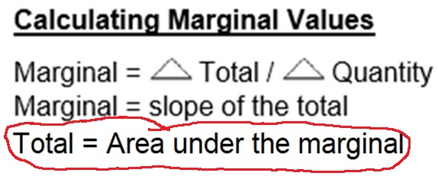
22a – Simple Immigration Model
Therefore: Total Product = area under MP
In a competitive product market:
Dlabor = MRP = VMP = P x MP
So the Dlabor is a measure of the MP,
and the area under the Dlabor is a
measure of Total Product (TP)

Slide 28
Simple Immigration
Model
YP 82 #5
Alphania's domestic labor force is F and that of Betania is g.
Wage L = wage m
1. As a result of migration:
World output will increase by mljh minus MLJH
Betania’s output will increase, Alphania’s decrease, but world output will stay the same
World output will increase by gjhf minus GJHF
World output will decrease by gjhf minus GJHF

Slide 29
Simple Immigration
Model
YP 82 #5
Alphania's domestic labor force is F and that of Betania is g.
1. As a result of migration:
World output will increase by mljh minus MLJH
Betania’s output will increase, Alphania’s decrease, but world output will stay the same
World output will increase by gjhf minus GJHF
World output will decrease by gjhf minus GJHF

Slide 30
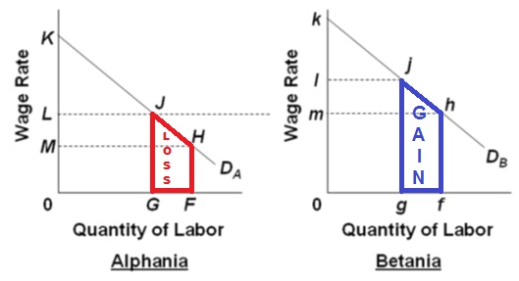
As a result of migration:
  wages up in source country
  wages down in destination country
  total output increases
22a - Immigration

Slide 31
2. Remittances from migrants could:
[Alphania's native labor force is F and that of Batania is g.]
YP 82 #6
Decrease the economic loss in Betania
Increase the economic gain in Betania
Decrease the economic loss in Alphania
Increase the economic gain in Alphania

Slide 32
2. Remittances from migrants could:
[Alphania's native labor force is F and that of Batania is g.]
YP 82 #6
Decrease the economic loss in Betania
Increase the economic gain in Betania
Decrease the economic loss in Alphania
Increase the economic gain in Alphania

Slide 33
3. If there initially was unemployment in Alphania instead of the assumed full employment, then:
YP 82 #7
Betania’s loss of output would have been greater
Betania’s loss of output would have been less
Alphania’s loss of output would have been less
Alphania’s loss of output would have been greater

Slide 34
3. If there initially was unemployment in Alphania instead of the assumed full employment, then:
YP 82 #7
Betania’s loss of output would have been greater
Betania’s loss of output would have been less
Alphania’s loss of output would have been less
Alphania’s loss of output would have been greater

Slide 35
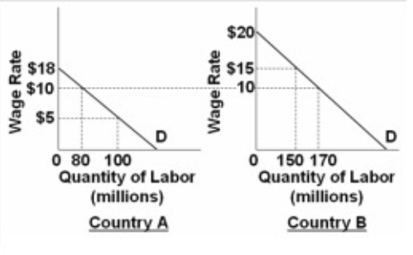
4. Assume that the pre-migration labor force in Country A is 100 and that it is 150 in country B.
The migration of labor will:
Increase wages in A and decrease wages in B
Increase wages in B and decrease wages in A
Increase wages in both
decrease wages in both

Slide 36
4. Assume that the pre-migration labor force in Country A is 100 and that it is 150 in country B.
The migration of labor will:
Increase wages in A and decrease wages in B
Increase wages in B and decrease wages in A
Increase wages in both
decrease wages in both

Slide 37
5. Assume that the pre-migration labor force in Country A is 100 and 150 in country B and 20 million migrate from A to B.
After immigration output in A will:
Decrease by $ 50
Decrease by $ 150
increase by $ 50
increase by $ 150

Slide 38
5. Assume that the pre-migration labor force in Country A is 100 and 150 in country B and 20 million migrate from A to B.
After immigration output in A will:
Decrease by $ 50
Decrease by $ 150
increase by $ 50
increase by $ 150

Slide 39
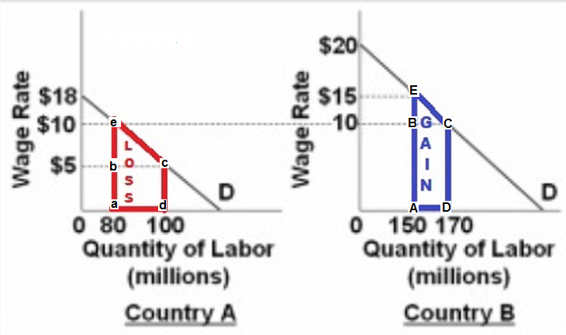
Loss = (20x5) + ½ (20x5) = $150
= abcd + bec = aecd

Slide 40
6. Assume that the pre-migration labor force in Country A is 100 and that it is 150 in country B.
After immigration output in B will:
increase by $ 50
Increase by $ 250
Decrease by $ 50
Decrease by $ 250

Slide 41
6. Assume that the pre-migration labor force in Country A is 100 and that it is 150 in country B.
After immigration output in B will:
increase by $ 50
Increase by $ 250
Decrease by $ 50
Decrease by $ 250

Slide 42
GAIN = (10x20) + ½ (20x5) = $250
= ABCD + BEC = AECD

Slide 43
Simple Immigration Model
Effects: YP 77 and 102
  Wages increase in source country
  Wages decrease in destination country
  Total output increases (the increase in output in the destination
  country is greater than the loss of output in the source country)
Complications (BUT):
  Costs of migration have been ignored
  – would reduce migration
  Remittances and backflows
  – reduce loss in source country and reduce gain in destination country
  Complementary resources vs. substitute resources
  – job GAINS in complementary occupations in destination country
  – therefore even greater gain in output
  Expansion of capital in destination country
  – therefore even greater gain in output
  We assumed full employment
  – if there was unemployment in source country then smaller loss of output

Slide 44
SUMMARY - Simple Immigration Model
  All economists agree that U.S. immigration increases U.S. domestic output and income and that highly educated immigrants and successful entrepreneurs add to the vitality of American enterprise.
  But in light of the complications just discussed, no single generalization is possible as to the impact of immigration on the wages of native-born U.S. workers.
    The best evidence indicates that immigration reduces the wages of native-born workers who have low educations, and also may reduce the salaries of some highly trained native-born workers.
    The overall effect of immigration on the average American wage is much less clear. Scholarly estimates on that effect range from minus 3 percent to plus 2 percent.

Slide 45
22a - Immigration
U.S. Immigration – The Numbers
Economic Effects of Immigration (Model)
The Illegal Immigration Debate (Model)

Slide 46
Illegal Immigration
Model
YP 84
Assumptions:
Employers in this market are willing and able to ignore minimum wage laws;
S_{d} represents the supply of domestically-born (and legal immigrant) workers;
S_{t} represents the total supply of workers in this labor market (S_{d} plus illegal immigrants); and
Unless otherwise stated, illegal immigration is not effectively blocked by the government.

Slide 47
Illegal Immigration
Model
7. How many domestically-born workers will be hired at equilibrium?
(YP 84 #2)
200,000
250,000
350,000
450,000

Slide 48
Illegal Immigration
Model
7. How many domestically-born workers will be hired at equilibrium?
(YP 84 #2)
200,000
250,000
350,000
450,000

Slide 49
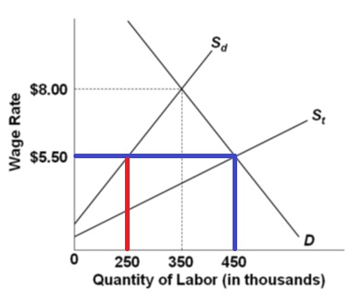
Total Employment = 450 = 250 domestic + 200 illegal
(450 – 250)

Slide 50
8. If initially the gov’t cannot stop illegal immigration, but then finds a way to block it, then ____ domestic workers gain jobs and ____ immigrants lose jobs. (YP 85 #5)
100,000 gain jobs, 200,000 lose
200,000 gain jobs, 200,000 lose
100,000 gain jobs, 250,000 lose
100,000 gain jobs, 150,000 lose

Slide 51
8. If initially the gov’t cannot stop illegal immigration, but then finds a way to block it, then ____ domestic workers gain jobs and ____ immigrants lose jobs. (YP 85 #5)
100,000 gain jobs, 200,000 lose
200,000 gain jobs, 200,000 lose
100,000 gain jobs, 250,000 lose
100,000 gain jobs, 150,000 lose

Slide 52
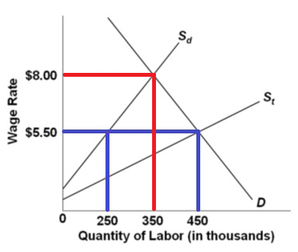
Total employment now = 350, so:
100 domestic workers gained jobs (350 – 250)
200 illegal workers lost jobs (450 – 250)

Slide 53
9. Illegal immigration tends to:
Increase wages and jobs where illegal workers are complements to domestic-born workers
Increase wages and jobs where illegal workers are substitutes to domestic-born workers
Increase wages and jobs in most industries
Reduce wages and jobs in most industries
"Do Illegal Immigrants Actually Hurt the U.S. Economy?"
Adam Davidson, New York Times, Feb. 12, 2013
http://www.nytimes.com/2013/02/17/magazine/do-illegal-immigrants-actually-hurt-the-us-economy.html

Slide 54
9. Illegal immigration tends to:
Increase wages and jobs where illegal workers are complements to domestic-born workers
Increase wages and jobs where illegal workers are substitutes to domestic-born workers
Increase wages and jobs in most industries
Reduce wages and jobs in most industries
"Do Illegal Immigrants Actually Hurt the U.S. Economy?"
Adam Davidson, New York Times, Feb. 12, 2013
http://www.nytimes.com/2013/02/17/magazine/do-illegal-immigrants-actually-hurt-the-us-economy.html

Slide 55
10. Illegal immigration positively contributes to the U.S. standard of living by reducing:
Fiscal burdens of state and local governments
Average wages of domestically-born workers
Crime rates
Prices of goods and services produced by illegal immigrant labor

Slide 56
10. Illegal immigration positively contributes to the U.S. standard of living by reducing:
Fiscal burdens of state and local governments
Average wages of domestically-born workers
Crime rates
Prices of goods and services produced by illegal immigrant labor

Slide 57
Illegal Immigration Model
(Impact of Illegal Workers in a Low Wage Market)
Employment Effects - YP 79
  PRO-immigration: Illegal immigrants take jobs that Americans do not want
  ANTI-immigration: Illegal immigrants take jobs from Americans
  Generally, illegal immigration causes some substitution of illegal workers for domestic workers, but the amount of displacement is less than the total employment of the illegal workers. Illegal immigration—as with legal immigration—increases total employment in the United States
Wage Effects - YP 79
  the overall effect of illegal immigration on the average wage rate in the economy is either a small decline or even an increase
  Illegal immigration has very little effect on the average level of wages in the United States. That average wage level depends mainly on the nation's overall level of labor productivity, which illegal immigration does not appreciably affect.

Slide 58
Illegal Immigration Model
(Impact of Illegal Workers in a Low Wage Market)
Price Effects - YP 79
  In industries where illegal immigrants are heavily used—for example, construction, agriculture, landscaping, home cleaning, restaurant meals, and lodging—the presence of illegal workers may have a discernable downward price effect.
  Lower prices raise the standard of living of all Americans and their families.
Fiscal Impacts on State and Local Governments - YP 79
  One major and very legitimate concern about illegal immigration is the negative fiscal impact it has on local and state governments, but the federal government gains.
Other Concerns - YP 79
  undermines general respect for the law
  unfair to the thousands of people enduring the expense and long waits associated with the process for legally gaining the right to live and work in the United States.
  some observers see national defense as the greatest long-term risk from porous borders.

