Slide 1
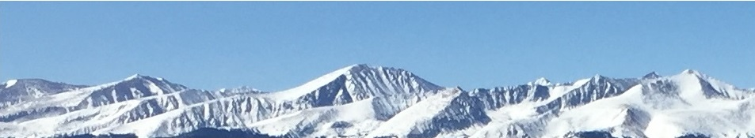
20a – Income Inequality
This web quiz may appear as two pages on tablets and laptops.
I recommend that you view it as one page by clicking on the open book icon at the bottom of the page.

Slide 2
20a – Income Inequality
Describing Income Distribution
Government Redistribution
Growing Inequality
The Equality Model (Pres. Trump example)
The Occupational Crowding Model
Guaranteed Basic Income

Slide 3
Review Lesson 13a – Labor Market Models
Monopsony
  YP 34 – Draw Graph
  YP 36 # 4 and 5
  YP 37 # 7 and 8
Unions: Bilateral Monopoly
  YP 39 Draw Graph
  YP 44 # 3 - 7
Minimum Wage
  Traditional Model: YP 54 # 6 - 10
  Min. Wage and a Monopsony Model: YP 55 # 11 – 14
  Min. Wage and Elasticity – Are the poor helped: YP 56 # 15-18
20a – Income Inequality

Slide 4

20a – Income Inequality
Wealth Inequality in America (Politizane YouTube) 6:24
http://www.youtube.com/watch?v=QPKKQnijnsM

Slide 5
Lesson 20a – Introduction
The gap between the rich and the poor is getting wider and income inequality has become an important political issue.
We will first look at some data on the distribution of income and learn how to measure it.
Then we will learn two models concerning income distribution:
  The Case for Equality Model: Maximizing Total Utility.
  (This is the President Trump Example from lesson 1b) and,
  The Occupational Discrimination (Crowding) Model
The YELLOW PAGES, the LESSONS webpage, and the MICWEBAPP have one page summaries of each of these models. You should find them and study them.
20a – Income Inequality

Slide 6
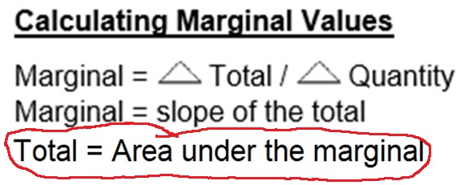
20a – Income Inequality
Two New Models:
  The Equality Model (Pres. Trump example)
  The Occupational Crowding Model
TU = area under MU
TP = area under MP

Slide 7
Lesson 20a – Something Interesting
Jan. 2018: According to an Oxfam report, just 26 people had as much wealth as the poorest 3.8 billion – half of the world’s population.
https://www.vox.com/future-perfect/2019/1/22/18192774/oxfam-inequality-report-2019-davos-wealth
In Jan. 2017 the number was 42. In Jan. 2016 it was 62 people. And, in 2015 it was 85. The gap between the rich and the poor is widening.
  Think about it. The wealth of the 26 richest people = the wealth of the 3.8 billion poorest.
In the U.S., the country’s 3 richest people have the same wealth as the poorest half of the American population.
20a – Income Inequality

Slide 8
Wealth vs. Income
Wealth and income are not the same.
Wealth is a STOCK concept – what do you have NOW?
Income is a FLOW concept – what do you make OVER TIME?
Wealth is more unequally distributed than Income, but the distribution of both is very unequal.
20a – Income Inequality

Slide 9
20a – Income Inequality
Describe the distribution of income in the United States by quintile distribution by households.
Explain how Lorenz curves and Gini ratios are used to describe income inequality.
Discuss the impact of income mobility on income distribution data.
Explain the broadened concept of income, which includes the effects of taxes and transfer payments, and how this affects the extent of inequality of income and poverty in the U.S.
List causes of an unequal income distribution.
Describe changes and causes for the changes in inequality since 1970.
The "Case for Equality Model" - Understand the connection between the Pres. Trump example of equity and the lesson 20a "Case for Equality Model" and what is the problem with this reasoning (the equality vs. efficiency argument)
Occupational Discrimination - "The Crowding Model"
Guaranteed basic income (also called "universal basic income" and "unconditional basic income")

Slide 10
20a – Income Inequality
Key Terms:
income inequality, quintile, Lorenz curve,
Gini ratio (Gini coefficient), income mobility, transfer payment, progressive income tax, noncash transfers, equality-efficiency trade-off, discrimination, occupational segregation, "President Trump example", guaranteed basic income (also called "universal basic income" and "unconditional basic income")

Slide 11
20a – Income Inequality
Describing Income Distribution
Government Redistribution
Causes of Inequality / Growing Inequality
The Equality Model (Pres. Trump example)
The Occupational Crowding Model
Guaranteed Basic Income

Slide 12
1. Which best describes the U.S.?
A
B
C
D

Slide 13
1. Which best describes the U.S.?
A
B
C
D

Slide 14
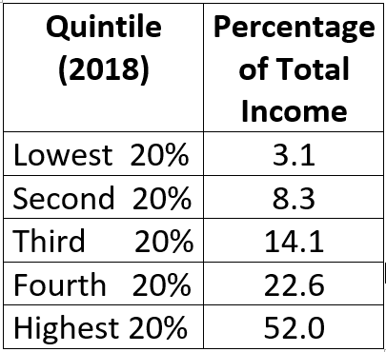
- Draw the Lorenz Curve
- Review: YP 61, #4
20a – Income Inequality

Slide 15
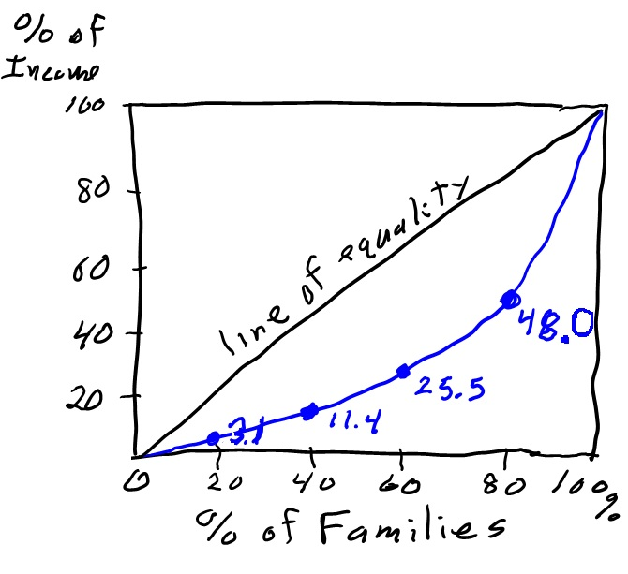
How to Draw the Lorenz Curve
- Draw the Lorenz Curve
- Review: YP 61, #4
20a – Income Inequality

Slide 16
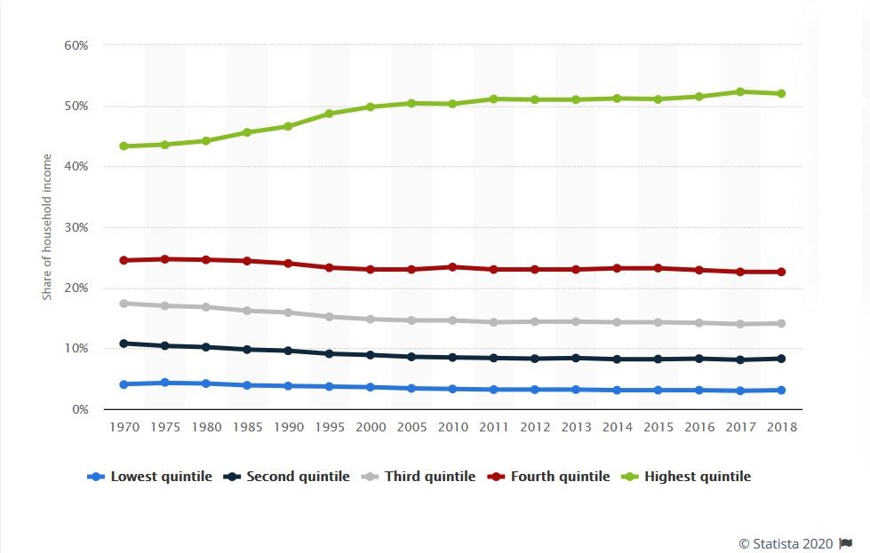
Changes in Income Distribution in the United States Over Time
https://www.statista.com/statistics/203247/shares-of-household-income-of-quintiles-in-the-us/

Slide 17
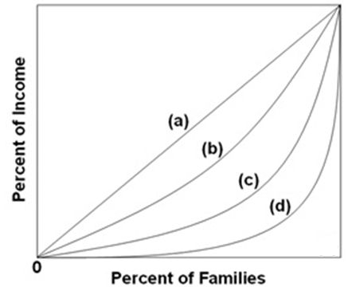
2. Lorenz curves (a) through (d) are for four different countries. Income is most unequally distributed in country:
a
b
c
d

Slide 18
2. Lorenz curves (a) through (d) are for four different countries. Income is most unequally distributed in country:
a
b
c
d

Slide 19
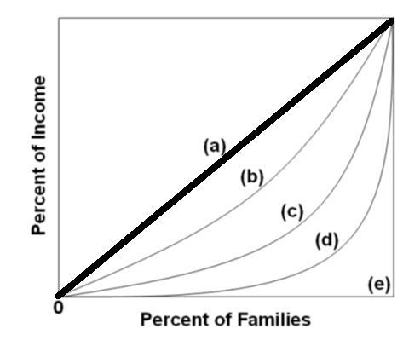
3. The greater the area between the Lorenz curve and the diagonal shows a:
Smaller Gini ratio and greater inequality.
Smaller Gini ratio and less inequality.
Larger Gini ratio and greater inequality.
Larger Gini ratio and less inequality.

Slide 20
3. The greater the area between the Lorenz curve and the diagonal shows a:
Smaller Gini ratio and greater inequality.
Smaller Gini ratio and less inequality.
Larger Gini ratio and greater inequality.
Larger Gini ratio and less inequality.

Slide 21
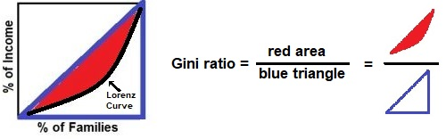
Gini Ratio: A measure of inequality
The larger the Gini Ratio = more inequality
20a – Income Inequality

Slide 22
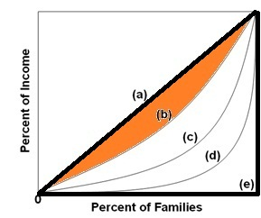
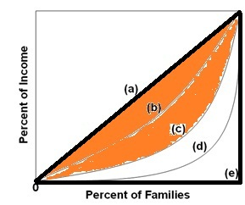
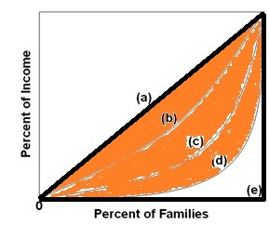
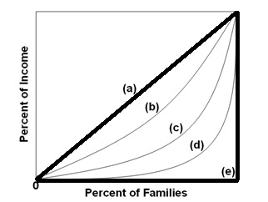
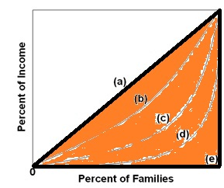
Equality: Gini = 0.0 1 person gets all: Gini = 1
Close to Equal <-------------------------------- > Very Unequal
Gini = 0.20 Gini = .75

Slide 23
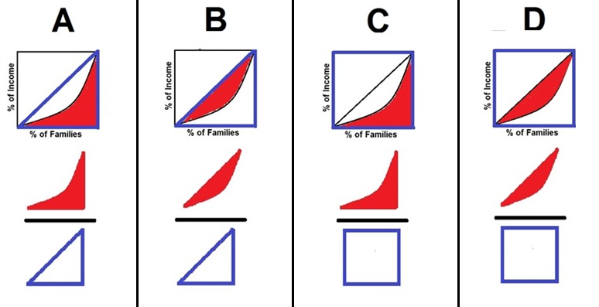
4. Which diagram below best explains how the Gini ratio is calculated? YP 61 #5
A
B
C
D

Slide 24
4. Which diagram below best explains how the Gini ratio is calculated? YP 61 #5
A
B
C
D

Slide 25
20a – Income Inequality
Nationmaster.com
https://www.nationmaster.com/country-info/stats/Economy/GINI-index
Google: “gini nationmaster”

Slide 26
5. People’s incomes are relatively low when they are young, reach a peak at middle age, and then decline. This fact helps explain:
The wide variations of Gini ratios among nations
The equality-efficiency tradeoff
Why the lifetime distribution of income is more equal than the annual distribution
Why the lifetime distribution of income is less equal than the annual distribution

Slide 27
5. People’s incomes are relatively low when they are young, reach a peak at middle age, and then decline. This fact helps explain:
The wide variations of Gini ratios among nations
The equality-efficiency tradeoff
Why the lifetime distribution of income is more equal than the annual distribution
Why the lifetime distribution of income is less equal than the annual distribution

Slide 28
Income mobility is the extent to which income receivers move from one part of the income distribution to another over some period of time.
It explains why the lifetime distribution of income is more equal than the annual distribution.
The longer the period of time considered, the more equal the distribution of income becomes.

Slide 29
20a – Income Inequality
Describing Income Distribution
Government Redistribution
Causes of Inequality / Growing Inequality
The Equality Model (Pres. Trump example)
The Occupational Crowding Model
Guaranteed Basic Income

Slide 30
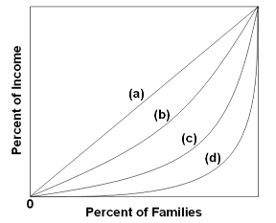
6. If line c represents the pretax and pre-transfer distribution of income in the United States, we would expect the post-tax and post-transfer distribution to be:
b
c
d

Slide 31
6. If line c represents the pretax and pre-transfer distribution of income in the United States, we would expect the post-tax and post-transfer distribution to be:
b
c
d

Slide 32
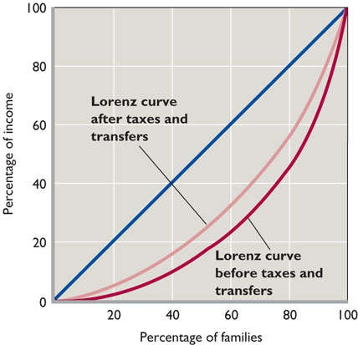

Slide 33
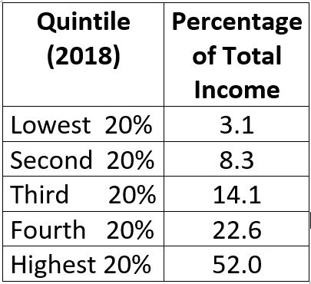
20a – Income Inequality

Slide 34
The income distribution data Table 21.1 and Figure 21.1 (19th edition 20.1)
include wages, salaries, dividends, and interest.
They also include all cash transfer payments such as Social Security, unemployment compensation benefits, and welfare assistance to needy families.
BUT: The data are before-tax data and therefore :
  They do not take into account the effects of personal income and payroll (Social Security) taxes that are levied directly on income receivers.
  They also do not include government noncash transfers, (also called in-kind transfers)
  for example, Medicare, Medicaid, housing subsidies, subsidized school lunches, and food stamps.
20a – Income Inequality

Slide 35
20a – Income Inequality
Describing Income Distribution
Government Redistribution
Causes of Inequality / Growing Inequality
The Equality Model (Pres. Trump example)
The Occupational Crowding Model
Guaranteed Basic Income

Slide 36
7 Causes of an Unequal Income Distribution
1. Ability
2. Education and Training
3. Discrimination
4. Preferences and Risks
5. Unequal Distribution of Wealth (see next slide)
6. Market Power
7. Luck, Connections, and Misfortune

Slide 37
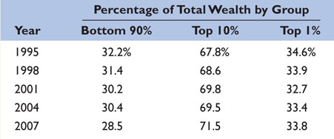
7 Causes of an Unequal Income Distribution
1. Ability
2. Education and Training
3. Discrimination
4. Preferences and Risks
5. Unequal Distribution of Wealth (see above)
6. Market Power
7.Luck, Connections, and Misfortune

Slide 38
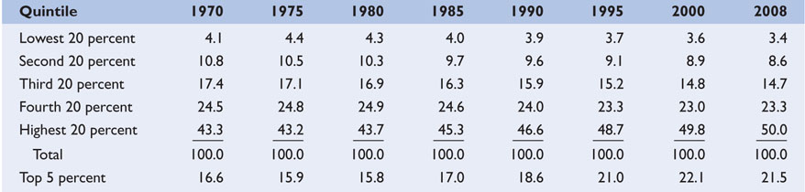
US Income Inequality is Increasing
US Gini: 1970 = .394; 2000 = .408; 2008 = .466
WHY? - Increased demand for high skills
- Demographic changes
- Trade, Immigration, and decline of Unions
20a – Income Inequality

Slide 39
Changes in Income Distribution in the United States Over Time
https://www.statista.com/statistics/203247/shares-of-household-income-of-quintiles-in-the-us/

Slide 40
Why is Inequality Increasing?
1. Greater Demand for Skilled Workers
2. Demographic Changes
  Baby boomers entering the work force in the 1970s and ’80s: young people earn less
  Growing tendency for people with high earning potential to marry each other
  Increasing number of low income single-mother households
3. Trade, Immigration, Decline of Unions

Slide 41
20a – Income Inequality
Describing Income Distribution
Government Redistribution
Causes of Inequality / Growing Inequality
The Equality Model (Pres. Trump example)
The Occupational Crowding Model
Guaranteed Basic Income

Slide 42
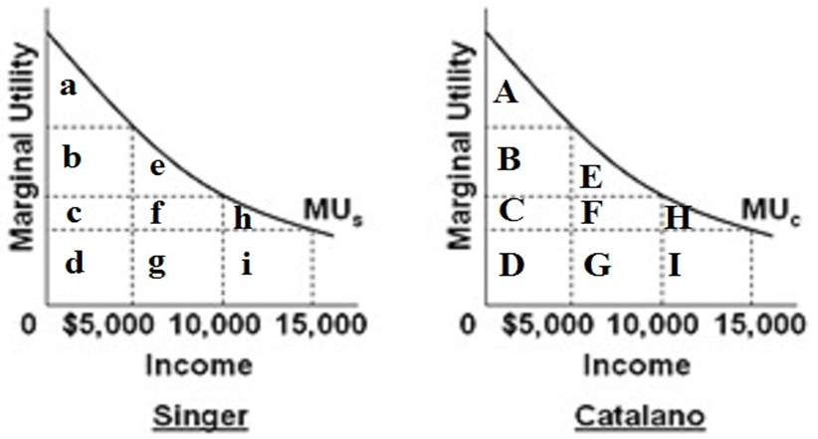
For the next two questions see YP 66
Assume: Two people have identical MU curves and a given income of $20,000 is distributed so that Singer gets $15,000 and Catalano get $5000
Model Summary on Yellow Page 59 or 100

Slide 43
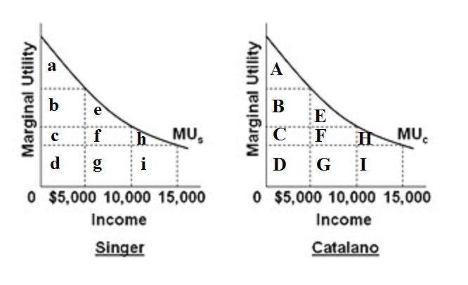
7. Singer’s total utility is _____.
Assume: Two people have identical MU curves and a given income of $20,000 is distributed so that Singer gets $15,000 and Catalano get $5,000
YP 66
A
A + B
A + B + C + D
E + F + G + H + I

Slide 44
7. Catalano’s total utility is _____.
Assume: Two people have identical MU curves and a given income of $20,000 is distributed so that Singer gets $15,000 and Catalano get $5,000
YP 66
A
A + B
A + B + C + D
E + F + G + H + I

Slide 45
20a – Income Inequality
Two New Models:
  The Equality Model (Pres. Trump example)
  The Occupational Crowding Model
TU = area under MU
TP = area under MP

Slide 46
8. The utility lost by Singer is _____ and gained by Catalano is:
Assume: NOW the income is equally distributed to $10,000 each
YP 66 #4
Lost: e+f+g ; Gain: E+F+G
Lost : h+i ; Gain: A+B+E
Lost : h+i ; Gain: E+F+G
Lost : a+b+e ; Gain: E+F+G

Slide 47
8. The utility lost by Singer is _____ and gained by Catalano is:
Assume: NOW the income is equally distributed to $10,000 each
YP 66 #4
Lost: e+f+g ; Gain: E+F+G
Lost : h+i ; Gain: A+B+E
Lost : h+i ; Gain: E+F+G
Lost : a+b+e ; Gain: E+F+G

Slide 48
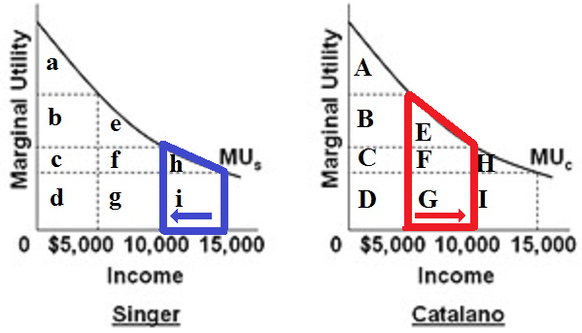
After redistribution the gains of Catalano (red)
are greater than the losses of Singer (blue)
See model summary on YP 59 or 100.
NOTE: the area under the marginal utility = the total utility

Slide 49
9. One problem with the “Case for Equality” (Pres. Trump example) is that (YP 59 or 100):
Utility cannot be measured
How income is distributed may affect how much income is available
Equality is not the same as equity
It does not account for government redistribution

Slide 50
9. One problem with the “Case for Equality” (Pres. Trump example) is that (YP 59 or 100):
Utility cannot be measured
How income is distributed may affect how much income is available (Equality-Efficiency Trade-off)
Equality is not the same as equity
It does not account for government redistribution

Slide 51
The Equality – Efficiency Trade-off
“How income is distributed may affect how much income is available”
A more equal distribution of income
may result in less total income
to redistribute
20a – Income Inequality

Slide 52
20a – Income Inequality
Describing Income Distribution
Government Redistribution
Causes of Inequality / Growing Inequality
The Equality Model (Pres. Trump example)
The Occupational Crowding Model
Guaranteed Basic Income

Slide 53
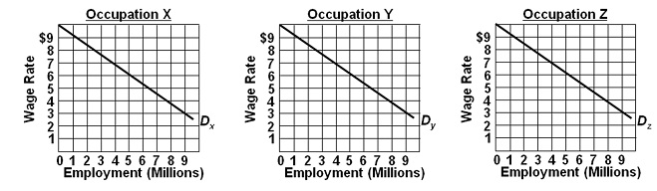
For the next two questions see yellow page 68 and 69
Assumptions:
  (1) the labor force is comprised of 9 million men and 9 million women workers;
  (2) the economy has 3 occupations, X, Y, and Z, each having identical demand curves for labor;
  (3) men and women workers are homogeneous with respect to their labor-market capabilities;
  (4) women are discriminated against by being excluded from occupations X and Y and are confined to Z; and
  (5) aside from discrimination, the economy is competitive.

Slide 54
10. With 9 women only in Z and 9 men in X and Y, men will be paid: ___ and women ____: (YP 68 #3)
men $5; women $5
men $5; women $4
men $6.50; women $3
men $6.50; women $6.50

Slide 55
10. With 9 women only in Z and 9 men in X and Y, men will be paid: ___ and women ____: (YP 68 #3)
men $5; women $5
men $5; women $4
men $6.50; women $3
men $6.50; women $6.50

Slide 56
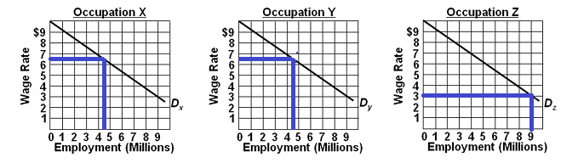
4.5 million 4.5 million 9 million
Men Men Women

Slide 57
11. If discrimination ended: (YP 69, #4)
men will leave X and Y and enter Z.
4 women will leave Z, with 2 entering X and 2 entering Y.
3 women will leave Z, with 1.5 entering X and 1.5 entering Y.
3 women will leave Z, all of whom will enter X.

Slide 58
11. If discrimination ended: (YP 69, #4)
men will leave X and Y and enter Z.
4 women will leave Z, with 2 entering X and 2 entering Y.
3 women will leave Z, with 1.5 entering X and 1.5 entering Y.
3 women will leave Z, all of whom will enter X.

Slide 59
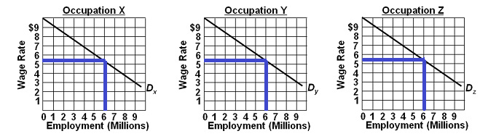
6 million workers 6 million workers 6 million workers
4.5 men 4.5 men 6 women
1.5 women 1.5 women
Wages will equalize at $5.50 for all.
Wages increase for women and decrease for men.
But, what happens to output? (YP 69, #6)

Slide 60
20a – Income Inequality
Two New Models:
  The Equality Model (Pres. Trump example)
  The Occupational Crowding Model
TU = area under MU
TP = area under MP

Slide 61
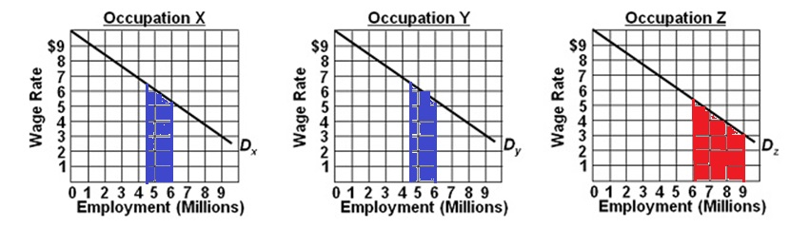
OUTPUT INCREASES when discrimination ends:
- GAIN: blue areas in occupations X and Y
- LOSE: Red area in occupation Z
Assuming a competitive product market then:
- DL = MRP = VMP = P x MP
- the area under the MP curve (Dlabor) is the TP (total output)
See YP 60 or 101 for model summary

Slide 62
FROM CHAPTER 1:
Economic discrimination is best represented by point “A”.
- Less is produced due to productive inefficiency:
(Not using resources where they are best suited)
Without discrimination more can be produced:
C, D, or E is possible.

Slide 63
20a – Income Inequality
Describing Income Distribution
Government Redistribution
Causes of Inequality / Growing Inequality
The Equality Model (Pres. Trump example)
The Occupational Crowding Model
Guaranteed Basic Income
  See article on YP 72-73
  As Our Jobs Are Automated, Some Say We'll Need A Guaranteed Basic Income
  NPR Morning edition, 9/24/2016 http://www.npr.org/templates/transcript/transcript.php?storyId=495186758

Slide 64
12. Why is the concept of a guaranteed basic income beginning to get a more serious consideration now?
A much larger percentage of the population is poor now than the past
Increased immigration will require radical changes to our welfare system
In the next few decades new technologies will be able to produce much more output with far fewer workers

Slide 65
12. Why is the concept of a guaranteed basic income beginning to get a more serious consideration now?
A much larger percentage of the population is poor now than the past
Increased immigration will require radical changes to our welfare system
In the next few decades new technologies will be able to produce much more output with far fewer workers

Slide 66
20a – Income Inequality
Guaranteed Basic Income
“ . . . [A]s technology replaces more workers, the traditional 40-hour-a-week job could become a thing of the past. If that happens, how will families get health insurance or save for retirement?
Some experts say the only answer is a government-guaranteed paycheck that would allow people to buy food and housing. That would not only help the individuals but would help keep the economic wheels spinning and generate tax revenues.
National Public Radio Sept. 24, 2016
Weekend Edition Saturday
https://www.npr.org/2016/09/24/495186758/as-our-jobs-are-automated-some-say-well-need-a-guaranteed-basic-income

