Slide 1

1d – Production Possibilities
This web quiz may appear as two pages on tablets and laptops.
I recommend that you view it as one page by clicking on the open book icon at the bottom of the page.

Slide 2
1d – Production Possibilities Curve – PPC
Making Decisions:
  Lesson 1c – Individual Decisions:
  Budget Lines
  Lesson 1d – Societal Decisions:
  Production Possibilities Curve
  Lesson 1d – How to make the best decisions:
  Benefit Cost Analysis

Slide 3
1d – Production Possibilities Curve – PPC
Topics
Assumptions behind the Production Possibilities Curve (PPC)
Define, Draw, Describe the Shape of the PPC
The Production Possibilities Curve (PPC) can be used to illustrate several important economic concepts:
  we must make choices
  choices have opportunity costs
  the law of increasing costs
  the effect of unemployment
  the effect of productive inefficiency
  the effect of economic growth
  how present choices affect future possibilities
  the gains from trade
  it does NOT show the optimum product mix (allocative efficiency)

Slide 4
1d – Production Possibilities Curve – PPC – Outcomes/ Must Know
Define, draw, and describe the shape of a production possibilities curve (PPC)
What are the assumptions behind the PPC
Illustrate the following using the production possibilities curve:
  - we must make choices
  - choices have opportunity costs
  - the law of increasing costs
  - the effect of unemployment
  - the effect of productive inefficiency
  - how present choices affect future possibilities
  - the effect of international trade
  - two types of "economic growth"
  - it does NOT show the optimum product mix (allocative efficiency)
Explain WHY the PPC has the shape that it does -- concave to the origin. What is the law of increasing cost? Why are there increasing costs? (Draw, Define. Describe all graphs)
What would the PPC look like if there were constant costs?
What does a point outside the PPC represent?
What two things (2 Es) would a point inside the PPC indicate?
Summarize the general relationship between investment and economic growth.
Describe the two types of economic growth ("achieving the potential" and "increasing the potential") and explain how are they shown on a PPC?
What would cause a PPC to shift inward?
Use a PPC to illustrate the effect of international trade

Slide 5
Key Terms
production possibilities, necessity of choice, law of increasing costs, concave to the origin, opportunity cost, constant cost, benefit-cost analysis (marginal analysis), economic growth, consumer goods, capital goods, shrinking PPC, nonproportional growth
1d – Production Possibilities Curve – PPC

Slide 6
1. A production possibilities curve illustrates:
the necessity of making choices.
market prices.
consumer preferences.
the distribution of income.

Slide 7
1. A production possibilities curve illustrates:
the necessity of making choices.
market prices.
consumer preferences.
the distribution of income.

Slide 8
1d – Making Choices:
Production Possibilities Curve
For ALL graphs:
DEFINE, DRAW, DESCRIBE the shape
STUDY SUGGESTION:
Prepare a 5” x 7” card on each graph this semester where you DEFINE, DRAW, and DESCRIBE the shape.

Slide 9
1d – Making Choices:
Production Possibilities Curve
For ALL graphs:
DEFINE, DRAW, DESCRIBE

Slide 10
2. The PPC shows:
The minimum amount that should be produced
The minimum amount that can be produced
The maximum amount that should be produced
The maximum amount that can be produced

Slide 11
2. The PPC shows:
The minimum amount that should be produced
The minimum amount that can be produced
The maximum amount that should be produced
The maximum amount that can be produced

Slide 12
1d – Making Choices: PPC
The Production Possibilities Curve (PPC) shows the maximum possible quantities that can be produced given certain assumptions.
Assumptions behind the Production Possibilities Curve (PPC):
  Fixed resources
  Fixed technology
  Full employment
  Productive efficiency
  Only two goods being produced
The Production Possibilities Curve (PPC) can be used to illustrate several important economic concepts:
  we must make choices
  choices have opportunity costs
  the law of increasing costs
  the effect of unemployment
  the effect of productive inefficiency
  the effect of economic growth
  how present choices affect future possibilities
  the gains from trade
  it does NOT show the optimum product mix (allocative efficiency)
    later we'll use benefit-cost analysis (MB=MC) to find the allocatively efficient quantity

Slide 13
1d – Making Choices: PPC
DEFINE, DRAW, DESCRIBE
YP 15 # 1-6

Slide 14
3. Which of the following is NOT one of the assumptions behind the PPC?
Fixed resources
Fixed technology
Productive efficiency
Allocative efficiency
Full employment
Only two goods

Slide 15
3. Which of the following is NOT one of the assumptions behind the PPC?
Fixed resources
Fixed technology
Productive efficiency
Allocative efficiency
Full employment
Only two goods

Slide 16
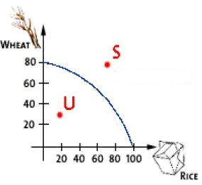
4. What does point S represent?
unattainable
unemployment
economic growth
satisfaction

Slide 17
4. What does point S represent?
unattainable
unemployment
economic growth
satisfaction

Slide 18
With International Trade – “S” is possible
We will learn in lesson 2a that with international trade ALL countries can consume quantities like point “S”.
With trade, ALL COUNTRIES can consume more than they can produce!

Slide 19
5. The combination of computers and bicycles shown by point F:
is unattainable, given currently available resources and technology.
is attainable, but implies productive inefficiency
is attainable, but implies allocative inefficiency
is attainable, but implies full employment
YP 21 # 14

Slide 20
5. The combination of computers and bicycles shown by point F:
is unattainable, given currently available resources and technology.
is attainable, but implies productive inefficiency
is attainable, but implies allocative inefficiency
is attainable, but implies full employment
YP 21 # 14

Slide 21
6. Refer to the diagram. This economy will experience unemployment if it produces at
A.
B.
C.
D.
E.
YP 19 # 8

Slide 22
6. Refer to the diagram. This economy will experience unemployment if it produces at
A.
B.
C.
D.
E.
YP 19 # 8

Slide 23
A Point INSIDE the PPC:
A point inside the PPC, like point “D”, represents what happens if there is UNEMPLOYMENT or PRODUCTIVE INEFFICIENCY.
The economy is not producing the maximum possible (points A, B, and C)

Slide 24
7. If all discrimination in the United States were eliminated, the economy would:
have a less concave production possibilities curve.
produce at some point closer to its production possibilities curve.
be able to produce at some point outside of its production possibilities curve.
shift the production possibilities curve outward.
YP 18 # 6

Slide 25
7. If all discrimination in the United States were eliminated, the economy would:
have a less concave production possibilities curve.
produce at some point closer to its production possibilities curve.
be able to produce at some point outside of its production possibilities curve.
shift the production possibilities curve outward.
YP 18 # 6

Slide 26
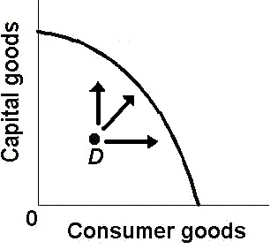
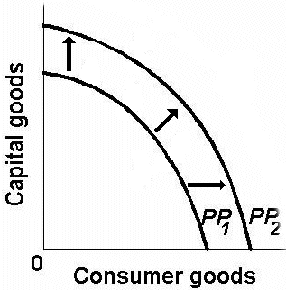
Reducing Unemployment Economic Growth
and Reducing Prod. Ineff.
Reducing unemployment or reducing productive inefficiency
will move an economy from a point inside the curve to a point
closer to the curve.
Reducing unemployment or reducing productive inefficiency
Helps the economy ACHIEVE its potential
Economic Growth INCREASES its potential

Slide 27
1d – Making Choices: PPC
DEFINE, DRAW, DESCRIBE
YP 16-17 # 7-18

Slide 28
8. What is the shape of the PPC?
convex
concave
concrete
confer

Slide 29
8. What is the shape of the PPC?
convex
concave
concrete
confer

Slide 30
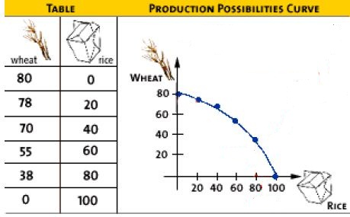
9. What is the opportunity cost of the first 20 rice?
80 wheat
78 wheat
70 wheat
2 wheat

Slide 31
9. What is the opportunity cost of the first 20 rice?
80 wheat
78 wheat
70 wheat
2 wheat

Slide 32
Law of Increasing Costs
First 20 rice costs 2 wheat
Second 20 rice costs 8 wheat
Third 20 rice costs 15 wheat
Fourth 20 rice costs 17 wheat
Fifth 20 rice costs 38 wheat
As we increase production of rice, more and more wheat must be given up for each additional rice. WHY?

Slide 33
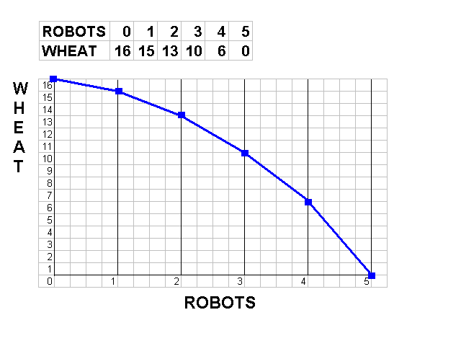
10. Why is the PPC concave to the origin, OR, why are there increasing costs?
More resources will cause economic growth
Fewer resources will cause the PPC to shift inwards
Many resources are better at producing one good than another
Resources are completely adaptable to alternative uses suited

Slide 34
10. Why is the PPC concave to the origin, OR, why are there increasing costs?
More resources will cause economic growth
Fewer resources will cause the PPC to shift inwards
Many resources are better at producing one good than another
Resources are completely adaptable to alternative uses suited

Slide 35
11. If the production possibilities curve is a straight line:
1. the two products will sell at the same market prices.
2. economic resources are perfectly substitutable between the production of the two products.
3. the two products are equally important to consumers.
4. equal quantities of the two products will be produced at each possible point on the curve.

Slide 36
11. If the production possibilities curve is a straight line:
1. the two products will sell at the same market prices.
2. economic resources are perfectly substitutable between the production of the two products.
3. the two products are equally important to consumers.
4. equal quantities of the two products will be produced at each possible point on the curve.

Slide 37
12. Which combination is preferred (optimal)?
78 wheat and 20 rice
70 wheat and 40 rice
55 wheat and 60 rice
We cannot tell

Slide 38
12. Which combination is preferred (optimal)?
78 wheat and 20 rice
70 wheat and 40 rice
55 wheat and 60 rice
We cannot tell

Slide 39
13. Which of the following will not produce an outward shift of the production possibilities curve?
an upgrading of the quality of a nation's human resources
the reduction of unemployment
an increase in the quantity of a society's labor force
the improvement of a society's technological knowledge

Slide 40
13. Which of the following will not produce an outward shift of the production possibilities curve?
an upgrading of the quality of a nation's human resources
the reduction of unemployment
an increase in the quantity of a society's labor force
the improvement of a society's technological knowledge

Slide 41
TWO TYPES OF “ECONOMIC GROWTH”
Achieving the Potential Increasing the Potential
Reducing Unemployment or Economic Growth
Achieving Productive Efficiency - more resources
- better resources
- better technology

Slide 42
14. Refer to the diagram. Other things equal, this economy will achieve the most rapid rate of growth if:
it chooses point A.
it chooses point B.
it chooses point C.
it chooses point D.
YP 19 # 7

Slide 43
14. Refer to the diagram. Other things equal, this economy will achieve the most rapid rate of growth if:
it chooses point A.
it chooses point B.
it chooses point C.
it chooses point D.
YP 19 # 7

Slide 44
15. Refer to the production possibilities curve. At the onset of the Second World War the Soviet Union was already at full employment. Its economic adjustment from peacetime to wartime can best be described by the movement from point:
c to point b.
b to point c.
a to point b.
c to point d.

Slide 45
15. Refer to the production possibilities curve. At the onset of the Second World War the Soviet Union was already at full employment. Its economic adjustment from peacetime to wartime can best be described by the movement from point:
c to point b.
b to point c.
a to point b.
c to point d.

Slide 46
16. Refer to the production possibilities curve. At the onset of the Second World War the United States had large amounts of idle human and property resources. Its economic adjustment from peacetime to wartime can best be described by the movement from point:
c to point b.
b to point c.
a to point b.
c to point d.

Slide 47
16. Refer to the production possibilities curve. At the onset of the Second World War the United States had large amounts of idle human and property resources. Its economic adjustment from peacetime to wartime can best be described by the movement from point:
c to point b.
b to point c.
a to point b.
c to point d.

