Slide 1
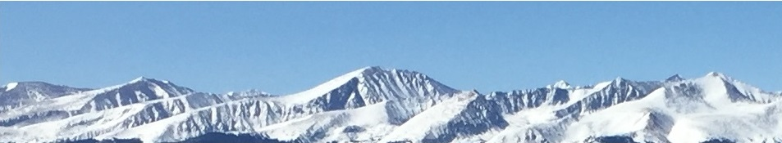
Benefit Cost Analysis
This web quiz may appear as two pages on tablets and laptops.
I recommend that you view it as one page by clicking on the open book icon at the bottom of the page.

Slide 2
1d – Benefit Cost Analysis
Must Know / Outcomes:
define benefit cost analysis (BCA) and use it to solve problems
define "marginal" and give examples
define marginal benefits (MB) and marginal costs (MC)
explain why we ignore fixed, or sunk, costs ("Don't cry over spilt milk.")
know what happens if MC increase? decrease?
know what happens if MB increase? decrease?
draw MB and MC on a graph and explain their shapes
be able to find the optimum choice from a table of total costs and total benefits and from a table of marginal costs and marginal benefits
use BCA to explain why Drivers with airbags may take more risks or why skiers with air bags may take more risks
what is a "sunk cost" (or fixed cost) and why are they ignored when using benefit-cost analysis?
"Don't cry over spilt milk " If you are deciding whether or not to come to class today, why does it not matter that you have already paid tuition? Why is the fact that you have paid tuition irrelevant when trying to decide whether to attend class today or skip?

Slide 3
1d – Benefit Cost Analysis
Key Terms
marginal costs (MC),
marginal benefits (MB),
MB=MC Rule,
sunk (fixed) costs

Slide 4
1. What does “marginal” mean?
additional
unique
efficient
unemployed

Slide 5
1. What does “marginal” mean?
additional
unique
efficient
unemployed

Slide 6
2. You should decide to go to a movie:
if the marginal cost of the movie exceeds its marginal benefit.
if the marginal benefit of the movie exceeds its marginal cost.
if your income will allow you to buy a ticket.
because movies are enjoyable.

Slide 7
2. You should decide to go to a movie:
if the marginal cost of the movie exceeds its marginal benefit.
if the marginal benefit of the movie exceeds its marginal cost.
if your income will allow you to buy a ticket.
because movies are enjoyable.

Slide 8
3. The marginal benefit curve is:
upsloping because of increasing marginal opportunity costs.
downsloping because of increasing marginal opportunity costs.
upsloping because additional units of a specific product yield less and less extra benefit.
downsloping because additional units of a specific product yield less and less extra benefit.

Slide 9
3. The marginal benefit curve is:
upsloping because of increasing marginal opportunity costs.
downsloping because of increasing marginal opportunity costs.
upsloping because additional units of a specific product yield less and less extra benefit.
downsloping because additional units of a specific product yield less and less extra benefit.

Slide 10
4. The marginal cost curve is:
upsloping because of increasing marginal opportunity costs.
upsloping because successive units of a specific product yield less and less extra utility.
downsloping because of increasing marginal opportunity costs.
downsloping because successive units of a specific product yield less and less extra utility.

Slide 11
4. The marginal cost curve is:
upsloping because of increasing marginal opportunity costs.
upsloping because successive units of a specific product yield less and less extra utility.
downsloping because of increasing marginal opportunity costs.
downsloping because successive units of a specific product yield less and less extra utility.

Slide 12
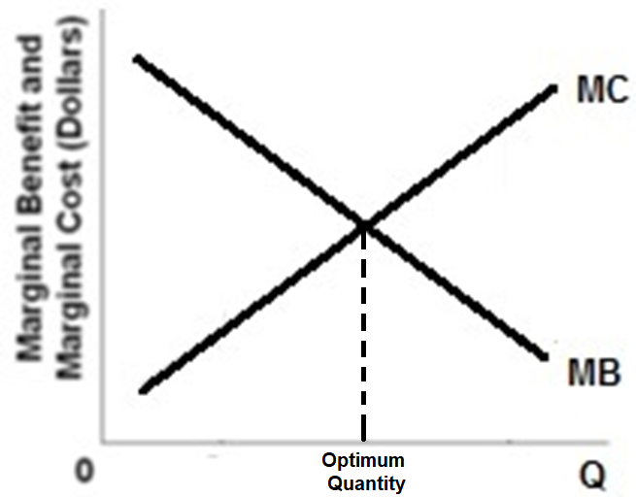
1d – Benefit Cost Analysis

Slide 13
5. According to the marginal-cost-marginal-benefit rule:
only government projects (as opposed to private projects) should be assessed by comparing marginal costs and marginal benefits.
the optimal project size is the one for which MB exceeds MC by the greatest amount.
the optimal project size is the one for which MB = MC.
project managers should attempt to minimize both MB and MC.

Slide 14
5. According to the marginal-cost-marginal-benefit rule:
only government projects (as opposed to private projects) should be assessed by comparing marginal costs and marginal benefits.
the optimal project size is the one for which MB exceeds MC by the greatest amount.
the optimal project size is the one for which MB = MC.
project managers should attempt to minimize both MB and MC.

Slide 15
6. If the MB > MC, then:
You should do more
You should do less
The result is optimal
The best choice was made

Slide 16
6. If the MB > MC, then:
You should do more
You should do less
The result is optimal
The best choice was made

Slide 17
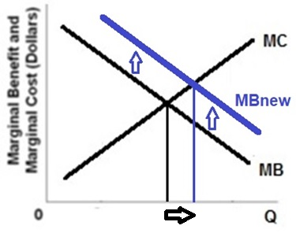
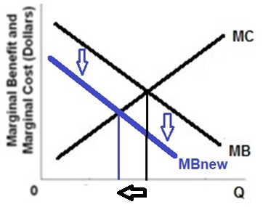
If MB increase then you should do more.
If MB decrease then you should do
less.
1d – Benefit Cost Analysis

Slide 18
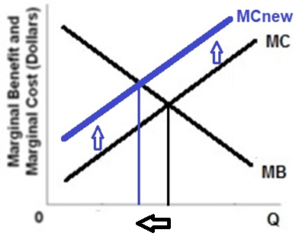
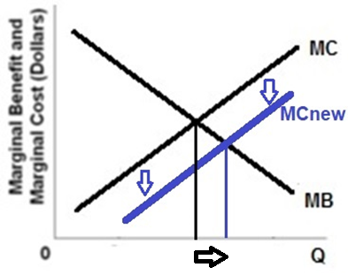
If MC increase then you should do
less.
If MC decrease then you should do
more.
1d – Benefit Cost Analysis

Slide 19
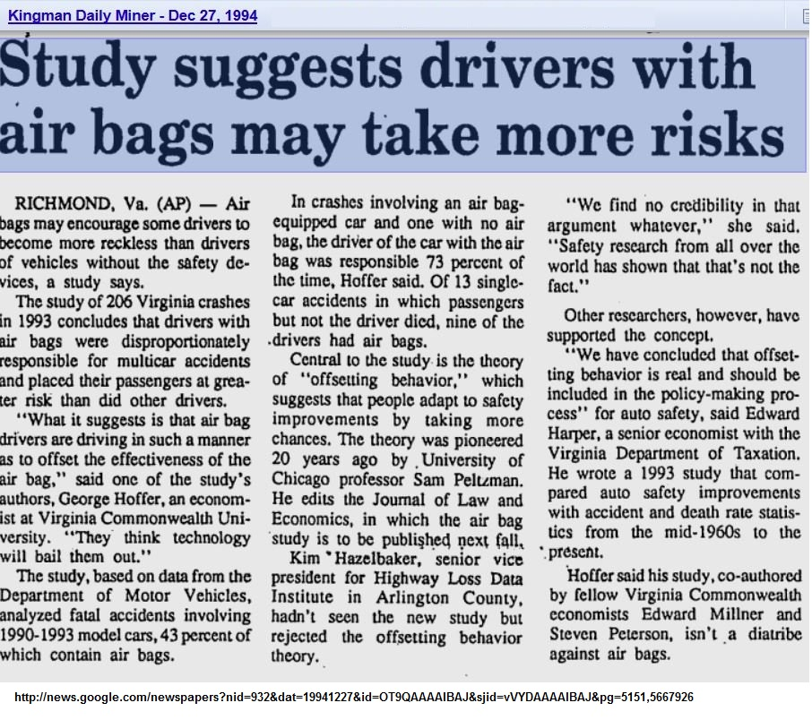

Slide 20
Why would airbags in cars cause more accidents?
A similar question for skiers is why did the invention of avalanche airbags cause more people to become caught in avalanches
After studying this lesson you should be able to use Benefit-Cost Analysis (MB=MC) to answer this question.
In a March 2013 blog post written by Utah Avalanche Center Director Bruce Tremper . . . Tremper says airbags are providing a false sense of security, leading more skiers into high-consequence terrain, and thus decreasing the effectiveness of said airbag. "Each gizmo we buy to increase our safety usually cause us to increase our level of risk at the same time. For instance, when we added seat belts and airbags to cars, yes fatalities decreased, but it also allowed us to drive faster, farther, crazier and talk on our mobile phones at the same time. So safety measures usually work but not nearly as well as we would hope because people just increase their risk (and “utility”) at the same time. In avalanche airbag case, we will also get more powder, more fun, and more risk in the bargain . . . . people will increase their exposure to risk because of the perception of increased safety, which will cancel out some, but not all, of the effectiveness of avalanche airbag."
What are avalanche airbags?
https://www.youtube.com/watch?v=h7QFRXc0R8M

Slide 21
7. Fixed (sunk) costs are ignored because:
They don’t affect total costs.
They don’t affect the MC or the MB.
They only affect costs, but not benefits.
They are very small and therefore insignificant.

Slide 22
7. Fixed (sunk) costs are ignored because:
They don’t affect total costs.
They don’t affect the MC or the MB.
They only affect costs, but not benefits.
They are very small and therefore insignificant.

Slide 23
8. Why are newspapers sold in vending machines that allow the buyer to take as many as they want?
Sellers know that people are irrational.
People are honest therefore most will only take one.
For the buyer, the MC of a second newspaper is higher than the first.
The MB of a second newspaper is close to zero.

Slide 24
8. Why are newspapers sold in vending machines that allow the buyer to take as many as they want?
Sellers know that people are irrational.
People are honest therefore most will only take one.
For the buyer, the MC of a second newspaper is higher than the first.
The MB of a second newspaper is close to zero.

Slide 25
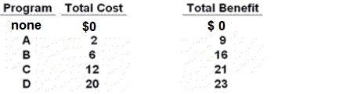
9. The data indicate that: (YP 25 #3)
Answer this question on the basis
of the above information for four
highway programs of increasing scope.
All figures are in millions of dollars.
1. the marginal costs and marginal benefits cannot be calculated
2. the marginal cost and marginal benefit of Program B are $6 and $16 respectively.
3. the marginal cost and marginal benefit of Program C are $6 and $5 respectively.
4. the marginal cost and marginal benefit of Program D are $2 and $9 respectively.

Slide 26
9. The data indicate that: (YP 25 #3)
Answer this question on the basis
of the above information for four
highway programs of increasing scope.
All figures are in millions of dollars.
1. the marginal costs and marginal benefits cannot be calculated
2. the marginal cost and marginal benefit of Program B are $6 and $16 respectively.
3. the marginal cost and marginal benefit of Program C are $6 and $5 respectively.
4. the marginal cost and marginal benefit of Program D are $2 and $9 respectively.

Slide 27
10. On the basis of the data we can say that it would be best to chose: (YP 25 #4)
Answer this question on the basis
of the above information for four
highway programs of increasing scope.
All figures are in millions of dollars.
1. Program A
2. Program B
3. Program C
4. Program D

Slide 28
10. On the basis of the data we can say that it would be best to chose: (YP 25 #4)
Answer this question on the basis
of the above information for four
highway programs of increasing scope.
All figures are in millions of dollars.
1. Program A
2. Program B
3. Program C
4. Program D

Slide 29
11. Refer to the diagram for athletic shoes. The optimal output of shoes is:
(YP 26 #6)
Q₁.
Q₂.
Q₃.
greater than Q₃.

Slide 30
11. Refer to the diagram for athletic shoes. The optimal output of shoes is:
(YP 26 #6)
Q₁.
Q₂.
Q₃.
greater than Q₃.

Slide 31
12. Refer to the diagram for athletic shoes. If the current output of shoes is Q₁, then:
(YP 26 #7)
society considers additional units of shoes to be more valuable than alternative uses of those resources.
society considers additional units of shoes to be less valuable than alternative uses of those resources.
society would experience a net loss by producing more shoes.
resources are being allocated efficiently to the production of shoes.

Slide 32
12. Refer to the diagram for athletic shoes. If the current output of shoes is Q₁, then:
(YP 26 #7)
society considers additional units of shoes to be more valuable than alternative uses of those resources.
society considers additional units of shoes to be less valuable than alternative uses of those resources.
society would experience a net loss by producing more shoes.
resources are being allocated efficiently to the production of shoes.

Slide 33
13. If MC increase then:
People will do more
People will do less
People will do it again
Nothing happens

Slide 34
13. If MC increase then:
People will do more
People will do less
People will do it again
Nothing happens

Slide 35
14. We know that people will go skiing more if:
The MC increase and the MB decrease.
The MC decrease and the MB increase.
The MC increase and the MB increase.
The MC decrease and the MB decrease.

Slide 36
14. We know that people will go skiing more if:
The MC increase and the MB decrease.
The MC decrease and the MB increase.
The MC increase and the MB increase.
The MC decrease and the MB decrease.

Slide 37
The best answer is always where MB = MC
For a Business:
What are the marginal costs (MC) of producing more output?
What are the marginal benefits (MB) of producing more output?
To maximize profit what quantity should a company produce?
The quantity where MB = MC
To maximize profits, produce the quantity where:
MR = MC
1d – Benefit Cost Analysis

Slide 38
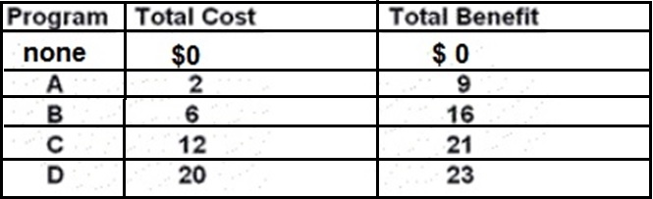
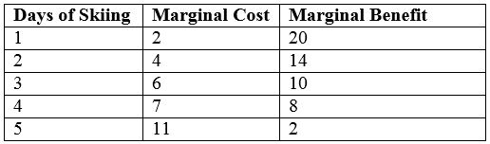
BE CAREFUL!
GIVEN TB and TC, you must calculate MB and MC. YP 25 #4
GIVEN MB and MC, all you have to do is compare MB and MC. YP 25 #5
1d – Benefit Cost Analysis

