Slide 1
1a – The Class and the Math
This web quiz may appear as two pages on tablets and laptops.
I recommend that you view it as one page by clicking on the open book icon at the bottom of the page.

Slide 2
ECO 211 1a - Welcome to Microeconomics
Top 3 Things You Should Know At Harper https://youtu.be/a4RAX0rh5Gs
Name Tents (both sides / meet)
Yellow Pages
MicWebApp (cell phone: search “micwebapp”)

Slide 3
LESSON 1a - The Class and the Math
How to Find Class Information
Basic Math Skills (See Lesson 1a WebQuiz)
Three Basic Concepts
Goal: Max. Society’s Satisfaction
Making Choices – Benefit Cost Analysis
Models / Graphs (See Lesson 1a WebQuiz)
1a – The Class and the Math

Slide 4
1a – The Class and the Math
TOPICS
How to Find Class Information
Basic Math Skills (See Lesson 1a WebQuiz)
Three Basic Concepts
Goal: Max. Society’s Satisfaction
Making Choices – Benefit Cost Analysis
Models / Graphs (See 1a Lesson WebQuiz)

Slide 5
1a - ECO 211 - SYLLABUS
Basic Info. / Course Description / Office Hours
Course Structure / SI (Supplemental Instruction)
Course Materials (Textbook / Videos / Yellow Pages / MicWebApp)
Blackboard, Websites, and E-mail
Grading
DAILY SCHEDULE
Outline / Outcomes
Syllabus Quiz on Blackboard
Other ANY QUESTIONS?
1a – How to Find Class Information

Slide 6
1. In this class, students are required to take an online Pre-Quiz BEFORE CLASS EVERYDAY (except exams and review). True or False?
True
False
Before what time?
1a – How to Find Class Information

Slide 7
1. In this class, students are required to take an online Pre-Quiz BEFORE CLASS EVERYDAY (except exams and review). True or False?
True
False
Before what time? 9:00 a.m.
1a – How to Find Class Information

Slide 8
2. Where do you find the DATES for the Pre-Quizzes, Readings and Videos, Papers, and Exams?
YELLOW PAGES
LESSONS
SCHEDULE
WEB QUIZ
1a – How to Find Class Information

Slide 9
2. Where do you find the DATES for the Pre-Quizzes, Readings and Videos, Papers, and Exams?
YELLOW PAGES
LESSONS
SCHEDULE
WEB QUIZ
1a – How to Find Class Information

Slide 10
3. Where do you find the correct daily reading assignments pages and the correct assigned video lectures?
SYLLABUS
YELLOW PAGES
SCHEDULE
LESSONS or MICWEBAPP
1a – How to Find Class Information

Slide 11
3. Where do you find the correct daily reading assignments pages and the correct assigned video lectures?
SYLLABUS
YELLOW PAGES
SCHEDULE
LESSONS or MICWEBAPP
1a – How to Find Class Information

Slide 12
1a – LESSONS / MICWEBAPP
Introduction
Something Interesting – Why are we studying this?
Assignments – Reading / Video Lectures
Outcomes – What you should learn
Key Term Flashcards
Key Problems
Web Quiz
Key Formulas
Key Graphs
Review Quiz
Review Videos (YouTube)
1a – How to Find Class Information

Slide 13
ECO 211 – Course Structure
BEFORE CLASS:
Read Lesson “Introduction” and “Something Interesting”
Read Textbook
Watch Video Lectures
Key Term Flashcards (KNOW THE VOCABULARY!)
Take Pre-Quiz on Blackboard (BEFORE WHAT TIME?)
DURING CLASS:
Clicker Quizzes
Yellow Pages
Lecture / Discussion / Questions
AFTER CLASS:
Required Activities (finish after each chapter)
Yellow Pages
finish after each lesson
see answers on Bb
Put answer .pdf on your computer or tablet
Web Quizzes
Key Problems
Review Quizzes
Other – see LESSONS or MICWEBAPP

Slide 14
Before the Next Class – Lesson 1b
See Schedule
Read Lesson “Introduction” and “Something Interesting”
Read Textbook and online reading
Watch Assigned Video Lectures
Key Term Flashcards (Quizlet)
Take Pre-Quiz for lesson 1b on Blackboard (Before what time?)
Start Writing Paper 1 – Get ahead!

Slide 15
1a – Basic Math Skills
TOPICS
How to Find Class Information
Basic Math Skills (Math Quiz on Blackboard)
Three Basic Concepts
Goal: Max. Society’s Satisfaction
Making Choices – Benefit Cost Analysis
Models / Graphs (See 1a WebQuiz)

Slide 16
1a – Basic Math Skills
Basic Math Skills – See Lesson 1a
Textbook Reading (appendix of chapter 1)
Video Lectures
Key Term Flashcards (Quizlet)
Web Quiz or Math Quiz (same quiz)
Key Formulas
Key Graphs
Review Videos

Slide 17
1a – Basic Math Skills
BASIC MATH SKILLS
Calculate marginal
Calculate average
Arithmetic of fractions and decimals
Find area of a rectangle
Find area of a triangle
Basic algebra
Calculate and use percentages
Graph a line on a Cartesian coordinate system
Marginal is the slope of the total
Total is the area under the marginal

Slide 18
1a – The Class and the Math
TOPICS
How to Find Class Information
Basic Math Skills (See 1a WebQuiz)
Three Basic Concepts
Goal: Max. Society’s Satisfaction
Making Choices – Benefit Cost Analysis
Models / Graphs (See 1a WebQuiz)

Slide 19
Introduction to Three Basic Concepts
Goal: Max. Society’s Satisfaction
Making Choices – Benefit Cost Analysis
Models / Graphs (See 1a WebQuiz)
The goal of economics is to reduce scarcity and increase society’s satisfaction.
1a – Three Basic Concepts – Max. Satisf.

Slide 20
4. LESSON 1b Assume that a hurricane has struck the coast of Florida causing massive destruction. As a result, the prices of many products like hotel rooms, water, plywood, etc. increase significantly. For example, let's say the price of plywood increases from a price of $10 a sheet before the hurricane to $30 a sheet after the hurricane. To help the people of Florida, should the Florida government pass a law keeping the price of these products (like plywood) to their levels before the hurricane struck? (What would most economists say?)
Yes. Pass law keeping prices low (at their pre-hurricane level)
No. Let prices increase (do nothing about prices)
https://mises.org/library/price-gouging-saves-lives-hurricane

Slide 21
4. LESSON 1b Assume that a hurricane has struck the coast of Florida causing massive destruction. As a result, the prices of many products like hotel rooms, water, plywood, etc. increase significantly. For example, let's say the price of plywood increases from a price of $10 a sheet before the hurricane to $30 a sheet after the hurricane. To help the people of Florida, should the Florida government pass a law keeping the price of these products (like plywood) to their levels before the hurricane struck? (What would most economists say?)
Yes. Pass law keeping prices low (at their pre-hurricane level)
No. Let prices increase (do nothing about prices)
https://mises.org/library/price-gouging-saves-lives-hurricane

Slide 22
5. LESSON 1b - Jan. 26, 2000, Coca-Cola announced plans to cut 6,000 jobs, about a fifth of its workforce. Assuming that they will produce the same amount of Coke, are these job cuts good for society? (What would most economists say?)
Yes
No
Coke Cutting 21% of Jobs
http://www2.harpercollege.edu/mhealy/eco211/lectures/day1/coke.html

Slide 23
5. LESSON 1b - Jan. 26, 2000, Coca-Cola announced plans to cut 6,000 jobs, about a fifth of its workforce. Assuming that they will produce the same amount of Coke, are these job cuts good for society? (What would most economists say?)
Yes
No
Coke Cutting 21% of Jobs
http://www2.harpercollege.edu/mhealy/eco211/lectures/day1/coke.html

Slide 24
6. LESSON 1b- Are gasoline prices too low? (What would many economists say?)
Yes
No
http://www.globalpetrolprices.com/gasoline_prices/

Slide 25
6. LESSON 1b- Are gasoline prices too low? (What would many economists say?)
Yes
No
http://www.globalpetrolprices.com/gasoline_prices/

Slide 26
Lesson 1a – The Class and the Math
Introduction to Three Basic Concepts
Goal: Max. Society’s Satisfaction
Making Choices – Benefit Cost Analysis
Models / Graphs (See 1a WebQuiz)
Because of scarcity we must make choices.
Benefit Cost Analysis helps us make the best decisions

Slide 27
Lesson 1a – The Class and the Math
For any decision the best answer will always be where:
MB = MC
Activity: I will give you $1.60 if you give me $1.00. Would you do it?

Slide 28
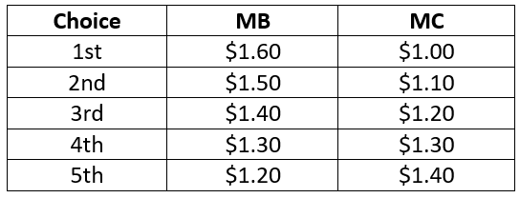
Lesson 1a – The Class and the Math
For any decision the best answer will always be where: MB = MC
Do all, up to and including, the fourth choice.

Slide 29
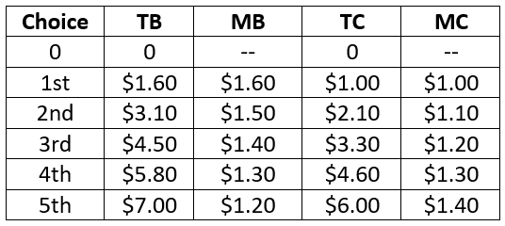
Lesson 1a – The Class and the Math
For any decision the best answer will always be where: MB = MC.
How to calculate the MARGINAL:

Slide 30
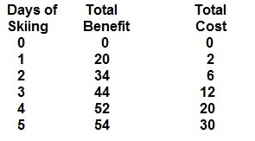
7. On the basis of the data below what is the optimal number of days to ski? (Use Benefit Cost Analysis)
1
2
3
4
5

Slide 31
7. On the basis of the data below what is the optimal number of days to ski? (Use Benefit Cost Analysis)
1
2
3
4
5

Slide 32
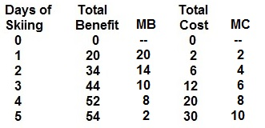
On the basis of the data below what is the optimal number of days to ski? (Use Benefit Cost Analysis)
1a – Three Basic Concepts – CHOICES

Slide 33
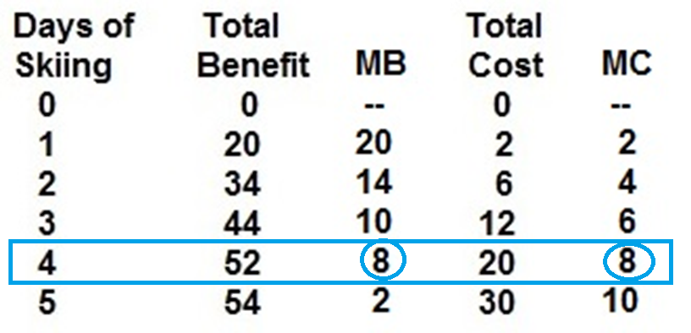
On the basis of the data below what is the optimal number of days to ski? 4 (Use Benefit Cost Analysis)
1a – Three Basic Concepts – CHOICES

Slide 34
Introduction to Three Basic Concepts
Goal: Max. Society’s Satisfaction
Making Choices – Benefit Cost Analysis
Models / Graphs (brief discussion)
More in later lessons (1c, 1d, 3c, etc.)
1a – Three Basic Concepts – MODELS / GRAPHS

Slide 35
CLASS INFORMATION
Syllabus
Blackboard
Yellow Pages
SCHEDULE
LESSONS webpage
MICWEBAPP
Key Term Flashcards
Key Problems
WebQuizzes
THREE BASIC CONCEPTS
Goal of Economics
Choices (MB=MC)
Models and Graphs
BASIC MATH SKILLS
Calculate marginal
Calculate average
Arithmetic of fractions and decimals
Find area of a rectangle
Find area of a triangle
Basic algebra
Calculate and use percentages
Graph a line on a Cartesian coordinate system
Marginal is the slope of the total
Total is the area under the marginal
1a – The Class and the Math

Slide 36
ECO 211 – Next Class – Lesson 1b
MICROECONOMICS: Our goal is to study whether the economy uses our limited resources to obtain the maximum satisfaction possible for society.
We will concentrate on three issues or goals:
Efficiency (allocative)
Efficiency (productive)
Equity
What does “EFFICIENCY” mean?

Slide 37
ECO 211 – Next Class – Lesson 1b
WHAT IS “EFFICIENCY” ?
Is EFFICIENCY the same as economic growth ?
Is EFFICIENCY using as few resources as possible when producing a product ?
Is EFFICIENCY using resources to produce more cell phones that people want and fewer land lines that they don't want ?
Is EFFICIENCY using all of our resources (full employment) ?
Is EFFICIENCY a fair distribution of products ?

Slide 38
The 5Es of Economics – Lesson 1b

Slide 39
Before the Next Class – Lesson 1b
See Schedule
Read Lesson “Introduction” and “Something Interesting”
Read Textbook and Online Reading
Watch Assigned Video Lectures
Key Term Flashcards (Quizlet)
Take Pre-Quiz for Lesson 1b on Blackboard (Before what time?)
Start Writing Paper 1 – Get ahead!

