Slide 1

13a – Labor Market Models
This web quiz may appear as two pages on tablets and laptops.
I recommend that you view it as one page by clicking on the open book icon at the bottom of the page.

Slide 2
13a – Labor Market Models
8 Labor Market Models
  1. Comp. Resource Market and Comp. Product Market (12a)
  2. Comp. Resource Market and Imperfect Product Market (12a)
  3. Monopsony
  4. Union: Demand Enhancement
  5. Union: Inclusive or Craft Union
  6. Union: Exclusive or Industrial Union
  7. Union: Bilateral Monopoly
  8. Minimum Wage
    Decrease employment – the traditional argument
    Increases employment? – Monopsony
    But how much? – Does it help the poor? – Elasticity

Slide 3
Review Lesson 12a - Demand for Resources
Competitive Product Market and Competitive Labor Market
  YP 12 – Draw Graph
  YP 13 and Summary
  Be sure to do YP 22 and 24
Imperfectly Competitive Product Market and Competitive Labor Market
  YP 16 Draw Graph
  YP 17 and Summary
  Be sure to do YP 23 and 25
Determinants of Labor Demand
  YP 5-6 and MicWebApp
  YP 26-27 # 1-7
Price Elasticity of Resource Demand
  YP 7 and MicWebApp
  YP 28 # 1-5
  For all graphs: DEFINE, DRAW, DESCRIBE
13a – Labor Market Models

Slide 4


Slide 5
Eight Resource Market Models
1. Comp. Resource Market and Comp. Product Market
2. Comp. Resource Market and Imperfect Product Market
3. Monopsony
4. Union: Demand Enhancement
5. Union: Exclusive or Craft Union
6. Union: Inclusive or Industrial Union
7. Union: Bilateral Monopoly
8. Minimum Wage
  Decrease employment – the traditional argument
  Increases employment? – Monopsony
  But how much? – Does it help the poor? – Elasticity

Slide 6
YP 18 - SOME IMPORTANT THINGS TO REMEMBER ABOUT LABOR MARKET MODELS
  TP = total product = quantity produced
  TR = Pproduct x TP = P x Q
  MRP = change in TR / change in quantity of labor
  MRC = change in TC / change in quantity of labor
  MP = change in TP / change in quantity of labor
  VMP = P x MP
  Profit maximizing quantity to hire: MRP = MRC (MB = MC)
  Allocatively efficient quantity to hire: VMP = W (MSB = MSC)
  Dlabor = MRP
  Slabor = W
  Pure competition in the product market: Dlabor = MRP = VMP
  Imperfect competition in the product market: Dlabor = MRP ≠ VMP
  (like a monopoly or oligopoly) (MRP is below the VMP)
  Pure competition in the labor market: Slabor = W = MRC
  Monopsony in the labor market: Slabor = W ≠ MRC
  (single employer) (MRC is above the W)
13a – Labor Market Models

Slide 7
Must Know / Outcomes:
List those factors that have led to an increasing level of labor productivity and real wages in the U.S.
Describe the following labor market models. Determine the equilibrium wage rate, employment level, and its effect on efficiency. Be able to Define, Draw, and Describe the shapes of the graphs for each model.
  Competitive labor market in a competitive product market (table of data and a graph)
  Competitive labor market in an imperfectly competitive product market (table of data and a graph)
  Monopsony (table of data and a graph)
  Union Model: increasing demand for labor
  Union Model: craft (exclusive) union
  Union Model: industrial (inclusive) union
  Union Model: bilateral monopoly
  Minimum Wage Models
    traditional minimum wage model
    minimum wage in a monopsony
    minimum wage and the price elasticity of demand for labor
Why wages differ - Explain the demand and supply factors that create wage differentials.
13a – Labor Market Models

Slide 8
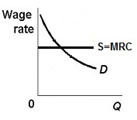
1. Which labor market model?
Pure comp. labor and pure comp. product markets
Pure comp. labor and imperfect comp. product
Monopsony
Union: enhancing demand
Union: craft (exclusive)
Union: Industrial (inclusive)
Union: Bilateral Monopoly
Minimum Wage

Slide 9
1. Which labor market model?
Pure comp. labor and pure comp. product markets
Pure comp. labor and imperfect comp. product
Monopsony
Union: enhancing demand
Union: craft (exclusive)
Union: Industrial (inclusive)
Union: Bilateral Monopoly
Minimum Wage

Slide 10
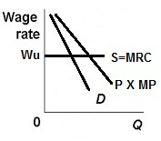
2. Which labor market model?
Pure comp. labor and pure comp. product
Pure comp. labor and imperfect comp. product
Monopsony
Union: enhancing demand
Union: craft (exclusive)
Union: Industrial (inclusive)
Bilateral Monopoly
Minimum Wage

Slide 11
2. Which labor market model?
Pure comp. labor and pure comp. product
Pure comp. labor and imperfect comp. product
Monopsony
Union: enhancing demand
Union: craft (exclusive)
Union: Industrial (inclusive)
Bilateral Monopoly
Minimum Wage

Slide 12
Eight Resource Market Models
1. Comp. Resource Market and Comp. Product Market
2. Comp. Resource Market and Imperfect Product Market
3. Monopsony YP 35, 92 and MicWebApp
4. Union: Demand Enhancement
5. Union: Exclusive or Craft Union
6. Union: Inclusive or Industrial Union
7. Union: Bilateral Monopoly
8. Minimum Wage
  Decrease employment – the traditional argument
  Increases employment? – Monopsony
  But how much? – Does it help the poor? – Elasticity

Slide 13
Monopsony ( 13a)
Explanation / Characteristics / Results:
A single buyer of labor
Examples:
  Major employer in a small town
  A mining town in Appalachia
  A Colorado ski town
Firm is a “wage maker” – they will try to pay as low a wage as possible, therefore the supply of labor graph is upward sloping.
MRC is higher than the wage because when they raise wages to hire more workers they must also raise the wages of all current employees which makes the cost of hiring another worker very high.
We assume a competitive product market so Dlabor = MRP = VMP
Results (see graph on next slide)::
  Profit maximizing (equilibrium) quantity to hire is Q1 (where MRP = MRC)
  Wage paid is W1
  Allocatively efficient quantity and wage is Q2 and W2 (where VMP = W)

Slide 14
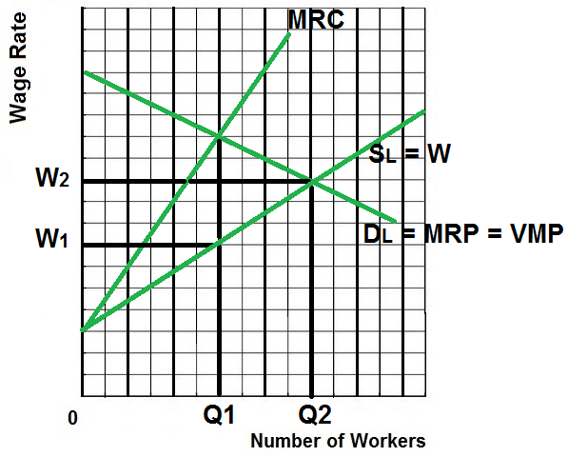
Monopsony (13a)
Qhired = Q1
Wage = W1
Alloc. Eff. Q = Q2
Not Efficient!
Why is the MRC above the Wage?
For all graphs: DEFINE, DRAW, DESCRIBE

Slide 15
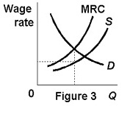
3. Which labor market model?
Pure comp. labor and pure comp. product
Pure comp. labor and imperfect comp. product
Monopsony
Union: enhancing demand
Union: craft (exclusive)
Union: Industrial (inclusive)
Bilateral Monopoly
Minimum Wage

Slide 16
3. Which labor market model?
Pure comp. labor and pure comp. product
Pure comp. labor and imperfect comp. product
Monopsony
Union: enhancing demand
Union: craft (exclusive)
Union: Industrial (inclusive)
Bilateral Monopoly
Minimum Wage

Slide 17
4. Monopsony: what Q would be hired at what wage?
Q₁ and W₁
Q₂ and W₂
Q₁ and W₂
Q₁ and W₃

Slide 18
4. Monopsony: what Q would be hired at what wage?
Q₁ and W₁
Q₂ and W₂
Q₁ and W₂
Q₁ and W₃

Slide 19
5. If this was pure competition in the labor market, what Q would be hired at what W?
W₁ and Q₁
W₂ and Q₂
W₂ and Q₁
W₃ and Q₁

Slide 20
5. If this was pure competition in the labor market, what Q would be hired at what W?
W₁ and Q₁
W₂ and Q₂
W₂ and Q₁
W₃ and Q₁

Slide 21
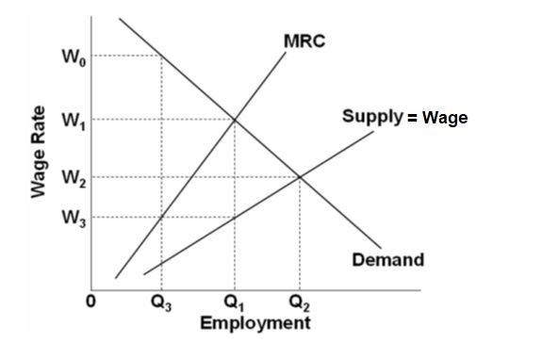
6. In this Monopsony, why is the MRC above the Supply (wage) curve?
(Why is the extra cost of hiring one more worker more than the wage that you pay that worker?)
because to hire one more worker you must raise the wage, i.e. the supply of labor curve is upward sloping
because we assume a competitive product market so Dlabor = MRP = VMP
because the profit maximizing quantity to hire is less than the allocatively efficient quantity of labor.
because when they raise wages to hire more workers they must also raise the wages of all current employees

Slide 22
6. In this Monopsony, why is the MRC above the Supply (wage) curve?
(Why is the extra cost of hiring one more worker more than the wage that you pay that worker?)
because to hire one more worker you must raise the wage, i.e. the supply of labor curve is upward sloping
because we assume a competitive product market so Dlabor = MRP = VMP
because the profit maximizing quantity to hire is less than the allocatively efficient quantity of labor.
because when they raise wages to hire more workers they must also raise the wages of all current employees

Slide 23
Eight Resource Market Models
1. Comp. Resource Market and Comp. Product Market
2. Comp. Resource Market and Imperfect Product Market
3. Monopsony
4. Union: Demand Enhancement -YP 40, 93, and MicWebApp
5. Union: Exclusive or Craft Union
6. Union: Inclusive or Industrial Union
7. Union: Bilateral Monopoly
8. Minimum Wage
  Decrease employment – the traditional argument
  Increases employment? – Monopsony
  But how much? – Does it help the poor? – Elasticity

Slide 24
Union Model – Increasing the Demand for Labor (13a)
Explanation / Characteristics / Results:
To increase wages some unions try to increase demand for union labor
To keep things simple assume a competitive product market so Dlabor = MRP = VMP
How? (See determinants of labor demand lesson 12a)
  Increase demand for the products they produce
  Example: unions lobby governments for more government construction projects
  Increase demand for union labor by increasing the price of substitute resources
  Example: unions support increases in the minimum wage even though union workers are already paid more than the minimum wage
  Increase demand for union labor by decreasing the price of complimentary resources
  Example: trucking unions support allowing more low wage foreign agricultural workers to enter the country so that there are more agricultural products to haul

Slide 25
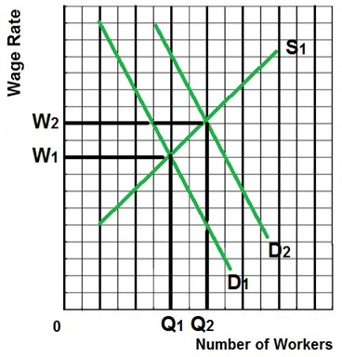
Union Model (13a)
Increase Demand
Qhired = Q2
Wage = W2
Alloc. Eff. Q = Q2
Probably Efficient.
For all graphs: DEFINE, DRAW, DESCRIBE

Slide 26
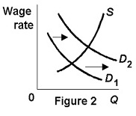
7. Which labor market model?
Pure comp. labor and pure comp. product
Pure comp. labor and imperfect comp. product
Monopsony
Union: enhancing demand
Union: craft (exclusive)
Union: Industrial (inclusive)
Bilateral Monopoly
Minimum Wage

Slide 27
7. Which labor market model?
Pure comp. labor and pure comp. product
Pure comp. labor and imperfect comp. product
Monopsony
Union: enhancing demand
Union: craft (exclusive)
Union: Industrial (inclusive)
Bilateral Monopoly
Minimum Wage

Slide 28
Eight Resource Market Models
1. Comp. Resource Market and Comp. Product Market
2. Comp. Resource Market and Imperfect Product Market
3. Monopsony
4. Union: Demand Enhancement
5. Union: Exclusive or Craft Union - YP 41, 94, and
MicWebApp
6. Union: Inclusive or industrial Union
7. Union: Bilateral Monopoly
8. Minimum Wage
  Decrease employment – the traditional argument
  Increases employment? – Monopsony
  But how much? – Does it help the poor? – Elasticity

Slide 29
Exclusive or Craft Union (Decreasing the Supply of Labor) 13a
Explanation / Characteristics / Results:
Some unions try to increase wages by reducing the supply of labor
To keep things simple assume a competitive product market so Dlabor = MRP = VMP
Examples – Some unions support:
  restricting immigration
  laws banning child labor
  compulsory retirement
  shorter work week
Craft (or Exclusive) Unions
  A union of workers that all possess a certain skill
  They then restrict membership in the union through various means including high fees and long apprenticeships
  Examples: electricians union, carpenters union, plumbers union
  A similar technique to increase wages is used by professional organizations like the American Medical Association (doctors), the American Bar Association (lawyers) and the National Education Association (teachers) which try to set strict and difficult requirements for getting a license to work in their fields
  Even barbers and hair stylists support licensing requirements that restrict how many people can cut and style hair.
Results (see graph on next slide):
  Therefore the firm will hire Q2 workers at a wage of W2. This is the equilibrium or profit maximizing quantity to hire.
Allocatively efficient quantity to hire is Q1 (where VMP = W). Exclusive unions cause allocative inefficiency in the labor market.

Slide 30
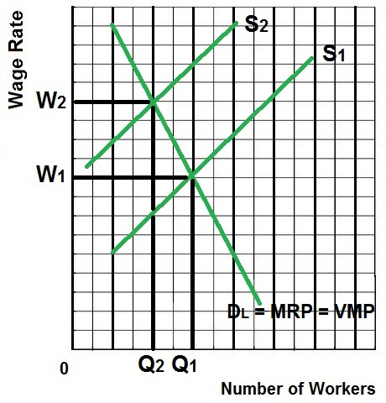
Union Model (13a)
Exclusive/Craft
(decrease supply)
Qhired = Q2
Wage = W2
Alloc. Eff. Q = Q1
NOT Efficient!
For all graphs: DEFINE, DRAW, DESCRIBE

Slide 31
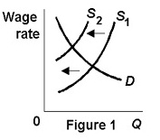
8. Which labor market model?
Pure comp. labor and pure comp. product
Pure comp. labor and imperfect comp. product
Monopsony
Union: enhancing demand
Union: craft (exclusive)
Union: Industrial (inclusive)
Bilateral Monopoly
Minimum Wage

Slide 32
8. Which labor market model?
Pure comp. labor and pure comp. product
Pure comp. labor and imperfect comp. product
Monopsony
Union: enhancing demand
Union: craft (exclusive)
Union: Industrial (inclusive)
Bilateral Monopoly
Minimum Wage

Slide 33
Eight Resource Market Models
1. Comp. Resource Market and Comp. Product Market
2. Comp. Resource Market and Imperfect Product Market
3. Monopsony
4. Union: Demand Enhancement
5. Union: Exclusive or Craft Union
6. Union: Inclusive or Industrial Union – YP 42, 95, and
MicWebApp
7. Union: Bilateral Monopoly
8. Minimum Wage
  Decrease employment – the traditional argument
  Increases employment? – Monopsony
  But how much? – Does it help the poor? – Elasticity

Slide 34
Inclusive or Industrial Union (13a)
Explanation / Characteristics / Results:
Inclusive (Industrial) Unions try to include all workers of a company in the union including skilled workers and unskilled workers, assembly line workers, secretaries, etc.
Then they increase wages by threatening to go on strike (all workers will stop working which will shut down the company).
To keep things simple assume a competitive product market so Dlabor = MRP = VMP
Examples:
  Autoworkers union
  Steelworkers union
Result (see graph on next slide):
  W1 is the competitive wage if there is no union
  W2 is the union negotiated wage rate
  Since all workers must be paid W2 it becomes the firms new MRC (extra cost of hiring one more worker)
  Therefore the firm will hire Q2 workers because this is where MRP = MRCnew (the new profit maximizing quantity to hire with the union contract)
  Q1 is the allocatively efficient quantity to employ (the competitive quantity) so inclusive unions cause allocative inefficiency in the labor market.
  At the Union wage of W2, Q3 workers want to work but only Q2 workers are hired creating a surplus of labor.

Slide 35
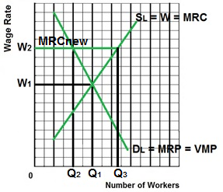
Union Model (13a)
Inclusive/Industrial
Qhired = Q2
Wage = W2
Alloc. Eff. Q = Q1
NOT Efficient!
For all graphs: DEFINE, DRAW, DESCRIBE

Slide 36
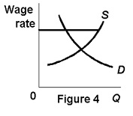
9. Which labor market model other than minimum wage?
Pure comp. labor and pure comp. product
Pure comp. labor and imperfect comp. product
Monopsony
Union: enhancing demand
Union: craft (exclusive)
Union: Industrial (inclusive)
Bilateral Monopoly

Slide 37
9. Which labor market model other than minimum wage?
Pure comp. labor and pure comp. product
Pure comp. labor and imperfect comp. product
Monopsony
Union: enhancing demand
Union: craft (exclusive)
Union: Industrial (inclusive)
Bilateral Monopoly

Slide 38
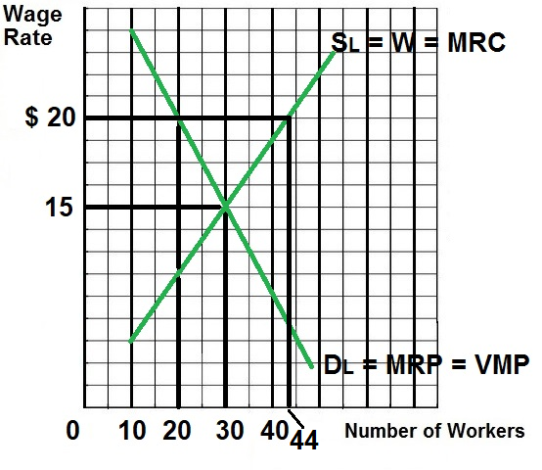
10. Assume an industrial union forms in this firm and bargains for, and wins, a wage of $20.
- What quantity of labor will be hired?
- What is the alloc. eff. quantity of labor?
Hired: 10; Eff: 44
Hired: 20; Eff: 44
Hired: 20; Eff: 30
Hired: 30; Eff: 30
Hired: 30; Eff: 20

Slide 39
10. Assume an industrial union forms in this firm and bargains for, and wins, a wage of $20.
- What quantity of labor will be hired?
- What is the alloc. eff. quantity of labor?
Hired: 10; Eff: 44
Hired: 20; Eff: 44
Hired: 20; Eff: 30
Hired: 30; Eff: 30
Hired: 30; Eff: 20

Slide 40
Eight Resource Market Models
1. Comp. Resource Market and Comp. Product Market
2. Comp. Resource Market and Imperfect Product Market
3. Monopsony
4. Union: Demand Enhancement
5. Union: Inclusive or Craft Union
6. Union: Exclusive or Industrial Union
7. Union: Bilateral Monopoly – YP 43, 96, and MicWebApp
8. Minimum Wage
  Decrease employment – the traditional argument
  Increases employment? – Monopsony
  But how much? – Does it help the poor? – Elasticity

Slide 41
Bilateral Monopoly (13a)
Explanation / Characteristics / Results:
A Bilateral Monopoly exists if you have an inclusive union working for a monopsony – a single seller of labor (the union) and a single buyer of labor (the large company)
Examples: Steel industry, automobile industry, professional sports teams, aircraft manufacturing
To keep things simple we assume a competitive product market so Dlabor = MRP = VMP
Result (see graph on next slide):
  Indeterminate; we can’t tell what the quantity of labor will be or the wage rate, it depends on negotiations between the company and the union
  The efficient quantity of labor and wage is Q2 and W2 (where VMP = W)
  The company (monopsony) wants to pay W1 and hire Q1 where MRP = MRC (alloc. Inefficiency in the labor market)
  The union wants a wage of W3 and the firm will hire Q1 (alloc. Inefficiency in the labor market)
  After negotiations, the likely resulting wage will be between W1 and W3.
  If they negotiate a wage rate of W2 then that rate becomes the firms new MRC (the extra cost of hiring one more worker will be the negotiated wage rate) and the firm will hire Q2 (where MRP = MRCnew)
  Once the union and the company agree on a wage rate between W1 and W2:
    MORE WILL BE EMPLOYED
    the labor market could achieve allocative efficiency (VMP = W at Q2)

Slide 42
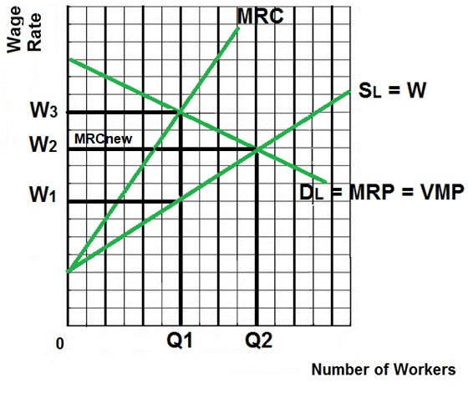
Union Model (13a)
Bilateral Monopoly
Qhired = unknown
Wage = unkown
Alloc. Eff. Q = Q2
IF UNION WINS:
  Qhired = Q1
  Wage = W3
  Alloc. Eff. Q = Q2
  NOT Efficient
IF MONOPSONY WINS
  Qhired = Q1
  Wage = W1
  Alloc. Eff. Q = Q2
  NOT Efficient.
Although the actual result cannot be determined it is likely that they could agree on a wage between W1 and W3, like maybe W2. If So:
  Qhired = Q2
  Wage = W2
  Alloc. Eff. Q = Q2
  MORE Efficient!

Slide 43
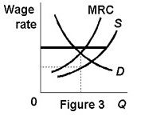
11. Which labor market model?
Pure comp. labor and pure comp. product
Pure comp. labor and imperfect comp. product
Monopsony
Union: enhancing demand
Union: craft (exclusive)
Union: Industrial (inclusive)
Bilateral Monopoly
Minimum Wage

Slide 44
11. Which labor market model?
Pure comp. labor and pure comp. product
Pure comp. labor and imperfect comp. product
Monopsony
Union: enhancing demand
Union: craft (exclusive)
Union: Industrial (inclusive)
Bilateral Monopoly
Minimum Wage

Slide 45
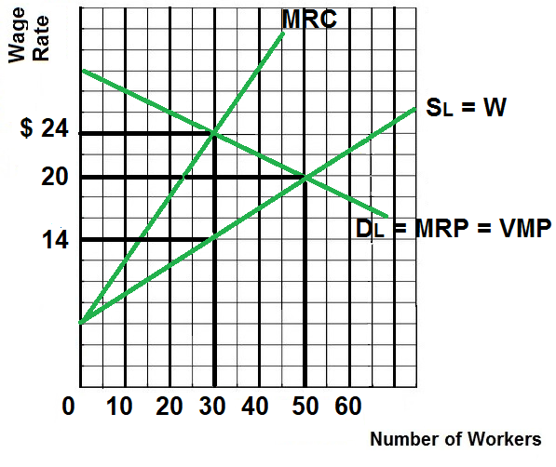
12. Assume no union.
- What quantity of labor will be hired?
-What wage would be paid?
Hired: 30; Wage: $14
Hired: 30; Wage: $20
Hired: 30; Wage: $24
Hired: 50; Wage: $20
Hired: 50; Wage: $14

Slide 46
12. Assume no union.
- What quantity of labor will be hired?
-What wage would be paid?
Hired: 30; Wage: $14
Hired: 30; Wage: $20
Hired: 30; Wage: $24
Hired: 50; Wage: $20
Hired: 50; Wage: $14

Slide 47
13. Assume an industrial union forms in this firm and bargains for a wage of $24. If the union wins:
- What quantity of labor will be hired?
-What is the alloc. Eff. Quantity of labor?
Hired: 30; Eff: 30
Hired: 50; Eff: 50
Hired: 30; Eff: 50
Hired: 50; Eff: 30
Hired: 40; Eff: 40

Slide 48
13. Assume an industrial union forms in this firm and bargains for a wage of $24. If the union wins:
- What quantity of labor will be hired?
-What is the alloc. Eff. Quantity of labor?
Hired: 30; Eff: 30
Hired: 50; Eff: 50
Hired: 30; Eff: 50
Hired: 50; Eff: 30
Hired: 40; Eff: 40

Slide 49
14. Assume an industrial union forms in this firm. After bargaining the firm and the union finally agree on a wage of $20.
- What quantity of labor will be hired?
- What happens to allocative Efficiency?
Hired: 30; more eff.
Hired: 30; less eff.
Hired: 30; no change in eff.
Hired: 50; more eff.
Hired: 50; less eff.
Hired: 50; no change in eff.

Slide 50
14. Assume an industrial union forms in this firm. After bargaining the firm and the union finally agree on a wage of $20.
- What quantity of labor will be hired?
- What happens to allocative Efficiency?
Hired: 30; more eff.
Hired: 30; less eff.
Hired: 30; no change in eff.
Hired: 50; more eff.
Hired: 50; less eff.
Hired: 50; no change in eff.

Slide 51
Eight Resource Market Models
1. Comp. Resource Market and Comp. Product Market
2. Comp. Resource Market and Imperfect Product Market
3. Monopsony
4. Union: Demand Enhancement
5. Union: Inclusive or Craft Union
6. Union: Exclusive or Industrial Union
7. Union: Bilateral Monopoly
8. Minimum Wage
  Decrease employment – the traditional argument
  YP 50, 97, and MicWebApp
  Increases employment? – Monopsony
  But how much? – Does it help the poor? – Elasticity

Slide 52
Minimum Wage
The Traditional Price Floor Model (FEWER are employed) 13a
Explanation / Characteristics / Results (see graph next slide):
Assume that without the minimum wage we have a competitive product market and a competitive labor market
Without the minimum wage Q1 will be employed at a wage of W1 and the labor market is allocatively efficient (MRP = MRC and VMP = W).
Results with a minimum wage set at W2:
  Higher wage (W2 instead of W1)
  Fewer employed (Q2 instead of Q1; where MRP = MRCnew)
  Allocative inefficiency. Fewer workers than the efficient (competitive) quantity will be employed.
  Similar to what happens with an effective price floor in the product market.

Slide 53
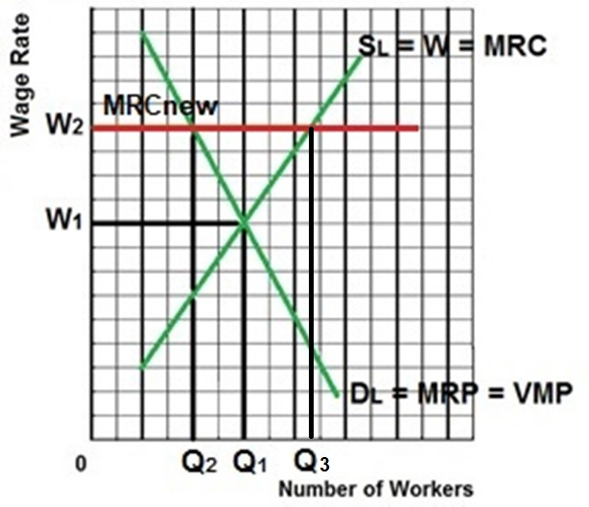
Minimum Wage (13a)
Traditional Model
Qhired = Q2
Wage = W2
Alloc. Eff. Q = Q1
NOT Efficient!
Creates more unemployment
How much UE?
Q3-Q2
For all graphs: DEFINE, DRAW, DESCRIBE

Slide 54
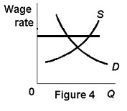
15. Which labor market model?
Pure comp. labor and pure comp. product
Pure comp. labor and imperfect comp. product
Monopsony
Union: enhancing demand
Union: craft (exclusive)
Union: Industrial (inclusive)
Minimum Wage

Slide 55
15. Which labor market model?
Pure comp. labor and pure comp. product
Pure comp. labor and imperfect comp. product
Monopsony
Union: enhancing demand
Union: craft (exclusive)
Union: Industrial (inclusive)
Minimum Wage

Slide 56
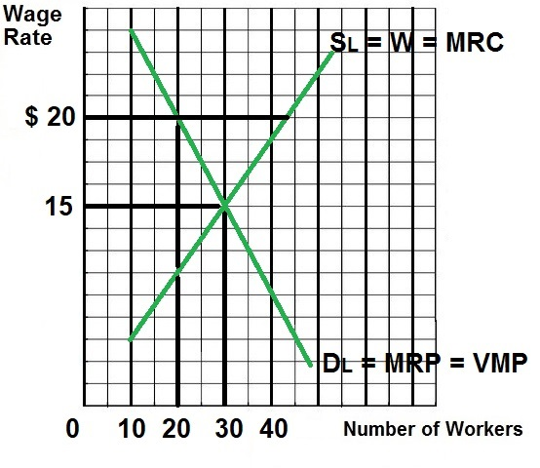
16. Assume a minimum wage of $20.
- What quantity will be hired?
- What quantity will be hire WITHOUT the min. wage?
- What is the alloc. Eff. quantity?
Hired: 40; Without; 30; Eff.: 30
Hired: 30; Without; 20; Eff.: 20
Hired: 20; Without; 20; Eff.: 20
Hired: 20; Without; 30; Eff.: 30

Slide 57
16. Assume a minimum wage of $20.
- What quantity will be hired?
- What quantity will be hire WITHOUT the min. wage?
- What is the alloc. Eff. quantity?
Hired: 40; Without; 30; Eff.: 30
Hired: 30; Without; 20; Eff.: 20
Hired: 20; Without; 20; Eff.: 20
Hired: 20; Without; 30; Eff.: 30

Slide 58
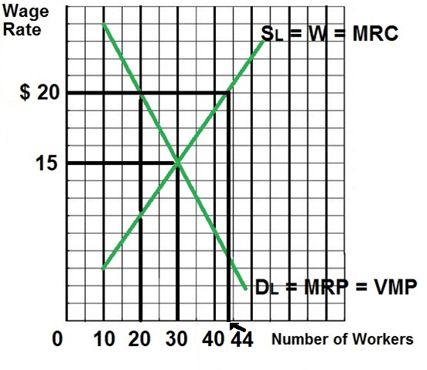
17. Assume a minimum wage of $20.
As a result of the minimum wage, how many workers lost their jobs?
10
20
24
30
40
44

Slide 59
17. Assume a minimum wage of $20.
As a result of the minimum wage, how many workers lost their jobs?
10
20
24
30
40
44

Slide 60
18. Assume a minimum wage of $20.
As a result of the minimum wage, how much unemployment was created?
10
20
24
30
40
44

Slide 61
18. Assume a minimum wage of $20.
As a result of the minimum wage, how much unemployment was created?
10
20
24
30
40
44

Slide 62
Eight Resource Market Models
1. Comp. Resource Market and Comp. Product Market
2. Comp. Resource Market and Imperfect Product Market
3. Monopsony
4. Union: Demand Enhancement
5. Union: Inclusive or Craft Union
6. Union: Exclusive or Industrial Union
7. Union: Bilateral Monopoly
8. Minimum Wage
  Decrease employment – the traditional argument
  Increases employment? – Monopsony
  YP 51, 98, and MicWebApp
  But how much? – Does it help the poor? – Elasticity

Slide 63
Minimum Wage with a Monopsony (MORE are employed) 13a
Explanation / Characteristics / Results (see graph on next slide):
To keep things simple we assume a competitive product market so Dlabor = MRP = VMP
Example: Minimum wage in a non-unionized one industry town like a steel mill town, mining town in Appalachia, or a small Colorado ski town.
The allocatively efficient quantity is Q2 (where VMP = W)
Without minimum wage Q1 would be employed by the monopsonist at a wage of W1 (allocative inefficiency)
Results with a minimum wage set at W2:
  Wages increase from W1 to W2
  Quantity of labor hired increases from Q1 to Q2 (where MRP = MRCnew)
    W2 becomes the firm’s new MRC curve (the extra cost of hiring one more worker is the minimum wage that they have to pay)
    To maximize profits firms will hire the quantity of labor where MRP = new MRC
    With the minimum wage the profit maximizing quantity to hire for a monopsony will be Q2, more than what they would hire if they could pay a lower wage.
    The quantity of labor will be allocatively more efficient

Slide 64
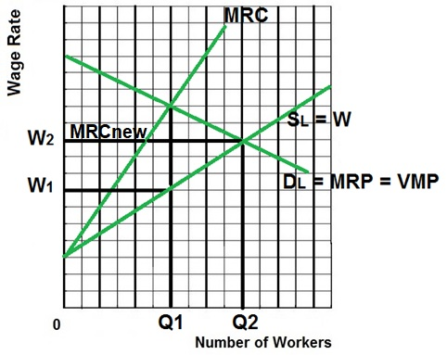
Minimum Wage (13a)
with a Monopsony
With Min Wage at W2:
Qhired = Q2
Wage = W2
Alloc. Eff. Q = Q2
MORE Efficient!
MORE Employment.
Without the minimum wage, the monopsony would:
Qhired = Q1
Wage = W1
Alloc. Eff. Q = Q2
NOT Efficient.

Slide 65
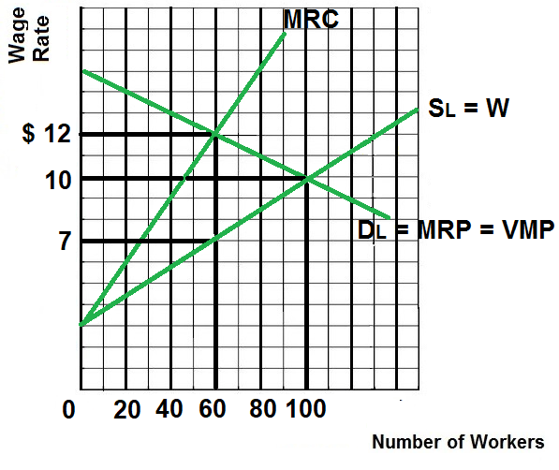
19. With no minimum wage:
- What quantity of labor will be hired?
- what wage would be paid?
- what is the alloc. Eff. quantity?
Hired 20; Wage: $12; Eff: 60
Hired 100; Wage: $10; Eff: 60
Hired 60; Wage: $12; Eff: 100
Hired 60; Wage: $7; Eff: 100

Slide 66
19. With no minimum wage:
- What quantity of labor will be hired?
- what wage would be paid?
- what is the alloc. Eff. quantity?
Hired 20; Wage: $12; Eff: 60
Hired 100; Wage: $10; Eff: 60
Hired 60; Wage: $12; Eff: 100
Hired 60; Wage: $7; Eff: 100

Slide 67
20. With a new minimum wage or $10:
- What quantity of labor will be hired?
- what wage would be paid?
- what is the alloc. Eff. quantity?
Hired 60; Wage: $10; Eff: 60
Hired 100; Wage: $10; Eff: 100
Hired 60; Wage: $7; Eff: 100
Hired 100; Wage: $12; Eff: 100

Slide 68
20. With a new minimum wage or $10:
- What quantity of labor will be hired?
- what wage would be paid?
- what is the alloc. Eff. quantity?
Hired 60; Wage: $10; Eff: 60
Hired 100; Wage: $10; Eff: 100
Hired 60; Wage: $7; Eff: 100
Hired 100; Wage: $12; Eff: 100

Slide 69
Eight Resource Market Models
1. Comp. Resource Market and Comp. Product Market
2. Comp. Resource Market and Imperfect Product Market
3. Monopsony
4. Union: Demand Enhancement
5. Union: Inclusive or Craft Union
6. Union: Exclusive or Industrial Union
7. Union: Bilateral Monopoly
8. Minimum Wage
  Decrease employment – the traditional argument
  Increases employment? – Monopsony
  But how much? – Does it help the poor? – Elasticity
  YP 52, 99, and MicWebApp

Slide 70
Minimum Wage and Price Elasticity of Demand for Labor 13a
(Jobs are lost, but do the poor gain more income?)
Explanation / Characteristics / Results (see graph on next slide):
To keep things simple we assume a competitive product market so Dlabor = MRP = VMP
The traditional minimum wage model predicts less employment, but will the poor be better off even though more are unemployed? Will their total incomes be higher?
It depends on the price elasticity of demand for labor
If the demand for labor is INELASTIC (see Labor Market 1 graph) :
raising the minimum wage from A to B will increase incomes from 0ADF to 0BCE. This is good for the working poor.
If the demand for labor is ELASTIC (see Labor Market 2 graph):
raising the minimum wage from a to b will decrease incomes from 0adf to 0bce. This is bad for the working poor.

Slide 71
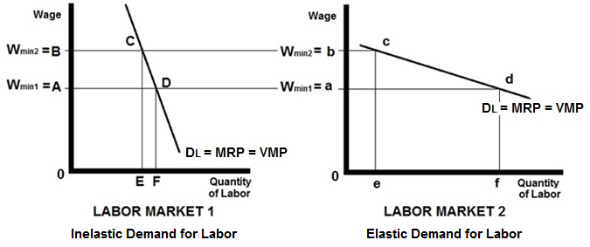
Minimum Wage (13a) and the Price Elasticity of Demand for Labor
(Jobs are lost but do the poor gain more income?)
Labor Market 1
Inelastic Demand
Raising min. wage from Wmin1 to Wmin2 will increase income for the working poor from 0ADF to OBCE.
Labor Market 2
Elastic Demand
Raising min. wage from Wmin1 to Wmin2 will decrease income for the working poor from 0adf to 0bce.

Slide 72
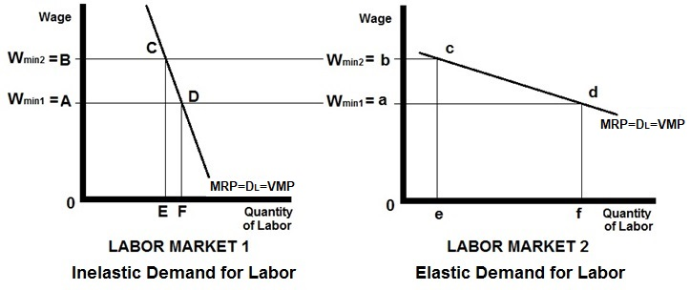
21. Use the figure above to answer this question. If the minimum wage is increased from Wmin1 to Wmin2 what will happen to the total income received by minimum wage workers? YP 56 # 15
increase in labor market 1 and decrease in labor market 2
decrease in labor market 1 and increase in labor market 2
increase in both labor markets
decrease in both labor markets

Slide 73
21. Use the figure above to answer this question. If the minimum wage is increased from Wmin1 to Wmin2 what will happen to the total income received by minimum wage workers? YP 56 # 15
increase in labor market 1 and decrease in labor market 2
decrease in labor market 1 and increase in labor market 2
increase in both labor markets
decrease in both labor markets

Slide 74
Why Wages Differ
Average Annual Wages in Selected Occupations, 2018
Source: Bureau of Labor Statistics, www.bls.gov
Occupation | Average Annual Wages
Surgeons | $255,110
Petroleum Engineers | 156,370
Financial Managers | 146,830
Aircraft Pilots | 146,660
Lawyers | 144,230
Marketing / Sales Managers | 143,000
Chemical Engineers | 114,470
Registered Nurses | 75,510
Dental Hygienists | 75,000
Police Officers | 64,460
Electricians | 59,190
Carpenters | 51,120
Travel Agents | 42,720
Barbers | 33,220
Janitors | 28,950
Retail Salespersons | 28,310
Child Care Workers | 24,610
13a – Labor Market Models

Slide 75
WHY WAGES DIFFER – Supply and Demand
Determinants of Resource Demand (YP 5-6 and MicWebApp)
1. Changes in Demand for the Product
(determinants: Pe, Pog, I, Npot, Tastes)
2. Changes in the Productivity of the Resource
3. Changes in the Prices of Other Resources
  Substitutes
  Substitution Effect
  Output Effect
  Complements
From Lesson 12a – Demand for Resources

Slide 76
Why Wages Differ (“Wage Differentials” From Textbook)
Explain the Demand and Supply Factors that Create Wage Differentials
How Much Labor Demand Is There?
  Demand for the Product
  Productivity of Labor (Marginal Revenue Productivity)
  Prices of Other Resources
How Much Human Capital Is There? (Noncompeting Groups)
  Differences in Ability
  Differences in Education and Training
Nonmonetary Aspects of Jobs (Compensating Differences)
Market Imperfections
  Lack of Job Information
  Geographic Immobility
  Unions and Government Restraints
  Discrimination
13a – Labor Market Models

