Slide 1
12a – The Demand for Resources (Labor)
This web quiz may appear as two pages on tablets and laptops.
I recommend that you view it as one page by clicking on the open book icon at the bottom of the page.

Slide 2
12a – Demand for Resources
Unit 4: Labor Markets, Income Inequality,
and Immigration
We will look at what determines wages and the quantity of workers that firms will employ. Then we will look at two labor market issues: income inequality and immigration.
See the last 17 pages of the Yellow Pages, or the MicWebApp, for summaries of the new models covered in Unit 4.

Slide 3
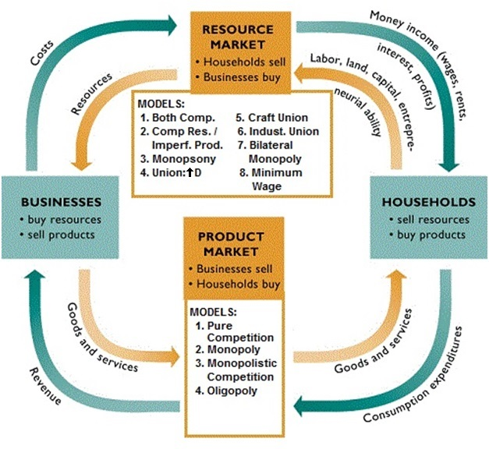
YP 2

Slide 4
12a – Demand for Resources
UNIT 4 – RESOURCE MARKETS
8 (actually 10) Labor Market Models: (YP 87-99 or MicWebApp)
Competitive Resource Market and Competitive Product Market
Competitive Resource Market and Imperfect Product Market
Monopsony
Union: Demand Enhancement
Unions: Exclusive or Craft union
Unions: Inclusive or Industrial Union
Unions: Bilateral Monopoly
Minimum Wage (3 models)
Income Inequality – 2 models (YP 100-101 or MicWebApp)
The Case for Equality = The President Trump Example of the 5Es
The Occupational Segregation Model of Discrimination
Immigration – 2 models (YP 102-103 0r MicWebApp)
Simple immigration Model
Impact of Illegal Workers in a Low Wage Labor Market

Slide 5
12a – Demand for Resources
8 (10) Labor Market Models
YP 4
Using Benefit-Cost Analysis to find:
Profit Max Q of labor to hire = What we get
Allocatively Efficient Q of labor = What we want
Compare: Are businesses efficient? (Are they the same quantity?)
Benefit Cost Analysis: MB = MC
Profit Max. Q of labor: MRP = MRC
What are the extra benefits to the firm if they hire one more worker? (MRP)
What is the extra cost to the firm if they hire one more? (MRC)
Firms will keep hiring as long as the extra benefits > extra costs (Hire all where MRP > MRC up to where MRP=MRC)
Alloc. Eff. Q of labor: VMP = W (P x MP = W)
What is the extra benefit to society (MSB) of hiring one more worker? (VMP or P x MP)
What is the extra cost to society (MSC) of hiring one more worker? (W or the opportunity cost of that worker to society)
Society wants firms to keep hiring as long as the extra benefits > extra costs (Society wants firms to keep hiring as long as VMP > W, up to where VMP = W)

Slide 6
Lesson 12a – Introduction
In Unit 3 we studied the FOUR PRODUCT MARKET MODELS to learn how product prices and quantity are determined. We learned characteristics and examples of each model. We discussed the differences between their demand curves. We drew their short run equilibrium graphs and found the long run equilibrium quantity, allocatively efficient quantity, and the productively efficient quantity. Finally we discussed other issues associated with some of the models.
In Unit 4 we will discuss the TEN LABOR (or resource) MARKET MODELS to learn how wages and the level of employment are determined. We will learn what determines how much people will be paid and how many people will be hired, i.e. the profit maximizing quantity to hire. Then we will determine whether businesses hire the allocatively efficient quantity of labor.
We will finish the unit by looking at two important issues associated with labor markets: income inequality and immigration.
12a – Demand for Resources

Slide 7
Lesson 12a – Something Interesting
Why are people paid differently?
Lowest Paying College Majors: See Next Two Slides
http://money.cnn.com/2015/05/08/pf/college/lowest-paying-college-majors/index.html
Highest Paying College Majors: See Next Two Slides
http://money.cnn.com/2015/05/07/pf/college/highest-paying-college-majors/index.html
12a – Demand for Resources

Slide 8
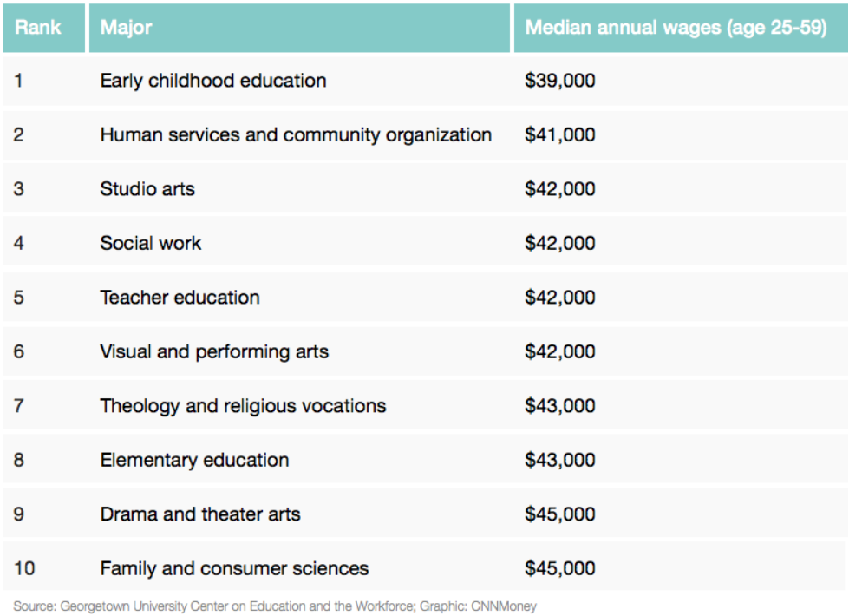
Lowest Paying College Majors

Slide 9
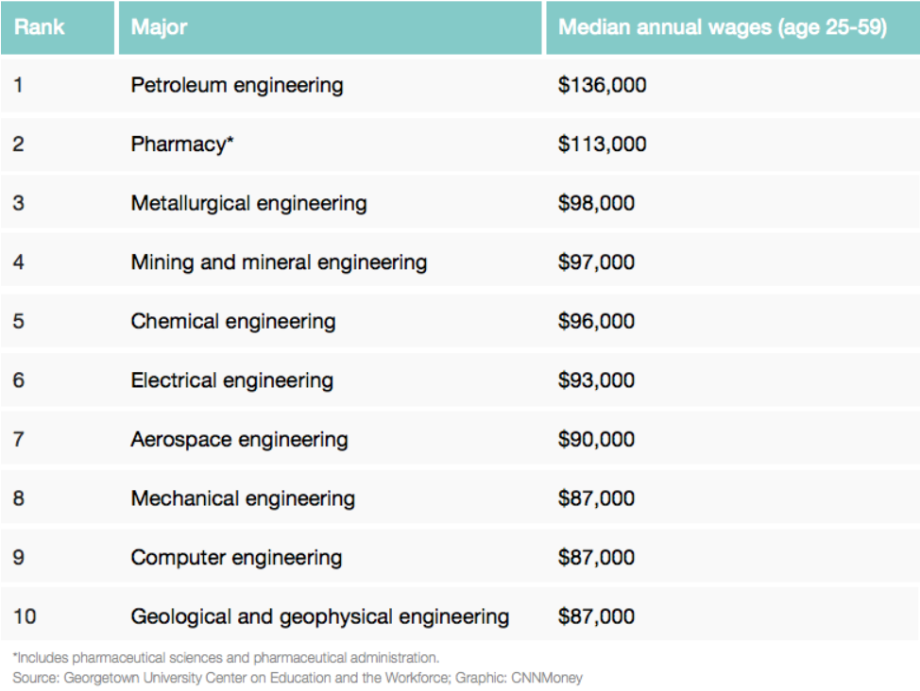
Highest Paying College Majors

Slide 10
Lesson 12a – Something Interesting
Why are people paid differently?
ANSWER: The supply and demand for labor helps explain why different people and different jobs receive different wages. But, there are also other factors that we will need to explore. We will end up with 8 (actually 10) different labor market models that will help us answer this question.
12a – Demand for Resources

Slide 11
12a – Demand for Resources
TOPICS – Lesson 12a:
Finding the Resource Demand Curve (MRP)
Determinants of Resource Demand
Elasticity of Resource Demand
The Profit Maximizing Quantity to Hire:
MRP = MRC (MB) = (MC)
The Allocatively Efficient Quantity to Hire:
VMP = W (MSB) = (MSC)
The First Two Labor Market Models:
Competitive labor market in a competitive product market
Competitive labor market in an imperfectly comp. prod. market

Slide 12
Must Know / Outcomes:
Why is resource demand a "derived demand?
Define and calculate the marginal-revenue-product (MRP). Explain why the MRP schedule of a resource is the firm's demand schedule for the resource in a purely competitive product market.. Explain why the resource demand curve is downward sloping. DEFINE, DRAW, DESCRIBE.
Describe a competitive labor market
For a competitive labor market use benefit-cost analysis (the MRP = MRC principle) to find the profit maximizing quantity of labor a firm will employ in a purely competitive product market and in an imperfectly competitive product market when given the data and graph.
For a competitive labor market use benefit-cost analysis (VMP = W) to find the allocatively efficient quantity of labor for a firm to employ in a purely competitive product market and in an imperfectly competitive product market when given the data and graph.
List the three determinants of demand for a resource and explain how a change in each of the determinants would affect the demand for the resource.
List three determinants of the price elasticity of demand for a resource, and state how changes in each would affect the elasticity of demand for a resource.
12a – Demand for Resources

Slide 13
Key Terms:
derived demand, productivity, marginal product (MP), marginal revenue product (MRP), marginal resource cost (MRC), profit maximizing rule for hiring resources (MRP=MRC rule), value of the marginal product (VMP), substitution effect, output effect, elasticity of resource demand, marginal productivity theory of income distribution
12a – Demand for Resources

Slide 14
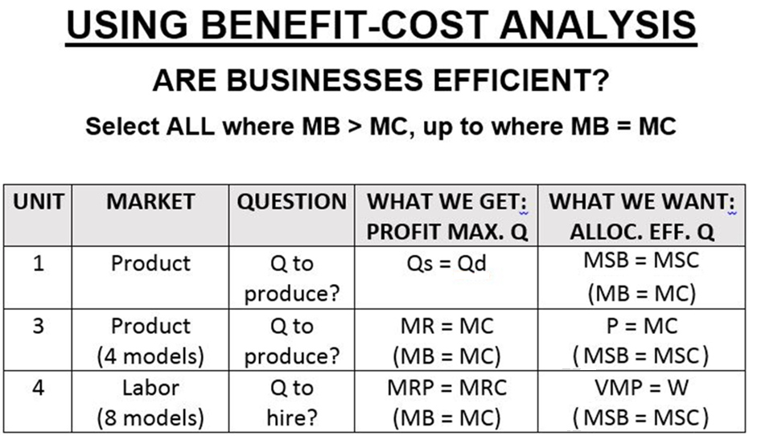
12a – Demand for Resources

Slide 15
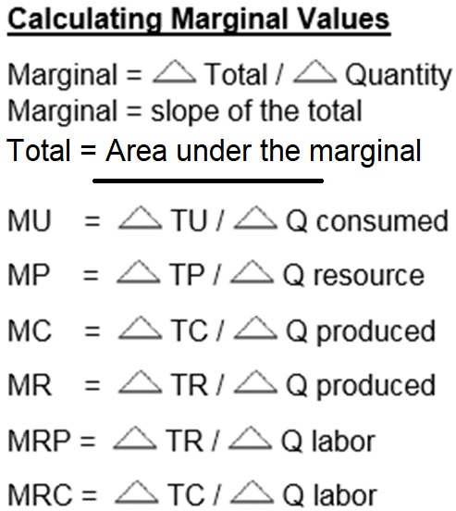
12a – Demand for Resources

Slide 16
For the 10 Labor Market Models, find:
The profit maximizing quantity of labor to hire: - the QLabor where MB = MC
- the QLabor where MRP = MRC
- this is what will be hired
The wage firms will pay (W)
The allocatively efficient quantity of labor:
- the QLabor where MSB = MSC
- the QLabor where VMP = W (or P x MP = W)
- this is what we want
Then answer the question: DID THEY HIRE THE EFFICIENT Q?
See
Formulas
on YP 4
12a – Demand for Resources

Slide 17
Our First
Model:
Perfect Competition in the Labor Market and
Perfect Competition in the Product Market
YP 10
Competitive Product Market (Pure Competition – Lesson 89a and 8/9b)
Very many producers
Producing a standardized product
No barriers to entry
No market power
The demand curve for the product is horizontal (perfectly elastic) at the market price
We assume a competitive product market so Dlabor = MRP = VMP
Example: Agriculture
Competitive Labor Market:
Very many qualified workers with identical skills, no union
Workers are therefore “wage takers” with no power to get a higher wage
Therefore the supply of labor graph (SLabor = W) is horizontal (perfectly elastic) at the market wage
Example: unskilled workers
Example: Agriculture hiring unskilled labor
12a – Demand for Resources

Slide 18
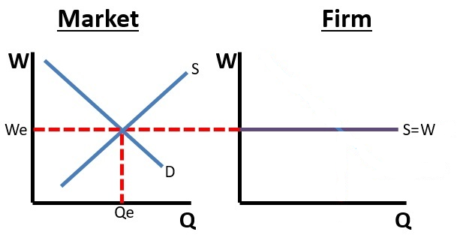
Our First
Model:
Perfect Competition in the Labor Market and
Perfect Competition in the Product Market YP 10
Competitive Labor Market:
Very many qualified workers with identical skills, no union
Workers are therefore “wage takers” with no power to get a higher wage
Therefore the supply of labor graph (SLabor = W) is horizontal (perfectly elastic) at the market wage
Example: unskilled workers
Example: Agriculture hiring unskilled labor
12a – Demand for Resources

Slide 19
Our First
Model:
Perfect Competition in the Labor Market and
Perfect Competition in the Product Market YP 10
Do YP 10 now.
- What Q of labor will be hired?
- What wage will be paid?
- What is the allocatively efficient Q of labor?
Answers on YP 11
12a – Demand for Resources

Slide 20
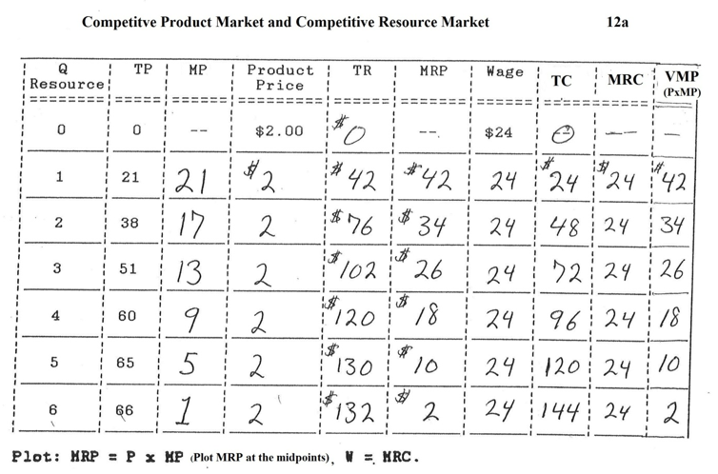
YP 10
12a – Demand for Resources

Slide 21
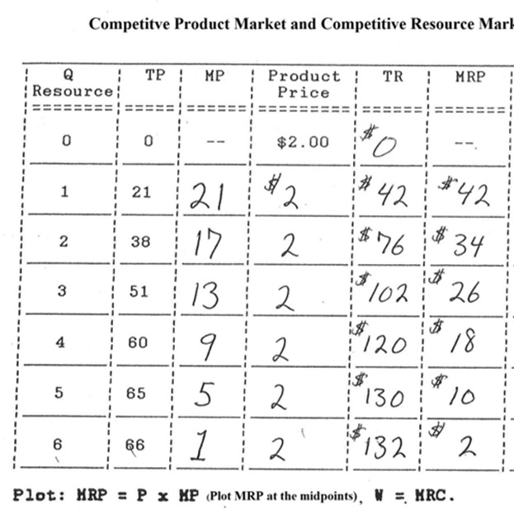
How to Find the Resource Demand Curve
Firm will hire (demand) the quantity where MRP = MRC
The demand for labor is a schedule showing the Q hired at different wages
We now know how to find the Q hired.
So let’s make up some Wage rates and see how many will be hired.
Remember, in a competitive labor market, W = MRC
W | Q hired
|
|
|
|
|
12a – Demand for Resources

Slide 22
How to Find the Resource Demand Curve
Firm will hire (demand) the quantity where MRP = MRC
The demand for labor is a schedule showing the Q hired at different wages
We now know how to find the Q hired.
So let’s make up some wage rates and see how many will be hired.
Remember, in a competitive labor market, W = MRC
W | Q hired
42 | 1
34 | 2
26 | 3
18 | 4
Note that Dlabor = MRC
12a – Demand for Resources

Slide 23
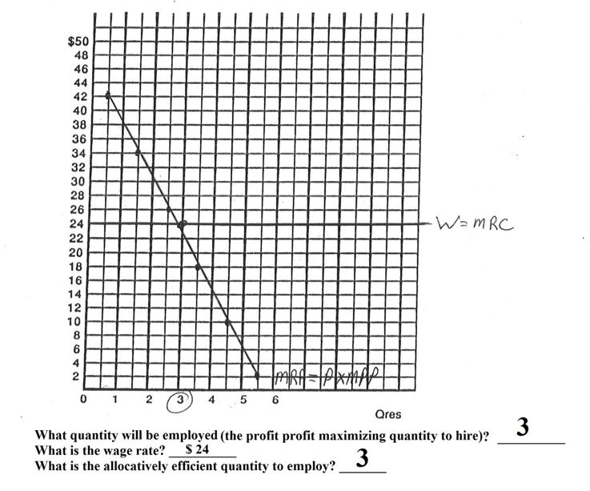
Perfect Competition in the Labor Market and Perfect Competition in the Product Market
YP 10
12a – Demand for Resources

Slide 24
Perfect Competition in the Labor Market and Perfect Competition in the Product Market
YP 13 or 90
Result:
Profit maximizing (equilibrium) quantity to hire is where MRP = MRC
Allocatively efficient quantity to hire is where VMP = W
The profit max. Q to hire = the alloc. Eff. Q to hire
We know that a competitive product market is allocatively efficient in the product market. They are also allocatively efficient in the labor market.
12a – Demand for Resources

Slide 25
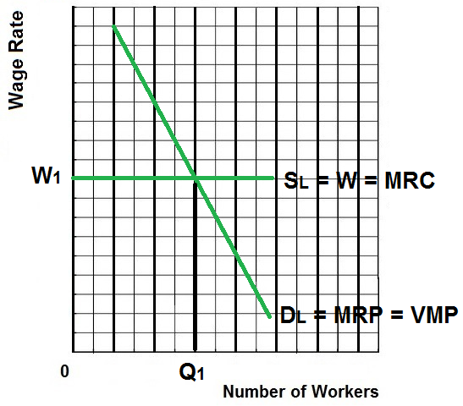
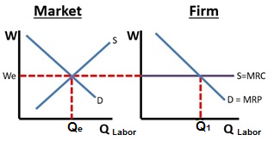
Perfect Competition in the Labor Market and Perfect Competition in the Product Market
Labor Market
Individual Firm
MRP = D for labor
S of labor = Wage
MRP = VMP only if the product market is competitive
MRC = S of labor only if the labor market is competitive
12a – Demand for Resources

Slide 26
1. The demand for labor is a firm’s ______ curve:
MR
MP
MRP
VMP

Slide 27
1. The demand for labor is a firm’s ______ curve:
MR
MP
MRP
VMP
VMP (value of the marginal product)
is the MSB of an additional worker

Slide 28
2. “Derived demand” for labor means when a firm hires labor, it gets its demand for labor:
Mathematically
Based on the labor supply
From the demand for the products that the labor produces
Based on the minimum wage

Slide 29
2. “Derived demand” for labor means when a firm hires labor, it gets its demand for labor:
Mathematically
Based on the labor supply
From the demand for the products that the labor produces
Based on the minimum wage

Slide 30
3. MRP =
TP/Qlabor
TP/ Qlabor
TR/Qlabor
TR/ Qlabor

Slide 31
3. MRP =
TP/Qlabor
TP/ Qlabor
TR/Qlabor
TR/ Qlabor

Slide 32
4. VMP (value of the marginal product) =
MP/Qlabor
TP/ Qlabor
TR/Qlabor
TR/ Qlabor
Pproduct x MP

Slide 33
4. VMP (value of the marginal product) = ___
MP/Qlabor
TP/ Qlabor
TR/Qlabor
TR/ Qlabor
Pproduct x MP
VMP (value of the marginal product)
is the MSB of an additional worker

Slide 34
5. What is the marginal revenue product of the third worker? YP 22
Perfect Competition in the Labor Market and
Perfect Competition in the Product Market
$90
$30
$18
$9
Omission in Yellow Pages: The price of the product is $3

Slide 35
5. What is the marginal revenue product of the third worker? YP 22
Perfect Competition in the Labor Market and
Perfect Competition in the Product Market
$90
$30
$18
$9
Omission in Yellow Pages: The price of the product is $3

Slide 36
6. How many workers will the firm hire if the wage rate is $11 per day? YP 22
Perfect Competition in the Labor Market and
Perfect Competition in the Product Market
1
2
3
4
5

Slide 37
6. How many workers will the firm hire if the wage rate is $11 per day? YP 22
Perfect Competition in the Labor Market and
Perfect Competition in the Product Market
1
2
3
4
5

Slide 38
7. What is the allocatively efficient quantity of labor? YP 22
Perfect Competition in the Labor Market and
Perfect Competition in the Product Market
1
2
3
4
5

Slide 39
7. What is the allocatively efficient quantity of labor? YP 22
Perfect Competition in the Labor Market and
Perfect Competition in the Product Market
1
2
3
4
5

Slide 40
Perfect Competition in the Labor Market and
Perfect Competition in the Product Market
Results:
Profit maximizing (equilibrium) quantity to hire is 5 (where MRP = MRC)
Allocatively efficient quantity to hire is 5 (where VMP = W)
.
12a – Demand for Resources

Slide 41
Perfect Competition in the Labor Market
and
Perfect Competition in the Product Market
YP 13 and 90 and MicWebApp
Results:
Profit maximizing (equilibrium) quantity to hire is Q1 (where MRP = MRC)
Allocatively efficient quantity to hire is Q1 (where VMP = W)
12a – Demand for Resources

Slide 42
Perfect Competition in the Labor Market and Perfect Competition in the Product Market
Labor Market
Individual Firm
MRP = D for labor
S of labor = Wage
MRP = VMP only if the product market is competitive
MRC = S of labor only if the labor market is competitive
12a – Demand for Resources

Slide 43
Perfect Competition in the Labor Market and
Imperfect Competition in the Product Market
YP 14
Imperfect Competition in the Product Market (Monopoly or Oligopoly)
One or Few producers
Significant barriers to entry
A lot of market power
The demand curve for the product is downward sloping – firm must lower its price to sell more
Example: Monopolies and Oligopolies
Competitive Labor Market:
Very many qualified workers with identical skills
Workers are therefore “wage takers” with no power to get a higher wage
Therefore the supply of labor graph (Slabor = W) is horizontal (perfectly elastic) at the market wage
Example: The market for unskilled labor
Example of imperfectly competitive product market in a competitive labor market:
Most businesses hiring unskilled labor
We know that monopolies and oligopolies will produce less and sell at a higher price and are allocatively inefficient in the product market, therefore they will hire fewer workers and are allocatively inefficient in the labor market.
12a – Demand for Resources

Slide 44
Our Second
Model:
Perfect Competition in the Labor Market and
Imperfectly Competitive Product Market YP 14
Do YP 14 now.
- What Q of labor will be hired?
- What wage will be paid?
- What is the allocatively efficient Q of labor?
Answers on YP 15
12a – Demand for Resources

Slide 45
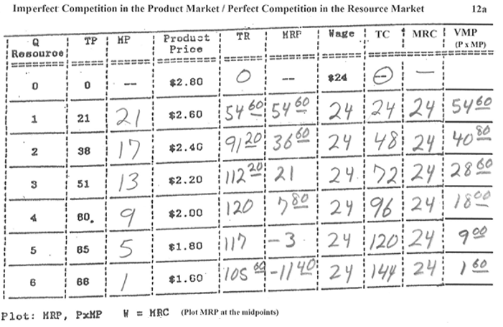
YP 14
12a – Demand for Resources

Slide 46
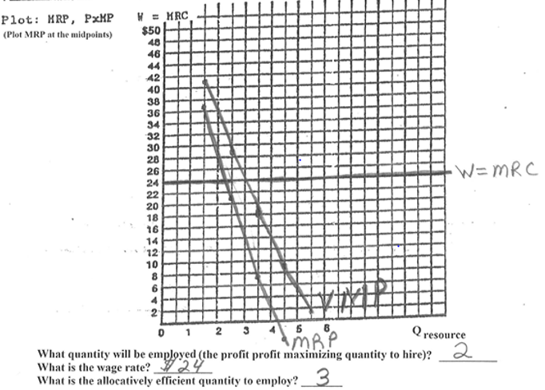
Perfect Competition in the Labor Market and Imperfect Competition in the Product Market
YP 14 (answer on 15)
12a – Demand for Resources

Slide 47
8. How many workers will the firm hire if the wage rate is $40 per day? YP 23 #12
Perfect Competition in the Labor Market and
Imperfect Competition in the Product Market
1
2
3
4
5

Slide 48
8. How many workers will the firm hire if the wage rate is $40 per day? YP 23 #12
Perfect Competition in the Labor Market and
Imperfect Competition in the Product Market
1
2
3
4
5

Slide 49
9. What is the allocatively efficient quantity of Labor if the wage rate is $40 per day? YP 23 #13
Imperfect Competition in the Labor Market and
Imperfect Competition in the Product Market
1
2
3
4
5

Slide 50
9. What is the allocatively efficient quantity of Labor if the wage rate is $40 per day? YP 23 #13
Imperfect Competition in the Labor Market and
Imperfect Competition in the Product Market
1
2
3
4
5

Slide 51
Imperfect Competition in the Labor Market and
Imperfect Competition in the Product Market
YP 23 #12 and #13
12a – Demand for Resources

Slide 52
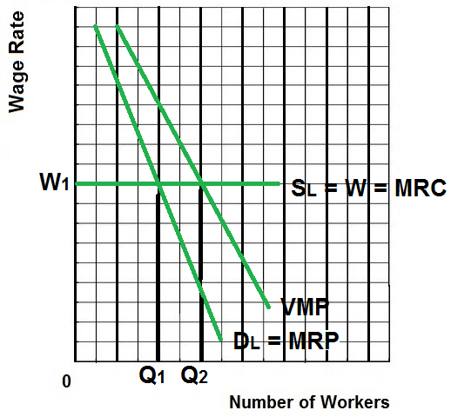
Perfect Competition in the Labor Market
and
Imperfect Competition in the Product Market
YP 17 and 91 and MicWebApp
Results:
Profit maximizing (equilibrium) quantity to hire is Q1 (where MRP = MRC)
Allocatively efficient quantity to hire is Q2 (where VMP = W)
We know that monopolies and oligopolies will produce less and sell at a higher price and are allocatively inefficient in the product market, therefore they will hire fewer workers and are allocatively inefficient in the labor market.
12a – Demand for Resources

Slide 53
Determinants of Resource Demand
YP 5-6 and MicWebApp
1. Changes in Demand for the Product (determinants: Pe, Pog, I, Npot, Tastes)
2. Changes in the Productivity of the Resource
3. Changes in the Prices of Other Resources
Substitutes
Substitution Effect
Output Effect
Complements
12a – Demand for Resources

Slide 54
Summary of Determinants of Resource Demand YP 5-6 and MicWebApp
Changes in Demand for the Product (derived demand)
If demand for the product increases then demand for labor used to make that product will increase
If demand for the product decreases then demand for labor used to make that product will decrease
2. Productivity Changes
If the productivity of labor increases then demand for labor will increase
If the productivity of labor decreases then demand for labor will decrease
Factors that affect the productivity of Labor:
the quantity of nonlabor inputs used: more other resources used with labor increases the productivity of labor
technological progress: more technological progress = more productivity of labor
labor quality: better quality = more productivity
12a – Demand for Resources

Slide 55
Summary of Determinants of Resource Demand
YP 5-6 and MicWebApp
3. Changes in the Prices of Other Resources (Substitutes and Complements)
Substitute Resources
Substitution effect
an increase in price of a substitute resource will cause the demand for labor to increase
a decrease in the price of a substitute resource will cause the demand for labor to decrease
Output effect
an increase in price of a substitute resource will cause the quantity of product produced to decrease and the demand for labor will decrease
a decrease in price of a substitute resource will cause the quantity of product produced to increase and the demand for labor will increase
Net effect
if the substitution effect is greater than the output effect then a decrease in the price of a substitute resource will decrease the demand for labor
if the output effect ois greater than the substitution effect then a decrease in the price of a substitute resource will increase the demand for labor
12a – Demand for Resources

Slide 56
Summary of Determinants of Resource Demand
YP 5-6 and MicWebApp
3. Changes in the Prices of Other Resources (Substitutes and Complements)
Complementary Resources
an increase in price of a complementary resource will cause the demand for labor to decrease
a decrease in the price of a complementary resource will cause the demand for labor to increase
12a – Demand for Resources

Slide 57
10. Which is NOT a determinant of resource demand?
Changes in Demand for the Product
Changes in the Productivity of the Resource
Changes in the Prices of Other Resources
Changes in the Supply of the Resource

Slide 58
10. Which is NOT a determinant of resource demand?
Changes in Demand for the Product
Changes in the Productivity of the Resource
Changes in the Prices of Other Resources
Changes in the Supply of the Resource

Slide 59
11. If the resource becomes more productive, then demand for the resource will:
Increase
Decrease
Become more elastic
Become less elastic

Slide 60
11. If the resource becomes more productive, then demand for the resource will:
Increase
Decrease
Become more elastic
Become less elastic

Slide 61
Price Elasticity of Resource Demand
YP 7
Elasticity: HOW MUCH does quantity demanded (employed) change when wages change?
Define:
Determinants:
1. Ease of resource substitutability
If there are many substitute resources, demand for the resource is MORE ELASTIC
If there are few substitute resources, demand for the resource is LESS ELASTIC
2. Elasticity of product demand
If demand for the product is more elastic, then demand for the resource is MORE ELASTIC
If demand for the product is more elastic, then demand for the resource is MORE ELASTIC
3. Ratio of resource cost to total cost
If the resource cost is a large fraction of the total costs then demand for the resource is MORE ELASTIC
If the resource cost is a large fraction of the total costs then demand for the resource is MORE ELASTIC
12a – Demand for Resources

Slide 62
12. Which is NOT a determinant of the elasticity of resource demand?
Ease of resource substitutability
Elasticity of product demand
Productivity of the resource
Ratio of resource cost to total cost

Slide 63
12. Which is NOT a determinant of the elasticity of resource demand?
Ease of resource substitutability
Elasticity of product demand
Productivity of the resource
Ratio of resource cost to total cost

Slide 64
13. If there are many substitutes for a resource, then the elasticity of demand for the resources will :
be unit elastic
be more elastic
be less elastic
not be affected

Slide 65
13. If there are many substitutes for a resource, then the elasticity of demand for the resources will :
be unit elastic
be more elastic
be less elastic
not be affected

