Slide 1
ARE BUSINESSES EFFICIENT? 11b – Oligopoly
This web quiz may appear as two pages on tablets and laptops.
I recommend that you view it as one page by clicking on the open book icon at the bottom of the page.

Slide 2
ARE BUSINESSES EFFICIENT?
11b – Oligopoly
TOPICS:
Oligopoly
Mergers
Game Theory

Slide 3
ARE BUSINESSES EFFICIENT?
11b – Oligopoly
1. Characteristics and Examples 2. Nature of the Demand Curve 3. Short Run Equilibrium 4. Long Run Equilibrium and Efficiency 5. Other Issues
Mergers
Game Theory
Advertising

Slide 4
Review Lesson 11a Monopolistic Competition
YP 44 - Draw the graphs for Monopolistic Competition in Short Run Equilibrium showing them earning:
Profits
Losses
and Shutting Down
(see lesson 10a Key graphs on MicWebApp or Lessons webpage)
YP 51 - Draw the graphs for Monopolistic Competition in Long Run Equilibrium show the:
Profit maximizing Q
Allocatively efficient Q
Productively efficient Q
For all graphs: DEFINE, DRAW, DESCRIBE
11a – Oligopoly

Slide 5
11b – Oligopoly - Must Know/Outcomes (1)
Describe the characteristics of an oligopolistic industry.
Differentiate between homogeneous and differentiated oligopolies.
Describe and compare the concentration ratio and the Herfindahl index as ways to measure market dominance in an industry.
Distinguish between three types of mergers.
Explain how the Herfindahl index is used as a guideline by the government in deciding whether to permit horizontal mergers.
Use a profit-payoffs matrix (game theory) to explain the mutual interdependence of two rival firms and why oligopolists might tempt to cheat on a collusive agreement.
Identify three possible models of oligopolistic price-output behavior.
Use the kinked demand curve theory to explain why prices tend to be inflexible.
Why is there a "kink" in the kinked demand curve?
Understand the adjustment process from the short run to the long run and the role of barriers to entry (why do oligopolistic firms earn economic profits in the long run?)
Draw the long run equilibrium graph for a kinked demand oligopoly and indicate the profit maximizing quantity, the allocatively efficient quantity, and the productively efficient quantity.

Slide 6
11b – Oligopoly - Must Know/Outcomes (2)
Explain the major advantages of collusion for oligopolistic producers and list the obstacles to collusive behavior.
Draw the long run equilibrium graph for a collusive oligopoly and indicate the profit maximizing quantity, the allocatively efficient quantity, and the productively efficient quantity. (Hint: it is just like the long run monopoly graph.)
Explain price leadership as a form of tacit collusion.
List the positive and negative effects of advertising.
Explain why some economists assert that oligopoly is less desirable than pure monopoly.
Are these mergers good for society (efficiency)?
Airline Mergers Push Fares Higher, NPR Morning Edition, April 18, 2013 http://www.npr.org/2013/04/18/177721489/airline-mergers-push-fares-higher
Mavericks, Hot Documents And Beer http://www.npr.org/blogs/money/2013/02/15/171955074/mavericks-hot-documents-and-beer
Beer Map: Two Giant Brewers, 210 Brands http://www.npr.org/blogs/money/2013/02/19/172323211/beer-map-two-giant-brewers-210-brands

Slide 7
KEY TERMS: oligopoly, homogeneous (standardized) oligopoly, differentiated oligopoly, mutual interdependence, inter-industry competition, collusion, kinked demand, cartel, price leadership, merger, horizontal merger, vertical merger, conglomerate merger, game theory, strategic behavior, prisoner's dilemma, dominant strategy, Nash equilibrium, self enforcing agreement
11b – Oligopoly

Slide 8
Lesson 11b – Introduction ARE BUSINESSES EFFICIENT?
Oligopolies are industries with just a few firms because there are high barriers to entry. So do they earn long-run profits (YES) and are they efficient (NO)?
Oligopolies are more complex than the other three models. Instead of one model to explain how oligopolies determine price and quantity we will have four:
1. kinked demand model 2. collusion 3. price leadership 4. game theory
11b – Oligopoly

Slide 9
Lesson 11a – Something Interesting WHY ARE WE STUDYING THIS?
Oligopolies often form as the result of mergers. Are these mergers good for society? How do they affect efficiency? Just skim the first few paragraphs of the following:
The T-Mobile-Sprint Merger: The End Is Near (2019)
Airline Mergers Push Fares Higher (2013)
Beer merger will not bring Budweiser, Miller under same roof (2015)
U.S. Justice Department urges judge to block AT&T-Time Warner merger (2018)
ANSWER: It is often up to the US Justice Department to determine whether or not to allow businesses to merge into one single business. Such mergers can reduce competition, raise prices, and cause allocative and productive inefficiency.
"Their [Justice Dept.] job, essentially, is to figure out whether a merger would reduce competition so much that a company could raise prices without losing business to competitors."
11b – Oligopoly

Slide 10
ARE BUSINESSES EFFICIENT?
11b – Oligopoly
1. Characteristics and Examples 2. Nature of the Demand Curve 3. Short Run Equilibrium 4. Long Run Equilibrium and Efficiency 5. Other Issues
Mergers
Game Theory
Advertising

Slide 11
1. Which is not a characteristic of oligopolies?
Few firms
Standardized or differentiated products
Blocked entry
Mutual interdependence
Collusion possible

Slide 12
1. Which is not a characteristic of oligopolies?
Few firms
Standardized or differentiated products
Blocked entry
Mutual interdependence
Collusion possible

Slide 13
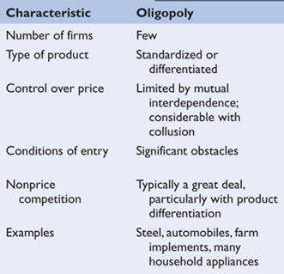

Slide 14
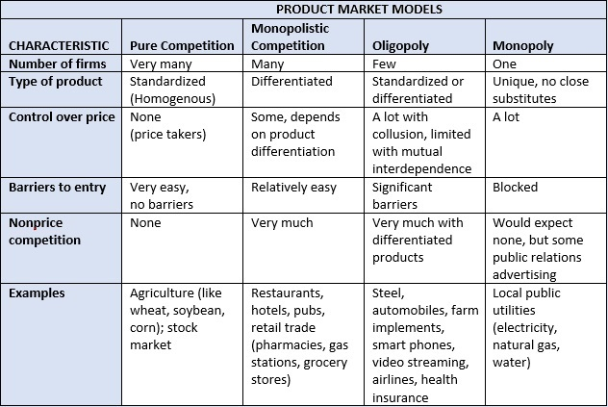

Slide 15
NUMBER OF FIRMS: Few -- How few is “Few”?
So few there is mutual interdependence
A situation in which a change in price strategy (or in some other strategy) by one firm will affect the sales and profits of another firm (or other firms); any firm which makes such a change can expect the other rivals to react to the change.
2. So few collusion is possible
A situation in which firms act together and in agreement (collude) to fix prices, divide a market, or otherwise restrict competition.
3. So few there is a High Concentration Ratio
4. So few there is a High Herfindahl Index
11b – Oligopoly

Slide 16
Type of Product: Some produce homogenous products, some produce differentiated products
homogeneous oligopoly - An oligopoly in which the firms produce a standardized product.
differentiated oligopoly - An oligopoly in which the firms produce a differentiated product.
11b – Oligopoly

Slide 17
Why are there only few firms?
Significant Barriers to Entry (see lesson 10a Monopoly)
1. economies of scale: costs 2. legal barriers
a) patents b) licenses
3. ownership of essential raw materials
4. pricing and other strategic barriers
11b – Oligopoly

Slide 18
CONTROL OVER PRICE:
much if there is collusion
limited by mutual interdependence
A situation in which a change in price strategy (or in some other strategy) by one firm will affect the sales and profits of another firm (or other firms);
any firm which makes such a change can expect the other rivals to react to the change.
11b – Oligopoly

Slide 19
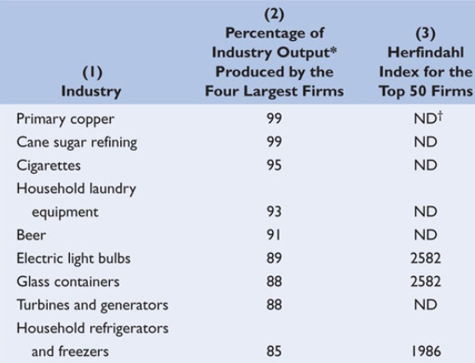

Slide 20
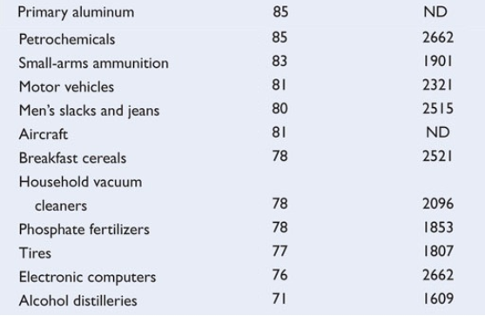
11b – Oligopoly

Slide 21
2. Calculate the Herfindahl Index. Company A market share: 50% Company B market share: 25% Company C market share: 25%
625
2500
3750
5000

Slide 22
2. Calculate the Herfindahl Index. Company A market share: 50% Company B market share: 25% Company B market share: 25%
625
2500
3750
5000

Slide 23
11b – Oligopoly
Calculate the Herfindahl Index. Company A market share: 50% Company B market share: 25% Company C market share: 25%
HI = SUM % market shares squared
HI = 50 squared + 25 squared + 25 squared
HI = 2500 + 625 + 625
HI = 3750

Slide 24
3. Suppose the Herfindahl Indices for industries A, B, and C are 1,200, 5,000, and 7,500 respectively. These data imply that:
Market power is greatest in industry A.
Market power is greatest in industry B.
Market power is greatest in industry C.

Slide 25
3. Suppose the Herfindahl Indices for industries A, B, and C are 1,200, 5,000, and 7,500 respectively. These data imply that:
Market power is greatest in industry A.
Market power is greatest in industry B.
Market power is greatest in industry C.

Slide 26
ARE BUSINESSES EFFICIENT?
11b – Oligopoly
1. Characteristics and Examples 2. Nature of the Demand Curve 3. Short Run Equilibrium 4. Long Run Equilibrium and Efficiency 5. Other Issues
Mergers
Game Theory
Advertising

Slide 27
4. Which of the following is not one of the three oligopoly pricing models?
Collusive pricing
Price leadership
Differentiated oligopoly
Kinked demand

Slide 28
4. Which of the following is not one of the three oligopoly pricing models?
Collusive pricing
Price leadership
Differentiated oligopoly
Kinked demand

Slide 29
Four Oligopoly Models:
1. Kinked Demand (new graph)
2. Collusion (monopoly graph)
3. Price Leadership (monopoly graph)
4. Game Theory (see other Clicker Quiz)
11b – Oligopoly

Slide 30
Why are there 4 different Oligopoly models?
diversity of specific market situations
2 firms or 20; standardized product or differentiated
collusion possible
A situation in which firms act together and in agreement (collude) to fix prices divide a market or otherwise restrict competition.
c) mutual interdependence
A strategy in which one firm’s product is distinguished from competing products by means of its design, related services, quality, location, or other attributes (except price).
Common pricing characteristics:
a) prices tend to be inflexible
b) when prices do change, firms tend to change prices together

Slide 31
Four (Three) Oligopoly Pricing Models:
- Kinked Demand
- Collusion (monopoly graph)
- Price Leadership (monopoly graph)
- Game Theory (see other Clicker Quiz)
11b – Oligopoly

Slide 32
Kinked Demand: Noncollusive Oligopoly
IMPORTANT: based on the assumption that rivals will:
- match a price decrease, and
ignore a price increase.
So, what does the demand curve look like?
11b – Oligopoly

Slide 33
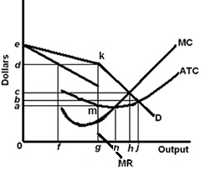
Kinked Demand: Noncollusive Oligopoly
YP 57
11b – Oligopoly

Slide 34
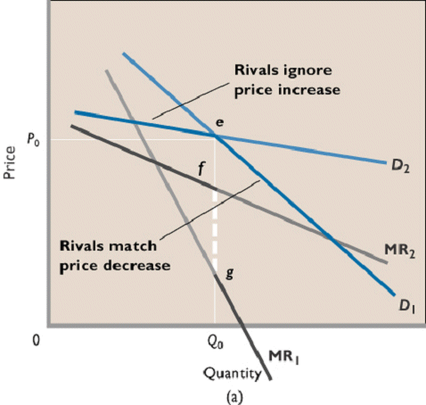
Kinked Demand: Noncollusive Oligopoly
Textbook:

Slide 35
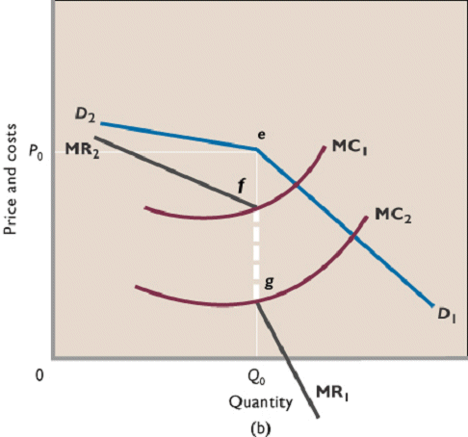
Kinked Demand: Noncollusive Oligopoly
Price
Inflexibility
Textbook:

Slide 36
Kinked Demand: Noncollusive Oligopoly
Textbook Graph: Our Graph:
Used to show price inflexibility Used to find Quantity and Price
Review: See YP 57 # 1-5

Slide 37
5. In the kinked demand model:
Demand is more price elastic above the kink
Firms collude to restrict output and raise the price
Firms ignore price decreases of competitors
Marginal revenue is always positive

Slide 38
5. In the kinked demand model:
Demand is more price elastic above the kink
Firms collude to restrict output and raise the price
Firms ignore price decreases of competitors
Marginal revenue is always positive

Slide 39
6. A problem with the kinked demand model is that:
It only applies to collusive oligopolies
It does not explain how the kink got where it is
The MR curve has a vertical section

Slide 40
6. A problem with the kinked demand model is that:
It only applies to collusive oligopolies
It does not explain how the kink got where it is
The MR curve has a vertical section

Slide 41
11b – Oligopoly – Kinked Demand
Criticisms:
- There is no explanation of why P is the original price.
- In the real world oligopoly prices are often not rigid, especially in the upward direction.
- Few real world examples
11b – Oligopoly

Slide 42
Four (Three) Oligopoly Pricing Models:
- Kinked Demand
- Collusion (monopoly graph)
- Price Leadership (monopoly graph)
- Game Theory (see other Clicker Quiz)
11b – Oligopoly

Slide 43
Collusive Oligopolies:
Collusion - a situation in which firms act together and in agreement (collude) to fix prices, divide a market, or otherwise restrict competition. When firms act together to set prices
Cartel - a formal agreement among firms to collude. Example: OPEC (overt collusion)
Covert Collusion - tacit understanding
Cartels are illegal in the U.S., so any collusion here is secret, or covert.
Examples of these illegal, covert agreements include:
the 1993 collusion between dairy companies convicted of rigging bids for milk products sold to schools
-in 1996, American agribusiness Archer Daniels Midland, three Japanese firms, and a South Korean firm were found to have conspired to fix the worldwide price and sales volume of a livestock feed additive.
North Dakota highway contractors
11b – Oligopoly

Slide 44
7. Which graph best shows a collusive oligopoly?
A
B
C
D

Slide 45
7. Which graph best shows a collusive oligopoly?
A
B
C
D

Slide 46
8. Which is NOT an obstacle to collusion?
It is often illegal
A large number of firms
Cheating
Price wars
Demand and cost differences
Lower barriers to entry
Recession

Slide 47
8. Which is NOT an obstacle to collusion?
It is often illegal
A large number of firms
Cheating
Price wars
Demand and cost differences
Lower barriers to entry
Recession

Slide 48
Obstacles to Collusion: (What makes collusion difficult?)
Differing demand and cost conditions among firms in the industry;
A large number of firms in the industry;
The temptation to cheat;
Recession and declining demand;
The attraction of potential entry of new firms if prices are too high;
Antitrust laws that prohibit collusion.
11b – Oligopoly

Slide 49
Four (Three) Oligopoly Pricing Models:
- Kinked Demand
- Collusion (monopoly graph)
- Price Leadership (monopoly graph)
- Game Theory (see other Clicker Quiz)
11b – Oligopoly

Slide 50
Price Leadership:
Definition An informal method which firms in an oligopoly may employ to set the price of their product: one firm (the leader) is the first to announce a change in price and the other firms (the followers) soon announce identical or similar changes.
Price leadership in oligopoly occasionally breaks down and sometimes results in a price war.
Examples –
A recent example occurred in the breakfast cereal industry in which Kellogg had been the traditional price leader.
Farm Machinery Cigarettes Cement
Copper Newsprint Glass Containers
Beer Fertilizer
11b – Oligopoly

Slide 51
ARE BUSINESSES EFFICIENT?
11b – Oligopoly
1. Characteristics and Examples 2. Nature of the Demand Curve 3. Short Run Equilibrium 4. Long Run Equilibrium and Efficiency 5. Other Issues
Mergers
Game Theory
Advertising

Slide 52
9. Which graphs best represent oligopolies in long run equilibrium?
A only
C and D
C only
D only
A and C

Slide 53
9. Which graphs best represent oligopolies in long run equilibrium?
A only
C and D
C only
D only
A and C

Slide 54
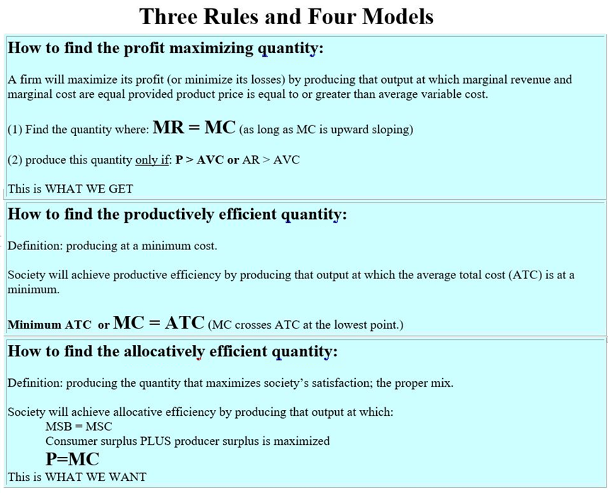
YP
58

Slide 55
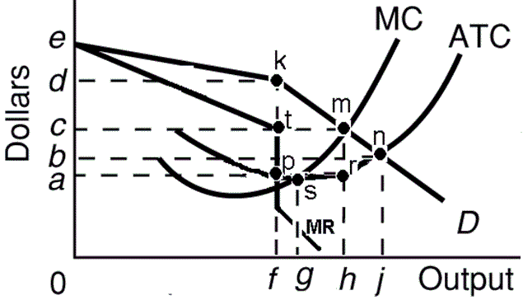
10. What is: - prof max Q - alloc eff Q - prod eff Q?
f, g h
g, h, f
h, f, j
f, h, g
f, h j
YP 59

Slide 56
10. What is: - prof max Q - alloc eff Q - prod eff Q?
f, g h
g, h, f
h, f, j
f, h, g
f, h j
YP 59

Slide 57
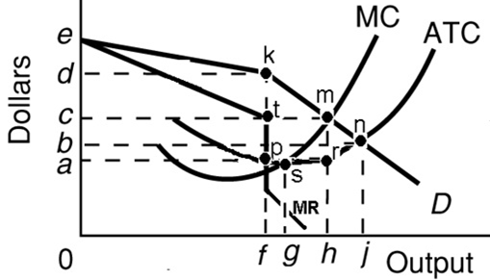
Oligopolies and
Efficiency (YP 59):
What is the profit maximizing quantity?
___0f____
What is the profit maximizing price?
___ 0d___
What is the allocatively efficient quantity? ___0h____
What is the productively efficient quantity?
___0g___
What are the long run profits? __adkp__
11b – Oligopoly

Slide 58
REVIEW -- Oligopolies and Efficiency:
YP 60 - Draw the Long Run Equilibrium for the Kinked Demand Model, show the - profit max. Q, - the allocatively Efficient Q, - the productively efficient Q
The exam 3 extra credit question will require you to be able to accurately draw and label the LONG RUN EQUILIBRIUM GRAPHS for ONE of the four product market models.
Furthermore, you will need to be able to indicate the following on the graphs: (1) the profit maximizing quantity, (2) the allocatively efficient quantity, and (3) the productively efficient quantity.
You can find the graphs in the textbook and on the last 13 pages of the Unit 3 YELLOW PAGES.
11b – Oligopoly

Slide 59
11. Why do some economists assert that oligopoly is less desirable than pure monopoly?
Oligopolies produce both standardized and differentiated products
Product differentiation may add to consumer welfare
Noncollusive oligopolists may face a kinked-demand curve
Because governments usually regulate pure monopolies, but not oligopolies

Slide 60
11. Why do some economists assert that oligopoly is less desirable than pure monopoly?
Oligopolies produce both standardized and differentiated products
Product differentiation may add to consumer welfare
Noncollusive oligopolists may face a kinked-demand curve
Because governments usually regulate pure monopolies, but not oligopolies

Slide 61
ARE BUSINESSES EFFICIENT?
11b – Oligopoly
1. Characteristics and Examples 2. Nature of the Demand Curve 3. Short Run Equilibrium 4. Long Run Equilibrium and Efficiency 5. Other Issues
Mergers
Game Theory
Advertising

Slide 62
Mergers: Merger - the combination of two (or more) firms into a single firm.
Horizontal Merger - the merger into a single firm of two firms producing the same product and selling it in the same geographic market. Example: if McDonald's were to merge with Burger King; if T-Mobile and Sprint merge.
Vertical Merger - the merger of one or more firms engaged in different stages of the production of a final product. Example: a car manufacturer purchasing a tire company; if a soft drink company merges with a sugar production company.
Conglomerate Merger- the merger of a firm in one industry with a firm in another industry (with a firm that is not a supplier, customer, or competitor). Example: if McDonalds bought a motorcycle company
11b – Oligopoly

Slide 63
Mergers
A merger between cell phone providers T-Mobile and Sprint was approved by the U.S. Justice Department - WHY?
How does the merger affect competition and efficiency?
BEFORE:
4-Firm Concentration Ratio: 98.8
Herfindahl Index: 2774
AFTER:
4-Firm Concentration Ratio: 100 (almost)
Herfindahl Index: 3258
RESULT: less competition, higher prices, less efficient (??)
11b – Oligopoly

Slide 64
Mergers
We would expect the T-Mobile and Sprint merger to reduce competition, raise prices, and cause more Inefficiency, BUT it might not be so Inefficient because:
Sprint may go bankrupt anyway
Conditions of the merger include selling Boost Mobile (currently a part of Sprint) to Dish Network and allowing Dish to use the new T-Mobil/Sprint network for seven years
So, if Sprint (and Boost) was about to go out of business, and if Dish becomes a new cell phone provider, the merger is not really reducing competition and efficiency.
11b – Oligopoly

Slide 65
Mergers
Examples of Mergers
Horizontal merger - Example: Sprint and T-Mobile
Vertical merger - Examples: Ebay bought PayPal (2002) , LiveNation bought Ticketmaster (2010)
Conglomerate merger - Examples: Amazon bought Whole Foods (2017), Samsung is a conglomerate which includes, electronics, cell phones, and shipbuilding
11b – Oligopoly

Slide 66
ARE BUSINESSES EFFICIENT?
11b – Oligopoly
1. Characteristics and Examples 2. Nature of the Demand Curve 3. Short Run Equilibrium 4. Long Run Equilibrium and Efficiency 5. Other Issues
Mergers
Game Theory
Advertising

Slide 67
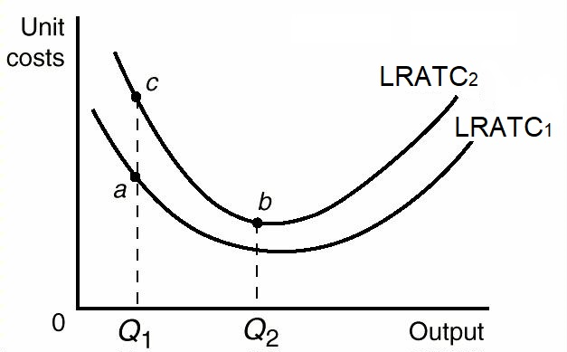
Advertising
Efficient or Inefficient?
Advertising increases the average total cost curve (ATC1 to ATRC2) because it requires resources.
If the quantity stays the same (Q1) advertising would be INefficient as costs go from “a” to “c”. This is similar to X-Inefficiency. BUT, If the advertising is beneficial to consumers then it may be worth it (efficient).
But if advertising increases consumption from Q1 to Q2, then costs will actually decrease from “a” to “b” because of economies of scale. Then advertising increases efficiency.
11b – Oligopoly

Slide 68
Four (Three) Oligopoly Pricing Models:
- Kinked Demand
- Collusion
- Price Leadership
- Game Theory – See other Lesson 11b Clicker Quiz
11b – Oligopoly

